Slide 1
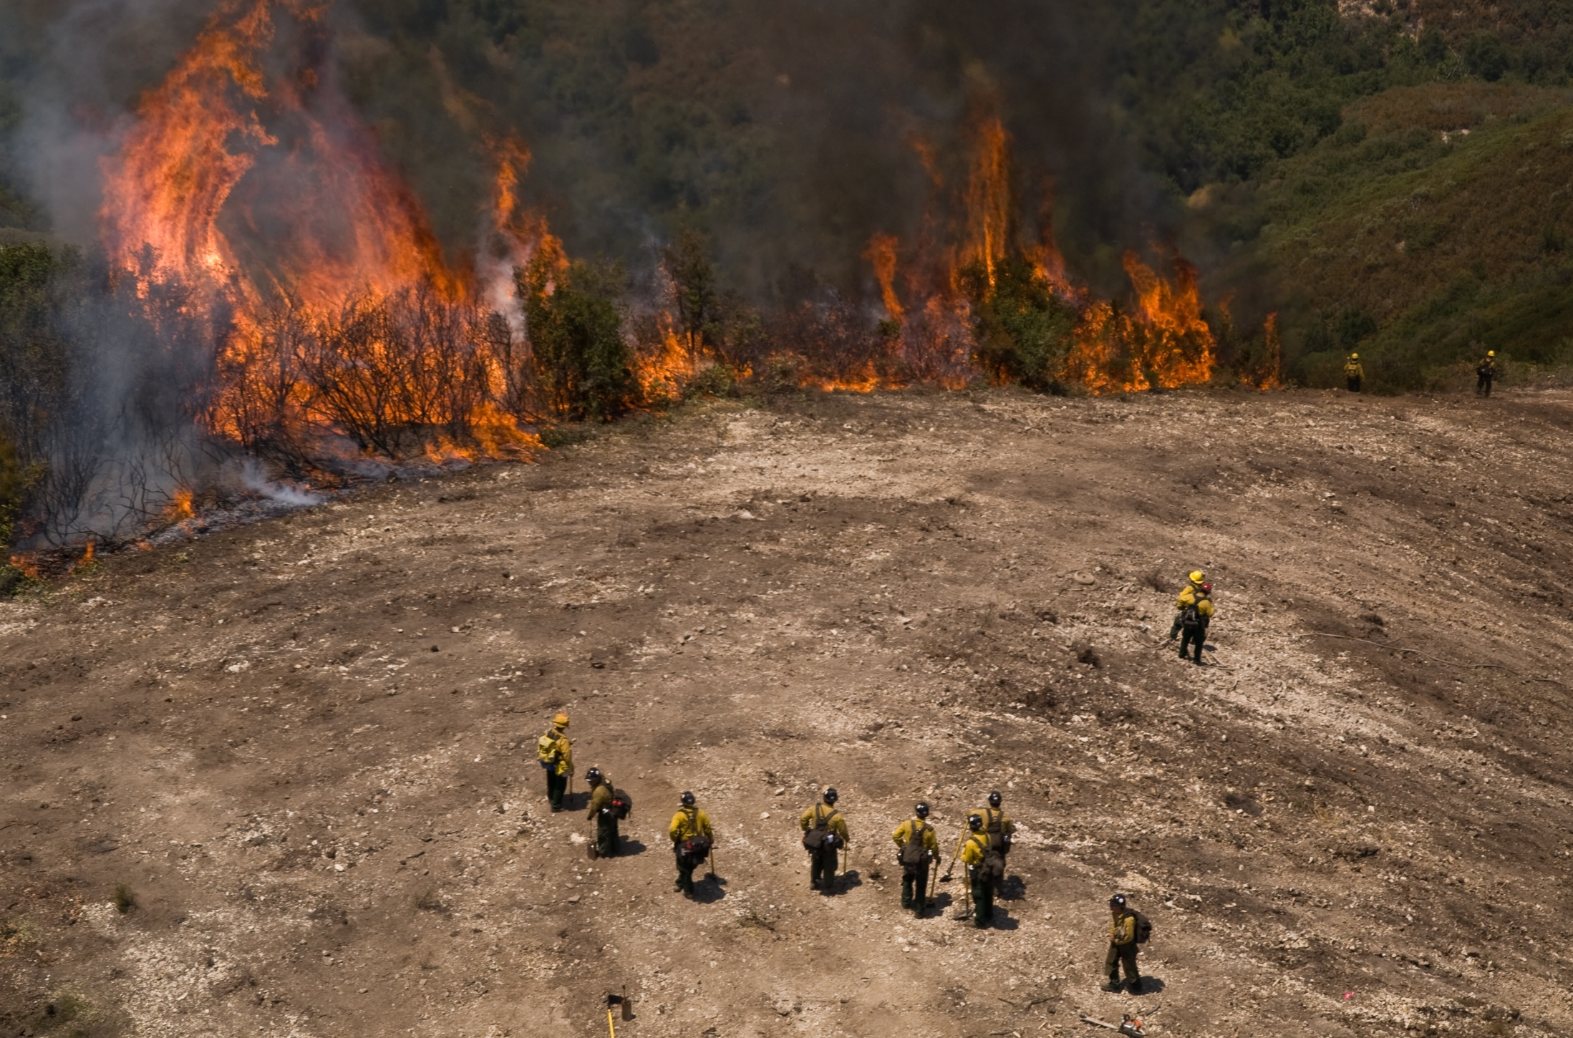
Standard Firefighting Orders

Slide 2
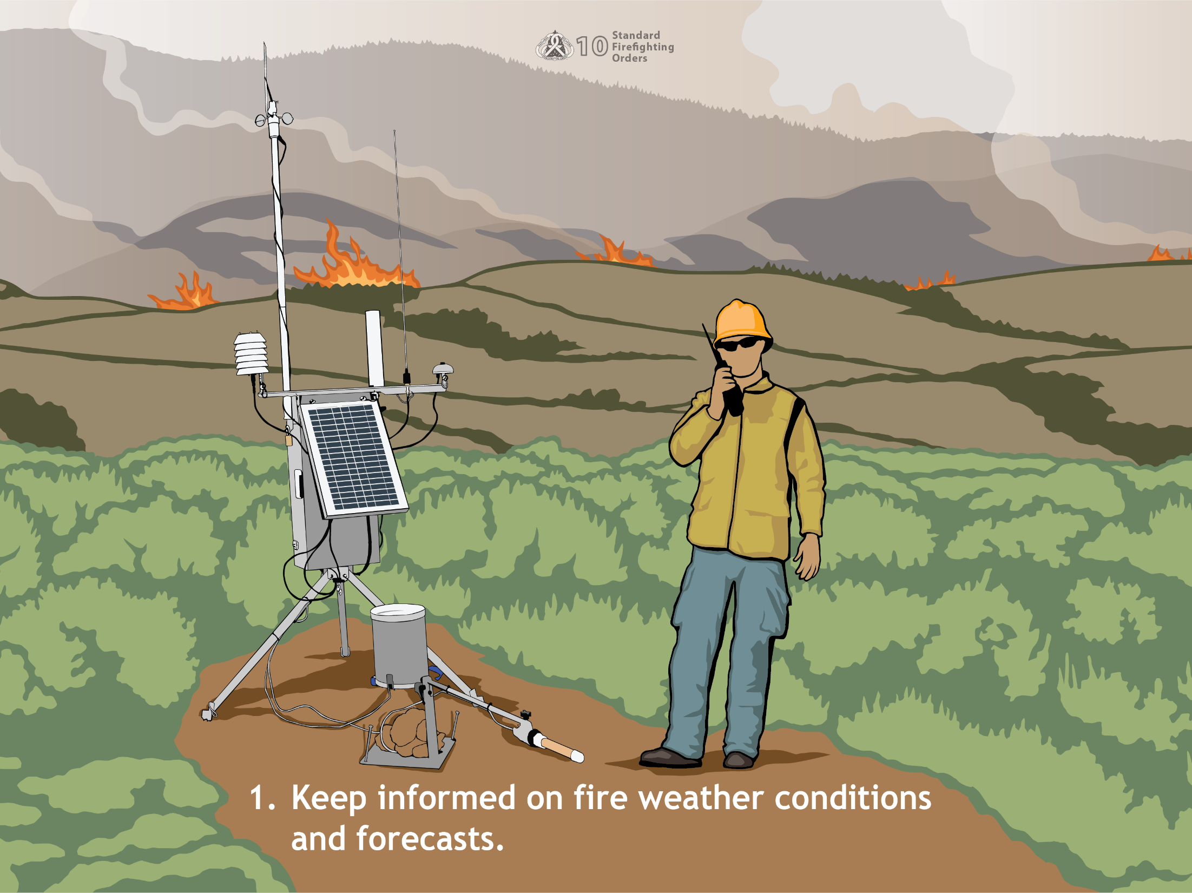
1.Keep informed on fire weather conditions and forecasts.
Notes:
Weather is a major factor in fire behavior. Use every means at your disposal to stay informed of weather conditions and forecasts to answer the following questions:
What is the weather in the fire area?
What is the weather likely to do?
Is the weather against us?
Is this the critical burning period?
Are we going to have winds, high temperatures, or low humidity?
Is there a chance of wind from a passing weather front or wind associated with cumulus or cumulonimbus clouds?
Use your senses and any other available means to determine weather conditions. Here are some tips to practice your weather forecasting skills:
Feeling - Even without the aid of a weather station, you can feel whether the temperature is increasing or decreasing. The time of day is also a good indicator of whether the temperature is likely to increase or decrease. Does your skin feel dry? Are your lips cracking? Those can be pretty good indicators that relative humidity is low.
Seeing - Wind vanes and anemometers give precise wind information, but they are not necessary to determine whether the wind is blowing. The IRPG Visual Estimate of Surface Windspeed chart, is great for using our surroundings on a fire to estimate winds. Determine the direction and velocity of the wind by looking at:
Vegetation
A flag
Cloud movement
The drift of smoke or dust
Hearing - Listen to fire weather forecasts. However, also listen to people who are familiar with the area and ask their opinions of what to expect from local weather patterns. For example, locals can confirm what kinds of winds are common in the area at a particular time of year.
Weather Kits - Portable or belt weather kits enable you to measure relative humidity, wind speed and direction, and temperature. Find these kits and practice with them. At any time, a supervisor could point at you and request a spot weather reading.

Slide 3
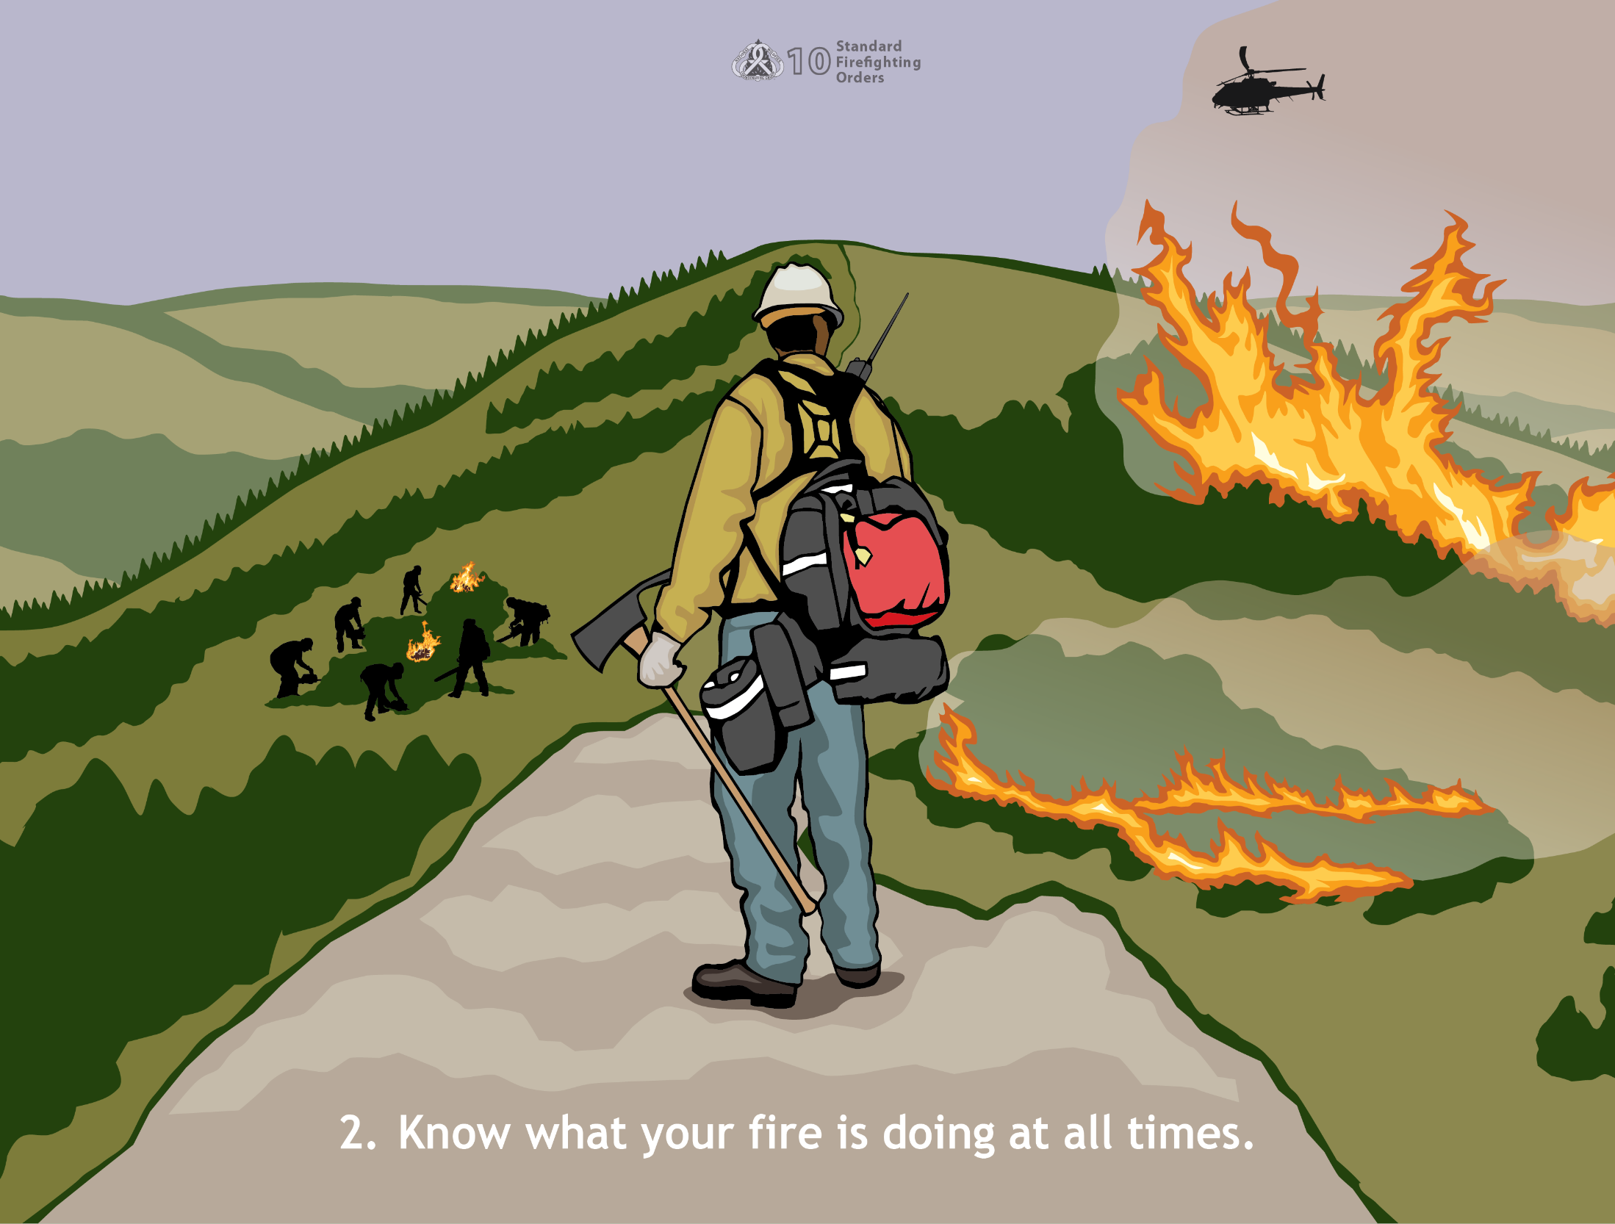
2. Know what your fire is doing at all times.
Notes:
Many small fires become large ones and sometimes very quickly. Actions to know what your fire is doing:
Personally observe the fire from a vantage point
Personally scout ahead
Send out reliable scouts who will then report back
Observe the fire from a helicopter or other aircraft if available
Inform all crew members of the current situation
Review the incident action plan (IAP) fire behavior section
Monitor the assigned radio frequency

Slide 4
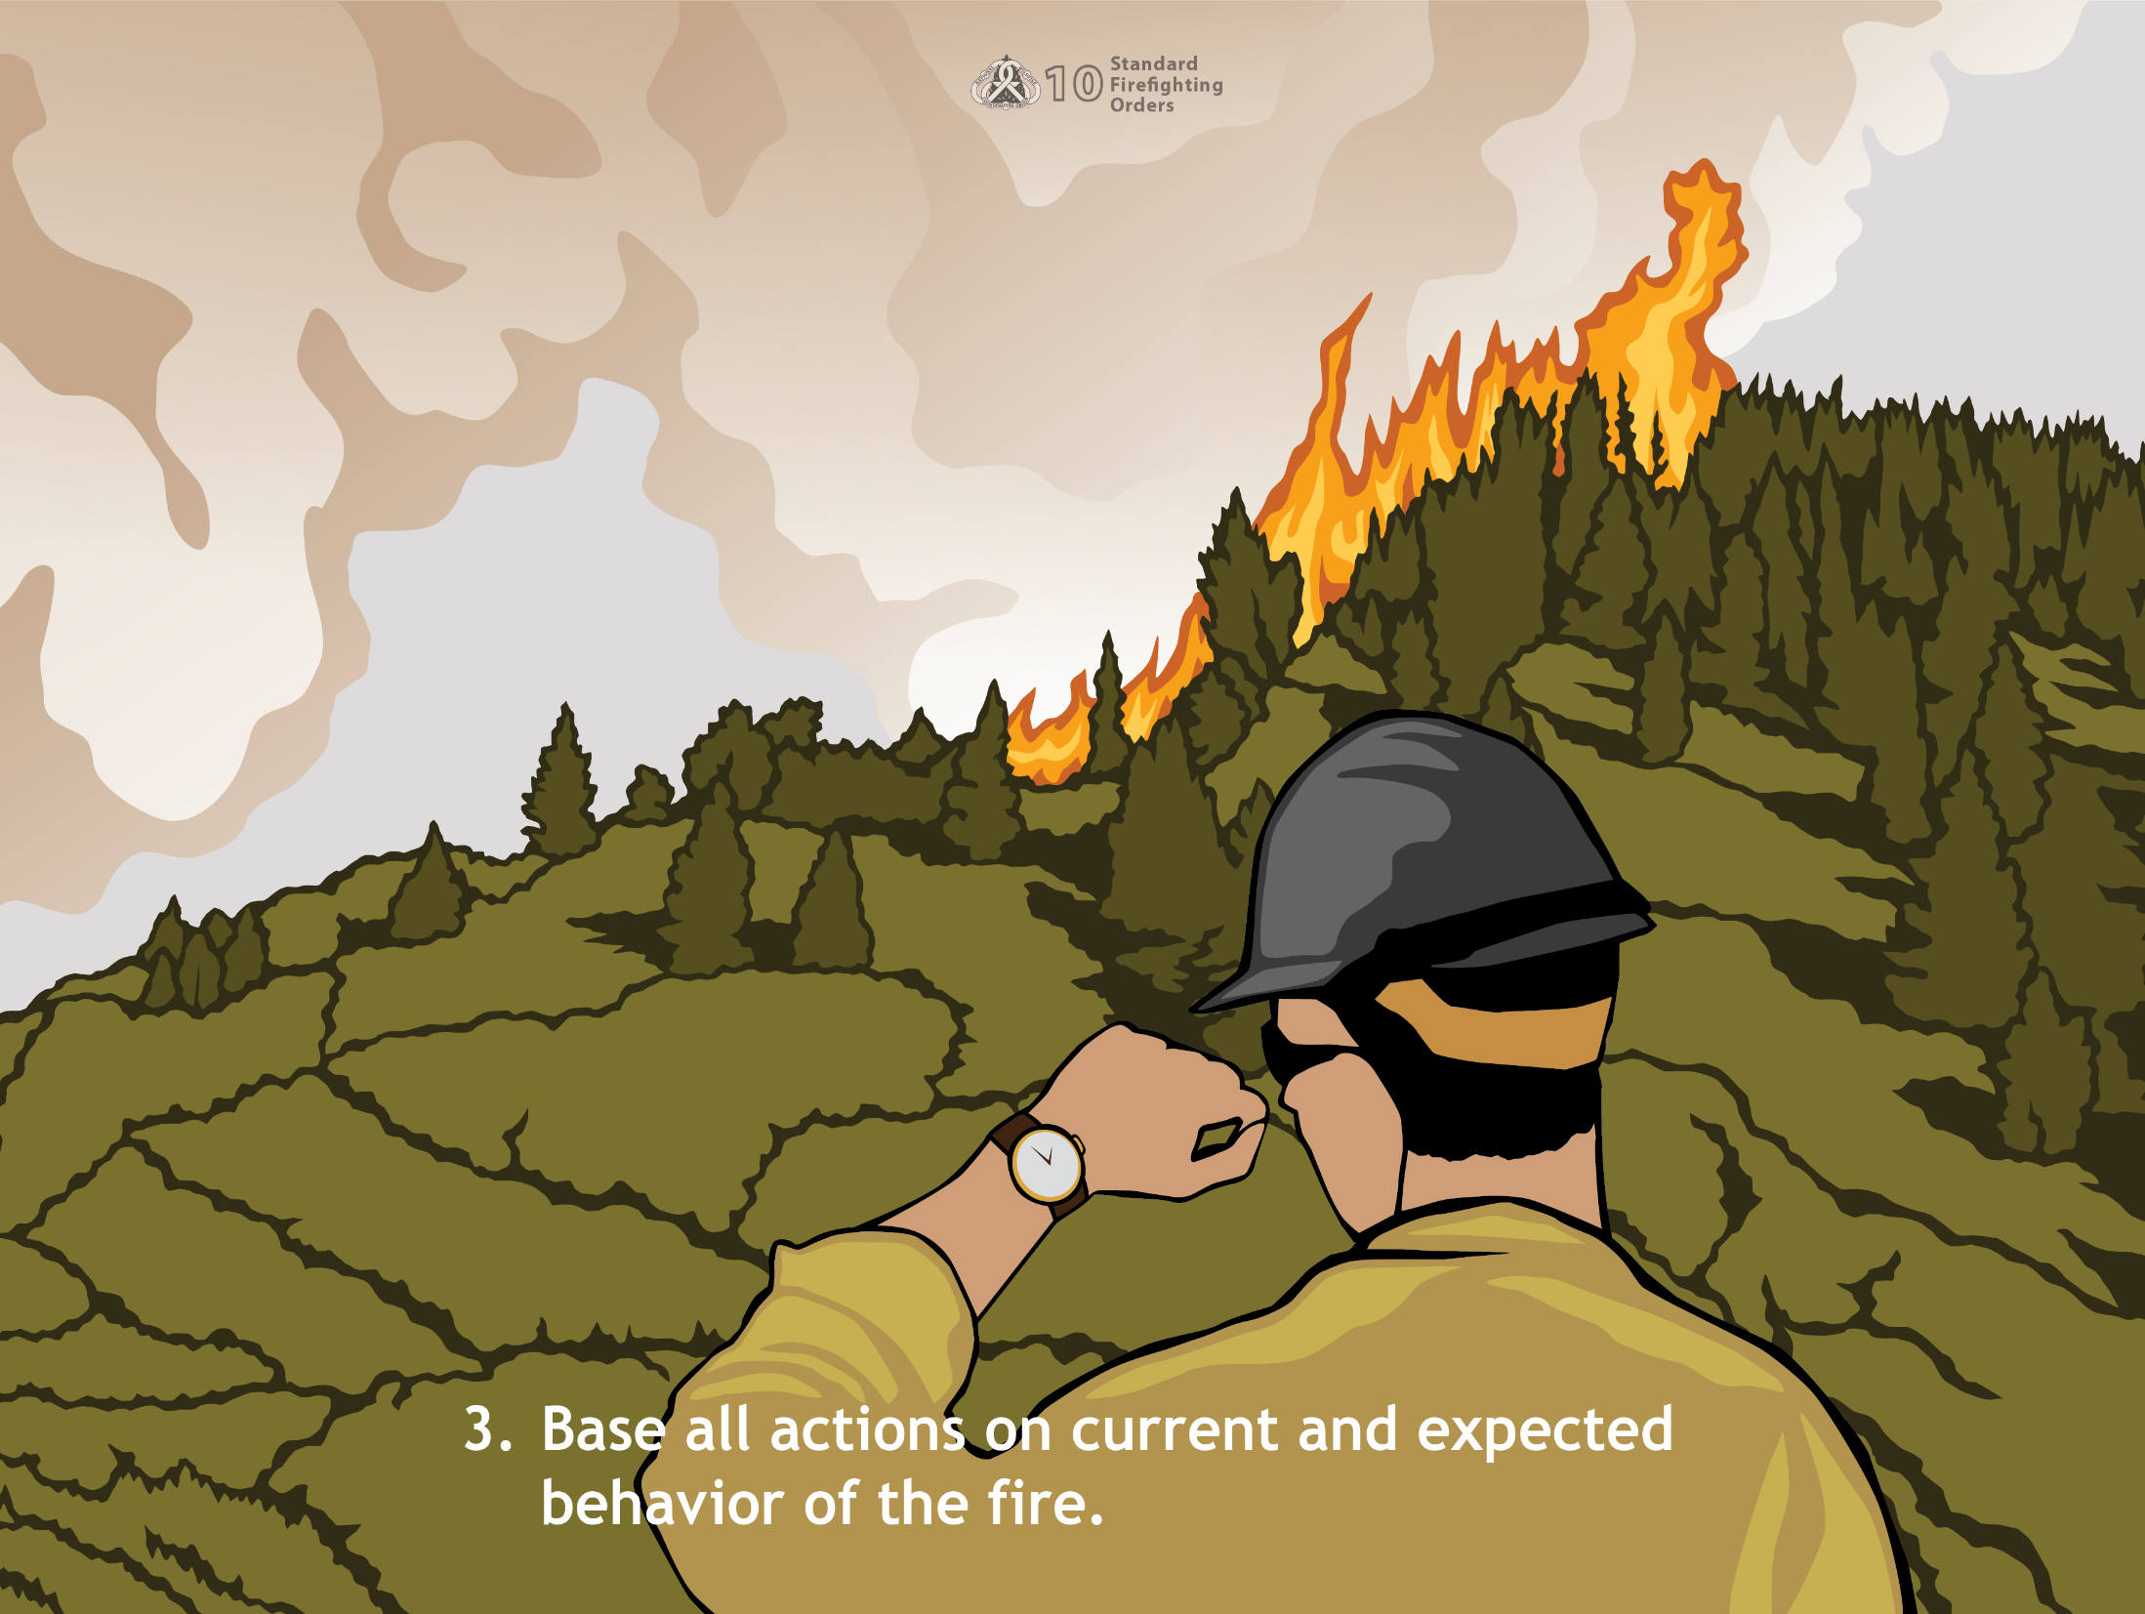
3.Base all actions on current and expected behavior of the fire.
Notes:
The varying conditions you may encounter force you to approach every fire differently. While all fires behave according to the same principles, no two fires are exactly alike because of all the possible variations in fuel, weather, and topography.
What is the fire doing now? Can we control it with the resources at the scene or en route? Do we need to request more resources?
What is the fire likely to do later? Can we flank it? Should we back off for an indirect attack?
What action is the crew taking now? Are we using equipment effectively? Are we making the attack at the right spot?
What is the weather in the fire area? What is the weather likely to do?
What type of fuel is burning? Can we build control lines fast enough? Is the fuel a type that can cause spot fires?
What type of fuel is the fire heading toward? Do we have the proper tools? Will we need aircraft or mechanized equipment?

Slide 5
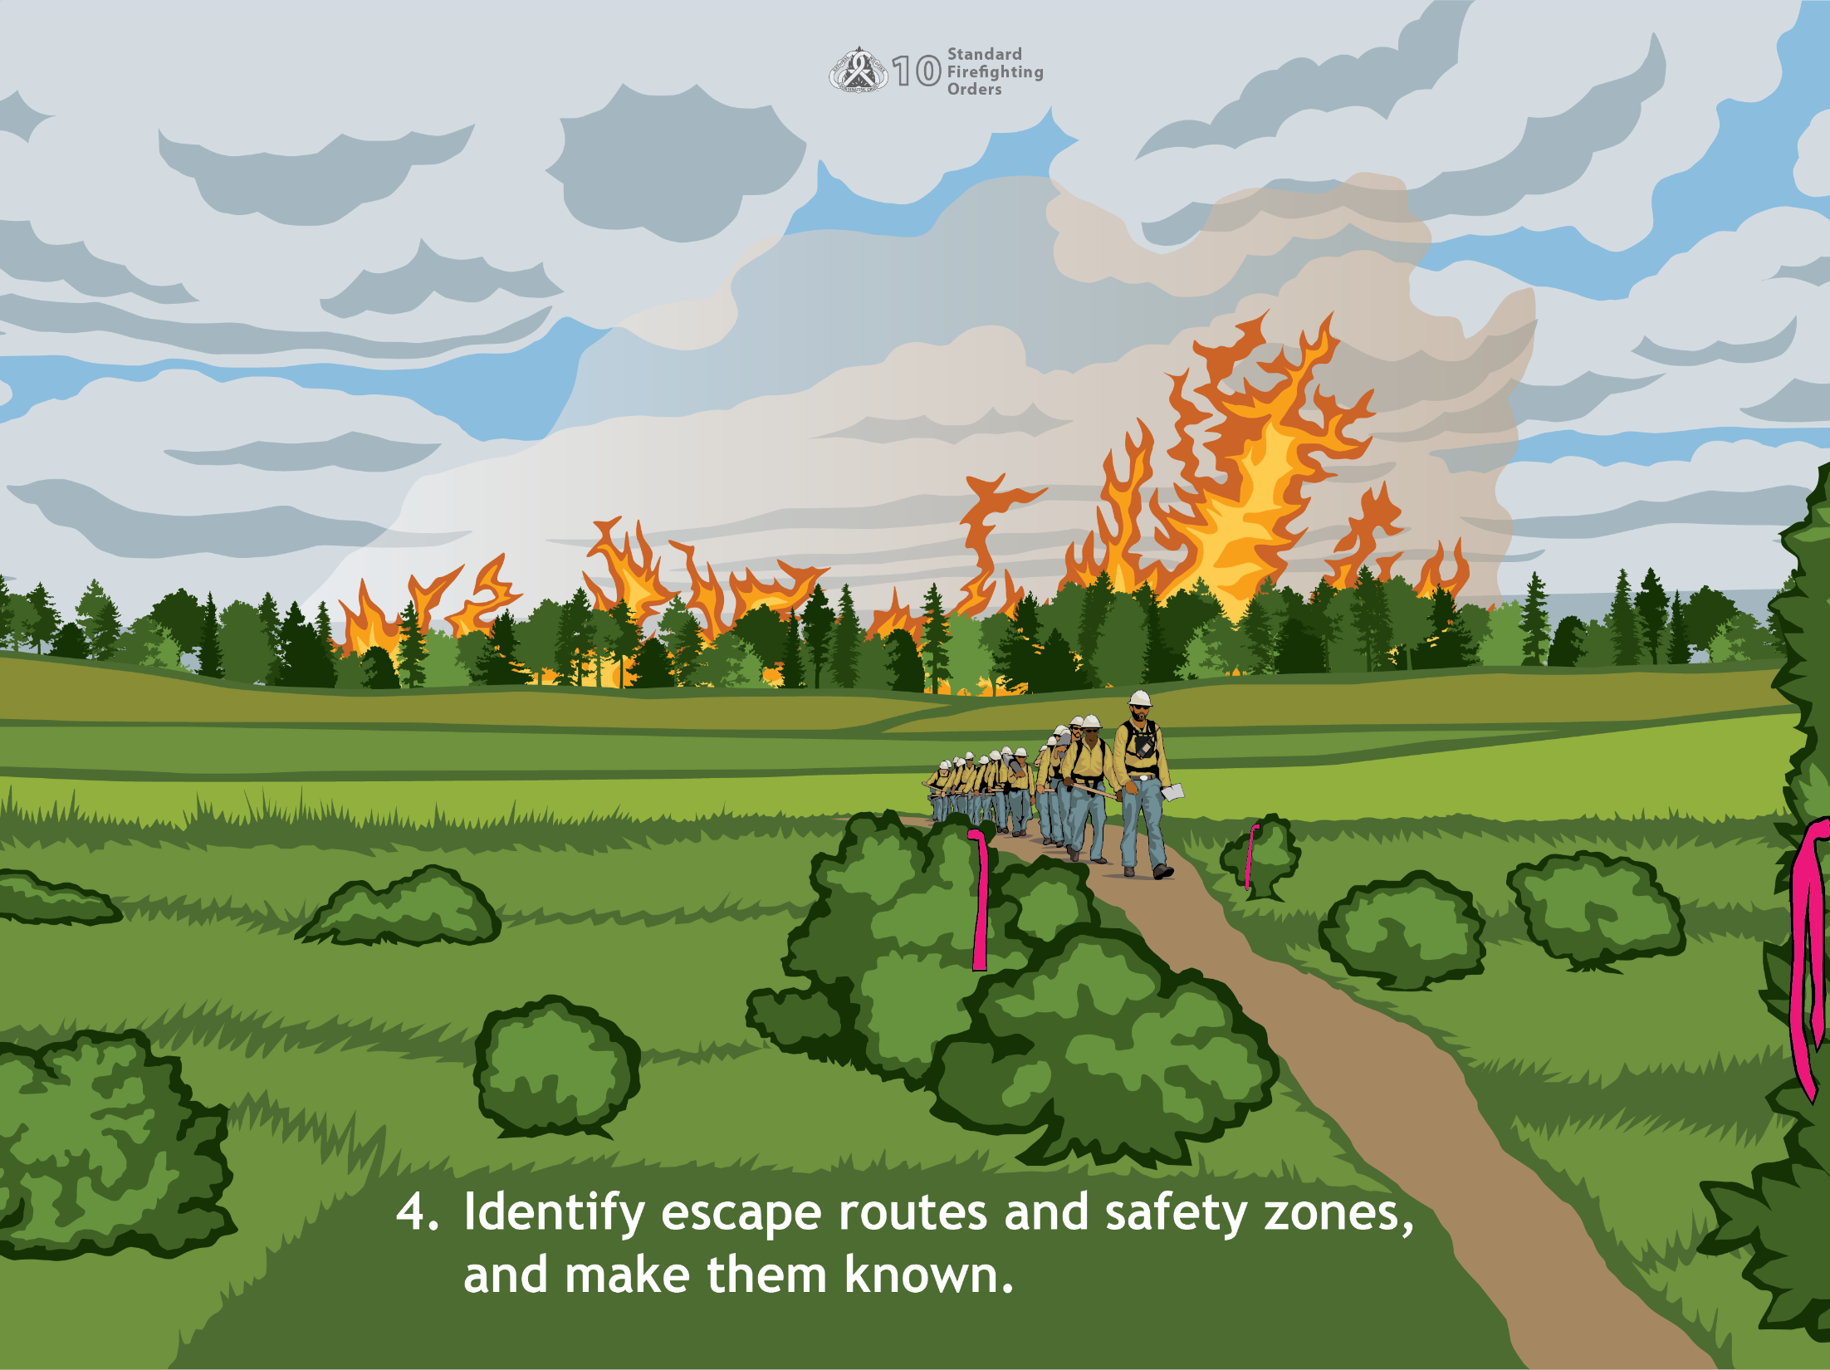
4. Identify escape routes and safety zones and make them known.
Notes:
Some good areas to select for safety zones are:
Burned area—make sure it is close enough so you can reach it
Safety zones—identify or construct them, and be sure everyone knows their location
Natural barriers—locate rocky areas, riverbeds, streams, lakes, dry lake beds, and slide areas; let others know about them
As crews progress around the fire additional safety zones may need to be identified and communicated to resources.
Make sure you have an escape route, even if you have to construct one. Mark a safe route into the burned area or cut one if the brush is too thick for travel. Consider this order at all times and especially when your crew is traveling cross country to a fire that has no control lines or to an area you are unfamiliar with.
Escape route cautions:
When you are attempting to determine safety zones and escape routes, consider these cautions:
Get with your supervisor and make sure the entire crew knows where the escape routes are, how to travel to them, and what to do when you get to a safety zone
Use extreme caution if an escape route passes through a chute, drainage, saddle, or any involved area that is not completely burned out
Be aware of necessary changes to the escape route that may have to be made (maybe more than once!) as a fire progresses
Escape route travel time changes as crews progress around the fire perimeter and will need to be evaluated based on expected fire behavior during critical burn period

Slide 6
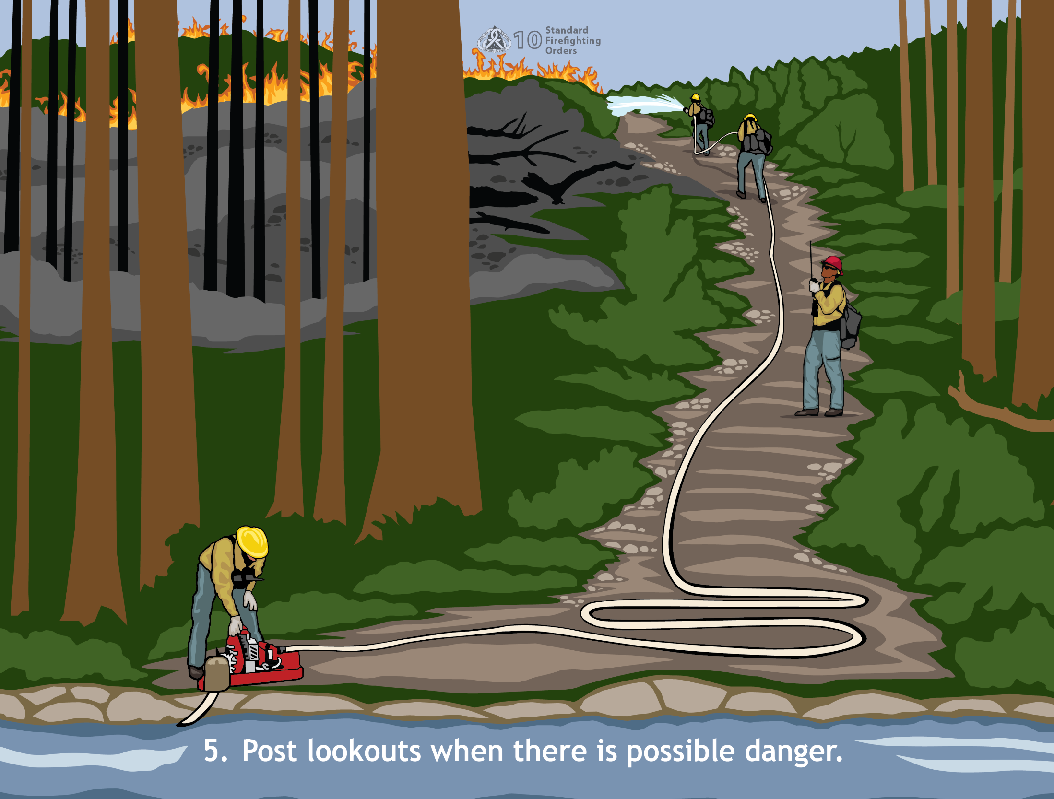
5. Post lookouts when there is possible danger.
Notes:
Make sure you have one or more lookouts in place when:
The head of the fire is not visible to the crew
Felling snags
Personnel and mechanized equipment are working closely together
Falling rocks could strike someone or burning material could cross the control line
An obvious hazard such as a snag cannot be felled
Airdrops are being made nearby
Firing operations are being conducted nearby
Use more than one lookout to maintain visual contact with both the fire and the crew.

Slide 7
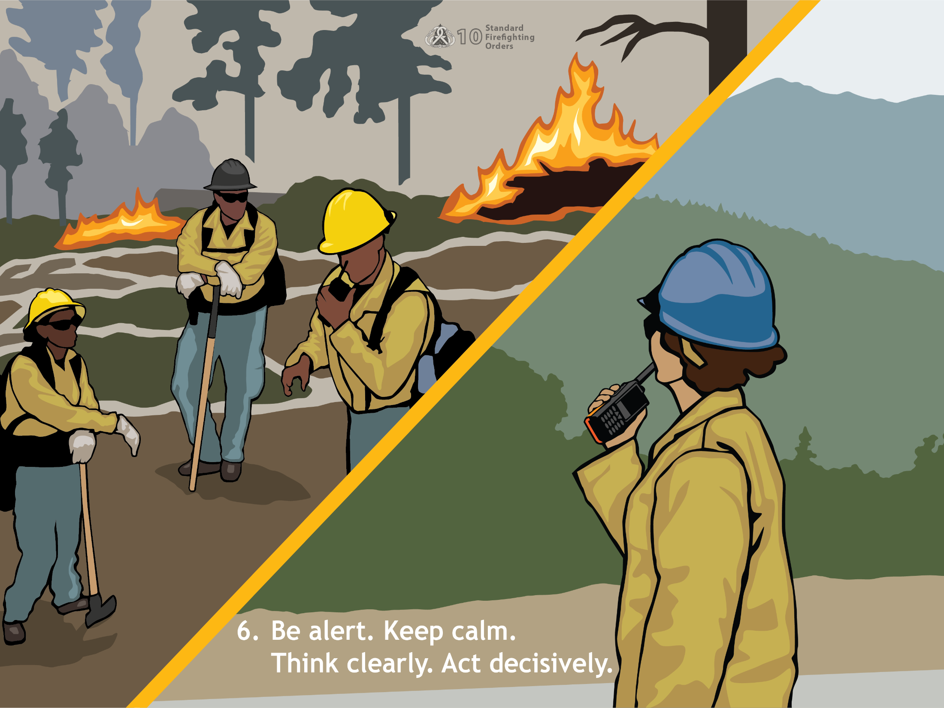
6. Be alert. Keep calm. Think clearly. Act decisively.
Notes:
When faced with a possible life-threatening problem, everyone, you, other crew members, and your supervisors should keep calm and analyze what is happening. Panic can endanger the supervisor as well as the crew. After evaluating the situation, supervisors should decide how to deal with it, and then do it!
Factors that can affect decision making include:
Fatigue – try to stay in shape, eat right, and get your sleep, and while on the Fireline, drink lots of fluids
Heat stress – do all the same things you’d do for fatigue and remember to drink!
Smoke (carbon monoxide) – try to reduce your exposure to it, and drink more water
Stress – know and understand the life-threatening situation you are in
Warning - If your decision-making ability becomes impaired on the fireline, you could be putting yourself as well as your crew members in jeopardy. To increase your decision-making ability:
Maintain self-control
Develop contingency plans
Become more cautious
Monitor the situation more closely
Double-check critical information
Seek information and advice from others
Know your own limitations

Slide 8
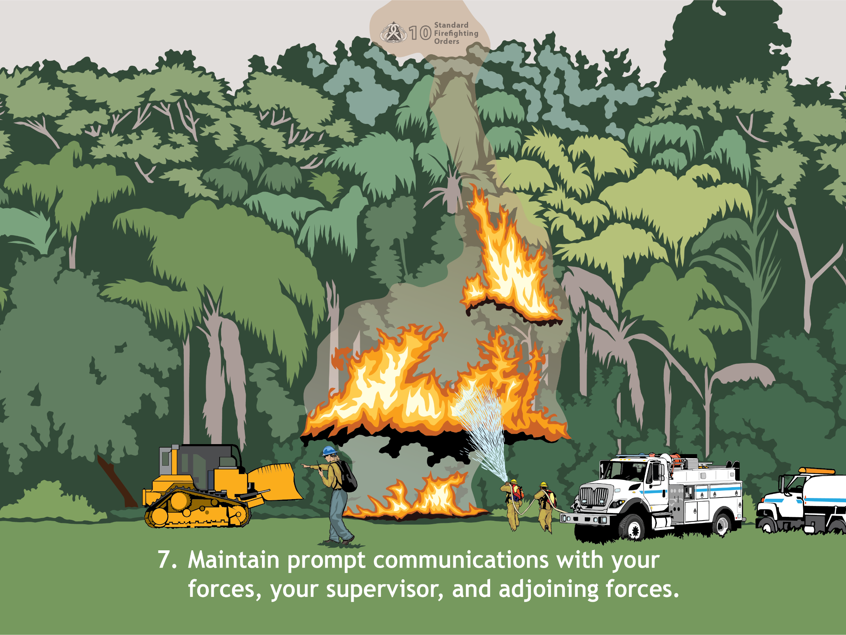
7. Maintain prompt communications with your forces, your supervisor, and adjoining forces.
Notes:
Adequate communication is essential to fireline safety. Always maintain good communication:
Within your unit
Between your unit and any scouts or lookouts
With other fire fighting units and adjoining forces, obviously you need to know who they are and what they’re up to. Communication during a wildland incident may be face to face or by radio, telephone, or any other reliable means.
The Wildland Fire Lessons Learned Center has a review of the Horse Park Fire Entrapment where communication with adjoining forces was critical in preventing fatalities. https://www.wildfirelessons.net/orphans/viewincident?DocumentKey=76bb3659-8026-4151-9dce-8b492a36b264

Slide 9
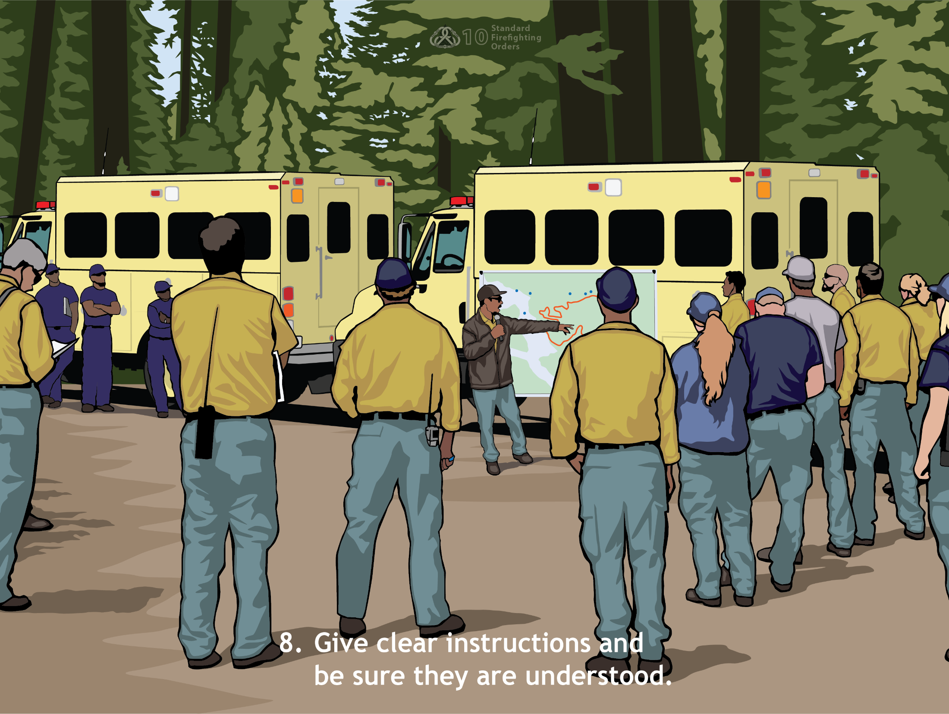
8. Give clear instructions and be sure they are understood.
Notes:
The likelihood of accidents occurring increases dramatically if supervisors give vague or ambiguous instructions. Although most instructions are given orally, there is also a place for concise, written instructions. Oral instructions are sometimes incomplete and are more likely to be misinterpreted or forgotten. Have your supervisor verify the following when you are given an assignment:
What to do – what is the objective
How to do it
Where to go
Where to finish
When to finish
Whom to coordinate with
Who the supervisor on the line is
Who the relieving person is
What the expected duration of attack is
What the available transportation to and from the fireline is
What the other pertinent information is, such as emergency procedures and safety considerations
The ‘Why’ is implied by the objective, but a good supervisor will always take time to tell a crew how they fit into the overall plan.

Slide 10
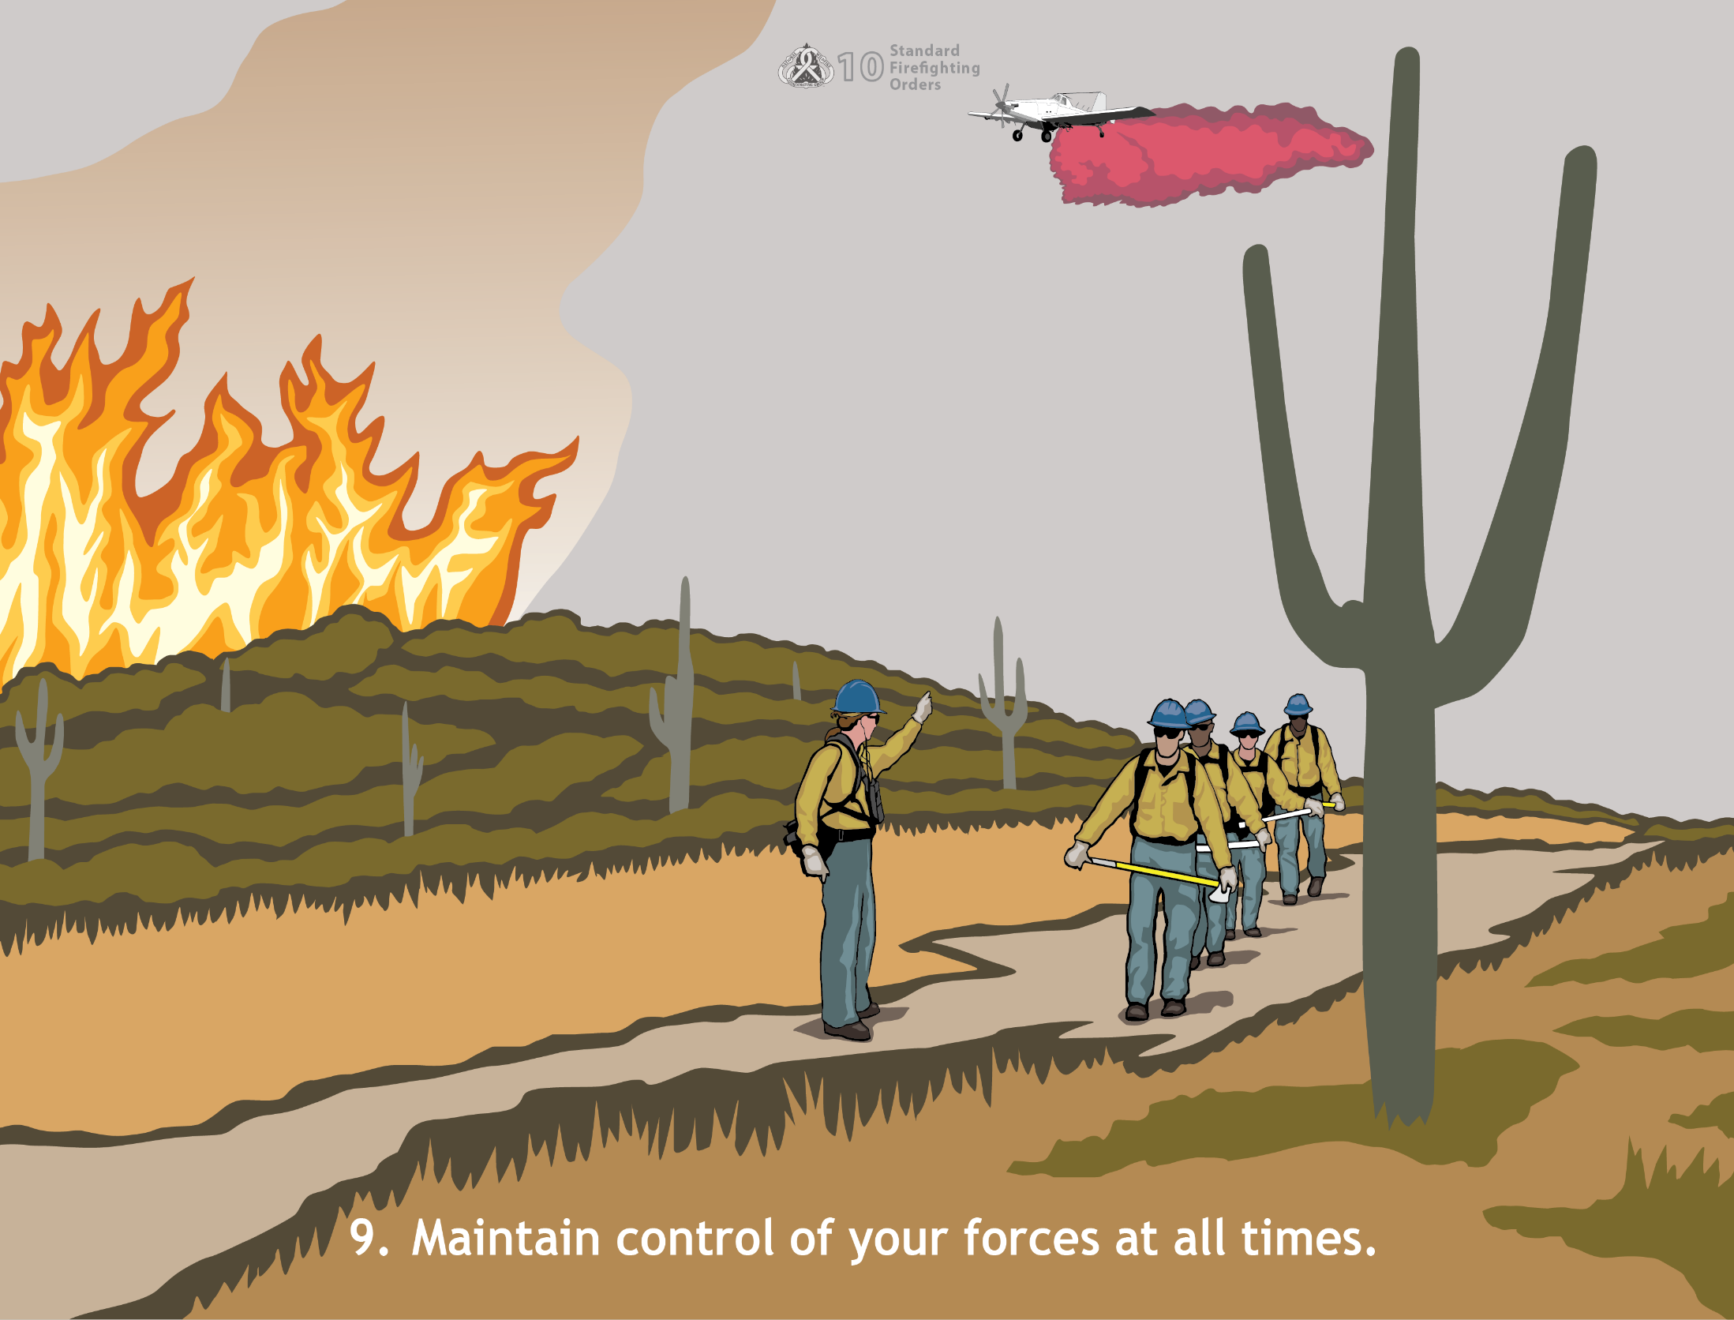
9. Maintain control of your forces at all times.
Notes:
Supervisors and crew leaders should be the ones in control at all times. Tips for them to follow include:
Consider the capabilities and limitations of crew members when making work assignments, is the crew rested and ready to work, or are they already exhausted from a previous assignment?
Inspect tools, coordinate work with available equipment, and make provisions for safety
Exhibit command presence
Follow the chain of command for the incident
Ensure that assignments and instructions are clear and understood
Establish and maintain communication
Know the location of your crew members at all times
Know the current status of the fire

Slide 11
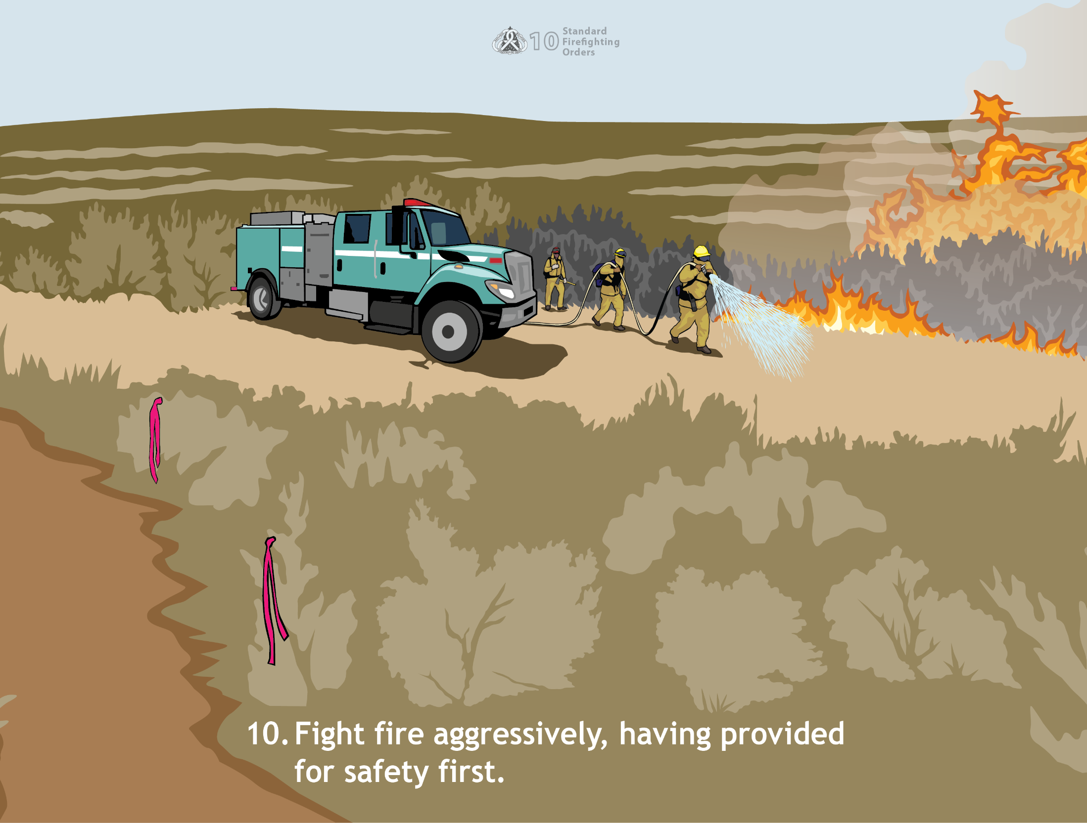
10. Fight fire aggressively, having provided for safety first.
Notes:
Aggressive action is the key to a successful fire suppression operation; however, safety is the first priority. Supervisors should analyze the situation and make an attack consistent with accepted practices and methods under the existing conditions.

Slide 12
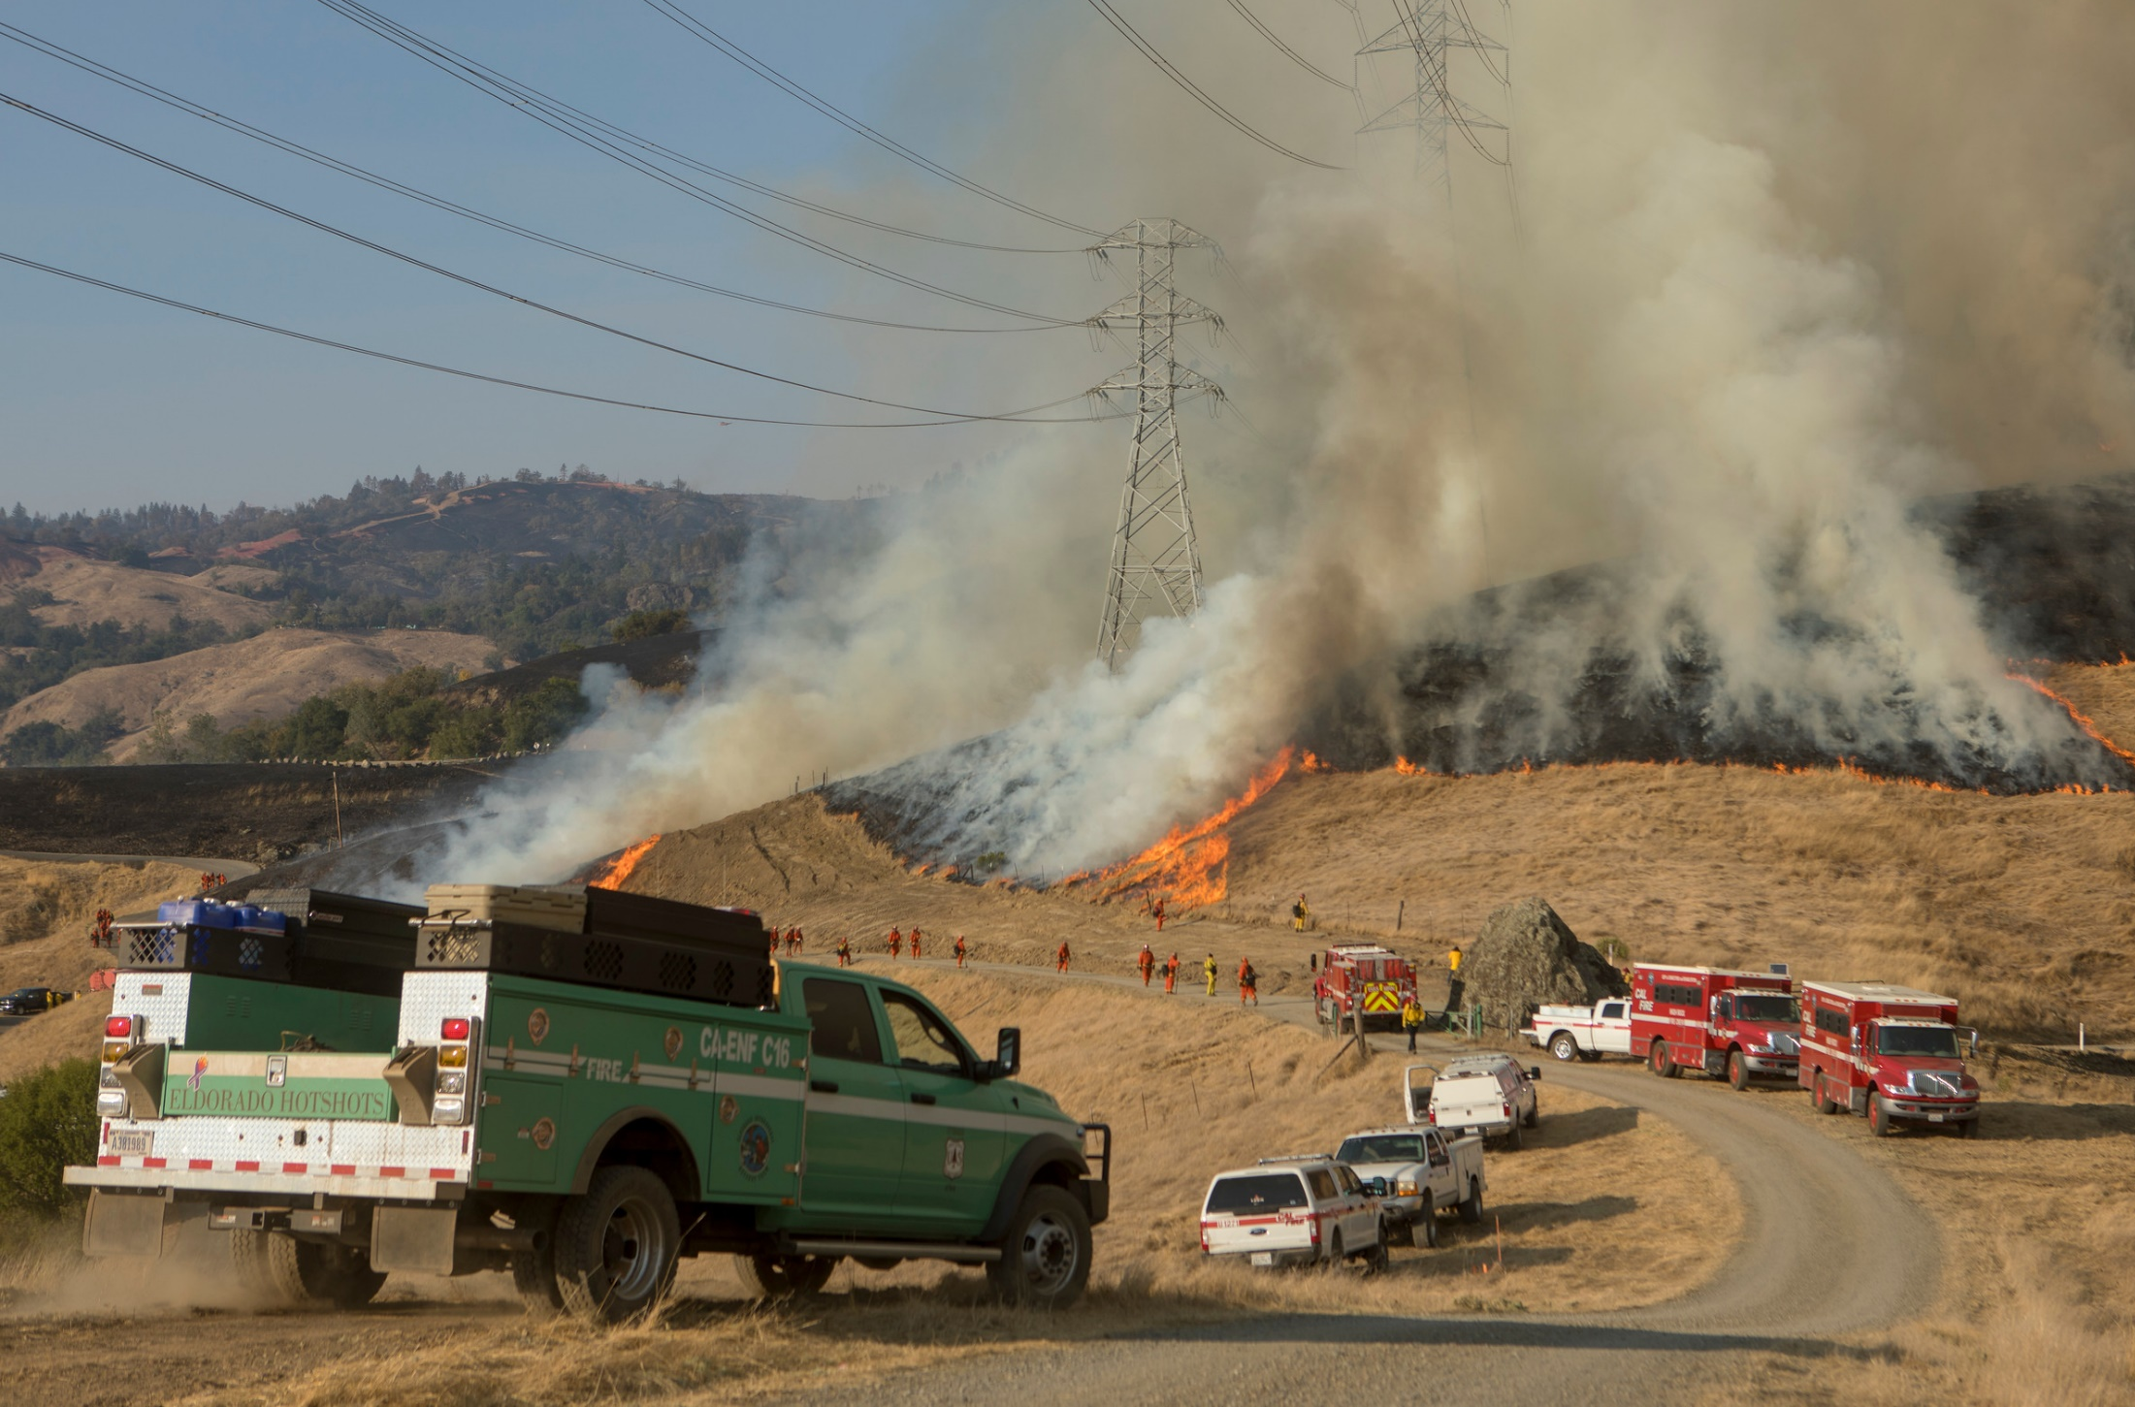
Watch Out Situations

Slide 13
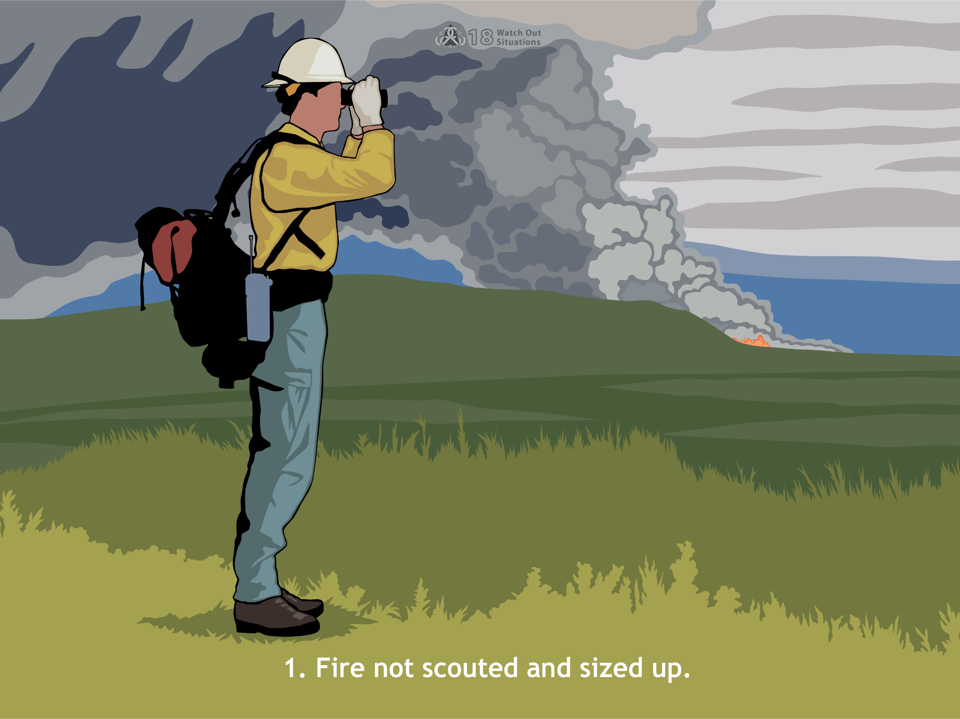
1. Fire not scouted and sized up.
Notes:
You’re in danger anytime your crew is assigned to fires or parts of fires where you cannot see the entire perimeter and someone from your crew has not had the opportunity to adequately perform a size-up or scout the fire. To provide a reasonable degree of safety, know where the fire is and what it is doing.

Slide 14
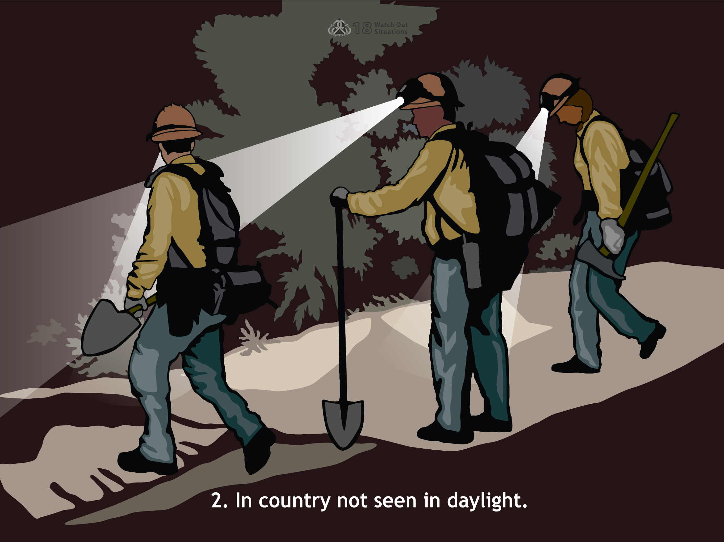
2. In country not seen in daylight.
Notes:
When you are in an area that no one from your crew has seen in daylight, you may not have the topographical information you need to work safely. The situation may be unsafe because you are unable to see the:
Shape of the land
Density of the vegetation
Distances between key landmarks
Gravity hazards (rolling rocks, snags, falling debris)

Slide 15
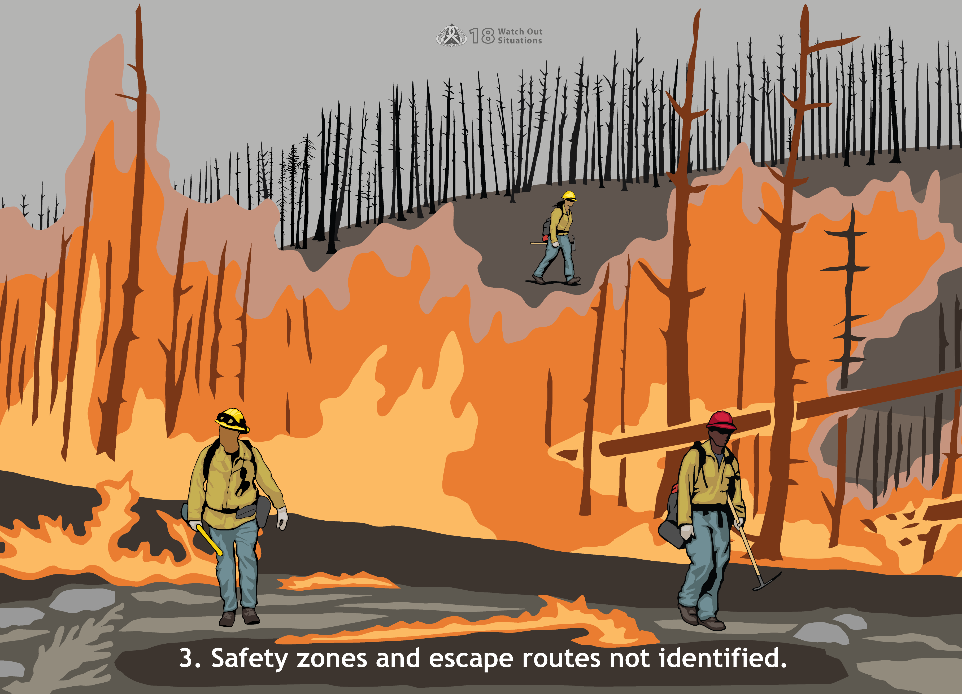
3. Safety zones and escape routes not identified.
Notes:
If you are on the line and don’t know where your safety zones and escape routes are, stop what you are doing until you find out the location of these critical safety features. Obviously, use your best judgment about when and where to stop, but do it immediately.

Slide 16
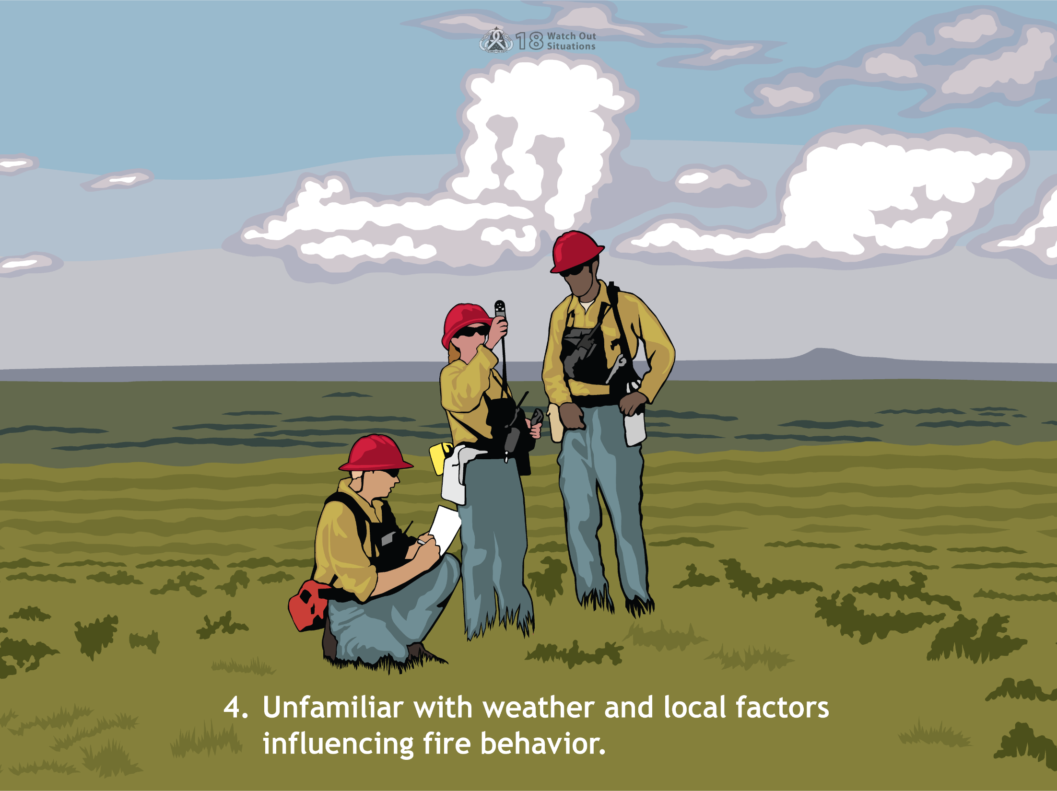
Unfamiliar with weather and local factors influencing fire behavior.
Notes:
You may find the local microclimate or burning conditions different from those in other areas. Safely coping with different conditions may require a change in strategy or tactics. Ask locals about weather patterns that might affect fire behavior.

Slide 17
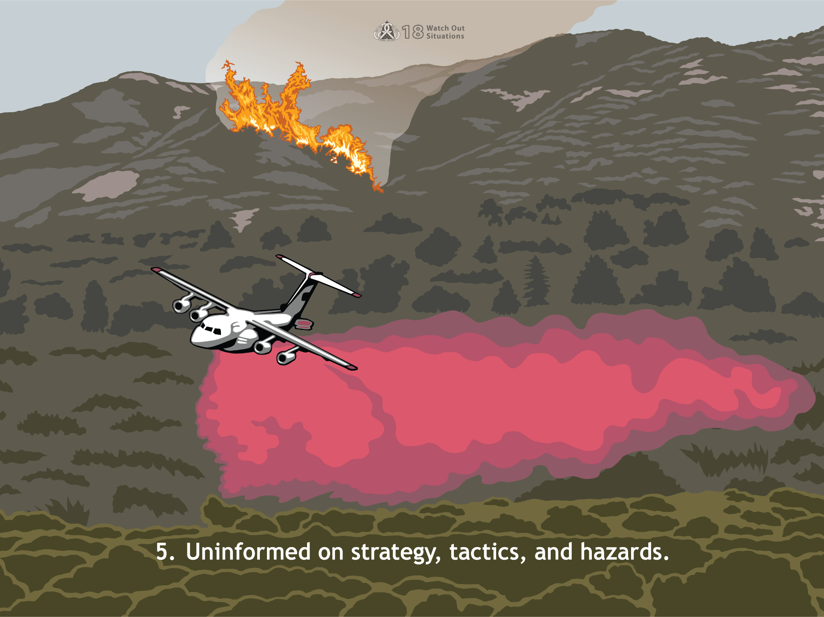
5. Uninformed on strategy, tactics, and hazards.
Notes:
Not knowing what the plan of attack is and how you fit into it can place your crew in serious jeopardy. You may be in the path of danger, such as airdrops or firing operations. Receiving assignments face to face is always best and helps provide clarity. Never, ever be shy about asking why you are performing a certain task.

Slide 18
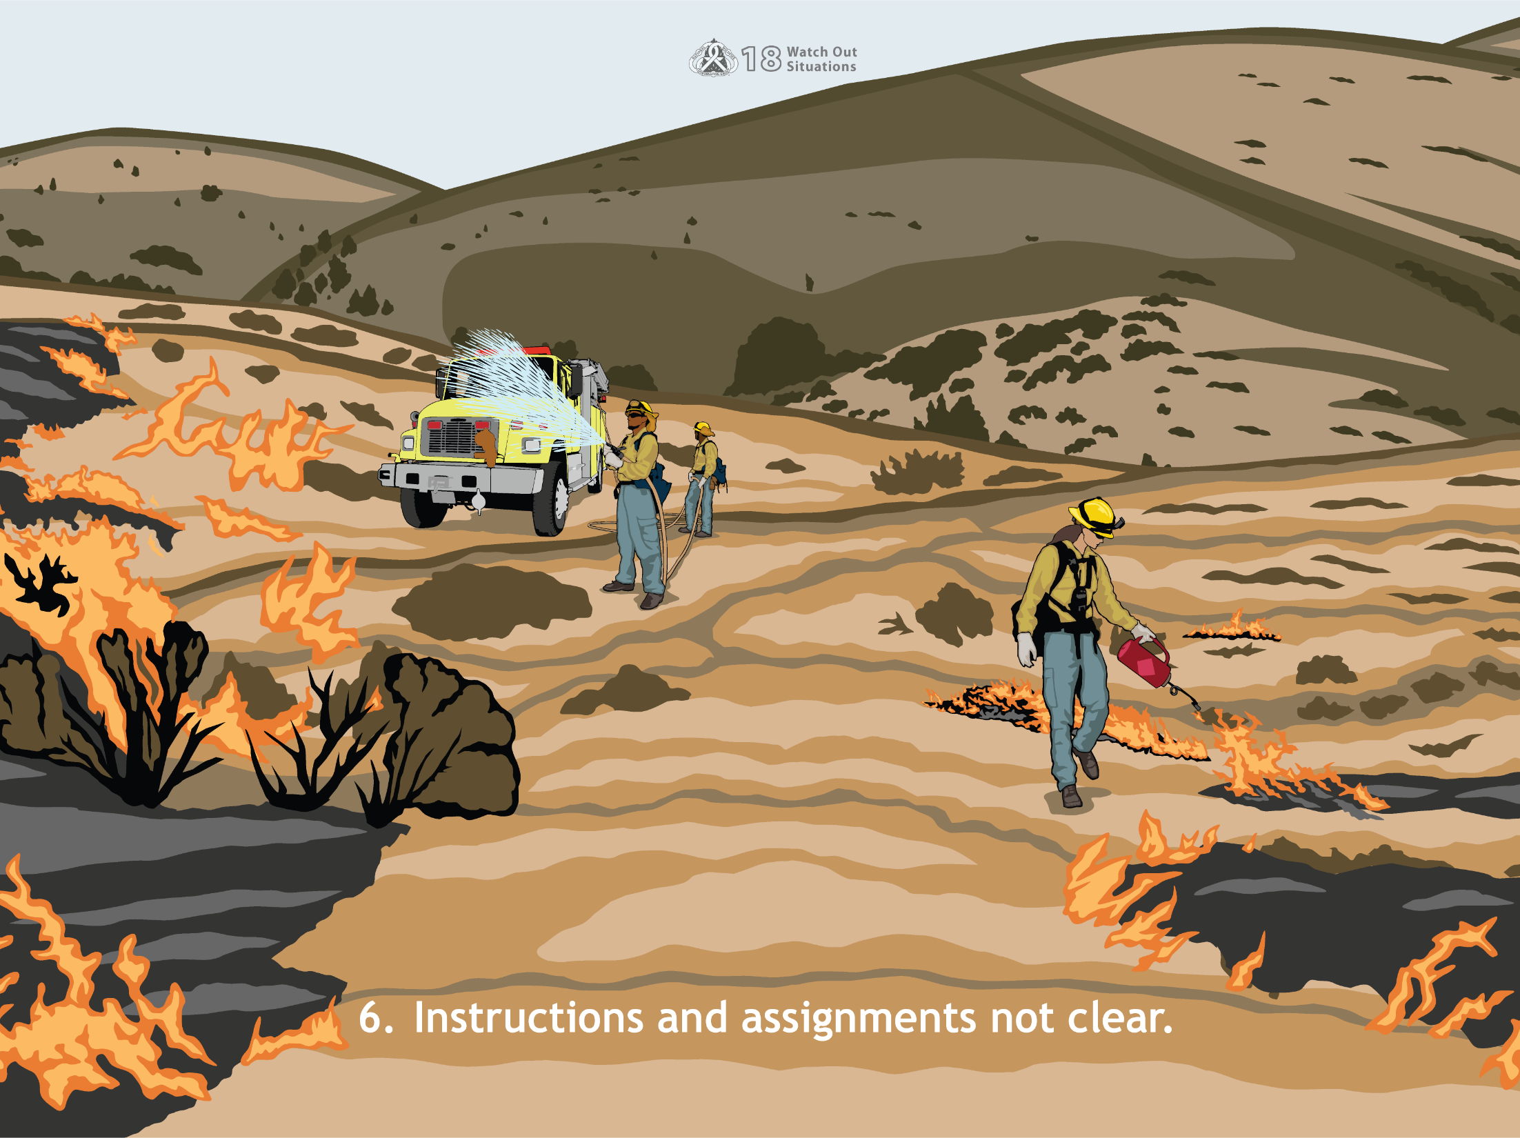
6. Instructions and assignments not clear.
Notes:
The results of poor communication can be both unproductive and dangerous. Once your crew is on the fireline, it may be too late to clarify orders. When in doubt, talk it out, repeat orders back to your supervisor.

Slide 19
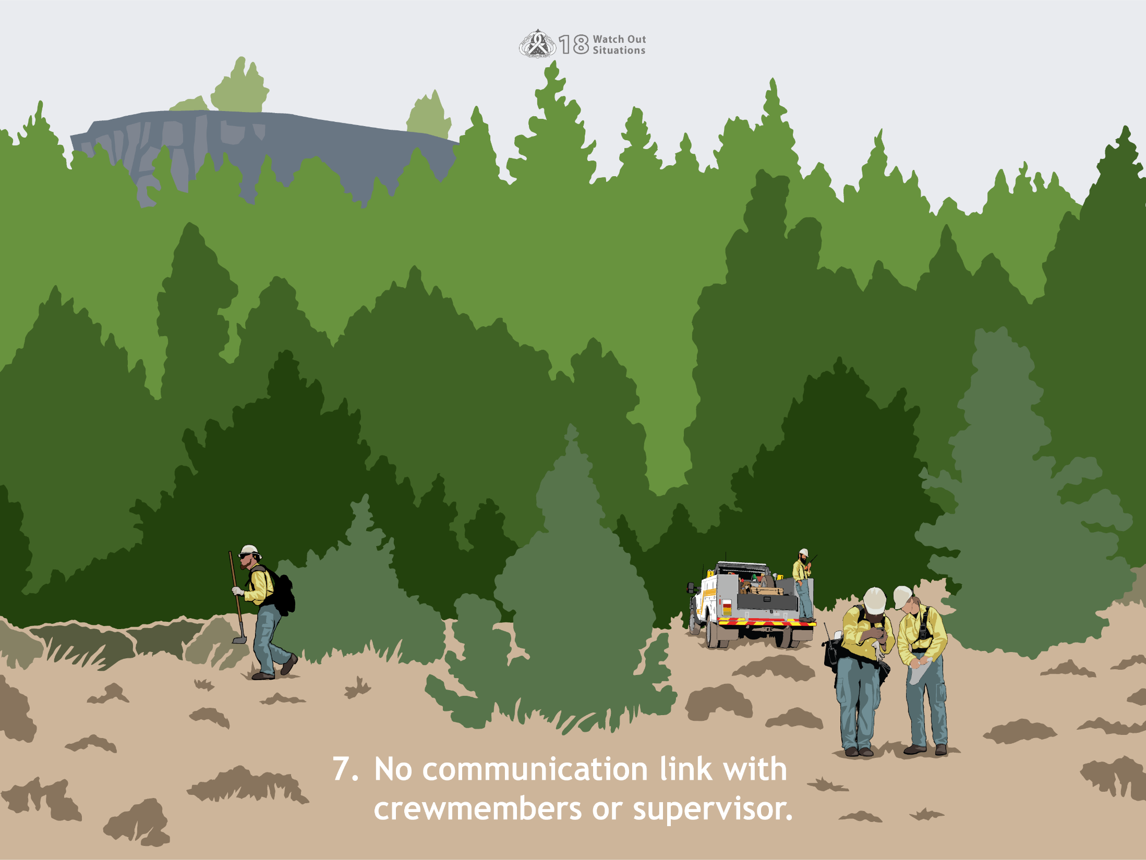
7. No communication link with crewmembers or supervisor.
Notes:
Lack of communication between crew members and supervisors can result in critical, lifesaving information not being passed up or down the chain of command. Maintain reliable communications between all levels.

Slide 20
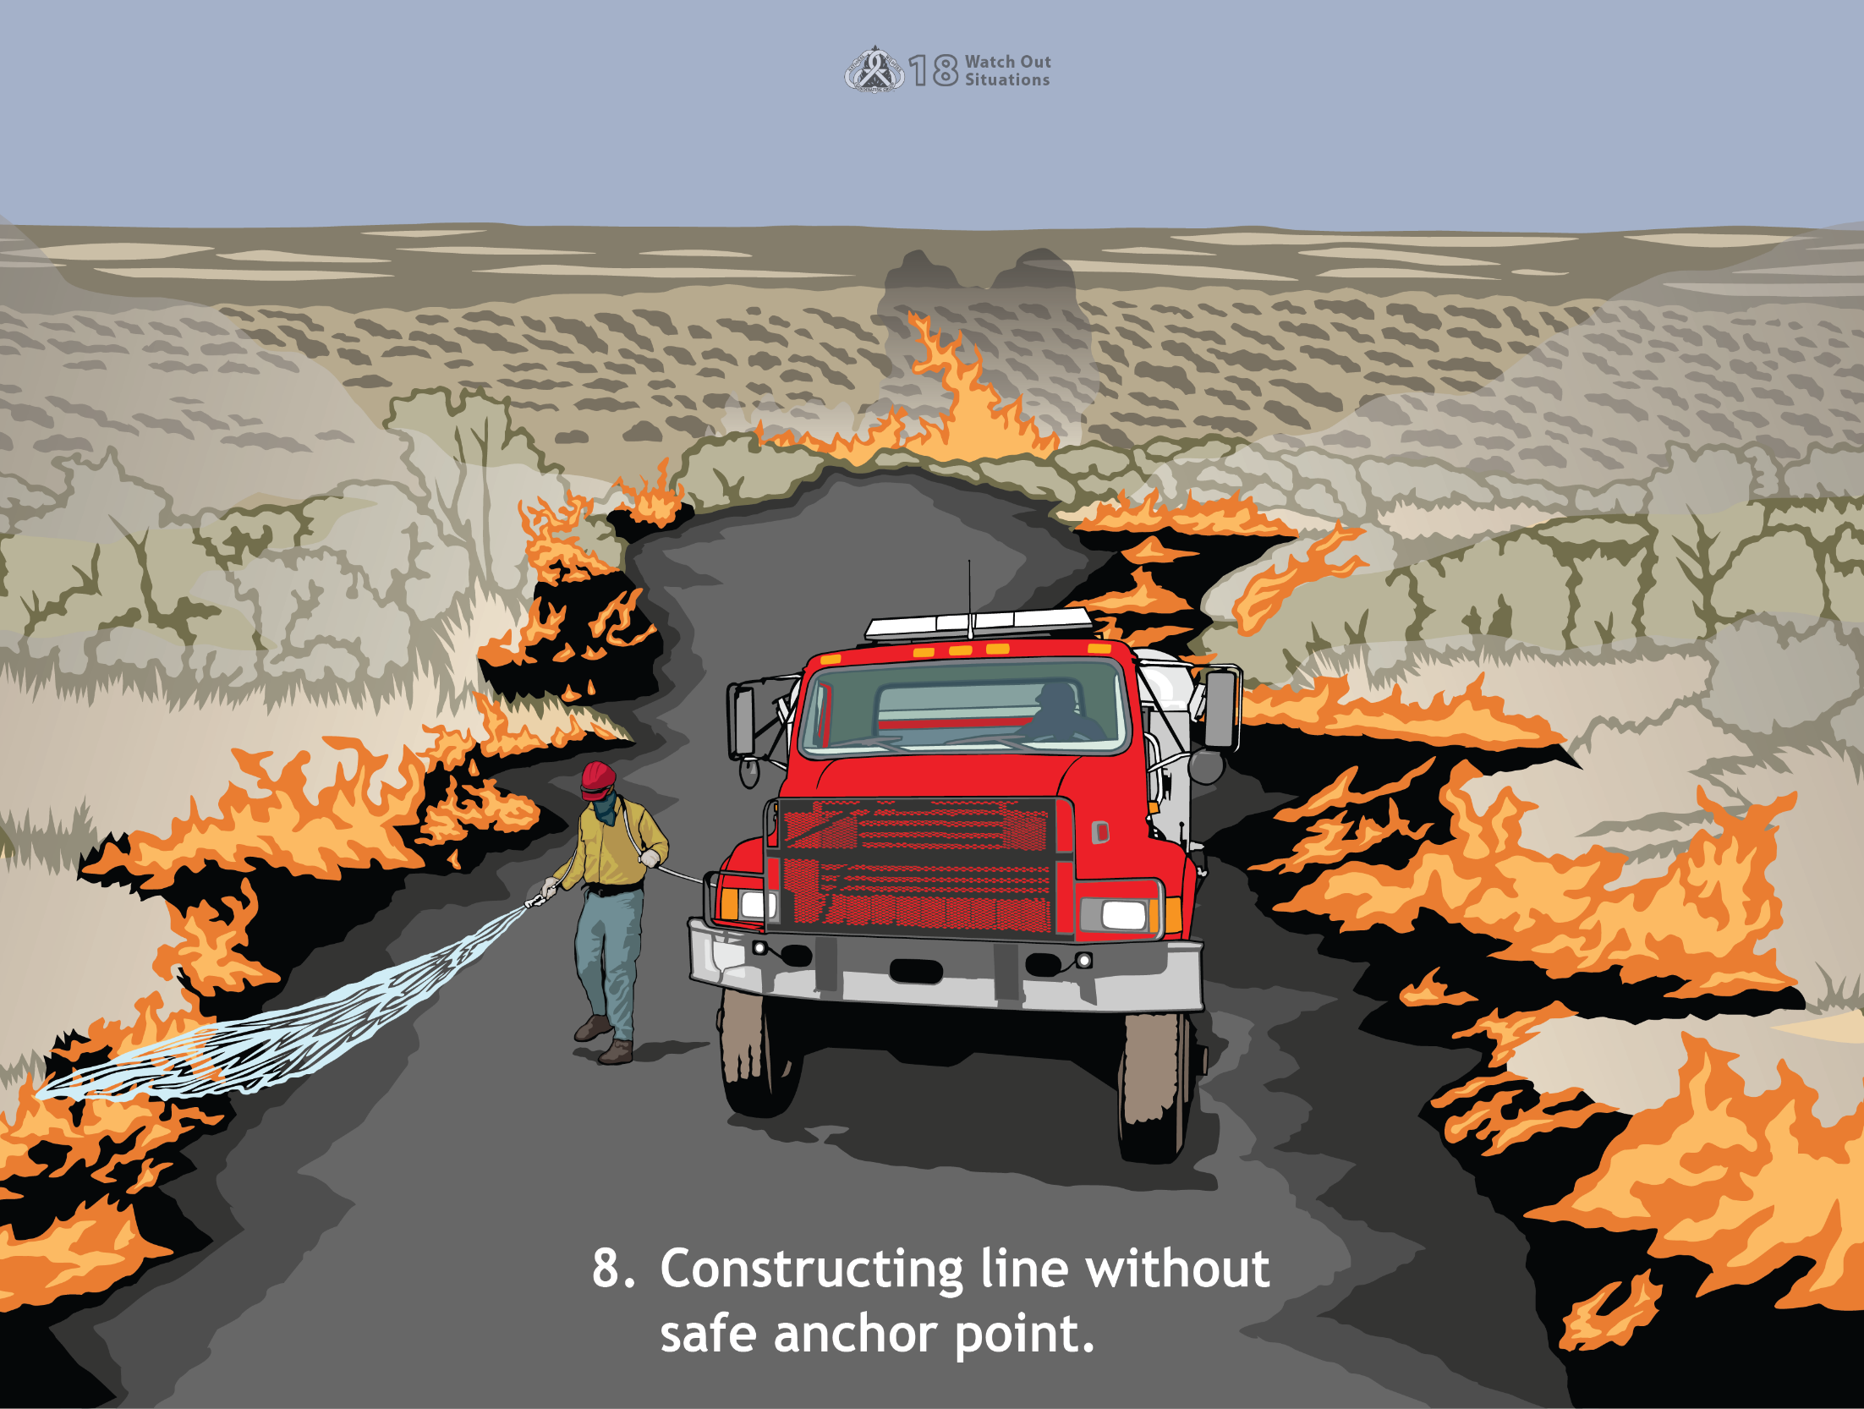
8. Constructing line without safe anchor point.
Notes:
A fireline should be anchored where there is a strong likelihood that it will not be overrun by the fire. That is the purpose of an anchor point. An anchor point is a natural or constructed barrier that will prevent fire spread and the possibility of a crew being flanked. Typical anchor points are roads, lakes, ponds, streams, previous fire scars, rockslides, and cliffs. Obviously, it would be unsafe to construct fireline without an anchor point.

Slide 21
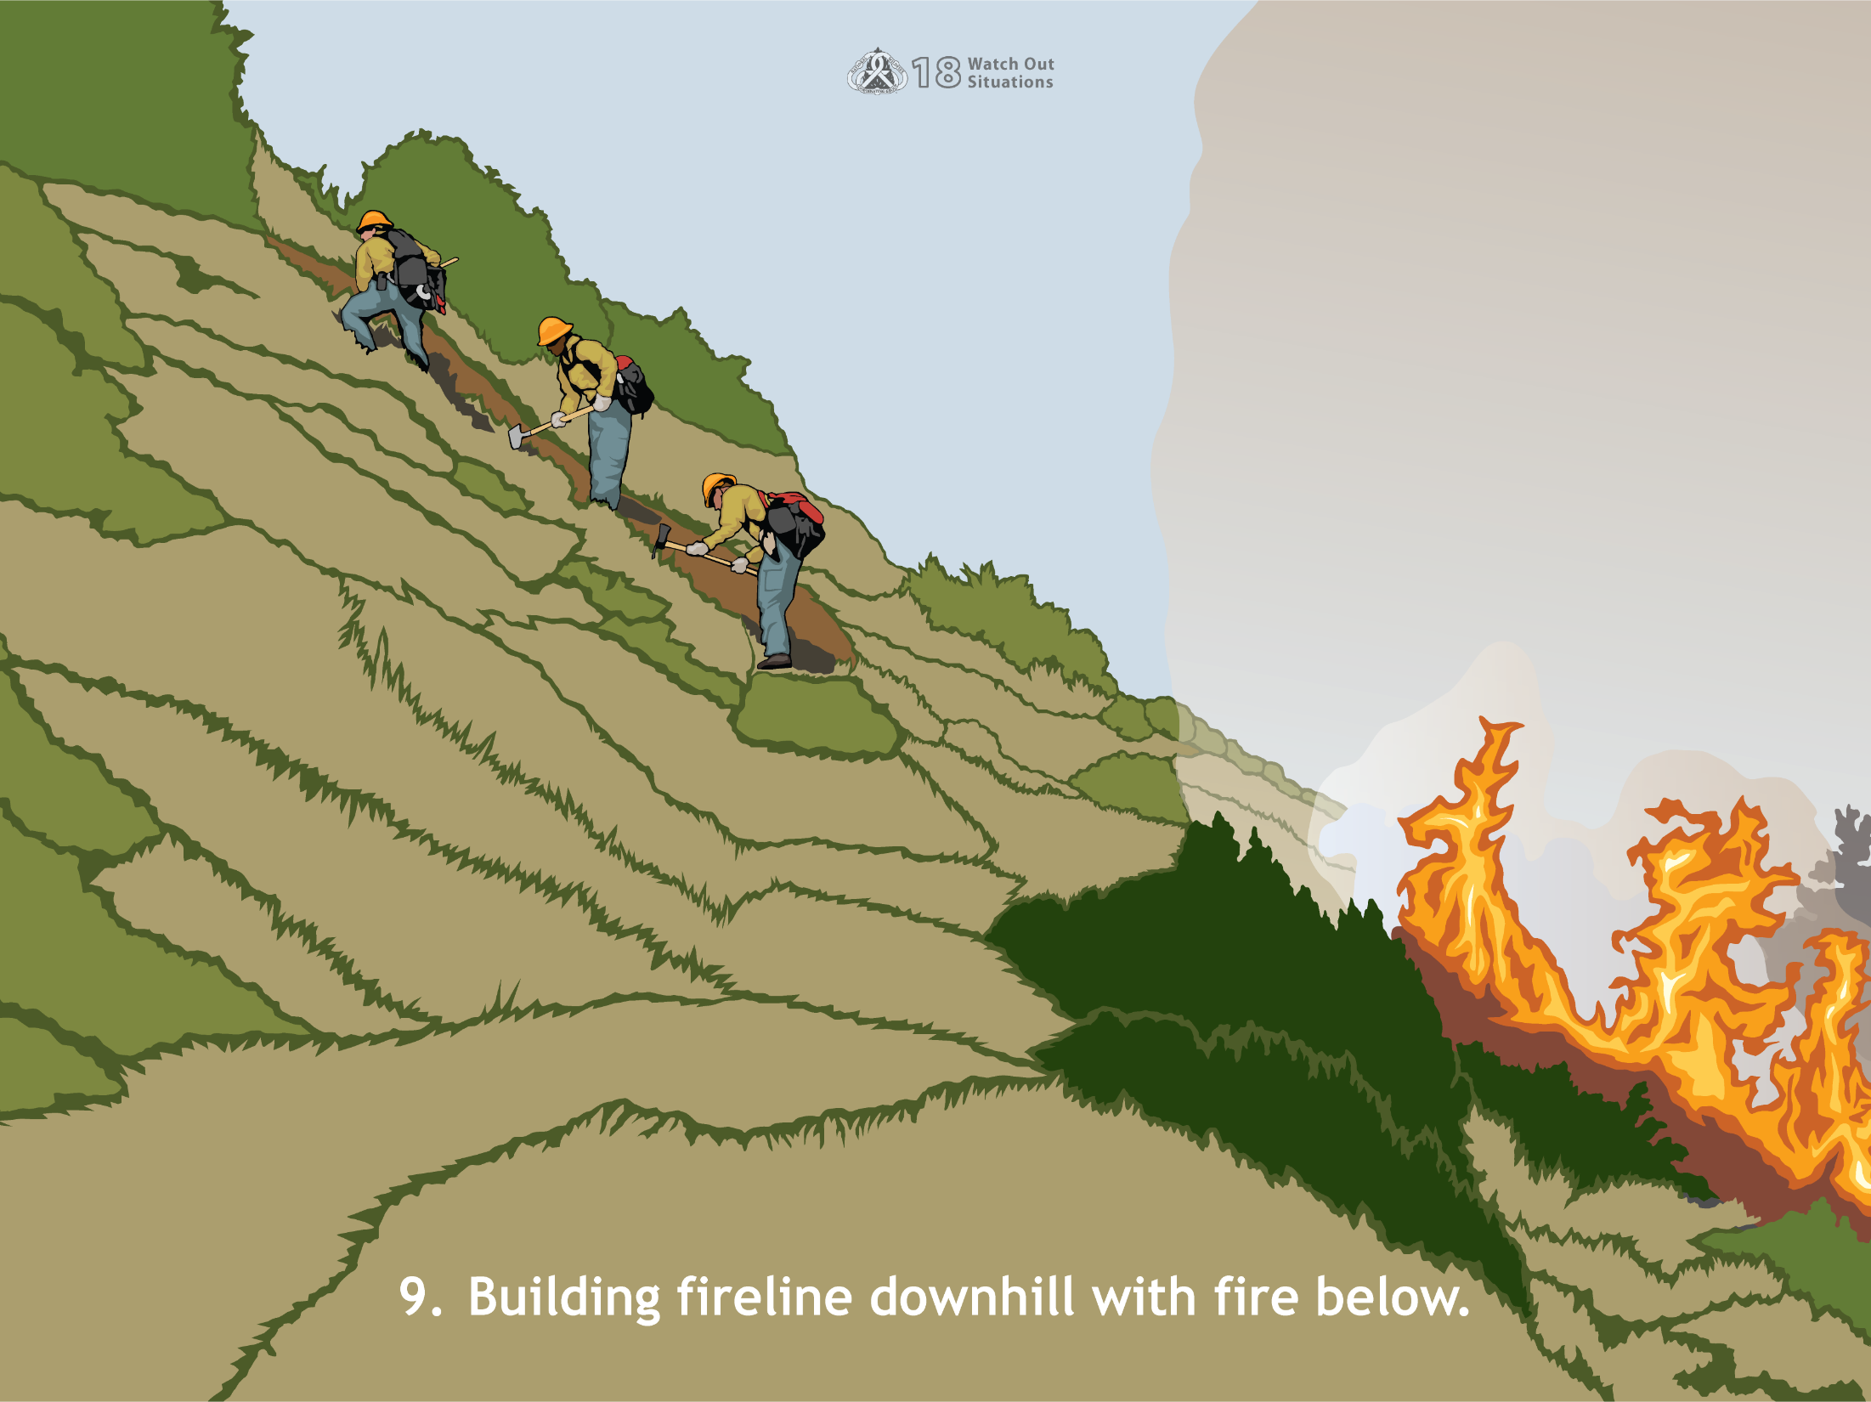
9. Building fireline downhill with fire below.
Notes:
Building a line downhill toward a fire is very dangerous. Fire normally burns faster uphill than downhill, you cannot predict how it will spread laterally, and there is a greater risk of the fire flanking crews that may be working downhill above the fire.
In this situation, it is difficult for firefighters to establish a safe anchor point, and they are not assured a safe escape from the fire if they have to escape uphill. Also, convective heat, smoke, and flame rising upslope make it difficult for you to breathe or see clearly, and you are likely to have very poor footing.
However, downhill line construction is sometimes a valid tactic, but only after carefully weighing the benefits against the risks, establishing LCES (lookouts, communications, escape routes, and safety zones), and following the downhill line construction checklist in the IRPG.

Slide 22
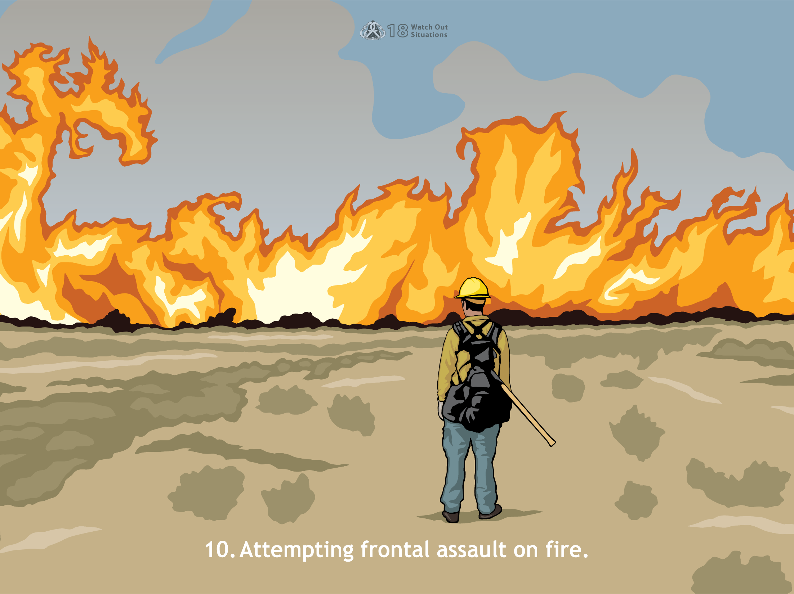
10. Attempting frontal assault on fire.
Notes:
Attempting a frontal assault (head of fire) on a fire from the green puts you in a terrible position, especially if your crew has too few hoselines or hoselines that are too small. Your fire can overrun you and flying sparks or embers may start fires behind you. Other dangers of a frontal assault are:
No anchor point
Lateral fire spread, you may be outflanked as a result
Rapid movement of fire toward you or over you
Intense heat and smoke
Inability to get to a satisfactory escape route and safety zone

Slide 23
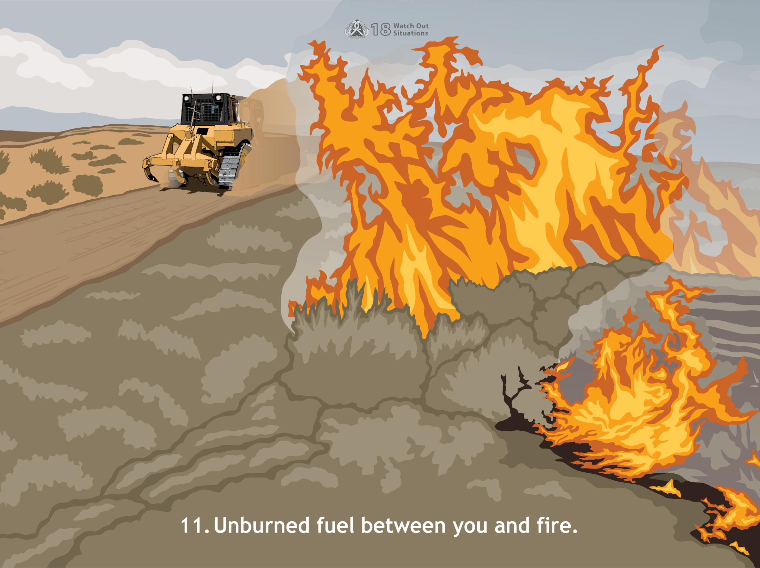
11. Unburned fuel between you and fire.
Notes:
It is dangerous for you to be in any type of ground cover with unburned fuel between you and a fire. Making a hose lay in the green towards a fire is very dangerous. Any time you are in the green and attempting to move through unburned fuel to reach the burned area, you are susceptible to the fire overrunning you. Have your escape routes and safety zones readily available. Post more than one lookout when crews are working indirect.

Slide 24
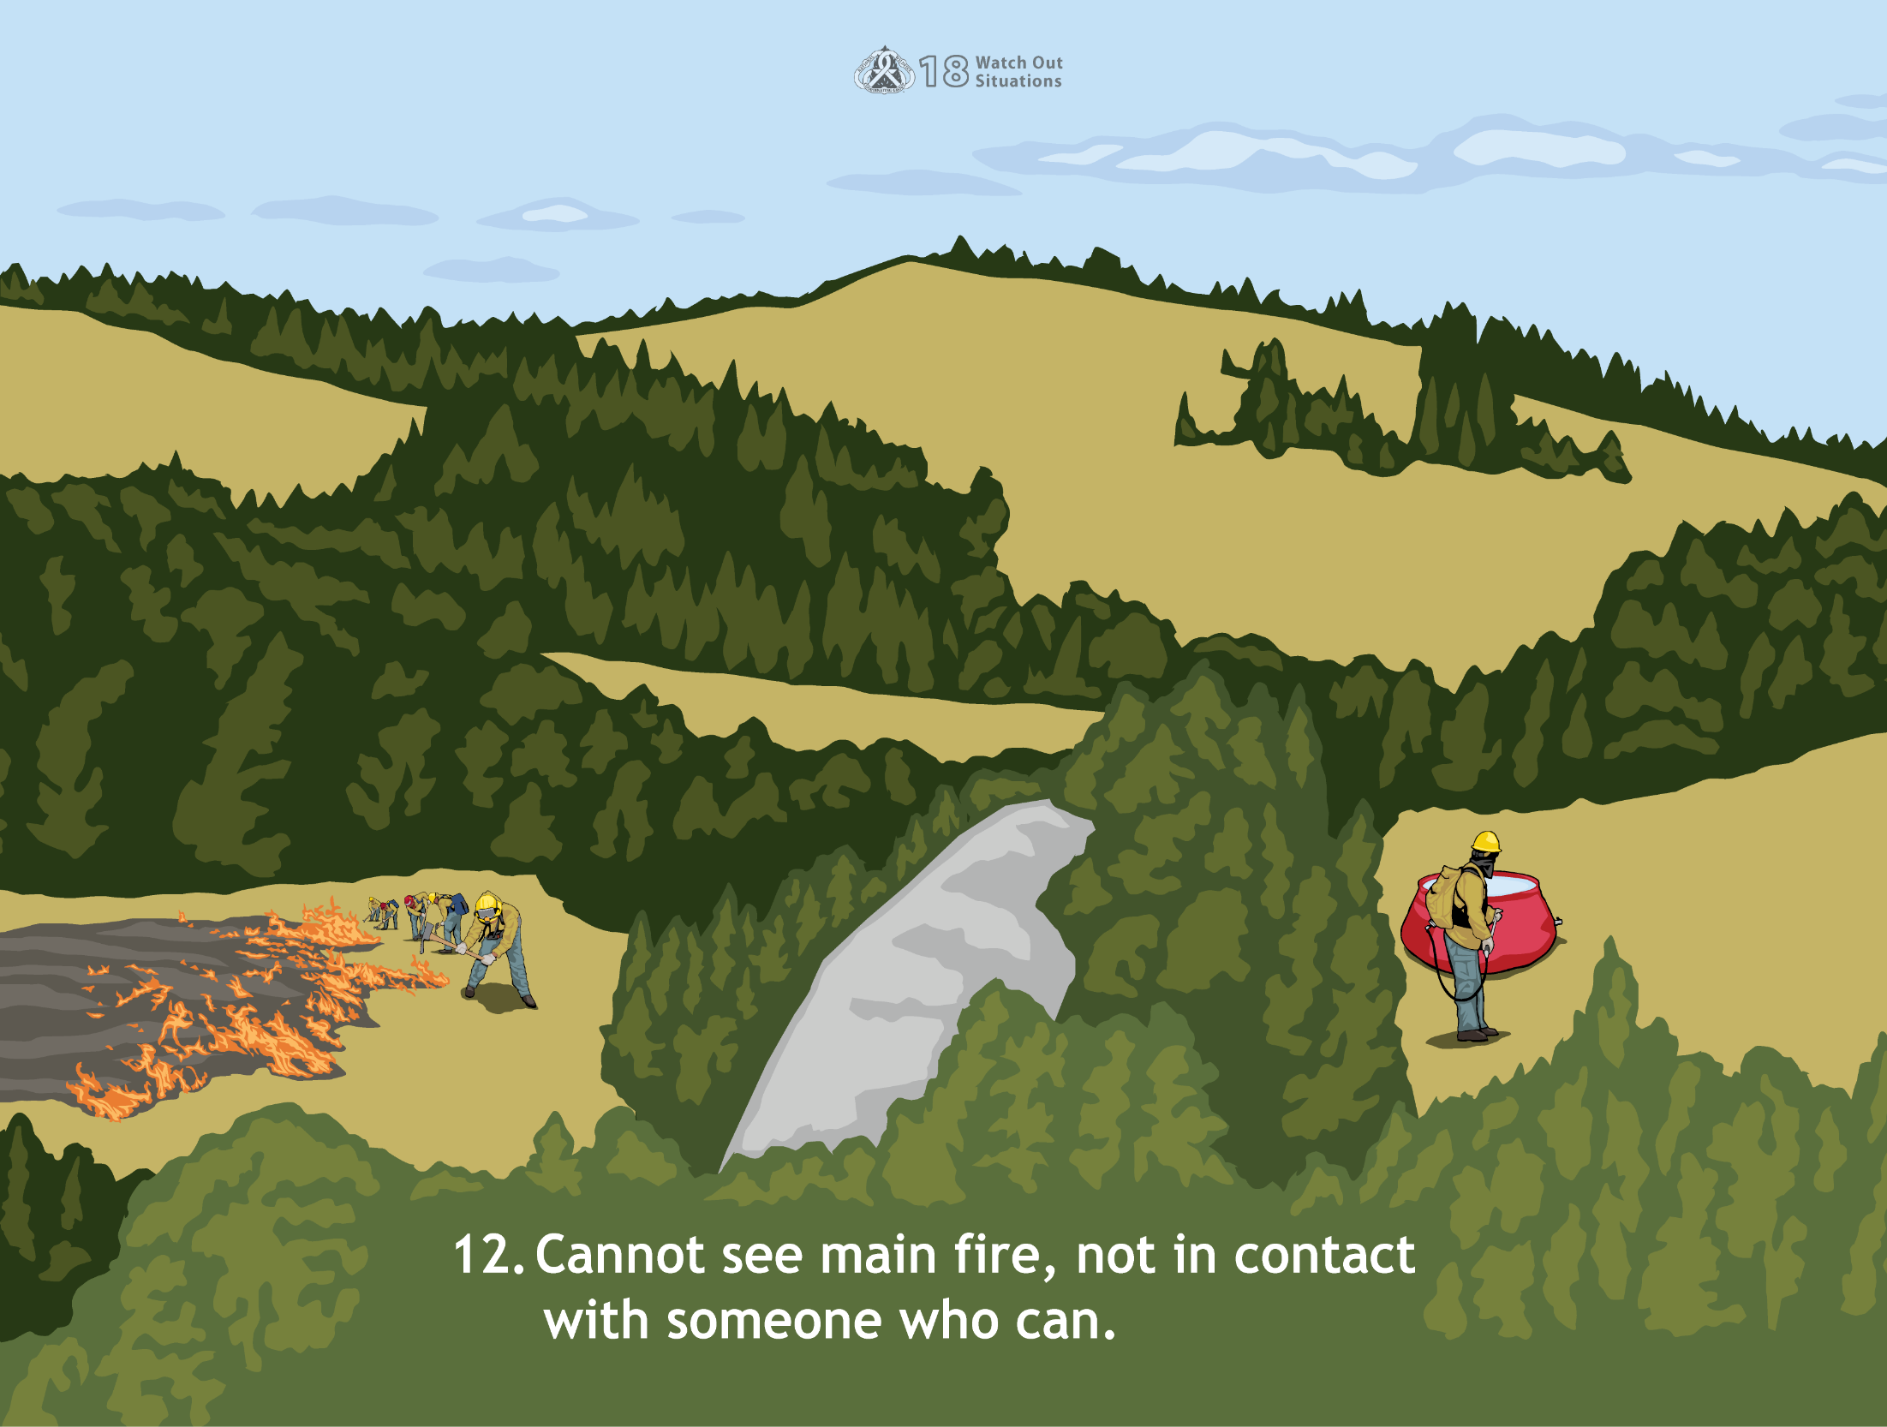
12. Cannot see main fire, not in contact with someone who can.
Notes:
If your crew is working out of sight of the fire and out of contact with anyone who can see the fire, an unseen blowup can put you in danger of being overrun. Post one or more lookouts who can see the progress of the fire.

Slide 25
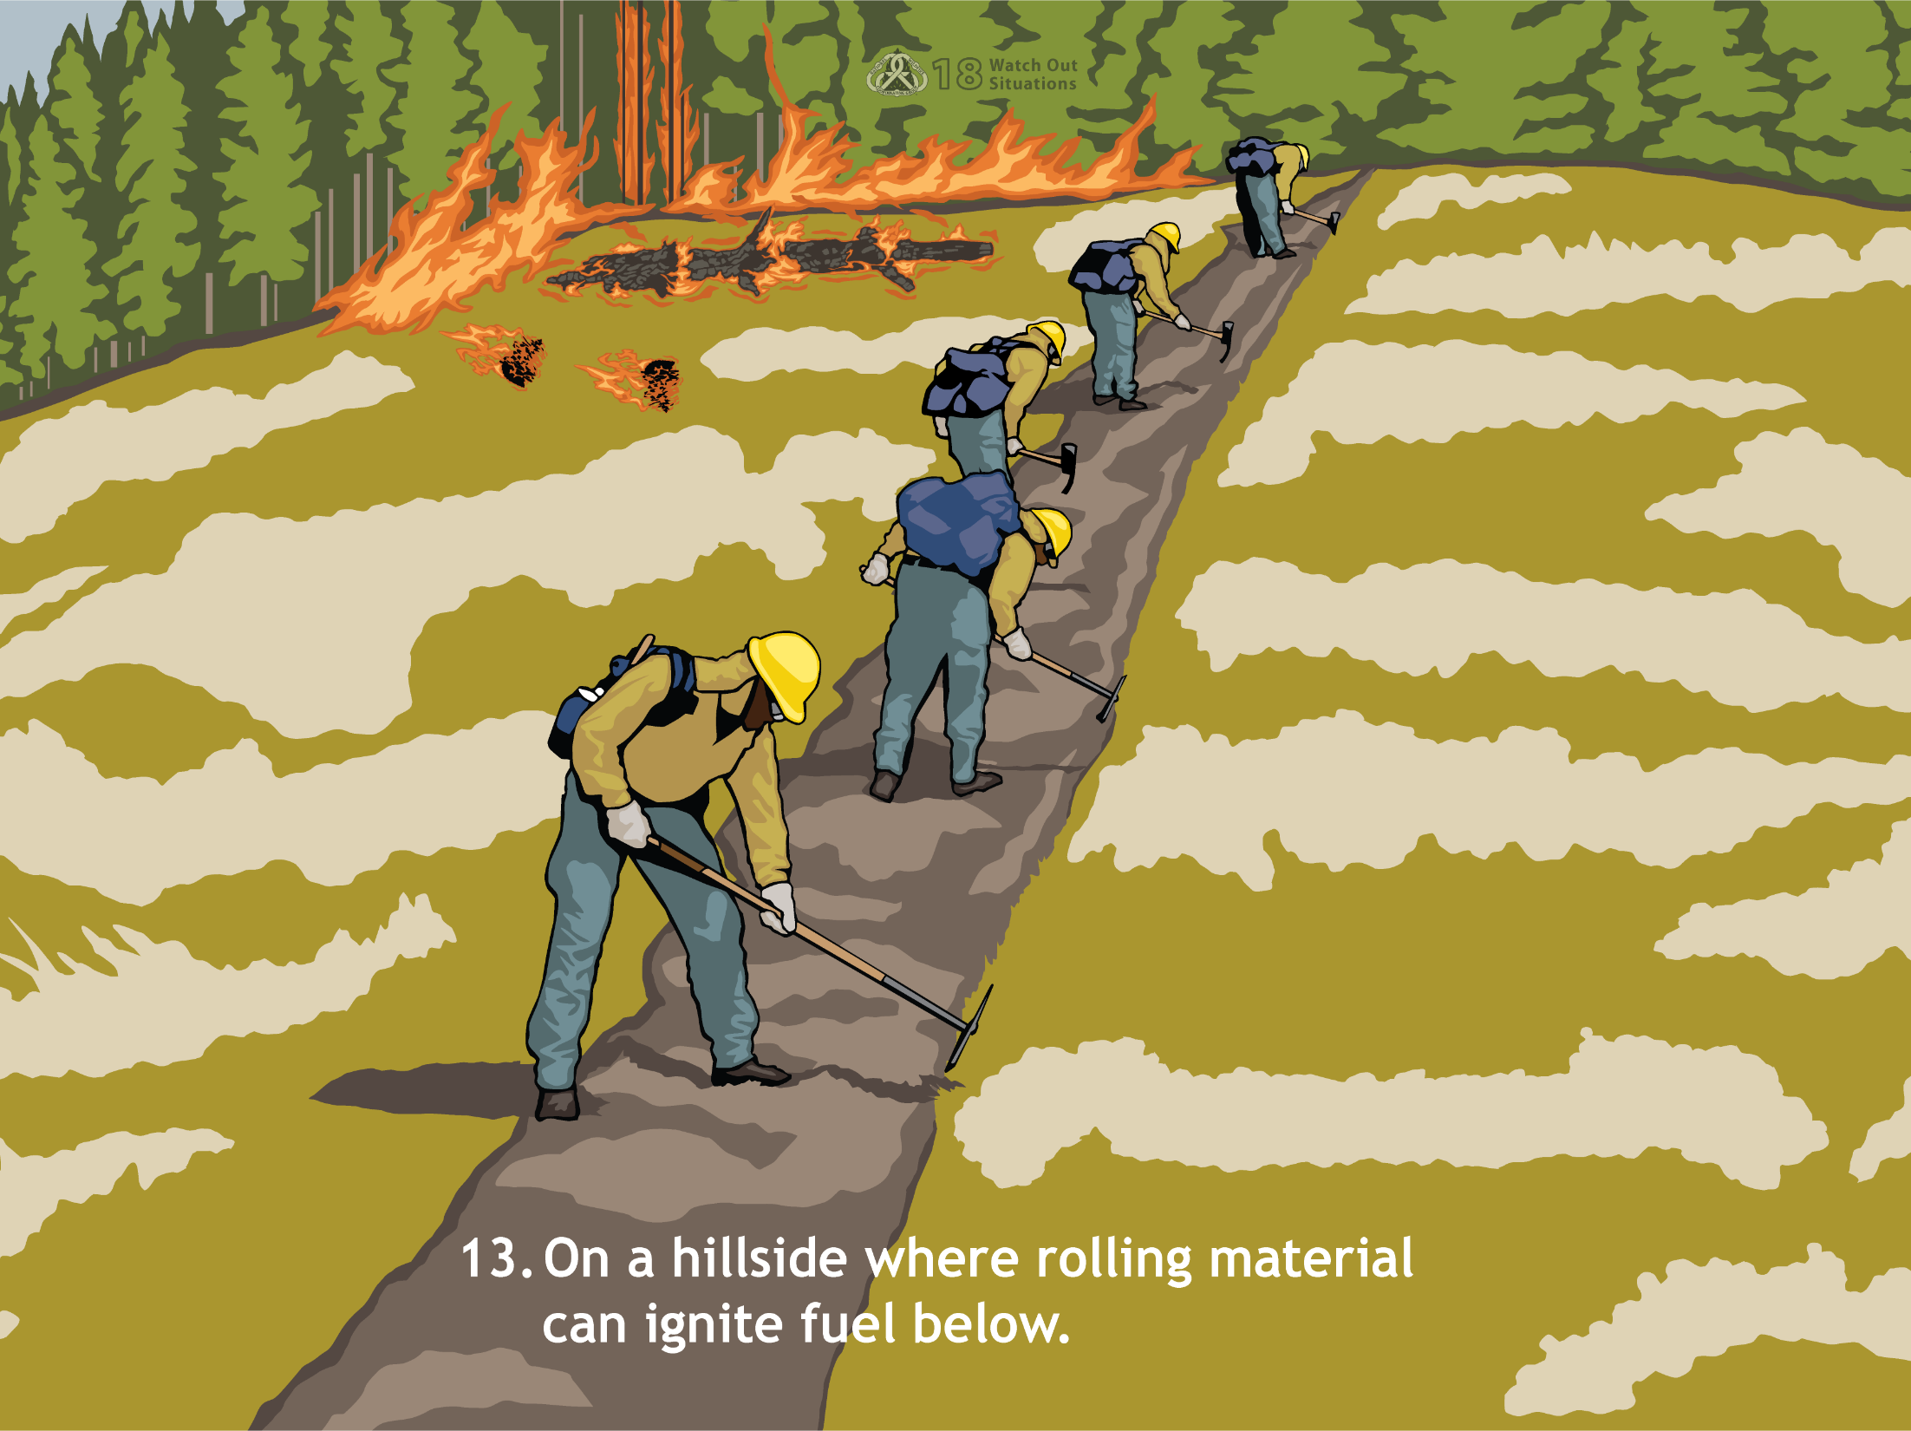
13. On a hillside where rolling material can ignite fuel below.
Notes:
If rolling materials start spot fires below your crew, a new fire may run upslope toward you. Since fire can spread rapidly upslope, you are not likely to be able to outrun the fire.

Slide 26
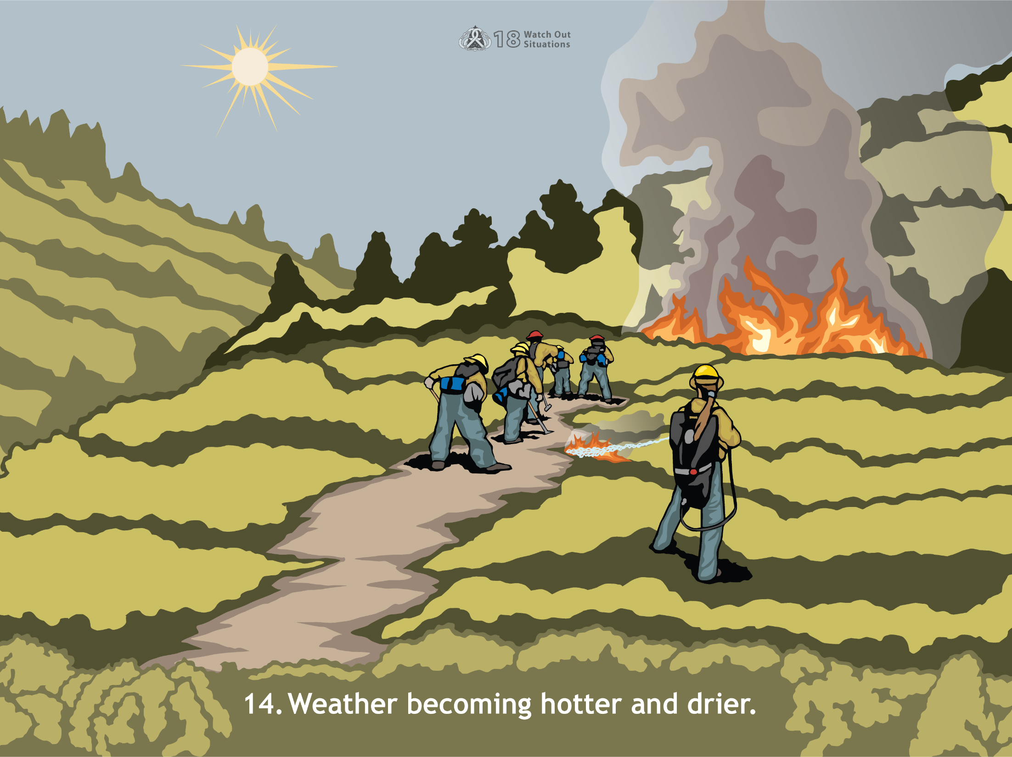
14. Weather becoming hotter and drier.
Notes:
Fires like hot, dry weather. That’s when they are most active. To determine if the weather is getting hotter and drier, you or your supervisor can:
Use your senses to observe fire behavior, look for more intense burning
Get frequent weather forecasts
Take weather measurements periodically with a weather kit
You may have to adjust tactics under these conditions:
New smoke appearing within the burn
Smoldering duff supporting visible flame
Up-canyon winds starting to blow through the ravines and across control lines
New spot fires increasing in number
Smoldering spot fires being fanned back into life
Crowning, or the likelihood of fire rising from ground level into the tree crowns and advancing from treetop to treetop, increases even during mop-up

Slide 27
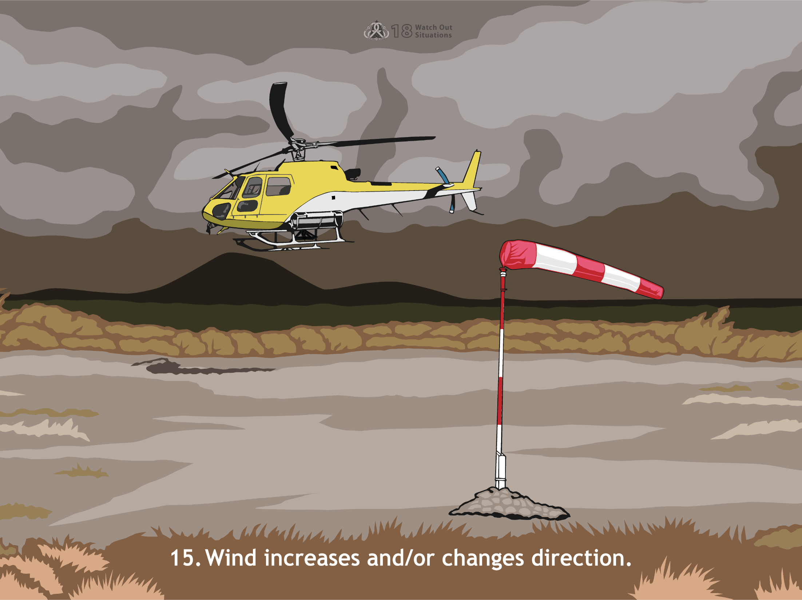
15. Wind increases and/or changes direction.
Notes:
Be aware of winds increasing or changing direction. Wind pushes flames into available fuels and increases the spread rate as well as pre-heating the fuels ahead of the flaming front. Wind blowing from the green into the black may suddenly reverse direction and blow hot materials or flames into new fuels. Wind also dries fuels out quicker increasing the probability of ignition.

Slide 28
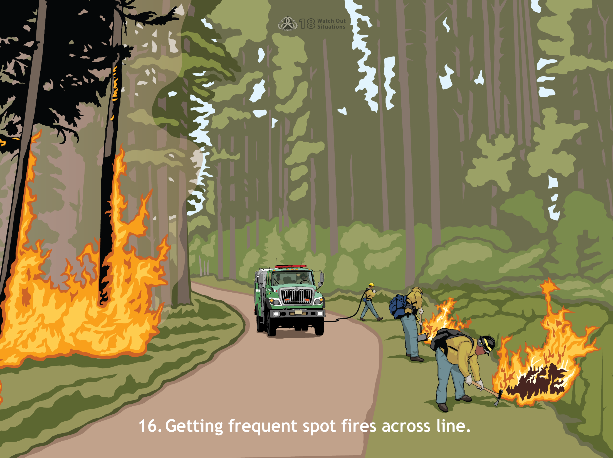
16. Getting frequent spot fires across line.
Notes:
If you’ve got more spot fires across the line than you can handle, you won’t be able to reach and contain them while they are still small. That’s a problem, if you don’t knock them down, they can combine to create area ignition. Spot fires can also develop into separate major fires, and you can suddenly find yourself and your equipment between two or more fires.

Slide 29
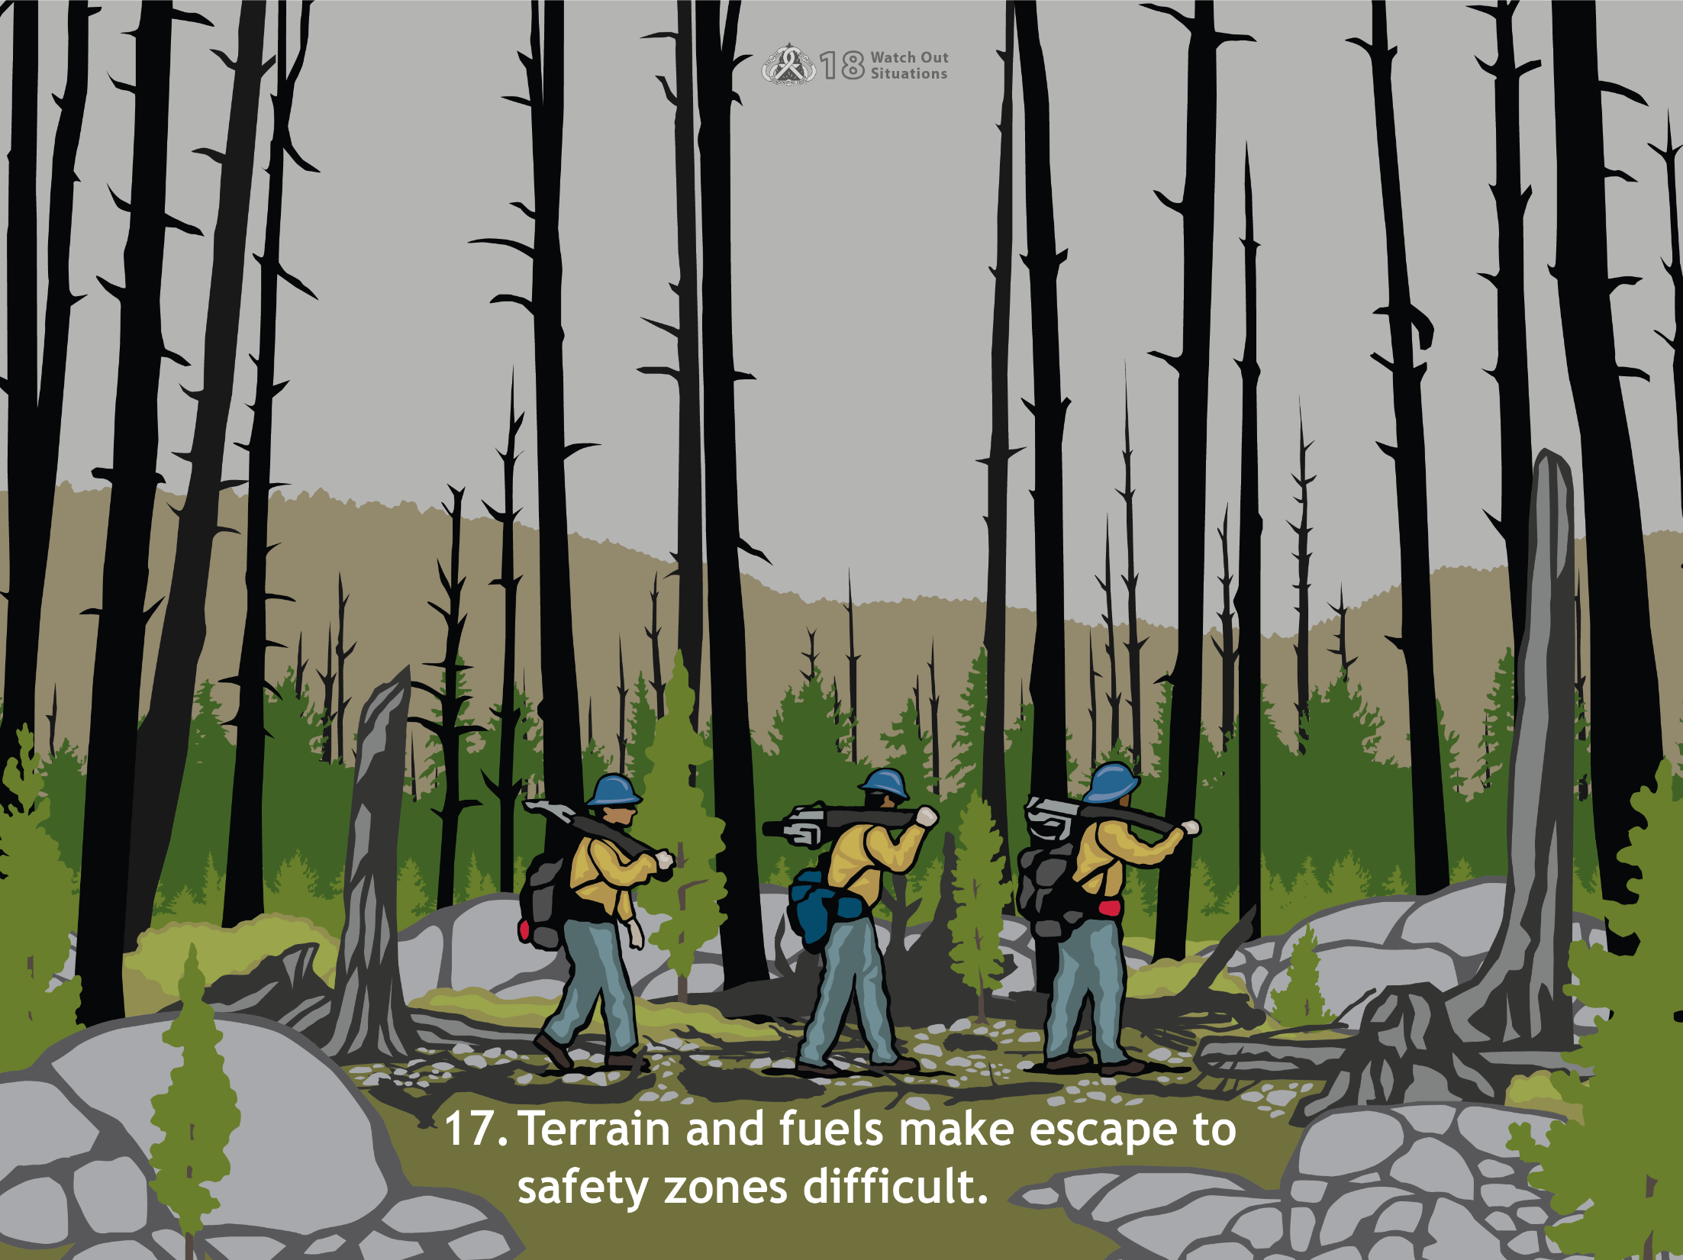
17. Terrain and fuels make escape to safety zones difficult.
Notes:
Sometimes you can be at some distance from the burned area or another safety zone in terrain or cover that makes travel difficult and slow. Watch out for:
Slopes that present hazards such as falling rocks and the potential for slipping and falling
Irregular terrain that can put you out of sight of the fire and other personnel
Heavy cover that may restrict your ability to see the fire and may obscure escape routes
The reason this is a Watch Out situation is that personnel should be able to escape the fire with reasonable ease. When terrain and fuels make escape difficult, you will need to increase your time estimate for escape and trigger points for reevaluating the situation will have to occur more frequently.

Slide 30
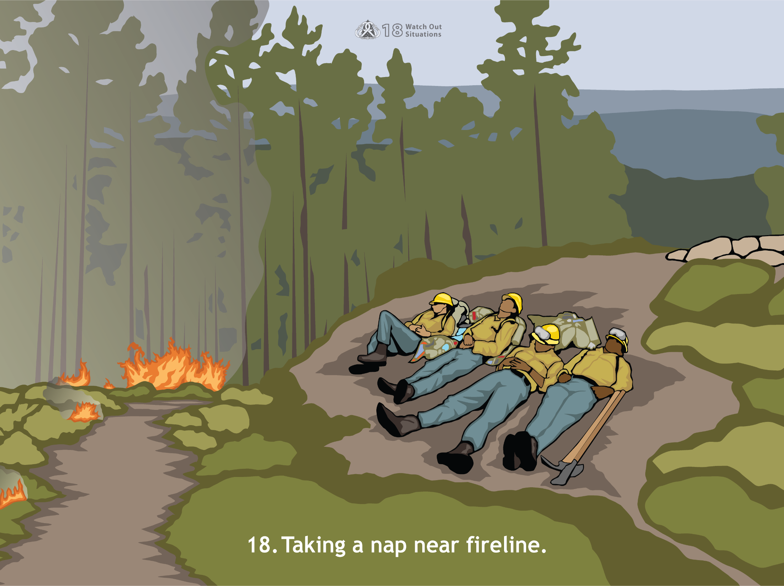
18. Taking a nap near fireline.
Notes:
Those who haven’t fought a major fire laugh when they see this one. It’s not so funny when you’ve been on the line for 20 hours of your first 24-hour operational period. You may find yourself asleep on your feet with your head on the handle of your shovel. A sleeping firefighter can be overrun by a fast-moving fire or by heavy equipment operating along the fireline.

