Slide 1
D-110 Unit 4 Creating Resource Requests, Pending Requests, Resource Status, and Edit Request

Slide 2
Objectives
Complete resource orders for overhead, crew and equipment requests from general message forms using the electronic resource tracking system (IROC).
Describe the use of the Pending Request screen.
Describe the use of the Resource Status screen.
Demonstrate the ability to utilize the Edit Request functionality.
Notes:
Review unit objectives

Slide 3
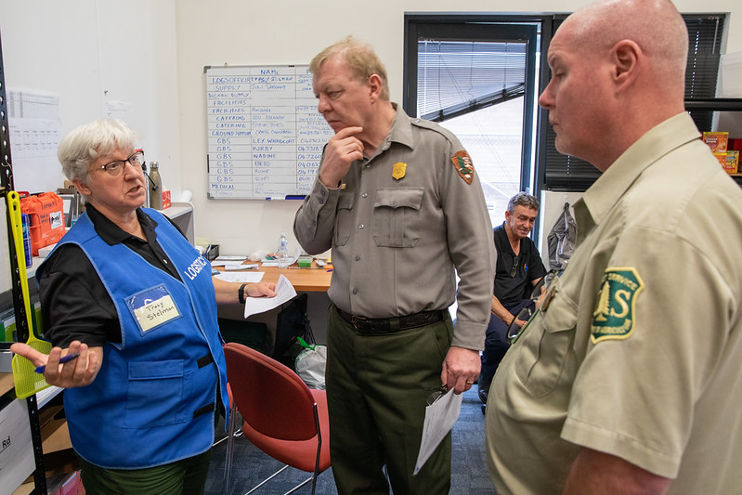
Source of Resource Request
From Initial Attack (IA)
From the Incident (ORDM)
By telephone, General Message, fax, e-mail, or radio
Notes:
Resource requests are typically received in expanded dispatch in two ways:
From Established Dispatch (IA).
From the Incident Ordering Manager (ORDM).
The requests typically come via:
Telephone
Radio
Email/text
Fax - Forms received from the ORDM at incident may be via fax.
General messages are tri-carbon forms.

Slide 4
General Message Form
Notes:
Discuss what information is necessary before you create a request.
Requestor Name. Who sent the general message, fax, or called?
During an initial briefing, your supervisor should identify individuals from whom resource requests will be accepted.
For example: Ordering Manager, Center Manager, Logistics Section Chief, Incident Commander, etc.
Resource requests from any other sources should be brought to the attention of the EDSD or EDSP.
Incident name. Why is this important - Answer: Expanded may be dealing with multiple incidents.
Item requested.
Quantity.
Date/time needed.
Reporting or delivery location.
Special needs, if any.
- For example: Crews double-lunched, rental car approved, special skills necessary, trainee acceptable, etc.
Signature of authorized approver (discuss local protocol).

Slide 5
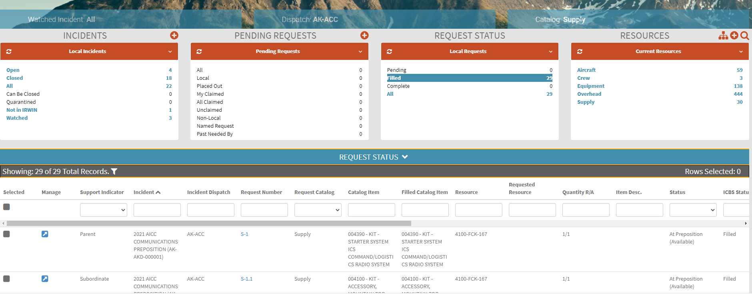
Content Selectors, Action Tiles and Main Work Areas
Notes:
Select incidents to watch in IROC
Have Students follow along and set up their incident list:
IROC Portal.
Incidents Action Tile > Open Incident.
Describe what the List Selector mean.
Describe how to sort and filter the Incidents Work Area – List View.
Explain how watching an incident populates the Watched Incident content selector.
Assign each group one of the Incidents in the list. Have students watch their incident.
Have students randomly select another incident, so that they will have at least two incidents in their content selector.

Slide 6
Resource Orders
Tools
NWCG Standards for Wildland Fire Resource Typing, PMS 200, https://www.nwcg.gov/publications/200
National Interagency Mobilization Guide, https://www.nifc.gov/nicc/mobguide/index.html
Notes:
Creating a Resource Order
Have students navigate to IROC Portal.
Demonstrate how to search using the Catalog Item field IROC Portal.
In the Incident Content Selector, selected assigned incident.
Pending Request Action Tile > “+” icon.
Show students how to select an incident from the Pending Request screen.
Select Catalog.
Describe overhead, crews, and equipment with examples of each type.
Demonstrate Catalog dropdown:
There are 5 resource functional area catalog choices:
Aircraft (typically handled by IA).
Crew
Equipment
Overhead
Supply (will be addressed in Unit 7).

Slide 7
Resource Items
Crews
Notes:
Creating a Crew Request
Select Catalog for Crew.
Select Catalog Category: Fire.
Explain the following:
Crew, Military, Battalion.
Crew, Type 1 (National Resource, Interagency Hot Shot crews [IHC]).
Crew, Type 2, or Crew, Type 2IA (IA/breakdown capable and have sawyers).
Crew, Type Any.
Select Catalog Category: Non-Fire.
Explain the following:
Camp crews.
Kitchen crews.
Trail crews.

Slide 8
Resource Items
Equipment
Notes:
Creating an Equipment Request
Select Catalog for Equipment.
Scroll through Catalog Categories.
Catalog Category: Dozer.
Catalog Category: Engine.
Catalog Category: Engine, Strike Team.
-Discuss local protocols.
Catalog Category: Food Service, Mobile.
- Once certain criteria are met on an incident a National Caterer must be requested.
See National Interagency Mobilization Guide, https://www.nifc.gov/nicc/mobguide/index.html.
- NICC dispatches all National Caterers. These requests are placed to the GACC and subsequently placed to NICC.
- Local caterers may be used when incident does not meet criteria or National Caterer is unavailable.
- Orders for caterers are handled by EDSDs or EDSPs.
- Discuss local protocol.
Catalog Category: Grey Water Truck.
- Grey Water is all wastewater except toilet waste and food waste.
Catalog Category: Medical.
Catalog Category: Potable Water Truck.
- Potable water is safe and suitable for drinking.
Catalog Category: Shower, Mobile.
- NICC dispatches all National Mobile Shower Units. These requests are placed to the GACC and subsequently placed to NICC.
- Orders for showers are handled by EDSDs or EDSPs.
- Discuss local protocol.
Catalog Category: Task Force.
- Task force requests are filled with resources of different types.
- Support overhead will be ordered as needed.
Catalog Category: Tender, Water (Support).
Catalog Category: Tender, Water (Tactical).
Catalog Category: Tractor Plow.
Catalog Category: Trailer.
- Scroll through the items.
Catalog Category: Transportation.
- Scroll through the items.

Slide 9
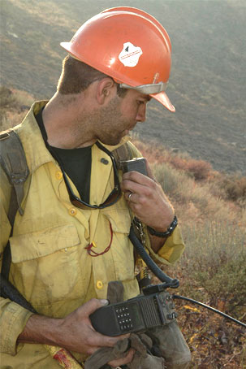
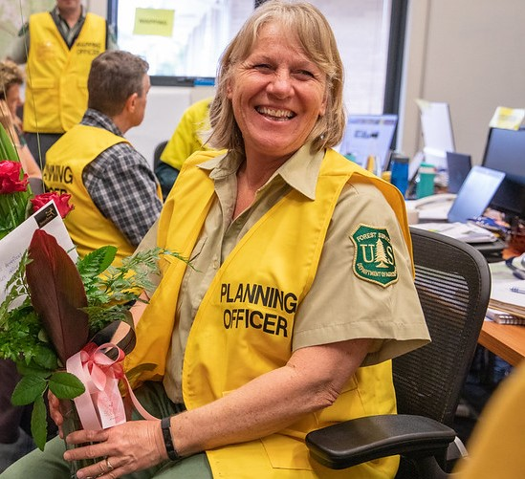
Resource Items
Overhead
Overhead
Leadership
Notes:
Creating an Overhead Request
Set Catalog to Overhead.
Catalog Category: Groups.
- Scroll through the items.
- Identify that Incident Management Teams are listed here.
- Discuss modules and squad.
Catalog Category: Positions.
- Catalog items are in alphabetical order and show the 4-letter position code.
Exercise
Have students practice using the search field on Catalog Item to locate position codes.
Students will search for various positions using the Search field in Catalog Item and position codes.
Select and filter several positions.
Materials Needed: Laptop with Chrome and internet access.
Time: 5 minutes
Input GM 2 - SUBJECT: OH Order 1.
Students will create a Fire Fighter Type 1, FFT1(t) request as the instructor demonstrates.
Enter Request for FFT1.
Number of requests block.
Ensure students have all selected FFT1 as the requested item.
All fields marked with * are required fields.
In the # of requests block, input the number of requests (1) to be created for the type of resource requested.
- If more than 1 FFT1 were requested, each request would be given its own number.
- Example: 4 FFT1 requests would create O-1, O-2, O-3, O- 4.
Financial Code.
Financial codes are created by the Established Dispatch when the incident is created.
If no code is shown, add a financial code using the Add New Financial Code button.
Next Number.
Custom Request Block discuss local protocol.
Discuss Date/ Time Needed.
Using the calendar select a date.
Enter the requested time, using military time.
Time zone will be automatically selected.
Deliver To.
Enter desired location.
Note to Instructor
Demonstration only. Default incident name will be used.
Select the incident name from the Deliver to drop down.

Slide 10
Too Many Contacts
Notes:
Consult EDSD or EDSP prior to adding new Deliver To location.
Show types of Deliver To locations, i.e., airports, locations, incident, Incident Command Post (ICP), staging area, or field office.
If reporting instruction are completed in Deliver To location, then Navigation/ Reporting Instructions is automatically populated.
Create New Location using Select from Existing and from Create New.
Students will use the default incident name for this request.
Request Contact.
Use Request Contact dropdown to make selections.
Avoid creating new contacts.
Incident Ordering Contact
Create New Contact > Ordering.
Who requested this resource?
Can be combination of name, position code, or phone number per local protocol, i.e. Tim Jones, ORDM, 555-1234.
Where can you find information on local protocol?
Ask your EDSD or EDSP.
Host unit’s expanded dispatch plan.
Special Needs
This block is used to justify and/or authorize specific needs or special skills required, such as:
POV Authorized, uniform required, strong IROC/ WildCAD skills, etc.
Must be self-sufficient.
Can work remotely.
Justification of name requests.
All the above need to be approved by the incident. These are not decided at dispatcher’s discretion.
Inclusions/Exclusions.
Federal vs. non-federal only.
Host agency only vs. state only.
EFF/AD Exclusion.
This indicates that the incident does not want EFF/AD in this position. EFF/AD = Emergency Firefighters & Administratively Determined employees.
Contractor not acceptable.
Portal-to-portal acceptable.
Overhead Details.
Trainee: No trainee vs. trainee acceptable vs. trainee required.
GM 2 - SUBJECT: OH Order 1 states trainee okay, so have students select Trainee Acceptable.
Named request.
Refer to policy in National Mobilization Guide.
Explain the use of Name Requests, giving examples of when appropriate.
Demonstrate the use of the search field by searching for a local individual.
Special Approval Check boxes.
Rental Vehicle Approved.
Cell Phone Approved.
Laptop Approved.
Exercise
Practice finding a specific resource (Name request).
Coaches assist students.
Guide students through steps to find and select the name requested FFT1 associated with their student number on list.
Materials Needed: Laptop with Chrome and internet access.
See Reference Material: FFT1 Name Request
Time: 5 Minutes
Create the Request.
Review request.
Is this request being created on the correct incident?
Is this the correct catalog item/position code?
Check the number of requests you are creating.
Has the date/time needed been adjusted?
Are there any necessary reporting instructions?
Has the financial code been selected?
Are there any special needs to add?
Save button:
Save button creates the request.
Click save to create the request.
Request will appear in the “Recent Records list” box at the right of the screen.
Requests will also populate the Pending Request and Request Status Action Tiles in the IROC Portal.
Document the request number generated (O-xx) on the general message form used to create the resource request.
- Students need this request number later to know which order is theirs when they work on the request filling process.
Exercise
Students to independently apply what has been covered so far.
Students work independently using coaches as needed.
Have students create DIVS request with special needs.
Materials Needed: Laptop with Chrome and internet access Instructions.
Refer to reference material: GM 3 – SUBJECT: OH Order 2. DIVS Name Request.
Time: 15 Minutes

Slide 11
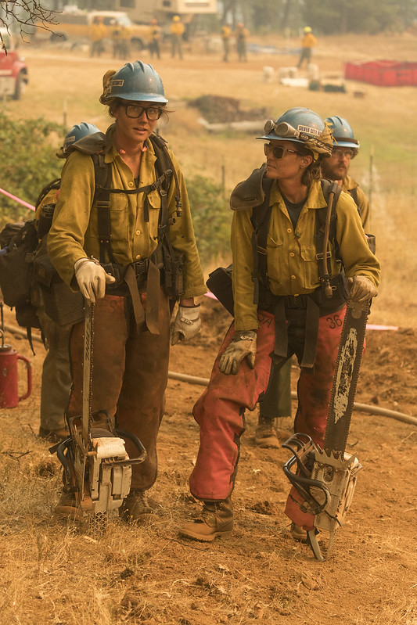
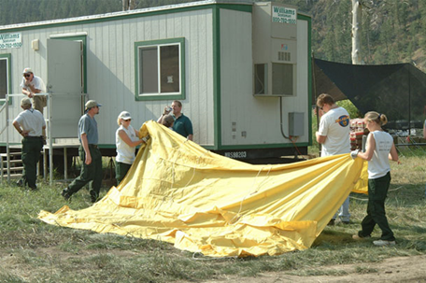
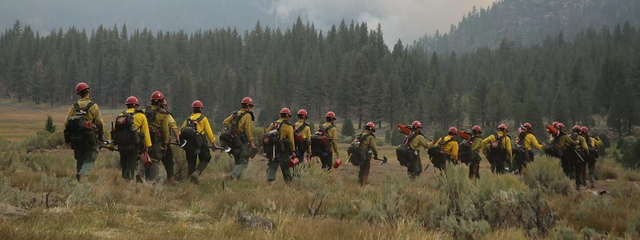
Resource Items
Crews
Hotshots
Type 2 and 3 Crews
Notes:
Creating Crew Request
Create New Request screen, Catalog: Crew.
Category:
Select Catalog Category: Fire
Select Catalog Item: Crew, Type 2 Any
- Either a T2 or T2IA crew is acceptable.
Request Features:
Inclusion/Exclusion: There is an option to exclude contract crews (Contractor Not Acceptable) and to approve portal-to-portal crews.
Special Needs: Examples: Lunched, double-lunched, tooled, will be spiking out, must be self-sufficient, etc.
Exercise
Have students apply previous knowledge with new resource type.
Students work independently with help from coaches, as necessary.
Have each student create 1 crew request (T2, any crew).
Materials Needed: Laptop with Chrome and internet access.
Reference Material: Crew Request.
Time: 15 Minutes.

Slide 12
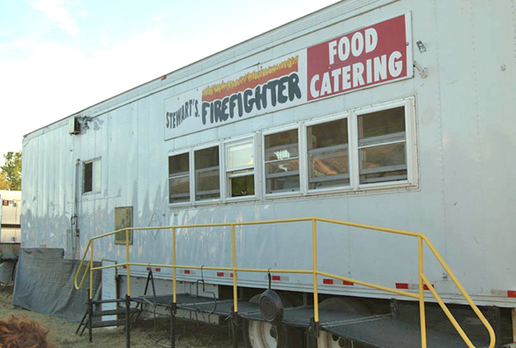
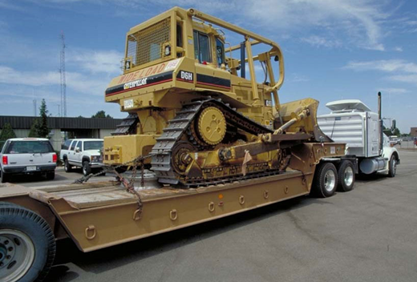
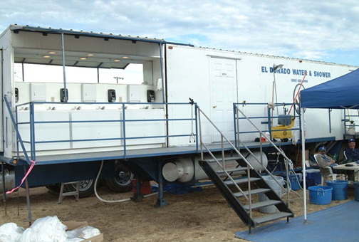
Resource Items
Equipment
Notes:
Creating an Equipment Order
Create New Request screen, Catalog: Equipment.
Category
Catalog Category: Engine
- Select Catalog Item: Engine, Type 3, 4, 5, or 6.
Request Features:
Special Needs
Examples: Double-shift capability, 3- way blade, self-sufficient, etc.
Features
Dependent on the catalog item chosen.
Selecting features could limit the receiving unit’s ability to fill the request.
Exercise
Have students independently create resource order for equipment.
Have students work independently with assistance from coach and/or other students.
Have students create the 2 equipment requests (engine, type 3, 4, 5, or 6, and dozer, type any).
Materials Needed: Laptop with Chrome and internet access.
Reference Material: GM 5 SUBJECT: Equipment Order
Time: 20 Minutes.

Slide 13
Manage Request Screen
Notes:
Manage Request
Demonstrate the Pending Request list selector and describe the options on the Pending Request Action Tile.
Pending Request Action Tile > All
Select incident in Watched Incident content selector OR search for incident in the Pending Request work area column header search field.
Explain claimed vs. unclaimed.
After selecting the student’s incident in Watched Incidents or searched for the incident in the work area, the students pending requests will be seen in the work area, list view.
To search for another incident’s requests, repeat the process.
Work Area - List View.
Action Buttons.
Most action buttons will become active once one or more requests are selected.
Action buttons will vary based on the work area (pending request, request status, etc.).
Identify Claim Button and Generate Resource Order Form Button.
Column Headers – can be search fields, drop downs or sort.
Selected column – allows you to select one or more requests.
Manage column – clicking on the manage icon takes you to the Manage Request Screen.
Support Indicator column – indicates if a request is a parent, subordinate, or support.
Incident column – search for incident name.
Incident Dispatch column – search for dispatch unit ID.
Request Number column – search for request number.
Point out that the O numbers present coincide with those the student wrote on the general message form after creating the request.
Need by Date/ Time column – sort by ascend or descend.
Needed by TZ (time zone) column – search by time zone.
Last Action column – indicates the last action taken on the request.
Request Catalog column – indicates the catalog of the request.
Catalog Item column – search for catalog item.
Requested Resource column – search for catalog item.
Resource Current Dispatch column – once a request is filled, search for current dispatcher unit ID.
Special Needs column – search for special needs.
Item Description column – search for item description.
Quantity R/A column – search for quantity requested and quantity assigned.
Previous column – indicates the last action that was taken on a request.
Current column – indicates the current dispatch center.
Trainee column – indicates is a request have trainee acceptable, trainee required or no trainee.
Claimed column – indicates if a request is claimed or not.
Claimed by column – indicates who has claimed the request.
Nav Instructions column – indicates the navigation instructions.
Created by column – indicates who created the request.
Have students claim their FFT1 request from GM 2 - SUBJECT: OH Order 1, using Claim action button.
Important to claim when multiple dispatchers are working in the same functional area to avoid duplication of effort and confusion.
Navigate the columns to the far right to display that their name is now listed in the Claim column.
Click on Manage Request icon for their FFT1 request.
This will open a new tab with the Manage Request screen.
The top portion of the Manage Request screen displays the request’s current location, current status and incident information.
Using the Info Action Tab, show students how to edit the request.
Exercise 1:
Have students become more familiar with the Action Tabs on the Manage Request screen.
Students work independently with help from coaches as needed.
Materials Needed: Laptop with Chrome and internet access.
Time 10 Minutes.
Complete the following:
Have students review the Info Action Tab.
Coaches will point out and discuss the difference between UTF, Cancel UTF and Cancel.
Demonstrate what can and cannot be edited on the Info Action Tab.
Hand GM 6 - SUBJECT: Crew Desk Edits to students with request to edit need by Date/Time for the Crew – Type 2, Any from the GACC.
Explain that students should talk to the incident ordering contact before making ANY changes on a request.
Have students click on the Fill Action Tab
The resources displayed under the Available tab indicate resources that have been statused as available (Local, State, GACC, or National), and can fill the request.
Explain the Non-Local, Preposition, Reserved, At Incident, Mob En-Route, Demob En-Route, Other (neighbors), IR, Tactical, Contracts, Exclusive Use, and VIPR tabs and when to use.
Exercise 2:
Apply what was learned to fill a resource order and introduce ETD/ETA travel.
Students work independently with help from coaches as needed.
Materials Needed: Laptop with Chrome and internet access.
Time: 20 Minutes
Complete the following:
Students make available and fill their FFT1 name request.
Fill Action Tab.
Search for Name Request. If not available, make resource available.
Click Assign.
Explain ETA/ETD.
Set travel for tomorrow 0700-0800, click save.
Check Print icon to generate resource order form.
Click Generate PDF.
Review resource order form.
Review the location of all blocks on the resource order form.
Guide students through placing their respective DIVS requests to a neighboring center on the Pending Request Work Area.
Students fill DIVS order following same process as FFT1.
Discuss any issues that need clarification.

Slide 14
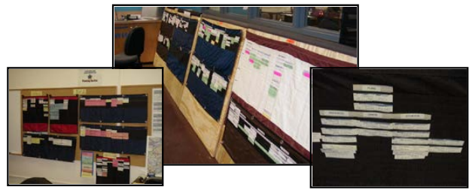
Resource Status Screen
Notes:
Resource Status
IROC Portal
Resource List Selector discuss Local Resources and Assigned, Non-Local, Local Resources
Resources Action Tile > Overhead.
Resources Work Area is activated.
Using the Resource Status column header, filter for Available, Returned from Assignment and Unavailable.
Set Resource Status.
Demonstrate changing availability from Available to Unavailable on the first highlighted name on the list.
Explain that statusing resource availability is not typically an EDRC function.
Demonstrate setting Availability Area from Local to National on the first highlighted name on the list.
National - available for assignment Nationally.
GACC - available for assignment within the Geographic Area.
State – available for assignments within the State.
Local - available on the local unit.
Have students locate the FFT1 they name requested and make them available Local.
In the Resources Work Area, click on Operational Name. This will open the Accordion View..
Organizations section.
Home Unit – the office, organization or jurisdiction to which a resource is physically attached.
Provider - is the organization responsible for the resource.
Owner - the organization or company to be compensated financially for providing a resource to an incident.
Unavailability- Demonstrate how to set an unavailability period.
Show students how to return from accordion view to list view.
Have one student from each table search for and highlight their coach (or other local instructor).
Search using Operational Name column then clear searched results.
Search using the Search Icon on the Resources Action Tile.
Demonstrate clicking on column headers to filter ascending to descend.
Exercise
Have students understand the variety of ways to search for resources and discover information about them in IROC.
Coaches assist students with navigating the screens.
Have Students work with coaches to investigate Resources Action Tile and Work Area.
Navigate to Resources Action Tile and use the search icon.
Materials Needed: Laptop with Chrome and internet access.
Time: 10 Minutes.

Slide 15
Objectives
Complete resource orders for overhead, crew and equipment requests from general message forms using the electronic resource tracking system (IROC).
Describe the use of the Pending Request screen.
Describe the use of the Resource Status screen.
Demonstrate the ability to utilize the Edit Request functionality.
Notes:
Review unit objectives.

