Slide 1
D-110 Unit 5: Filling and Placing a Request, DPL, Mobilizing, and Travel/Travel Procedures

Slide 2
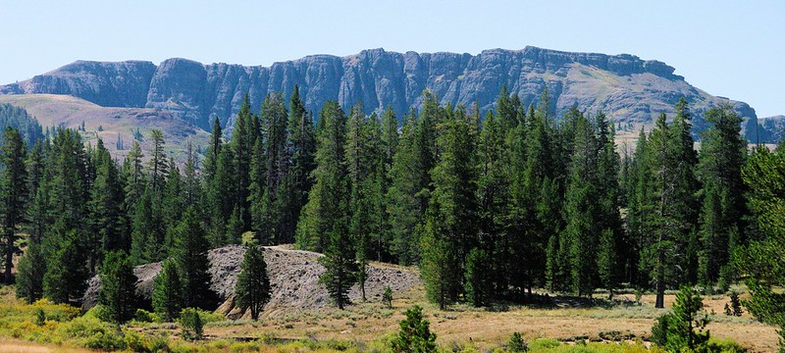
Objectives
Demonstrate filling and placing requests.
Describe Dispatch Priority Lists (DPLs).
Describe the various methods of mobilizing a resource to an incident.
Identify government travel procedures.
Identify Travel Screen.
Notes:
Review unit objectives.

Slide 3
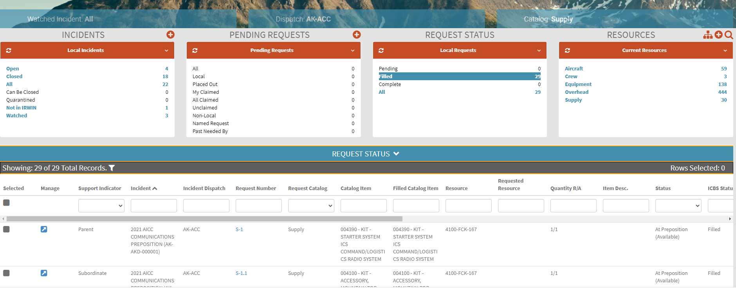
Content Selectors, Action Tiles and Main Work Area
Filling Crew Requests
Filling Equipment Requests
Notes:
Filling Crew Requests
IROC Portal
In the Incident Content Selector, select assigned incident.
Pending Request Action Tile > All
Click on the Manage Request icon for the Crew Type 2 Any request the student created.
In the Manage Request screen > Fill Action Tab.
Demonstrate how to fill a crew order.
Demonstrate that the Roster Action Tab is now available.
- Roster information is provided to dispatch on the Handout: SF 245 Passenger and Cargo Manifest BLANK.
- Discuss the Filling Option drop down.
- Rosters will generate subordinate orders for crewmembers. Example: C- 1.1, C-1.2, etc.
Exercise
Have students fill out crew request noting difference from overhead.
Student works independently with assistance from coach as needed.
Have student fill their crew requests with single resource (no roster).
Materials Needed: Laptop with Chrome and internet access.
Time: 5 Minutes.
Demonstration
Filling Equipment Requests
Demonstrate ONLY – as students will be perform action in Unit 6.
IROC Portal.
In the Incident Content Selector, selected assigned incident.
Pending Request Action Tile > All.
Click on the Manage Request icon for the Engine, Type 3, 4, 5 or 6 request the student created.
In the Manage Request screen > Fill Action Tab.
- All requests will be filled with agency resources first. Check local protocol.
- Once agency resources are exhausted, filling with cooperators or contracted resources will be considered.
- Click on the Contracts tab and discuss contract equipment found on local Dispatch Priority Lists (DPLs).
- Click Virtual Incident Procurement (VIPR) tab and discuss VIPR DPLs.

Slide 4
Dispatch Priority List
Notes:
Dispatch Priority Lists (DPLs)
Navigate to VIPR web site: https://www.fs.fed.us/business/incident/dispatch.php?tab=tab_d
Vendors are ranked according to “best value” for the government.
Discuss local protocol.
Describe how the host dispatch center uses it.
EDSD or EDSP should be involved any time you need to order contracted resources off a DPL.
Discuss the importance of documenting ALL contacts with vendors.
Exercise
To practice filling equipment requests and introduce roster page. Also reiterate the importance of communication and how expanded works.
Students work independently with coach’s assistance as needed.
Materials: Laptop with Chrome and internet access.
Time: 15 minutes
PART ONE
Fill engine type 3, 4, 5 or 6 request with assignment roster (build from scratch). Coaches should assist students with creating a two-person roster (i.e., ENOP, FFT2).
Fill the dozer, type any request.
PART TWO
Discuss the following scenario in your group. Select a representative to present answers to the class.
A crew was ordered, and the incident is planning to provide transportation, lunches, and tools upon their arrival. The crew is arriving via NICC jet. The aircraft desk gives the EDRC the travel information. You are assigned to the crew desk, what do you do with this information?
EDRC needs to relay fill information to:
- The incident.
- Supervisor.
- Supply desk.
- Equipment desk.
What happens if the EDRC does nothing?
- The incident is unaware of the incoming resource arrival time.
- Supervisor is unable to coordinate with the other functional areas.
- If the supply and equipment desks are not notified then the transportation, lunches, and tools may not be ready when the crew arrives.
Review group answers in the class.

Slide 5
IROC Travel Action Tab
Notes:
Travel
Have students discuss and write down the variety of ways a resource can get to an incident.
Materials Needed: White board or flip chart.
Time: 5 Minutes
Have students discuss various methods of mobilizing a resource to an incident.
Possible Answers
GOV
POV
Rental Vehicle
Commercial airline
Charter aircraft
Train
Bus (crews)
Lowboy (equipment)
The use of ETD/ETA option when inputting travel has already been discussed.
Discuss commercial travel procedures.
There are different travel providers for arranging commercial travel for different agencies. Check local travel protocol.
Explain that airport designators can be found on AirNav, https://www.airnav.com/.
Students navigate to the site and click on the Airports tab. Explain that there are 4-letter designators assigned by the FAA for all airports. IROC uses 3-letter designators.
Type “San Francisco” into the identifier box and click Get Airport Information. Note there are 7 identifiers that come up.
Question: How would we know which one to use?
Answer: Remarks column indicates it is a commercial airport.
Explain that there are 2-letter designators for airlines that are used by dispatch.
Examples: AA=American Airlines, DL=Delta Airlines. Airline Codes https://www.bts.gov/topics/airlines-and-airports/airline-codes

Slide 6
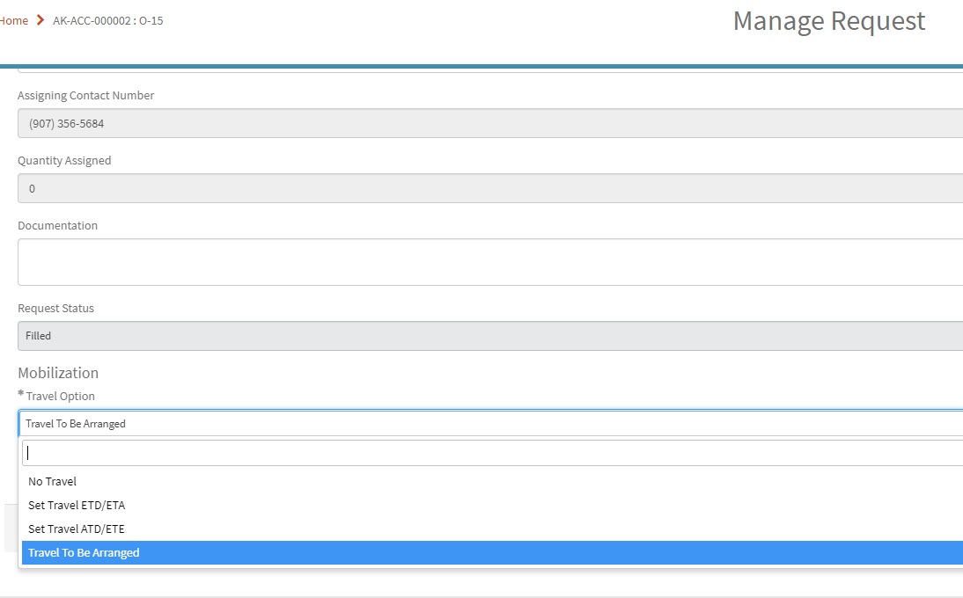
IROC Travel Action Tab
Notes:
Navigate to IROC Travel Action Tab. This tab becomes active on the Manage Request screen once a request has been filled.
1. Discuss that travel information can also be found in the Info Action Tab.
2. Explain the different Travel Options.
No Travel
Set Travel ETD/ETA
Set Travel ATD/ETE
Travel to be Arranged
Discuss local process on inputting commercial travel or multi-leg travel into IROC.
Discuss ability to attach travel documents such as flight itinerary.

Slide 7
Objectives
Demonstrate filling and placing requests.
Describe Dispatch Priority Lists (DPLs).
Describe the various methods of mobilizing a resource to an incident.
Identify government travel procedures.
Identify Travel Screen.
Notes:
Review unit objectives.

