Slide 1
D-110 Unit 6: Request Status and Support Requests
D-110 Unit 6: Request Status, Support, and Subordinate Requests

Slide 2
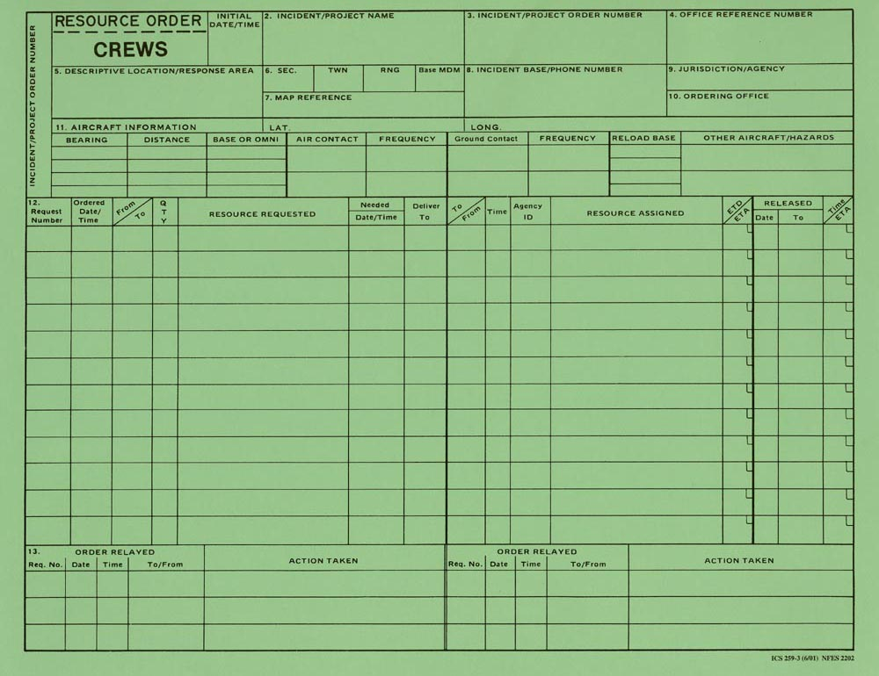
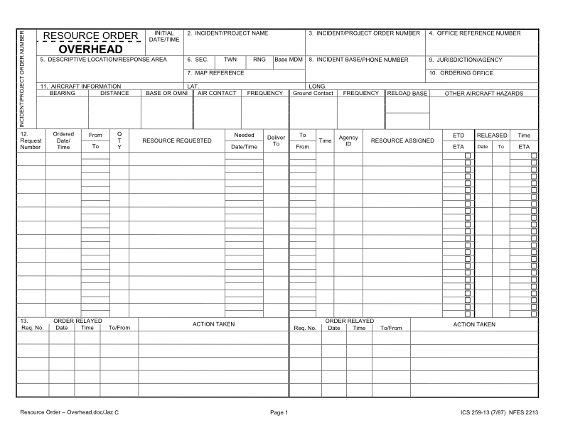
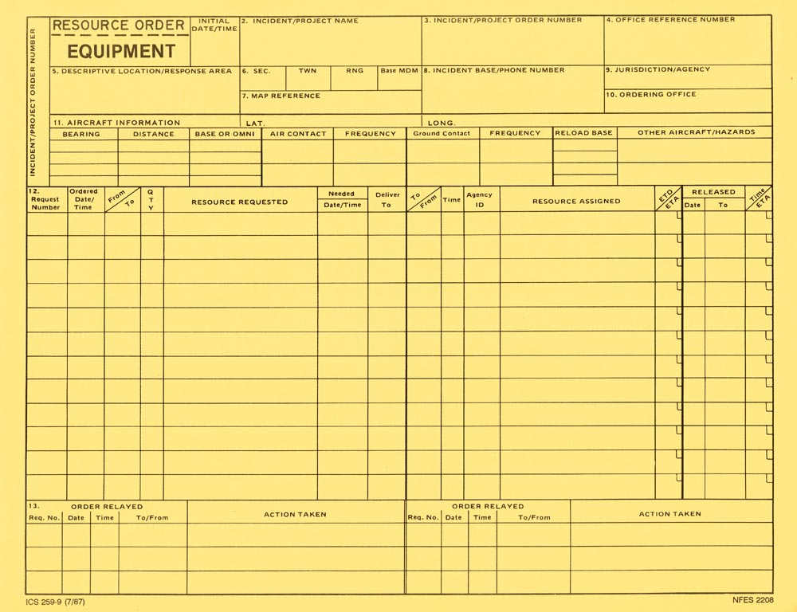
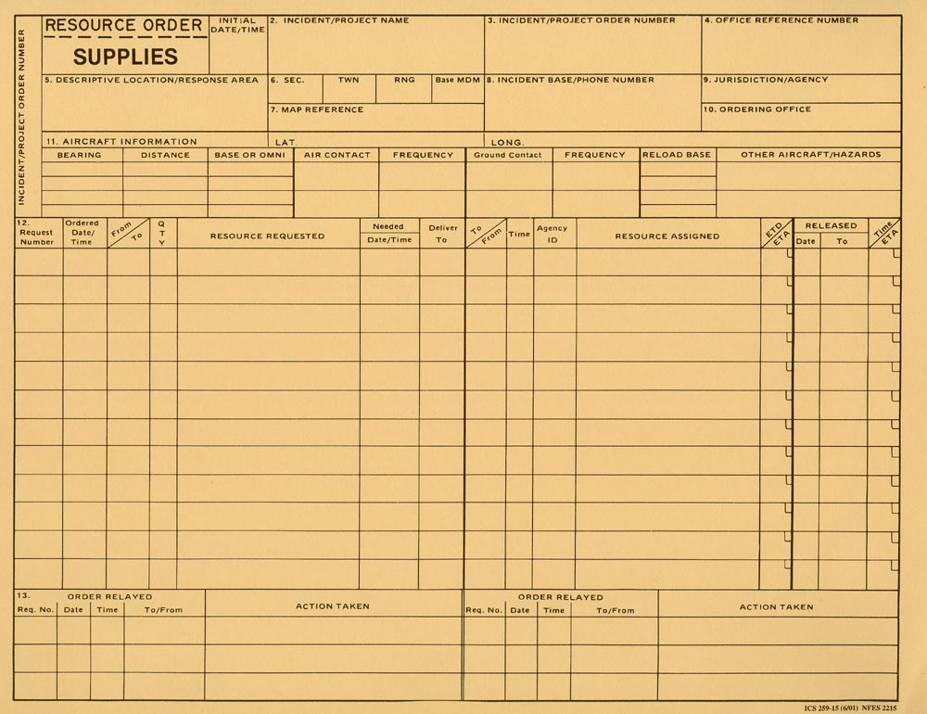
Objectives
Navigate to and describe the Request Status screen.
Describe the difference between support and subordinate requests.
Demonstrate the ability to utilize the Edit Request functionality.
Notes:
Review unit objectives.
REQUEST STATUS ACTION TILE
IROC Portal
Select an incident from Watched Incident Content Selector.
In the Request Status Tile List Selectors, demonstrate filter by different categories.
Local Request.
Non-local.
Requests by Catalog.
Requests Needing Travel.
Closed Incidents.
By hovering over each category, it will give you a brief description of the filter criteria.
You can also click in the tile itself to select filter criteria.
This will populate the Work Area.
Selecting a request will activate the Action Buttons.
Demonstrate Request Status, List Selectors, and Action Tile Options.
Discuss the changes that occur in the main work area.
Demonstrate how selecting a request by checking the box activates action buttons.
SUBORDINATE VS. SUPPORT REQUESTS
Subordinate requests.
Associated with a parent request by extension.
Example: A Crew request is C-1. Crewmembers (subordinates of the crew) are C-1.1 thru C-1.20.
Support requests.
One request associated with another request.
Each request may be from a different catalog item.
Example: An overhead request (DIVS, O-1) associated with a support equipment request. (Pick-up truck, E-1).
When the parent request is viewed in Accordion View, it will have a request listed as a Child Request.
Exercise
Ensure students understand the difference between subordinate and support requests.
Students work independently with assistance from coaches, as necessary.
Have students create a support request and fill request for a bus for the T2 crew request.
Demonstrate the request has been completed.
Materials Needed: Laptop with Chrome and internet access.
Time: 15 minutes
EDIT REQUEST FUNCTIONALITY
Demonstrate how to edit a request.
Discuss the importance of documentation when editing a request.

