Slide 1
D-110 Unit 7: IROC Supplies

Slide 2
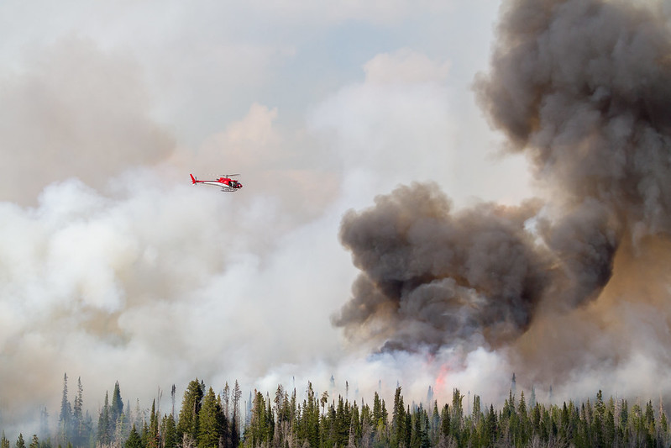
Objectives
Complete a Supply Resource Order.
Identify and utilize the National Fire Equipment
System (NFES) catalog (electronic).
Identify the difference between National Equipment System (NFES) and non-NFES supplies.
Notes:
Review unit objectives.

Slide 3
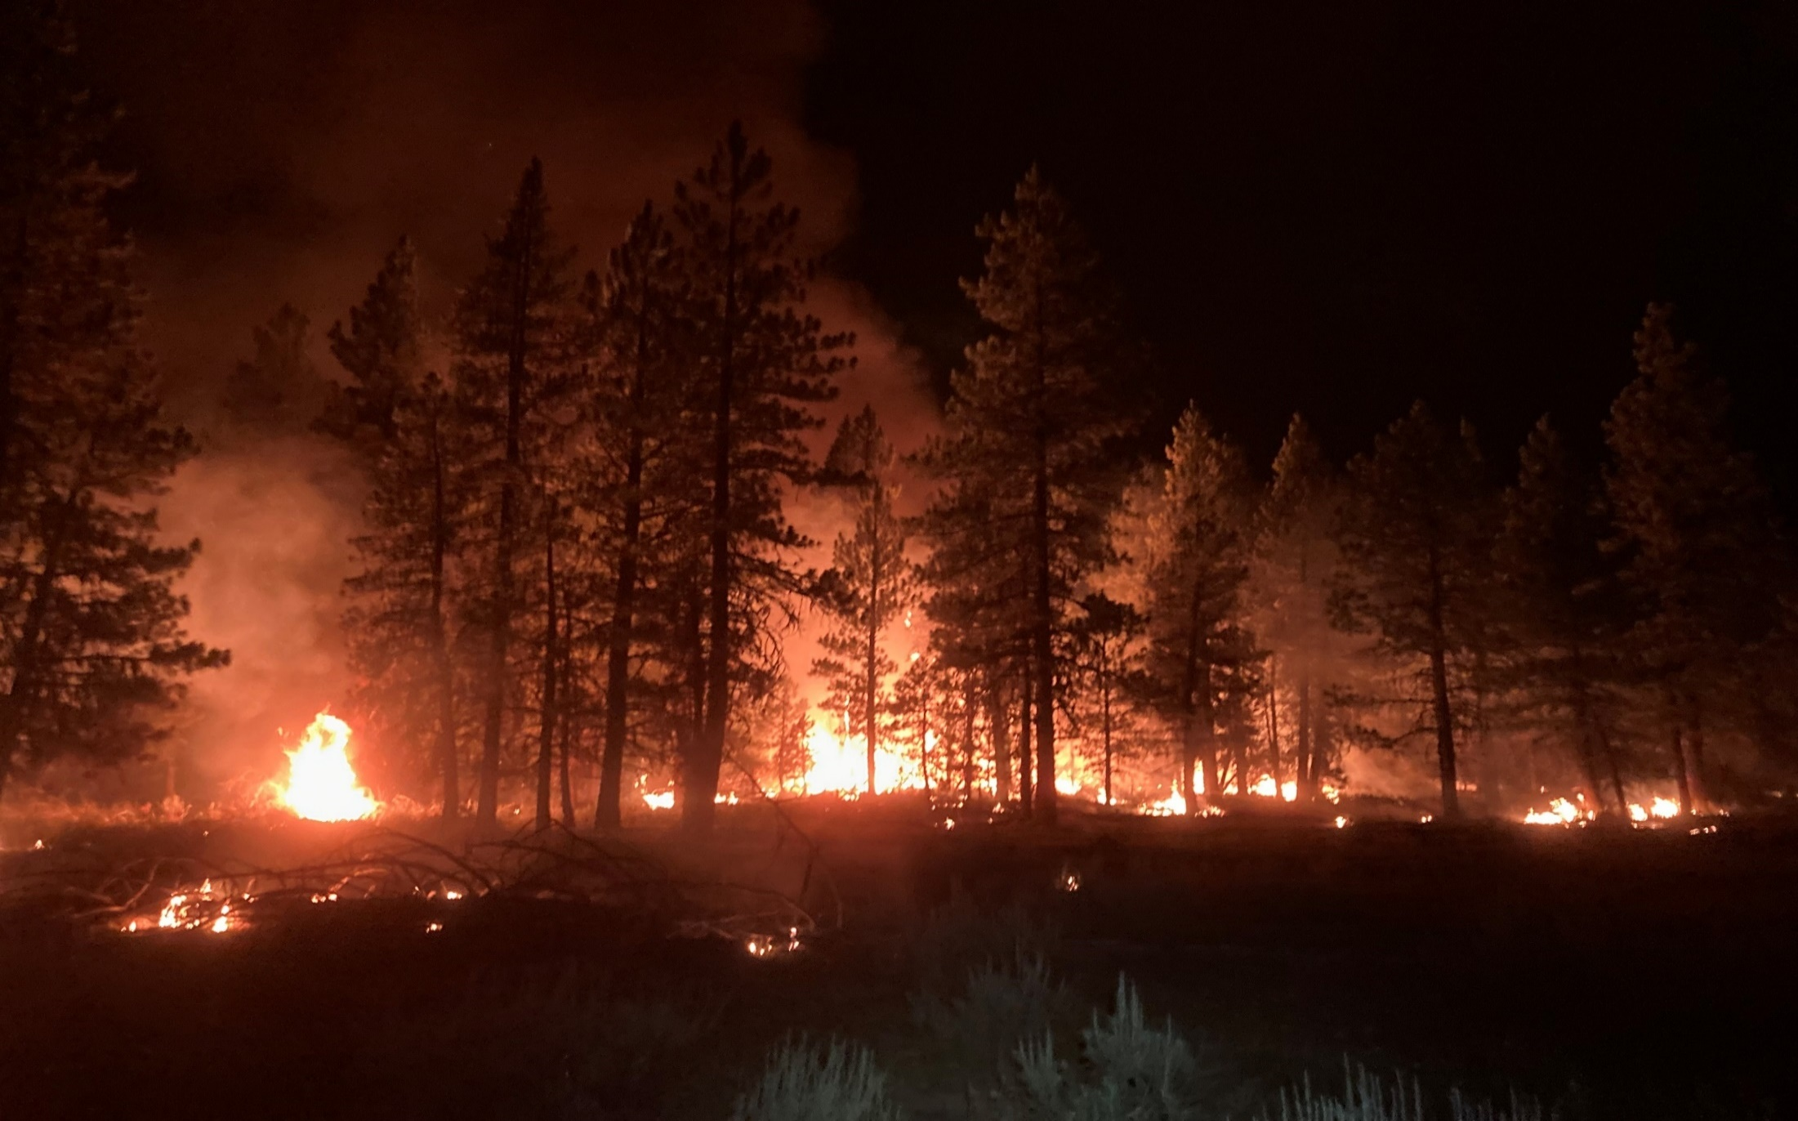
Objectives
Identify the difference between service and supply.
Identify the difference between local purchase, local cache, and national cache.
Describe the role of buying teams in incident support.
Notes:
Review unit objectives.

Slide 4
IROC Supplies
Notes:
IROC Supplies
Supply Orders
Have students navigate to the electronic National Fire Equipment System (NFES) catalog, https://www.nwcg.gov/publications/pms449-1.
This is for Part 1, which is the actual supply list.
Demonstrate the Inventory Price List Spreadsheet on the left side of the page.
Demonstrate how to use the search function in the electronic version.
Exercise
Get students familiar with online NFES catalog and searching for items.
Students work independently with assistance from coaches.
Coaches provide general message with supply order to students. Have students locate each item, making sure to discuss unit of issue and standard pack concepts. Have students write the NFES number for each item on the handout. Refer to: GM 7 - SUBJECT: Supply Order 1.
Materials Needed: Laptop with Chrome and internet access.
Time: 20 min
Have students navigate to the IROC Portal.
In the Watched Incident Content Selector, selected assigned incident.
Pending Request Action Tile > + icon.
Select Catalog>Supply.
Review Categories: Note that depending on the catalog category selected different fields will become available to the dispatcher.
*Service, Category Not Listed.
Do not use this category (unless specified by local protocol).
The “Resource Requested” and “Resource Assigned” will then be *Service, Category Not Listed. Dispatcher should put in the “Special Needs” what the service is.
NFES Supplies
These are items in the fire cache system.
Kits are located here by NFES number.
All National Cache unit identifiers end in K.
Identify which National Cache(s) provides support in your area.
NON-NFES Supplies
Use “Not in Catalog Supplies” for local purchases.
Notice that the “Item Description” field under “Not in Catalog Supplies” is a free text field, enabling the user to type in locally purchased items.
Identify local data entry standards when typing in this text box.
Note option to track item throughout its life on the incident.
Service, Communications
Cell service, satellite phones, voice/data lines.
Service, Delivery
Ice, newspaper, potable water delivery.
Use this option for ongoing services.
Service, Facility-Land Rental
Conference room, land use, refrigeration and shower facility rental.
Service, Fuel Delivery
Diesel/Gas, Other, Propane, Aviation.
Service, Meals, Food, Lodging
Food catering (when the # of incident personnel hasn’t met the threshold of ordering a caterer off the National Contract or a National Contract Caterer is not available).
Demonstrate the difference between number of requests and quantity of meals.
Lodging, Meals, Groceries/Sundries (review documentation in the resource order).
Service, Miscellaneous
Dust abatement, equipment inspection, excavation, laundry, medical, mobile mechanic, mobilization center, road grading.
Service, Office Support
Fax rental, audio visual equipment rental, computer rental, copy machine rental, other office equipment rental, office machine repair.
Service, Sanitation
Grey water removal, handwashing stations (portable), porta-potties, recycling, garbage/container removal, other sanitation.
From this point, move to the top right of the New Request screen.
Have students select Category > NFES Supplies
Demonstrate how to search by item name.
Demonstrate how to enter the NFES number.
Identify “Standard Pack”. Refer students back to NFES catalog and point out that Standard Pack can be different than Unit of Issue.
“Quantity”. Supplies are the only functional area that can have multiple identical items per request.
“Default Number Block”. Explain blocks of numbers can be issued to others outside of expanded for tracking purposes (established dispatch, buying teams, incident management teams, etc.).
Refer to local protocols.
Need Date Time.
Navigation Reporting.
Request Contact.
Ordering Contact.
Special Needs.
Supply Details.
Shipping Contact.
Shipping Method.
Select one of three options:
Shipping Address (pick or add an address associated with this incident).
Shipping Instructions (used most often). This will open a text box to the right to populate the shipping instructions.
Will Pick Up at Cache (brings up different text boxes).
Discuss Servicing Cache.
“Shipping Contact”. Name and phone number should be selected from the pick menu. Emphasize that students can add a name and phone number; however, they should always check with the supervisory dispatcher prior to doing so.
Exercise
Practice application of lecture.
Have students work independently with assistance from coach as needed.
Have students create supply requests from both handouts.
Ensure students write the S number on the general message forms. (GM 7 - SUBJECT: Supply Order 1 and GM 8 - SUBJECT: Supply Order 2).
Pending Request Action Tile “+” icon.
Select Catalog > Supply.
Select Category > Service, Sanitation.
Identify that when certain services are selected, the Quantity Requested box changes to Number of Requests.
Explain that when a service is filled, user will be prompted to enter travel. Most services remain assigned to an incident so the order can be tracked for billing purposes.
Materials Needed: Laptop with Chrome and internet access.
Time: 20 min.
Question: Students what are different ways to fill a Supply Order?
Answer: Local purchase, caches, and buying teams.
Questions: Cover Local Protocols
What is considered a local purchase?
What is the difference between the local cache and the national cache?
How does an EDRC decide when an NFES order can be filled at the local cache instead of the national cache?
What is a buying team? How does expanded dispatch generally interact with buying teams?
Discuss IROC capability to identify request is for the BUYT.
Optional: Demonstrate filling a local purchase.
Exercise
Have students remember how to place an order through the Pending Request tile.
Have student work independently with assistance from coach as needed.
Have students place NFES items to the appropriate national cache(s).
Materials Needed: Laptop with Chrome and internet access.
Time: 5 min.

Slide 5
Objectives
Complete a Supply Resource Order.
Identify and utilize the National Fire Equipment
System (NFES) catalog (electronic).
Identify the difference between National Equipment System (NFES) and non-NFES supplies.
Notes:
Review unit objectives.

Slide 6
Objectives
Identify the difference between service and supply.
Identify the difference between local purchase, local cache, and national cache.
Describe the role of buying teams in incident support.
Notes:
Review unit objectives.

