Slide 1
D-110 Unit 9: Demobilization

Slide 2
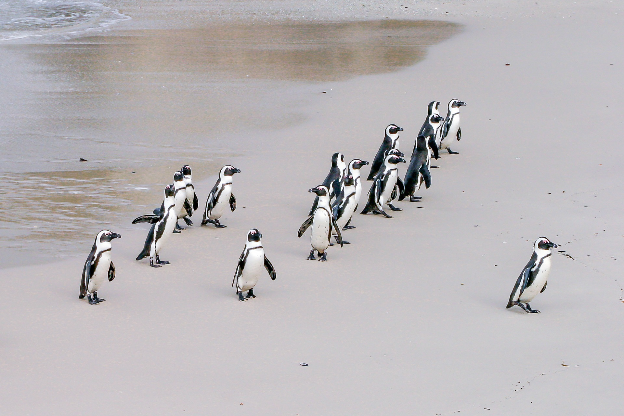
Objectives
Demonstrate the functionality of the Incident Resource screen.
Demonstrate the different ways to release a resource in IROC (Manage Request Screen and Work Areas Release Button).
Demonstrate the demobilization of resources from an incident.
Discuss reassignment of resources.
Notes:
Review unit objectives.

Slide 3

Demobilizing Resources
Notes:
Go through steps in demobilizing resources.
Discuss Demobilization form.
Variety of forms used.
Demobilization printout generated via I-Suite.
Refer to: Emergency Release Message Form
Refer to: ICS 221 Form - Demobilization Check Out
From Content Selector, select your watched incident.
From the Content Request Status Tile, select filled to populate the Main Work Area with the filled requests.
Demonstrate how to search for the item you want to release by Request Number, Request Category, Catalog Item, Resource and Status.
Use arrow to get to the Manage Request Screen or can select the box to activate the Action buttons.
From Manage Request, Select Release.
Date
Time
Time Zone
Documentation
Click Release
3. Travel Options
No Travel
Rarely used.
Set Travel ETD/ETA
Set Travel ATD/ATE
Travel to Be Arranged
Travel will default to this.
4. Determine demobilization travel mode.
Items to consider when demobilizing a resource
Is ground transportation needed?
Does the resource need a flight arranged?
Is there a support request that needs to be released?
From the Main Work Area, select the tab Copy the Demob.
Travel from the Parent Request.
Is the resource a national resource (Caterer, Shower, Type 1 Crew, etc.)?
Notify your EDSD or EDSP when a national resource is available for demobilization or reassignment.
Discuss reassignments briefly.
Exercise:
Practice demobing resources from an incident Refer to: GM 9 - SUBJECT: Crew Desk Edits.
Students work independently with assistance from coach as needed.
Have students review release functions in IROC.
Have students demob the resources per handout.
Question: What if the EDRC received a demob for a resource (Type 6 engine) and is aware that there is another incident with a pending request for the same resource?
Materials Needed: Laptop with Chrome and internet access.
Time: 20 Minutes

Slide 4
Objectives
Demonstrate the functionality of the Incident Resource screen.
Demonstrate the different ways to release a resource in IROC (Manage Request Screen and Work Areas Release Button).
Demonstrate the demobilization of resources from an incident.
Discuss reassignment of resources.
Notes:
Review unit objectives.

