Slide 1
Welcome
Notes:
The Welcome Presentation is provided for all NWG courses to cover:
NWCG mission.
Administration and logistics information.
Expectations of students.
Course Evaluations.
Instructor and student introductions.
Note to Instructor
Revise these slides as desired to customize the information to the course, location, and agency presenting the course.

Slide 2
National Wildfire Coordinating Group
NWCG provides national leadership to enable interoperable wildland fire operations among federal, state, local, tribal, and territorial partners.
To achieve this, NWCG establishes common national interagency wildland fire operations standards.
NWCG training enables consistent application of these standards in support of efficient, effective, and safe national interagency wildland fire operations.
https://www.nwcg.gov

Slide 3
Administration and Logistics
Course Coordinator contact information
Sign-in sheet
Tuition receipts
Training facility layout (restrooms, exits, etc.)
Classroom rules (food, beverages, phones, etc.)
Breaks (coffee, snacks, tobacco use areas, etc.)
Schedule

Slide 4
Expectations of Students
Engage, participate, and contribute to the success of the course.
Build a collaborative and constructive learning environment.
Respect student and instructor diversity in background, experience, and teaching or learning style.
Be punctual. Complete all assignments.
Provide constructive feedback to improve future wildland fire training.
Professionally represent your home unit and agency.

Slide 5
NWCG Course Evaluation
https://www.nwcg.gov/course-evaluation
Enter Course Coordinator email address when submitting feedback.
Notes:
Suggested areas for feedback include quality and relevance of materials, applicability to position, expectations met or exceeded, most and least valuable aspects of course and materials, etc.
Provide Course Coordinator email to students in order to receive copies of the submission.

Slide 6
Instructor Introductions
Name
Current job
Home unit
ICS qualifications and experience
Teaching experience
Why are you here?
Notes:
Other suggested introductions:
Tell students one unique thing about yourself, work or non-work related.

Slide 7
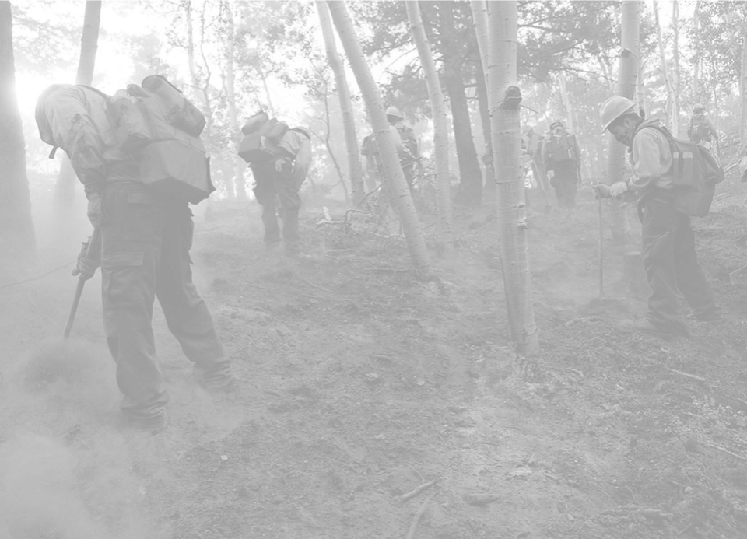
Student Introductions
Name
Current job
Home unit
Why are you here?

Slide 8
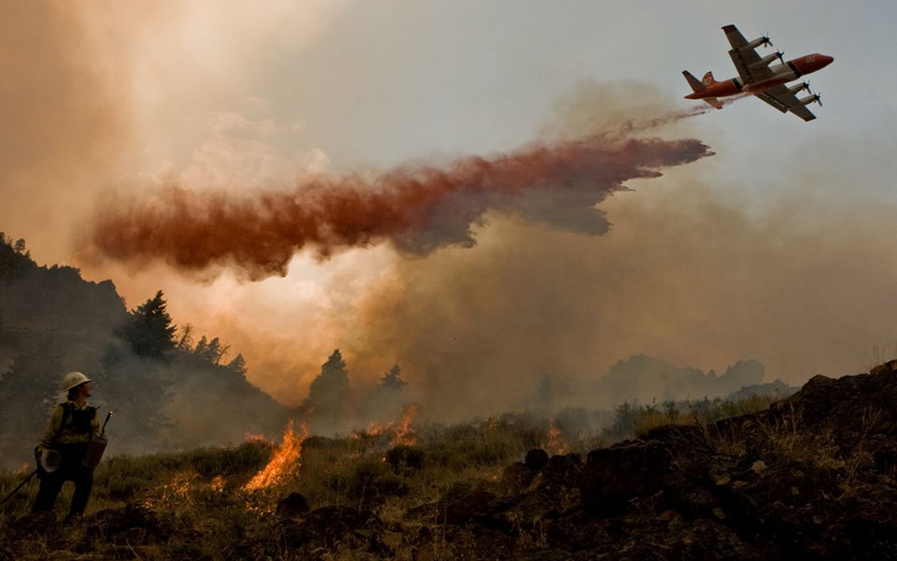
Introduction Exercise
Notes:
Insert an icebreaker activity or other exercise to help students and cadre get to know one another.
A suggested exercise follows:
EXERCISE: Student Expectations for the Course
Purpose: Students develop a list of their expectations for the course.
Time: 25 minutes
Format: Students work in small groups of three to five students.
Materials Needed: Flip charts and markers
Instructions:
1. Instruct groups to write their responses to the following question on a flip chart:
Question: What do you expect to learn from this course?
2. Have each group present their expectations to the class.
3. Answer any questions.
4. Post lists around the room and refer to them throughout the course to ensure students’ expectations are being met.

