Slide 1
P-310
Unit 5: Operations

Slide 2
Unit Objective
Identify the operational characteristics of a Fire Prevention Education Team (FPET).
Notes:
Review unit objective.

Slide 3
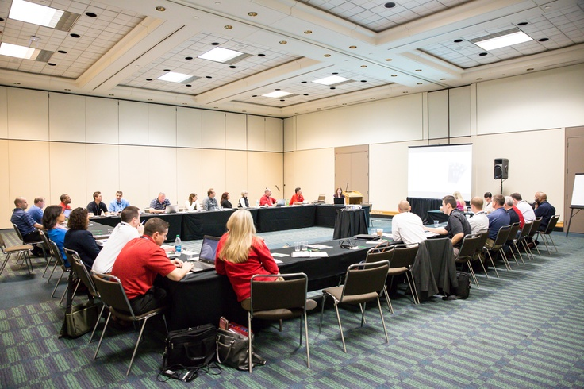
Introduction
FPET assignments can be measured by how effective the entire team is at supporting each other.
Notes:
FPET assignments can be measured by how effective the entire team is at supporting each other, their host unit, and how well they communicate the mission with all involved agencies and public they are serving.
The operational aspects play a vital role in the support structure developed for the size, scope, and complexities of the mission.
A successful outcome depends on how well everyone works together to reduce the number of human-caused ignitions. A coordinated group of energetic, creative people can make all the difference.

Slide 4
Operations Overview
Requesting unit roles and responsibilities.
Pre-assignment preparation.
FPET on-site tactics.
Final report and transition.
Notes:
The operations section is where the FPET discuss the assignment needs and how the team will get the job done.

Slide 5
Requesting Unit: Roles and Responsibilities
Delegation of Authority (DOA)
Notification of arriving FPET
Key contact list
Funding
Notes:
Before the team’s arrival, the requesting unit should:
Determine expectations of the team and document these expectations in a Delegation of Authority (DOA).
The DOA is negotiated with the team lead and frame the objectives of the team. The DOA is an official document that is signed by the agency administrator and team lead.
Make appropriate notifications of the arrival of the team and their mission. It is important employees and external partners know a FPET is arriving and why they have been ordered.
Notification should include people at the following levels:
Local
Internal
Partners
National Fire Prevention Education Team (NFPET) Coordinator
The host agency should document the methods that were used in making these notifications.
The host unit and Prevention Education Team Leader (PETL) will gather a list of persons and agencies that the team should immediately contact upon arrival.
Agency liaison person
Local finance/procurement specialist
Local Public Affairs Specialist
Host unit is responsible for securing the funding.
Who is the source of this funding and what are the limitations of that funding?
This should be done before bringing in a FPET.

Slide 6
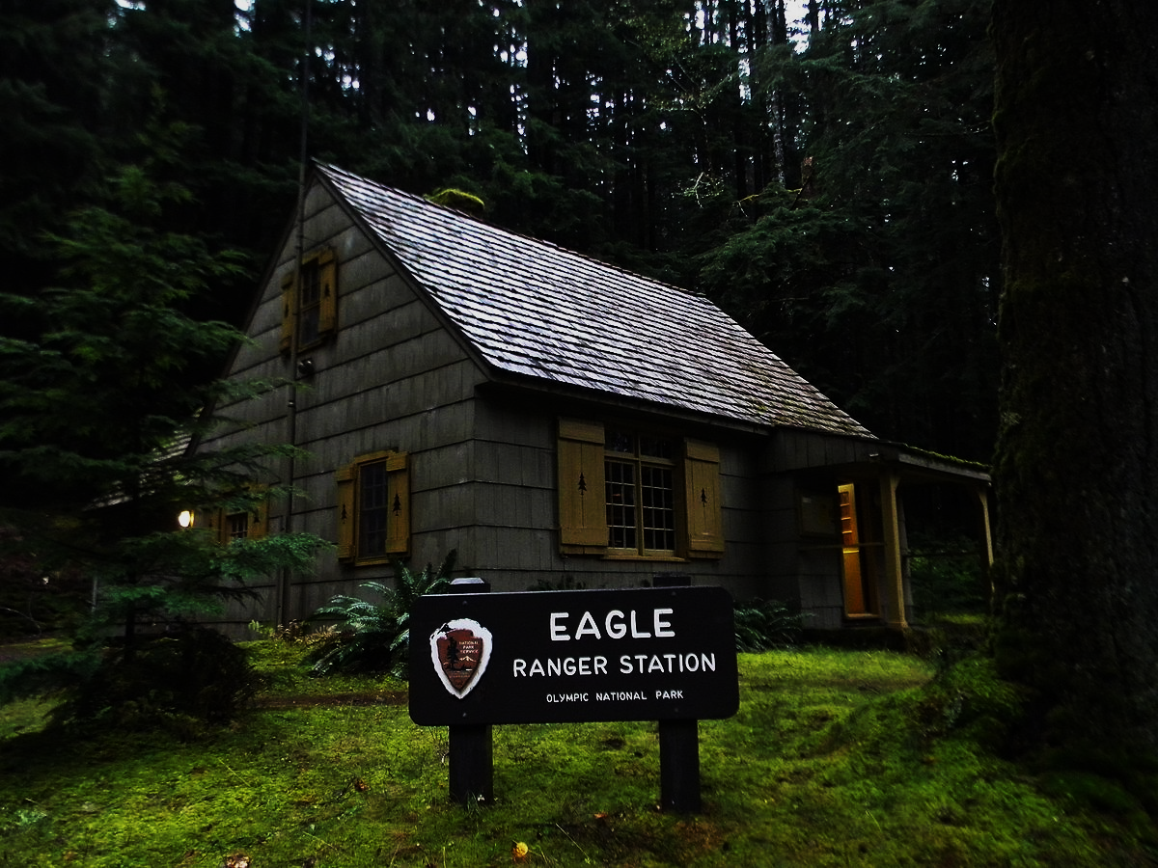
Pre-Assignment Preparation
Pre-assignment preparation should include understanding the assignment and being comfortable with it before accepting.
Contact the PETL to get an overview of the assignment.
Virtual assignment consideration should include notifying your home unit that you will not be available to address local concerns.
Notes:
If this is not a fire assignment, the FPET will have time available to complete needed prepare before travel. Proper preparation will be essential to the assignment’s successful completion.
Contact the PETL to get an overview of the assignment.
What is the nature and expectations of this assignment? Have everything lined up when you make yourself available, so assignments can be accepted when called.
What resource materials will I need to take with me to this assignment? Have a kit and follow the direction provided on the resource order.
Note to Instructor
Remind students that they may find it important to reach out to individuals for technical assistance, while you are on assignment, so make sure to have personal network contact information.
Things to consider:
Attire
Equipment
Local Area Research
Other Logistics
Travel and purchase cards
Research the local area, regarding local issues, politics and demographics.

Slide 7
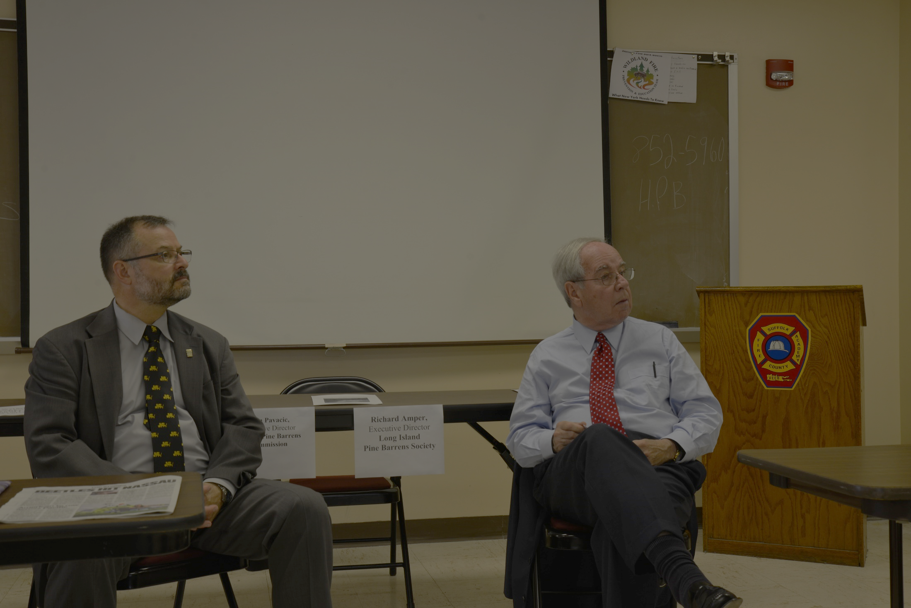
FPET On-Site Tactics
Briefing and orientation
Organization
Documentation
Host Information
Notes:
Briefing and Orientation
Upon arrival at the assignment, the FPET should receive a briefing and orientation.
All Prevention Education Team Members (PETMs) should have a clear understanding of the team’s mission, goals, and objectives.
Will the team be creating the fire prevention education plan or implementing a plan developed by the local fire management group?
The team may be transitioning with a previous FPET and implementing a plan that they created.
The duration of the severity can last longer than 14 days, so FPETs or PETMs may come and go.
Receive a copy of the team’s DOA letter.
Organization
What is the chain of command?
Where does the team fit?
Who does the team report to?
What is expected of the team and how will the evaluation take place?
Establish reporting procedures.
Documentation
What type of final report will be required at closeout?
What other kinds of documents might be desired?
Host Information
Ensure the briefing includes local and specific information.
Issues and sensitivities.
Understand that preexisting conflicts and relationship strains between and within agencies may act as a barrier to your success. It is your job to remain objective and serve all parties equally. The FPET can help influence positive change.

Slide 8
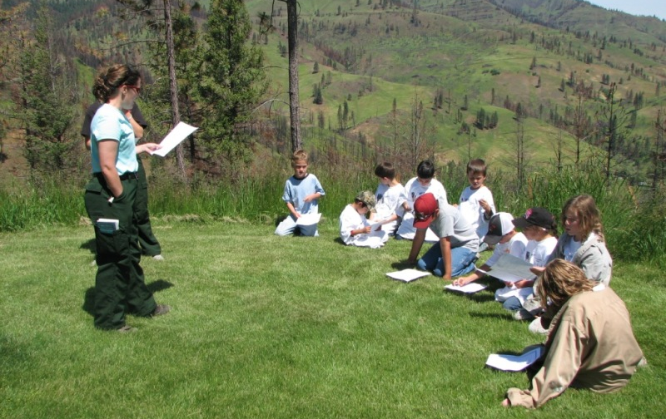
FPET On-Site Tactics (continued)
Financial rules and constraints.
Priorities and time constraints.
Logistics and support.
Develop Wildland Fire Prevention Plan.
Notes:
Financial rules and constraints
Not a wildfire response so funding is not limitless.
The DOA will identify budgets, how funds can be spent, and a finance liaison to support the FPET.
Priorities and time constraints
The priorities are established in the DOA and are agreed upon by the PETL and the host agency.
The time constraints are usually held to a 2-week assignment, not more than 12-hour days.
Logistics and Support
Who might the FPET be working with? Depending on the assignment, the team can expect to work with several technical specialists. The specialists may include:
Fire prevention
Public affairs
Writer editor
Prescribed fire
Environmental education
Webmaster or computer publications
Law enforcement
Determine and order the resources that will be needed.
Wildland Fire Prevention Plan
Includes a communication plan.

Slide 9
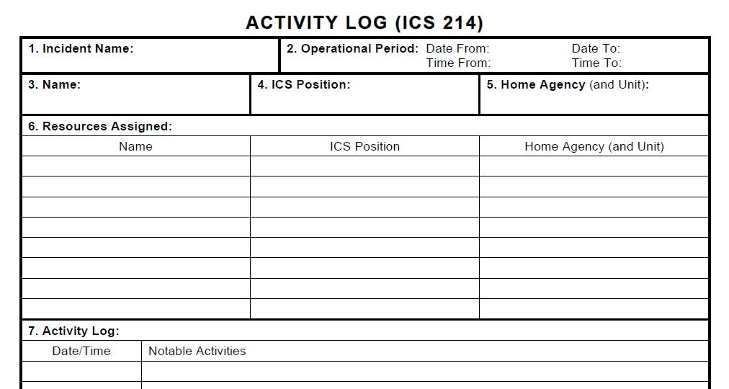
FPET On-Site Tactics – Documentation
Documentation
Activity log
Daily contact log
Conversation record
Final report
Notes:
Documentation
Remember to document all FPET actions along the way. There are several forms that may be helpful.
Activity Log
PETMs should document details regarding their activities and work accomplishments. Each team member’s activity log will be essential in the preparation of the closeout report.
Activity Log, ICS 214, https://www.nwcg.gov/publications/ics-forms.
Daily Contact Log
Conversation Record
Unit 5-SR1-FPET Conversation Record
Final Report
This is a summary of everything the team worked on during the assignment and will cover the transition and closeout in detail.
Review Activity Log, ICS 214, https://www.nwcg.gov/publications/ics-forms and Unit 5-SR2-FPET Conversation Record with students.
Go over any documentation that the students should be using from the student resources/handouts provided in Unit 2.

Slide 10
FPET On-Site Tactics (continued)
Recognition
  Identify individuals or groups who assisted the FPET.
Recommendations and observations.
Notes:
Recognition
Identify any special recognition or awards for individuals or groups who provided outstanding fire prevention education programs.
As the FPET prepares to depart, make the final, thank you for your assistance, phone calls and visits to key contacts, including internal unit employees. Make them thoughtful, relevant and concise.
Recommendations and Observations
Document challenges, and gaps. focus on the positive and highlight opportunities and accomplishments.

Slide 11
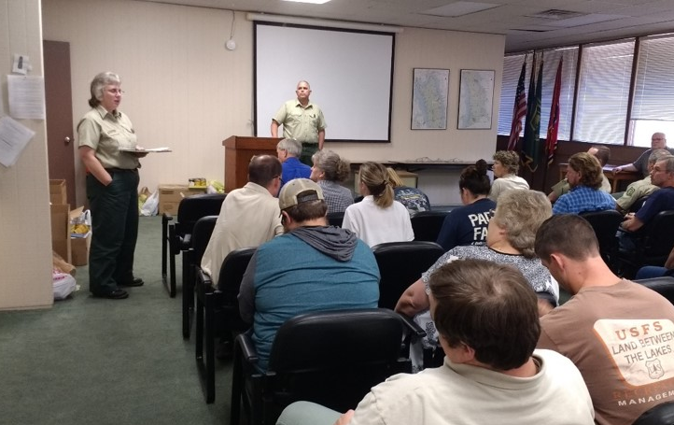
Final Report and Transition
Nearing the end of an assignment, prepare a final report and engage in a meaningful transition with the incoming FPET.

Slide 12
Operations Summary
Operations is the nuts and bolts of the FPET assignment.
We have discussed the:
  Requesting unit: roles and responsibilities.
  Pre-assignment preparation.
  On-site assignment tactics.
  Documentation and wrap-up.
Notes:
Note to Instructor
Hold a Q & A period here, before moving to the group exercise in Unit 13.

Slide 13
Review Unit Objective
Identify the operational characteristics of a Fire Prevention Education Team (FPET).
Notes:
Review unit objective.

