Slide 1
P-310 Unit 11: Fire Prevention Material

Slide 2
Lesson Objectives
Develop on-site fire prevention education material.
Review online resources and identify where fire educational materials can be found.
Notes:
Review unit objectives.

Slide 3
Introduction
Fire Prevention Education Teams (FPETs) will:
Need to know how to obtain appropriate materials to be effective.
Learn what’s available.
How to develop custom elements.

Slide 4
Lesson Content
Sources
Challenges
Funding
Borrowing/Sharing
Ordering
GPO
Tools of the Trade
Material Available
Notes:
Sources of fire prevention educational supplies.
Challenges associated with obtaining fire prevention educational materials.
Funding considerations.
Sources of borrowing and sharing.
Ordering procedures.
Federal Government Printing Office procedures.

Slide 5
Lesson Content
Development Tools
Material Used on Teams
Publication Examples
Custom Designs
Resources Available to Create
Available Software
Before You Create
Demonstrations

Slide 6
Sources of Materials
Host Agency
State and County Partners
Private Print Shops
Donated materials, media, in-kind contribution
Local Fire Agencies
Local Businesses
Notes:
Unit 11-HO1: Sources of Materials.
Discuss that the slide lists general sources, the handout lists specific sources.
List of sources to acquire various materials and supplies:
National Symbols Cache – https://apps.fs.usda.gov/symbols
Past FPETs materials at the FPET Digital Library – https://www.nwcg.gov/fpetdl/
National Fire Equipment and Supplies System (NFES), NWCG training materials
Approved commercial licensees – https://www.fs.usda.gov/working-with-us/contracts-commercial-permits/smokeybearlicensing
Unicor – fire prevention signs, https://www.unicor.gov/index.aspx
Government Printing Office (GPO) – https://www.gpo.gov/
National Fire Safety Council – https://nfsc.org/
National Fire Protection Association (NFPA) – https://www.nfpa.org/
County Extension Services
National Association of State Foresters Catalog – https://www.stateforesters.org/
NWCG NFES Catalog - Part 2: Publications, PMS 449-2 – https://www.nwcg.gov/publications/449-2
Ad Council – https://www.adcouncil.org/find-assets
Smokey Bear – https://smokeybear.com/en See toolbox and fire prevention for educator's link.

Slide 7
Considerations Obtaining Materials
Smokey Bear Use Policy
Timeframes
GPO regulations
Bilingual Materials
Copyright regulations
Notes:
Unit 11-SR1-Smokey Bear Do’s and Dont’s and FAQ, https://www.fs.usda.gov/sites/default/files/finalsmokeyhandoutsacessibleforweb.pdf
Unit 11-SR2-Smokey Bear Use Guidelines
Considerations associated with obtaining fire prevention education materials.
The following are some things to consider when purchasing, obtaining or creating materials:
Use of Smokey. Follow policy. See smokeybear.com for Do’s and Don’ts and FAQ sheet and Smokey Bear Guidelines as a starter.
Smokey Bear Costume Use, https://smokeybear.com/en.
Establish timeframes for need and distribution.
Think ahead and consider weekend and holiday closure.
Follow GPO regulations.
Bilingual materials if appropriate or requested.
Use current, up-to-date, and existing materials when possible and available.
Public Service Advertising (PSA), Consider translating when needed, use geographic area specific materials.
Copyright regulations make sure that any use of materials, internet or otherwise, provides authorization for use.

Slide 8
Funding Considerations
Whose money, is it?
Where is it coming from?
Are there limitations?
Are there in-kind contributions or cooperative funds?
Notes:
Funding considerations. When considering funding for materials, consider the following:
Whose money, is it? (agency)
Where is it coming from (program area) and is it available now? No year funds, obligated?
How much? (purchasing limits)
Limitations? (special appropriations)
Is cooperative money available? (in-kind contributions)

Slide 9
Sources of Borrowing and Sharing
Local fire departments
State forest agencies
Regional inventories
Notes:
Sources of Borrowing and Sharing.
Research other opportunities to obtain prevention materials.
Local Fire Departments
International Association of Fire Chiefs
State Foresters
Regional Prevention Inventories

Slide 10
Ordering Procedures
Identify Needs
Prepare requisitions
Get approvals
Identify optimum purchasing procedures
Notes:
Ordering Procedures. Know the ordering system and seek help from specialists. Make them a partner.
Identify needs.
Prepare requisition.
Get approval from finance or local purchasing agent.
Get team leader approval.
Identify funding through finance or local purchasing agent.
Network with agencies to identify optimum purchasing procedures.
Discuss that the agency administrator may set limits on how much can be spent in the area of printing materials.

Slide 11
Government Printing Office (GPO)
If printing or reproduction needs extend beyond the resources you have on hand (i.e., local copy machine) then you must consult GSA.
Notes:
Review Unit 11-SR3-GSA Printing Rules.

Slide 12
GPO
Certain items do not require GPO use. A waiver exists but is seldom granted.
Items necessary to protect public health and safety and prevent resource damage.
News media releases.
Notes:
Refer students to the Federal Acquisitions Regulations, https://www.acquisition.gov/browse/index/far for more information.

Slide 13
Material Use
Existing Materials
Samples of Materials
Notes:
Speak with students about what qualities make good materials and what are things to avoid.
Demonstrate and discuss the use of various materials.

Slide 14
Material Use on Team Assignments
Focus on the target audience.
Gather intelligence from locals.
Select appropriate medium.
Notes:
Demonstrate and discuss the use of various material.
https://smokeybear.com/en
https://www.adcouncil.org/find-assets
Wildfire prevention guides. https://www.nifc.gov/prevEdu/prevEdu_communicatorGuide.html
Materials development tool demonstration.
Demonstrate the FPET digital library – https://www.nwcg.gov/fpetdl
Past FPETs materials at the FPET digital library.
The FPET must be innovative in selecting the best way to reach their target audience with a fire prevention message.
Select the medium that will get the most exposure and reach the most people.
Gather intelligence from locals in the area. They are your best source of information about what works in their community to deliver messages.
Be sure to differentiate between your target audiences. Most likely there will be different values for targeting residents versus recreationists using the area the team is serving.

Slide 15
Examples of Materials Use
Pre-movie PSA
Billboards
Electronic Media Boards
Flyers
Sport events

Slide 16
Samples of Materials Use
Bumper stickers
Grocery bags
Utility bills
Placemats
UPS
Posters
Trading cards

Slide 17
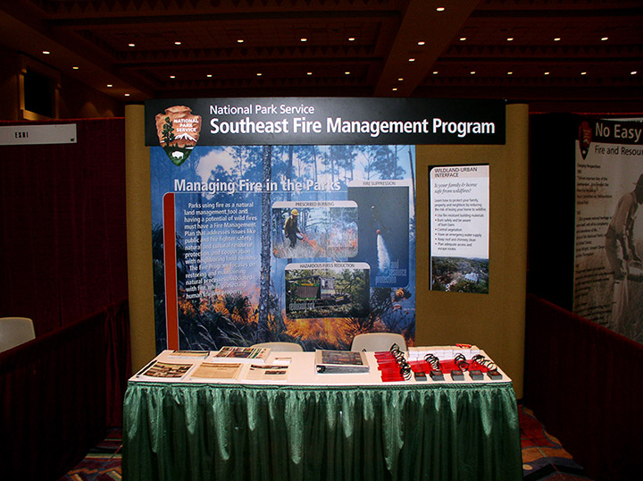
Samples of Material Use
Magnets
Rest Areas
Fairs
Exhibits
Community
meetings

Slide 18
Effective Materials Use Examples
Cooperators and Partnerships
Cable/Local television
Home and garden shows
Interviews
Exhibits
And . . .

Slide 19
Talk Shows

Slide 20
Sports Events

Slide 21
Homeowner Contacts

Slide 22
Displays

Slide 23
Interagency Activities
Notes:
Survey the students on additional activities. Document on flip charts.

Slide 24
Before You Create
Explore the need for materials.
Review team objectives.
Review current publications.
Can you modify an existing publication?
Where are you going to print?
Notes:
Conduct a discussion about programs used to create and modify graphics.
Speak with students about what qualities make good materials and things to avoid.

Slide 25
Before You Create
What format does the host agency and printer prefer?
Select a font that crosses most programs.
Make sure to get Vector Files from the printer.
Do you have the appropriate software?
Will it be posted on the web?
Notes:
Where are you going to print your publication?
Ask Host agency how/what format they prefer.
When going to a print shop, ask how they want the file format before doing the project.
Select the software that meets the needs of your printing and sharing of the files. Is it being shared via e-mail?
Does everyone have the program installed that the publication was created in?

Slide 26
Group Exercise
Group creates sample product(s) for target audience identified in prevention strategy and within budget
given in the DOA.
Notes:
Classroom exercise: Create a sample product as it relates to your identified target audiences, key messages, budget, social considerations, and fire prevention strategy.
Instructors Notes
Use of the digital library is encouraged.

Slide 27
Review Objectives
Develop on-site fire prevention education materials.
Review online resources and identify where fire educational materials can be found.
Notes:
Review unit objectives.

