Slide 1
S-130 Unit 1: Briefings

Slide 2
Objectives
Students will be able to:
Describe briefings and their purpose.
Describe some of the common briefing components and their purpose.
Describe the elements of the briefing checklist and their purpose.
Describe the concept of debriefings, After Action Reviews (AARs), and their purpose.
Notes:
Review unit objectives.

Slide 3
Briefings
Notes:
Fire managers must ensure that briefings are occurring throughout the fire organization, and that safety factors are addressed through the IC or their designee and communicated to all incident personal at operational briefings.
A briefing is the action of informing or instructing someone and should provide all the information for the safe completion of a task. It provides the who, what, when, where, why, and how of the operational period.
Reference Communication Responsibilities in the Incident Response Pocket Guide (IRPG), PMS 461, https://www.nwcg.gov/publications/461.
Discuss that of the 5 communication responsibilities that all firefighters have, this unit will focus on the first two:
Brief others as needed.
Debrief your actions.
Reference Leader’s Intent in the Incident Response Pocket Guide (IRPG), PMS 461, https://www.nwcg.gov/publications/461.
Discuss that to ensure firefighters have been provided all the information for a safe completion of a task, all leaders of firefighters have the responsibility to provide leader’s Intent.

Slide 4
Briefing Checklist
Notes:
Discuss that a standardized briefing checklist is often used to ensure a consistent and effective briefing.
Reference Briefing Checklist in the Incident Response Pocket Guide (IRPG), PMS 461, https://www.nwcg.gov/publications/461.
Review and discuss the Briefing Checklist with participants by focusing on the 6 primary categories and what they mean:
Situation – What is happening.
Mission/Execution – What are we going to do and how.
Communications – How are we going to talk to each other and other resources.
Service/Support – What do we have to help us accomplish the mission.
Risk Management – What are the hazards to the mission and how can we manage those hazards.
Questions or Concerns – Does anyone have any.
Note to Instructor:
It is not advisable at this point in the course to discuss each individual briefing checklist component. Focus on the 6 primary categories.

Slide 5
Incident Briefings
Incident Action Plan (IAP)
Notes:
Discuss that an Incident Action Plan (IAP) is a common element of on-going incidents.
Discuss that an IAP incorporates many of the elements of the briefing checklist. The IAP reflects the overall incident strategy and specific tactical actions and supporting information for a designated operational period.
Discuss that the IAP may be oral or written, but the following elements are key components:
Incident objectives
Organization assignment list
Division assignment
Incident radio communication plan
Medical plan
Traffic plan
Safety plan
Incident map

Slide 6
Incident Briefings
The Morning Briefing
Notes:
Discuss that a morning briefing is a daily element of all on-going incidents and is where the IAP is distributed to incident resources.
Provide an overview of how an incident briefing is conducted and how the elements of the IAP are communicated.

Slide 7
Daily Briefings
The Shift Briefing
Notes:
Discuss that a daily briefing, or shift briefing, is a common occurrence for all fire crews when not on an incident.
Provide an overview of when and how a shift briefing is conducted on your home unit.
Discuss that because the shift briefing is not conducted when on an incident, it will often incorporate some of the following information:
Crew agenda for the day.
Crewmember assignments.
Known incidents in local area.
Resource availability in local area.
Weather forecast in local area.
Fire indices in local area,
Note to Instructor
Slides 8 – 9 will provide detailed information on the Incident Management Situation Report (IMSR / SIT Report) and Fire Weather Forecast.

Slide 8
Common Briefing Components
Notes:
Discuss that the images represent the following common briefing components:
Left Image – The National Incident Management Situation Report (IMSR / SIT Report)
Top Right – Fire Danger Ratings
Bottom Right – Fire Indices
Discuss the purpose of the IMSR / SIT Report:
Provides a summary of national wildland fire activity that occurred the previous day.
Also reports non-fire incidents whenever a significant number of wildland fire resources are committed to these incidents.
Exercise
Divide participants into groups.
Ensure each group has access to an IMSR / SIT Report (current or archived), https://www.nifc.gov/fire-information.
Assign a cadre member and task them to brief their assigned group on the following items:
National Preparedness Level
National Fire Activity
Activity level for the geographic area the class is in and summary of the number one incident.
Advise participants that different geographic areas and crews have varying practices regarding how the IMSR / SIT Report is used.
Note to Instructor
Consider sharing the Fire Potential Outlook for the geographic area in which the course is being taught. Geographic Area Outlooks, https://www.predictiveservices.nifc.gov/outlooks/outlooks.htm.

Slide 9
Common Briefing Components
Fire Weather Forecast
Notes:
Pre-Video Discussion
Discuss that The National Weather Bureau started forecasts specifically for the fire weather community in 1914.
Discuss that the Fire Weather Forecast is a zone-type product used by land management personnel primarily for input in decision-making related to pre-suppression and other planning.
Play Video
Title Fire Weather Forecasting, https://youtu.be/8O2npk2Y-pM
Summary Introduction to the elements of the fire weather forecast
Time (06:29)
Audio
Post-Video Discussion
Obtain a fire weather forecast for the zone in which the course is being taught. National Weather Service (Fire Weather), https://www.weather.gov/fire/.
Task each participant with taking notes.
Conduct a fire weather briefing for the entire class.
Task a volunteer to share with the entire class the notes they took during the briefing.
Discuss the briefing items that were captured by the volunteer.

Slide 10
Knowledge Check
The document shown below is known as the_____.
Incident Action Plan
IMSR / SIT Report
Briefing Checklist
Notes:
Question: The document shown below is known as the_____.
Answer: IMSR / SIT Report

Slide 11
Debriefings
Notes:
Discuss that debriefing your actions is the second communication responsibility of all firefighters.
Discuss that a debriefing can be categorized as the act of telling someone else about what has happened in relation to a specific task, mission, project or action.
Discuss that conducting frequent debriefings with the team to identify lessons learned and build the team is a tenant of wildland fire operational leadership.

Slide 12
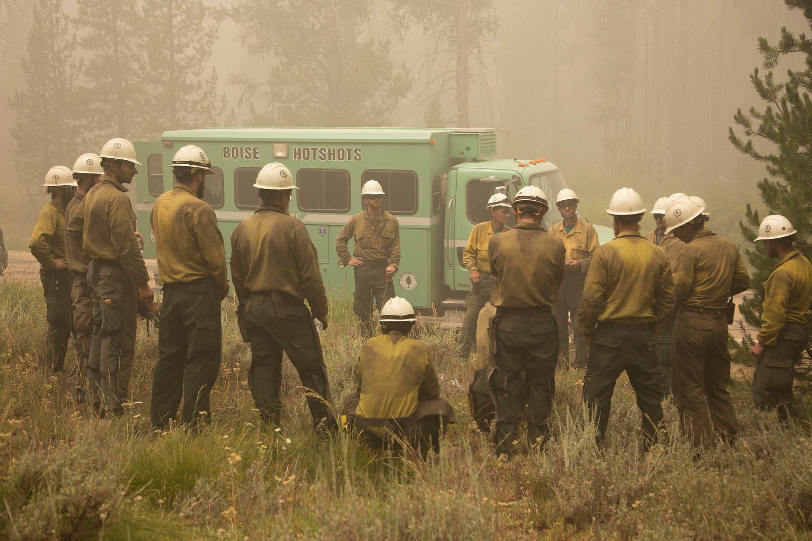
After Action Review (AAR)
Notes:
Reference After Action Review (AAR) in the Incident Response Pocket Guide (IRPG), PMS 461, https://www.nwcg.gov/publications/461.
Review and discuss the AAR with participants, focusing discussion on the four primary questions that make up an AAR:
What was planned?
What actually happened?
Why did it happen?
What can we do next time?
Discuss importance of using an AAR as an avenue for speaking up and building a reporting culture in which everyone has a voice.
Discuss that an AAR is meant to create better firefighters and a better team by learning from mistakes as well as successes.
Note to Instructor
Consider using the AAR format as a method for reviewing the unit objectives.

Slide 13
Knowledge Check
Name the 4 primary questions asked in an AAR.
Answer:
What was planned?
What actually happened?
Why did it happen?
What can we do next time?
Notes:
Question: Name the 4 primary questions asked in an AAR.
Answer: What was planned?
What actually happened?
Why did it happen?
What can we do next time?

Slide 14
Objectives
Students will be able to:
Describe briefings and their purpose.
Describe some of the common briefing components and their purpose.
Describe the elements of the briefing checklist and their purpose.
Describe the concept of debriefings, After Action Reviews (AARs), and their purpose.
Notes:
Review unit objectives.

