Slide 1
S-131 Unit 1: Position Responsibilities and Operational Leadership

Slide 2
Objectives
Students will be able to:
Identify position responsibilities of Firefighter Type 1 (FFT1) and Incident Commander Type 5 (ICT5).
Demonstrate the ability to apply operational leadership principles.
Demonstrate the ability to locate and apply standard wildland fire operating procedures found in the Incident Response Pocket Guide (IRPG), PMS 461, and other identified fireline references.
Notes:
Review unit objectives.
Position Descriptions
FFT1, https://www.nwcg.gov/positions/fft1/position-ipd
ICT5, https://www.nwcg.gov/positions/ict5/position-ipd
Incident Response Pocket Guide (IRPG), PMS 461, https://www.nwcg.gov/publications/461.

Slide 3
Position Responsibilities
Preparation & Capabilities
Obtain complete information from dispatch when receiving the assignment.
Bring adequate personal gear within established weight requirements.
Bring FFT1/ICT 5 Kit
Notes:
Specific examples of information needed:
Incident name and order number.
Incident phone number.
Reporting time.
Reporting location (drop point).
Transportation arrangements and travel routes.
Contact procedures during travel (telephone and radio).
Kit should contain enough critical information and materials to allow you to operate for the first 48 hours without the need for support. Examples include:
IRPG and other guides.
Incident Organizer.
ICS Forms.
Programmable radio.
Cell phone.
Writing materials.
Compass and GPS.
Belt weather kit.
Flagging.
Batteries.
Camera.
Tell students to consider:
Their reporting location.
Is it out of their area or region?
Will they will have to drive or fly to the location?
What they may need for the type of mission or incident.
(Optional) Show examples of kit contents.

Slide 4
Position Responsibilities
Preparation & Capabilities
Follow safety procedures for transporting personnel and equipment.
Arrive at the incident and check-in.
Notes:
Consider safety procedures for the following types of transportation:
Foot.
Vehicle (e.g., engines or crew buggies).
Boat.
Helicopter.
Fixed-wing aircraft.
Discuss potential tasks that the FFT1 may be assigned or asked to accomplish upon check-in. Some examples are:
Obtaining logistical supplies for the mission at hand.
Getting vehicles repaired.
Getting manifest ready for flying.
Discuss the similarities between check-in and demobilization, such as:
Turning in documentation.
Returning equipment.
Finalizing timesheets
Vehicle repairs.

Slide 5
Position Responsibilities
Preparation & Capabilities
Inspect crew members and their personal protective equipment (PPE), and ensure personnel and equipment meet agency requirements, serviceability, conditions of hire, and supervisor’s instructions.
Obtain initial briefing from the supervisor.
Notes:
Check crew members’ qualifications and ensure the crew members meet agency qualification requirements for tasks and assignments.
Notify supervisor of any corrective action needed.
Discuss the procedure to follow if a crew member is missing a PPE item, red card, etc.
Examples of briefing information:
Task or assignment (instructions may be written and/or oral).
Current incident situation.

Slide 6
Position Responsibilities
Preparation & Capabilities
Correctly prepare a radio for operation on the incident, and properly use the portable or mobile multichannel radio.
Accurately navigate to an assigned destination.
Apply the principles of the Incident Command System (ICS).
Notes:
Actions to ensure good communications:
Obtain a communications plan.
Program the radio for incident use, and successfully complete the radio check.
Exercise proper radio discipline and etiquette.
Use clear text.
Protect the radio from damage.
Describe agency procedures for emergency notification (emergency traffic).
Have the students describe some limitations of radio communications. Examples include:
Bandwidth.
Repeater coverage.
Incompatible systems.
Possible discussion items:
Proper use of maps, compass, Global Positioning System (GPS), or other tools.
Follow the chain of command.
Use appropriate ICS terminology.

Slide 7
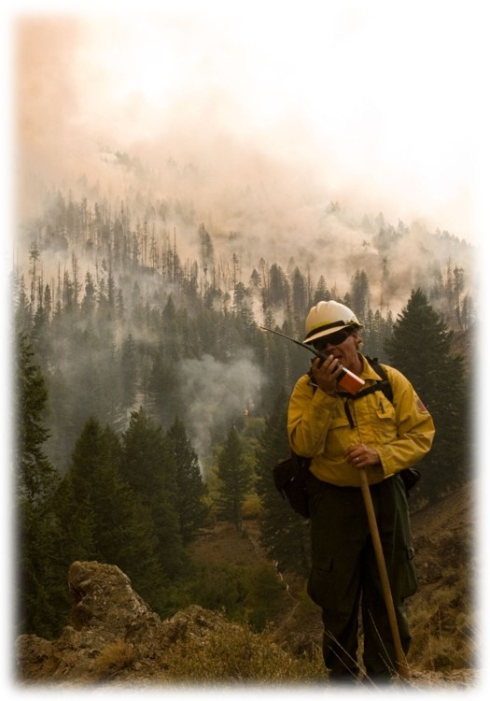
Position Responsibilities
Common Responsibilities of FFT1 and ICT5
Provide leadership for members of your crew.
Provide for the safety and welfare of assigned personnel.
Serve as a lookout.
Notes:
Leadership actions:
Obtain and understand priorities and determine work objectives.
Delegate tasks to employees and hold them accountable for their actions.
Ensure the supervisor’s work objectives and performance standards are met.
Evaluate your crew members’ performances.
Provide praise or discipline to crew members, as warranted.
Ask students the importance of having a broad experience base with various fire suppression tools and equipment, skills, and techniques when assigning and leading daily tasks.
Discuss how the FFT1 and/or ICT5 would assess the capabilities and limitations of their assigned personnel.
Considerations in providing for crew welfare and safety:
Recognize, mitigate, and communicate potentially hazardous situations during tactical operations.
Maintain accountability of assigned personnel and monitor their status.
Provide for the care of crew members, and notify the supervisor in the event of sickness, injury, or accident.
Discuss agency policy and safety procedures appropriate to conditions. Some topics include:
Work-to-rest ratio.
Smoke exposure.
Paperwork requirements for injuries.
Heat-related illnesses, and personnel issues.
Have the students briefly discuss the qualities of a good lookout. Lookout discussion is continued in Unit 3.

Slide 8
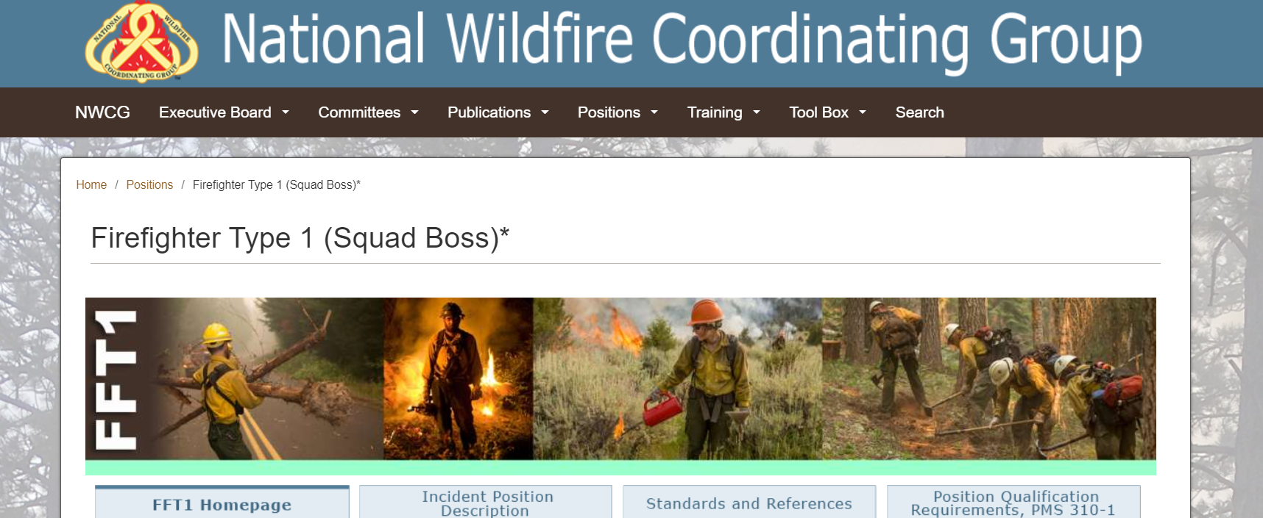
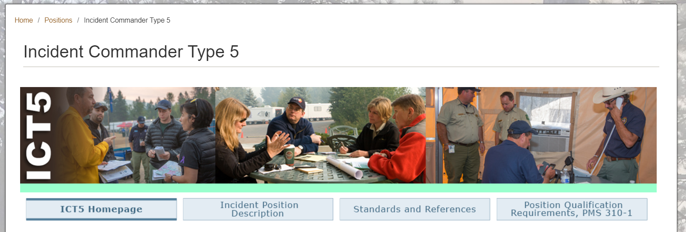
Position Responsibilities
Position Catalog
Notes:
Position specific details and references for Firefighter Type 1 and Incident Commander Type 5 are available in the NWCG Position Catalog.
Firefighter Type 1 (Squad Boss), FFT1, https://www.nwcg.gov/positions/fft1.
Incident Commander Type 5, ICT5, https://www.nwcg.gov/positions/ict5.
If the classroom has internet access, show the students the Position Pages for FFT1 and ICT5 from the NWCG website by clicking on the image of the Position Page in the PowerPoint slide. Review the information in the Incident Position Description.

Slide 9

Operational Leadership Principles
Wildland Fire Leadership Values and Principles
Exhibit principles of duty.
Exhibit principles of respect.
Exhibit principles of integrity.
Notes:
Principles of duty.
Be proficient in your job, both technically and as a leader.
Make sound and timely decisions.
Ensure tasks are understood, supervised, and accomplished.
Develop your subordinates for the future.
Principles of respect.
Know your subordinates and look out for their well-being.
Keep your subordinates informed.
Build the team.
Employ your subordinates in accordance with their capabilities.
Principles of integrity.
Know yourself and seek improvement.
Seek responsibility and accept responsibility for your actions.
Set the example.

Slide 10
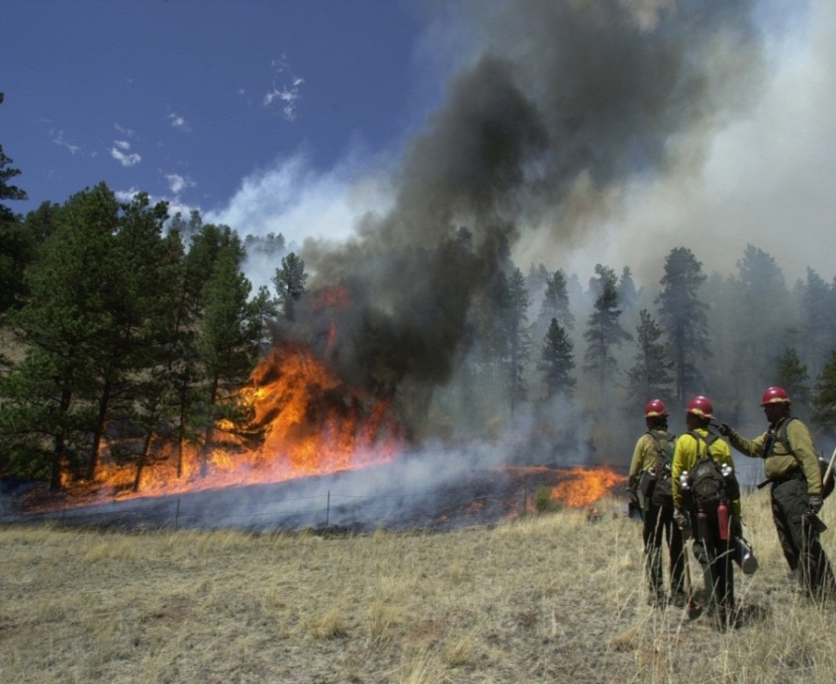
Operational Leadership Principles
Basic Traits of an Effective Leader
Exhibits a command presence.
Establishes and maintains open and effective communication with assigned resources.
Develops and fosters crew cohesiveness.
Develops the ability to make good decisions.
Notes:
Read definitions of command climate and command presence in the NWCG Glossary of Wildland Fire, PMS 205, https://www.nwcg.gov/about-the-nwcg-glossary-of-wildland-fire, or Leading in the Wildland Fire Service, PMS 494-2, https://www.nwcg.gov/publications/494-2, and discuss.
Behaviors that exhibit open and effective communication:
Sets expectations and maintains accountability.
Seeks commitment and input.
Focuses on the team result.

Slide 11
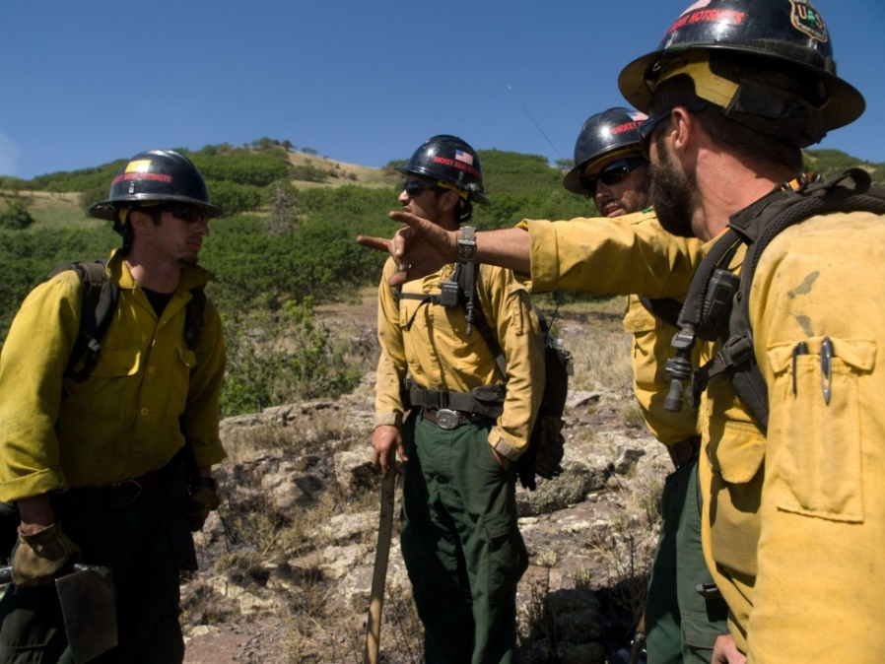
Operational Leadership Principles
Leader’s Intent
All leaders of firefighters have the responsibility to provide complete briefings and ensure that their subordinates have a clear understanding of their intent for the assignment:
Task = What is to be done
Purpose = Why it is to be done
End state = How it should look when done
Notes:
Discuss with students: In the absence of direct supervision, clear leader’s intent gives fireline personnel the flexibility to adapt to changing situations and successfully meet the objective(s).

Slide 12
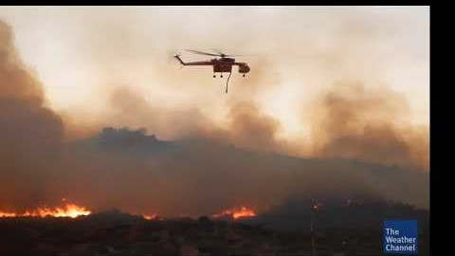
Operational Leadership Principles
Notes:
Play video https://youtu.be/vsTBuEsLiO4 .
Title: Leading in the Wildland Fire Service
Summary: Characteristics of leadership and conversations about successful leadership in wildland fire.
Time (20:56)
Audio
Discuss with students:
What did they find to be the most important message from the video?
What are some examples of leadership they have seen on the fireline that demonstrated the leadership concepts in the video?

Slide 13
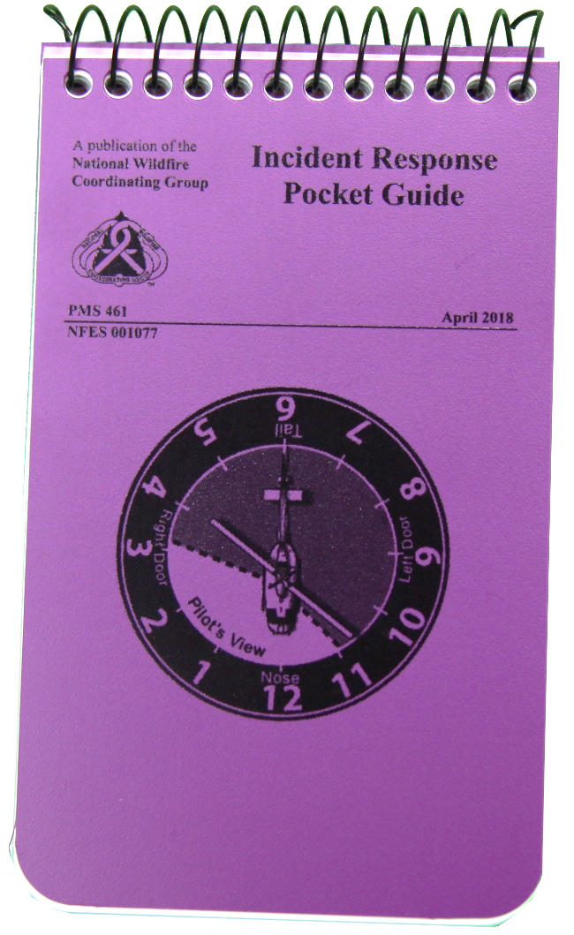
Fireline Reference Materials
Incident Response Pocket Guide (IRPG),
PMS 461
Purpose
Features
Sections
Notes:
Discuss the importance of the IRPG, https://www.nwcg.gov/publications/461, and the Wildland Fire Incident Management Field Guide, PMS 210, https://www.nwcg.gov/publications/210, and how you have used them on the fireline.
Stress that the IRPG is one of the most important reference materials available.
Serves as a field reference guide that is comprised of checklists and other information that are standard operating procedures (SOPs) for wildland fire incidents.
Priority information is located on the cover pages of the IRPG.
The size of the IRPG is intended to fit into a pocket.
Sections are color-coded for easy reference.
Briefly discuss with students the information on the cover pages of the IRPG.
Sizeup report.
Briefing checklist.
Standard firefighting orders.
Watch out situations.
Refer students to the IRPG’s table of contents, which identifies the various sections in the IRPG. Use one of the following strategies:
Walk the class through each chapter and apply the information to the FFT1 and/or ICT5 positions.
Have students break into small groups and ask the groups to make presentations regarding the applicability of an assigned section.

Slide 14
Fireline Reference Materials
Other Reference Material
Wildland Fire Incident Management Field Guide, PMS 210
Leading in the Wildland Fire Service, PMS 494-2
Position-specific webpages from NWCG Position Catalog
Notes:
Briefly describe the listed reference materials.
Wildland Fire Incident Management Field Guide, PMS 210, https://www.nwcg.gov/publications/210.
Leading in the Wildland Fire Service, PMS 494-2, https://www.nwcg.gov/publications/494-2.
NWCG Position Catalog, https://www.nwcg.gov/positions.
Describe any other reference materials that are commonly used in your local area.

Slide 15
Exercises
Through the following hands-on exercises, you will gain familiarity with fireline reference tools, which will help you perform fireline duties safely and efficiently.
Notes:
Exercises
The purpose of the following exercises is to orient students to the contents of the IRPG. However, additional information may also be in other references, such as:
Wildland Fire Incident Management Field Guide, PMS 210, https://www.nwcg.gov/publications/210.
Leading in the Wildland Fire Service, PMS 494-2, https://www.nwcg.gov/publications/494-2.
NWCG Position Catalog, https://www.nwcg.gov/positions.
It is important for students to understand that the IRPG is not an all-encompassing document and that other informational sources exist.
For each of the scenarios on the next three slides, read the statement, and then ask the corresponding question.
Students can work in small groups, or the instructor can have a general class discussion.
Research and be familiar with the answers to the exercises to respond to student solutions.

Slide 16
Exercises
1) Your crew reaches a point where you must begin building fireline downhill on the steepest terrain in the area.
Briefly identify the specific reference tool items you would use to address this situation.
Notes:
Exercise 1:
Instruct students to refer to the IRPG, https://www.nwcg.gov/publications/461, to complete the exercise, paying attention to the Downhill Checklist.
Review and reinforce the procedures.

Slide 17
Exercises
2) After you have analyzed your downhill line assignment, you believe it is unsafe to proceed.
What are some considerations to properly refuse this risk?
Notes:
Exercise 2.
Instruct students to refer to the IRPG, https://www.nwcg.gov/publications/461, paying attention to the pages about How to Properly Refuse Risk.
Review and reinforce the procedures.

Slide 18
Exercises
3) During your briefing, you are told that potential risks exist on your new assignment.
What tool will you use and what actions will you take to properly manage the risks that have been identified?
Notes:
Exercise 3:
Instruct students to refer to the IRPG, https://www.nwcg.gov/publications/461, paying attention to the pages about Risk Management.
Review and reinforce the procedures.
Stress to students the importance of personalizing their fireline reference tools and updating them, as necessary. The more familiar they become with their tools, the more safely and efficiently they will be able to perform their fireline duties.

Slide 19
Review Objectives
Students will be able to:
Identify position responsibilities of Firefighter Type 1 (FFT1) and Incident Commander Type 5 (ICT5).
Demonstrate the ability to apply operational leadership principles.
Demonstrate the ability to locate and apply standard wildland fire operating procedures found in the Incident Response Pocket Guide (IRPG), PMS 461, and other identified fireline references.
Notes:
Review unit objectives.
Incident Response Pocket Guide (IRPG), PMS 461, https://www.nwcg.gov/publications/461.

