Slide 1
S-131 Unit 2: Communication

Slide 2
Objectives
Students will be able to:
Identify the communication and documentation responsibilities of a Firefighter Type 1 (FFT1) and Incident Commander Type 5 (ICT5).
Demonstrate the ability to give and receive a briefing following the Briefing Checklist found in the Incident Response Pocket Guide (IRPG), PMS 461.
Notes:
Review unit objectives.
Incident Response Pocket Guide (IRPG), PMS 461, https://www.nwcg.gov/publications/461.

Slide 3
Importance
WHY IS GOOD COMMUNICATION IMPORTANT?
Communication is identified as a major contributing factor in fatality and near miss incidents.
Communication is vital in implementing the Risk Management Process.
Communication directly affects the safe and efficient completion of an assignment.
Notes:
Results of many fatalities and near-miss reviews on emergency incidents indicate poor or lack of communication was a major contributing factor.
Acquire an Incident Review from an incident where communications played a role. Discuss with the students how communication was a factor in the incident. A possible source would be the Incident Review Database from the Wildland Fire Lessons Learned Center, http://wildfirelessons.net.
As a firefighter, it is your responsibility to understand the importance of establishing and maintaining effective fireline communication. Communication is vital in implementing the Risk Management Process.
Briefly present the elements of the Risk Management Process in the IRPG, https://www.nwcg.gov/publications/461, and discuss how vital communication is to using the process. The students can review the Risk Management process in their IRPGs.
The quality of communication will directly affect the success of completing an assignment safely and effectively.

Slide 4
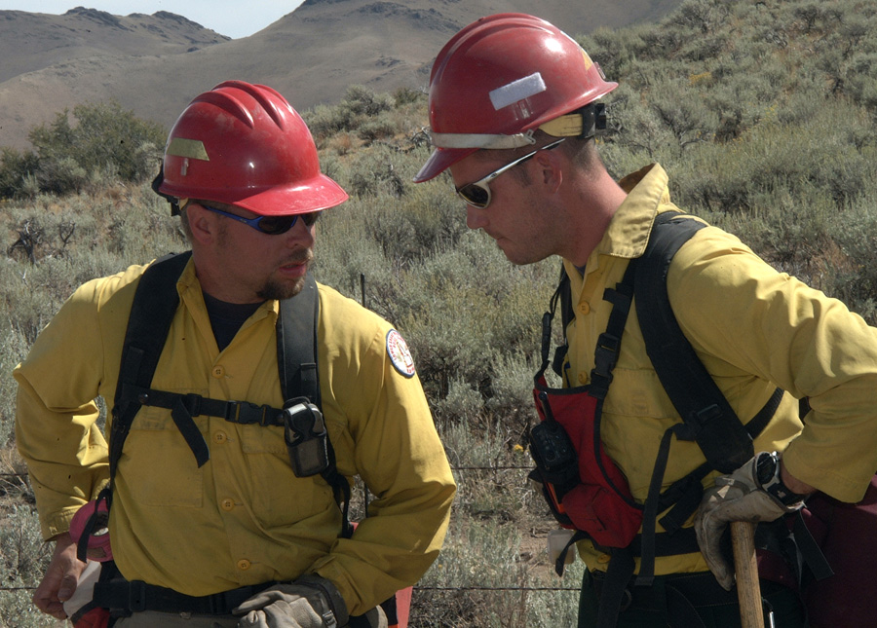
Effectiveness
WHAT IS EFFECTIVE COMMUNICATION?
The transfer of information in terms understood by both parties.
SENDER
RECEIVER
Notes:
Effective communication is the transfer of information in terms that are understood by all parties.
Discuss effective communication. Ask students to describe behaviors exhibited by senders and receivers that indicate effective communication is occurring.
Effective communication occurs when both parties are engaged as senders and receivers. Indicators could include body language, paraphrasing, asking questions, using checklists, etc.
Ask students how reference materials such as those listed below could be used as tools to enhance communication.
IRPG Briefing Checklist
Helicopter Passenger Briefing and PPE checklist
Sizeup Report
Medical Incident Report

Slide 5
Five Communication Responsibilities
Notes:
Play video. https://www.nwcg.gov/publications/training-courses/rt-130/leadership/ld603
Title: Five Communication Responsibilities
Summary: This video discusses the responsibilities of all individuals in the communication process.
Time: (09:48)
Audio

Slide 6
Five Communication Responsibilities
Brief others as needed.
Debrief your actions.
Communicate hazards to others.
Acknowledge messages.
Ask if you don’t know.
Notes:
Discuss each of the five elements, and what tools are available that could be used to apply the five responsibilities.
Tell students that these responsibilities should be considered standard communication procedures, which they will use throughout their careers.
Emphasize that good communication is created when information flows easily from top to bottom and back up.

Slide 7
Types of Communication
Oral: Face-to-face
Notes:
Perhaps the most effective and preferred method of communication.
Logistical considerations often make this impractical.
Stress that face-to-face communication provides the best opportunities to implement the five communication responsibilities.

Slide 8
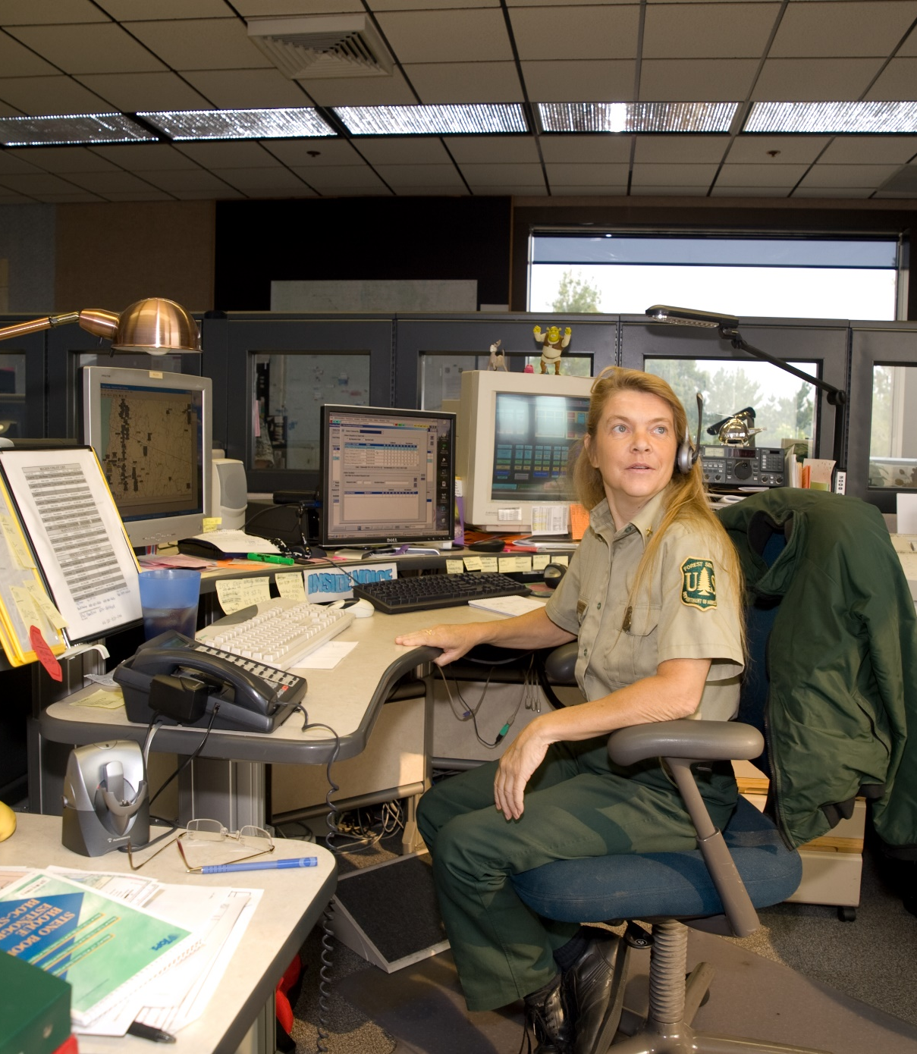
Types of Communication
Oral:
Radios
Notes:
Radios are one of the most efficient and practical methods used to communicate on emergency incidents.
Stress how radio communication is practical but is also prone to unclear and misunderstood messages.
Discuss how radio operating procedures could be enhanced to address the five communication responsibilities.
Example: Someone sends a tactical message over the radio, and the receiver’s reply is “copy.” This doesn’t exactly leave the sender with the confidence that the receiver fully understands.
Discuss how messages could be acknowledged better by reading back or paraphrasing the message.

Slide 9
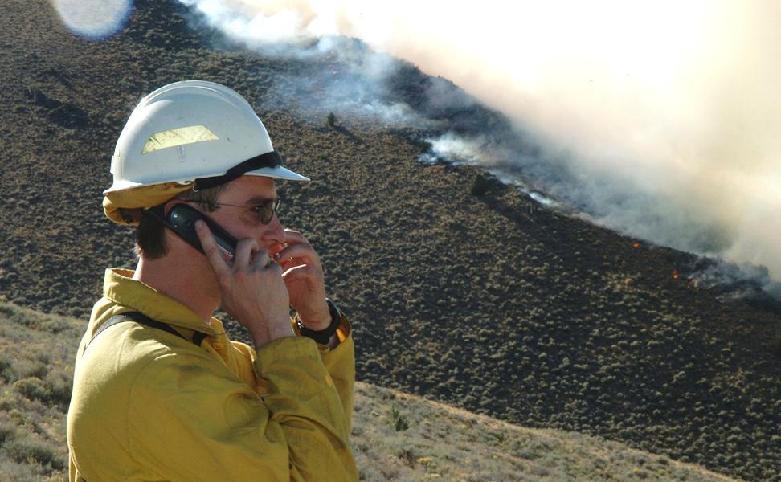
Types of Communication
Oral:
Telephones
Notes:
This includes cell phone, satellite phone, or landline communication.
Emphasize why phones should not be used for tactical purposes.
Phones should be used cautiously when making tactical decisions because of the potential that numerous people might not be in the communication loop.

Slide 10
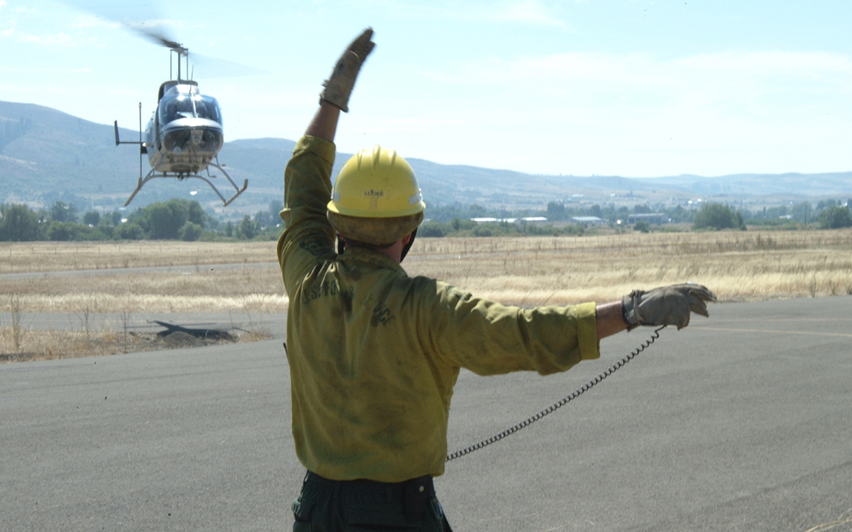
Types of Communication
Visual:
Hand Signals
Notes:
Hand signals may be an appropriate means of communication when:
Distance between individuals is an issue.
High noise levels exist within the fire environment.
Ensure students are familiar with the section in the IRPG, https://www.nwcg.gov/publications/461, concerning helicopter hand signals.

Slide 11
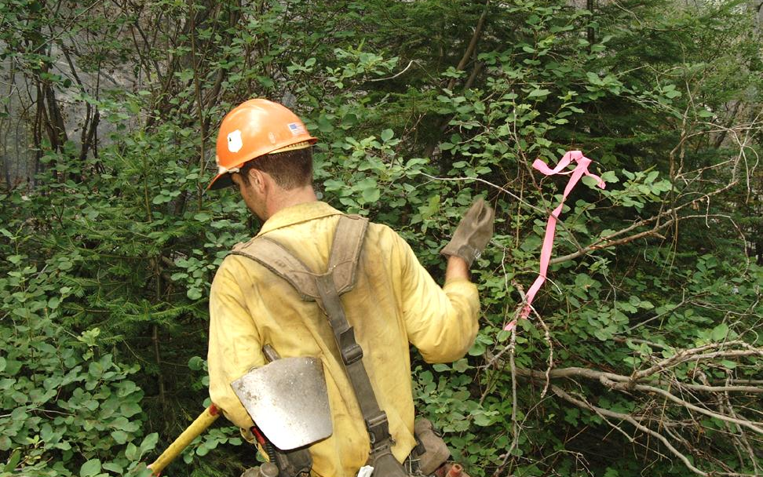
Types of Communication
Visual:
Flagging
Notes:
Flagging:
A simple way of transferring information.
Enhances recall of information that had been previously discussed.
Ask students what experience they have had with flagging on fireline assignments. Give personal accounts of using flagging to communicate on the fireline.

Slide 12
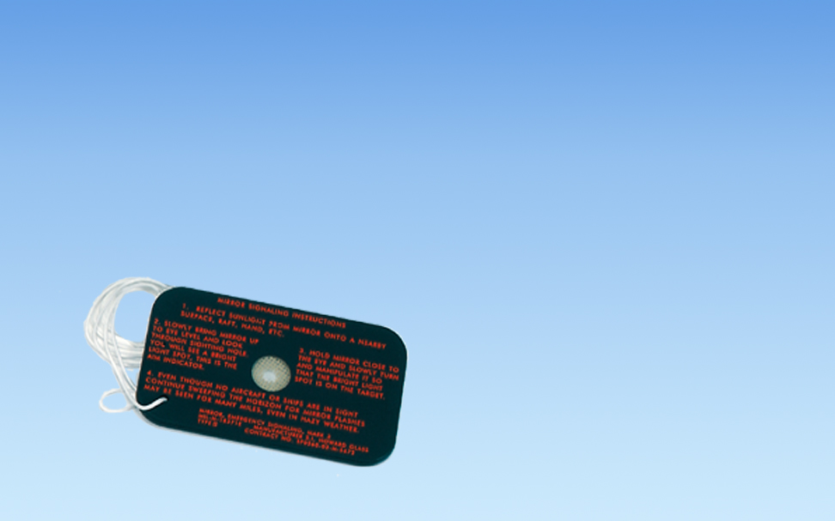
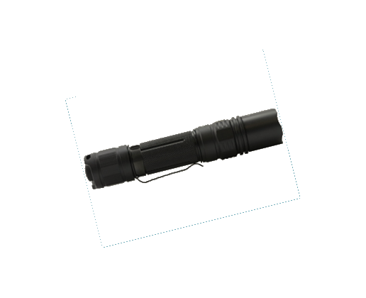
Types of Communication
Visual:
Mirrors and Strobe Lights
Notes:
Mirrors or strobe lights can be used to locate individuals or signal aircraft.
Ultra bright (1,000-lumen) strobes or flashlights can work in cloudy or shaded conditions.
Discuss the option of using alternative methods of signaling such as:
Marker panels
Colored smoke canisters
Flares
Flags
Signs

Slide 13
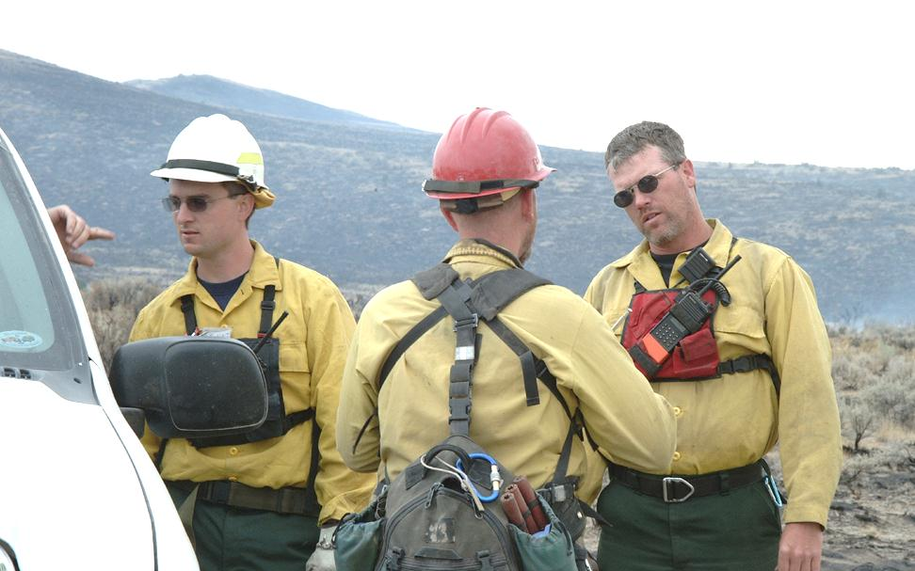
Types of Communication
Visual:
Body Language
Notes:
Body language can be used to determine if an individual exhibits fatigue, understands the task, understands intent, etc.
Emphasize that some research indicates the largest percentage of all communication is nonverbal.
Discuss how people demonstrate active communication through body language. Ask students to give examples of positive and negative body language.
Elaborate as necessary concerning body language.

Slide 14
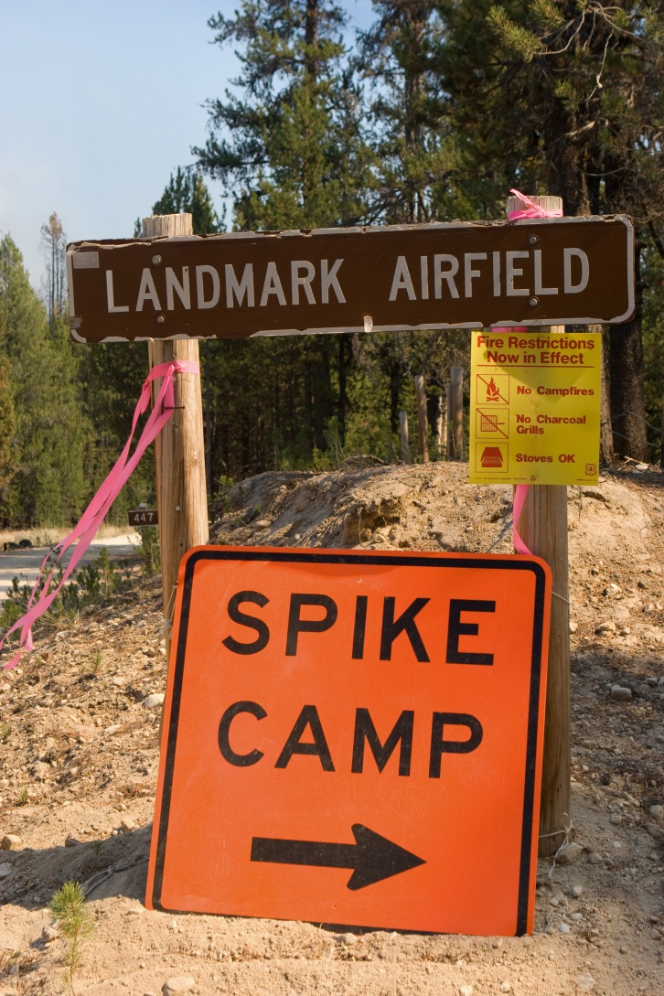
Types of Communication
Written:
Acitvity Log (ICS-214)
General Message (ICS-213)
Incident Organizer
Text/email messages
Other
Notes:
Discuss the use of written communication.
Discuss the increasing prevalence of text and email messages.
Emphasize the potential downside of using mobile phones for tactical purposes.

Slide 15
Documentation
The importance of documentation cannot be underestimated.
Records help recall events and important information regarding the incident when the memory fails.
Documentation provides relief forces with incident activities to date.
Notes:
Ask the students to determine why the statements on the slide are important.

Slide 16
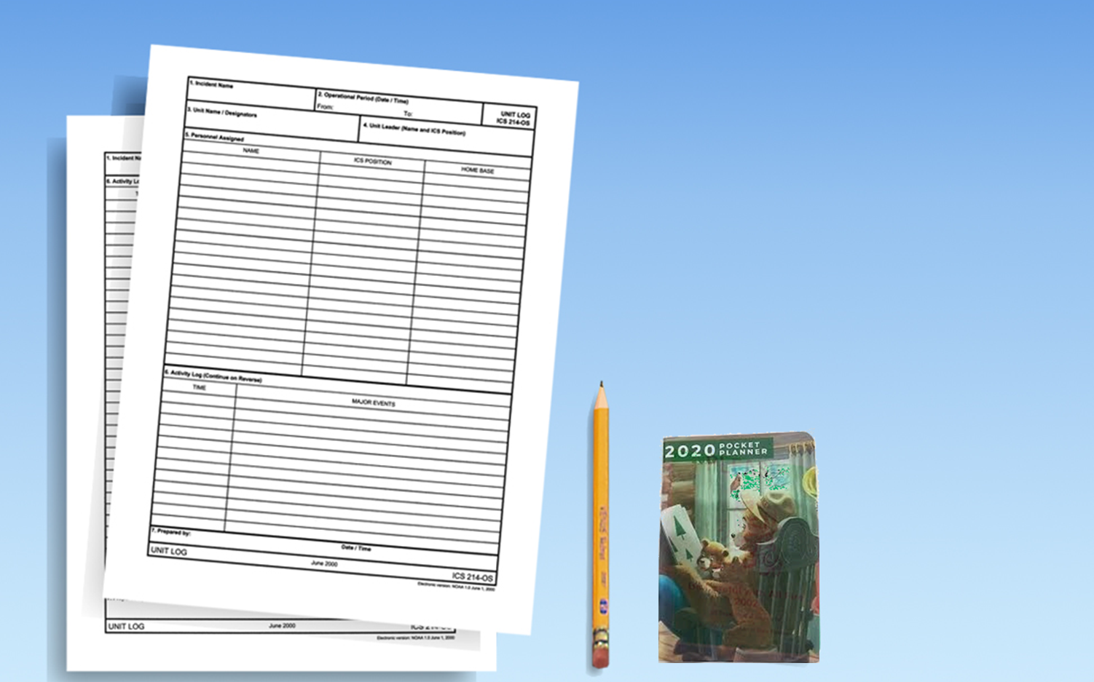
Documentation
Written:
ICS Forms
Activity Log
General Message
Incident Briefing
Pocket notebook

Slide 17
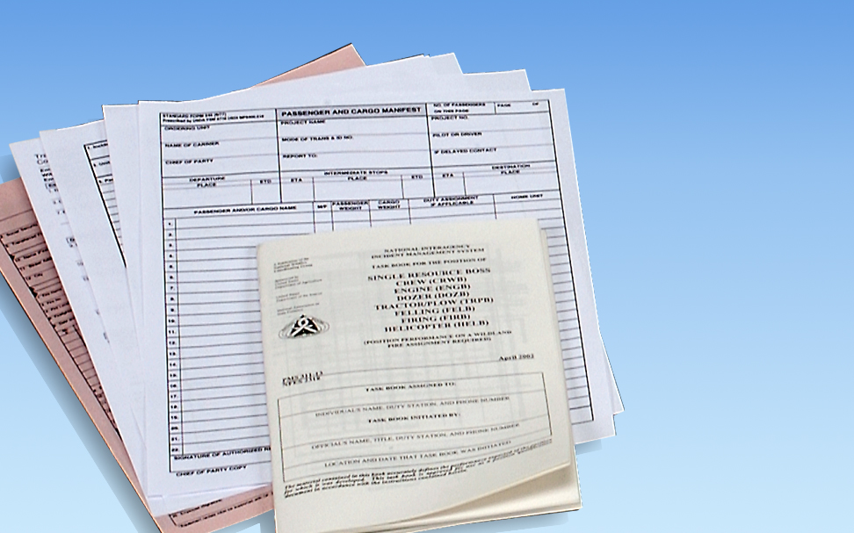
Documentation
Written:
Agency- specific forms
Notes:
Solicit responses from the class in terms of what type of agency forms they have been required to use.
Stress to students that agencies have different form completion requirements such as time reporting, claims, accidents, etc.

Slide 18
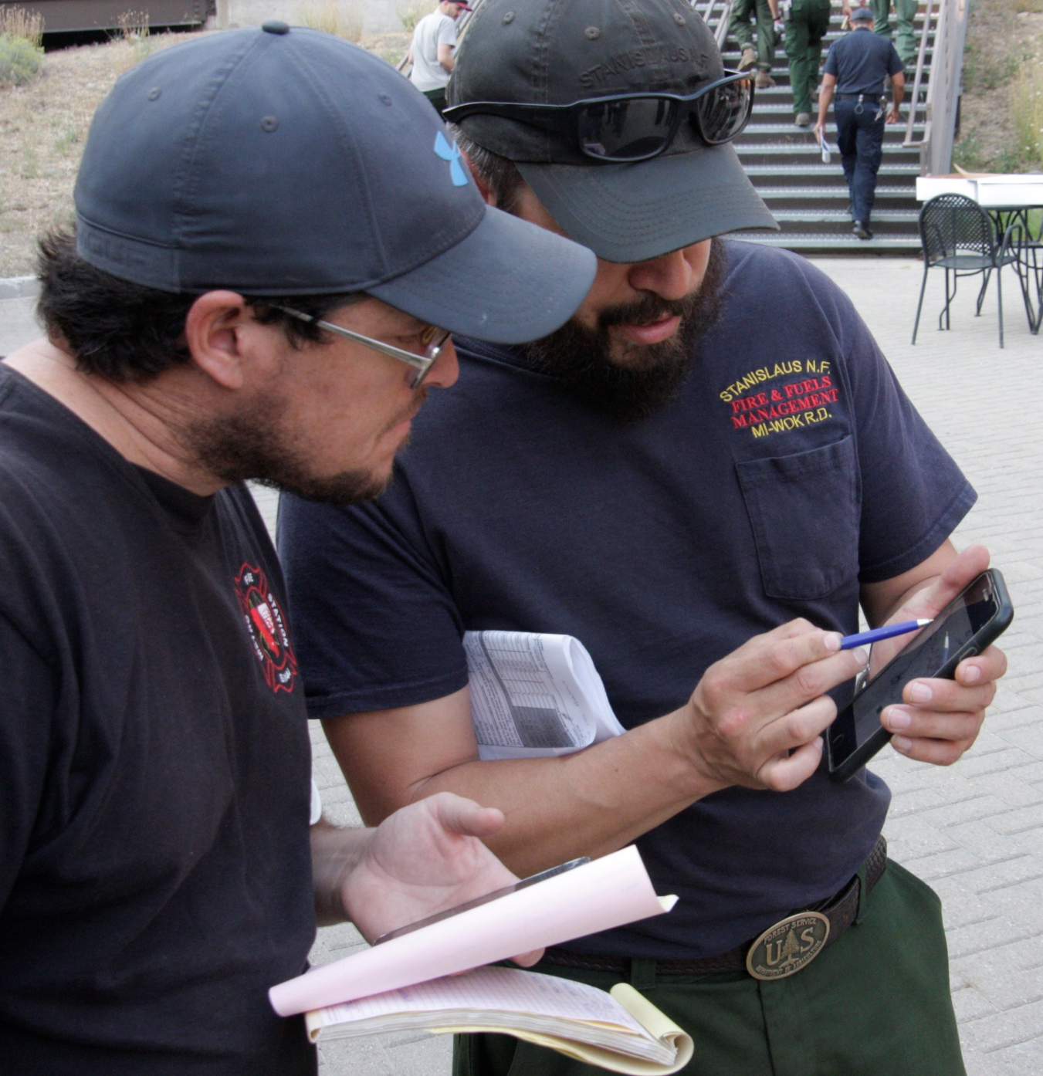
Documentation
Electronic:
Smartphone
GPS
Voice Recorder
Computer or tablet
Notes:
Advise students that all forms may not be available or appropriate for use.
The FFT1 and ICT5 should use whatever form or tool is available to document a situation.
Transfer can be made later to the appropriate medium.

Slide 19
Documentation
What should be documented?
Any event that you think is significant enough to remember should be photographed or written down.
Think of documentation as another tool to aid your memory.
Notes:
Ask students why documentation may be useful in the situations listed below.
Change in fire behavior
Weather observations
Inappropriate behavior (human resource issues)
Change in assignment or location
Injuries and accidents
Adjacent resources and call numbers
Deficiencies in individual and crew performance
Additional training needed
Resources on scene upon arrival
Cutting fences for access into a fire
Property modifications during structure protection or damage or loss
Investigation of a point of origin or fire cause
Involvement with search and rescue, vehicle accidents, or law enforcement
Assignments, instructions, directions, etc.
Personnel time
Time of day when any of the above occurs

Slide 20
Briefing Example
Notes:
Play video and discuss https://www.youtube.com/watch?v=e4lzZA6WTyI&feature=youtu.be
Title: Briefing Example
Summary: Morning crew briefing given by crew leader.
Time: (02:54)
Audio

Slide 21
Briefing Exercise
Notes:
Exercise: Briefing
Purpose:
The briefing exercise is designed to bring the concepts of this unit together by having the students either give and/or receive a briefing.
The emphasis is on the value of applying the IRPG briefing format, documentation habits, and the five communication responsibilities.
Format:
The students should be assembled in small groups of four to five. Two students from each group will be identified to give briefings. One of the students who will give the briefing should have an IRPG, one should not.
Exercise Instructions:
Have the two students who were selected to give the briefing read the scenario below. Do not allow the other students to read the scenario.
One of the students can use the briefing checklist and any notes for the delivery of his or her briefing. The other student must rely on memory.
Have each of the two selected briefers give the briefing one after the other.
All students in the group receiving the briefing should follow along using the briefing checklist and apply the five communication responsibilities.
After the briefings are concluded, discuss the value of using a standardized briefing checklist for information exchange.
Scenario:
You are one of two squad bosses on a 20-person crew, and you work directly for the crew boss. It is July 30, and at 1330, your crew has arrived at the Goat Creek fire. The local fire officer, Bud Garland, is the Type 3 Incident Commander. Aside from Bud, your crew is the only resource currently on the fire. The following observations are made by the crew boss after sizing up the fire.
Fire Size: 4 acres
Fuel Type: Pinyon/juniper with sage and grass understory.
Temperature: 94 °F
Relative Humidity: 22%
Wind Speed/Direction: Southwest, but the direction is variable and frequently shifting. The average speed is 7 mph gusting up to 15 mph with frequent changes in speed.
Fire Behavior: Active fire front with a defined head that shifts direction with the wind.
Flame Lengths: Four feet in grass/sage with intermittent torching to 10 feet plus in pinyon/juniper.
Rate of Spread: Approximately 20–25 chains per hour.
Topography: Rolling, gentle slopes of 10–20 percent.
The IC and the crew boss agree to split the crew anchoring off at the roadside using direct attack. Additional resources have been ordered including four Type 3 engines and one airtanker. The crew boss designates you as having the right flank and the other squad boss taking the left flank with his crew. Because of the intense situation, your crew boss must leave the anchor point location. As he is leaving, he reemphasizes: “One foot in the black, monitor the air-to-ground frequency on 170.000, and to stay on the tactical channel (3) 168.200.”

Slide 22
Review Objectives
Students will be able to:
Identify the communication and documentation responsibilities of a Firefighter Type 1 (FFT1) and Incident Commander Type 5 (ICT5).
Demonstrate the ability to give and receive a briefing following the Briefing Checklist found in the Incident Response Pocket Guide (IRPG), PMS 461.
Notes:
Review unit objectives.
Incident Response Pocket Guide (IRPG), PMS 461, https://www.nwcg.gov/publications/461.

