Slide 1
S-200 Initial Attack Incident Commander
Unit 4
Manage the Incident
Unit 4

Slide 2
MANAGE THE INCIDENT BY APPLYING THE PRINCIPLES OF EFFECTIVE LEADERSHIP
Unit 4 Intent
Unit 4
Click on screen to show introduction video

Slide 3
Unit 4 Objectives
Brief and keep subordinates informed of plan of action.
Direct and coordinate resources.
Unit 4
Notes:
Instructor Note: You will be reviewing the Leadership foundation skills to set-up the students for the next exercises

Slide 4
Brief and keep subordinates informed of plan of action
Develop command presence
Be aware of the leadership environment
Communicate leader’s intent
Utilize references
Unit 4
Notes:
Command Presence –Competent, Composed, Decisive, Self confident, Goal Oriented
Leadership Environment – Team, Leader, Task
Decisive action during the early stages of a fire often determines the success or failure of the initial attack.

Slide 5
Direct and Coordinate Resources
Apply Leadership Styles
Direct
Delegate
Participate
Unit 4

Slide 6
Operational Leadership
Take Charge
Motivate
Demonstrate Initiative
Communicate
Supervise
As outlined in the IRPG
Unit 4

Slide 7
Dynamic Environment
Maintain LCES and 10 and 18
Monitor Weather and Fire Behavior
Maintain Span-of-Control
Monitor Crew Welfare
Incident Complexity
Re-evaluate Objectives, Strategies and Tactics
Unit 4

Slide 8
Budder Fire Sand Table Exercise
The Budder Fire continues…
TDGS #4
Manage the Incident
Unit 4
Notes:
Begin the Initial Attack Dispatch TDGS
Refer to the Instructor Guide for TDGS at the end of the Unit. It is very important that the instructor and coaches are well prepared for the TDGS
Instructor: Your level of success for the TDGS will be based on your level of preparation

Slide 9
TDGS Ground Rules
Two simulations will run simultaneously on two tables.
Each sand table will have an instructor and an appropriate number of coaches.
Unit 4

Slide 10
TDGS Ground Rules
When players are not face to face on the Budder Fire, communication will be over the radio.
An instructor or coach will be in the Dispatch and FMO roles.
Unit 4

Slide 11
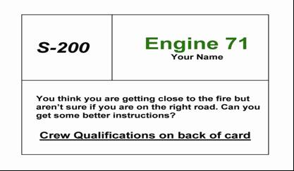
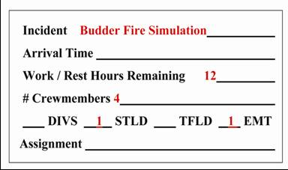
TDGS Ground Rules
Facilitator will have two types of input cards for each simulation.
GREEN CARDS: These cards are given to each player. Each card shows position and current status. On the back are categories of information which can be developed during the simulation.
RED CARDS: These are timed inputs handed out at times determined by the unit number shown in the upper left corner.
Unit 4

Slide 12
TDGS Ground Rules
Simulation Task Book elements can be signed off in all roles.
Conduct yourself as you would on an actual incident.
Utilize appropriate references.
You will be evaluated on your documentation; everyone will document as if they are the IC.
Unit 4

Slide 13
Budder Fire TDG #4
TDGS Instructions:
1. From the previous exercises, you should have developed your Situational Awareness and have a plan of action ready to deliver in the form of a briefing.
2. Use the Incident Organizer to track resources and significant events.
Unit 4

Slide 14
Unit 4 Objectives
Brief and keep subordinates informed of plan of action.
Direct and coordinate resources.
Unit 4

