Slide 1
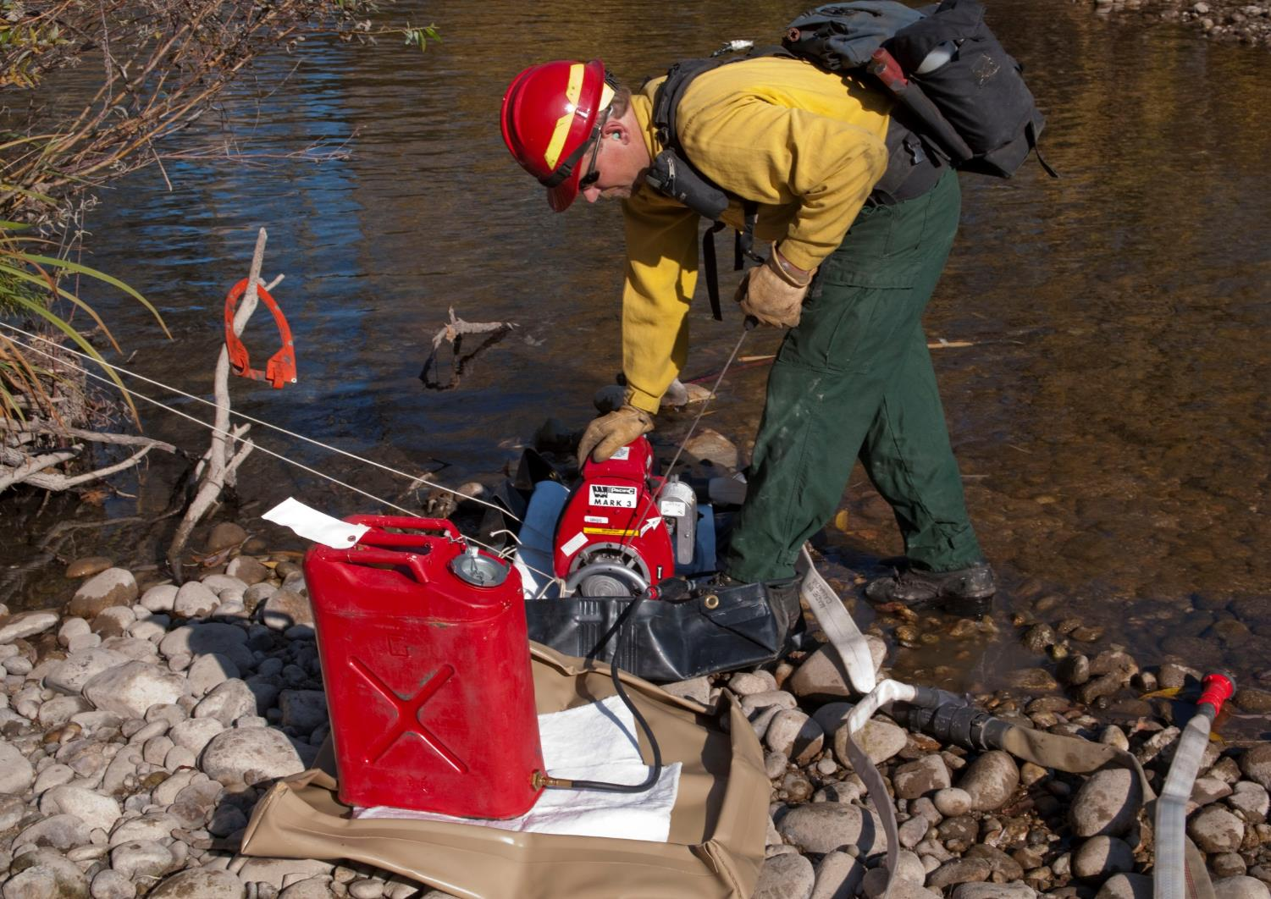
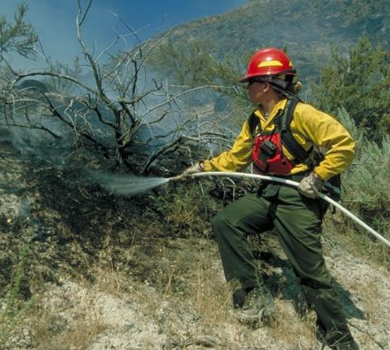
RESPONSIBILITIES
S-211
Portable Pumps and Water Use
Unit 3
Unit 3 - Responsibilities
Slide 3 - 1

Slide 2
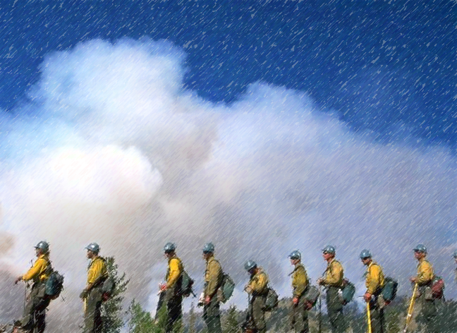
Words of Experience
Click icon to hear firefighter story about pumps.

Slide 3
Objectives
Given scenarios and photos, identify risk management, fuel handing, and environmental concerns.
Identify methods to prevent cavitation and water hammer.
List the four components that should be included in the design of a portable water delivery system.
Given photos, critique a portable pump setup.

Slide 4
Objectives
Identify how to prevent the engine from flooding when starting the pump.
Identify how to troubleshoot common problems with portable pumps.
Identify how to select nozzles and apply water to achieve tactical objectives.
List general guidelines for maintaining and retrieving hoses.

Slide 5
General Responsibilities

Slide 6
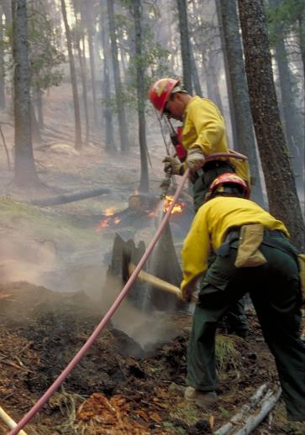
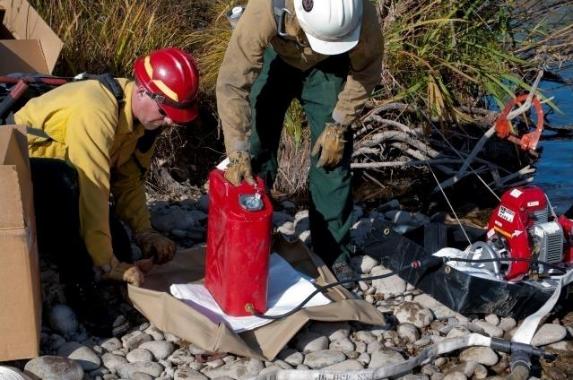
Risk Management
Always wear PPE; keep sleeves down.

Slide 7
Risk Management
Always wear PPE; keep sleeves down.
Ensure LCES is established and known.

Slide 8
Risk Management
Always wear PPE; keep sleeves down.
Ensure LCES is established and known.
When handling fuel, follow additional safety precautions.

Slide 9
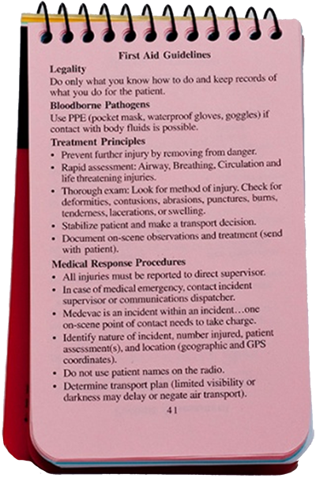
Risk Management
Always wear PPE; keep sleeves down.
Ensure LCES is established and known.
When handling fuel, follow additional safety precautions.
Follow first aid guidelines.

Slide 10
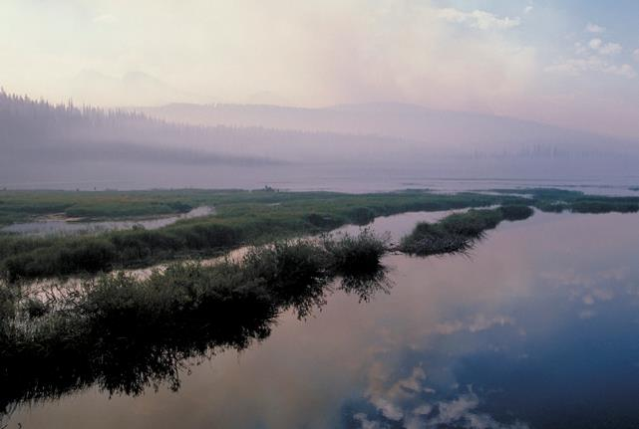
Environmental Concerns
Fuel spills
Species considerations
Minimize impact to site
Rehabilitate site

Slide 11
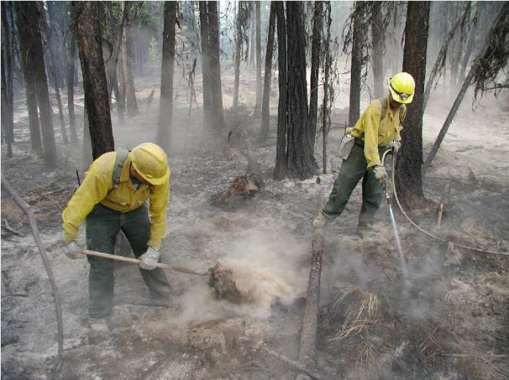
Communication
Nozzle operator
Supervisor
Pump operator
Hand crew or other fireline personnel

Slide 12
Communication Methods

Slide 13
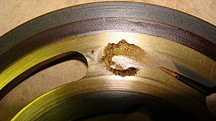
Cavitation
Definition: When cavities or bubbles form in the water in the low pressure (suction side) of the pump, causing deep pits in the surface of the impeller

Slide 14
Cavitation
Causes
Restricted water flow
Air entering suction hose
Suction hose diameter too big or too small
Downhill hose lay with extreme water demand
High-altitude pumping
What are symptoms that cavitation is occurring?

Slide 15
Prevent Cavitation
Keep strainer clean and free of debris.
Locate pump as close to water source as practical.
Ensure adequate water supply.
Ensure diameter of suction hose is accurate.

Slide 16
Water Hammer
Occurs when flowing water is suddenly stopped, resulting in shock waves traveling back the length of hose at high speeds, producing rapid vibrations.

Slide 17
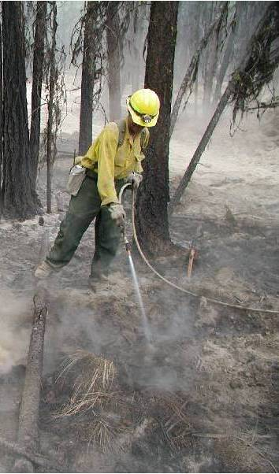
Water Hammer
Cause
Valves or nozzles closed suddenly at end of line
Vehicle driven over hose
What are symptoms that water hammer is occurring or has occurred?

Slide 18
Prevent Water Hammer
Slowly close valves and nozzles.
Keep nozzles slightly cracked open at all times.
Protect hoses from being driven over.

Slide 19
Exercise
Pump Accident Investigation Report

Slide 20
Design Responsibilities

Slide 21
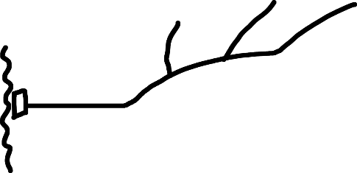
Design Responsibilities

Slide 22
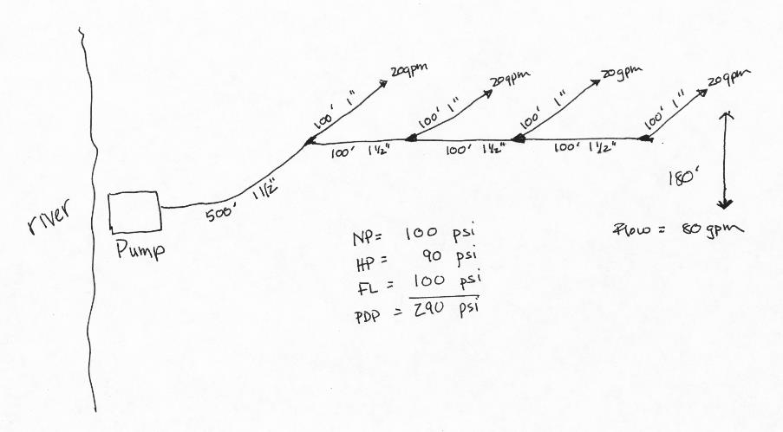
Design Responsibilities

Slide 23
Design Responsibilities
Incorporate these components into the design:
Portable pump configurations
Hose lay design
Nozzle type(s)
Hydraulic calculations

Slide 24
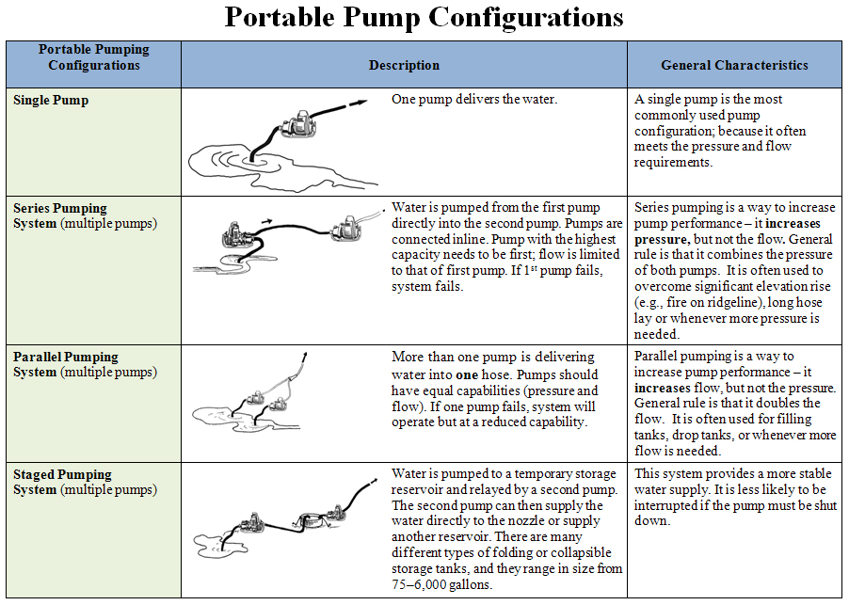

Slide 25
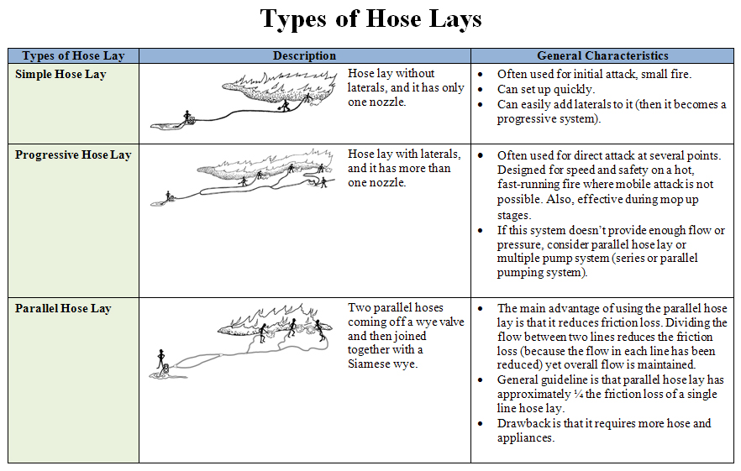

Slide 27
Hydraulic Calculations

Slide 28
Portable Pump Responsibilities

Slide 29
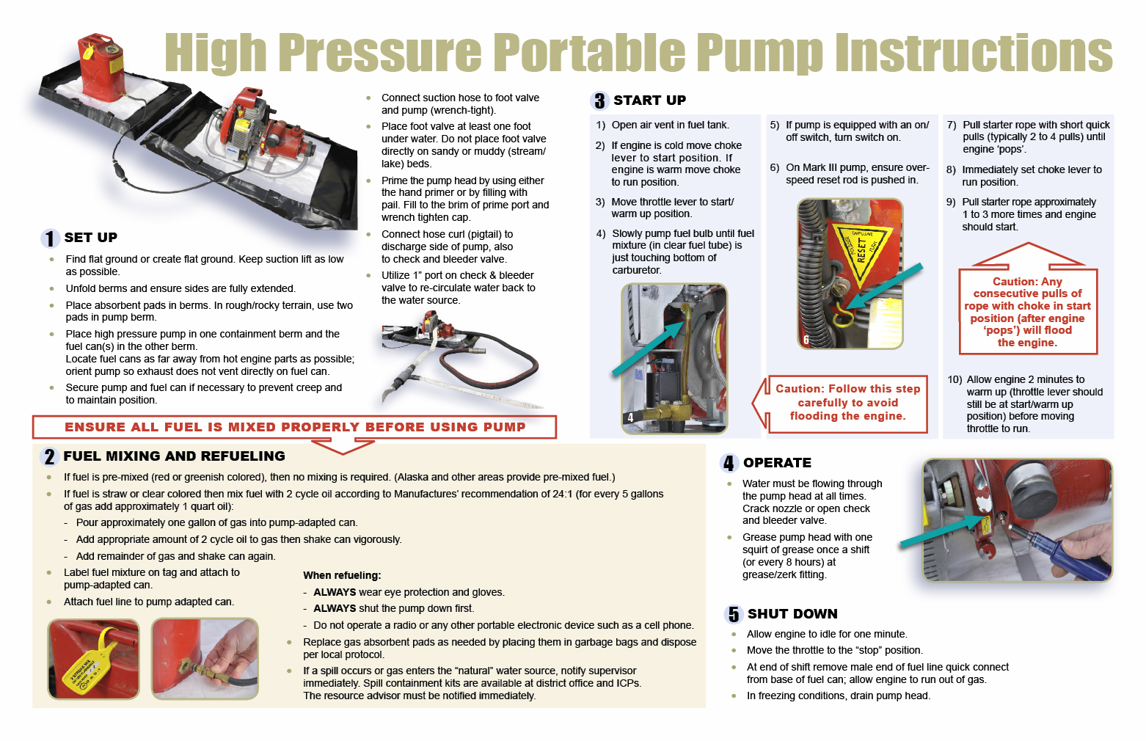
S-211
Portable Pumps and Water Use
Unit 3 - Responsibilities
Slide 3 - 29

Slide 30
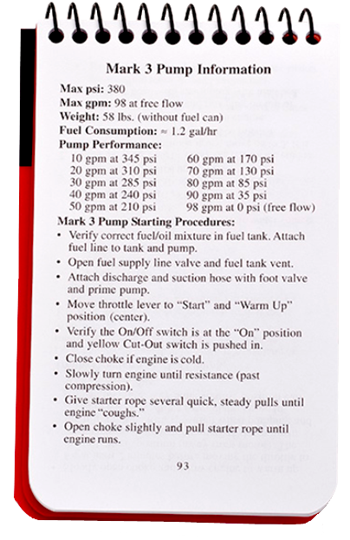

Slide 31
Portable Pump Responsibilities
Obtain equipment and supplies.
Set up and prime pump; connect hoses.
Mix gas and oil, and refuel.
Start pump.
Operate and maintain pump.
Shut down pump.
Troubleshoot.

Slide 32
Obtain Equipment and Supplies

Slide 33
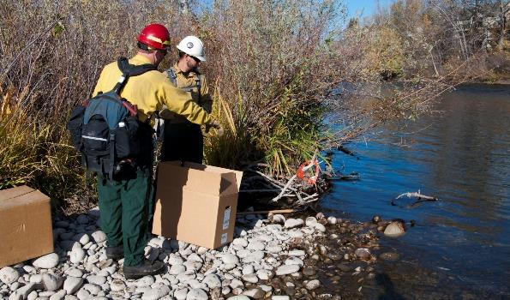
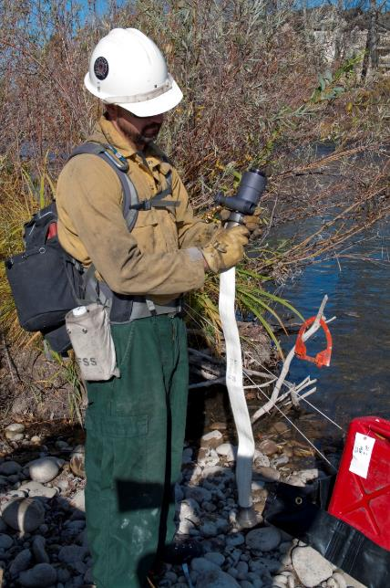
Set Up Pump, Connect Hoses, and Prime Pump
Select a site.
Unpack kit; inventory and inspect.

Slide 34
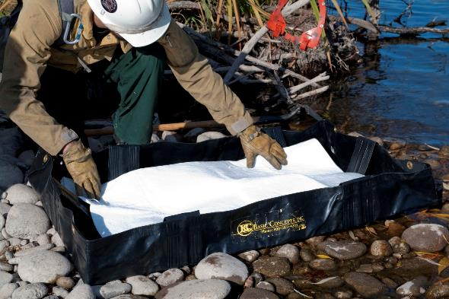
Set Up Pump, Connect Hoses, and Prime Pump
Set up containment berms.
Place pump in one berm and fuel can in the other berm.

Slide 35
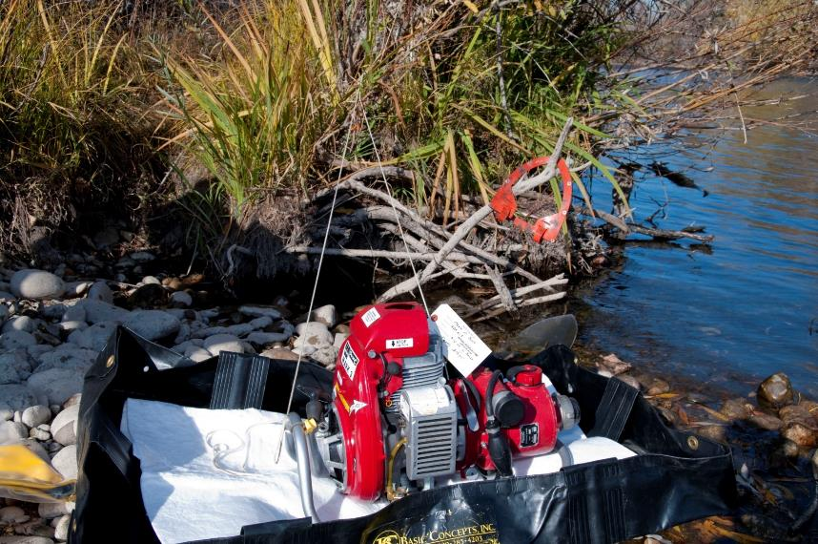
Set Up Pump, Connect Hoses, and Prime Pump
Secure pump and fuel can.

Slide 36
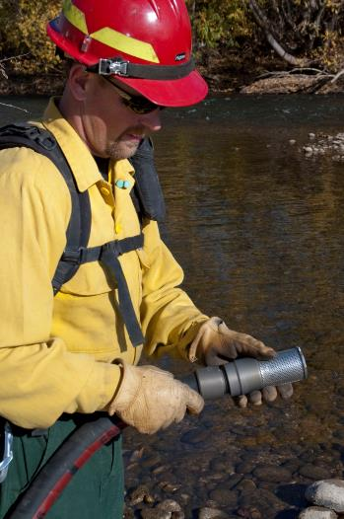
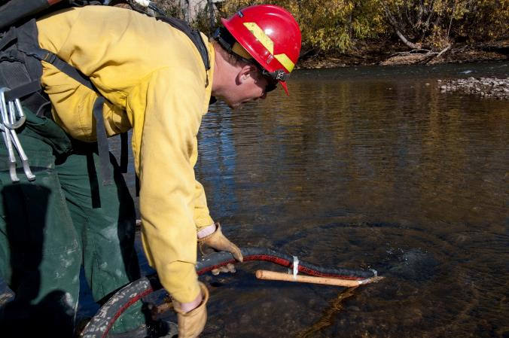
Set Up Pump, Connect Hoses, and Prime Pump
Place foot valve at least 1 foot under water; keep strainer clean and free of debris.
Connect foot valve/strainer to suction hose; fill with water; connect to pump.

Slide 37
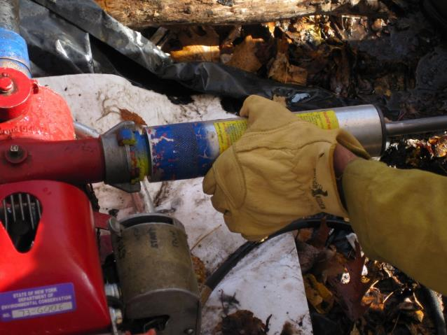
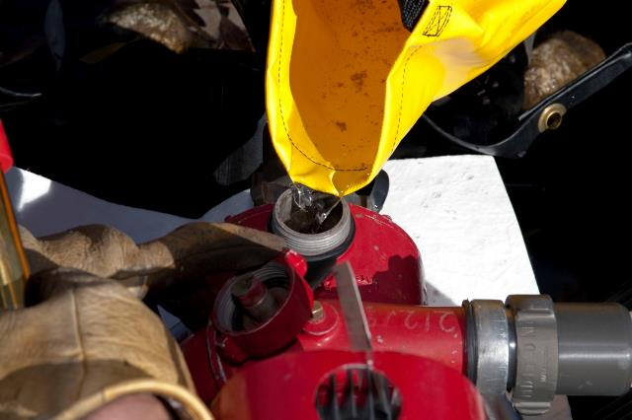
Set Up Pump, Connect Hoses, and Prime Pump
Prime the pump using a hand primer or by filling with water from a pail

Slide 38
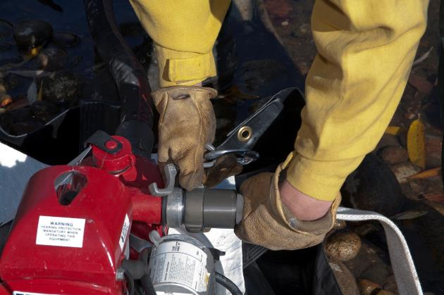
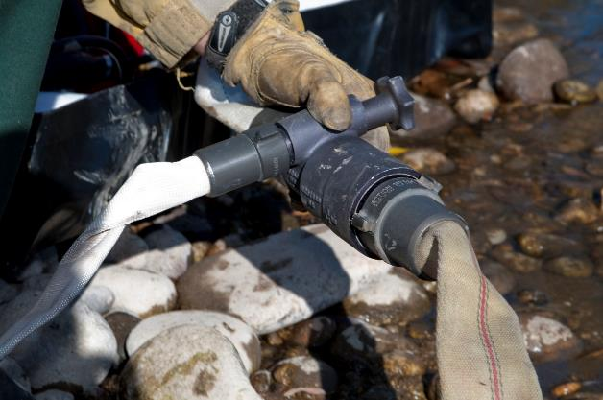
Set Up Pump, Connect Hoses, and Prime Pump
Connect hose curl (pigtail) to discharge side of pump and the other end of hose curl to check and bleeder valve.

Slide 39
Mix Gas and Oil, and Refuel

Slide 40
Safety Procedures When Working With Fuel
ALWAYS wear eye protection and gloves.
ALWAYS shut the pump down before opening the fuel tank.
Never operate a radio, cell phone, or other portable device when working with fuel.

Slide 41
Fuel and Environmental Concerns
Pumps and fuel cans often leak.
ALWAYS use containment berms and absorbent pads.
ALWAYS mix fuel over the containment berm.
If spill occurs:
Contain the spill.
Ensure no more fuel is spilled.
Notify supervisor, Resource Advisor, or both, immediately.
If fuel has to be transported or stored, follow agency policy.

Slide 42
All two cycle pumps require UNLEADED GAS mixed with TWO CYCLE OIL.

Slide 43
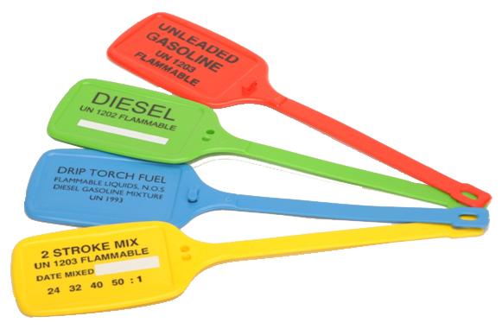
Is fuel pre-mixed?
Pre-mixed fuel (yellow tag)
Fuel color – red or greenish
Slippery to touch
Regular gas(red tag)
Gas color – straw or has no color (clear)
Needs to be mixed with two cycle oil

Slide 44
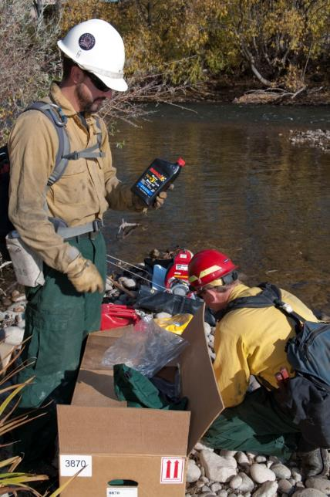
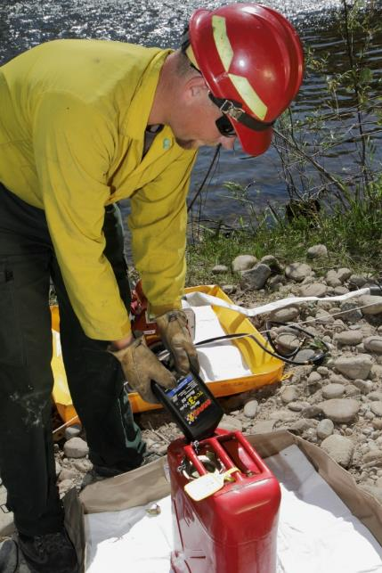
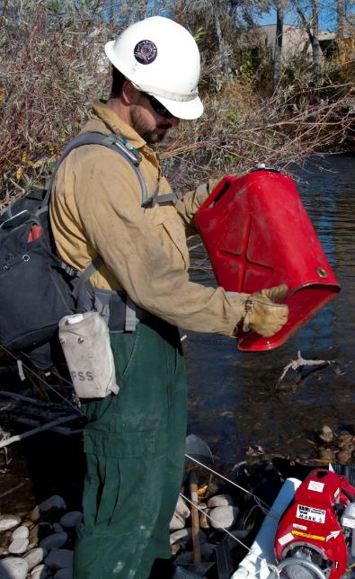
Fuel Mixing Instructions
1
2
3
24:1 Ratio
(5 gal gas: 1 qt oil)
Mix gas and oil.
Shake, and add remaining gas.

Slide 45
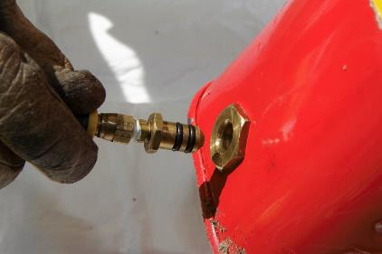
Mix Fuel and Refuel
Write on the appropriate tag the date fuel was mixed, and attach tag to the fuel can.
Attach fuel line to pump-adapted can.
Replace pads; dispose according to agency protocol.

Slide 46
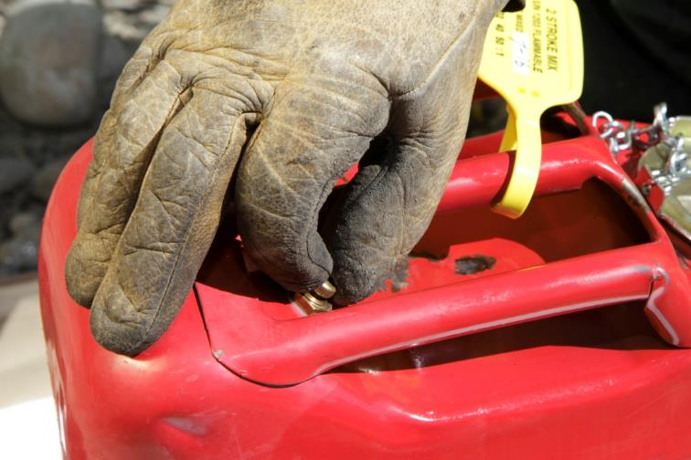
Start Pump
Tell nozzle operator the pump is ready to start.
Open air vent on fuel can.

Slide 47
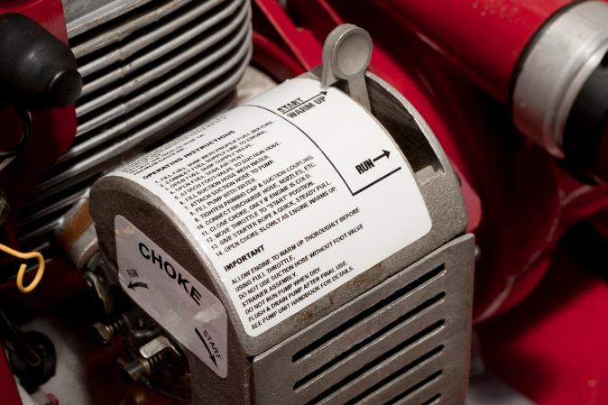
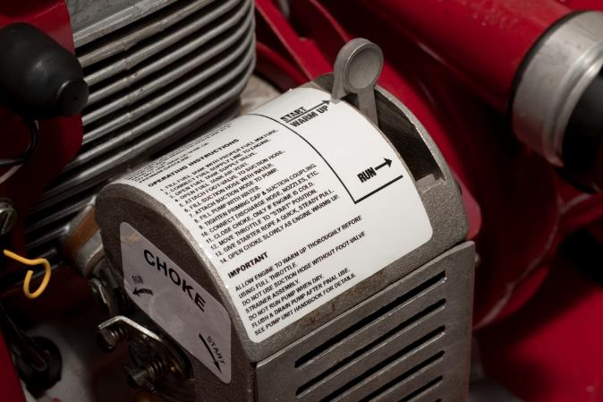
Start Pump
Cold engine:
Choke in start position.
Throttle in start/warm up position.
Warm engine:
Choke in run position.
Throttle in start/warm up position.

Slide 48
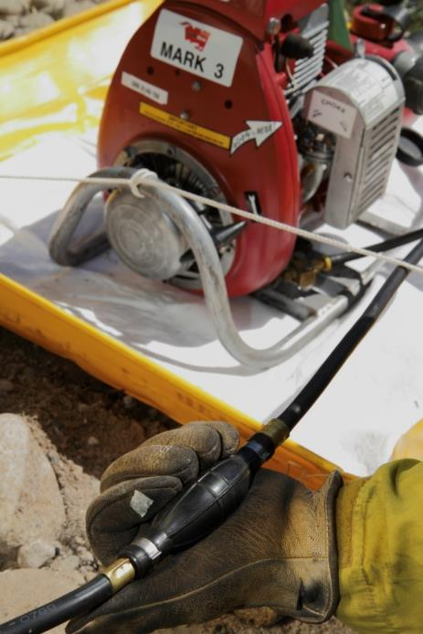
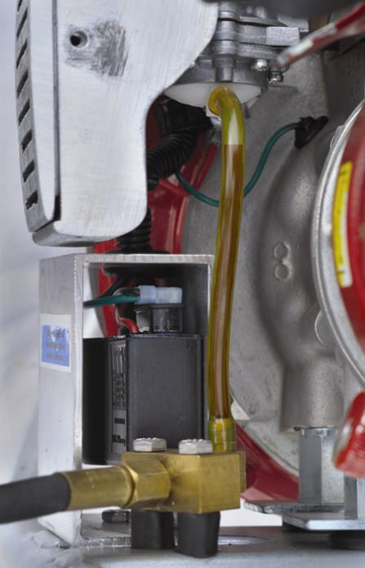
Start Pump
Slowly pump fuel bulb until fuel mixture (in clear fuel tube) is just touching bottom of carburetor.

Slide 49
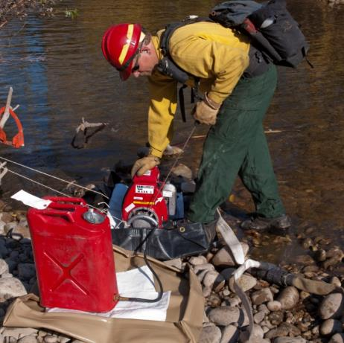
Start Pump
Turn switch on (if there is a switch).
On Mark 3 pump, ensure overspeed reset rod is pushed in.
Pull starter rope with short, quick pulls (2 to 4 pulls) until engine “pops.”
Immediately set choke lever to run position.
Click icon to hear engine pop.

Slide 50
Start Pump
Pull starter rope 1 to 3 more times, and the pump engine should start.
Additional pulls of rope with choke in start position (after engine pops) will flood engine.
Allow engine 2 minutes to warm up before moving throttle to run position.

Slide 51
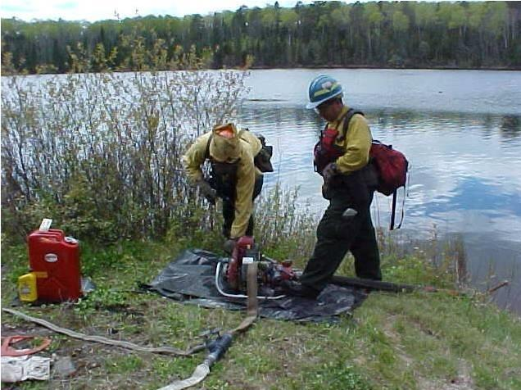
Operate and Maintain Pump
Prevent pump cavitation and water hammer.
Ensure water is flowing through pump head at all times. Crack nozzle open or open bleeder valve.

Slide 52
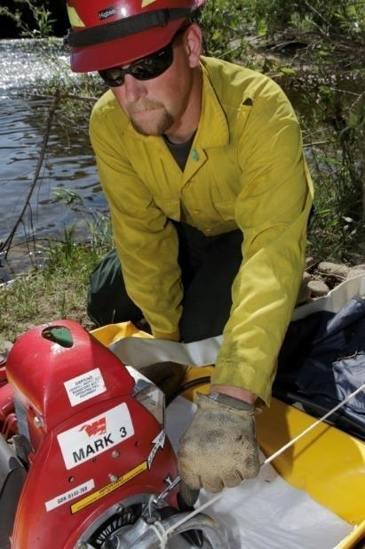
Operate and Maintain Pump
Grease pump head.
Tighten loose nuts and bolts.

Slide 53
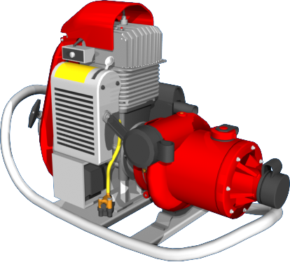
Operate Pump
Listen to pump
Lugging
Rapid rpms
Sputtering
Click on the sound icon to play audio.

Slide 54
Sputter
Sputtering may indicate a carburetor problem.
Significant elevation change may cause carburetor to not work correctly (fuel/air mixture problems).

Slide 55
Pump Carburetor Adjustment
CONSULT WITH YOUR SUPERVISOR OR FOLLOW LOCAL POLICY, OR BOTH REGARDING ADJUSTMENT OF CARBURETOR.

Slide 56
Do not adjust the low idle screw.
When pump’s engine is warm, run at full throttle.
Slowly turn high idle screw until maximum rpm is reached and passed.
Turn high idle screw the opposite direction until maximum rpm is reached again.
Turn screw counter clockwise ¼ of a turn to obtain both maximum rpm and proper engine lubrication.
Click the screen to play the video clip.

Slide 57
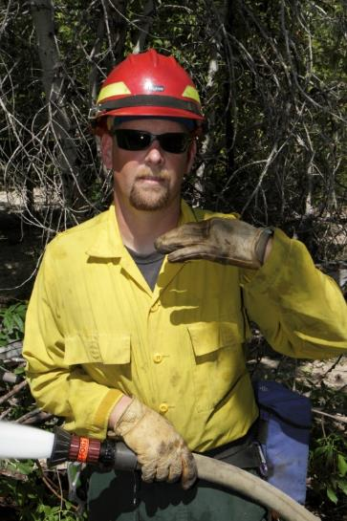
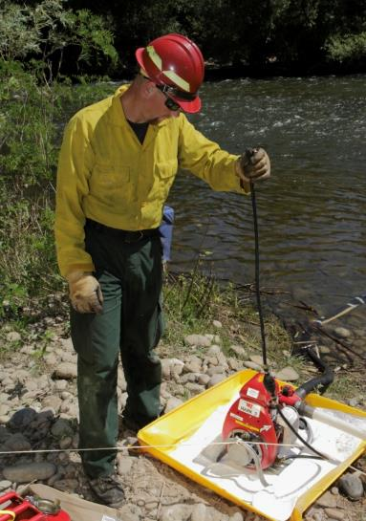
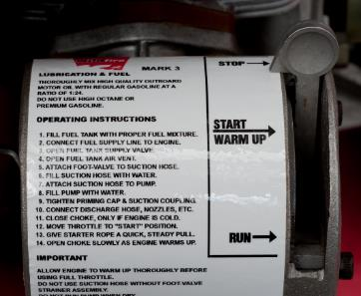
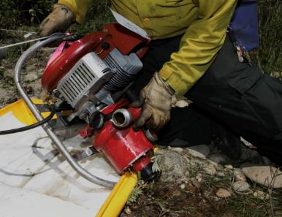
Shutdown Pump
1
3
Communicate with nozzle operator.
Drain fuel line.
2
4
Move throttle lever to “stop” position.
Drain pump head (in freezing conditions).

Slide 58
Troubleshooting Pump Problems
Click the video window to play the video clip.

Slide 59
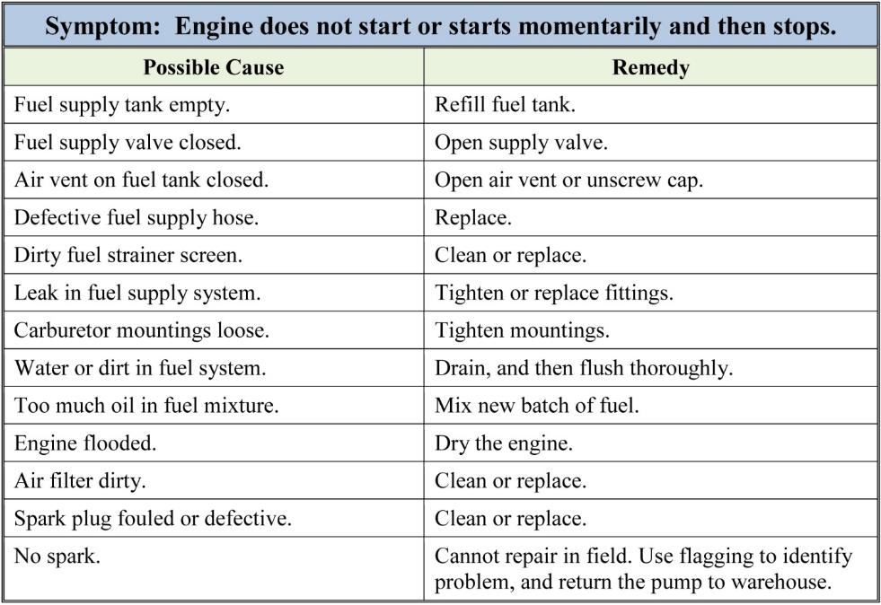
Troubleshooting – Symptoms and Remedies

Slide 60
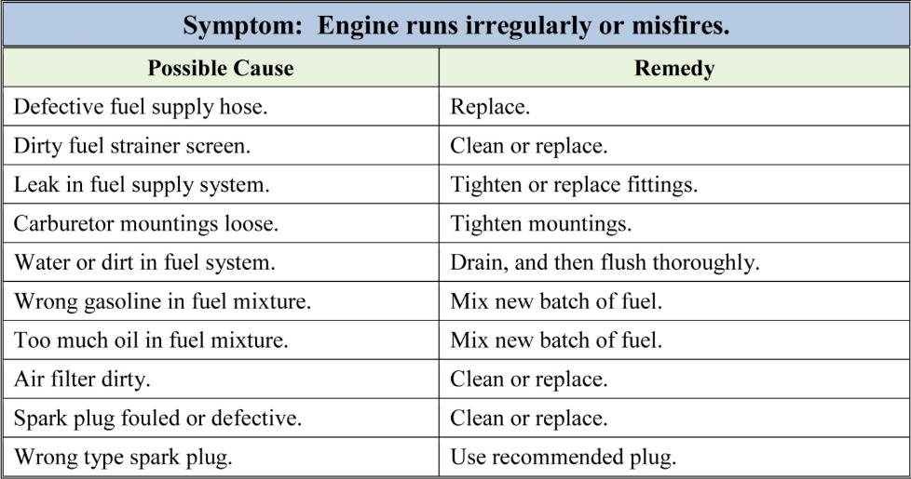
Troubleshooting – Symptoms and Remedies

Slide 61
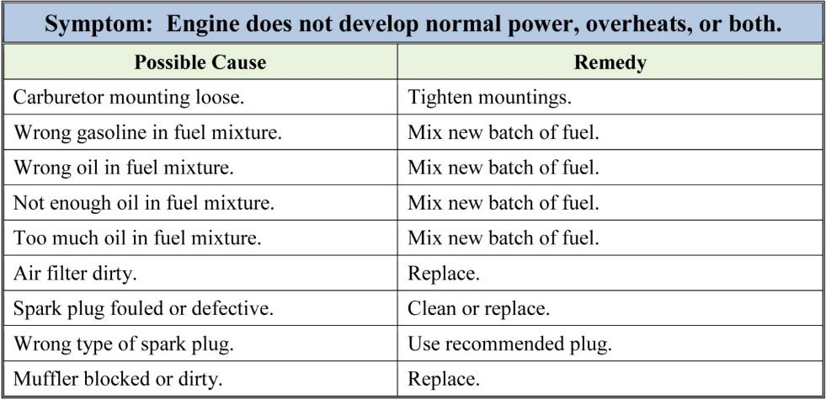
Troubleshooting – Symptoms and Remedies

Slide 62
Troubleshooting – Symptoms and Remedies

Slide 63
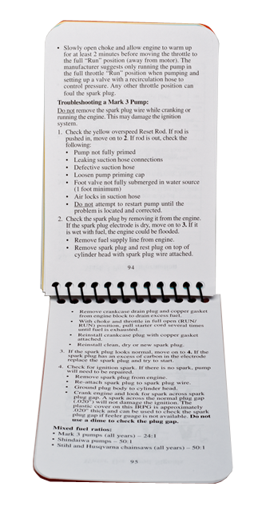
Troubleshoot: Step-by-Step Process Using the IRPG

Slide 64
S-211
Portable Pumps and Water Use
Unit 3 - Responsibilities
Slide 3 - 64

Slide 65
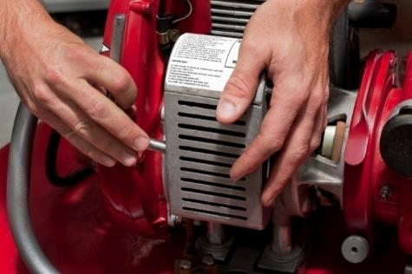
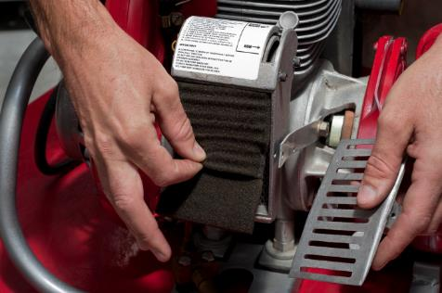
Troubleshooting – Check Air Filter
1
2
3
4
5

Slide 66
Troubleshooting – Broken Starter Assembly
1
2
Remove starter housing.
Wrap piece of rope or cord around starter assembly, and pull to start pump.

Slide 67
Identify Problems With Flagging

Slide 68
nozzle responsibilities

Slide 69
Select Nozzle(s)
Twin tip nozzles
Adjustable barrel nozzles
Sprinklers

Slide 70
Apply Water
Straight stream
Fire too hot to get close
Fire confined to small area
Reach long distance (snags, treetops, hot roots or beds)
Fog or spray
Hot spotting, wet lining, direct attack, mop up
Close work
Fire covers large area
Smaller volume of water is required
Slide 3 - 70

Slide 71
Guidelines for Applying Water
Approach fire with charged hose.
Aim at base of flame and use sweeping motion.

Slide 72
Guidelines for Applying Water
Avoid excessive water pressure.
Watch for flare-ups.
Conserve water.

Slide 73
Straight stream or fog/spray?
1
2
3
4

Slide 74
Operation and Maintenance
Open and close nozzles slowly to prevent water hammer.

Slide 75
Operation and Maintenance
Unclog nozzle tips.

Slide 76
Communication
Communicate up and down the hose lay to know how many nozzles can be open at a time.
Hose lay may have 15 laterals, but pump can only support 3 or 4 nozzles being open simultaneously.

Slide 77
Hose Lay Responsibilities

Slide 78
Set Up Hose Lay – Simple Hose Lay

Slide 79
Set Up Hose Lay – Progressive Hose Lay

Slide 80
Maintain and Retrieve Hose Lay
Replace protective caps on accessories and male hose ends.
Replace broken hose and check for kinked hose.

Slide 81
Maintain and Retrieve Hose Lay
Keep hose line out of hot spots.
Use accepted method of rolling hose.
Properly store hose in a safe location.

Slide 82
Setting up Multiple pump systems

Slide 83
Series Pumping
Set up Pump 1.
Set up Pump 2.
Double check all appliances.
Start Pump 1.
Start Pump 2.
Monitor fuel levels.
Shut down:
Open check and bleeder on Pump 2.
Slow down Pump 2 to idle.
Slow down Pump 1 to idle.
After pumps cooled down, turn them off.

Slide 84
Parallel Pumping
Set up two pumps.
Either pump may be started or stopped at any time.
Monitor fuel levels.
Shut down:
Slow down to idle speed to cool off.
Turn off.

Slide 85
Staged Pumping
Setup, operation, and shutdown are the same as using one pump.

Slide 86
Chemicals

Slide 87
Review

Slide 88
Review
1. There is a fuel spill. What should you do?
Answer:
Contain the spill.
Ensure no more fuel is spilled.
Notify supervisor or resource advisor immediately.

Slide 89
Review
What are some risk management issues specific to operating a portable pump and hose lay?
Possible answers:
Wear full PPE
Pump operator needs to wear eye, ear, and hand protection.
Nozzle operator needs to wear eye and hand protection.
Ensure LCES is established and known. Nozzle operator at high risk of injury.
Fuel handling requires additional safety precautions (i.e., no talking on the radio or cell phone).
Follow first aid guidelines.

Slide 90
Review
What are the four components that should be included in the design of a delivery system?
Possible answers:
Pump configuration
Hose lay design
Nozzle type
Hydraulic calculations, as appropriate

Slide 91
Review
Critique this pump set up:
Possible answers:
Pump and fuel can in one berm; should be in separate berms.
Pump and fuel can are not secured.
Muffler on pump facing fuel can.

Slide 92
Review
When fueling or refueling, what are safety procedures the pump operator should follow?
Possible answers:
Wear full PPE, including eye, and hand protection.
When pouring fuel or mixing gas with oil, do it over a containment berm.
Shut down pump before opening fuel can (i.e., to check fuel level).
Never operate a radio or electronic device when working with fuel.

Slide 93
Review
When you start the pump, what can you do to prevent flooding the engine?
Possible answer:
After engine “pops,” don’t pull rope with choke in start position.

Slide 94
Review
You hear the pump lugging; what could be the problem?
Possible answer:
Pump is running out of fuel.
Nozzle shut down.
Hydraulic or mechanical problems.

Slide 95
Review
You hear the pump having rapid rpms. What could be the problem?
Possible answer:
Pump lost its prime.
Broken discharge hose.
Broken suction hose.
Open nozzle.

Slide 96
Review
What could cause the pump to lose its prime?
Answer:
Suction hose connections are leaking.
Suction hose is defective.
Priming cap is loose.
Foot valve not fully submerged in water source.

Slide 97
Review
What can a pump operator do to prevent pump cavitation?
Answer:
Keep strainer clean and free of debris.
Locate pump as close to water source as practical.
Ensure adequate water supply.
Ensure diameter of suction hose is accurate.

Slide 98
Review
What can a pump and nozzle operator do to prevent water hammer?
Answer:
Slowly close valves and nozzles.
Slightly crack open nozzles at all times.
Protect hoses from being driven over.

Slide 99
Review
In what situations would it be advantageous for the nozzle operator to use the straight stream?
Answer
Fire is too hot to get close.
Fire is confined to small area.
A lot of pressure is needed to reach long distance (snags, tree tops, hot roots or beds).

Slide 100
Review
In what situations would it be advantageous for the nozzle operator to use the fog/spray?
Answer:
Hot spotting, wet lining, direct attack, and mop up.
Close work is needed.
Fire covers a larger area.
A smaller volume of water is required to put out the fire or water conservation is necessary.

Slide 101
Review
What are some general guidelines for applying water?
Answer:
Approach fire with charged hose.
Aim at base of flame and maintain water stream in sweeping motion.
Avoid excessive water pressure.
Conserve water.
Watch for flare-ups.

Slide 102
Review
What are some general guidelines for maintaining and retrieving hoses?
Answer:
Replace protective caps on accessories and male hose ends.
Be sure female ends have a gasket.
Replace broken hose.
Check for kinked hose.
Keep hose line out of hot spots.
Use accepted method of rolling hose when retrieving.
Properly store hose in a safe location.

Slide 103
Objectives
Given scenarios and photos, identify risk management, fuel handing, and environmental concerns.
Identify methods to prevent cavitation and water hammer.
List the four components that should be included in the design of a portable water delivery system.
Given photos, critique a portable pump setup.

Slide 104
Objectives
Identify how to prevent the engine from flooding when starting the pump.
Identify how to troubleshoot common problems with portable pumps.
Identify how to select nozzles and apply water to achieve tactical objectives.
List general guidelines for maintaining and retrieving hoses.

