Slide 1
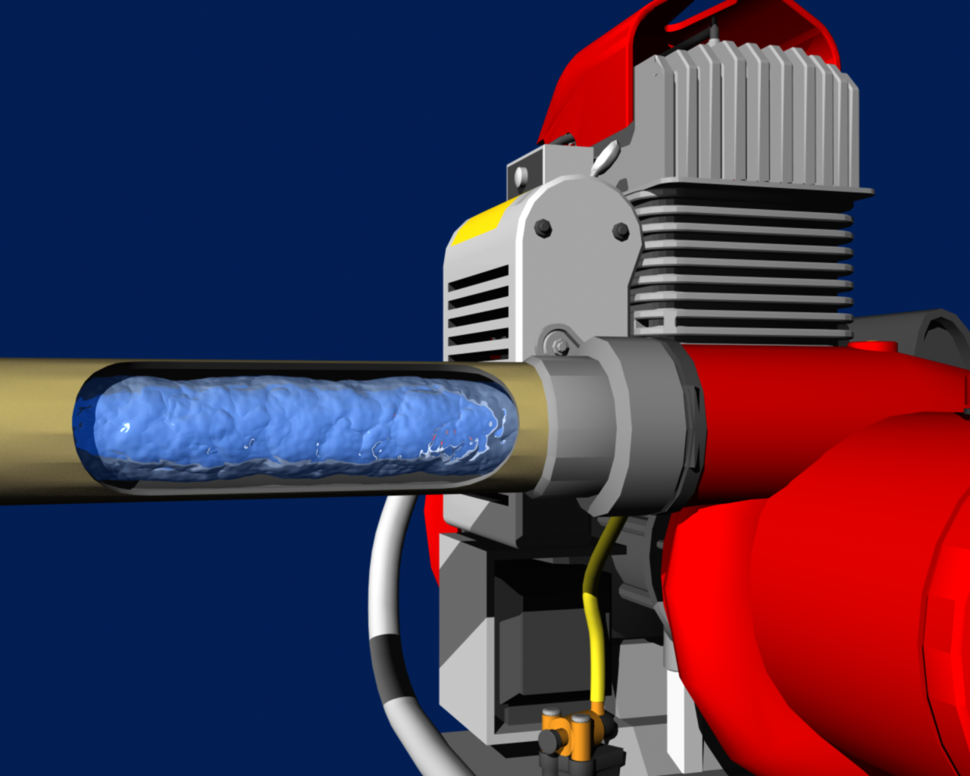
System Design and Hydraulics
S-211
Portable Pumps and Water Use
Unit 4
Unit 4 – System Design and Hydraulics
Slide 4 - 1

Slide 2
Words of Experience
Click icon to hear firefighter story about pumps.

Slide 3
Objectives
List one reason it is important for a pump and nozzle operator to have a basic understanding of hydraulics.
Given scenarios, determine flow and pump discharge pressure, and select appropriate pump(s).

Slide 4
Objectives
Given scenarios, draw a schematic of the design of a water delivery system, and troubleshoot the delivery system.
Given scenarios, determine whether parallel hose lay, series pumping, or parallel pumping would be the best option.

Slide 5
Introduction

Slide 6
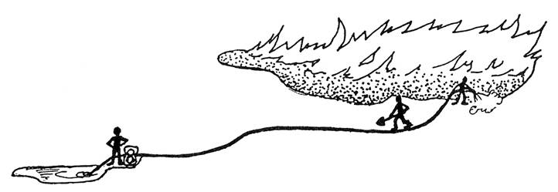
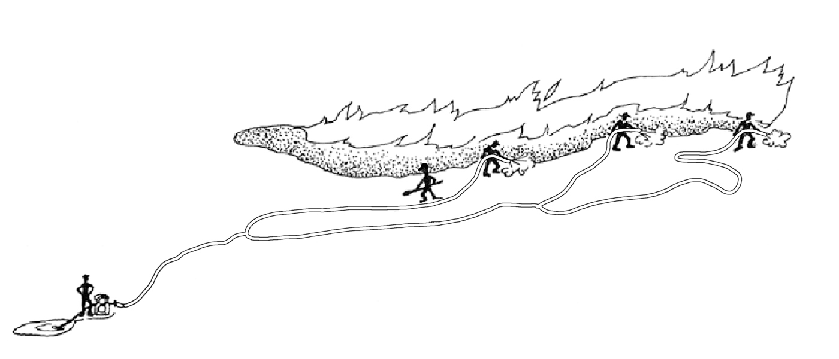

Slide 7
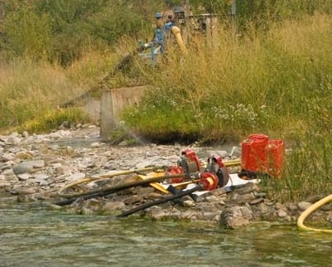
How does the crew boss, squad boss, or pump operator determine….
What pumping configuration(s) will work?
What hose lay design will work?
What type of nozzle(s) to use?

Slide 8
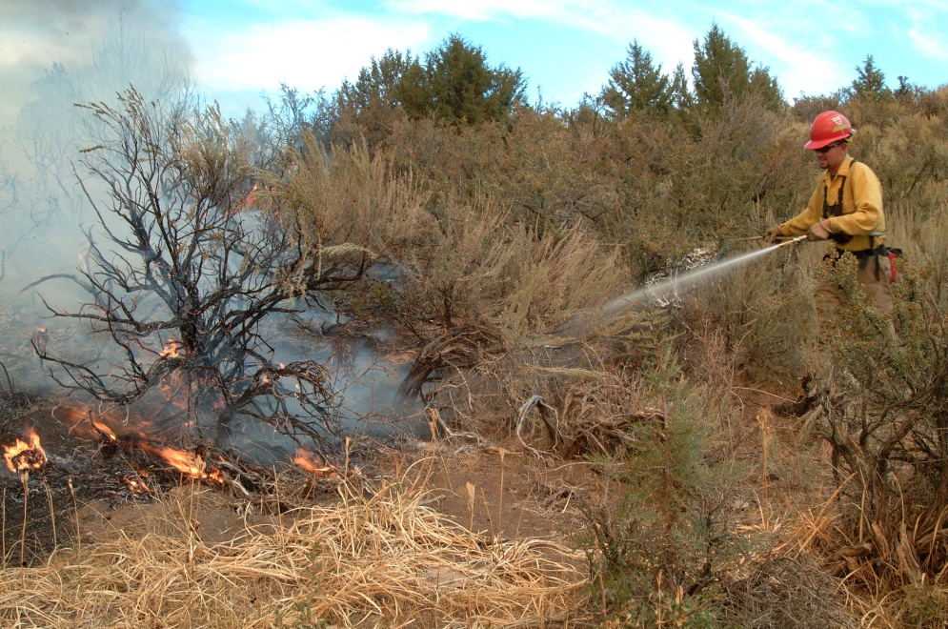
Making Decisions
Trial and error (not always the best way)
Planning ahead (reduces guesswork)

Slide 9
Hydraulics is the science and engineering that deals with fluids at rest and in motion.

Slide 10
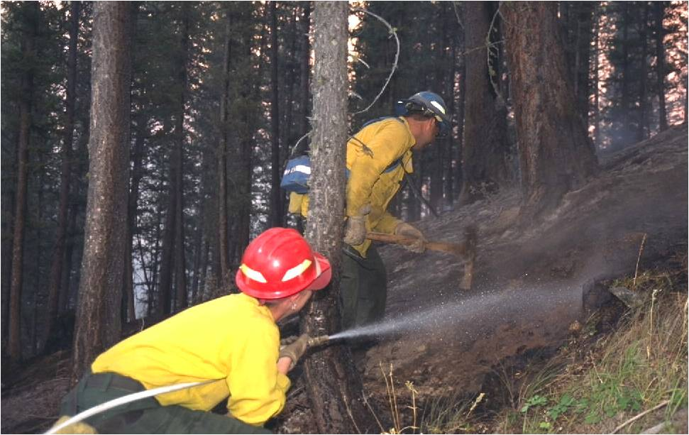
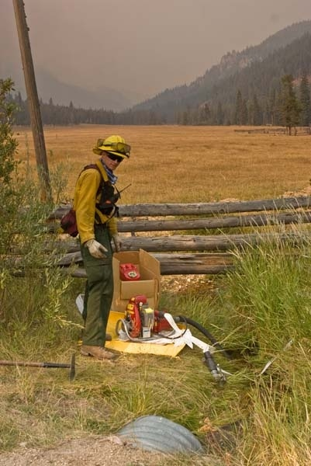
Why is hydraulics important?
To ensure proper amount of water and pressure is delivered to the nozzle(s).
To determine equipment needed, keep it working, and prevent damage.
To design and troubleshoot the water delivery system.
To help ensure a safe work environment.

Slide 11
Three-step process

Slide 12
Step 1 – Determine flow rate (gpm).
Step 2 – Calculate Pump Discharge Pressure (psi).
Step 3 – Determine what types of pumps are capable of providing flow and PDP.

Slide 13
hose lays with no laterals

Slide 14
Three-Step Process
Step 1 – Determine flow rate.
Step 2 – Calculate Pump Discharge Pressure (PDP).
Step 3 – Determine what types of pumps are capable of providing flow and PDP.

Slide 15
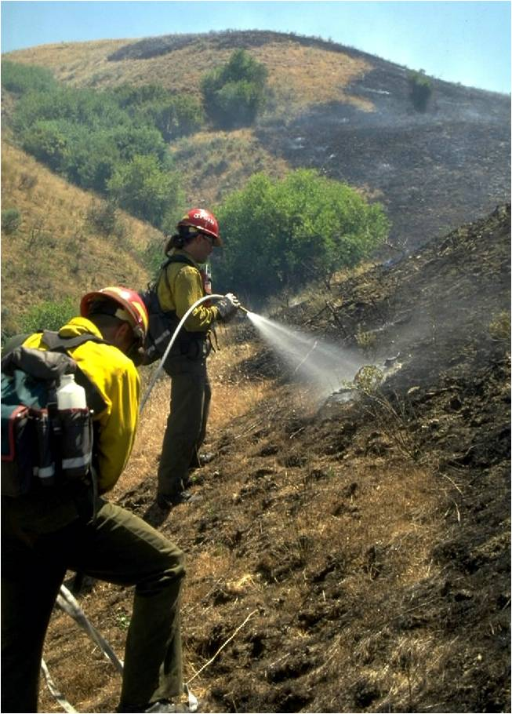
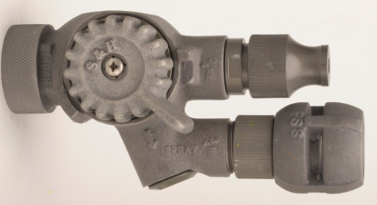
Step 1 – Determine Flow Rate
The type of nozzle(s) on the hose lay determines flow rate, for example:
Twin Tip
Adjustable Barrel

Slide 16
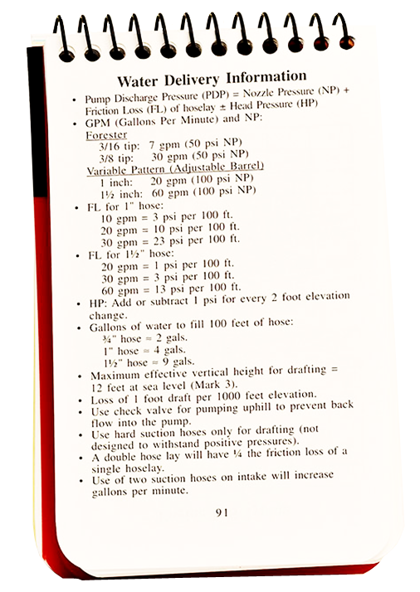
Step 1 – Determine Flow Rate
Refer to IRPG for flow rates of commonly used nozzles.

Slide 17
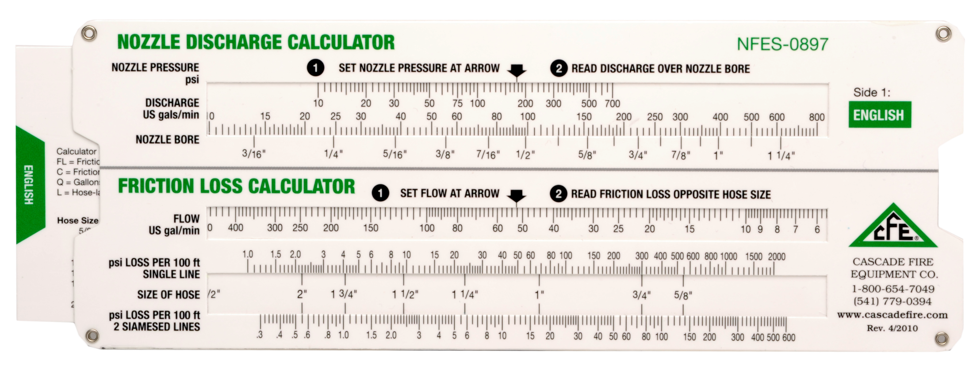
Step 1 – Determine Flow Rate
Click on the calculator image above to launch the Interactive Calculator application.
If for some reason the link is broken, locate the file named “Calculator_gui.exe,” and double click on it to start.

Slide 18
Practice
What is the flow rate from a 3/8" tip at 50 psi?
Answer: 30 gpm

Slide 19
Three Step Process
Step 1 – Determine flow rate.
Step 2 – Calculate Pump Discharge Pressure (PDP).
Step 3 – Determine what types of pumps are capable of providing flow and PDP.

Slide 20
NP ± HP + FL = PDP
NP = Nozzle Pressure
HP = Head Pressure
FL = Friction Loss
PDP = Pump Discharge Pressure

Slide 21
NP ± HP + FL = PDP
Nozzle Pressure (NP) = Pressure (psi) the nozzle is designed to operate at most efficiently.
NP
Click on the image to play animation.

Slide 22
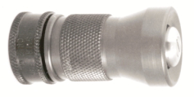
NP ± HP + FL = PDP
Twin tip nozzle – 50 psi
Adjustable barrel nozzle – 100 psi

Slide 23
NP ± HP + FL = PDP
Refer to IRPG for nozzle pressures.

Slide 24
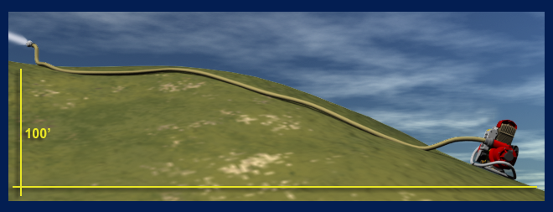
NP ± HP + FL = PDP
Head Pressure (HP) = Pressure (psi) exerted by a column of water.
Click on the image to play animation.

Slide 25
NP ± HP + FL = PDP
±HP | = | Number of feet in elevation change from pump to nozzle | ÷ | 2 psi/1'
Level ground: HP = 0.
Uphill: Add HP.
Downhill: Subtract HP.

Slide 26
NP ± HP + FL = PDP
General Rule: HP is 1/2 the elevation rise or fall.

Slide 27
Practice
The nozzle is 250' (elevation change) uphill from the pump. What is the head pressure?
Answer: +125 psi
The nozzle is 100' (elevation change) downhill from the pump. What is the head pressure?
Answer: -50 psi
The nozzle is 250' (elevation change) downhill from the pump. What is the head pressure?
Answer: -125 psi

Slide 28
NP ± HP + FL = PDP
Friction Loss (FL) = Loss of pressure due to water turbulence and resistance along the inside wall of the hose.
Click on the image to play animation.

Slide 29
NP ± HP + FL = PDP
Why is friction loss important?
The pump has to overcome the loss of pressure (from friction in the hose lay) to provide adequate pressure to the nozzle.

Slide 30
NP ± HP + FL = PDP
FL per 100' section of hose lay | x | Number of 100' sections of hose lay | = | Total FL for hose lay
To determine FL per 100' section of hose lay you will need to know flow and hose diameter; and then refer to the the IRPG or friction loss calculator.

Slide 31
NP ± HP + FL = PDP
What is the total friction loss for 100' of 1" hose with flow rate of 30 gpm?
Answer: 23 psi
FL per 100' section of hose lay | x | Number of 100' sections of hose lay | = | Total FL for hose lay

Slide 32
Practice
What is total FL for 300' of 1½" hose @ 30 gpm?
FL per 100' section of hose lay | x | Number of 100' sections of hose lay | = | Total FL for hose lay
 | x |  | =
3 psi
3
9 psi
100' of 1½"
100' of 1½"
100' of 1½"
3 psi
3psi
3 psi
Flow = 30 gpm

Slide 33
NP ± HP + FL = PDP
FL per 100' section of hose lay | x | Number of 100' sections of hose lay | = | Total FL for hose lay
Click on the calculator image above to launch the Interactive Calculator application.
If for some reason the link is broken, just locate the file named “Calculator_gui.exe,” double click on it to start.

Slide 34
Practice
What is total FL for 300' of 1" hose @ 30 gpm?
FL per 100' section of hose lay | x | Number of 100' sections of hose lay | = | Total FL for hose lay
 | x |  | =
23 psi
3
69 psi
100' of 1"
100' of 1"
100' of 1"
23 psi
23psi
23 psi
Flow = 30 gpm

Slide 35
Practice
What is total FL for 300' of ¾" hose @ 30 gpm?
FL per 100' section of hose lay | x | Number of 100' sections of hose lay | = | Total friction loss
100 psi | x | 3 | = | 300 psi
100' of ¾"
100' of ¾"
100' of ¾"
100 psi
100 psi
100 psi
Flow = 30 gpm

Slide 36
Friction Loss Principles
Friction loss principles help explain the RELATIONSHIP between friction loss and flow, hose diameter, and hose length.

Slide 37
Friction Loss Principle:
When FLOW (gpm) decreases, friction loss decreases (when hose diameter is constant).
Click on the image to play animation.

Slide 38
Practice
Flow rate is 40 gpm. What is friction loss in 1" hose?
Answer: 40 psi per 100'
Flow rate is 20 gpm. What is friction loss in 1" hose?
Answer: 10 psi per 100'
Link to Calculator

Slide 39
Friction Loss Principle:
When HOSE DIAMETER INCREASES, friction loss DECREASES.
Click on the image to play animation.

Slide 40
Practice
Flow rate is 30 gpm. What is the friction loss in 1" hose?
Answer: 23 psi per 100'
Flow rate is 30 gpm. What is the friction loss in 1½" hose?
Answer: 3 psi per 100'

Slide 41
Friction Loss Principle:
Longer hose lengths have increased friction loss.
1½" ; 800'; flow = 30 gpm; friction loss = 24 psi
1½" ; 300'; flow = 30 gpm; friction loss = 9 psi

Slide 42
Practice
Flow rate is 20 gpm. What is FL in 100' of 1" hose?
Answer: 10 psi
100' of 1"
FL = 10 psi
Flow = 20 gpm

Slide 43
Practice
Flow rate is 20 gpm.
What is friction loss in 300' of 1" hose?
Answer: 30 psi
100' of 1"
100'of 1"
100' of 1"
FL = 10 psi
FL = 10 psi
FL = 10 psi
Flow = 20 gpm

Slide 44
NP ± HP + FL = PDP
Step 1 – Determine flow rate (gpm).
Step 2 – Calculate Pump Discharge Pressure (psi).
Step 3 – Determine what types of pumps are capable of providing flow and PDP.
PDP = the pressure (psi) required to deliver a specific pressure and flow at the nozzle.

Slide 45
Scenario A
The hose lay has 500' of 1½" hose; one Forester nozzle with a 3/8" tip attached. There is no elevation difference between the nozzle and pump.
Step 1: What is flow rate?
Step 2: What is PDP?
3/8" Tip
500' of 1½"

Slide 46
Scenario A
Link to Calculator
Step 1: Flow rate | = | 30 gpm
Step 2: PDP | = | 65 psi
NP | = | +50 psi
±HP | = | 0 psi
FL | = | +15 psi
PDP | = | 65 psi
Flow = 30 gpm
500' of 1½"
3/8 " Tip
FL = 3 psi
FL = 3 psi
FL = 3 psi
FL = 3 psi
FL = 3 psi

Slide 47
Three Step Process
Step 1: What is flow rate?
Step 2: What is PDP?
Step 3: Identify types of pumps capable of providing flow and PDP.

Slide 48
Scenario A
Link to Calculator
Step 1: Flow rate | = | 30 gpm
Step 2: PDP | = | 65 psi
Step 3: Identify Pump(s) |  | Mark 3; Wick 375
Refer to Pump Performance Chart
Flow = 30 gpm
500' of 1½"
3/8" tip
FL = 3 psi
FL = 3 psi
FL = 3 psi
FL = 3 psi
FL = 3 psi

Slide 49
Scenario B
The hose lay has 1000' of 1½" hose; one Forester nozzle with 3/8" tip attached. Nozzle is located 50' above the pump.
Step 1: What is flow rate?
Step 2: What is PDP?
Step 3: Identify types of pumps capable of providing flow and PDP.
3/8" tip
50'
1000' of 1½"

Slide 50
Scenario B
Link to Calculator
Step 1: Flow rate | = | 30 gpm
Step 2: PDP | = | 105 psi
Step 3: Identify pump(s) |  | Mark 3; Wick 375
NP | = | +50 psi
+/-HP | = | +25 psi
FL | = | +30 psi
PDP | = | 105 psi
Refer to Pump Performance Chart
Flow = 30 gpm
3/8 " tip
FL = 3 psi
1000' of 1½"
FL = 3 psi
FL = 3 psi
50'
FL = 3 psi
FL = 3 psi
FL = 3 psi
FL = 3 psi
FL = 3 psi
FL = 3 psi
FL = 3 psi

Slide 51
Scenario C
The hose lay has 900' of 1" hose; one Forester nozzle with ¼" tip attached. Nozzle is located 150' above the pump.
Step 1: What is flow rate?
Step 2: What is PDP?
Step 3: Identify types of pump capable of providing flow and PDP.
¼" tip
900' of 1"
150'

Slide 52
Scenario C
Link to Calculator
Step 1: Flow rate | = | 13 gpm
Step 2: PDP | = | 161 psi
Step 3: Identify pump(s)
NP | = | +50 psi
±HP | = | +75 psi
FL | = | +36 psi
PDP | = | 161 psi
Refer to Pump Performance Chart
Flow = 13 gpm
1/4" tip
FL = 4 psi
FL = 4 psi
150'
900' of 1"
FL = 4 psi
FL = 4 psi
FL = 4 psi
FL = 4 psi
FL = 4 psi
FL = 4 psi
FL = 4 psi

Slide 53
Scenario D
The hose lay has 1200' of 1½" hose; one 60 gpm adjustable barrel nozzle. Nozzle is located 180' below the pump.
Step 1: What is flow rate?
Step 2: What is PDP?
Step 3: Identify pumps capable of providing flow and PDP.
1200' of 1½"
Adjustable barrel nozzle
180'

Slide 54
Scenario D
Link to Calculator
Step 1: Flow rate | = | 60 gpm
Step 2: PDP | = | 166 psi
Step 3: Identify pump(s)
NP | = | +100 psi
±HP | = | -90 psi
FL | = | +156 psi
PDP | = | 166 psi
Refer to Pump Performance Chart
Flow = 60 gpm
FL = 13 psi
1200' of 1½"
Adjustable barrel nozzle
FL = 13 psi
FL = 13 psi
180'
FL = 13 psi
FL = 13 psi
FL = 13 psi
FL = 13 psi
FL = 13 psi
FL = 13 psi
FL = 13 psi
Link to Calculator
FL = 13 psi
FL = 13 psi

Slide 55
hose lay (no laterals) with different size hoses

Slide 56
When a hose lay has different size hoses, how does the step-by-step process change?
Step 1: Flow rate (same process)
Step 2: PDP
NP (same process)
HP (same process)
Friction loss (different process)
Friction loss is calculated for each hose size and then added together to get total friction loss.
Step 3: Identify pump (same process)

Slide 57
Scenario E
The hose lay has 500' of 1½" hose, which is reduced down to 100' of 1" hose. One Forester nozzle with 3/8" tip attached. There is no elevation difference between the pump and the nozzle.
Step 1: What is flow rate?
Step 2: What is PDP?
Step 3: Identify pumps capable of providing flow and PDP.
3/8" tip
500' of 1½"
100' of 1"

Slide 58
Scenario E
Link to Calculator
Step 1: Flow rate | = | 30 gpm
Step 2: PDP | = | 88 psi
Step 3: Identify pump(s)
NP | = | +50 psi
±HP | = | 0 psi
FL | = | +38 psi
PDP | = | 88 psi
Refer to Pump Performance Chart
Flow = 30 gpm
3/8" tip
500' of 1½"
100' of 1"
FL = 15 psi
Link to Calculator
FL = 23 psi

Slide 59
hose lay with laterals

Slide 60
When a hose lay has laterals, how does the step-by-step process change?
Step 1: Flow rate (slightly different process)
Calculate flow in all laterals to determine flow rate in each section of the trunk.
Step 2: PDP
Nozzle pressure (same process)
Head pressure (same process)
Friction loss (slightly different process)
Calculate FL for only 1 lateral.
Calculate FL for each section of the trunk.
Step 3: Identify pumps (same process)

Slide 61
Scenario F
The hose lay has 300' of 1½" hose with a gated wye that goes into two 100' 1" laterals, each with ¼" tip. There is no elevation difference between the pump and nozzle.
Step 1: What is flow rate?
Step 2: What is PDP?
Step 3: Identify pumps capable of providing flow and PDP.
1/4" tip
100' of 1"
300' of 1½"
100' of 1"
1/4" tip

Slide 62
Scenario F
Link to Calculator
Step 1: Flow rate Lateral A Lateral B Trunk | = = = | 13 gpm 13 gpm 26 gpm
Step 2: PDP Calculate FL for only 1 lateral and for each section of the trunk. | = | 60 psi
Step 3: Identify Pump(s)
Calculate flow in all laterals to determine flow rate in each section of the trunk.
NP | = | +50 psi
±HP | = | 0 psi
FL lateral A | = | +4 psi
FL trunk | = | +6 psi
PDP | = | 60 psi
Refer to Pump Performance Chart
1/4" tip
Lateral A flow – 13 gpm
Lateral A FL = 4 psi
100’ of 1”
300' of 1½"
Trunk flow – 26 gpm
100’ of 1"
Trunk FL = 6 psi
Lateral B flow– 13 gpm
1/4" tip

Slide 63
Scenario G
The hose lay has 700' of 1½" hose until the first lateral. Then there is another 100' of 1½" hose to the second lateral and another 100' of 1½" hose to the third lateral. All laterals have 100' of 1" hose and ¼" tips. There is no elevation difference between the pump and nozzle.
Step 1: What is flow rate?
Step 2: What is PDP?
Step 3: Identify pumps capable of providing flow and PDP.
1/4" tip
1/4“ tip
1/4" tip
100‘ of 1"
100' of 1"
100' of 1"
700' of 1½"
100'of 1½"
100' of 1½"

Slide 64
Scenario G
Link to Calculator
Step 1: Flow rate Lateral A Lateral B Lateral C Trunk Z Trunk Y Trunk X | = = = = = = | 13 gpm 13 gpm 13 gpm 13 gpm 26 gpm 39 gpm
Step 2: PDP | = | 91 psi
Step 3: Identify pump(s)
Calculate flow in all laterals to determine flow rate in each section of the trunk. These flow rates will also be used to determine friction loss.
NP | = | 50 psi
±HP | = | 0 psi
FL lateral C | = | 4 psi
FL trunk Z | = | 0 psi
FL trunk Y | = | 2 psi
FL trunk X | = | 35 psi
PDP | = | 91 psi
Refer to Pump Performance Chart
1/4" tip
1/4" tip
1/4" tip
Lateral B
Lateral A
100' of 1"
Lateral C
700' of 1½"
100' of 1"
100' of 1"
Trunk X
100' of 1½"
100' of 1½"
Trunk Y
Trunk Z

Slide 65
advanced water delivery Systems

Slide 66
Scenario H
Step 1: Flow rate | = | 60 gpm
Step 2: PDP | = | 286 psi
Step 3: Identify pumps |  | No pumps
NP | = | 100 psi
±HP | = | +30 psi
FL | = | 156 psi
PDP | = | 286 psi
60 gpm adjustable barrel nozzle
1200' of 1½"
60'

Slide 67
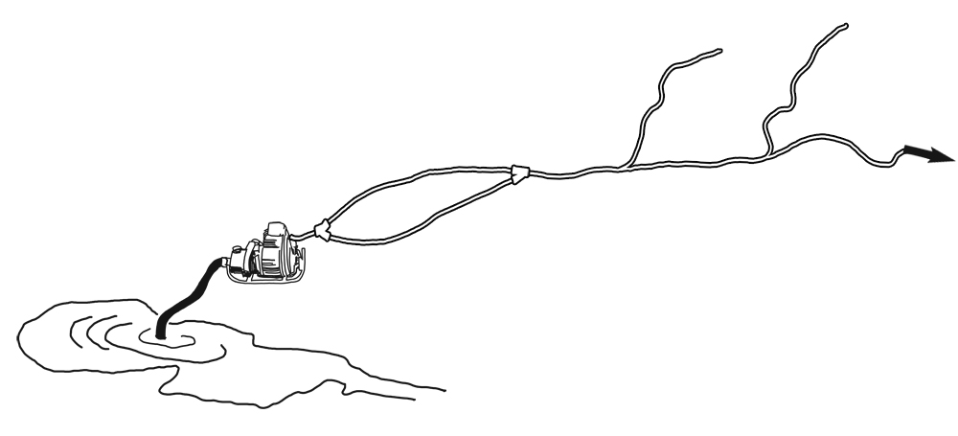
Parallel Hose Lay
What is the main advantage of a parallel hose lay?
What is a general guideline to determine the friction loss for a parallel hose lay?

Slide 68
Will parallel hose lay work?
 |  | Scenario H | Scenario H and Parallel Hose Lay Design
Step 1: Flow rate | = | 60 gpm | 60 gpm
Step 2: PDP | = | NP = +100 psi HP = +30 psi FL = +156 psi PDP = 286 psi | NP = +100 psi HP = +30 psi FL = +39 psi PDP = 169 psi
Step 3: Identify pump |  | No pumps | Mark 3; Wick 375.
Refer to Pump Performance Chart
The parallel hose lay reduces friction loss.
60'

Slide 69
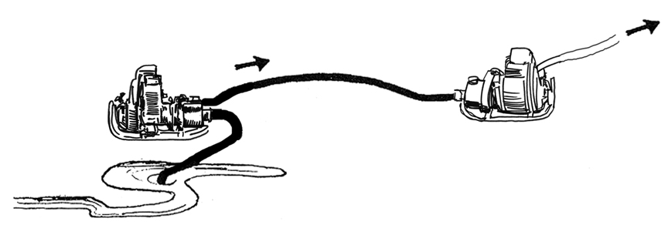
Series Pumping
Increases pressure but not flow.
When using series pumping, pump pressures are combined, but flow stays the same.
For Example:
1 Mark 3 pump will produce 60 gpm at 170 psi. If another Mark 3 pump is added in series, the combination will produce 60 gpm at 340 psi.

Slide 70
Will series pumping work?
 |  | Scenario H | Series Pumping and Scenario H
Step 1: Flow rate | = | 60 gpm | 60 gpm
Step 2: PDP | = | NP = +100 psi HP = +30 psi FL = +156 psi PDP = 286 psi | NP = +100 psi HP = +30 psi FL = +156 psi PDP = 286 psi
Step 3: Identify pump |  | No pumps alone can provide flow and PDP. | Use two pumps in series (Mark 3; Wick 375).
Refer to Pump Performance Chart
The Mark 3 can produce 60 gpm at 170 psi. If two Mark 3 pumps are set up as series pumping, they can provide 60 gpm at 340 psi. Since this hose lay requires 60 gpm at 286 psi – series pumping works.
60 gpm
60'
1200' of 1½"

Slide 71
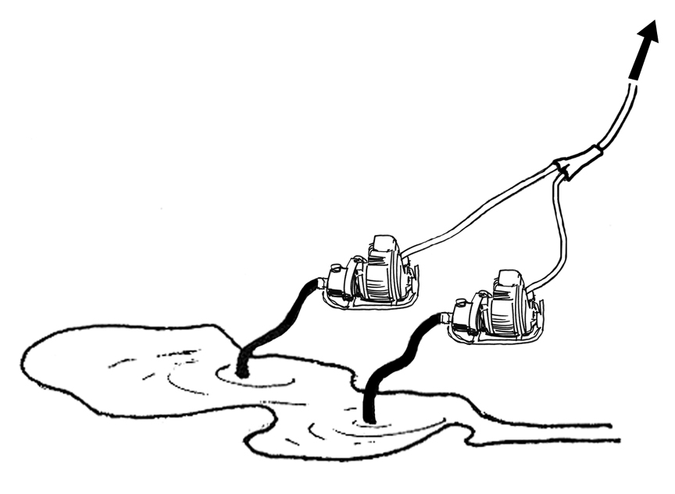
Parallel Pumping
General rule - doubles the flow but doesn’t increase pressure.
When pumps are used in parallel, flow from each pump is added together with no change in pressure.

Slide 72
Will parallel pumping work?
 |  | Scenario H | Parallel Pumping
Step 1: Flow rate | = | 60 gpm | 60 gpm
Step 2: PDP | = | NP = +100 psi HP = +30 psi FL = +156 psi PDP = 286 psi | NP = +100 psi HP = +30 psi FL = +156 psi PDP = 286 psi
Step 3: Identify pump |  | No pumps alone can provide flow and PDP. | Use two pumps in parallel (Mark 3; Wick 375).
Refer to Pump Performance Chart
With parallel pumping, flow from each pump is added together with no change in pressure. The Mark 3 can produce 30 gpm at 285 psi. If two Mark 3 pumps are set up for parallel pumping then together they can provide 60 gpm at 286 psi. This is also true for the Wick 375 pump.
60 gpm
60'
1200' of 1½"
60’
Slide 4 - 72

Slide 73
Review
Parallel Hose Lay |  | Reduces friction loss in hose lay.
Series Pumping |  | Increases pump performance – by using two pumps to increase pressure.
Parallel Pumping |  | Increases pump performance – by using two pumps to increase flow.

Slide 74
Troubleshooting
the delivery system
from a Hydraulic perspective

Slide 75
Troubleshooting – Factors to Consider
Pump discharge pressure
Nozzle pressure – Change nozzle type, tip size, or both.
Head pressure – Move pump to reduce elevation change.
Friction loss – Reduce friction loss by increasing hose diameter, shortening hose length, using parallel hose lay, and/or reducing flow.
Pump capability
Use a pump with higher performance capability.
Use series pumping system to increase pressure.
Use parallel pumping system to increase flow.

Slide 76
Exercise
Troubleshooting a
Water Delivery System
From a
Hydraulic Perspective

Slide 77
Exercise
Nozzle Pressure | = | +50 psi
Head Pressure | = | +200 psi
Friction Loss | = | +150 psi
PDP |  | 400 psi
FLOW | = | 60 gpm

Slide 78
Designing a Water
delivery system using hydraulic concepts

Slide 79
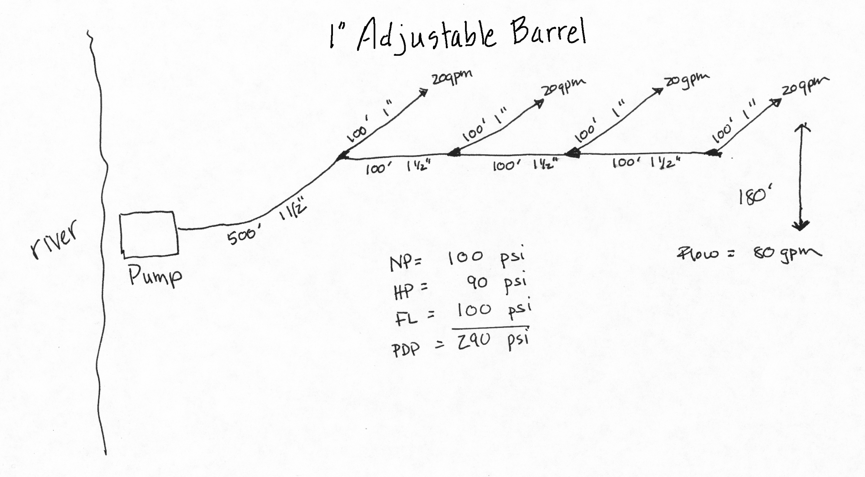
Delivery System Design

Slide 80
Exercise
How to Design a Hydraulically Sound Water Delivery System

Slide 81
Exercise
Your squad is mopping up a ½-acre spot fire burning in heavy slash. There is a 200' elevation change from the pump site (river) to the fire, and the distance is 2000'. The following equipment is available:
2 Mark 3 pumps
2 MK 26 pumps
2500' of 1½" hose
500' of 1" hose
3 Forester nozzles with 3/16" tip
3 adjustable barrel nozzles (1")
Assorted appliances and adapters

Slide 82
Review

Slide 83
1. Why is it important to understand hydraulic principles?
Possible answers:
Ensure proper amount of water is delivered to the nozzle.
Determine appropriate equipment for the job.
Troubleshoot problems with the water delivery system.
Reduce damage to equipment.

Slide 84
2. The hose lay has 500' of 1½" hose, and one Forester nozzle with a 3/8" tip is attached. The nozzle is 30' above the pump.
a) What is flow?
b) What is PDP?
c) Identify pumps capable of providing flow and PDP.
Answer:
a) Flow = 30 gpm
b) PDP = 80 psi
NP = +50 psi
HP = +15 psi
FL = +15 psi
PDP = 80 psi
c) Mark-3 and Wick 375
Link to Calculator

Slide 85
3. What is the definition of pump discharge pressure (PDP)? Where is pump discharge pressure measured?
Answer: PDP is the pressure required to deliver a specific pressure and flow at the nozzle.
PDP is measured at the pump panel.

Slide 86
4. When the nozzle is located uphill from the pump, do you subtract or add head pressure in the PDP formula?
Answer: Add

Slide 87
5. When hose diameter increases, does friction loss increase or decrease?
Answer: Decrease

Slide 88
6. When flow (gpm) decreases, does friction loss increase or decrease?
Answer: Decrease

Slide 89
7. Do longer hose lengths have more or less friction loss than shorter hose lengths (of same diameter)?
Answer: More

Slide 90
8. If there is significant elevation rise from the pump to the nozzle and one pump cannot provide the pressure that is needed, which multiple pump system would most likely solve the problem – series pumping or parallel pumping?
Answer: Series pumping

Slide 91
9. You are filling a drop tank, and it is going slow. You want to increase the flow to speed it up. What pump configuration would you use – series pumping or parallel pumping?
Answer: Parallel pumping

Slide 92
10. What impact do parallel lines have on friction loss – increase friction loss or decrease friction loss?
Answer: Decrease

Slide 93
11. Friction loss needs to be reduced. What options should be considered?
Possible Answers:
Increase hose diameter.
Shorten hose length.
Use a parallel hose lay.
Reduce flow.

Slide 94
Objectives
List one reason it is important for a pump and nozzle operator to have a basic understanding of hydraulics.
Given scenarios, determine flow and pump discharge pressure, and select appropriate pump(s).

Slide 95
Objectives
Given scenarios, draw a schematic of the design of a water delivery system, and troubleshoot the delivery system.
Given scenarios, determine whether parallel hose lay, series pumping, or parallel pumping would be the best option.

