Slide 1
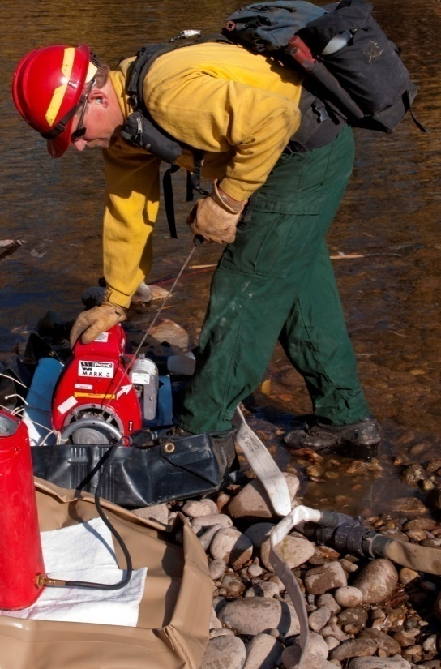
S-211 Portable Pumps and Water Use
UNIT 0

Slide 2
National Wildfire Coordinating Group
NWCG TRAINING BRANCH
Mission:
To develop relevant National Wildfire Coordinating Group training in a cost-effective manner to meet the needs of the wildland fire community.
Vision:
To develop professional training packages which provide a solid training foundation and enhanced training experience to the wildland fire community.
E-mail comments or suggestions pertaining to this or any NWCG course to: BLM_FA_nwcg_evaluation@blm.gov Online: training.nwcg.gov

Slide 3
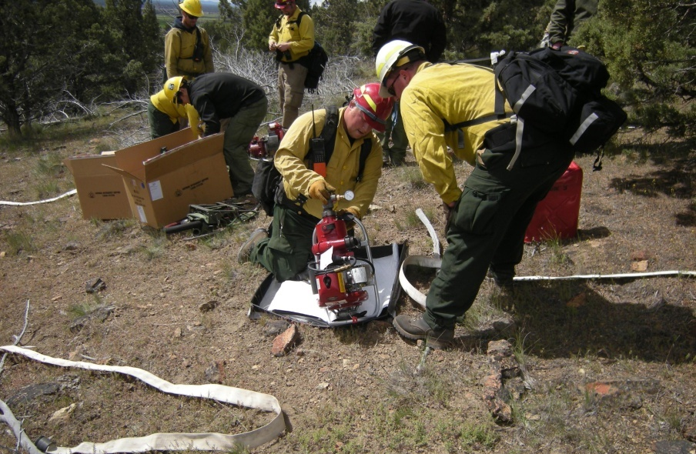
Course Objective
Demonstrate knowledge and skills needed to design, set up, operate, troubleshoot, and shut down portable water delivery systems.

Slide 4
Course Structure
Unit 1 – Portable Water Delivery Systems
Unit 2 – Equipment
Unit 3 – Responsibilities
Unit 4 – System Design and Hydraulics
Unit 5 – Field Exercise

Slide 5
How Students Will Be Evaluated
Students must obtain a minimum score of 70% on the final exam to receive a certificate of completion for the course.
Final exam consists of two parts:
Written exam
Evaluation of student participation during the field exercise

Slide 6
Course Materials
Student Workbook
IRPG
Fire Stream/Nozzle Discharge & Friction Loss Calculator

Slide 7
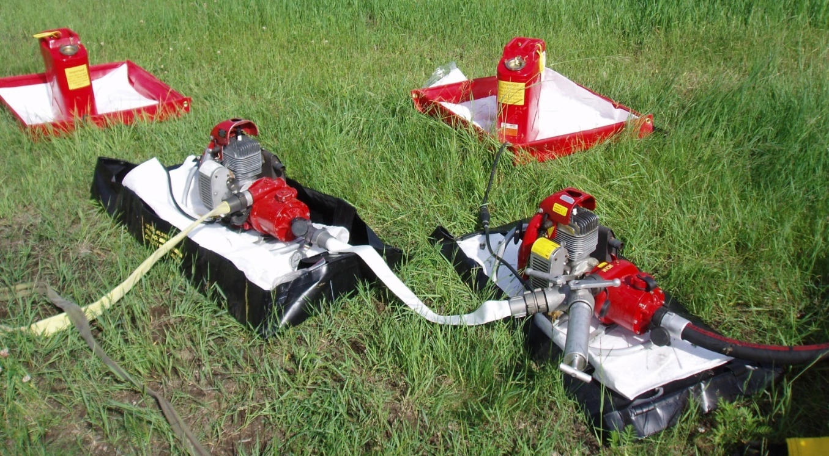
Course Evaluation Forms
Students are expected to complete a course evaluation form at the end of the course.

