Slide 1
S-215 Fire Operations in the Wildland/Urban Interface
Unit 1
Firefighter Safety
in the Interface

Slide 2
Unit Objectives
Describe operating principles and unique safety concerns to firefighters in the interface.
Describe escape routes, temporary refuge areas, and safety zones as they apply to firefighting in the interface.

Slide 3
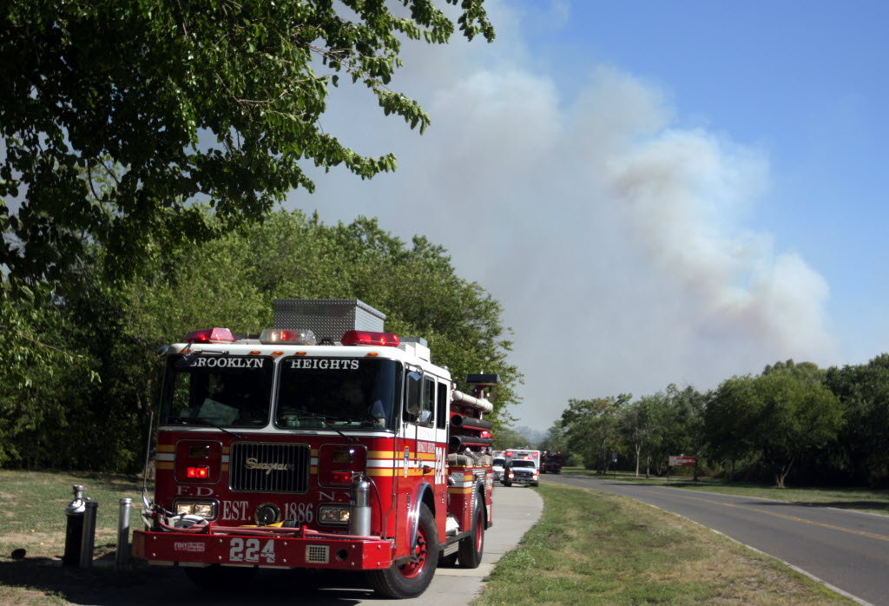
Interface Operating Principles
Firefighter and public safety is the priority.
Defending property and improve-ments is secondary.
Take action only when it is safe to do so.

Slide 4
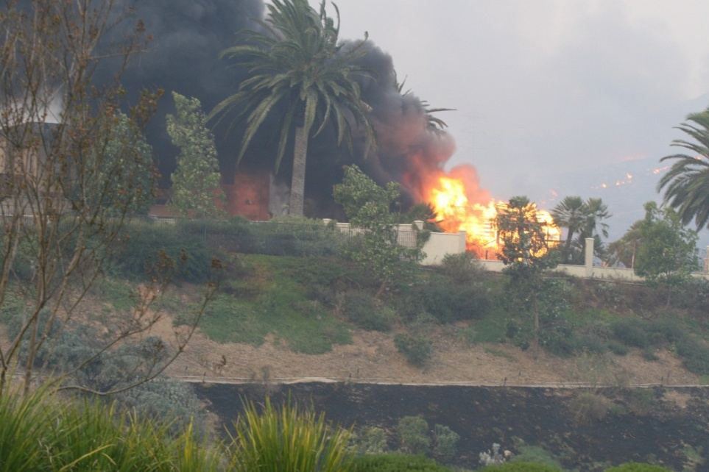
Interface Operating Principles
Each firefighter is responsible for his or her judg- ment and actions.
Every firefighter must have accurate situation awareness (SA).
Communication and information flow is critical.

Slide 5
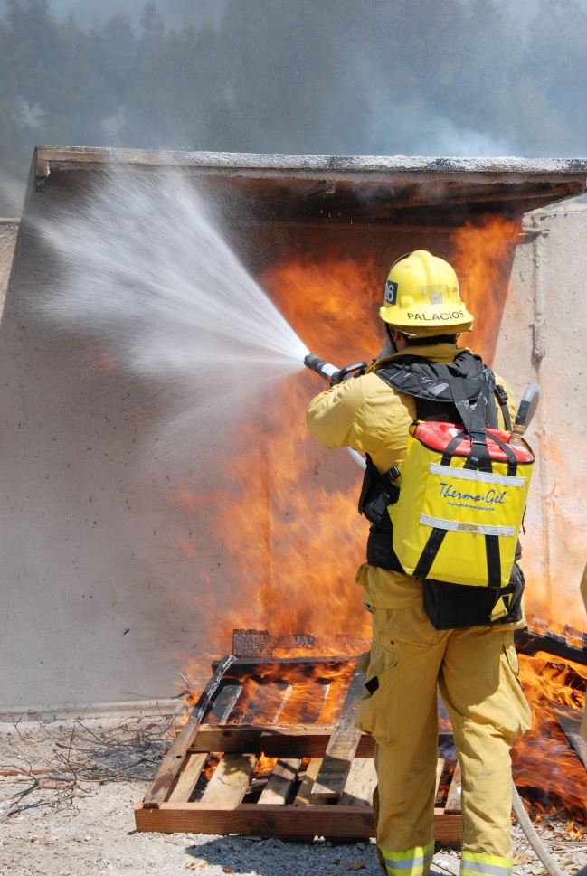
Individual Firefighter Safety in the Interface
Structures are just another fuel type.
Safety cannot be compromised to meet tactical objectives.
Learn to leave and leave to live.

Slide 6
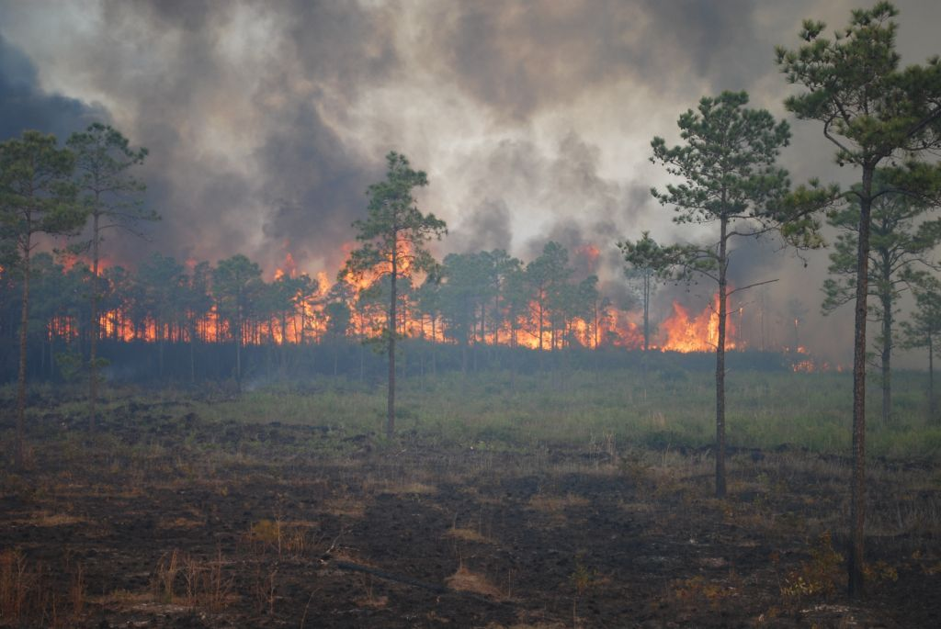
Individual Firefighter Safety in the Interface
Firefighters can be both aggressive in suppressing the fire while maintaining their safety.
Develop accurate SA and update frequently.

Slide 7
Situation Awareness in the Interface
Three Fire Orders
Which ones apply to SA?
Look Up, Look Down, and Look Around Indicators
Risk Management Process

Slide 8
Situation Awareness in the Interface
Every firefighter must understand and recognize limitations to their SA.
Apply your experience, planning, training, and personal judgment to observe, orient, decide, and act in preparation for the worst-case scenario.

Slide 9
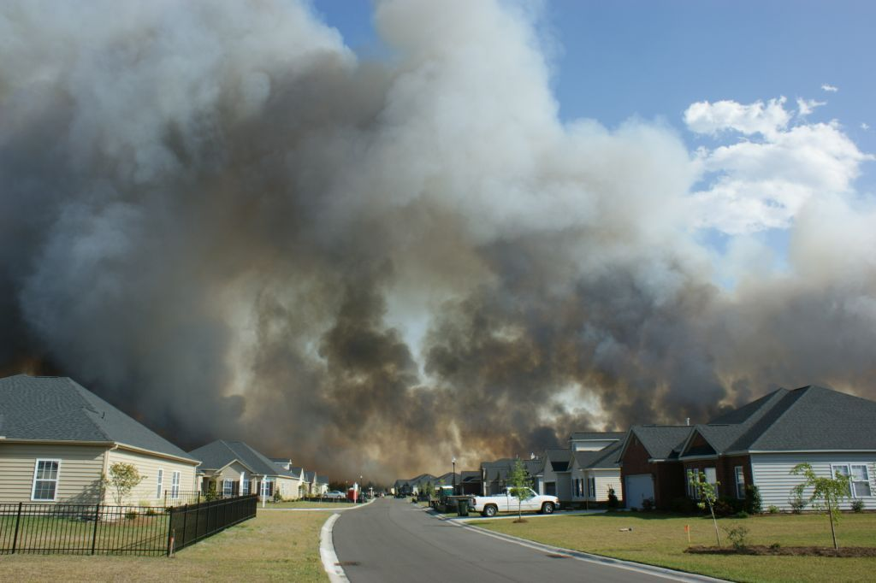
Situation Awareness in the Interface
First three fire orders
Look Up, Look Down, Look Around
Risk Management Process

Slide 10
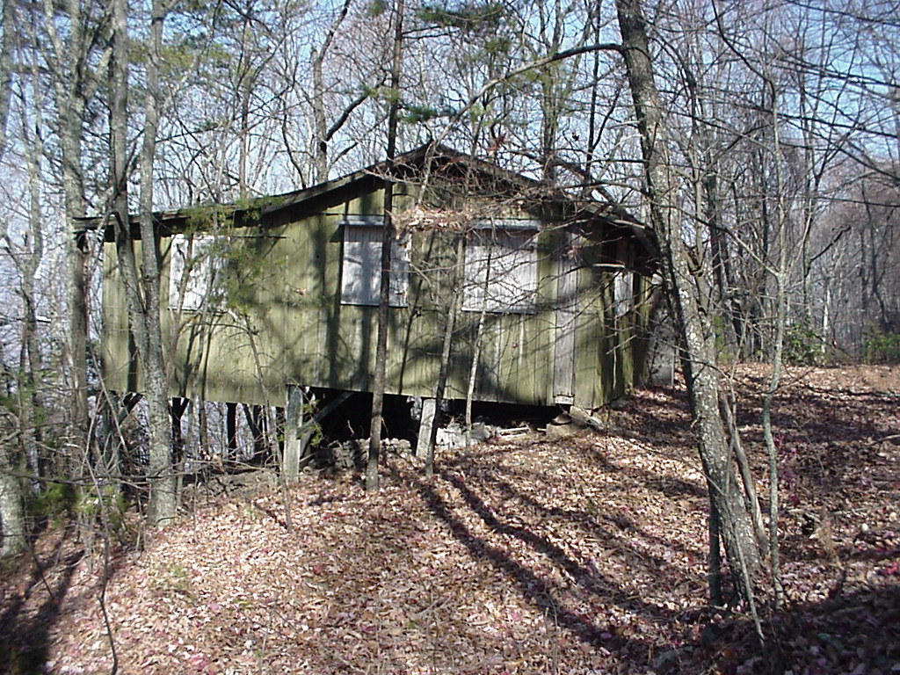
Fire Behavior Prediction
Topography
Fuel Type
Structure Composition

Slide 11
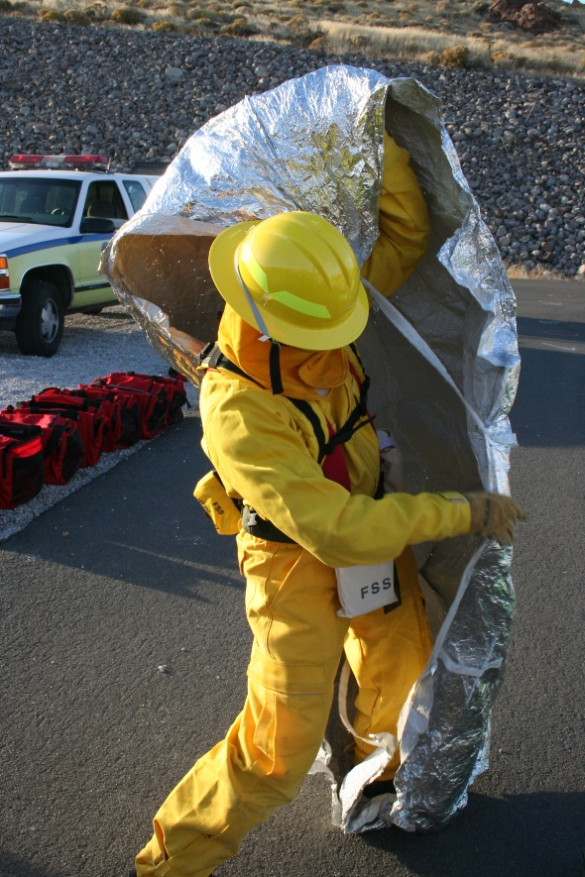
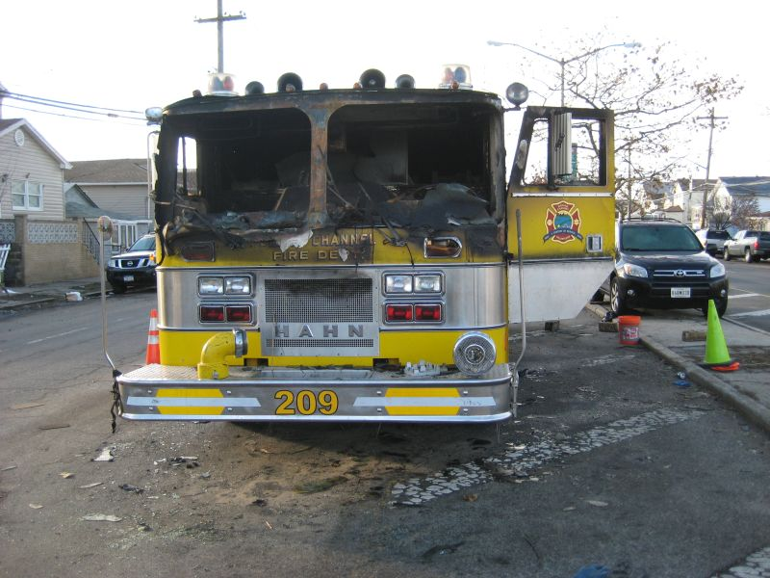
Fire Shelters in Vehicles
How can your fire shelter be used in a vehicle as a last resort option?

Slide 12
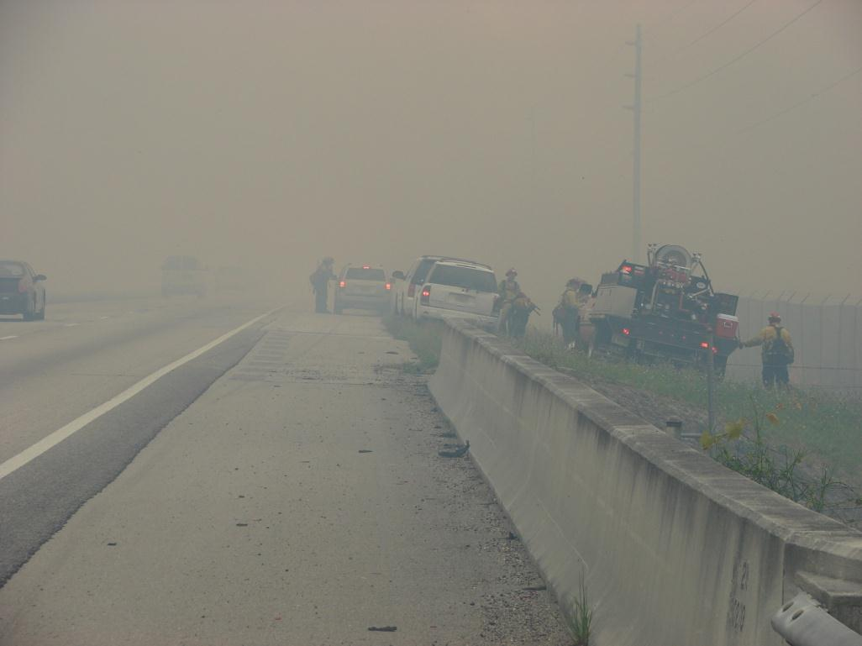
Driver Safety Awareness in the Interface
Risks unique to the interface
Use tactically sound operational procedures to be most effective
What are some actions taken to increase safety?

Slide 13
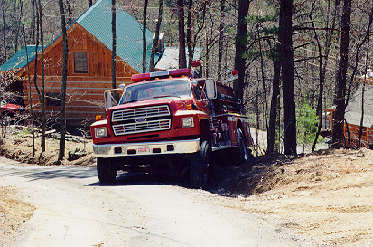
Fire Apparatus Safety in the Interface
Positioning
Parking
Operation

Slide 14
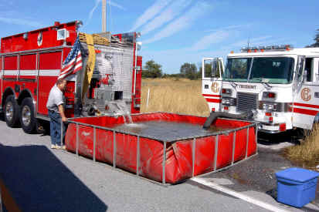
Fire Apparatus Safety in the Interface
Never pass up opportunities to fill tank
Cover flammable items in bed
Maintain at least 100 gallons in your tank

Slide 15
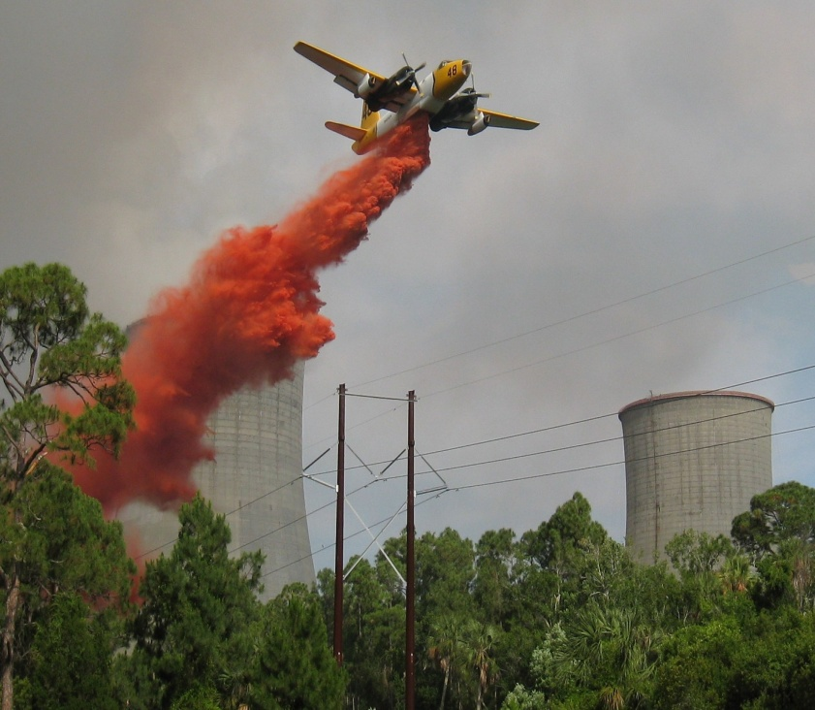
Power Lines in the Interface
Assume line is active.
Avoid applying water to power lines, poles, or service boxes.
Heavy smoke, water, and retardant will all conduct electricity.
What else should you consider?

Slide 16
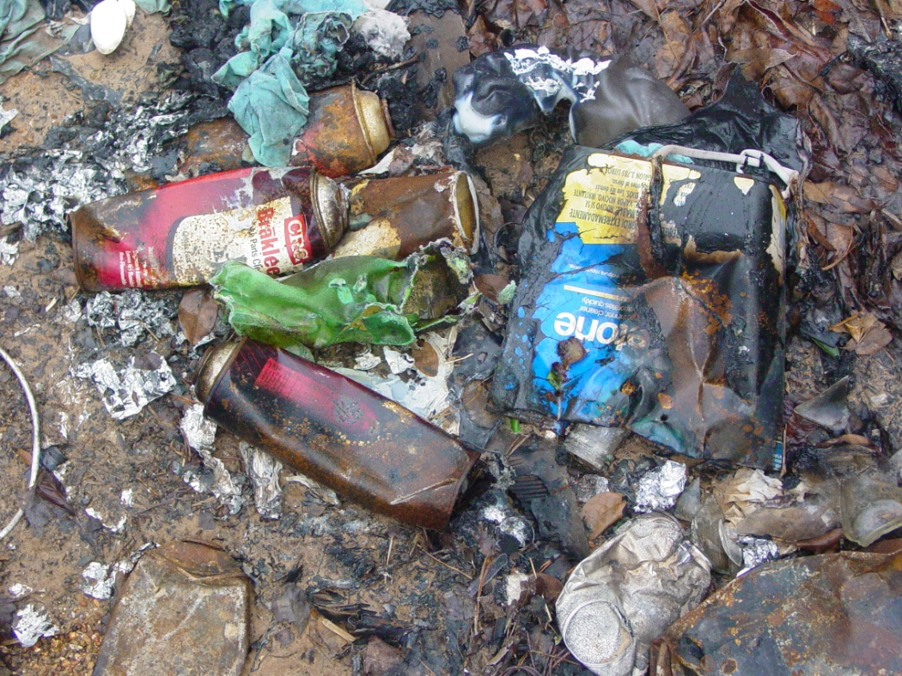
HAZMAT in the Interface
Sources and/or locations of HAZMAT around structures
Indicators and types of HAZMAT
Indicators of HAZMAT involved in the fire

Slide 17
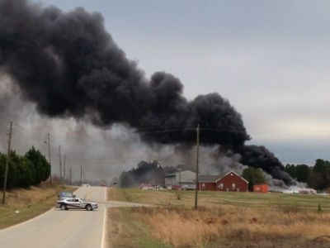
HAZMAT in the Interface
Smoke color and intensity may provide indicators of HAZMAT

Slide 18
Escape Routes and Safety Zones in the Interface
Differences for purely wildland fire vs. interface fires.
Safety zones in IRPG are not for interface fires.
Do not commit to stay and protect a structure unless an adequate escape route and safety zone are available.

Slide 19
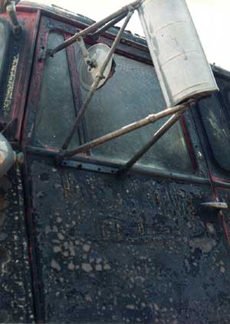
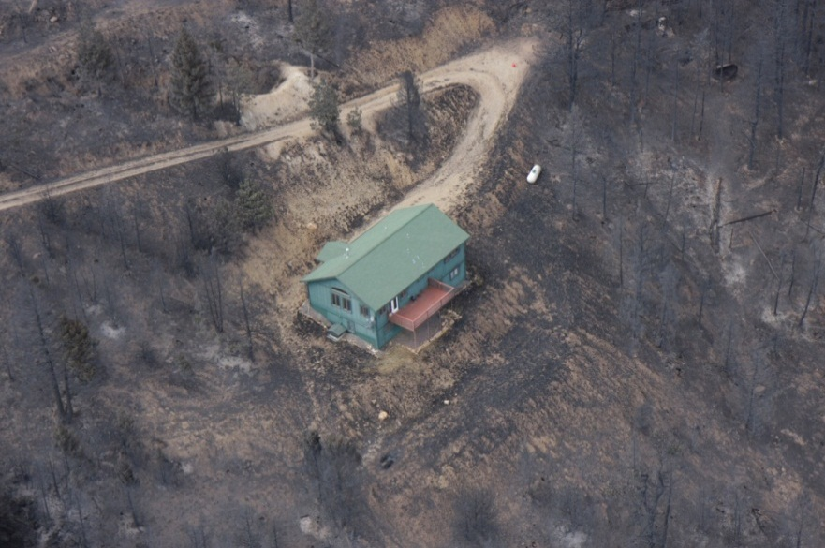
Temporary Refuge Areas
Structures
Vehicles
A LAST RESORT SURVIVAL OPTION!

Slide 20
Conclusion
Values at risk can be replaced, individual human life cannot.
Defend structures only when it is safe to do so.
The interface can vary in complexity like any wildland fire incident.

Slide 21
Review Unit Objectives
Describe operating principles and unique safety concerns to firefighters in the interface.
Describe escape routes, temporary refuge areas, and safety zones as they apply to firefighting in the interface.

