Slide 1
S-215 Fire Operations in the Wildland/Urban Interface
Unit 2
Managing Human Factors in the Interface

Slide 2
Unit Objectives
Discuss how preparing for and responding to interface fires is a shared responsibility as outlined in the Federal Wildland Fire Policy.
Describe some human factors encountered in the interface that affect critical decisionmaking for firefighter and public safety.
Discuss the value of the Incident Command System (ICS) and mutual aid situations as they apply to an interface incident.

Slide 3
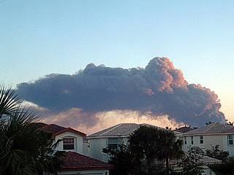
Introduction
A partnership between:
Government agencies
Property owners
Firefighting agencies
Individual firefighters
It’s a shared responsibility

Slide 4
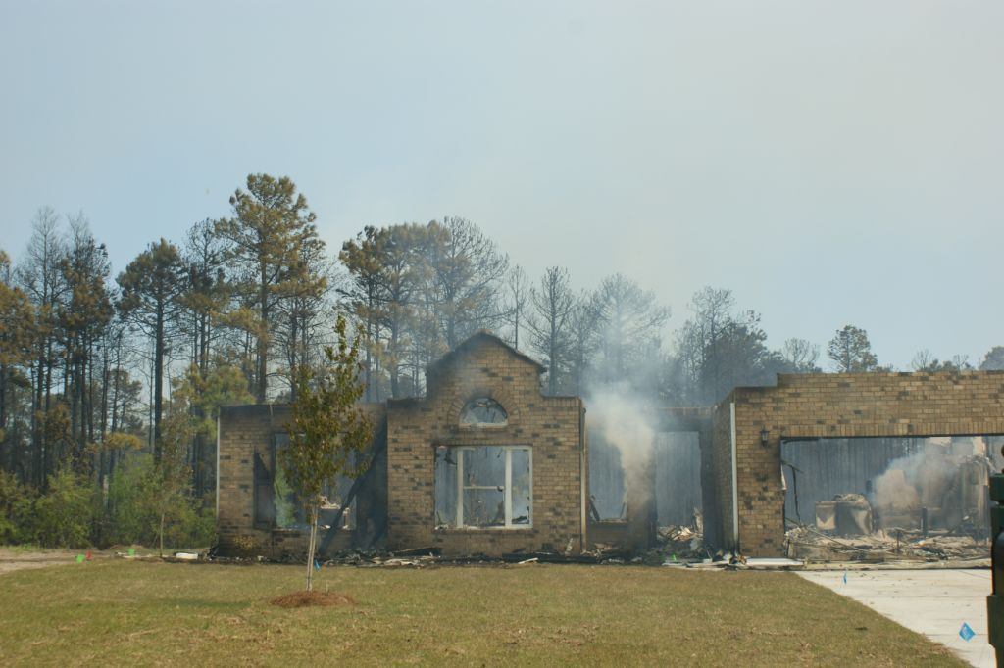
Roles and Responsibilities
Exercise to discuss different roles and responsibilities of four groups sharing responsibility
Government
Landowners and homeowners
Firefighting agencies
Firefighters

Slide 5
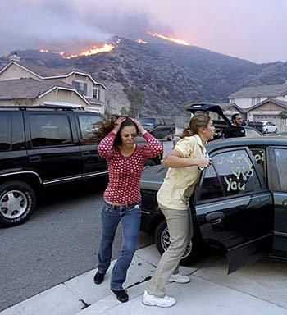
Impaired Decisionmaking
Homeowner’s
Business owner’s
Firefighter’s

Slide 6
Impaired Decision Making Alabaugh Fire
On July 8, 2007 at about 0020 two Black Hills National Forest firefighters assigned to the Alabaugh Canyon Fire were entrapped by the fire and deployed a single fire shelter. At the time of the accident the firefighters were conducting burn out operations around a residence in the wildland urban interface.

Slide 7
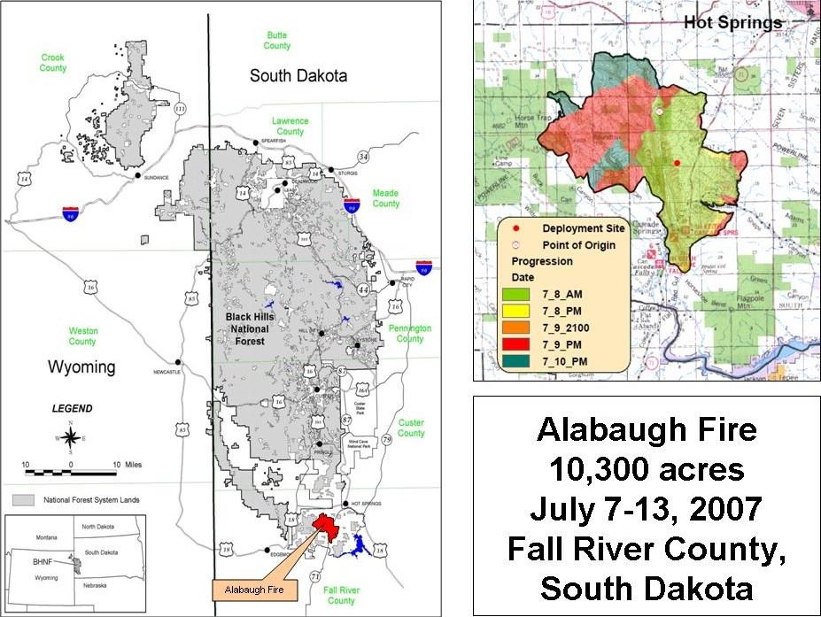
Impaired Decision Making Alabaugh Fire
Following will be a brief exercise using video excerpts discussing some challenges to decision making which occurred during the Alabaugh Canyon fire.

Slide 8
Impaired Decision Making Alabaugh Fire

Slide 9
Impaired Decision Making Alabaugh Fire

Slide 10
Impaired Decision Making Alabaugh Fire

Slide 11
Impaired Decision Making Alabaugh Fire

Slide 12
Unique Interface Pressures on Decision Making
The public and firefighting community expects and tolerates firefighters accepting a notably higher risk for structure protection on wildland fires, than when other resources/values are threatened by wildfire.
Interaction with the homeowners may sway your decision even though the homeowner didn’t take the time to do any preparation.

Slide 13
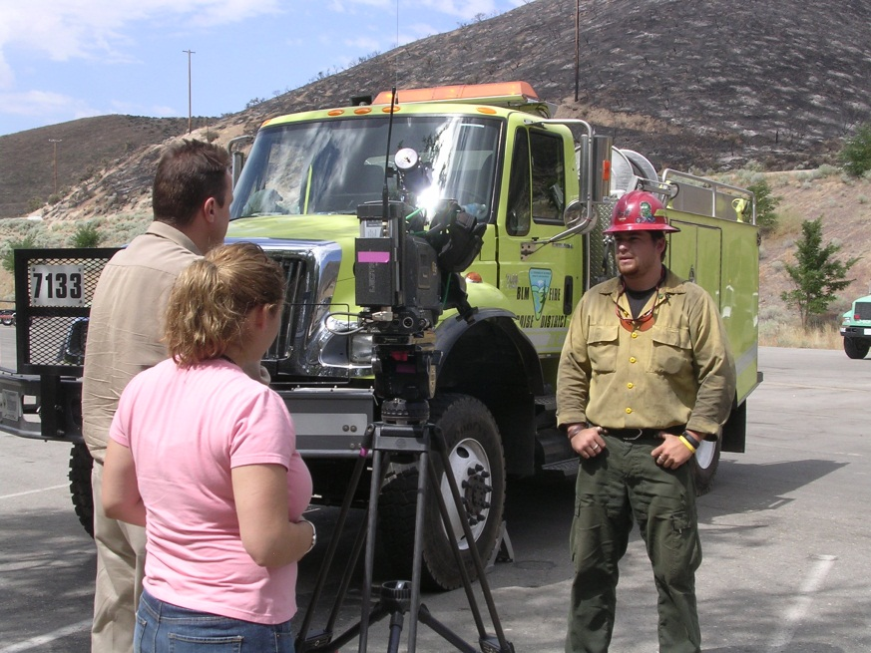
Managing Public Interactions
Be prepared for a multitude of questions.
Be professional and avoid speculation.
Anticipate media interest and request public information officer if necessary.

Slide 14
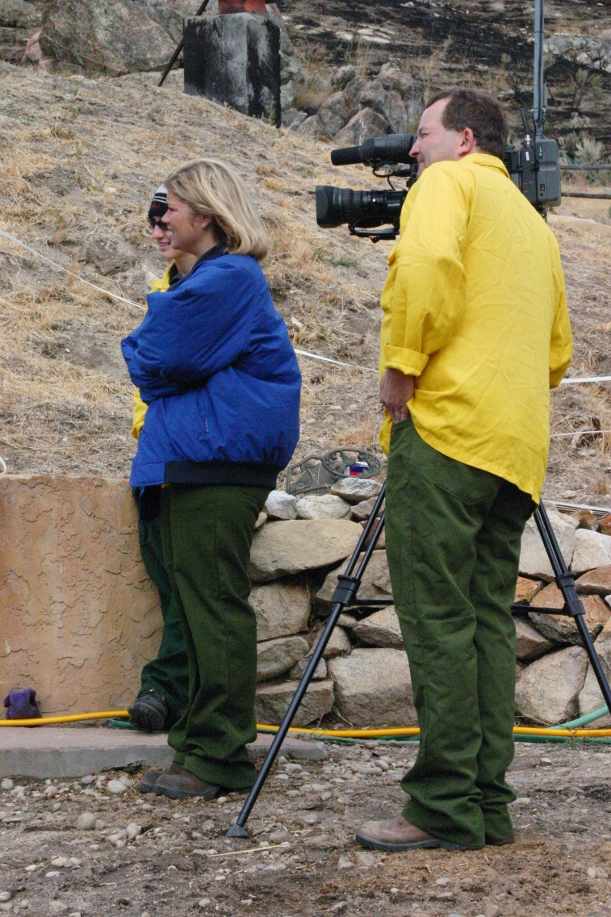
Managing Public Interactions
Use Media Interviews section of the IRPG.
If you don’t know the answer, find somebody who does.

Slide 15
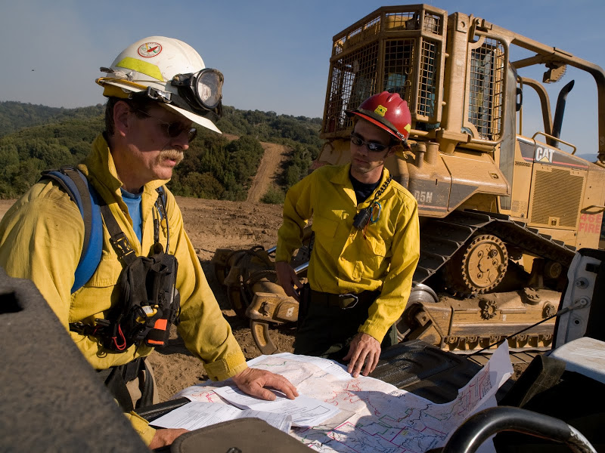
Incident Command System in the Interface
FIRESCOPE
Defines responsibilities
Able to expand and contract as needed

Slide 16
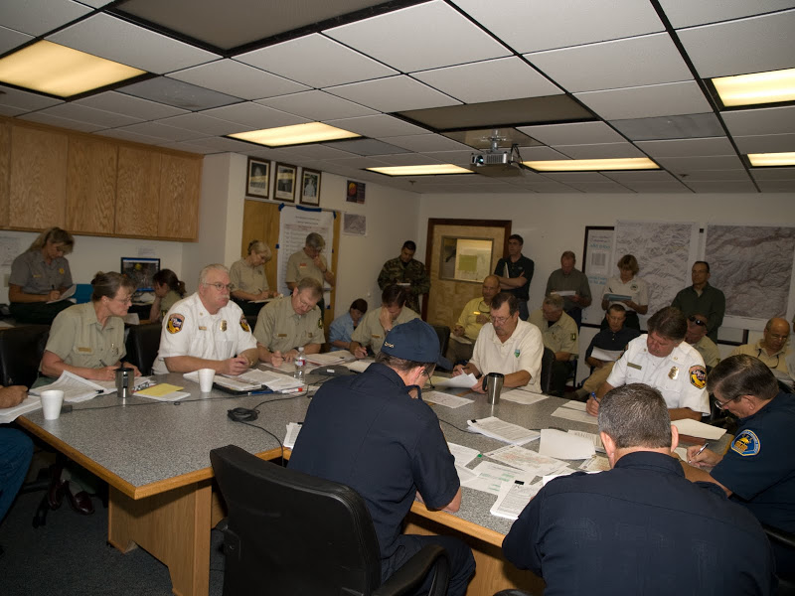
Mutual Aid Situations
Increasing in frequency
Regardless of political boundaries, your own agency policy still applies
What values lie in having a prior agreement?

Slide 17
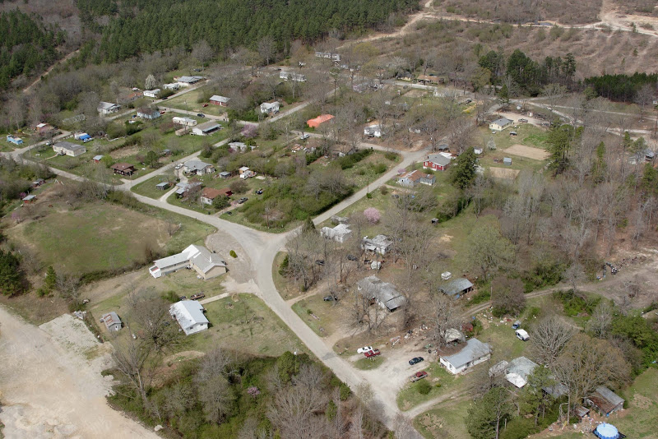
Conclusion
What will you and your agency do to effectively manage human factors in the interface?

Slide 18
Review Unit Objectives
Discuss how preparing for and responding to interface fires is a shared responsibility as outlined in the Federal Wildland Fire Policy.
Describe some human factors encountered in the interface that affect critical decisionmaking for firefighter and public safety.
Discuss the value of the Incident Command System (ICS) and mutual aid situations as they apply to an interface incident.

