Slide 1
S-215 Fire Operations in the Wildland/Urban Interface
Unit 8
Tactical Operations and Resource Use in the Interface

Slide 2
Unit Objectives
Identify tactics employed in confronting a fire at a structure.
List tactical uses of different resources at an interface incident.
Given a firing operation in the interface, list methods used to protect structures.
Unit 8 – Tactical Operations and Resource Use in the Interface

Slide 3
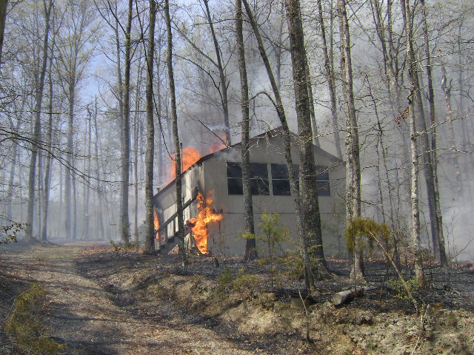
Introduction
Tactics are decided by considering fire environment, structure defensibility, and resource availability.

Slide 4
Confronting the Fire at the Structure
Within spotting zone
Full containment around structure
Partial containment around structure
No containment around structure

Slide 5
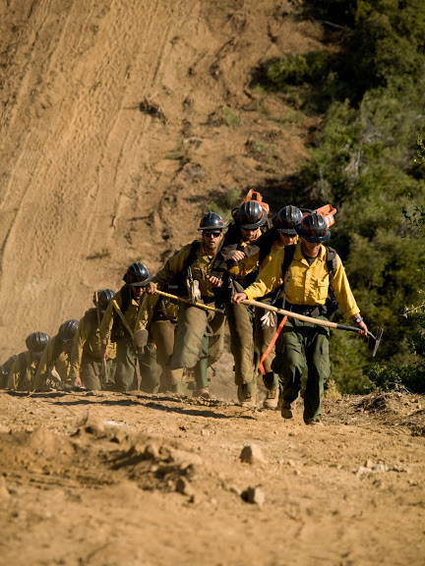
Tactical Use of Resources – Hand Crews

Slide 6
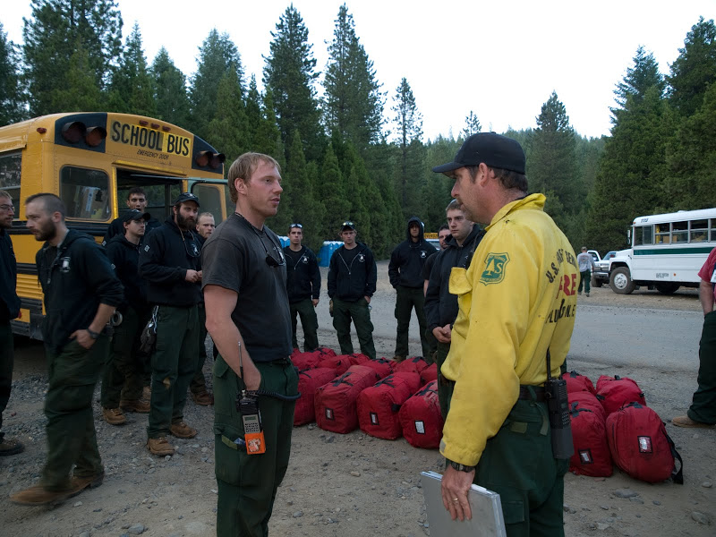
Limitations and Considerations
Discuss some limitations and considerations of hand-crew use.

Slide 7
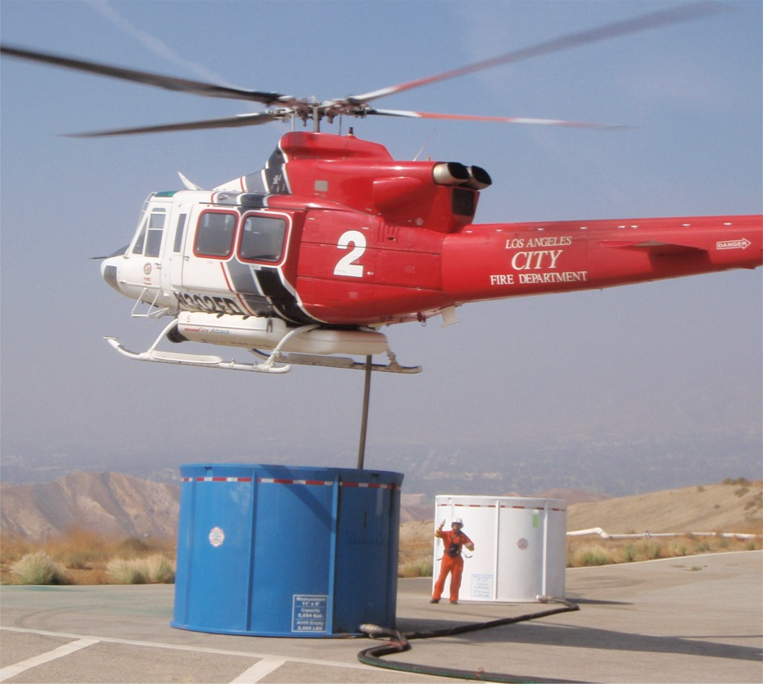
Tactical Use of Resources – Aircraft

Slide 8
Limitations and Considerations
Notes:
Turn around time reload, flight duty hours

Slide 9
Aircraft – Tactical Planning

Slide 10
Limitations and Considerations

Slide 11
Tactical Use of Resources – Heavy Equipment

Slide 12
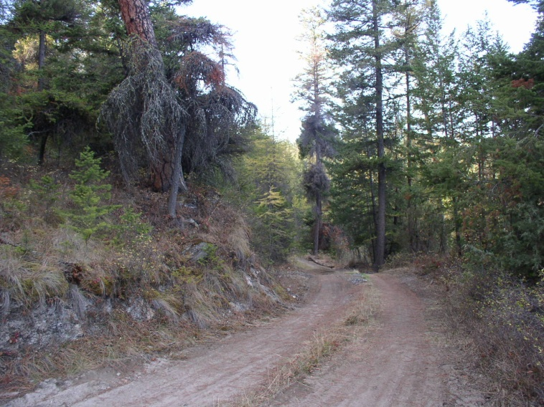
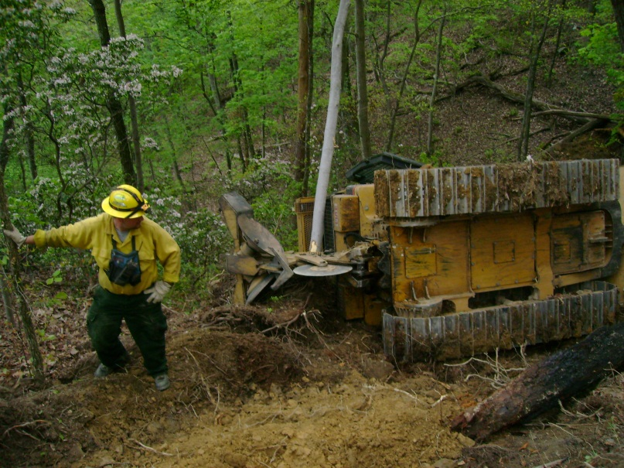
Limitations and Considerations

Slide 13
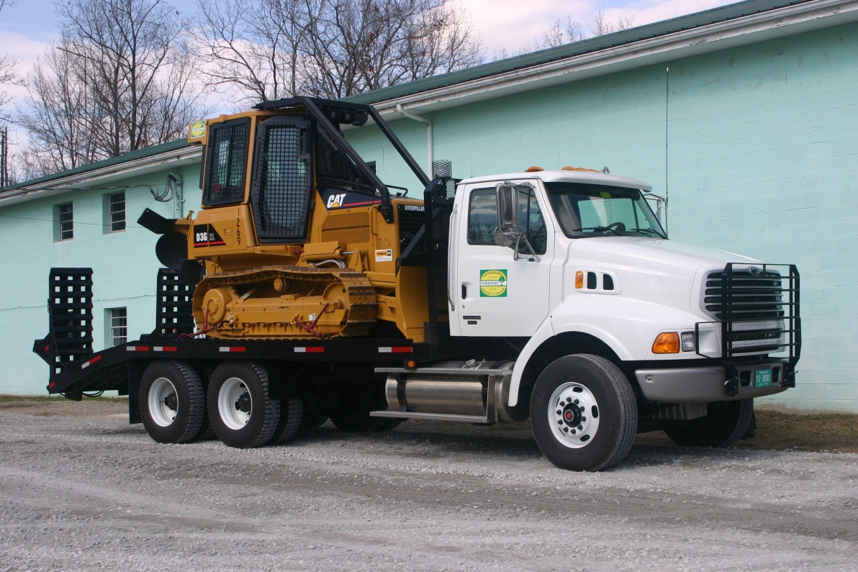
Types of Heavy Equipment

Slide 14
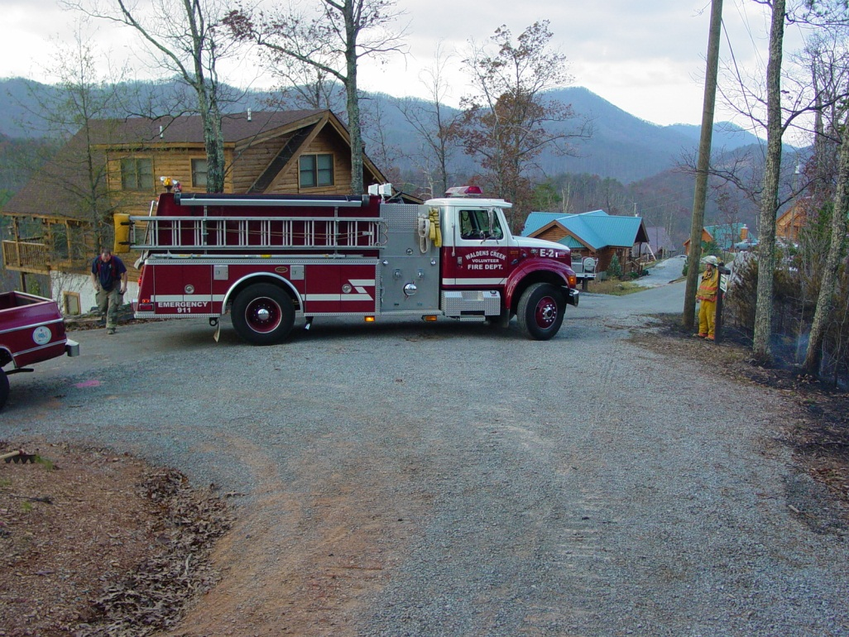
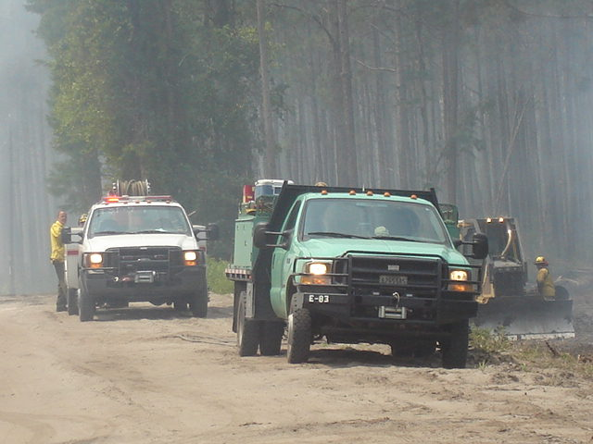
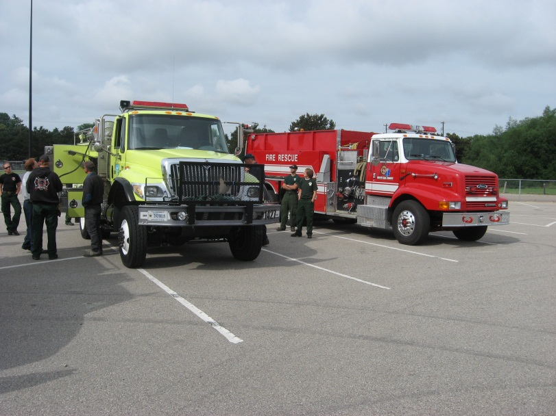
Engines

Slide 15
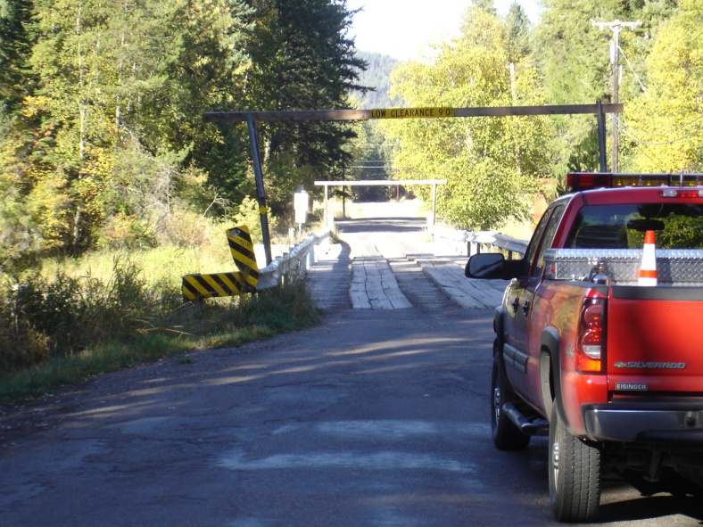
Limitations and Considerations

Slide 16
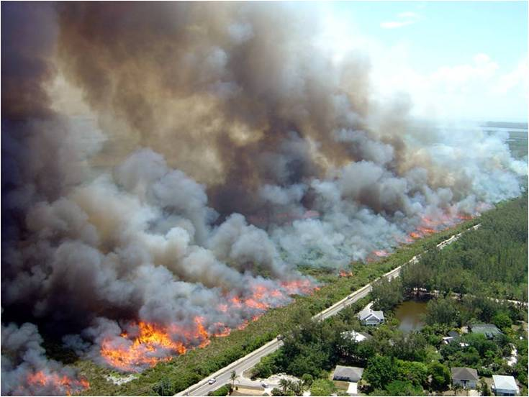
Firing Operations

Slide 17
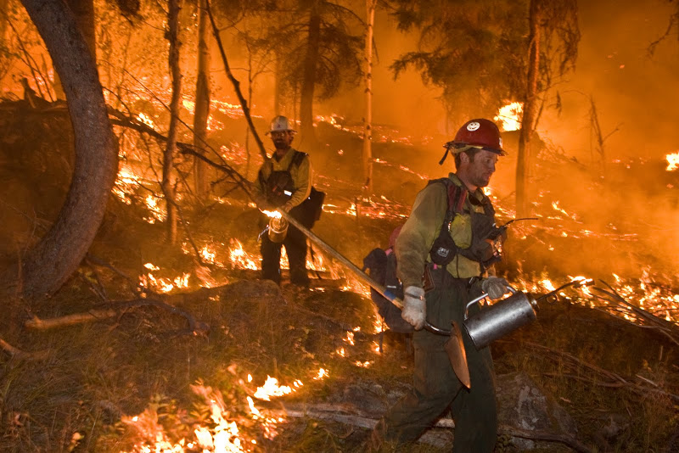
Limitations and Considerations
Burning out vs. backfiring

Slide 18
Conclusion
Every resource has different strengths and weaknesses. Some resources have specific applications, whereas others can perform a wide variety of duties. Choose accordingly.

Slide 19
Review Unit Objectives
Identify tactics employed in confronting a fire at a structure.
List tactical uses of different resources at an interface incident.
Given a firing operation in the interface, list methods used to protect structures.

