Slide 1
Aviation Management and Safety
Unit 2

Slide 2
Unit 2 Objectives
Describe the importance of flight planning and flight following for aircraft missions.
Specify the safety procedures to follow while loading and unloading passengers and cargo from an aircraft.
Describe Federal agency pilot and aircraft certification procedures.

Slide 3
Unit 2 Objectives
Identify what hazardous materials cannot be transported on any aircraft and the exemptions.
Describe your responsibility for accident prevention.
Describe the procedure for reporting an incident or mishap.

Slide 4
Safety Responsibility
The Entire Organization Must Be Committed to Safety!

Slide 5
Safety Management System
Uses techniques to identify system weaknesses from initial planning stage to mission completion.
Identifies conditions that if left unchanged, could lead to unwanted events.
Safety promotion communicates concerns to users.

Slide 6
Safety Management System
SAFECOMS are an important part of Safety Management Systems and quality assurance.
Focuses resources toward mitigation or elimination of risk as a proactive program.

Slide 7
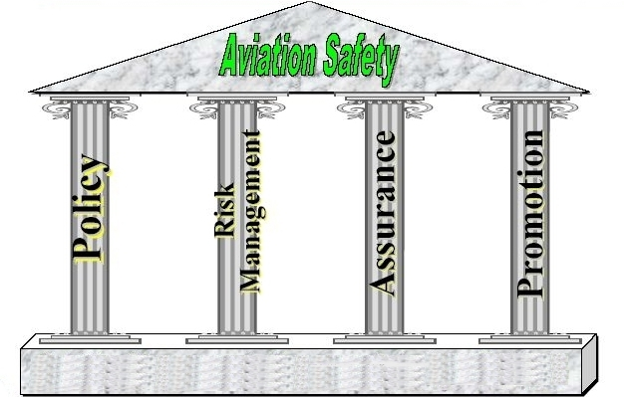
Safety Rests on These
Four Pillars

Slide 8
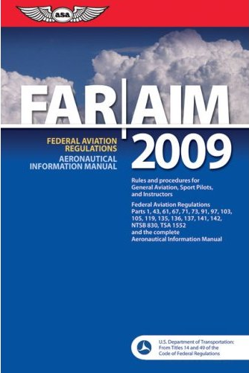
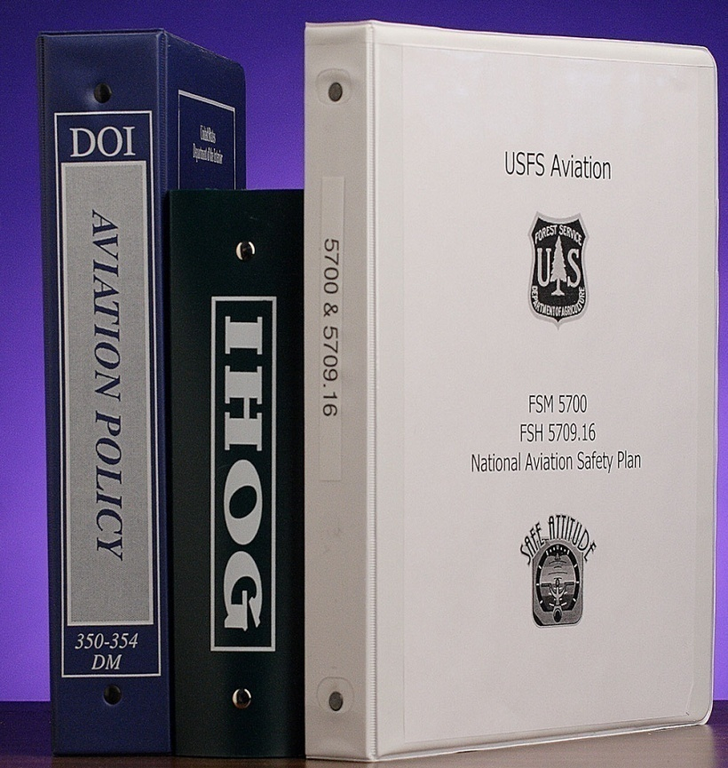
Policy

Slide 9
Where Can You Find Policy?
In Your Pocket
Agencies provide a variety of tools to enable
you to comply with policy and procedures.
The “orange card” is one
such tool. The five steps
were developed to enable
you, the user, to implement
agency aviation policies.

Slide 10
Risk Management
Risk Management Worksheet
Job Hazard Analysis
Go-No Go checklists
SMS risk assessments
Crew resource management “team decision-making”
Assignment “turn-down” policy

Slide 11
Quality Assurance
Briefings
Training
FAST teams
Duty limitations
Check rides/carding requirements
Accident investigations
Program reviews

Slide 12
Promotion
We want to promote safe practices and a well informed reporting and safety culture.

Slide 13
Promotion
Lessons Learned bulletins
Safety alerts
Training
Briefings
SAFECOM reporting system
Airward
Effective leadership
Safety communication

Slide 14
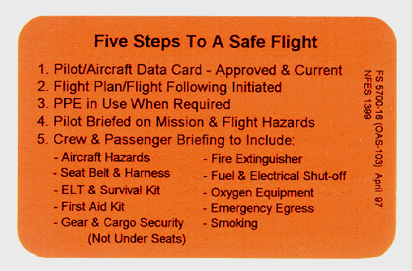

Slide 15
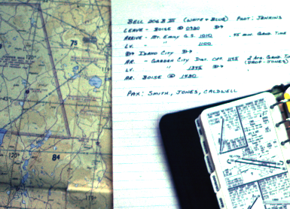
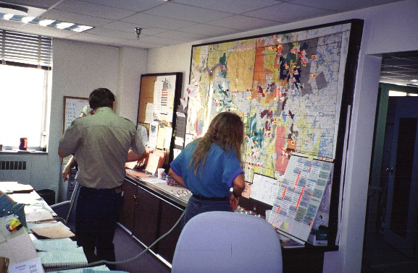
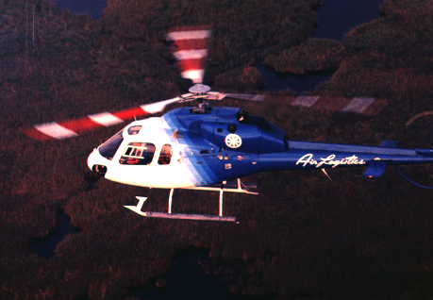
Mission
Planning

Slide 16
Classification of Flights
Point-to-point or administrative – flights from airport to airport
High reconnaissance - flights more than 500 feet above ground level (AGL)
Special use activities - flights lower than 500 feet AGL (firefighting, wildlife surveys, other types of natural resource missions, etc.)

Slide 17
Aircraft Sources
Aircraft used by Federal agencies:
  Agency owned (fleet) aircraft
  Agency contracted aircraft
  Aircraft Rental Agreement (ARA)
  Military/cooperator aircraft
  Call When Needed (CWN) aircraft
  On-call aircraft
  Exclusive use

Slide 18
Flight Plans
All aviation missions for USFS and Department of the Interior agencies are required to have a completed flight plan filed.
This is a detailed outline of where, when, and how the mission will
be flown.

Slide 19
Flight Plans
Either is acceptable:
Federal Aviation Administration Flight Plan (for point-to-point flights) with agency flight following.
FAA Flight Plans shall be filed by the pilot before take-off whenever possible.

Slide 20
Flight Manager
Assigned for each flight.
Agency representative.
Ensure aircraft and pilot are “carded” for the mission.
Helitack personnel will perform this function when transporting personnel by helicopter.

Slide 21
Dispatch or Aviation Managers Should Provide:
Aircraft type and “N” number
Aircraft color
Pilot name(s)
Passenger name(s)
Passenger/cargo weight
Nature of mission
Flight hazards

Slide 22
Dispatch or Aviation Managers Should Provide:
Flight routes, point of departure, and destination
Planned fuel stops
Estimated duration of mission
Check-in procedures
Estimated time of departure
Estimated time of arrival

Slide 23
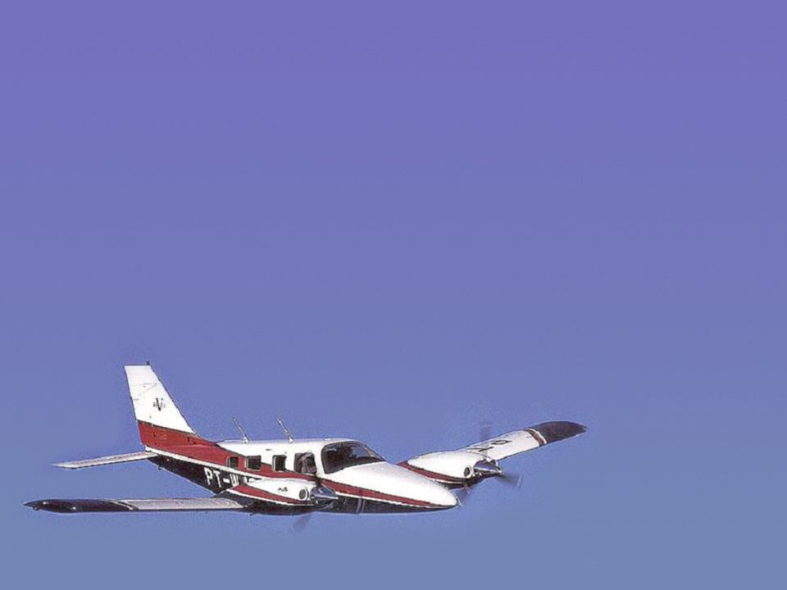
Preflight Preparations
You are assured that the aircraft and
pilot are approved for mission.
Pilot is in command of the aircraft.
Flight manager or passengers can
terminate flight for safety concerns.

Slide 24
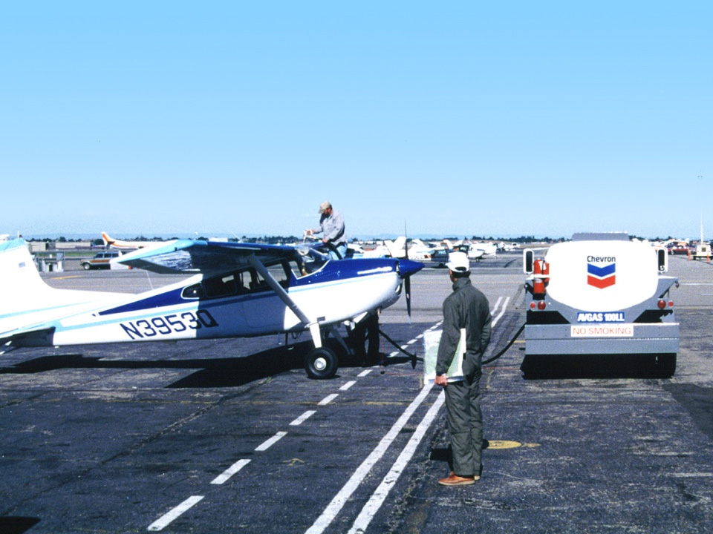
Aircraft Fueling
You will not be involved in refueling; this is the responsibility of the pilot/contractor.
Safety Practices
  No passengers on board
  No smoking within 50 feet

Slide 25
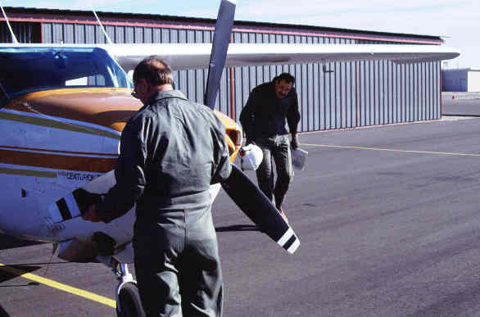
Preflight Inspection
Visual inspection of overall condition
Exterior
damage
Oil or fuel
leaks
Tires
Control
surfaces
Drain water &
sediment
This is the responsibility of the pilot.

Slide 26
Preflight Briefing
Flight manager must brief pilot on:
Specifics of mission
Manifest with accurate weights of passengers
Accurate weight of cargo
All hazardous material to be transported
Radio frequencies
Flight following procedures

Slide 27
Preflight Briefing
Flight manager must brief pilot on:
Other aircraft that may be in area
Current and forecasted weather conditions
Fire Traffic Areas (FTA), airspace issues, etc.
Hazards in flight area (review hazard map)

Slide 28
Hazard Map
Federal agency field offices must have a hazard map showing location of:
Power lines
Military aircraft training routes
Towers
Special use airspace
Any other hazards to the flight

Slide 29
Hazard Map
Maps must be updated annually or
as hazards change.
If hazard map is not available,
check with unit dispatch office
for hazards in flight area.

Slide 30
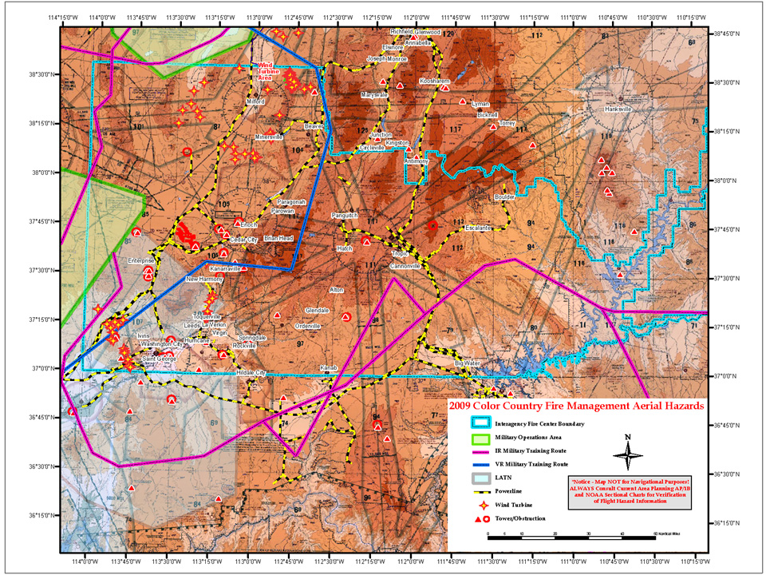
Hazard Map

Slide 31
Passenger Safety Briefing
Before any flight, all passengers must receive a passenger safety briefing from the pilot or helitack personnel.
The briefing should include:
Approaching, entering and exiting, or departing the aircraft
Loading and storage of gear or cargo
Smoking rules
In-flight rules

Slide 32
Passenger Safety Briefing
Seat belt use and seat back in upright position
Location and operation of emergency exits and passenger doors
Use of oxygen, if appropriate
Location and operation of fire extinguisher
Location of first aid kit/survival equipment
Location and operation of Emergency Locator Transmitter (ELT)

Slide 33
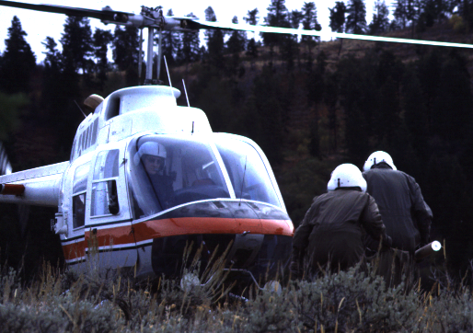
Approach and Departure
From front of aircraft
in full
view of pilot.

Slide 34
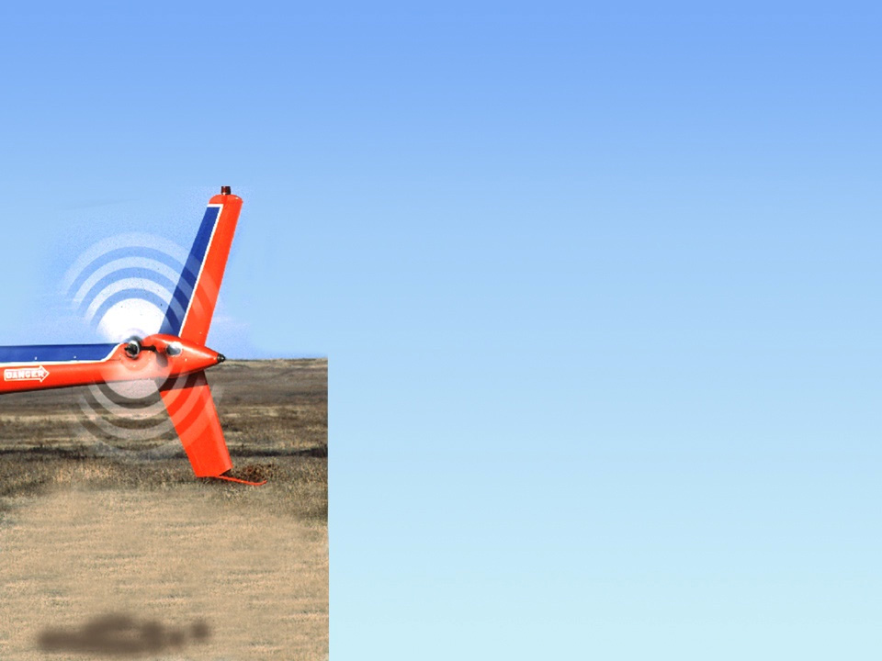

Helicopter Rotor Hazard
DANGER!
STAY AWAY!

Slide 35
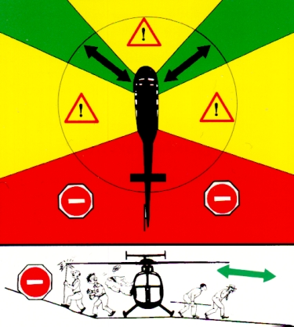

Slide 36
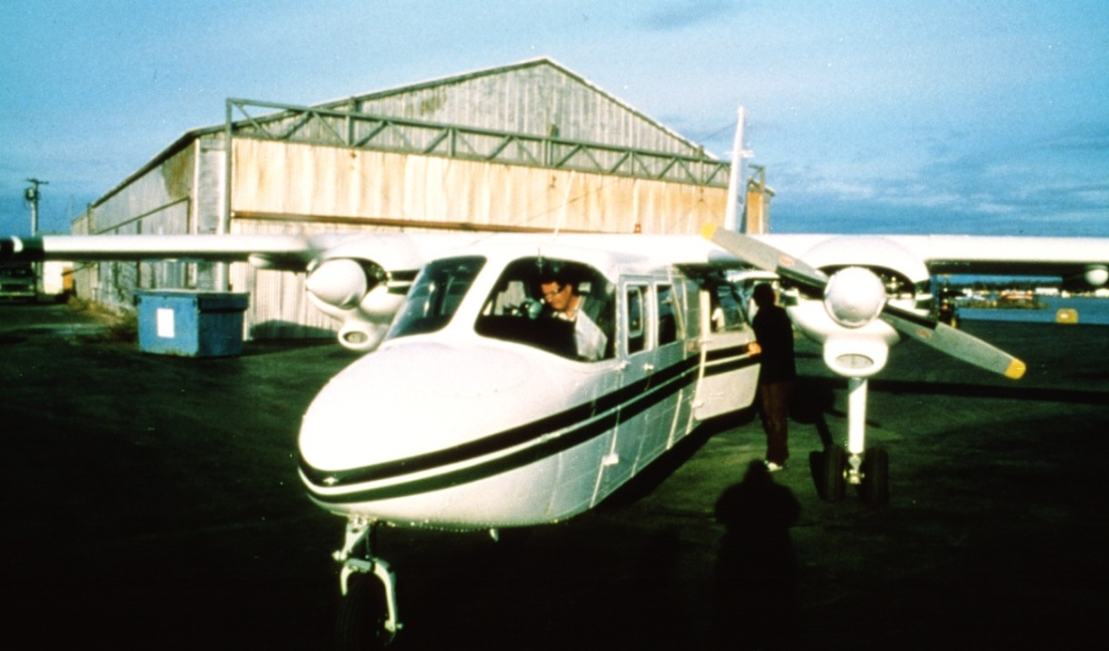
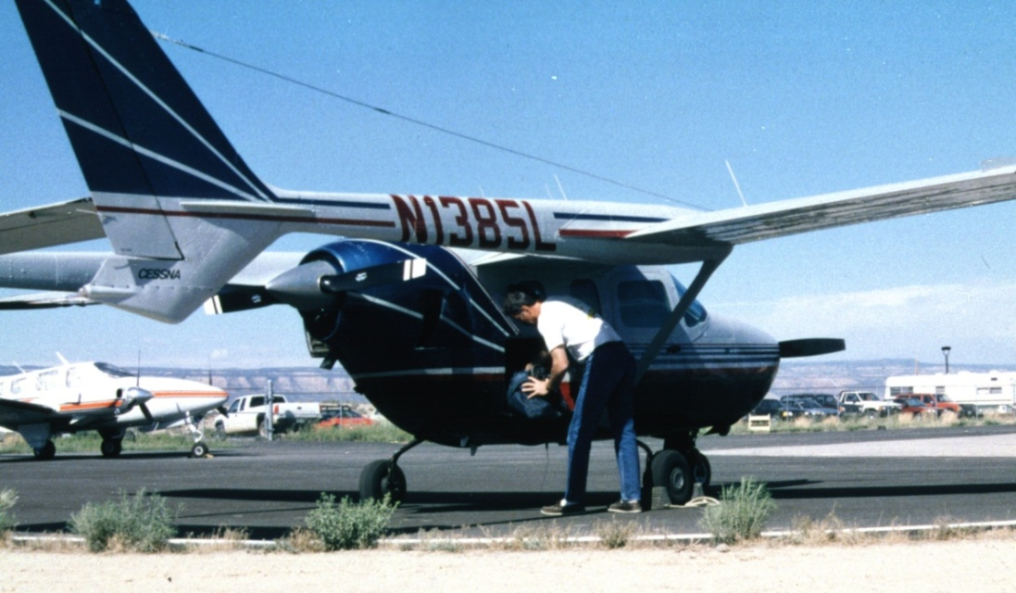
Approach when engine is off and propellers are stopped,
with the pilot’s
permission.

Slide 37
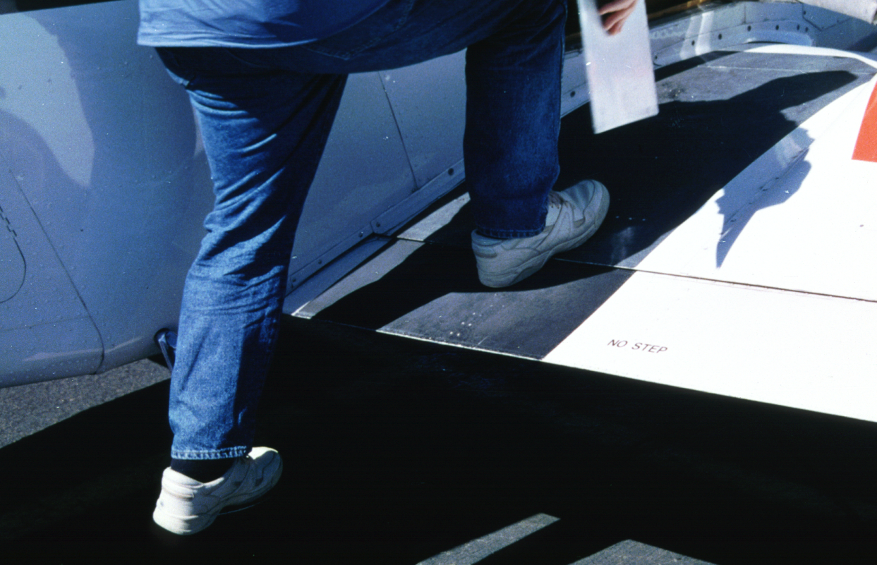
Watch Your Step
when entering and exiting.

Slide 38
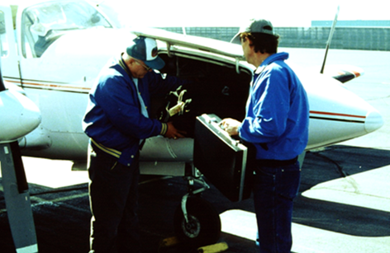
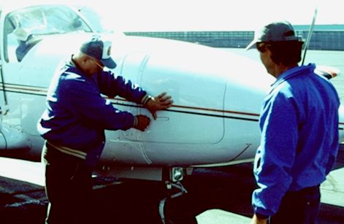
Pilot
Should
Load.
Lock
Before
Takeoff.

Slide 39
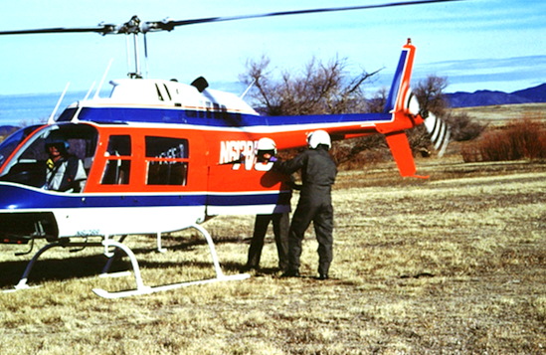
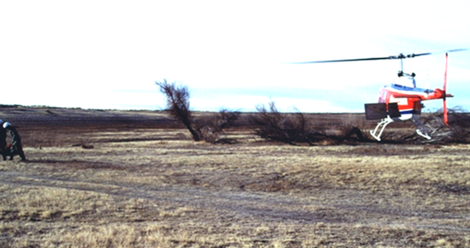
Secure
and
Latch
the
Cargo
Door.

Slide 40
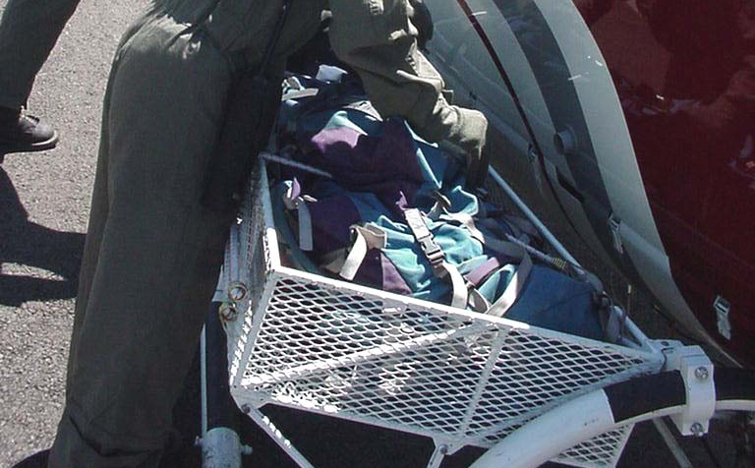
Secure Cargo in Basket.
Check Straps.

Slide 41
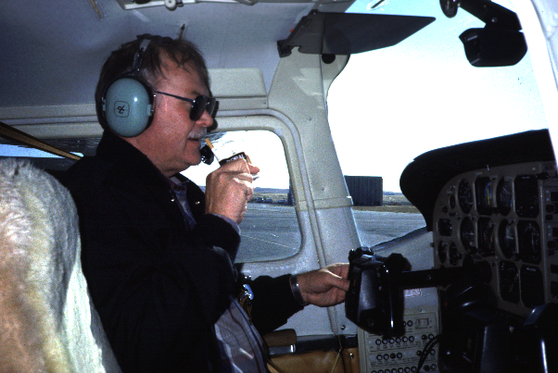
No Smoking

Slide 42
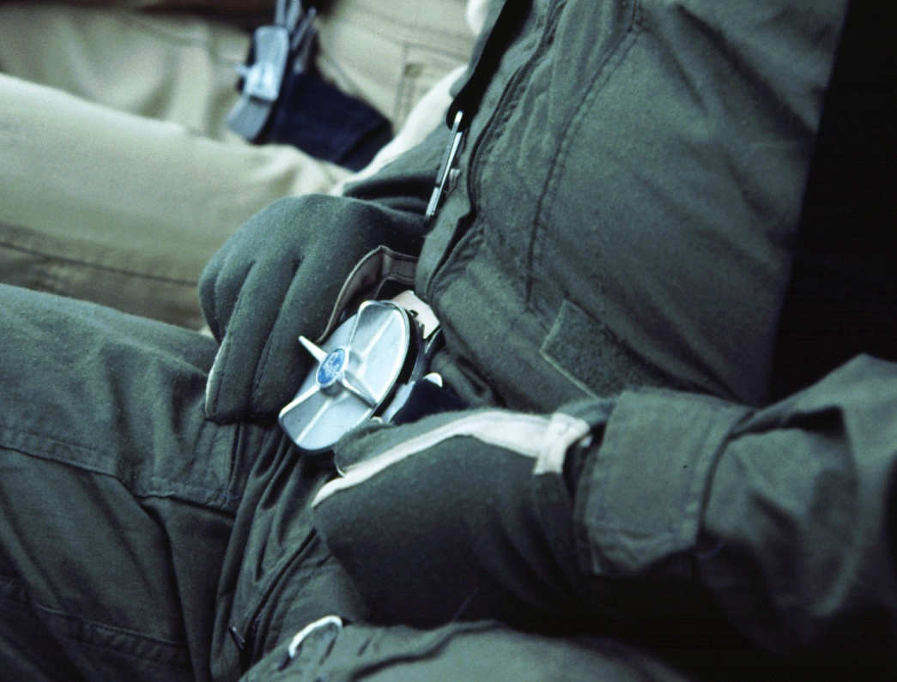
Fasten Seat Belt
before departure.

Slide 43
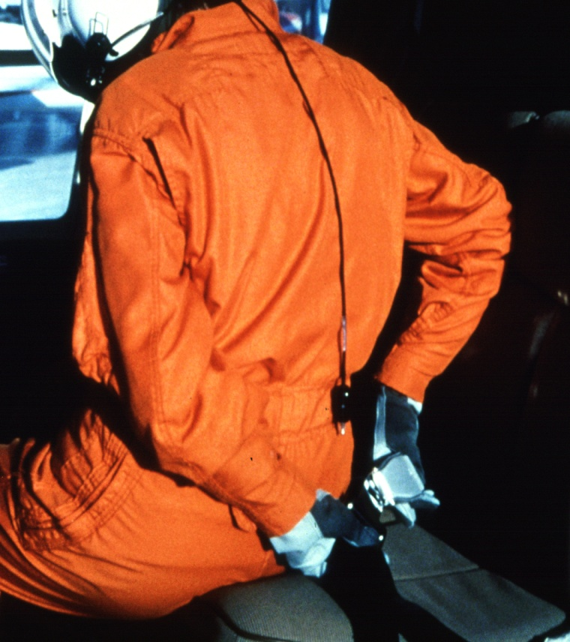
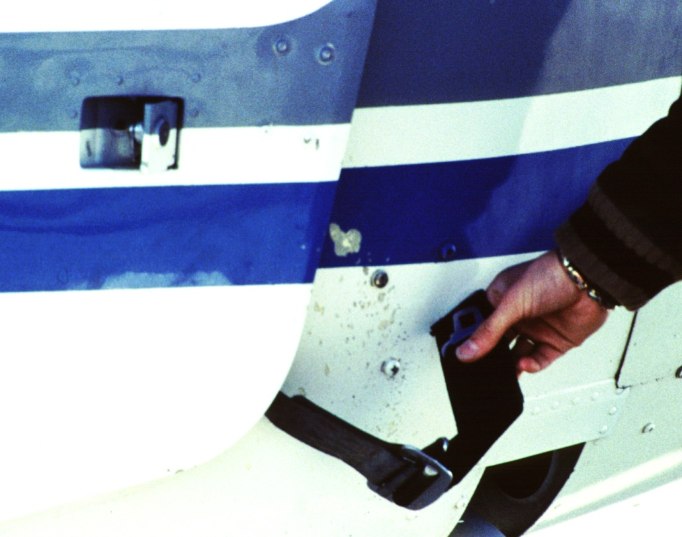
Eliminate Damage to Aircraft –
fasten seat belt behind you before exiting aircraft!

Slide 44
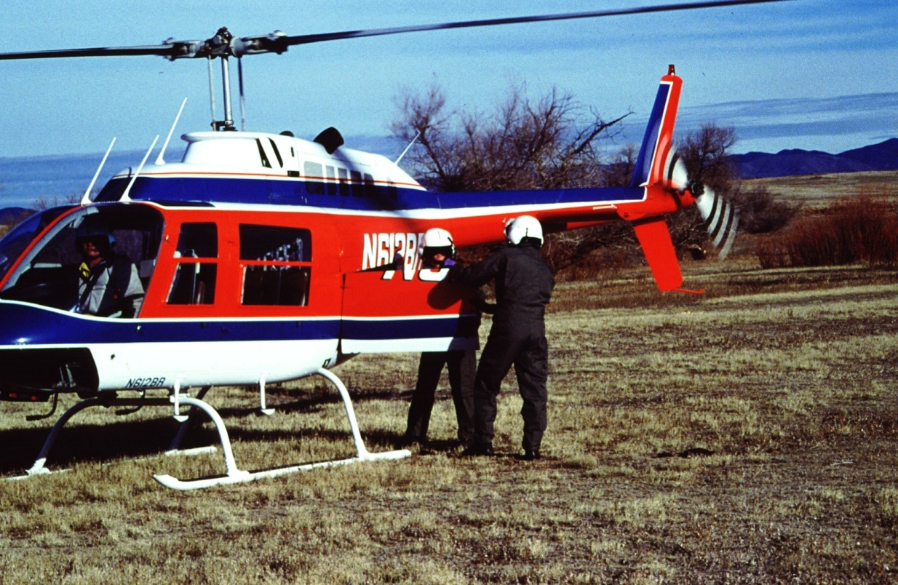
Operation of Doors and Exits
Including Cargo Doors

Slide 45
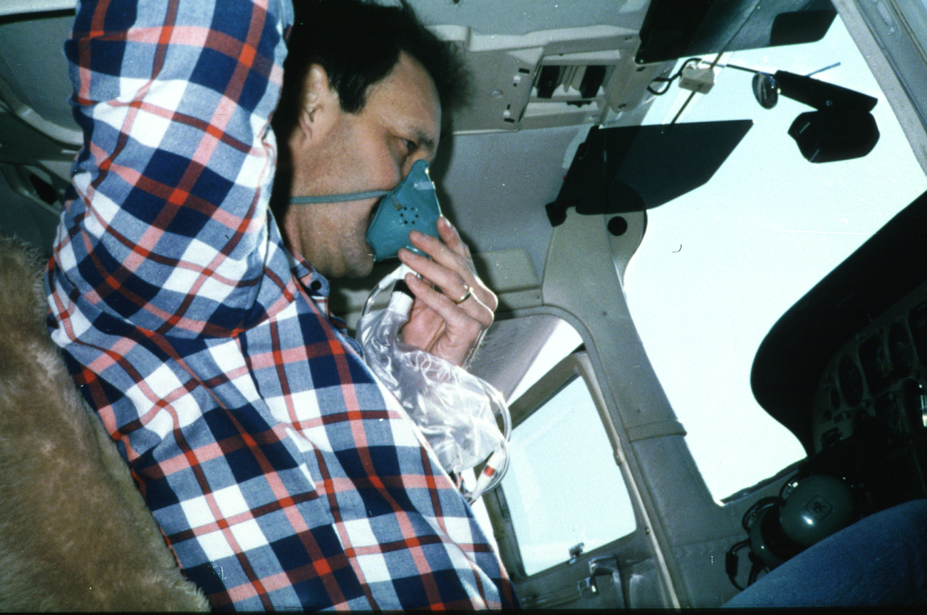
Use of Oxygen

Slide 46
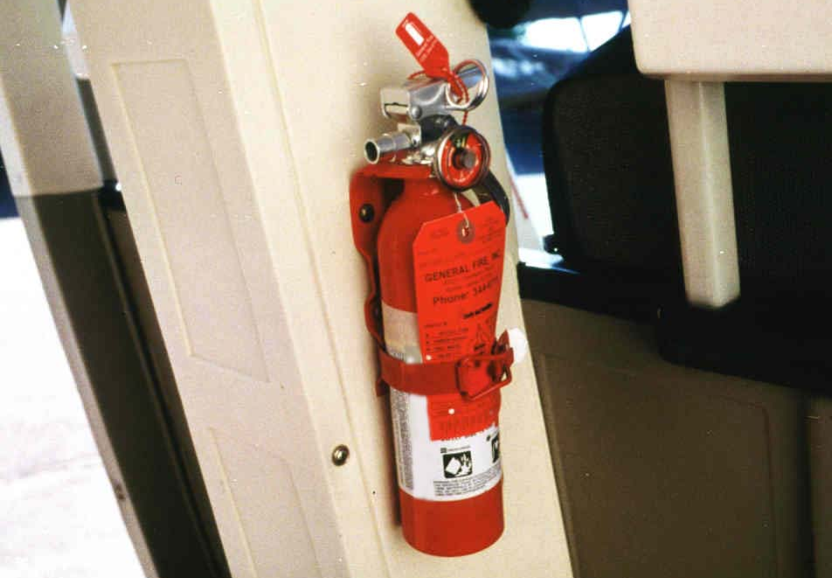
Fire Extinguisher
Location and Operation

Slide 47
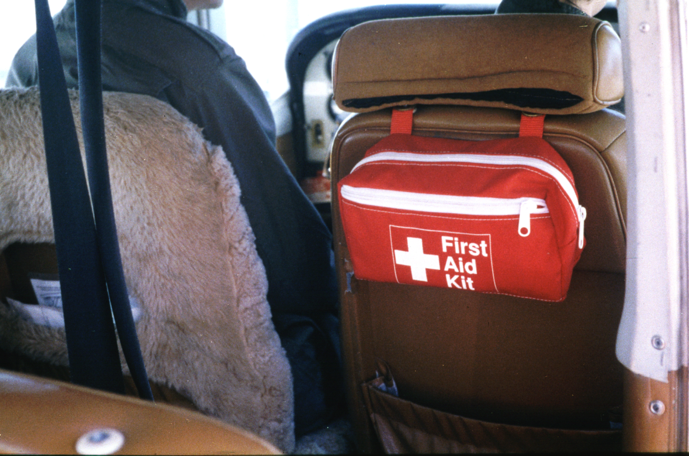
Location of First Aid Kit

Slide 48
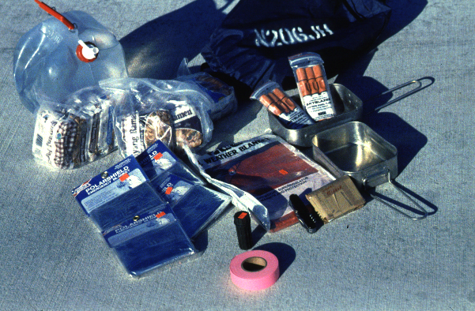
Survival Kit

Slide 49
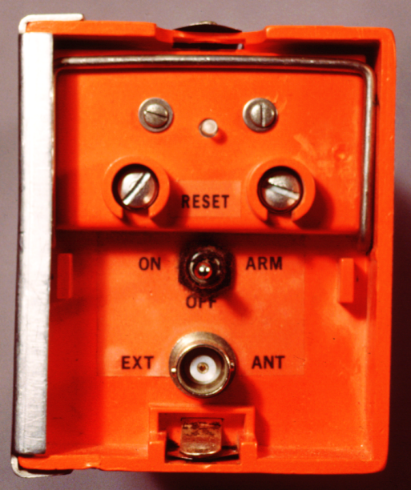
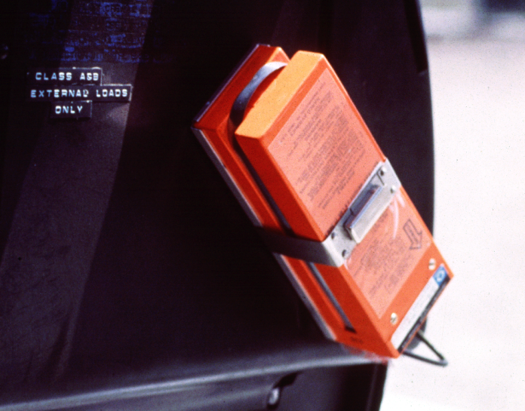
Emergency Locator Transmitter (ELT) Operation

Slide 50
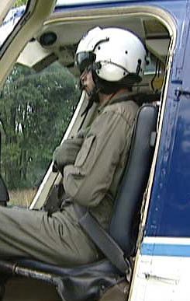
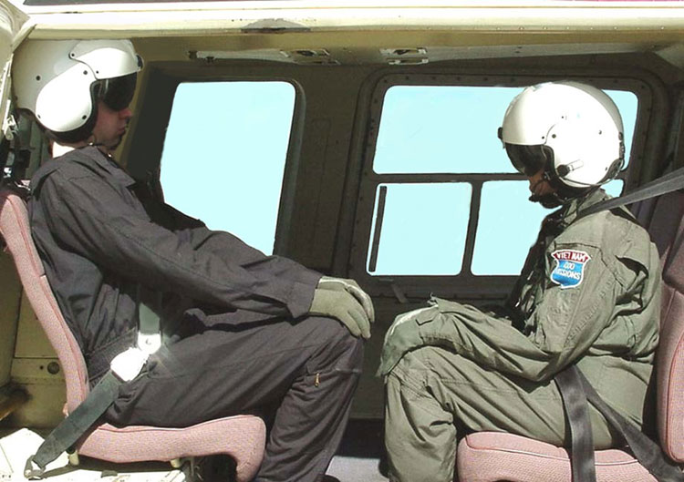
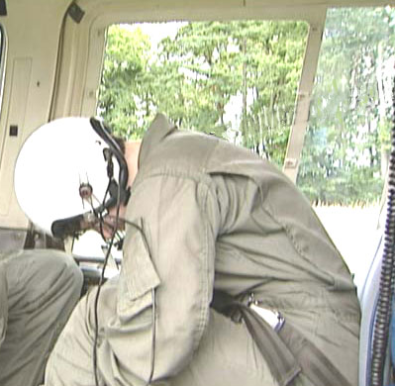
Crash Positions
Lap Belt with Shoulder Restraint
Lap Belt Only

Slide 51
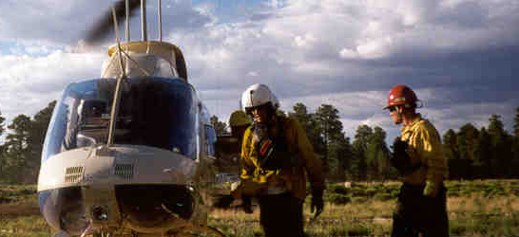
Personal Protective Equipment (PPE)

Slide 52
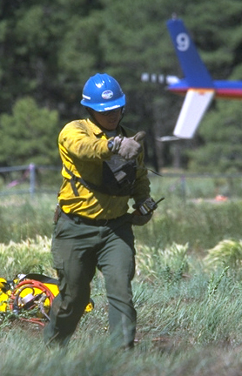
PPE Required for Helicopter Flights
Flight helmet
Hard hat with chin strap (fire crew transport only when overseen by helitack)
Fire resistant clothing
Leather or Nomex
flight gloves
Leather boots
Nonsynthetic under garments
Eye and ear protection

Slide 53
Manifesting
All passengers will be manifested prior to the flight.
Airplane manifests are completed by dispatch or flight manager.
Helicopter manifests are completed by helitack personnel.

Slide 54
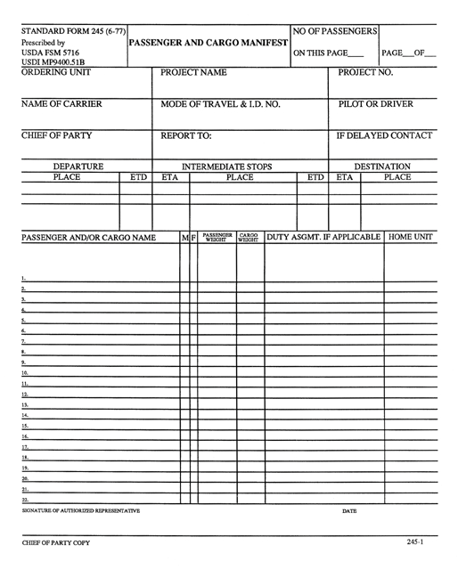
Passenger Manifest

Slide 55
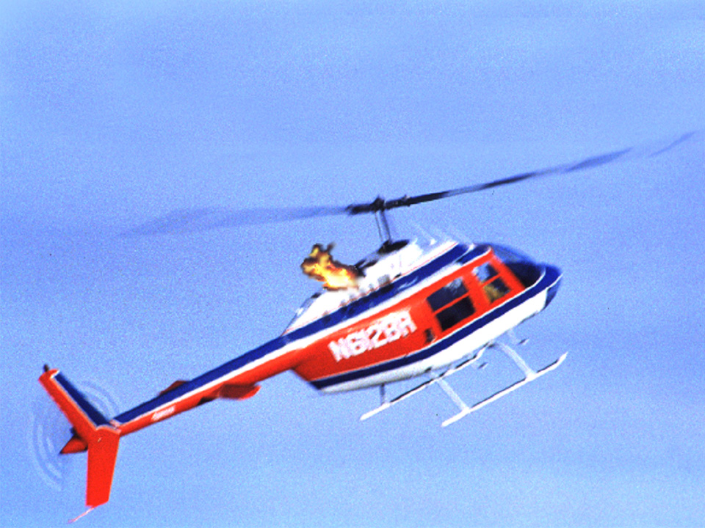
Inflight Emergency

Slide 56
Inflight Emergency
If the pilot declares an emergency:
Collars turned up and sleeves rolled down
Gloves on
Hardhat on with chinstrap in place
Visor down on flight helmet with adjustment knob tightened
Seat restraints snug

Slide 57
Inflight Emergency
Keep away from controls
Secure loose gear
Locate emergency exit(s)
Assume crash position
Wait for all motion to stop before
exiting unless there is a postcrash
fire!

Slide 58
Flight Following
Flight following accomplished under agency’s written flight following policy.
Radio contact made at predetermined intervals not to exceed 1 hour (most agencies use 15 – 30 minutes).
Position reports or updates are communicated and recorded.
Flight following personnel must monitor radio at all times during flight.

Slide 59
Flight Following Plan
Must minimally include:
Aircraft type and identification “N” number
Aircraft color
Pilot name(s)
Fuel on board
Passenger name(s)

Slide 60
Flight Following Plan
Must minimally include:
Passenger and cargo weights
Nature of mission
Flight routes and destination
Estimated duration of mission
Estimated time of departure
Estimated time of arrival
Check-in procedures

Slide 61
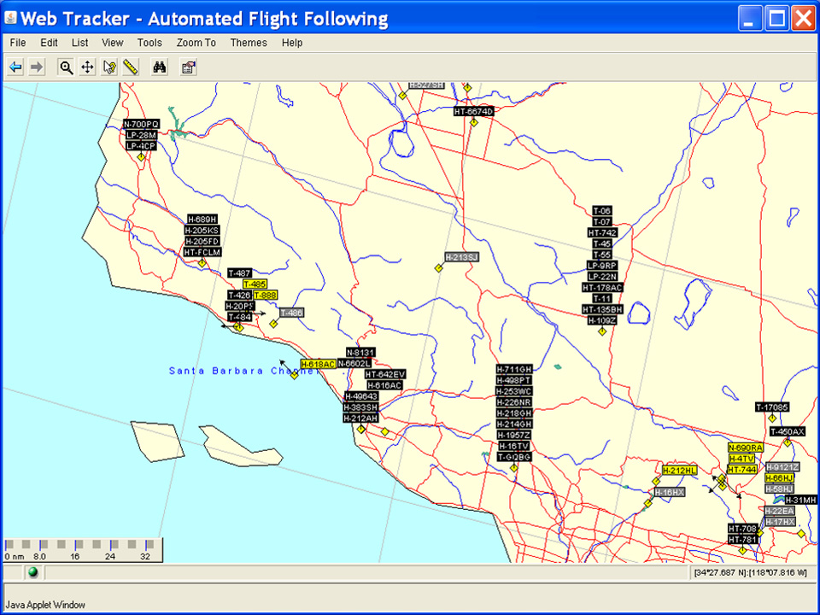
Automated Flight Following
The Flight Track for the Aircraft Selected Will Be Displayed
https://www.aff.gov

Slide 62

Overdue and Missing Aircraft
Report overdue and missing aircraft orally to your supervisor, dispatcher, or aviation manager immediately.

Slide 63

Overdue Aircraft
An aircraft is considered “overdue” when the pilot fails to check in within the timeframe specified in the agency’s flight
following request or when operating on
an FAA flight plan, fails to
arrive within 30
minutes past ETA and its location
cannot be established.

Slide 64
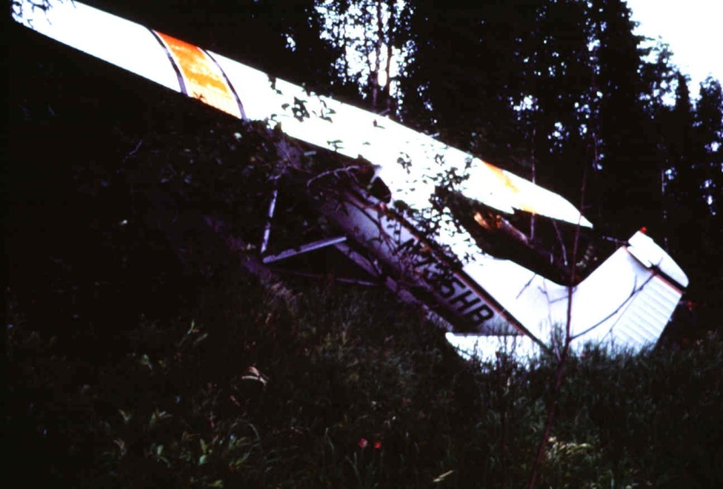
Missing Aircraft
The aircraft is officially “missing” when its fuel duration has been exceeded and the aircraft’s location is not known.

Slide 65
Emergency Response
Filing a written flight plan and flight following dramatically decreases the response time for SAR efforts.
It may require more than 5 hours for individuals to check and confirm there is a missing aircraft.

Slide 66
Emergency Response
The average time for SAR initial notification is about 30 minutes after an aircraft is determined to be overdue or missing.
Average time for SAR units to arrive on scene is about 4 hours.

Slide 67
Flight Planning – Emergency Response
Without a flight plan, in a downed
aircraft, if you have even minor
injuries, the chances of your survival
are slim.
It may take more than a day for
someone to acknowledge that you are
missing (FAA average of 35.5 hours).

Slide 68
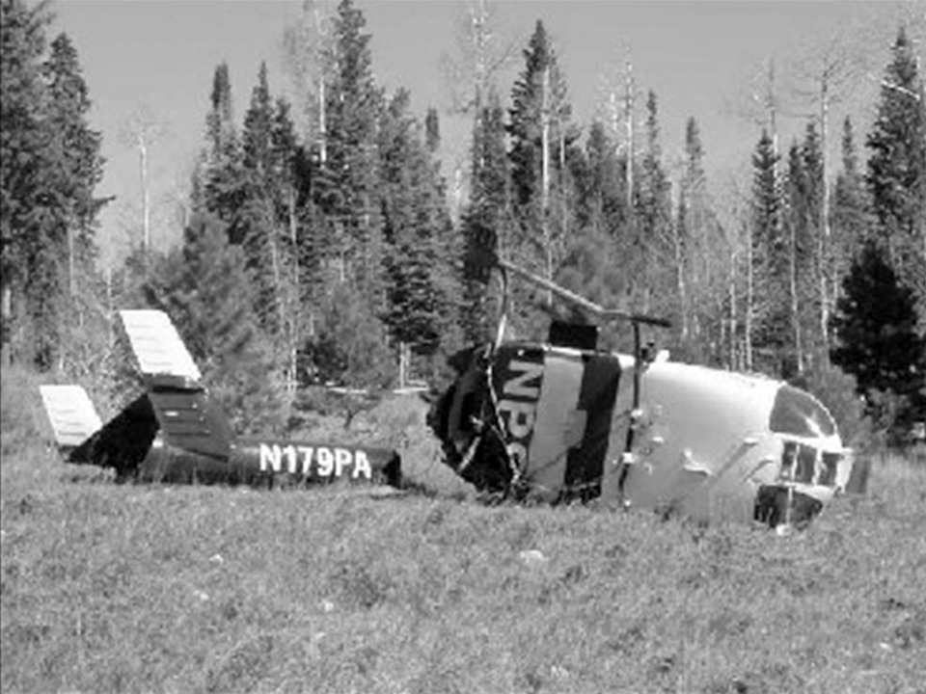
Emergency Response
Postcrash Survival Time
Injured – 24 hours
Uninjured – 72 hours
 | SAR Alert | Arrival
Flight Following | 0.5 hours | 4.0 hours
Flight Plan | 5.5 hours | 38.0 hours
No Flight Plan | 35.5 hours | 82.0 hours

Slide 69
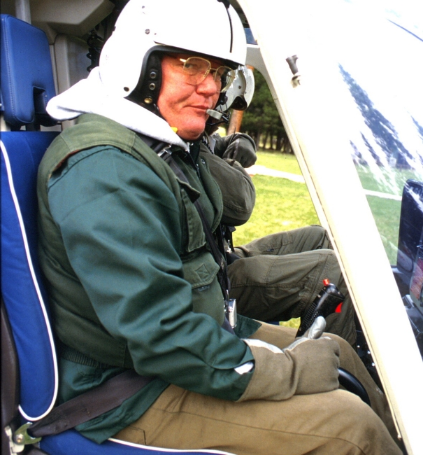
AIRCRAFT AND PILOT REQUIREMENTS

Slide 70

Federal Aviation Administration (FAA)
FAR 14 CFR parts:
91, 133, 135, 137
Common acronyms:
Notice to Airmen (NOTAM)
Advisory Circulars (AC)
Temporary Flight Restrictions (TFRs)
Instrument Flight Rules (IFR)
Visual Flight Rules (VFR)

Slide 71
Aircraft and Pilot Requirements
Aircraft and pilots used by Federal agencies must:
Meet Federal Aviation Administration (FAA) aircraft safety and pilot qualification requirements
Meet Federal agency requirements (aircraft inspection, pilot proficiency training, flight hours, medical and physical requirements, etc.)

Slide 72
Pilot Qualification Card
Provides information regarding what types of aircraft and missions the pilot is approved to fly.
Special use missions require the pilot to demonstrate and to perform to the satisfaction of an AMD or USFS pilot inspector.
AMD and USFS use the same Pilot Qualification Card.

Slide 73
Pilot Qualification Card
Pilots must keep the card in their possession at all times.
Check card expiration date for currency.
If type of mission has a slash through it and is not initialed, do not fly that mission.

Slide 74
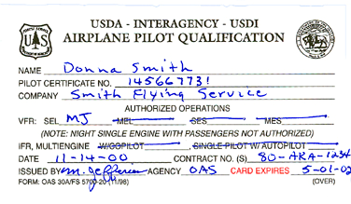
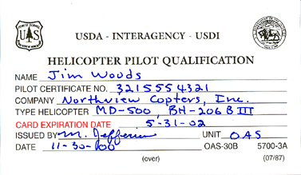
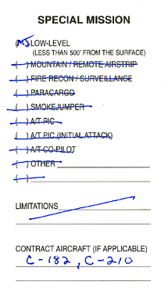
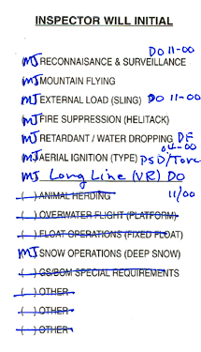
Pilot
Qualification
Card

Slide 75
Aircraft Data Card
Identifies authorized uses of aircraft.
Inspected for “special use” activities.
Helicopter Data Card stamped with red “Interagency Fire” is approved for interagency fire use.
Check expiration date for currency.
If mission on card has a slash through it and is not initialed, do not fly that mission.

Slide 76
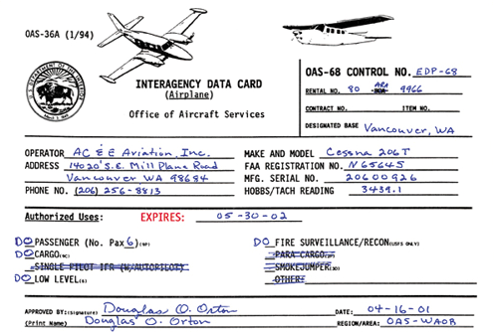
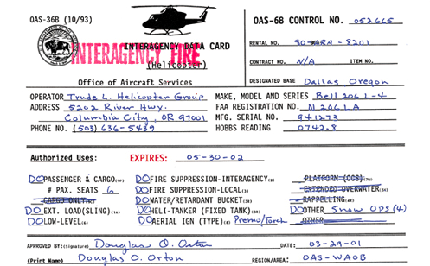
Aircraft
Data Card
(Airplane)
AMD
Aircraft
Data Card
(Helicopter)
AMD

Slide 77


Aircraft
Data Card
(Airplane)
USFS
Aircraft
Data Card
(Helicopter)
USFS

Slide 78
Aircraft Data Card
Airplanes not approved for special use missions are issued a separate card/letter.
Card or letter will state “Rental Only – Not for Special Use” or “Point-to-Point” use.
These aircraft can be used only for point-to-point or administrative flights (airport to airport).

Slide 79
Aircraft and Pilot Requirements
If either the Pilot Qualification Card or the Aircraft Data Card has expired or is missing prior to the flight,
DO NOT GO!!!!
Report situation to your dispatcher, immediate supervisor, or unit aviation specialist.

Slide 80
Pilot Qualification Card and
Aircraft Data Card
As a passenger, you should ensure the pilot and aircraft are qualified for the mission by asking to see the pilot/aircraft cards.

Slide 81
Cooperator Aircraft
(State, Private, Military)
Memorandum of Understanding (MOU) required.
USFS or AMD must approve aircraft and pilots.
USFS or AMD issues letter identifying approved aircraft and pilots.

Slide 82

Single Pilot Flight and
Duty Limitations
8 hours flight
time/day
14 consecutive
duty hours/day
10 hours rest
between days
36 hours in 6
days (not to
exceed 42 hours)
2 days off in any 14-day period

Slide 83
Single Pilot Flight and
Duty Limitations
Cooperator aircraft pilots may have different rules than federal agencies.
For example, CAL FIRE only flies 7 hours regardless of jurisdiction and federal agencies follow these rules when working under CAL FIRE jurisdiction.

Slide 84

Accident Prevention

Slide 85
Proactive Passenger Responsibilities
Question things you encounter that are unusual. Don’t be afraid to speak up.
Decline flights you feel are unsafe and report these to an aviation manager.
Ensure the pilot is aware of discrepancies you observe.
Trust your senses and don’t be intimidated by peers or superiors. If it doesn’t feel right, it probably isn’t.

Slide 86
Proactive Passenger Responsibilities
Be professional, continue to learn, maintain situational awareness, and respond to challenging situations appropriately.
Adhere to standard operating procedures.
Never assume the pilot sees everything. Look for and notify the pilot of potentially hazardous situations.

Slide 87

Maintenance Deficiency
Any serious defect
or failure causing mechanical difficulties encountered in aircraft operations and not specifically identified as an aircraft incident or aviation hazard.

Slide 88

Transportation of Hazardous
Material

Slide 89

Hazardous Materials
A substance or material that has been determined by the Secretary of Transportation to be capable of posing an unreasonable
risk to health, safety,
and property when
transported in
commerce.

Slide 90
Hazardous Materials
Not allowed on commercial airlines:
  Fuel and oil containers
  Gasoline
  Strike-anywhere matches
  Fusees and other firing devices
  Fireline explosives
  Compressed gas
  Chainsaws
  Guns and ammunition

Slide 91
Hazardous Materials
Through a limited Grant of Exemption, Federal agencies can carry hazardous materials on agency fire use aircraft (including contract aircraft) in approved, properly labeled and secured containers.
Pilot can still refuse to carry hazardous material that is determined to be unsafe for flight.

Slide 92
Exercise:
Hazardous Material Transport
Assigned hazardous materials: chainsaws, fusees, pepper spray, guns, ammunition, batteries, gasoline, and compressed gases.
Using the IATHMG, look up the correct way to transport your assigned hazardous material(s) in an aircraft.
Select a spokesperson to inform the class of the proper way to transport your assigned hazardous material(s).
When finished, review group answers and discuss why it is important to follow this guide.

Slide 93

Reporting Aviation Mishaps

Slide 94

Aircraft Accident
An occurrence associated with the operation of an aircraft, which takes place between the time any person boards the aircraft with the intention of flight and the time all such persons have disembarked, and in which any person suffers death or
serious injury, or in which
the aircraft receives
substantial damage.

Slide 95

Incident with Potential
An incident that narrowly misses
being an accident and in which the circumstances indicate serious potential for substantial damage or injury.

Slide 96

Aircraft Incident
An occurrence, other than an accident, associated with the operation of an aircraft that affects, or could affect, the safety of operations or the mission.

Slide 97
Aircraft Incident
Failure to file a flight plan or flight following.
Precautionary landing.
Aircraft ground mishap.
Near midair collision.

Slide 98

Aviation Hazard
Any condition, act, or set of circumstances that compromises
the safety of personnel engaged in aviation activities.

Slide 99
Aviation Hazard
Deviation from policies, procedures, and regulations
Hazardous materials handling and/or transport
Flight following
Deviation from planned operations or flight plan
Failure to use required PPE
Inadequate training, or failure to meet training requirements

Slide 100
Aviation Hazard
Failure to use load calculations and/or manifests correctly
Weather conditions
Ground operations pilot procedures
Fuel contamination
Unsafe actions by pilot, air crew, passengers, or support personnel

Slide 101
The Aviation Safety Communiqué (SAFECOM)
The Department of the Interior (DOI) and the U.S. Forest Service (FS) have an incident/hazard reporting form called The Aviation Safety Communiqué (SAFECOM).
The SAFECOM is used to report any condition, observance, act, maintenance problem, or circumstance that has the potential to cause an aviation-related mishap.
A SAFECOM’s sole purpose is for mishap prevention.
A SAFECOM is not intended to point fingers or place blame and should not be used in disciplinary action against any employee or used against contractors in any manner including contract evaluations.
Use of a SAFECOM for any other purpose is prohibited.

Slide 102

Internet Site

Slide 103



SAFECOM Program
Who can submit a SAFECOM?
  A SAFECOM may be submitted by anyone who observes an aviation hazard (or a commendable action).
    Government employees and managers
    Contractor employees
    Aviation users

Slide 104


Fill in all blanks
until completed
then choose
continue

Slide 105

SAFECOM form can be faxed to DOI, AMD, Aviation Safety
(208) 433-5007 or to the FS at (208) 387-5735 ATTN: SAFETY

Slide 106
Reporting Aviation Mishaps
Report mishaps orally to your supervisor, dispatcher, or aviation manager as soon as possible or practical.
Make factual notes of situation leading up to the mishap, and protect the site for investigators.
Responsible personnel shall file SAFECOM as per agency policy.
State agencies will use appropriate agency form and reporting procedures.

Slide 107
What is our best mechanism for accident prevention?
A JUST CULTURE
that uses the
SAFECOM system

Slide 108
Exercise: Hazardous Situations
Students list hazardous situations involving aircraft.
Divide class into groups and assign each group an equal amount of hazards.
Each group lists corrective action(s) for each hazard and spokesperson presents corrective action(s) to the class.

Slide 109

Safety is
Everyone’s Responsibility!

Slide 110


Slide 111
Safe Flight
Anyone can refuse or curtail a flight when an unsafe condition may exist.
Never let undue pressure influence your judgment.
Avoid mistakes and don’t hurry.
Never pressure the pilot to accomplish the mission.

Slide 112
Safety
Accident prevention is of the greatest importance, and this can
be accomplished by THINKING and USING COMMON SENSE when around aircraft.

Slide 113
Review Unit 2 Objectives
Describe Federal agency pilot and aircraft certification procedures.
Describe the importance of flight planning and flight following for aircraft missions.
Specify the safety procedures to follow while loading and unloading passengers and cargo from an aircraft.

Slide 114
Review Unit 2 Objectives
Identify what hazardous materials cannot be transported on any aircraft and the exemptions.
Describe your responsibility for accident prevention.
Describe the procedure for reporting an incident or mishap.

