Slide 1
Aircraft missions
Unit 3

Slide 2
Unit 3 Objectives
1. Define tactical and logistical use of aircraft.
Identify the advantages and disadvantages of the various tactical aircraft missions.
Identify the different logistical aircraft missions and their purpose.

Slide 3
Unit 3 Objectives
4. Describe the proper air-to-ground communication procedures.
Describe safety procedures to follow during aerial fire suppression operations.
Describe Special Operations.

Slide 4
Tactical Aircraft Missions

Slide 5
Tactical Aircraft Missions
Tactical aircraft missions can be defined as any mission that uses an aircraft to accomplish a specific tactical task during fire suppression efforts, e.g., aerial fire suppressant delivery, deliver smokejumpers, transport firefighters and equipment, rappeller delivery, and aerial ignition.

Slide 6
Aerial Fire
Suppressants Delivery
Both airplanes and helicopters are used to drop aerial fire suppressants (retardant, water, gel, and foam) onto a wildland fire in an effort to slow its advancement and to contain the fire.
Very effective during initial attack.

Slide 7
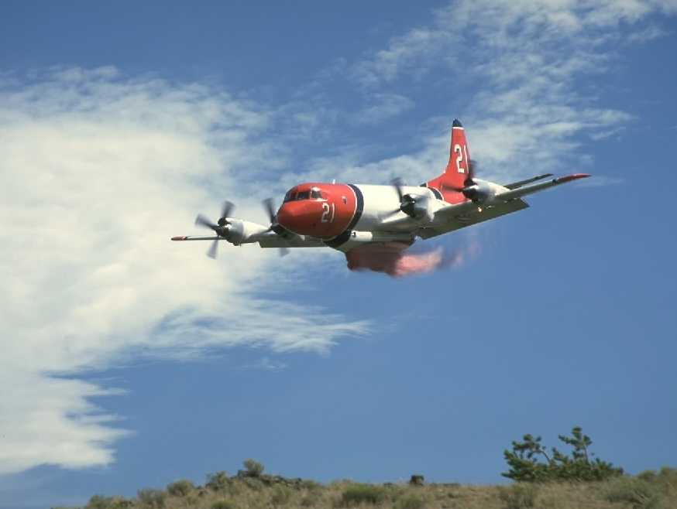
air tanker/seat
Advantages
Large volumes
Multiple drop capability
Fast travel times
Good for initial attack

Slide 8
air tanker/seat disadvantages
Nonaccessible terrain
Long turnaround times
Less accurate than helicopters
Single purpose use
Interrupt other aircraft missions
Only about 20 to 24 Federal large air tankers available in any given year

Slide 9
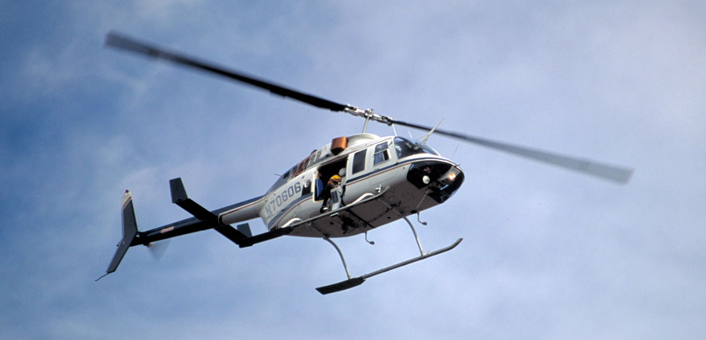
Helicopter Advantages
Drop more gallons per hour if a close source is available.
Used for other types of missions.
Work in steep terrain.
Make accurate drops near homes.

Slide 10
Helicopter disadvantages
Helicopters have wind limitations affecting their use in high winds.
Limited by size, payload, airspeed, and range.
Weather and daylight dependent.

Slide 11
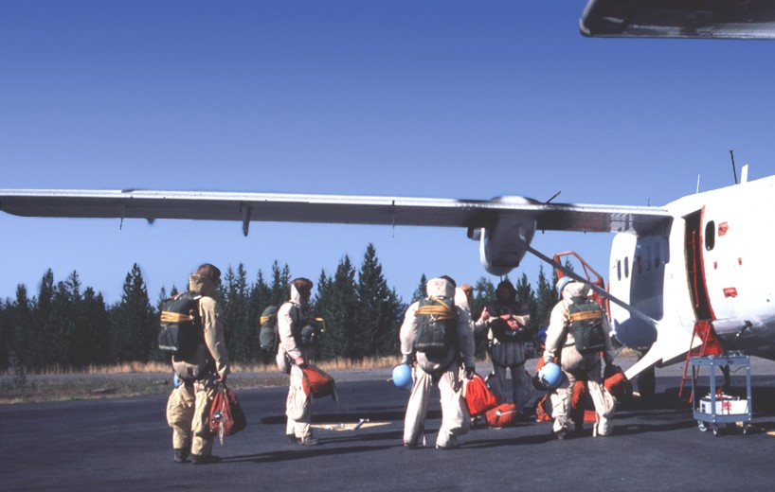
Smokejumper
Advantages
Rapid delivery of firefighters
No aircraft landing area required
Self-supporting for two shifts
Aircraft can deliver fire supplies and equipment (paracargo)

Slide 12
Smokejumper Disadvantages
High training & equipment costs
Can’t jump in high winds
Logistics of retrieval (pack out)
Weather and daylight dependent

Slide 13
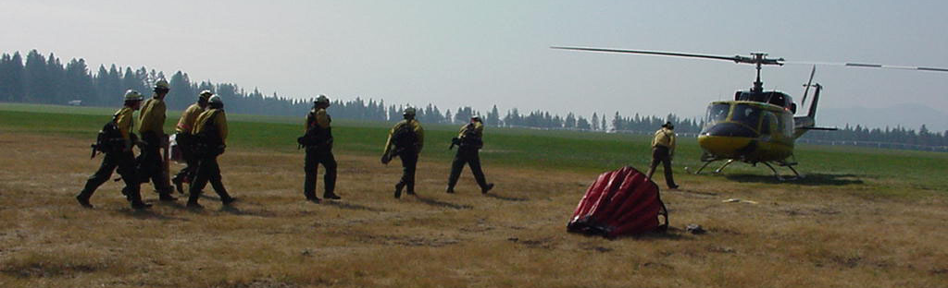
Fire Crews and
Equipment Delivery
Aircraft have the ability to rapidly
deliver for tactical assignment:
Firefighters, crews, and their equipment

Slide 14
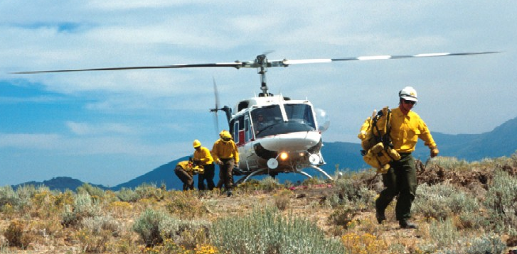
Helitack
Aerially delivered firefighters specially
trained in helicopters operations are
called helitack crews.
Effective for initial attack.

Slide 15
Helitack advantages
Rapid aerial delivery of firefighters
to remote areas
Self-supporting for two shifts

Slide 16
helitack Disadvantages
Dependent on natural or
preestablished landing areas
Limited by aircraft size, airspeed, and range
Weather and daylight dependent

Slide 17
rappelling
Rappelling is delivering firefighters to an area where it is impossible or unsafe to land a helicopter.
Firefighters descend down ropes from a hovering helicopter.
Can be effective for initial attack in remote areas.

Slide 18
Rappelling advantages
Rapid delivery of firefighters to remote areas.
No landing area is required.
Self-supporting for two shifts.
Rappel helicopter can be used to deliver firefighting supplies and equipment and for water bucket work.

Slide 19
rappelling Disadvantages
Higher training and equipment cost.
Limited by aircraft size, airspeed, and range.
Limited to rappel rope length.
Unable to hover in high winds to let down rappellers.
Weather and daylight dependent.

Slide 20
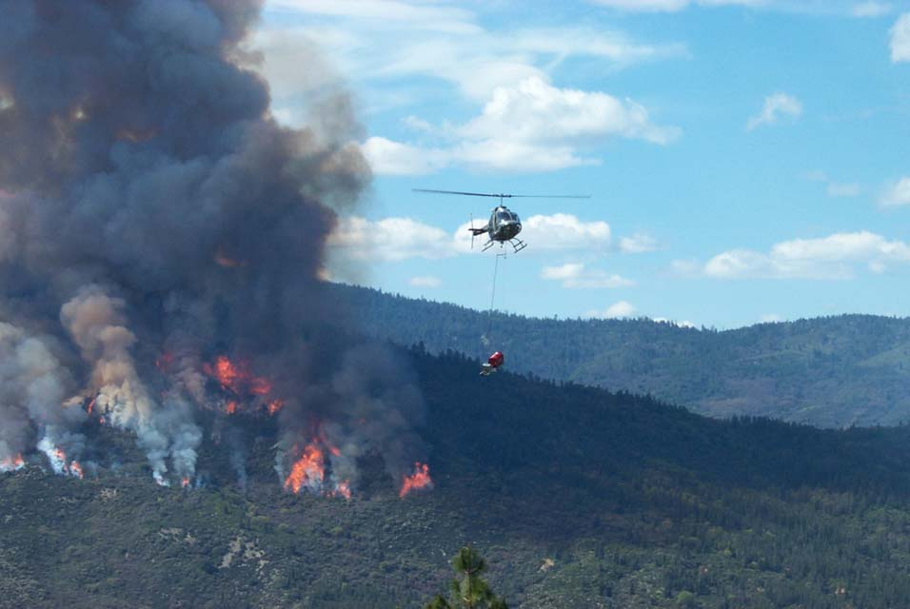
Aerial ignition
Aerial ignition systems are used to apply fire on the ground from the air to assist in the containment and control during fire suppression efforts.

Slide 21
Aerial ignition
Ignition is done quicker than ground igniting methods.
Ignition can cover a large area.
Area to be burned is inaccessible or unsafe for people on the ground to accomplish.

Slide 22
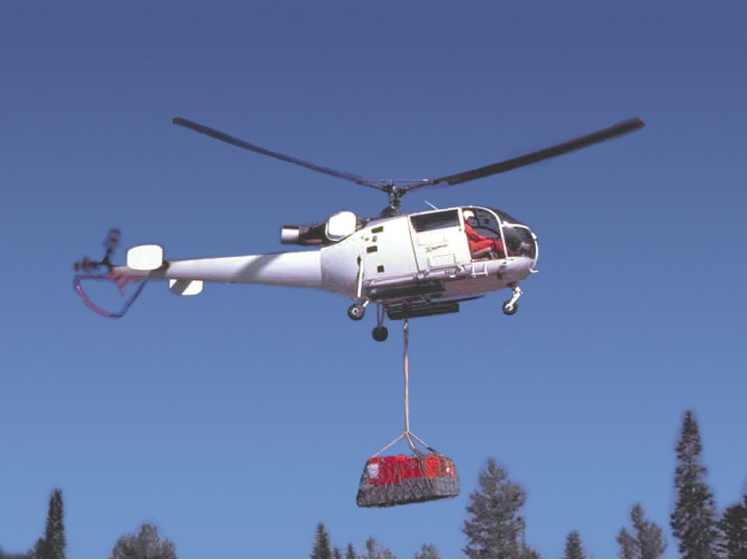
Logistical Missions
Any aviation activities that support suppression of a fire or project but are not in themselves tactical.

Slide 23
Transportation of People and Supplies
People or equipment must be moved long distances.
When ground transport methods are not feasible.
Short timeframe exists to meet the needs of the fire suppression efforts.
Aircraft may range from a light single-engine to a large Boeing 737.

Slide 24
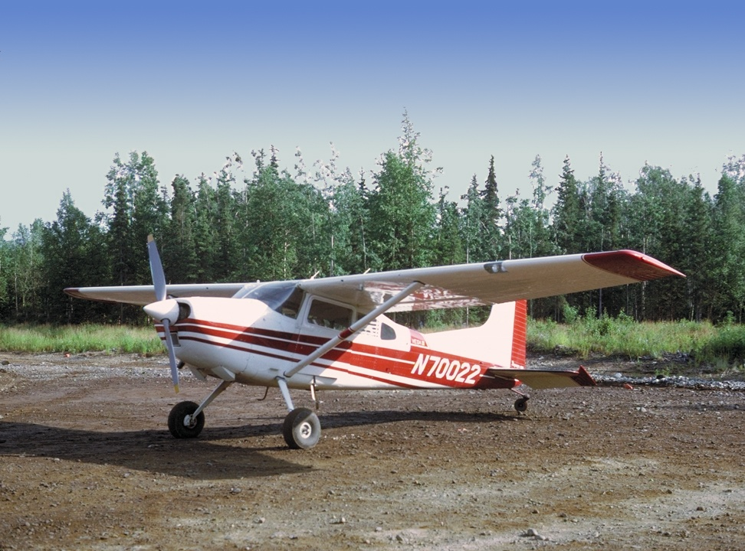
Single-Engine

Slide 25
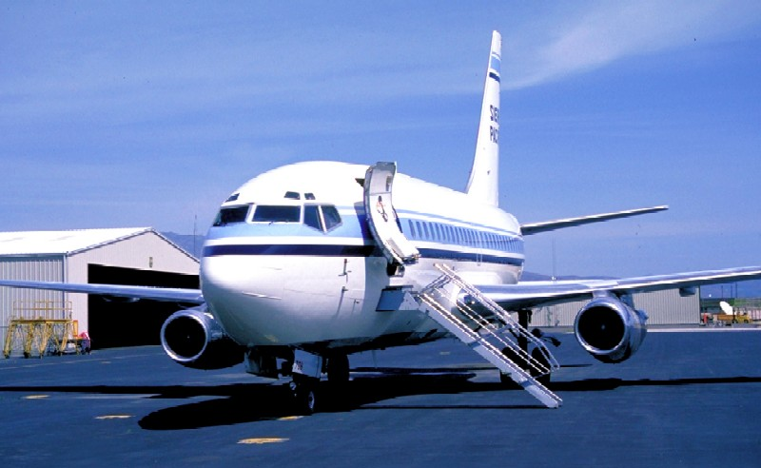
Large Transport Aircraft

Slide 26
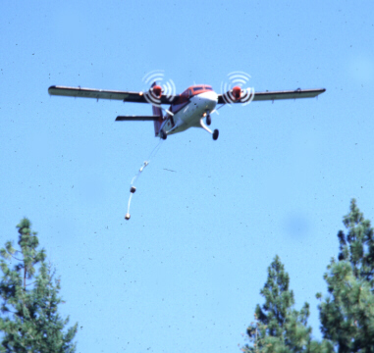
Paracargo Drop

Slide 27
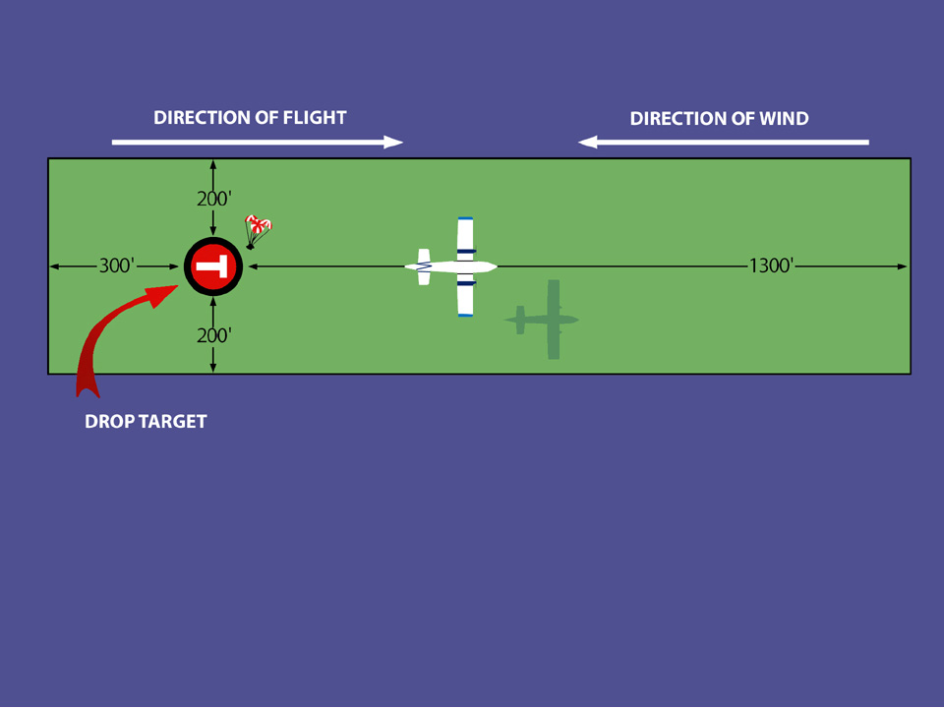
Paracargo drop zone
safety requirements

Slide 28
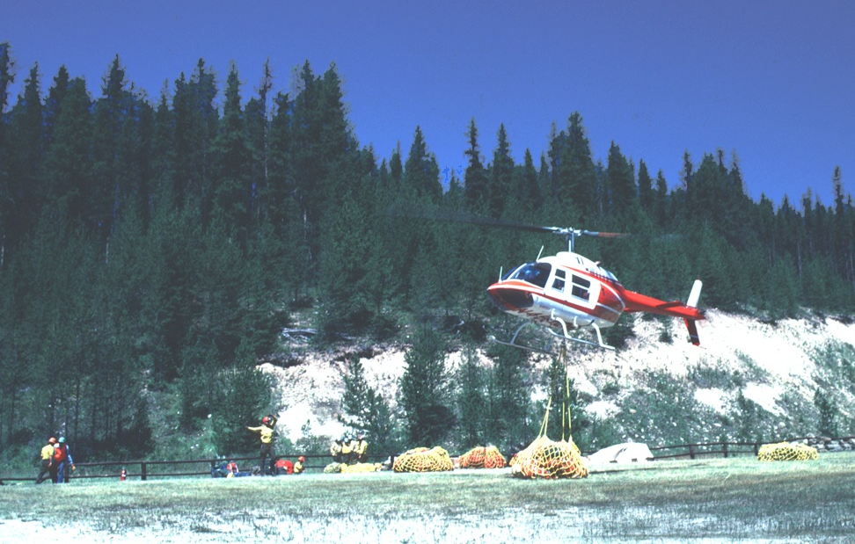
Helicopters
transport equipment and supplies internally and externally.

Slide 29
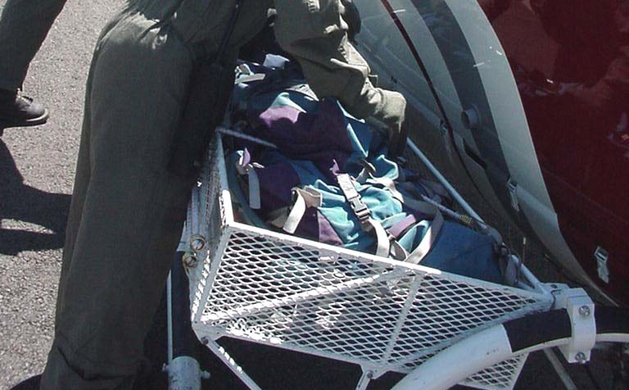
External Cargo rack

Slide 30
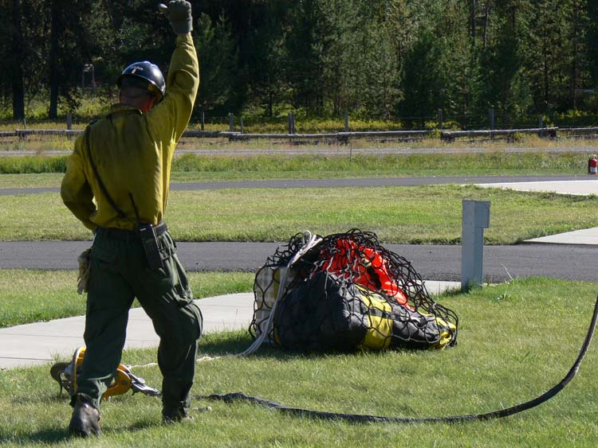
Sling Loads
require qualified personnel.

Slide 31
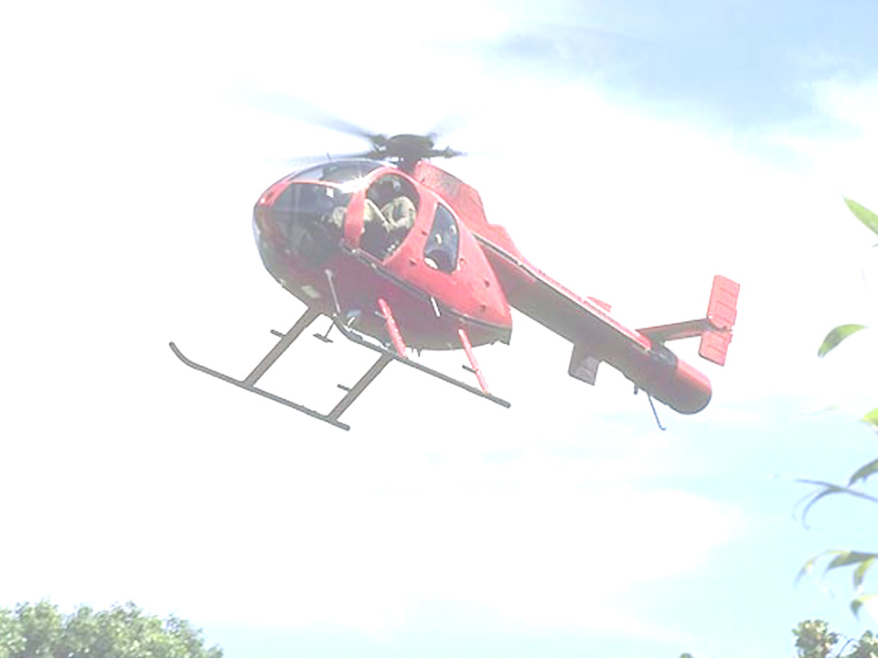
Fire Perimeter Mapping
A Field Observer (FOBS) from the Planning Section will be onboard the aircraft with a global positioning system (GPS).
As the aircraft flies the perimeter, the FOBS will enter waypoints of the perimeter into the GPS unit.

Slide 32
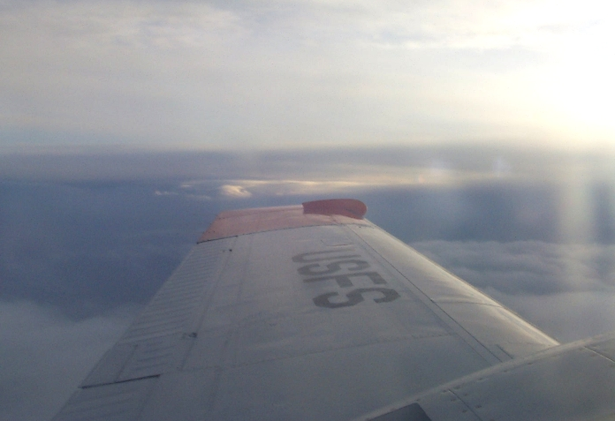
Detection and Reconnaissance

Slide 33
Detection and
Reconnaissance
Aircraft are often used for detection and reconnaissance of fires:
Ability to cover vast areas in a short time to detect or find fires.
Better visual vantage point for reconnaissance.
Sometimes the only safe or possible way to monitor the fire’s behavior is by aircraft.

Slide 34
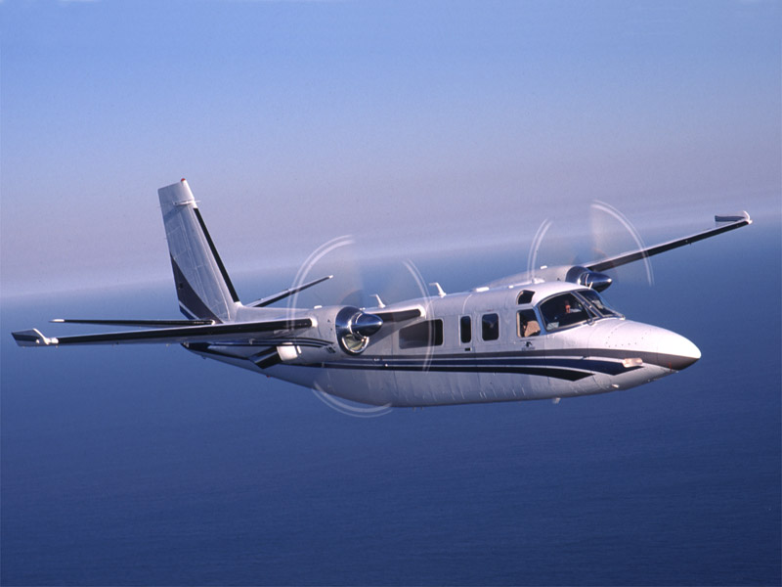
Detection and reconnaissance
NOTE:
Aircraft is not a substitute for a ground-based lookout on a fire.

Slide 35
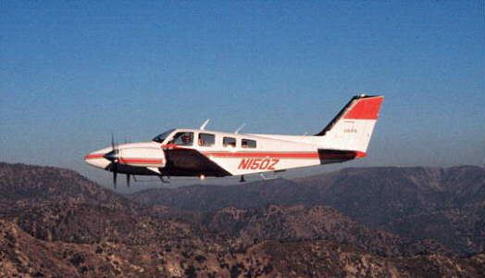
Detection and
Reconnaissance
Single or small twin-engine airplanes used:
  For flights above
  500 feet
  To cover long
  distances
  To monitor fire
  for long durations

Slide 36
Helicopters Used
For special use
missions
(flights lower
than 500 feet
AGL)
For close
scouting and
mapping of the
fire perimeter

Slide 37
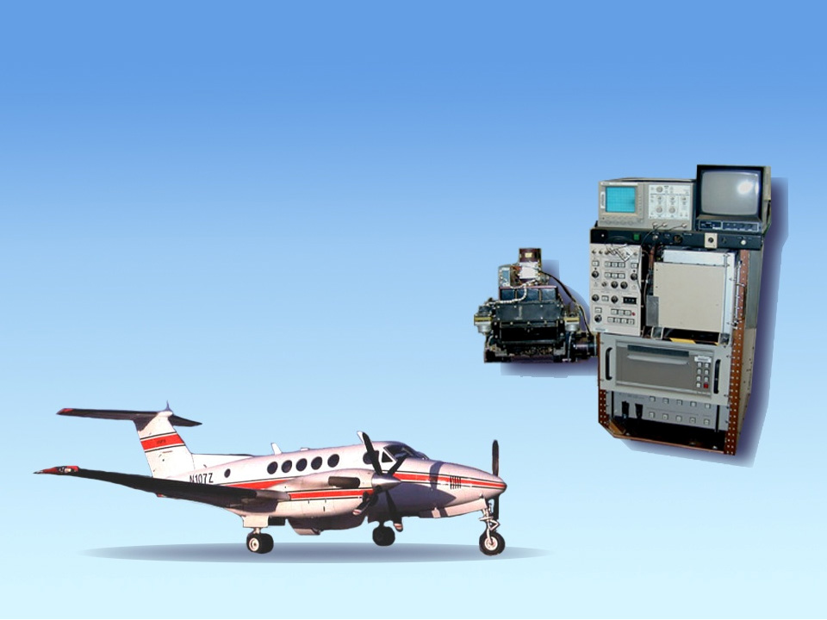
Infrared Mapping System

Slide 38
Infrared
Mapping SYSTEM
Heat detecting devices, which can be mounted or operated from an aircraft to allow firefighters to:
  Determine where the fire is burning during poor visibility conditions.
  Locate hot spots not easily detected outside the fire perimeter.
  Assist in mop up by pinpointing heat sources.

Slide 39
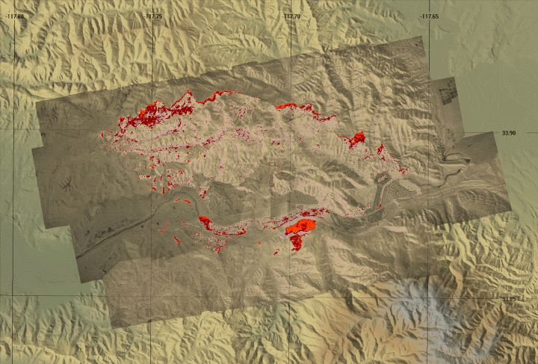
Infrared Mapping

Slide 40
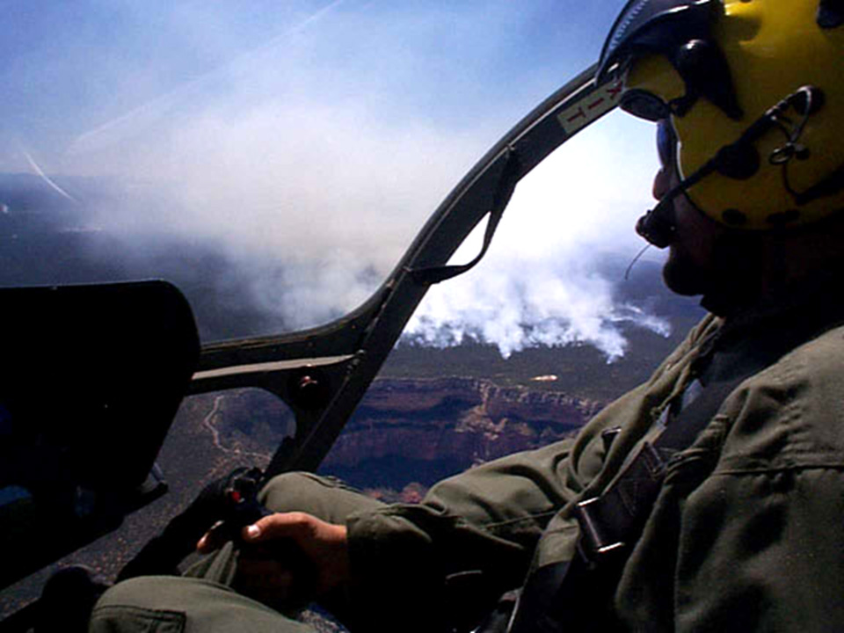
Aerial Photography and
Video Recording
Fire behavior documentation
Training purposes
Public relations (news media)

Slide 41
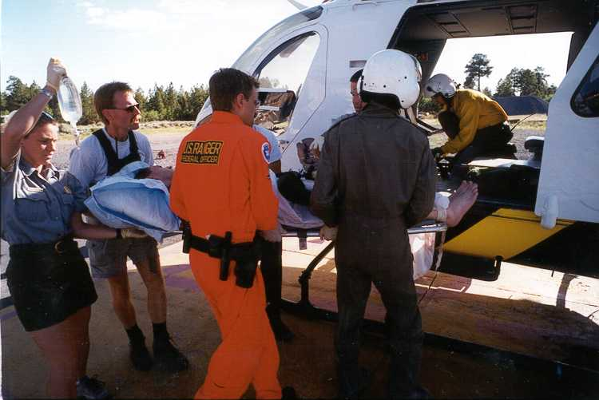
Medical Aid
Airplanes and helicopters are used to deliver medically trained personnel.
Helicopters are
often the only
means of
evacuating
injured
personnel.

Slide 42
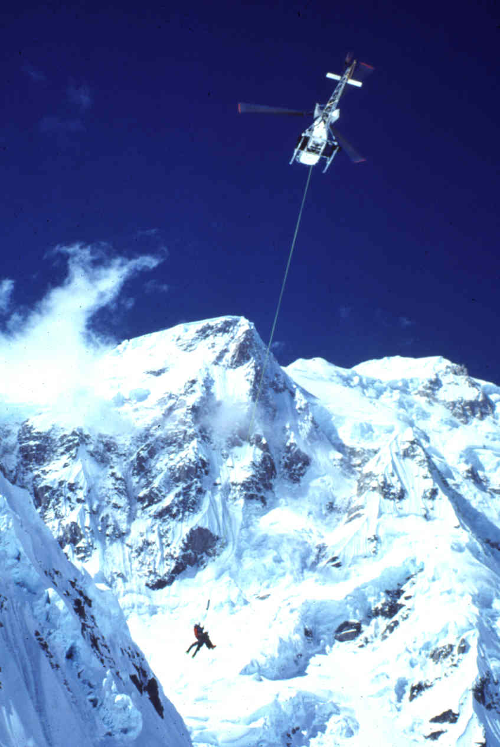
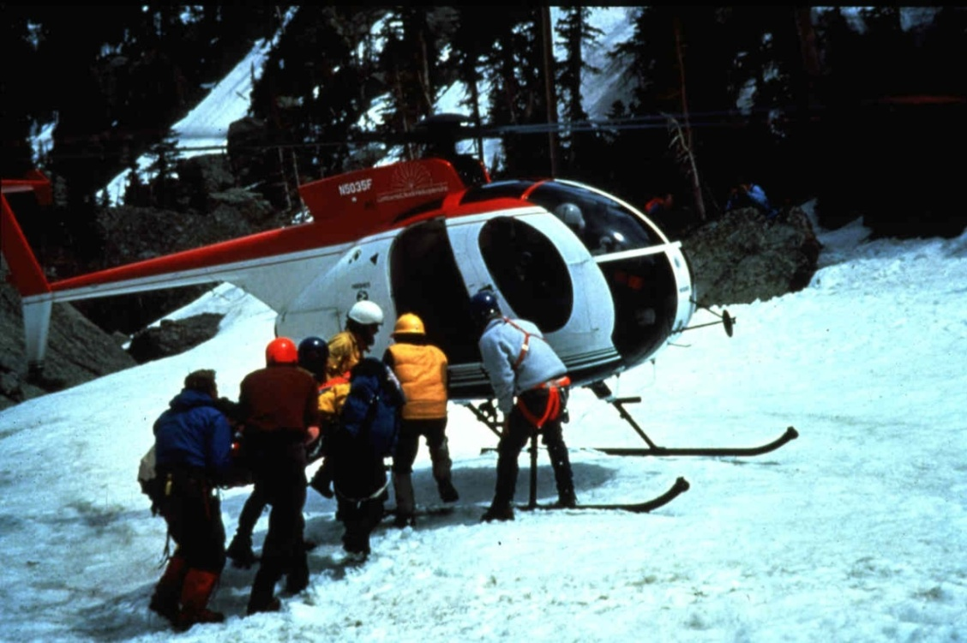
Search and Rescue (SAR)

Slide 43
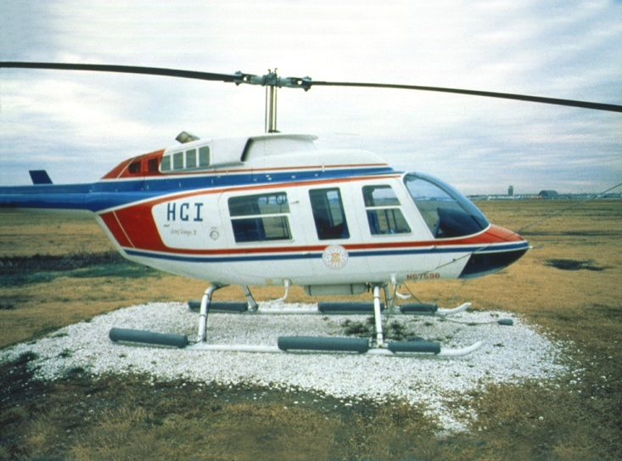
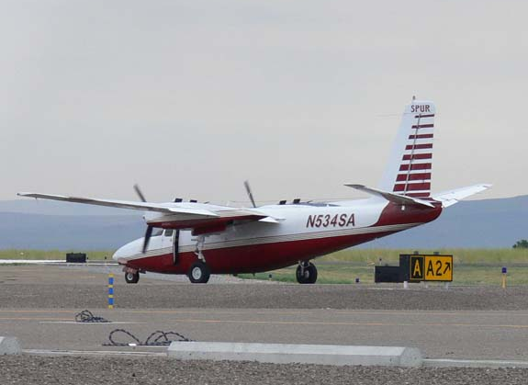
Selection of Aircraft for the Mission
First, you must determine if an aircraft
is absolutely necessary or can the
mission be accomplished by other
ground resources.

Slide 44
Selection of Aircraft for the Mission
Specific aircraft for missions are
selected and assigned based on the
following criteria:
Aircraft operational requirements
Payload

Slide 45
Selection of Aircraft for the Mission
Special Considerations:
Aircraft speed
Aircraft range
Aircraft cost
Mission accomplishment
Logistics
Landing site

Slide 46
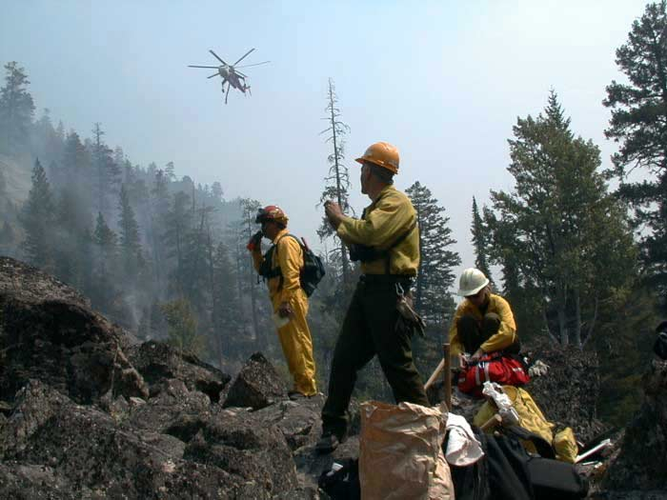
Air-to-Ground Communications

Slide 47
Use of Radios
Air-to-ground frequency normally designated and known by ground personnel and pilots.
Air-to-ground frequency may be discrete frequency or assigned tactical frequency for your division or fire.
During IA, this may be the forest net.

Slide 48
Radio Use
Be sure assigned frequencies are programmed in your radio:
Preassigned initial attack frequencies.
Incident assigned air-to-ground frequency.
Air guard frequency can be used for emergency or establish initial contact with aircraft (all aircraft must monitor this frequency).

Slide 49
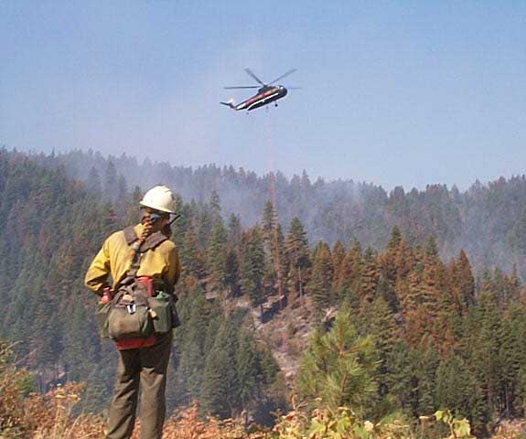
Target Description (TD)
TD is a systematic technique:
Meant to enable the pilot
to locate and identify
the target.
Accomplished by radio
communication between
the ground contact and the pilot.
Meant to communicate the target description and the target location.

Slide 50
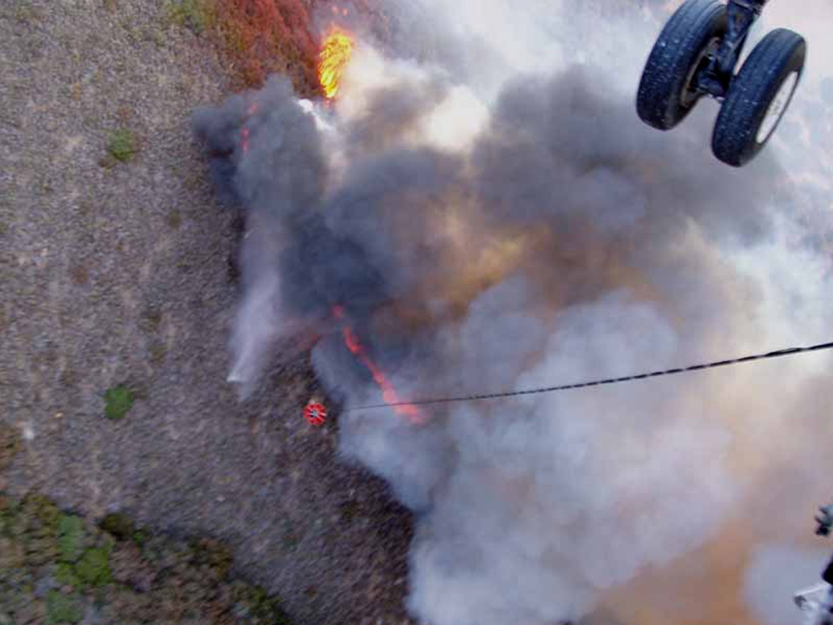
Purpose of TD:
To have the aircraft in the “low and slow” zone the shortest amount of time possible to reduce risk exposure to air and ground personnel.

Slide 51
The Ground Contact Communicates with:
Air Tactical Group Supervisor (ATGS)
or
Aerial Supervision Module (ASM1)
Air Tanker Coordinator
Helicopter Coordinator
(ATCO)
(HLCO)
Lead Plane Pilot
Air Tanker Pilot
Helicopter Pilot
Helicopter Pilot

Slide 52
Before Contacting Aircraft
Need to know:
Hazards to aircraft
Your location
Your call sign
Your tactical objectives (plan)
Aircraft call sign
Aircraft frequencies
Primary and secondary targets
Wind speed and direction

Slide 53
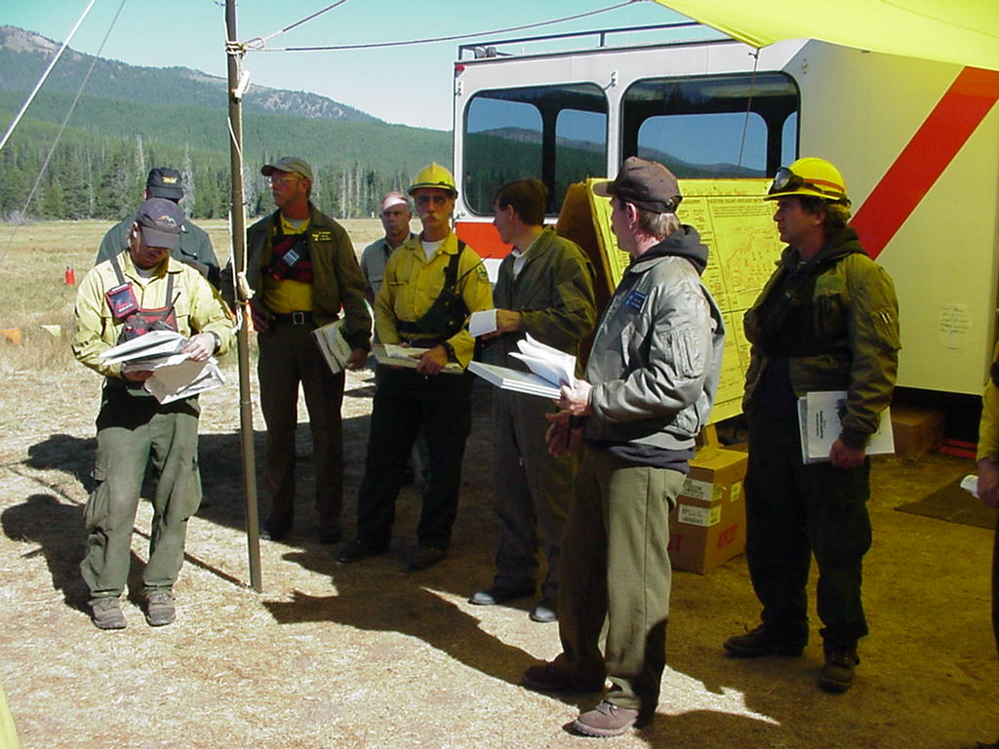
Where do you get this information?
Helibase
IAP (ICS 204 and 220)
Appropriate incident
supervisor
Personal observations
Radio traffic
Briefings

Slide 54
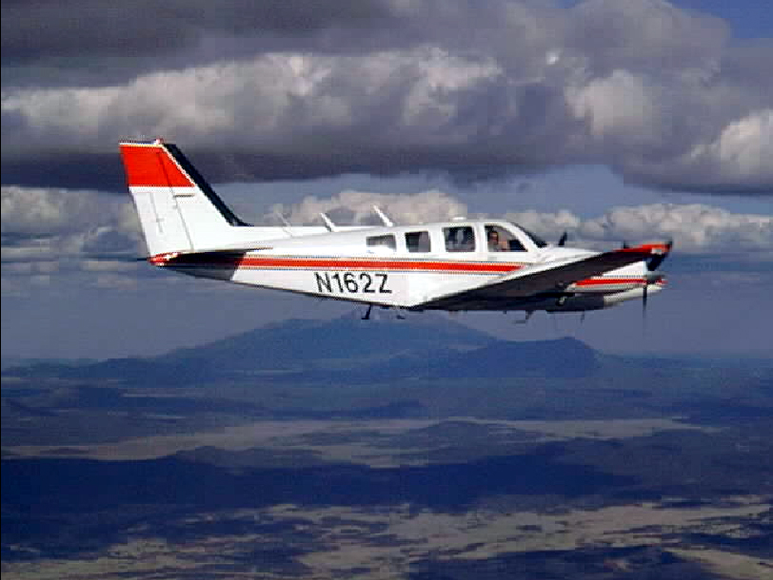
Operating Procedures
Use the ICS aerial supervision resources to request and coordinate drops:
  ATGS
  HLCO
  ATCO

Slide 55
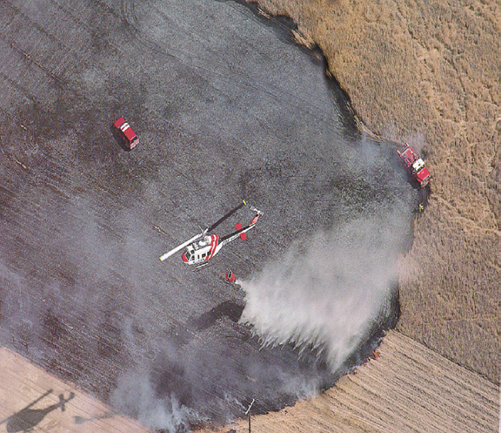
Operating Procedures
Have and know
the tactical plan:
  Anchor & flank
  Hot spot
  Buy time
  Secure the edge

Slide 56
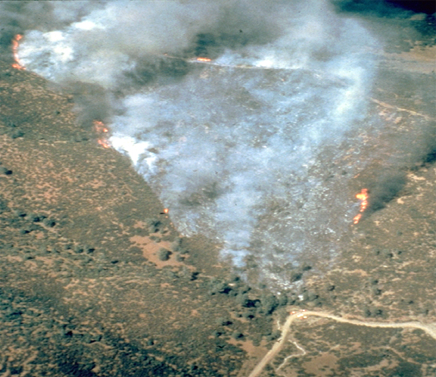
Operating Procedures
Use standard fire terminology
Head
Spot Fire
Right
Flank
Left Flank
Hot
Spot
Heel

Slide 57

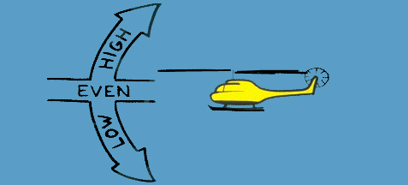
Operating Procedures
Use standard target orientation techniques:
  Parts of the fire
  Clock orientation
  Right, left, nose, tail
  High, even, low
  Cardinal points
  (north, south, east,
  west). only use if
  you and pilot agree
  which way is north.

Slide 58
Clock Orientation Exercise:
From the following slides, establish yourself as a reference point using the clock orientation technique and
if you are high, even, or low.

Slide 59
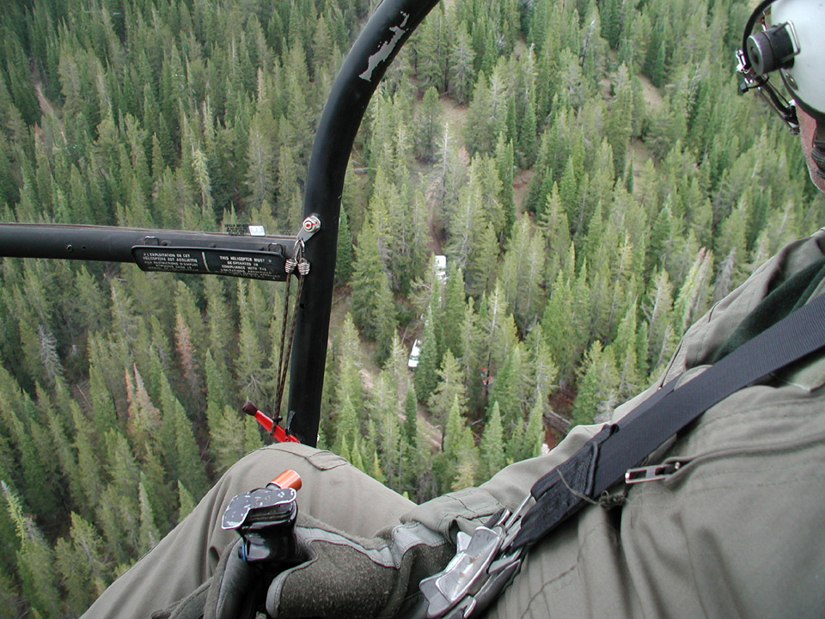
Describe Your Position (clock orientation)
3 o’clock Low
You are here

Slide 60
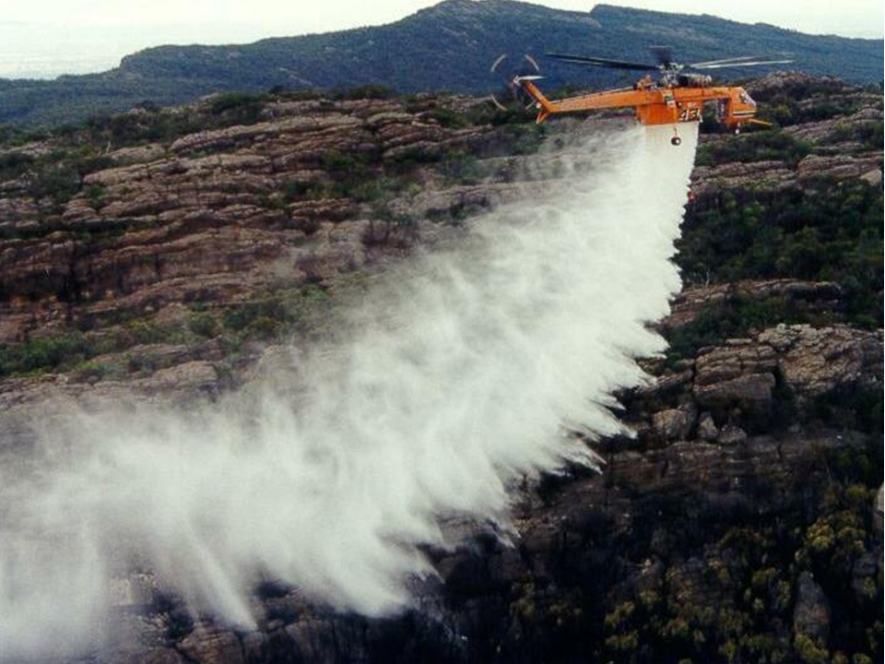
11 o’clock Even
You are here
Describe
Your Position
(clock orientation)

Slide 61
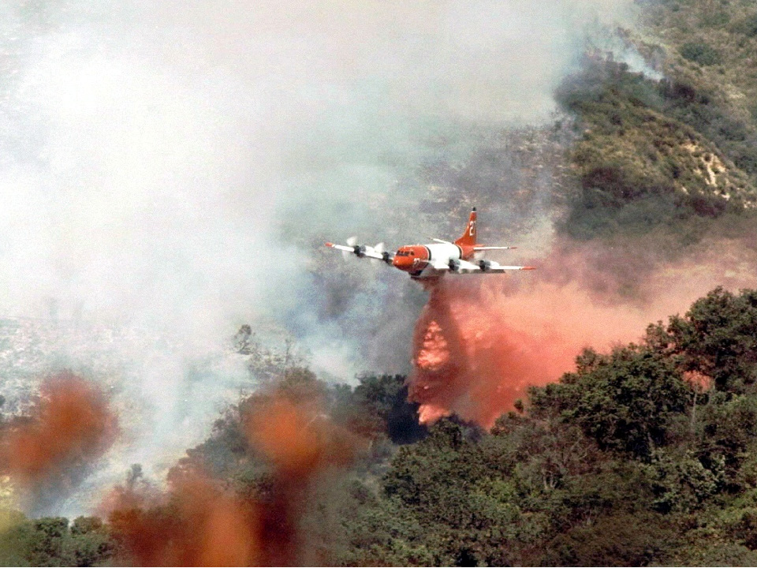
Describe Your Position
(clock orientation)
1 o’clock Low
You are here

Slide 62
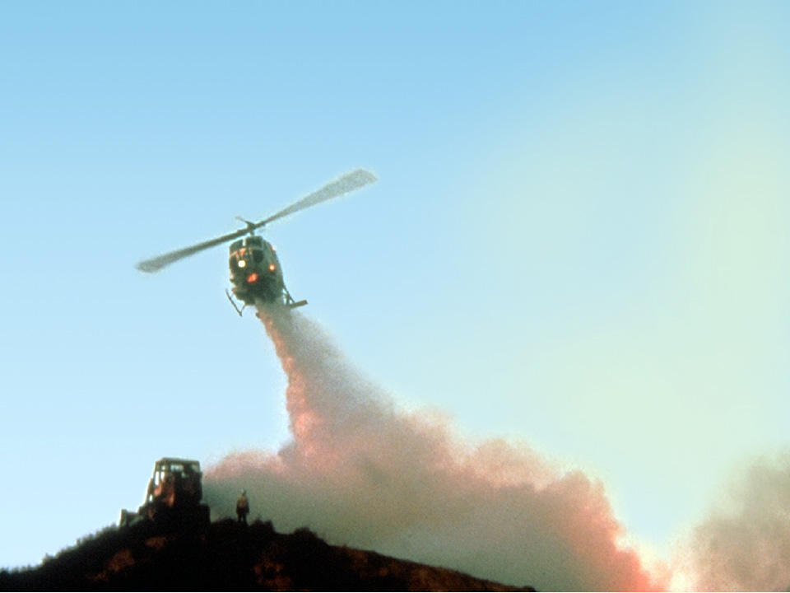
Describe Your Position (clock orientation)
12 o’clock Low
You are here (helicopter is dropping in front of you)

Slide 63
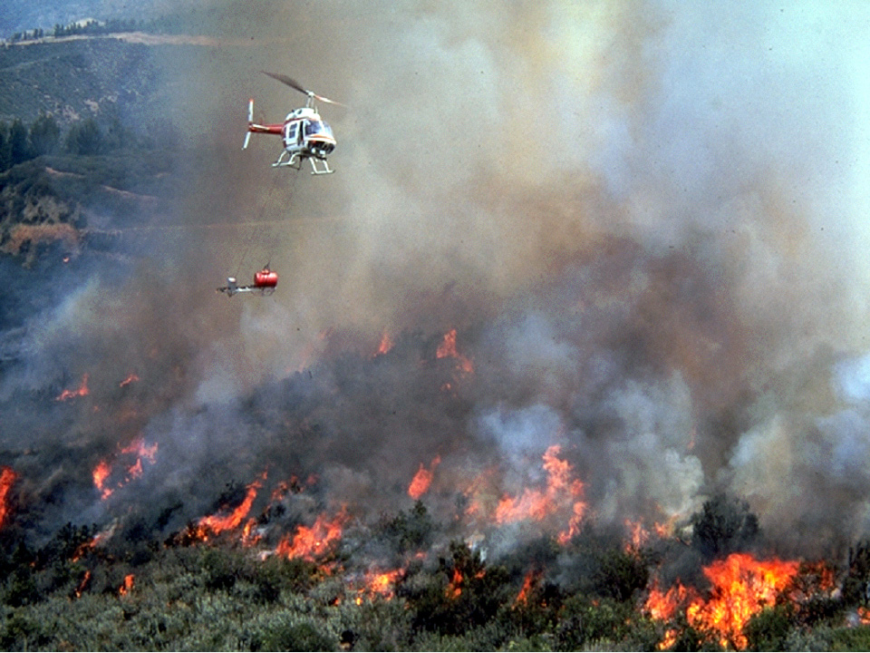
Describe Your Position (clock orientation)
You are here
5 o’clock Low

Slide 64
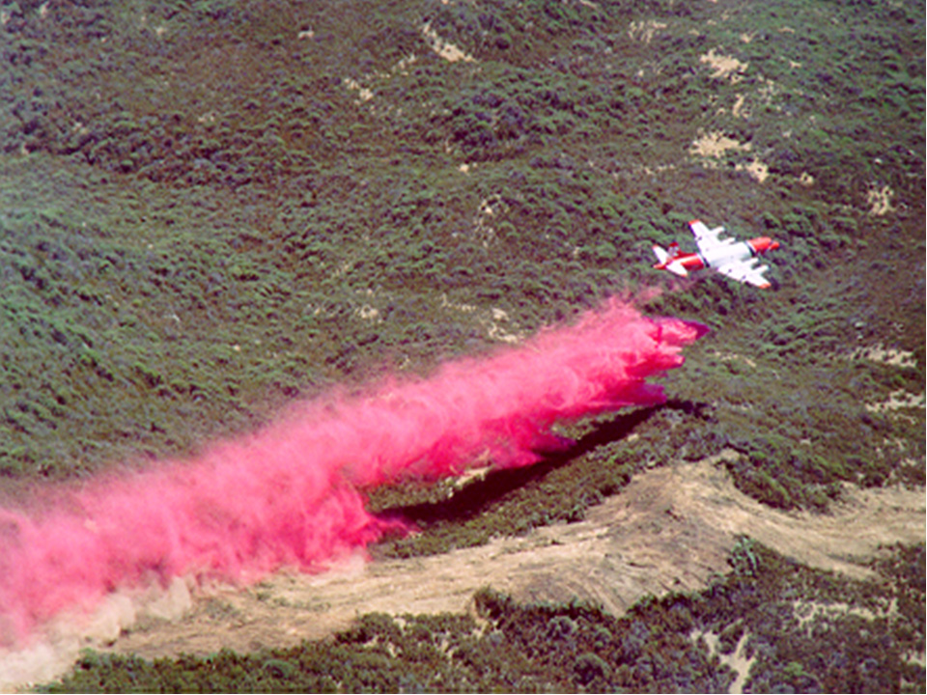
Describe Your Position (clock orientation)
4 o’clock Low
You are here

Slide 65
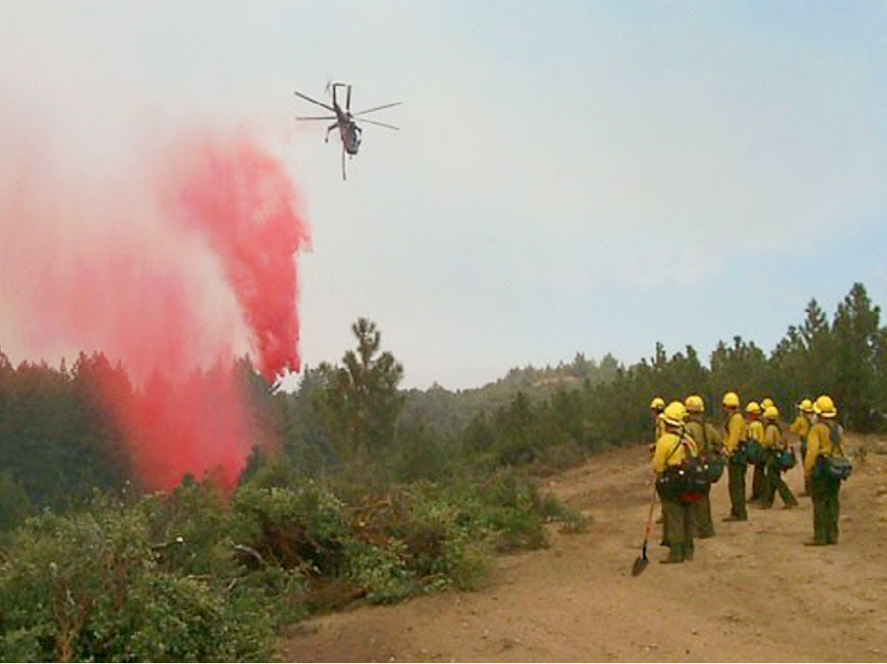
Describe Your Position (clock orientation)
4 o’clock Low
You are here

Slide 66
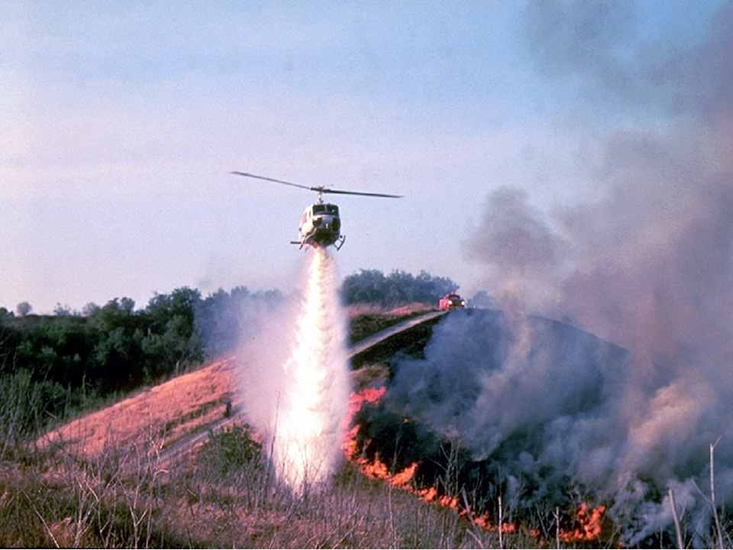
Describe Your Position (clock orientation)
8 o’clock Low
You are here

Slide 67
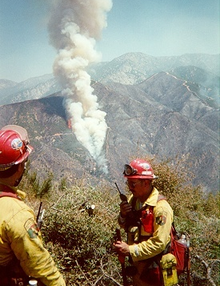
TD Operating Procedures
Use easily identifiable target references such as:
  Extend previous drop
  From your position
  To topographic or
  terrain features
  To human-made features
  Part of fire or fire activity
  To cardinal points
  (agree with pilot which
  way is north)

Slide 68
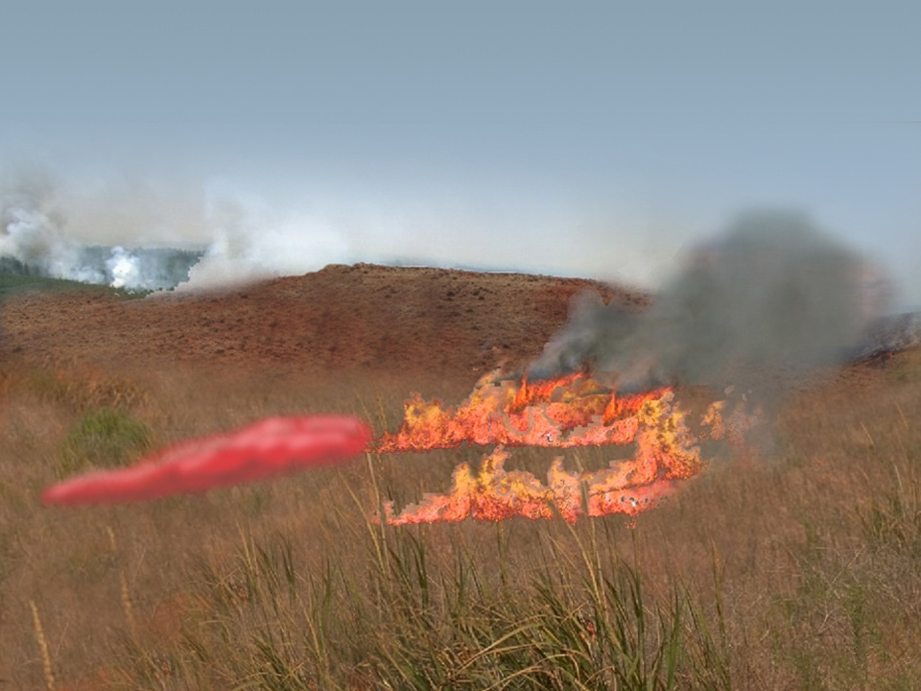
Reference to loads already dropped
“Extend to/from your previous drop”

Slide 69
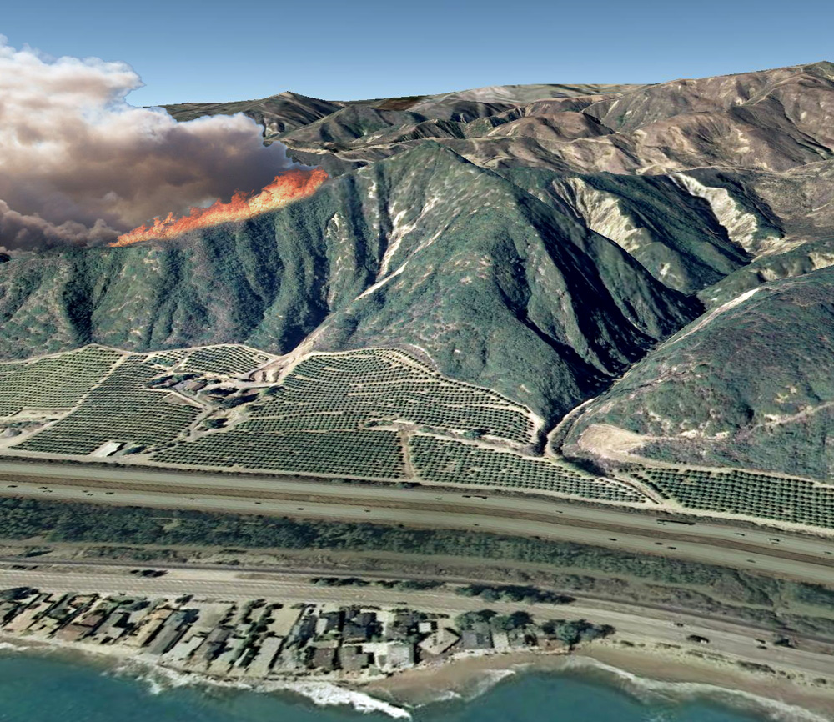
Terrain Features such as draws, ridges, etc.
Human-Made Features
such as roads, structures, etc.

Slide 70
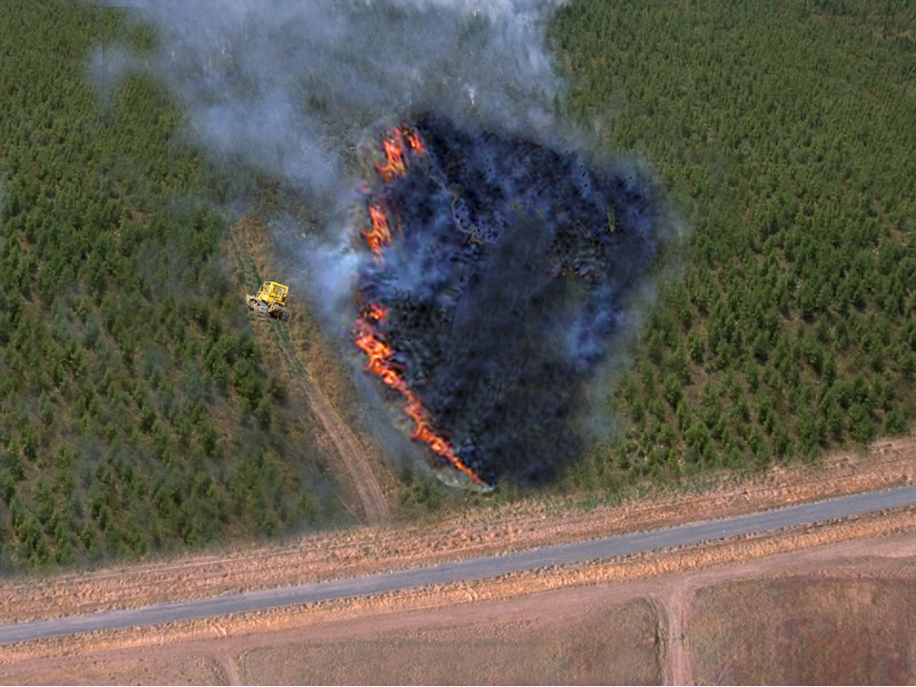
Reference to Cut Areas
(human-made)
“The dozer line
on the left flank”

Slide 71
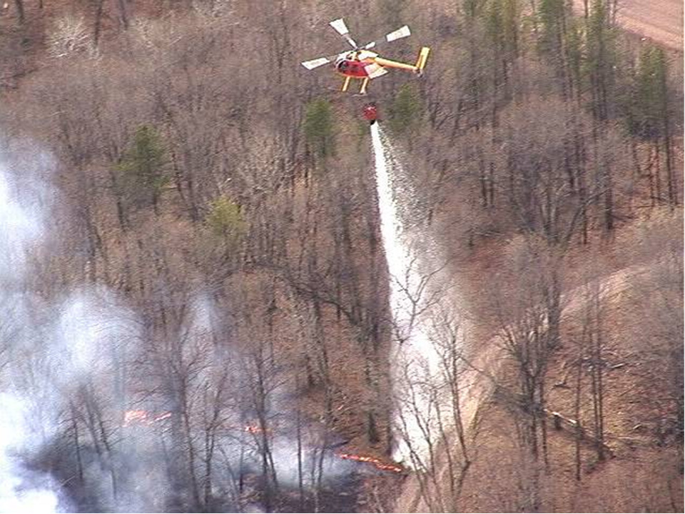
Part of fire
Drop on head of fire,
anchoring from road

Slide 72
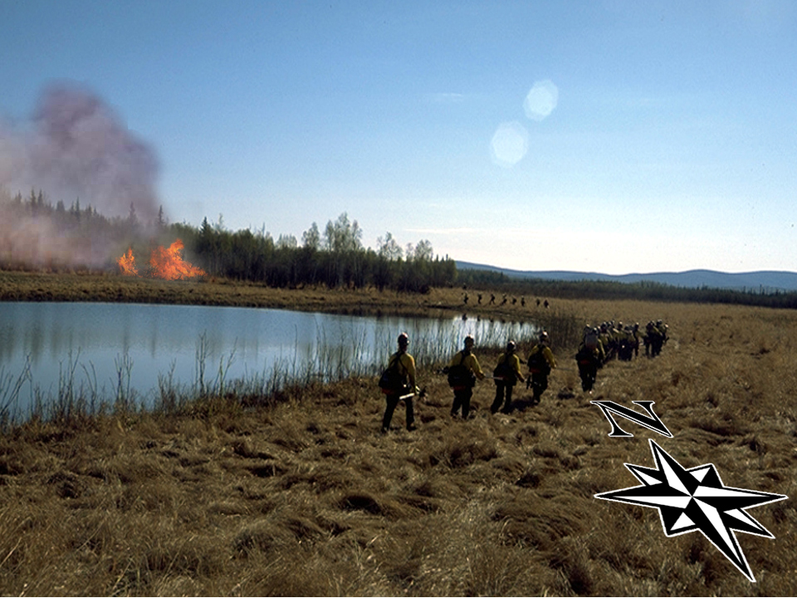
Reference to Cardinal Points
“The spot fire north of the lake”

Slide 73
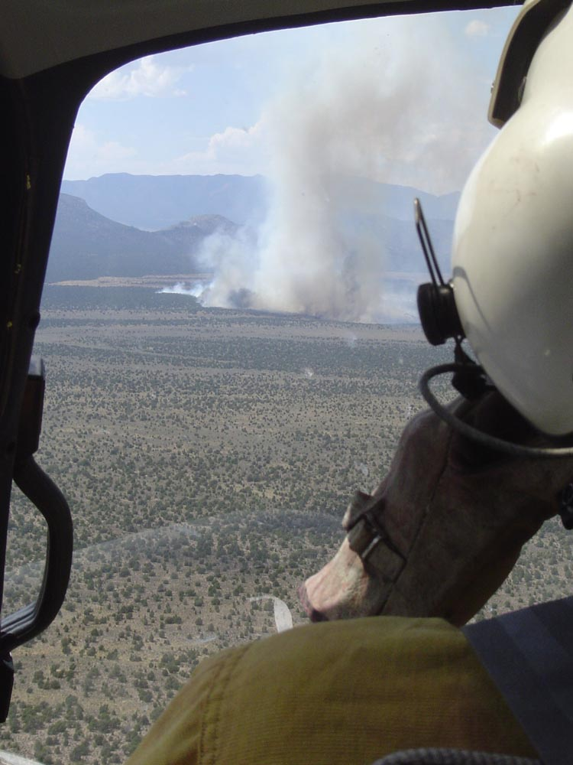
Describe target when pilot can see target!
Use clear text
Be brief, clear, and to the point
Plan your transmission before you key the radio
Don’t “think out loud” on the radio

Slide 74
Stages of Pilot Orientation
Long distance
Medium distance
Short distance

Slide 75
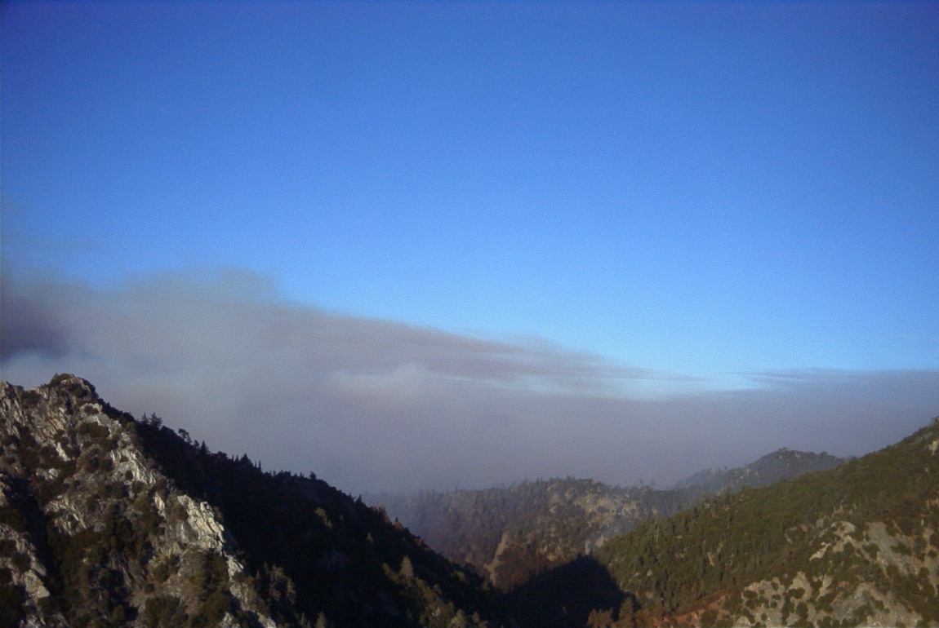
Long Distance Stage
Radio contact but no visual contact with aircraft
Geographical and topographical reference points must be large and obvious.
GPS coordinates
are useful if air
crew has time to
enter information.
Relay lat/longs to
helibase or ATGS
when ordering
aircraft.

Slide 76

Long Distance Stage
Radio contact but no visual contact with aircraft
Keep positive communication with aircraft until visual contact is
established
(both the ground
contact and pilot).

Slide 77

Medium Distance Stage
May or may not have visual contact with aircraft
Reference points must be obvious.
If aircraft is in sight, use the clock orientation technique.
Signaling devices
are effective
(mirrors, strobes,
flares).

Slide 78

Medium Distance Stage
May or may not have visual contact with aircraft
Keep positive radio communication until visual contact is established
(both the ground
contact and pilot).
Relay aerial hazards
to pilot.
If appropriate, relay
tactical plan to pilot.

Slide 79

Short Distance Stage
Have visual contact with aircraft
Reference point must be unique to your target area.
Clock orientation
technique is effective.
Signaling devices are
effective (mirrors,
strobes, flares,
space blankets,
flagging).

Slide 80

Short Distance Stage
Have visual contact with aircraft
Describe target(s) and give tactical plan to pilot.
Reemphasize
aerial hazards.
If the aircraft is getting close and the pilot doesn’t have the target location, communicate any known aerial hazards!!!

Slide 81

Feedback
Give an honest, constructive,
and timely evaluation
of the drop.
Early, late, uphill, downhill,
on target, etc.
If conditions allow, pilot
will adjust drop(s) based
on your feedback.

Slide 82
Sterile Cockpit Procedures
Sterile cockpit procedures means that we must maintain radio silence except in emergencies.
As a passenger, you must always adhere to safe practices.
Regardless of the type of airspace you are going into, you must maintain sterile cockpit procedures during approach and departure phases of flight.
This applies to aerial fire suppressant delivery.

Slide 83
Sterile Cockpit Procedures
Are used:
Upon pilot request, within 5-mile radius of an airport or target-area, there should be no communications within the aircraft.
Unless you need to inform the pilot of other aircraft or hazards, do not distract them from their takeoff or approach within 5 mile radius.

Slide 84

Aerial Fire Suppression
Operations

Slide 85

Air Tactical Group Supervisor (ATGS)
On incidents where there are numerous aircraft
assigned, an ATGS will also be assigned to
coordinate the aircraft flights over the incident
(tactical and logistical) for safety and efficiency.

Slide 86
ATGS Safety Responsibilities
Determines what aircraft are operating within area of assignment.
Determines and recommends aircraft needs for the incident.
Ensures that a good flight following plan is in place for all aircraft.

Slide 87
ATGS Safety Responsibilities
Determines that adequate and appropriate FM and VHF radio frequencies are used.
Identify aviation safety issues and mitigates any hazards.
Responsible for airspace and air traffic management for incident.

Slide 88
ATGS Safety Responsibilities
Establishes and maintains communications with Air Operations Branch Director, air tanker and Helicopter Coordinators, Helibase, fixed-wing bases, and ground resources.
Receives and acts on reports of nonincident aircraft violating TFR.

Slide 89
ATGS Safety Responsibilities
Makes tactical recommendations to appropriate operations section personnel.
Informs Air Operations Branch Director of tactical recommendations affecting the air operations portion of the IAP.

Slide 90
air tanker/fixed-wing Coordinator (ATCO)
Establishes communication with the ATGS and obtains operational briefing on overall strategy and tactics.
Establishes communication with the air tanker pilot(s) and ensures compliance with the communication plan.
Surveys incident for hazards to ensure the safe operation of all aircraft.

Slide 91
air tanker/fixed-wing Coordinator (ATCO)
Assigns air tanker(s) to specific tasks based on the action plan and the limitations of the air tanker(s).
Ensures that the air tanker pilot understands the overall strategy and tactics.
Coordinates with the ATGS for safe separation of rotor and fixed-wing aircraft.

Slide 92
air tanker/fixed-wing Coordinator (ATCO)
Gives direct supervision to air tankers. Will lead air tankers on specific runs to ensure safe drops and exit route.
Can fulfill some responsibilities of the ATGS if requested.

Slide 93
air tanker Pilot
Deliver retardant at the direction of the ATCO.
Confirm with the ATCO that the tactics and strategy are appropriate.
Communicate with the ATCO on air tanker capabilities and limitations.

Slide 94
air tanker Pilot
Air tanker Captain, in conference with the co-pilot, has the final authority on the mission.
Air tanker pilots carded for initial attack can assume some of the responsibilities of the ATCO and the ATGS in their absence.

Slide 95
Helicopter Coordinator
Establishes communication with the ATGS and obtains operational briefing on overall strategy and tactics.
Establishes communication with the incident helibase to determine logistical needs of incident to be supported by helicopter.

Slide 96
Helicopter Coordinator
Surveys incident for hazards to ensure the safe operation of all aircraft.
Assigns helicopters to specific tasks based on incident action plan and the capabilities and limitations of the assigned helicopter(s).

Slide 97
Temporary Flight Restriction (TFR)
To keep nonincident aircraft out of the
incident airspace for safety purposes, a
TFR may be requested by incident
aviation management.

Slide 98

Temporary flight restriction (tfr)
Incident dispatch
will make formal
TFR request to
Federal Aviation
Administration (FAA).

Slide 99
Think of a standard TFR as having the attributes of a cylinder placed over a piece of land
(fire area)
Radius
Vertical
height
Center point

Slide 100
Temporary Flight Restriction (TFR)
A TFR shape can be:
Circular – Single incident
Noncircular – To accommodate multi-incidents

Slide 101
TFR
If TFR is approved, FAA will issue notification that all nonincident aircraft must avoid entering the TFR area.
When TFR is no longer needed, the incident dispatch will make a request to the FAA to cancel the TFR.

Slide 102


Aerial Fire suppressant Delivery

Slide 103

air tankers

Slide 104

Air Tanker Base

Slide 105

Some air tankers
can reload from large lakes and rivers.

Slide 106

Single-Engine air tanker (SEAT)

Slide 107

P2V Tank and Doors
Air tankers have various
tank configurations.

Slide 108

Coverage Level
Number of
gallons of
retardant
covering
100 ft²
of fuel on
the ground

Slide 109
Coverage Level
Coverage Level
#1 (1 gal/100 ft²)
#2 (2 gal/100 ft²)
#3 (3 gal/100 ft²)
#4 (4 gal/100 ft²)
#6 (6 gal/100 ft²)
#6+ (6+ gal/100 ft²)
FB Fuel Model
1, 2
2, 8, 9
3, 5, 11
10
4, 6
4, 12, 13

Slide 110
Trail Drop

Slide 111

Salvo Drop

Slide 112

Retardant should fall as mist or light rain

Slide 113


Minimum Drop Height
200 feet above canopy for Type 1-3 air tankers
60 feet above canopy for Type 4 (SEATs)

Slide 114
Accuracy
Accuracy is a function of a number of
factors:
Density altitude
Ground speed
Drop height
Aiming error
Line of flight
Wind and mountain currents
Equipment (release) response time
Variability in drop trajectory

Slide 115


Helicopters

Slide 116


Bucket systems
Buckets range from 72 to 3,000 gallons.

Slide 117

Collapsible Bucket

Slide 118

Collapsible Bucket

Slide 119

Rigid Bucket

Slide 120

Semirigid Bucket

Slide 121

Fixed Tank Systems

Slide 122

Fixed Tank

Slide 123

Fixed Tank and Snorkel

Slide 124

Fixed Tank and Snorkel

Slide 125

Portable Retardant Base

Slide 126

6 Minutes for Safety
Handout:
Working With Helicopter Drops

Slide 127
Exercise: Retardants and suppressants
Read the “Basic Guide for Use of Aerial Retardant” in student workbook, pages 3.43 to 3.50.
Answer four questions:
1. Define retardant.
2. Define suppressant.
3. List six factors to consider before using retardant.
4. List six indicators of effective
retardant use.

Slide 128
Exercise Answer
Define Retardant:
A fire suppression chemical mixture or formulation applied ahead of a fire front to reduce rate of spread or intensity.

Slide 129
Exercise Answer
Define Suppressant:
A fire suppression chemical mixture or formulation, including water, applied directly to a fire, usually at the base of the flames to suppress the flames, not just to prevent their spread.

Slide 130
Exercise Answers
Factors to consider before using retardant:
Values at risk
Availability of other fire suppression resources
Fire behavior
Purpose of retardant use
Availability of air tankers and retardant
Flight conditions

Slide 131

Exercise Answers
Indicators of effective retardant use:
Retardant hit intended target.
Fire intensity or
rate of spread
is reduced or
stopped.

Slide 132

Exercise Answers
Indicators of effective retardant use:
Penetrated the forest or fuel canopy
Fell as light
rain or mist

Slide 133

Exercise Answers
Indicators of effective retardant use:
Ground forces are available to follow up.
Continuous drops
can be made to support ground forces.
Allowed you to catch up or buy time you needed.

Slide 134

Safety Procedures During Aerial Operations

Slide 135

Low Drop Accident

Slide 136

Low Drop Accident
Retardant spray and shrapnel damage
Aircraft engine landed 6 feet from fire engine

Slide 137
Before air tanker
Makes a Drop
ATGS will assure drop zone is clear.
If no ATGS, air tanker coordinator (lead plane) or air tanker will make a low level dry run over drop area.
Move out of drop area.

Slide 138

Stay Clear of Helicopter Drops
Rotor wash
Dislodged branches and limbs
Blow over standing snags
Dropped and damaged bucket

Slide 139
Before air tanker
Makes a Drop
Clear area by moving away, at right angle to flight path, at least 200 feet.
Clear of snags. Move away 1-1/2 times the height of the tallest snag.
Watch for dislodged materials.
Wet retardant is slippery. Watch your footing when working in drop areas.

Slide 140

If caught in retardant drop area
Lie face down
Hard hat (with chinstrap fastened) toward approaching plane
Hold tool on downhill side
Oncoming plane

Slide 141


air tanker and Helicopter Tactics

Slide 142
Indirect Attack
Usually a large fire tactic.
A considerable distance away from fire edge.
Use natural barriers.
Burn out between.
Ridgeline

Slide 143

Pretreat Fireline

Slide 144
Direct Attack
Working directly on the fire edge

Slide 145

Direct Attack

Slide 146
Parallel Attack
Move off fire edge a short distance.
Take advantage of light fuels or barriers.
Straighten ragged fire edge
Burn out between.

Slide 147

Tying in the line for parallel attack

Slide 148

Aerial Ignition Systems

Slide 149

Helitorch
An aerial ignition device, suspended by cables below a helicopter, which ignites and dispenses a gelled gas mixture

Slide 150

Helitorch

Slide 151

Logistical Support for a Helitorch Operation
No passengers are allowed in the helicopter.
Only trained and qualified personnel shall assist with supporting helitorch operations.

Slide 152

Premo
MK III
Aerial Ignition Device
Plastic Sphere Dispenser

Slide 153

Plastic Sphere Dispenser Mounted in Helicopter

Slide 154

Must be trained and qualified to operate
Only operator and Ignition Specialist may be on board.

Slide 155

BURNING SPHERE

Slide 156

Circular burn patterns from spheres

Slide 157




Special Operations

Slide 158

Special Operations
Nonfire Missions
Within the Federal
government, agencies
depend on aircraft
to do their daily
operations.
Each natural resource project requiring the use of an aircraft may require a Project Aviation Safety Plan (PASP).

Slide 159


Special Operations
Animal Capture and Eradication
(ACETA)

Slide 160


Special Operations
Aerial Seeding
Aerial seeding may
require an aircraft to dispense the seeds over a large area.

Slide 161



Special Operations
Law Enforcement
Patrol
Surveillance
Access to remote area
Drug interdiction

Slide 162




Special Operations
Other Missions
Forest health
surveys
Military operations
Short haul
Hydro mulch
Cone collection
Habitat restoration

Slide 163
Unit 3 Objectives
1. Define tactical and logistical use of aircraft.
Identify the advantages and disadvantages of the various tactical aircraft missions.
Identify the different logistical aircraft missions and their purpose.

Slide 164
Unit 3 Objectives
4. Describe the proper air-to-ground communication procedures.
Describe safety procedures to follow during aerial fire suppression operations.
Describe Special Operations.

