Slide 1
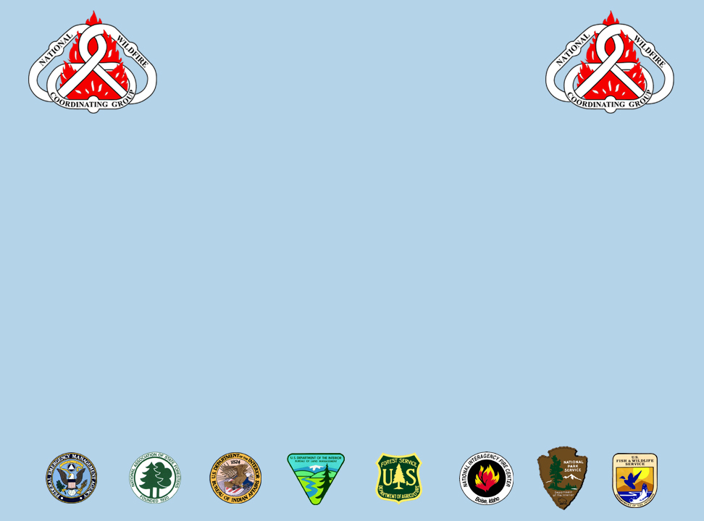
National Wildfire
Coordinating Group
Mission Statement
The purpose of NWCG is to coordinate programs of the participating wildfire management agencies to avoid wasteful duplication and to provide a means of constructively working together. The goal is to provide more effective execution of each agency’s fire management program. The group provides a formalized system to agree upon standards of training, equipment, qualifications, and other operational functions.
E-mail comments or suggestions pertaining to this
or any NWCG course to: nwcg_evaluation@nifc.blm.gov
NWCG Web site: http://www.nwcg.gov

Slide 2
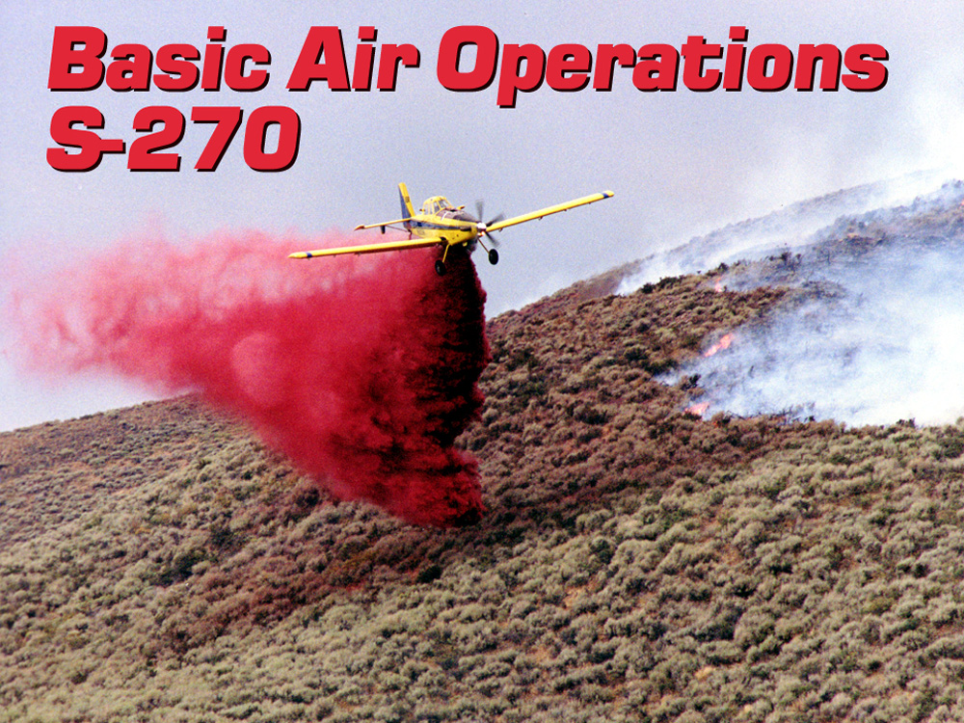

Slide 3
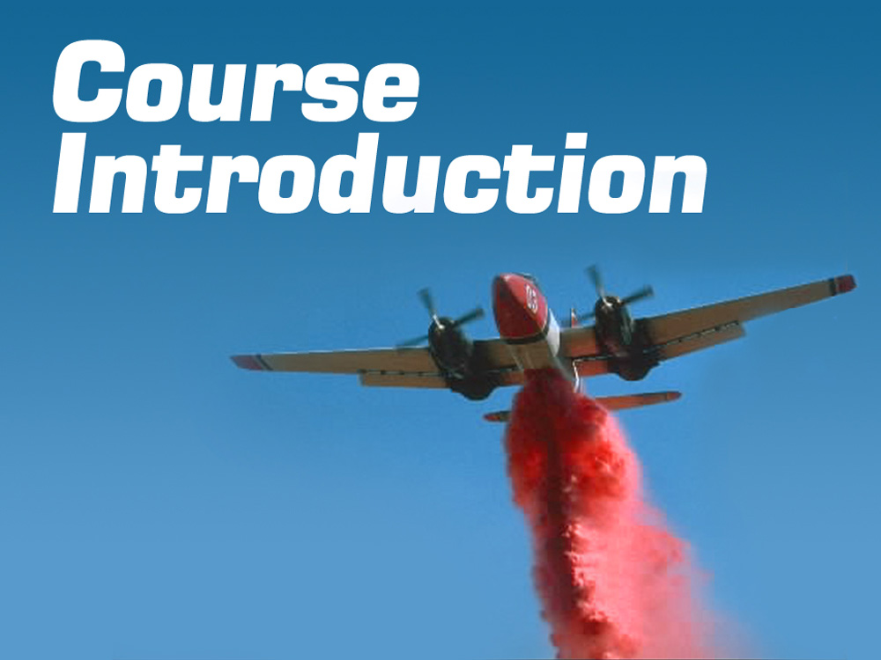
UNIT 0

Slide 4
Unit 0 Objectives
Introduce instructors and students.
Discuss course logistics.
Provide a course overview.

Slide 5
Unit 0 Objectives
Explain student evaluation methods.
Discuss students’ expectations for the course.
Review pre-course work.

Slide 6
Welcome and Introductions
Instructors and Students
Name and job title
Agency and home unit
Brief background
  Incident qualification
  Aviation experience

Slide 7

Course Logistics
Lodging
Transportation
Ground rules
Facilities
Cell phones
Messages
Meals
Agenda
Breaks
Restrooms
Smoking policy
Other information

Slide 8
Course Overview
Course Objective:
Upon completion of this course the student will have obtained the basic understanding of the different functions of Air Operations.

Slide 9
Course Overview
Reference Materials
Basic Aviation Safety
Interagency Helicopter Operations Guide (IHOG)
Incident Response Pocket Guide (IRPG)

Slide 10
Course Overview
Unit and Course Evaluation Forms
Students will complete a unit evaluation form at the end of each unit.
Students are expected to complete a course evaluation form at the end of the course.

Slide 11
Student Evaluation
Final Examination
Students must obtain a minimum of 70% on the final exam to receive a certificate of completion for the course.

Slide 12
Expectations
What are your expectations for this
course?
On a flip chart, record your expectations.
Some expectations may be difficult to
achieve because:
This is an introduction to aviation operations class. The discussion of tactical use of aircraft will be minimal.

Slide 13
Review Pre-Course Work
Basic Aviation Safety

Slide 14
Additional Training
Interagency Aviation Training
(www.iat.gov)
A-101 Aviation Safety
A-105 Aviation Life Support Equipment (ALSE)
A-106 Aviation Mishap Reporting
A-110 Aviation Transport of Hazardous Materials
A-112 Mission Planning & Flight Request Process

