Slide 1
National Wildfire Coordinating Group
Mission Statement
The purpose of NWCG is to coordinate programs of the participating wildfire management agencies to avoid wasteful duplication and to provide a means of constructively working together. The goal is to provide more effective execution of each agency’s fire management program. The group provides a formalized system to agree upon standards of training, equipment, qualifications, and other operational functions.
E-mail comments or suggestions pertaining to this or any NWCG course to: nwcg_evaluation@nifc.blm.gov
NWCG Website: http://www.nwcg.gov/

Slide 2
S-271 Helicopter Crewmember

Slide 3
Unit 0 - Objectives
Introduce the course coordinator, instructor, and students.
Review and discuss course logistics.
Present and go over the course overview.
Review and discuss instructor and student course expectations.
Identify the course references and essential materials.
Review and discuss the position responsibilities.

Slide 4
Introductions
Name and job title
Agency, home unit
ICS qualifications
Experience relative to the position as either a trainee, or a trainer/coach; both positive and negative.

Slide 5
Course Logistics
Message and telephone location
Cell phone policy
Facilities: restrooms, vending, evacuation policy, etc.
Local information
Computer use
Punctuality, meals, and breaks
Other concerns

Slide 6
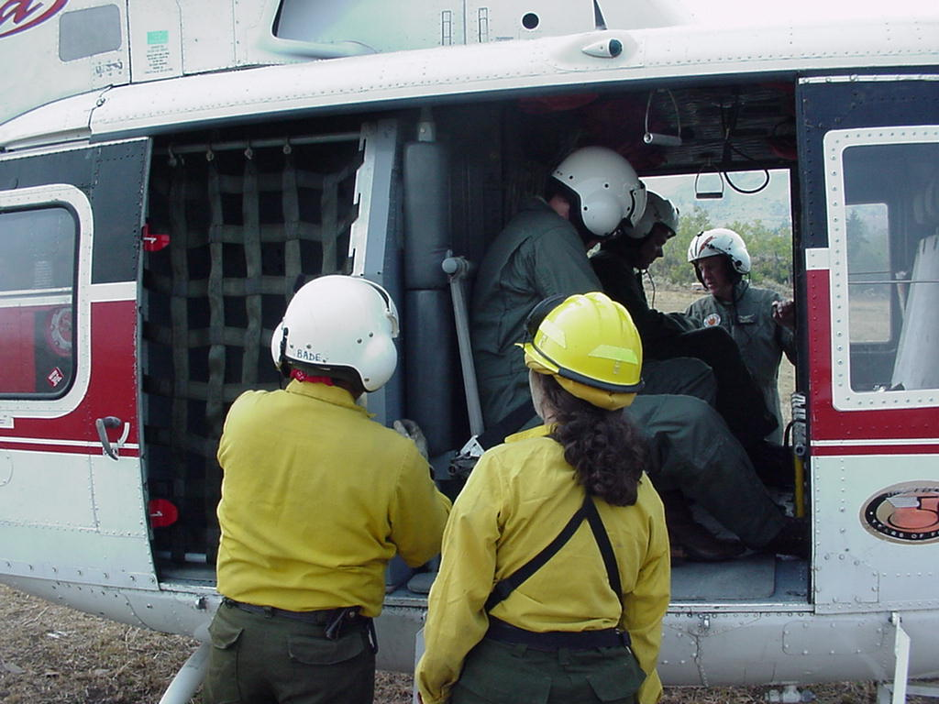
Course Objective
Upon completion of this course, the student will be
able to demonstrate proficiency in all identified areas
of helicopter use to safely achieve
efficiency and
standardization.

Slide 7
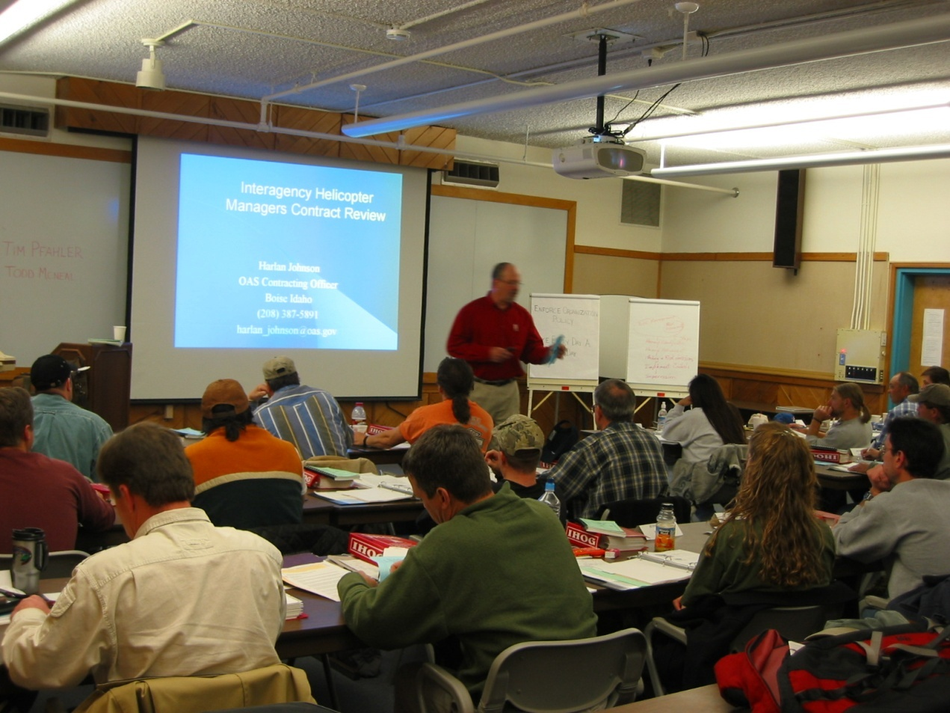
Instructional Methods
Facilitation/short lectures with PowerPoint
Discussions
Exercises
Hands-on

Slide 8
Student Assessment/Evaluation
To successfully complete the course, students must:
Participate in all classroom discussions, exercises, and scenarios.
Complete all quizzes.
Achieve 70% or higher on the final assessment/scenario.

Slide 9
Course Evaluation Form
Student are given the opportunity to comment on the course and the quality of the instruction.

Slide 10
Student Expectations
EXERCISE: Expectations
Instructions:
In your groups, answer the following question and record it on a flip chart.
What do you expect to gain from this course?
2. When finished, present your expectations to the class.

Slide 11
Instructor Expectations
Students will:
Have an interest in becoming a Helicopter Crewmember (HECM).
Exhibit mutual cooperation with the group.
Be open-minded to accomplishments during the course presentation.
Participate actively in all of the training exercises presented in the course.

Slide 12
Instructor Expectations
Students will:
Return to class at stated times.
Use what is presented in the course to effectively perform the duties of a HECM.
Not leave the course with any unanswered questions.

Slide 13
Reference Materials
Incident Response Pocket Guide, PMS 461
Interagency Helicopter Operations Guide (IHOG), NFES 1885
Interagency Aviation Transport of Hazardous Materials, NFES 1068

Slide 14
Helicopter Crewmember
The Helicopter Crewmember in the Incident Command System
The HECM is a designated member of an Incident Management organization.
The HECM is supervised by the Helicopter Manager (HMGB), Air Operations section of the Incident Management organization.

Slide 15
Position Task Book
Common tasks and additional specific tasks for the HECM.
Tool for observing and evaluating performance.
Must complete the tasking in the PTB to become qualified as a HECM.
The PTB can only be initiated by the home unit.

Slide 16
HECM Duties
The Helicopter Crewmember (HECM) for both Fire and
Resource Exclusive – Use and Call-When-Needed
(CWN) serves as a trained member of a helicopter
crew, assisting the Manager in the performance and
completion of helicopter missions.

Slide 17
Questions?

