Slide 1

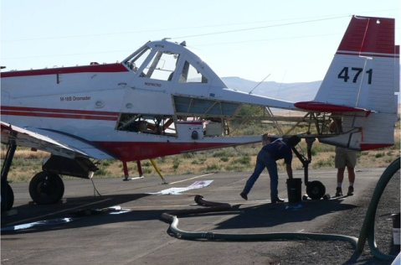
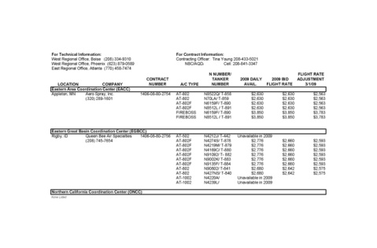
Unit 5
Contract Administration

Slide 2

Objectives
Name the three types of aircraft contracts.
Identify the contract administration line of authority.
Find contractual clauses to solve contract problems or answer contractor questions.

Slide 3
Different Types of Federal SEAT Contracts Available

Slide 4
National On-Call Contract
Most common contract used
Used for unspecified timeframe
Awarded every 3 years
Used nationally

Slide 5
National Variable Term Contract
New type of contract
Two unique concepts
  Contractors are rated
  Pre-bid 30-60-90 days
Awarded every
3 years
Used nationally

Slide 6
Exclusive Use Contract
Made for order contracting – each contract has different specs
Requesting unit will customize specs and timeframes
Has to go through standard contract solicitation and awarding process
Contract awarded to
one contractor
Awarded every year with
2 additional optional years

Slide 7
Discussion Point
Where do you find the different types of contracts?

Slide 8
Contract Information Sheet

Slide 9
Contract Authority
Official government authority to enter into, administer, and terminate the SEAT contract.
Only one who can authorize a modification.
Obligate payment of money by the government.
The CO represents BOTH contractor and government.
The CO for the SEAT program is not a field position; does not do the day-to-day administration.
CO
Contract Officer
(CO)
DOI-AM
Contract Officer
(CO)
DOI-AM
Contract Officer
(CO)
DOI-AM
Contract Officer
Technical Representative
( COTR )
( DOI-AM Technical Specialist )
Contract Officer
Technical Representative
( COTR )
( DOI-AM Technical Specialist )
Contracting Officer
Representative
(COR)
(COR duties assigned to specific individuals based on agency’s recommendations.)
Contracting Officer
Representative
(COR)
(COR duties assigned to specific individuals based on agency’s recommendations.)
SEMG/ Project Inspector
(PI)
SEMG/ Project Inspector
(PI)

Slide 10
Contract Authority
COTR
Contract Officer
(CO)
DOI-AM
Technical inspector
Your contact for mechanical problems
Regional offices (east/west)
Always have an on-call inspector available.
Contract Officer
Technical Representative
( COTR )
( DOI-AM Technical Specialist )
Contract Officer
Technical Representative
( COTR )
( DOI-AM Technical Specialist )
Contracting Officer
Representative
(COR)
(COR duties assigned to specific individuals based on agency’s recommendations.)
SEMG/Project Inspector
(PI)

Slide 11
Contract Authority
COR
Appointed by the CO
Authorized to take actions related to administrative functions
Considered the operational specialist (balances contract/ops)
Most CORs are designated at a state or regional level.
Contract Officer
(CO)
DOI-AM
Contract Officer
(CO)
DOI-AM
Contract Officer
Technical Representative
( COTR )
( DOI-AM Technical Specialist )
Contract Officer
Technical Representative
( COTR )
( DOI-AM Technical Specialist )
Contracting Officer
Representative
(COR)
(COR duties assigned to specific individuals based on agency’s recommendations.)
Contracting Officer
Representative
(COR)
(COR duties assigned to specific individuals based on agency’s recommendations.)
Contracting Officer
Representative
(COR)
(COR duties assigned to specific individuals based on agency’s recommendations.)
SEMG/Project Inspector
(PI)
SEMG/ Project Inspector
(PI)

Slide 12
Contract Authority
PI/SEMG
Contract Officer
(CO)
DOI-AM
Project Inspector (PI)/SEMG:
Field-level contract administrators
Day-by-day administration
PI designated in writing
SEMG acts like the PI
Contract Officer
(CO)
DOI-AM
Contract Officer
Technical Representative
( COTR )
( DOI-AM Technical Specialist )
Contract Officer
Technical Representative
( COTR )
( DOI-AM Technical Specialist )
Contracting Officer
Representative
(COR)
(COR duties assigned to specific individuals based on agency’s recommendations.)
Contracting Officer
Representative
(COR)
(COR duties assigned to specific individuals based on agency’s recommendations.)
SEMG/ Project Inspector
(PI)
SEMG/Project Inspector
(PI)
SEMG/ Project Inspector
(PI)

Slide 13
Contract Authority
CONTRACT AUTHORITY
Exclusive Use Contracts
CONTRACT AUTHORITY
National On-Call Contracts
CONTRACT AUTHORITY
Variable Term
Contracts
Contract Officer
(CO)
DOI-AM
Contract Officer
(CO)
DOI-AM
Contract Officer
(CO)
DOI-AM
Contract Officer
(CO)
DOI-AM
Contract Officer
(CO)
DOI-AM
Contract Officer
(CO)
DOI-AM
Contract Officer
Technical Representative
( COTR )
( DOI-AM Technical Specialist )
Contract Officer
Technical Representative
( COTR )
( DOI-AM Technical Specialist )
Contract Officer
Technical Representative
( COTR )
( DOI-AM Technical Specialist )
Contract Officer
Technical Representative
( COTR )
( DOI-AM Technical Specialist )
Contract Officer
Technical Representative
( COTR )
( DOI-AM Technical Specialist )
Contract Officer
Technical Representative
( COTR )
( DOI-AM Technical Specialist )
Contracting Officer
Representative
(COR)
(COR duties assigned to specific individuals based on agency’s recommendations.)
Contracting Officer
Representative
(COR)
(BLM National Program Manager)
Contracting Officer
Representative
(COR)
(BLM National Program Manager)
Contracting Officer
Representative
(COR)
(COR duties assigned to specific individuals based on agency’s recommendations.)
Contracting Officer
Representative
(COR)
(COR duties assigned to specific individuals based on agency’s recommendations.)
Contracting Officer
Representative
(COR)
(COR duties assigned to specific individuals based on agency’s recommendations.)
SEMG
( Duties defined in the contract)
Project Inspector
(PI)
( Nominated by the COR, appointed
by the CO )
SEMG
( Duties defined in the contract)
Project Inspector
(PI)
( Nominated by the COR, appointed
by the CO )
SEMG
SEMG

Slide 14
SEAT Manager Role
The National On-Call Contract outlines the SEMG’s duties, responsibilities, and scope of authority.

Slide 15
SEMG Role With Exclusive Use or Variable Term Contracts
SEMG can have various roles assigned to them with the Exclusive Use or Variable Term contract.
If an SEMG is appointed as a PI or a COR for one of these contracts, it is done in writing and their duties are clearly defined.

Slide 16
Discussion Point
What role does the local fire and aviation management have when working with contract officers or their representatives?

Slide 17
Contract Comparison

Slide 18
Contract Comparison
Contract Specifications

Slide 19
Contract Comparison
Contracted Service Time

Slide 20
Contract Comparison
Daily Availability Cost

Slide 21
Contract Comparison
Contract Bid Rates

Slide 22
Contract Comparison
Designated Home Base

Slide 23
Contract Comparison
Per-Diem/Services Miles Cost

Slide 24
Contract Comparison
Relief Crew Costs

Slide 25
Contract Comparison
Contract Authority

Slide 26
Pros and Cons of the Different Types of Contracts

Slide 27
Pros and Cons of the Different Types of Contracts
Exclusive Use

Slide 28
Pros and Cons of the Different Types of Contracts
National On-Call

Slide 29
Pros and Cons of the Different Types of Contracts
Variable Term

Slide 30
Parts of a Contract
Table of Contents
Section A
Section B
Section C
Exhibits

Slide 31
Parts of a Contract
Section A Requirements and Prices

Slide 32
Parts of a Contract
Section B
Technical Specifications

Slide 33
Parts of a Contract
Section C
Contract Terms and Conditions

Slide 34
Contract Issues or Concerns

Slide 35
Discussion Point
If a support vehicle becomes unavailable but the SEAT can continue to reload from another contractor’s support vehicle, can you as a SEAT Manager authorize this action or negotiate a lower rate?
Keep in mind the fire really needs the aerial support.

Slide 36
Tips for SEMG With Contract Modifications or Amendments
Ask the contractor if there have been any modifications to their contract. Ask for a copy of the modification.
If any situation arises in the field that has the capability of changing the technical specifications or terms and conditions of the contract, immediately contact the CO.

Slide 37
Tips for SEMG With Contract Modifications or Amendments
If any changes have been made to the contact, document the scenario, or proposed actions, and the solutions or modifications agreed to between the CO and vendor on daily diary section of the SEAT Daily Operations Worksheet (SEAT-002).

Slide 38
Conflicts or Disagreements
The SEAT Manager should involve the appropriate level of contract authority in the beginning of the documentation process to ensure that they are not outside their scope of authority or committing the government to unobtainable solutions.

Slide 39
Conflicts or Disagreements
General contact guideline for requesting assistance from contract authority:
  If the problem is contractual and operational related, contact the COR.
  If the problem is technical in nature, contact the COTR.

Slide 40
Tips for SEMG With Conflicts or Disagreements
It is important that the SEAT Manager objectively document all events, conversations, and actions taken concerning a conflict or disagreement. Only use facts.
Always keep the local agency supervisor apprised of any conflicts, discussions, or problems that may come up during operations.

Slide 41
Tips for SEMG With Conflicts or Disagreements
Protect your good working relationship with the contractor by not spend unproductive time arguing with them. Contact the appropriate level of contract authority early in the discussions for help and advice.
They have the authority to work directly with the contractor for possible solutions or modifications.

Slide 42
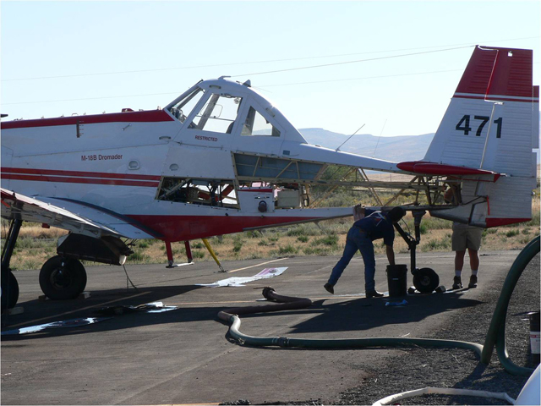
Availability/Unavailability
Payment for daily availability is based on a 14-hour period for all national SEAT contracts.

Slide 43
Availability/Unavailability
Example:
The contractor is in service at
0900. They were released for the day at 1800 with no flight hours. Is the contractor still paid for a full day (14/14th) of availability?

Slide 44
Availability/Unavailability
Example:
If the Daily Availability (AV) Rate is $2,450.00 per day, to find the hourly rate, divide $2,450.00 by 14 = $175.00 per hour.

Slide 45
Availability/Unavailability
Unavailability is defined in the contract as whenever the Contractor fails to comply with the availability requirements specified herein pursuant to the operations schedules by the Government.

Slide 46
Availability/Unavailability
Example:
If the contractor is in service at 0900 and the support equipment is unavailable from 1015 to 1125 and the contractor is released at 1800, how many hours of availability is the contractor paid for?

Slide 47
Conversion Chart

Slide 48
SEMG’s Responsibilities If Unavailability Occurs
If any unavailability occurs, contact the appropriate level of contract authority.
Document the cause, timeframe, and all actions taken during the time of the unavailability.
Immediately notify the incident or dispatch office of the unavailability status.
Obtain progress report from the vendor.

Slide 49
SEMG’s Responsibilities If Unavailability Occurs
If the problem is technical in nature, the SEMG should contact the COTR.
Notify the incident or dispatch office when the aircraft and support equipment are checked back into service.
Document the unavailability on the pay documents and cost summaries.
May need to write a SAFECOM depending on the nature of the unavailability.

Slide 50
EXERCISE
Common Terminology
and Concepts
Click here to launch exercise

Slide 51
EXERCISE
Contracting Familiarity

Slide 52
Review Objectives
Name the three types of aircraft contracts.
Identify the contract administration line of authority.
Find contractual clauses to solve contract problems or answer contractor questions.

