Slide 1
Unit 8
Safety

Slide 2
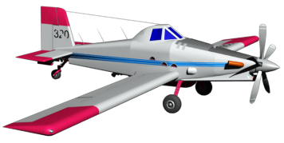
Objectives
Identify and obtain available safety reference material.
Identify safety issues at SEAT bases and during SEAT operations.

Slide 3
Objectives
Identify the categories of the System Safety Assessment.
Describe mitigation measures to reduce safety hazards.
Describe the key steps to a safe SEAT operation.

Slide 4
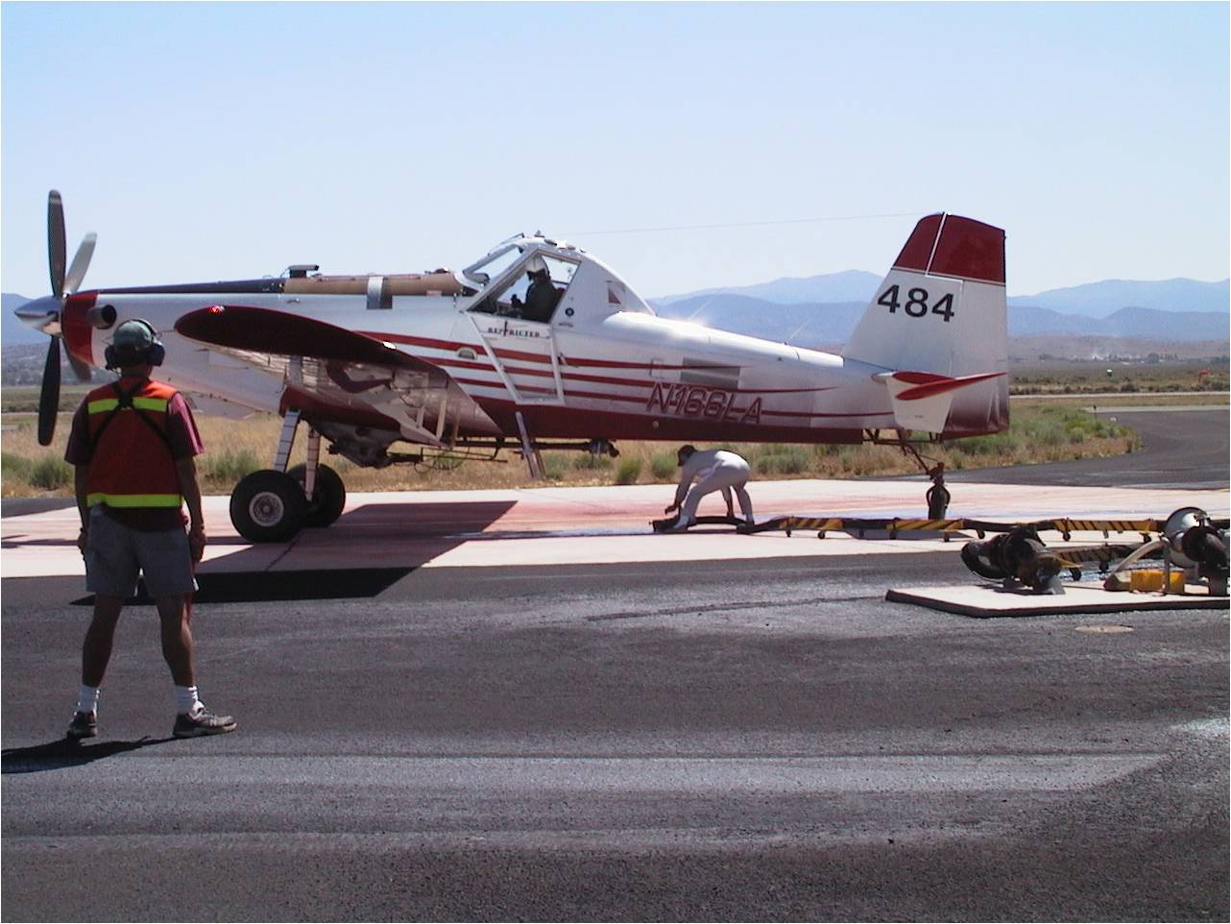
Safety should always be foremost in the mind of the SEMG.

Slide 5
SEMG Responsibilities for Safety
The primary duty:
Provide for the safety and welfare of all assigned personnel at the SEAT base.
A secondary duty:
Create an environment that encourages safe flight operations.

Slide 6
System Safety Concept
The System Safety concept is a comprehensive process to analyze system characteristics and engineer solutions to prevent mishaps from occurring.

Slide 7
System Safety Concept
Safety Management System (SMS) is an approach to managing safety that includes the necessary organizational structures, accountabilities, policies, and procedures. It encompasses the entire aviation program.

Slide 8
Safety Management Systems (SMS)
The ultimate goal of SMS is to provide an organizational framework or roadmap for developing and promoting a true safety culture, ultimately reducing our accident rate.

Slide 9
Safety Management Systems (SMS)
What does SMS do for us?
Takes a proactive, “systemic” (big-picture) approach to managing aviation safety
Helps identify hazards and control measures
Provides for ongoing “quality assurance”

Slide 10
Safety Management Systems (SMS)
SMS is based on the following premises:
Every person in the organization accepts that safety is a conscious and ongoing mindset as opposed to simply a box to be checked.

Slide 11
Safety Management Systems (SMS)
Four “Pillars” or Components of SMS
Safety Policy
Safety Risk Management
Safety Assurance
Safety Promotion

Slide 12
Discussion Point
What do each of the four pillars mean to you?

Slide 13
Safety Management Systems (SMS)
Negative Organizational and Cultural Influences
Improper use of SAFECOMs
Failure to understand or follow policy
Fiscal/staffing constraints
Overemphasis on mission accomplishment vs. safety

Slide 14
Safety Information Sources and Tools
Aviation Safety Alerts

Slide 15
Safety Information Sources and Tools
Aviation Technical Bulletin

Slide 16
Safety Information Sources and Tools
Aviation Accident Prevention Bulletins

Slide 17
Safety Information Sources and Tools
Aviation Lessons Learned

Slide 18
Safety Information Sources and Tools
The Pilot Read File is intended to assist pilots in understanding critical Safety of Flight information.
Pilots are required to sign the Airbase Read File Items document verifying that they have reviewed all current alerts and bulletins identified in the Pilot Read File.

Slide 19
Safety Information Sources and Tools
Six Minutes for Safety – Aviation
Jointly developed by agency and vendor personnel
Intended for use at all aviation bases
Can be utilized as additional briefing information
Available at the Lessons Learned Web site

Slide 20
Safety Information Sources and Tools
Aviation Safety Communiqué (SAFECOM)

Slide 21
Safety Information Sources and Tools
Risk Management Worksheet (RMW)
Job Hazard Analysis (JHA)

Slide 22
Safety Information Sources and Tools
System Safety Assessment (SEAT)

Slide 23
Risk Management Techniques
Briefings and debriefings
After Action Review (AAR)
Job Hazard Analysis
Coordination and communication
Situation awareness

Slide 24
SEAT Operations Safety Mitigations
SEAT Safety Management System Categories
SEAT Aircraft
Maintenance
SEAT Base Facilities
SEAT Contracts
Personnel (Government)
Personnel (Contractor)
SEAT Operations

Slide 25
SEAT Operations Safety Mitigations
SEAT Safety Management System, Safety Assessment Topics
Each of the seven categories include the pre-designated topics listed below
Sub-system
Hazards
Pre-mitigation value
Mitigation
Post-mitigation value

Slide 26
Key Steps to Safe SEAT Operations
Utilize a Risk Assessment Tool
Continual communications
Plan, monitor, and evaluate
Operate within the established guidelines
Document your operations

Slide 27
Objectives
Identify and obtain available safety reference material.
Identify safety issues at SEAT bases and during SEAT operations.

Slide 28
Objectives
Identify the categories of the System Safety Assessment.
Describe mitigation measures to reduce safety hazards.
Describe the key steps to a safe SEAT operation.

