Slide 1
Unit 1 The Fire Environment

Slide 2
Unit 1 Objectives
Describe the three components of the wildland fire environment.
List and give examples of the three methods of heat transfer.
List three methods of mass transport of firebrands on wildland fire.
Explain the relationship between flame height/length and its relationship to the fireline intensity.

Slide 3
Unit 1 Objectives
5. Describe primary environmental factors affecting ignition, fire intensity, and rate of spread of wildland fires.
6. Discuss the relationship of wildland fires of different intensities to their environments.
7. Describe the behavior of wildland fires using standard fire behavior terminology.

Slide 4
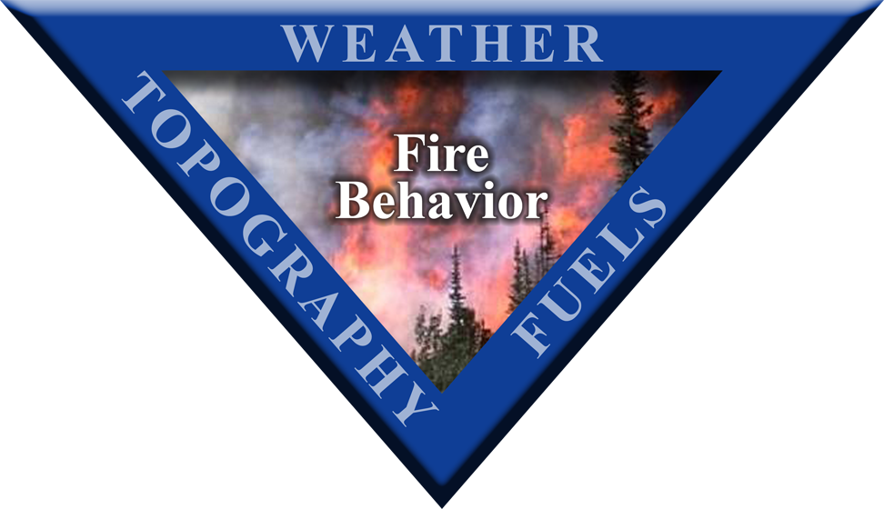
Fire Environment Triangle
Notes:
4

Slide 5
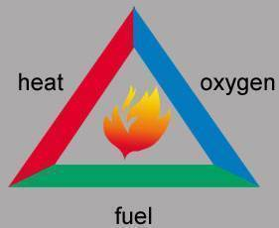
Fire Environment Triangle
S-190, Introduction to Wildland Fire Behavior explained:
The fire triangle
heat
oxygen
fuel
And introduced
The fire behavior triangle
fuels
weather
topography
Notes:
5

Slide 6
Fire Environment Triangle
The Three Components of the
Wildland Fire Environment:
Weather
Topography
Fuels
Notes:
6

Slide 7
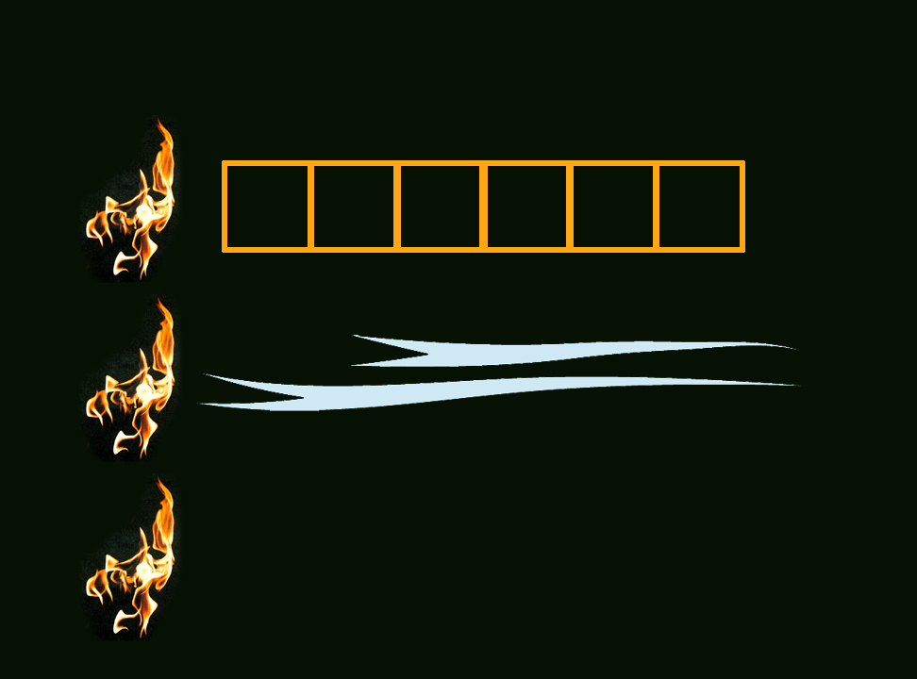
Three Methods of Heat Transfer
Conduction
Transfer of heat through solids
Convection
Transfer of heat by movement of air
Radiation
Transfer of heat by electromagnetic waves
01-7-S290-EP

Slide 8
Conduction
Conduction is the transfer of heat from one molecule of matter to another.
Relatively slow transfer and operates within solid fuel particles.

Slide 9
Convection
Convection is the transfer of heat resulting from the motion of air (or fluid).

Slide 10
Convection also includes direct flame contact, a powerful heat transfer process, especially in a head fire.

Slide 11
Radiation
Radiation is the transmission of heat energy by electromagnetic waves passing from a heat source to an absorbing material.

Slide 12
The amount of heat received by fuels ahead of the fire depends on the fire intensity and the distance from the fire.

Slide 13
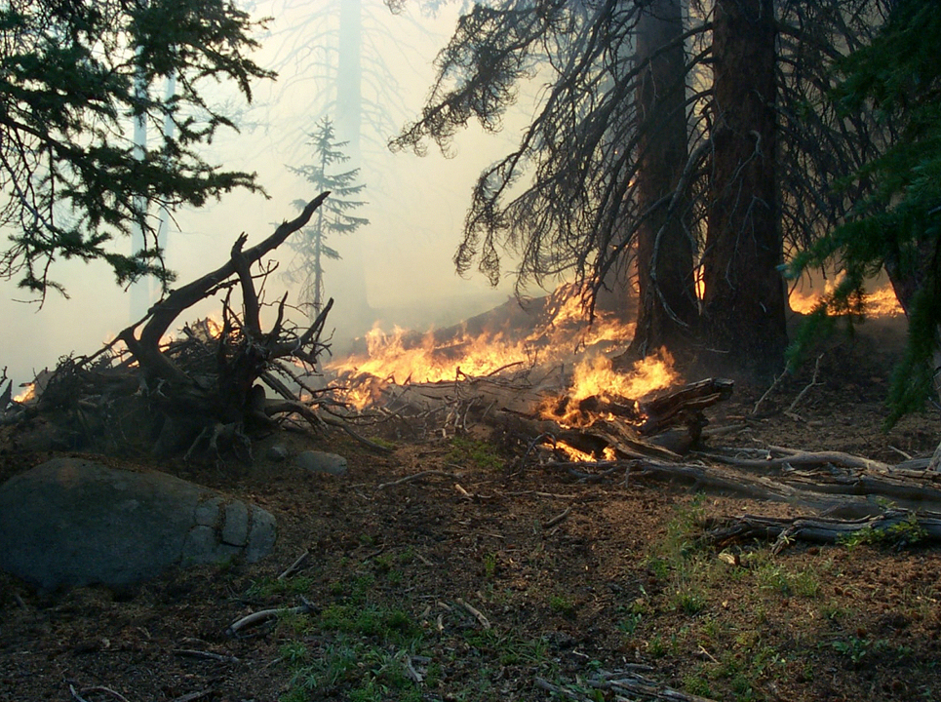
Branches are preheated by radiation and convection.
1-13-S290-EP

Slide 14
Tree trunk is preheated by radiation and convection.
1-14-S290-EP

Slide 15
Logs are preheated by radiation and conduction.
1-15-S290-EP

Slide 16
Litter and duff are preheated by radiation and conduction.
1-16-S290-EP

Slide 17
Head Fire Backing Fire
Wind and/or slope affect fire spread with radiant and convective heat.
Conduction/radiation within fuel bed is dominant factor in fire spread. Much less dependent on wind and slope.

Slide 18
Three Methods of Mass Transport of Firebrands on Wildland Fire

Slide 19
Watch Out #16
Getting frequent spot fires across line.
The primary cause of spot fires is firebrands.

Slide 20
Transfer of firebrands by convection.
Click image to play video clip

Slide 21
Transfer of firebrands by wind.
Click image to play video clip

Slide 22
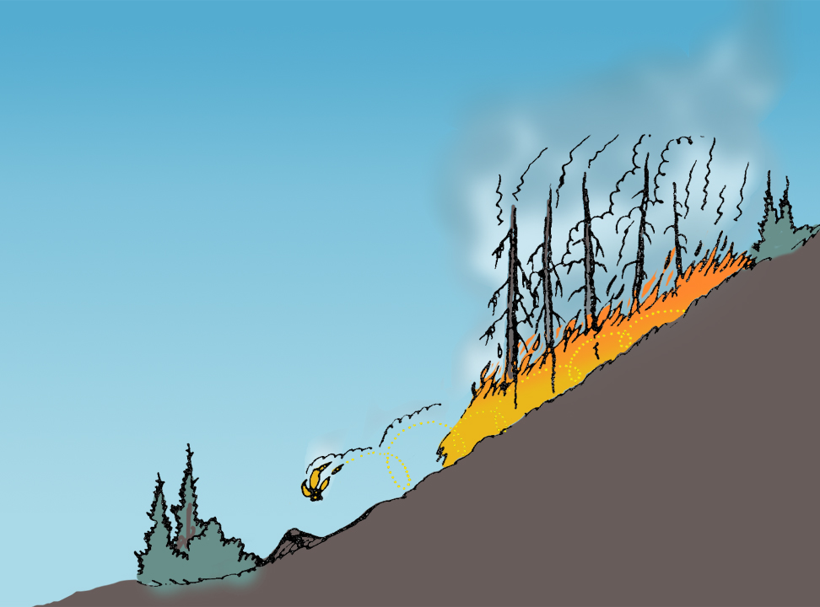
Transfer of firebrands by gravity.
1-22-S290-EP

Slide 23
Flame Height/Flame Length and its Relationship to Fireline Intensity

Slide 24
Flame height is the average height of flames as measured on a vertical axis. It may be less than flame length if flames are angled.

Slide 25
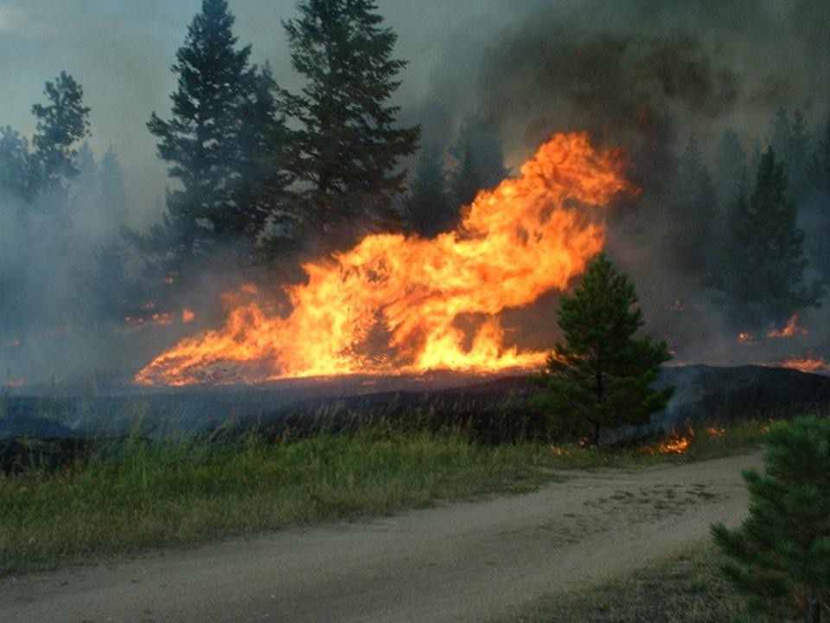
Flame Height
1-25-S290-EP

Slide 26
Flame length is the distance measured from the average flame tip to the middle of the flaming zone at the base.

Slide 27
Flame Length
1-27-S290-EP

Slide 28
The Primary Environmental Factors Affecting the Ignition, Fire Intensity, and Rate of Spread of Wildland Fires

Slide 29
Ignition
Size and shape of fuels
Compactness or arrangement of fuels
Fuel moisture content
Fuel temperature

Slide 30
Fireline Intensity = The rate of heat released per foot of fire front per second.

Slide 31
Fire intensity is primarily affected by:
Fuel loading
Compactness or arrangement of fuels
Fuel moisture content
The rate of spread

Slide 32
Rate of Spread (ROS)
The activity of fire in extending its horizontal dimensions.

Slide 33
Primary Factors that Affect Rate of Spread
Wind speed
Steepness of slope
Changes in fuel type

Slide 34
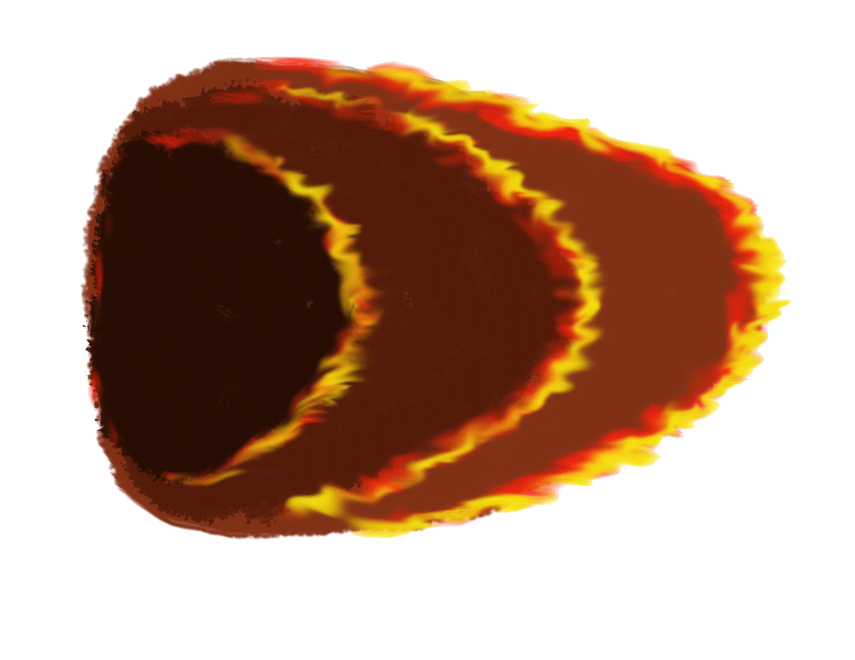
Fire Spread and Area Growth
Left Flank
Wind 5 MPH
In 3 hours the fire will have burned 4 X (3 X 3) acres or 36 acres
Rear
X
Head
Right Flank
1300 Hrs.
8 Chains
4 Acres
1400 Hrs.
1500 Hrs.
1600 Hrs.
8 Chains
16 Acres
8 Chains
36 Acres

Slide 35
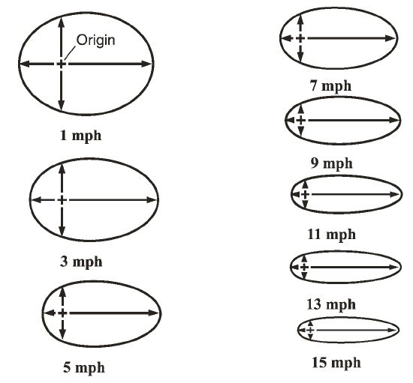
Elliptical spread pattern

Slide 36
Relationship of Wildland Fires of Differing Intensities to Their Environments

Slide 37
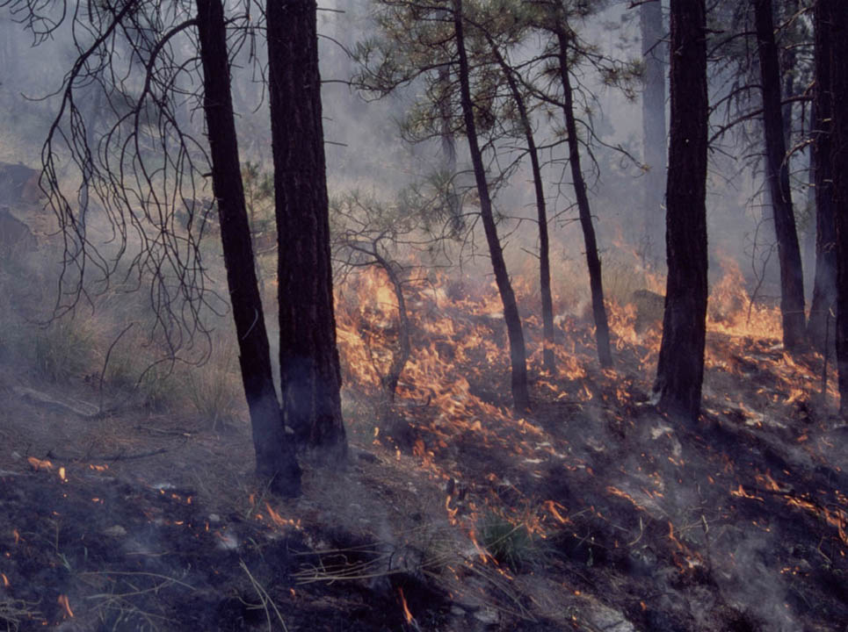
Low intensity fires
1-37-S290-EP

Slide 38
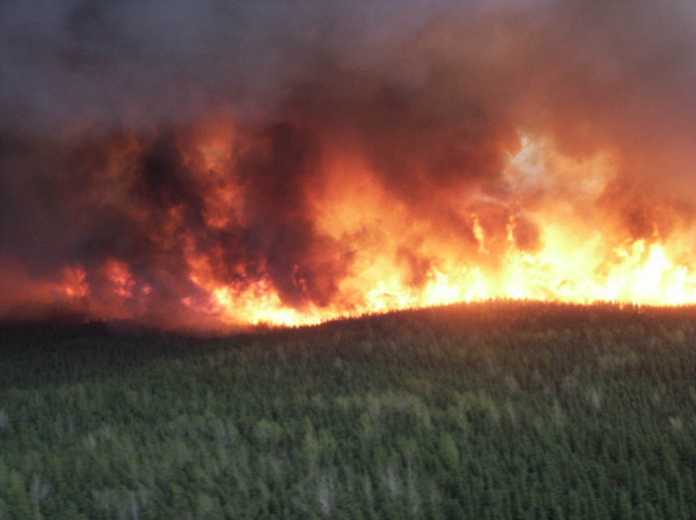
High intensity fires
1-38-S290-EP

Slide 39
Stability of the Lower Atmosphere

Slide 40
Atmospheric Stability
A state of the atmosphere in which the vertical distribution of temperature is such that an air particle will resist vertical displacement from its level.

Slide 41
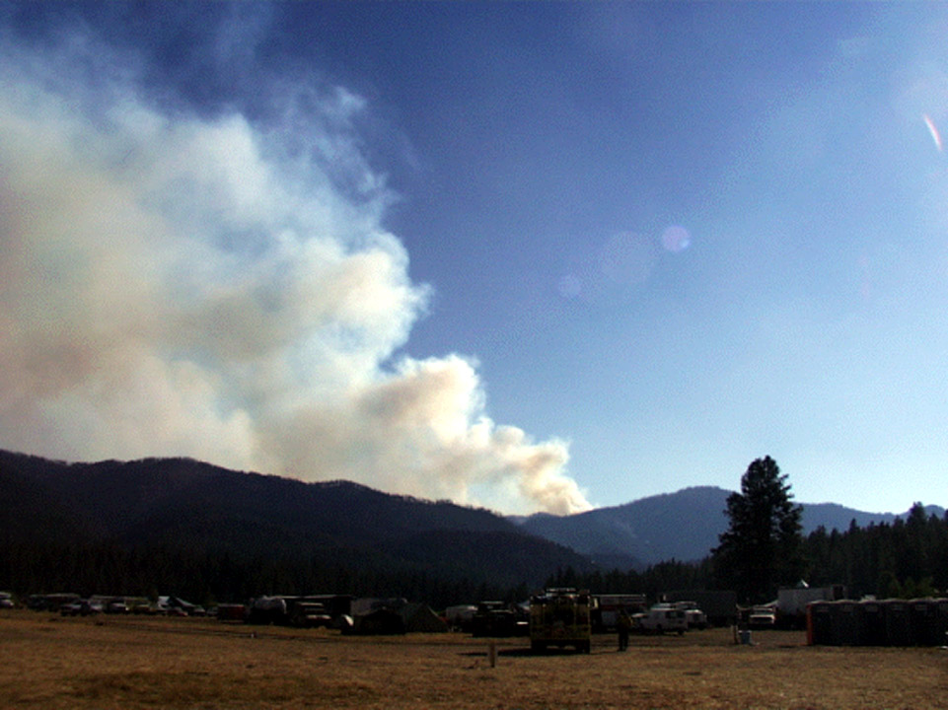
Winds Aloft
1-41-S290-EP

Slide 42
Stability vs. Wind
Winds aloft
horizontal motion
Rising air
unstable
atmosphere
Sinking air stable atmosphere
vertical motion
vertical motion
Surface wind
horizontal motion
1-42-S290-EP

Slide 43
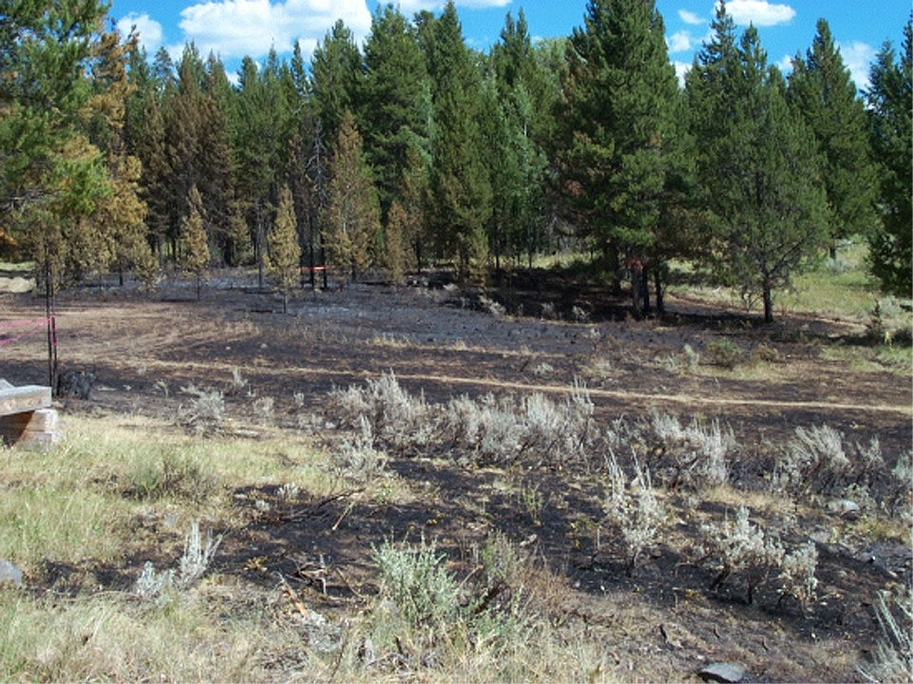
Closed
Open
1-43-S290-EP

Slide 44
The Behavior of Wildland Fires in Standard Fire Behavior Terminology

Slide 45
Exercise

Slide 46
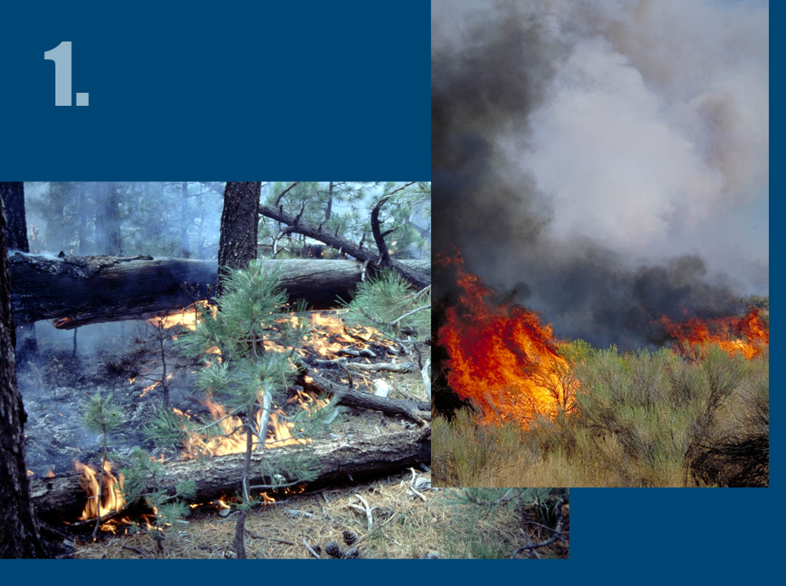
01-46-S290-EP
1-46-S290-EP

Slide 47
1-47-S290-EP

Slide 48
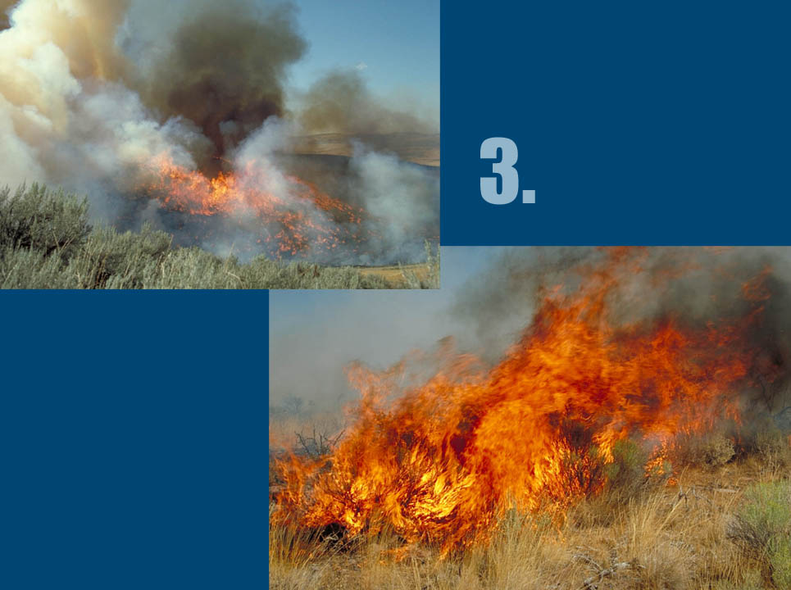
1-48-S290-EP

Slide 49
01-49-S290-EP

Slide 50
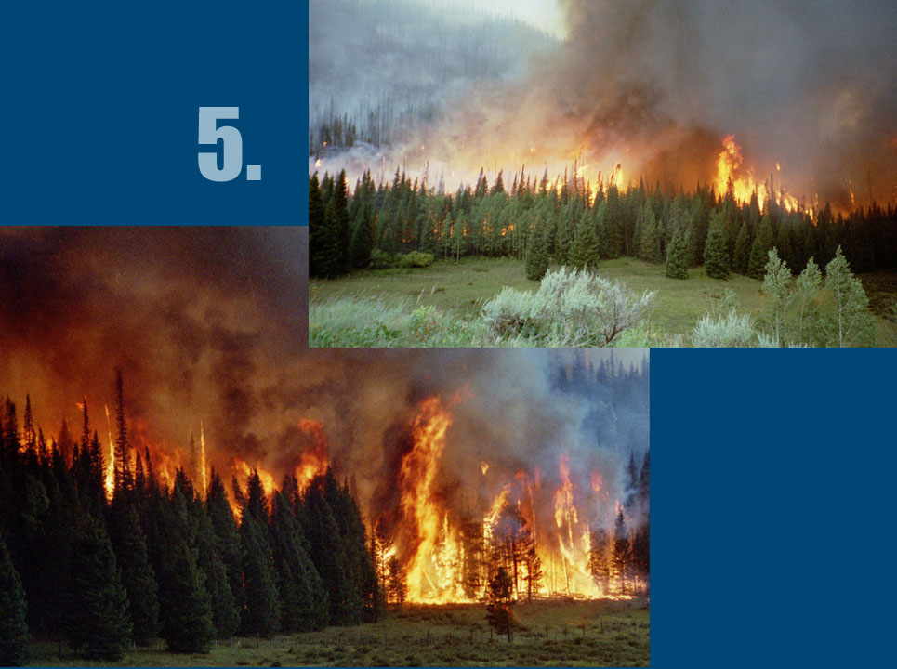
1-50-S290-EP

Slide 51
1-51-S290-EP

Slide 52
1-52-S290-EP

Slide 53
1-53-S290-EP

Slide 54
1-54-S290-EP

Slide 55
1-55-S290-EP

Slide 56
1-56-S290-EP

Slide 57
Unit 1 Objectives
Describe the three components of the wildland fire environment.
List and give examples of the three methods of heat transfer.
List three methods of mass transport of firebrands on wildland fire.
Explain the relationship between flame height/length and its relationship to the fireline intensity.
Notes:
57

Slide 58
Unit 1 Objectives
5. Describe primary environmental factors affecting ignition, fire intensity, and rate of spread of wildland fires.
6. Discuss the relationship of wildland fires of different intensities to their environments.
7. Describe the behavior of wildland fires using standard fire behavior terminology.
Notes:
58

