Slide 1
Unit 12 - Part 2 Gauging Fire Behavior & Guiding Fireline Decisions
Introduction to FLAME
Notes:
82

Slide 2
Overall FLAME Purpose
A systematic method for applying what you have learned to assessing “current” and “expected” fire behavior…a key “firefighting order”.
Fire science in a fireline-practical tool.
Enhances “situational awareness”.
Designed to serve a variety of needs that change over one’s career.
Notes:
83

Slide 3
Comparing FLAME Predictions to Reported Fatality Fires
Line of perfect
agreement
600
Dude
South Canyon
500
20% difference
400
ROS-ratio predicted by FLAME
Fatality reports must reconstruct a probable picture, and assumptions are made in comparing reported data with FLAME predictions, but the general agreement suggests the predictions are realistic.
300
200
Cramer
100
30mile
100
200
300
400
500
600
ROS-ratio measured from fatality investigation reports

Slide 4
The “Next Big Change”
Assessing the effects of the “next big change” can be done with a simple and systematic application of fire behavior science.

Slide 5
Method for Estimating ROS Changes in Fire Behavior will Focus on the Big-Change Factors
Identify changes in fuel-type (considering RH)
Fuels ahead of the fire
Transitions between surface and crown fuels
Figure the change in effective wind speed
Incorporate patterns of variation in wind speed over the terrain
Incorporate forecasted weather

Slide 6
Estimate Changes in Fire Behavior Using ROS-Ratio
Obtain the magnitude of change in ROS (from a look-up table) using the changes in fuel type and wind speed.
Estimate changes in flame length from the fuel and from the change in ROS.

Slide 7
ROS-Ratio Table
How to handle each situation:
Identify the change in fuel type (example: crown to grass)
EWS biggest in faster fuel type
EWS less in grass
Litter
to/from
Crown
Litter
to/from
Grass
Crown
to/from
Grass
Crown
to/from
Grass
Litter
to/from
Grass
EWS
Ratio
No fuel
change
1
1
4
14
4
3
10
2
2
10
30
8
1
5
3
4
15
60
13
1
3
Figure the change in effective wind speed (example: a 3-fold increase)
4
5
20
80
20
Yellow highlights cases
In which ROS will be greater in the grass fuel.
1.5
3
5
7
30
100
27
2
2
6
9
35
130
35
3
2
8
12
50
180
4
1
10
16
60
240
5
1
Look up the ROS-ratio (here a 13-fold increase)… basically
multiplying the effects
12
20
80
300
6
1.5
16
30
100
440
8
2
20
40
140
600
10
3
24
50
180
700
13
3
30
60
220
1000
17
4
40
Red highlights: ROS-ratios increases of 60x and greater have been associated with fatalities
80
300
1300
25
6
50
110
400
1800
30
8
60
140
500
2200
40
10
12-88-S290-EP

Slide 8
FLAME Application Progresses from One Stage to Another Based on Need
Initial
Describe current fire behavior and identify the next big change — this is a very important first step; it might be all you need to decide to proceed or to disengage.
Notes:
Fix font and look of 89,90,91 maybe add graphic of flame worksheet

Slide 9
Standard
Input current and expected conditions
RH
Fuel type
EWS
Predict the ROS-ratio
Prompts the consideration of all the dominant factors and indicates the degree of potential danger.

Slide 10
Full
Combine current fire-spread timeline with ROS-ratio to predict future fire ‘spread times’
Information can guide evaluation of escape routes or the choice of effective tactics.
Notes:
91

Slide 11
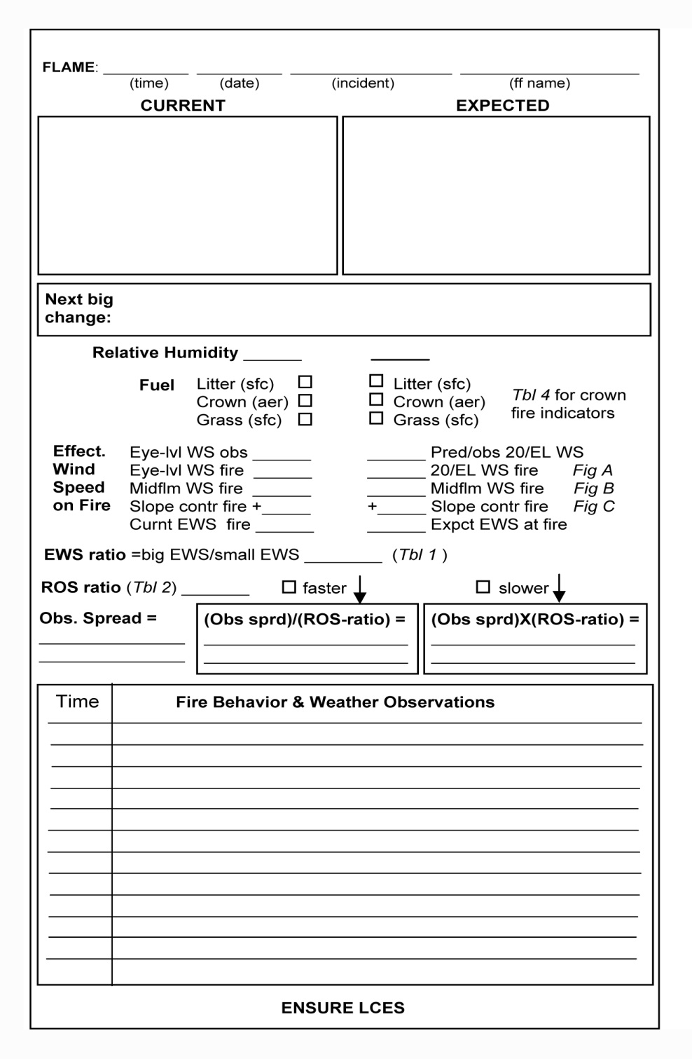
Use a worksheet that covers the FLAME
application process.
Current conditions:
on left
Expected conditions:
on right
INITIAL APPLICATION
Next Big Change:
STANDARD APPLICATION
The worksheet:
guides a systematic approach
yields valuable documentation of your assessment.
FULL APPLICATION
In all cases, use the
information in LCES.

Slide 12
Learning to Apply FLAME
The best way to learn the FLAME method is by seeing illustrations and working exercises.
Don’t be discouraged by the new process or by using numbers; you will learn by using FLAME.

Slide 13
Learning to apply FLAME
Animations, illustrations and exercises portray the nature of the change, and leads your thinking to the future.
Exercise sheets use simple diagrams, to provide a clear picture of the key factors in the problem. Unneeded blanks are not filled in.
Depict “current” and “expected” situations in your own style on the FLAME worksheets.

Slide 14
How do changes in fuel type affect ROS and spread time?
Assessing Changes in Fuel
Type with FLAME

Slide 15
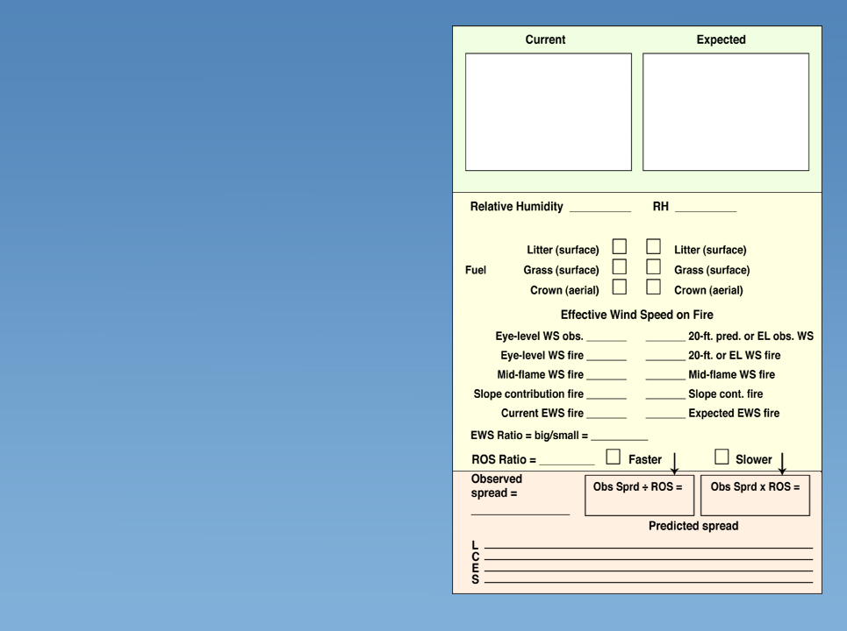
Illustration #1: Change in Fuel Type
Fuel type changes from grass to litter
x
x
1X
14X
x
Observed conditions:
Fire moves upslope in grass
with no wind.
Conditions do not favor crown fire
Fire will move in grass to midslope in 20 minutes
Weather Forecast:
No changes
½ slope in
20 min
½ slope in 4+ hrs
If the fire moves 14x slower it will take 14x longer to go the same distance. 14x(20 min) = 4+ hrs.
12-96-S290-EP

Slide 16
ROS-Ratio Table
EWS biggest in faster fuel type
EWS less in grass
Litter
to/from
Crown
Litter
to/from
Grass
Crown
to/from
Grass
Crown
to/from
Grass
Litter
to/from
Grass
EWS
Ratio
No fuel
change
Yellow highlights cases
In which ROS will be greater in the grass fuel.
1
1
4
14
4
3
10
2
2
10
30
8
1
5
3
4
15
60
13
1
3
4
5
20
80
20
1.5
3
5
7
30
100
27
2
2
Red highlights: ROS-ratio increases of 60x and greater have been associated with fatalities.
6
9
35
130
35
3
2
8
12
50
180
4
1
10
16
60
240
5
1
12
20
80
300
6
1.5
16
30
100
440
8
2
20
40
140
600
10
3
24
50
180
700
13
3
30
60
220
1000
17
4
40
80
300
1300
25
6
50
110
400
1800
30
8
60
140
500
2200
40
10
12-97-S290-EP

Slide 17
Exercise #1: Litter to Brush-Crown Fuel
litter
brush
Lower slope 2 hrs
litter to crown fuel change
20
20
x
x
1X
Observed conditions:
Fire moves upslope in woodland litter with no wind; RH 20%.
Fire will move in litter to midslope in 2 hours
Weather Forecast:
No changes
4X
x
½ slope
in 2 hr
½ slope in ½ hr
Complete the
Exercise
If the fire moves 4x faster it will take 4x less time to go the same distance. (2 hrs)/4 = ½ hr.
12-98-S290-EP

Slide 18
ROS-Ratio Table
EWS biggest in faster fuel type
EWS less in grass
Litter
to/from
Crown
Litter
to/from
Grass
Crown
to/from
Grass
Crown
to/from
Grass
Litter
to/from
Grass
EWS
Ratio
No fuel
change
Yellow highlights cases
In which ROS will be greater in the grass fuel.
1
1
4
14
4
3
10
2
2
10
30
8
1
5
3
4
15
60
13
1
3
4
5
20
80
20
1.5
3
5
7
30
100
27
2
2
Red highlights: ROS-ratio increases of 60x and greater have been associated with fatalities.
6
9
35
130
35
3
2
8
12
50
180
4
1
10
16
60
240
5
1
12
20
80
300
6
1.5
16
30
100
440
8
2
20
40
140
600
10
3
24
50
180
700
13
3
30
60
220
1000
17
4
40
80
300
1300
25
6
50
110
400
1800
30
8
60
140
500
2200
40
10
12-99-S290-EP

Slide 19
How do changes in effective wind speed affect ROS and spread time?
Wind Change Comparisons

Slide 20
Wind Adjustment Table For Topographic Location
Wind speed to be adjusted
Adjustment | 2 | 4 | 6 | 8 | 10 | 12 | 16 | 20 | 24 | 28 | 32 | 36 | 40 | 50 | 60
1 → ½ or ½ → ¼ | 1 | 2 | 3 | 4 | 5 | 6 | 8 | 10 | 12 | 14 | 16 | 18 | 20 | 25 | 30
½ → 1 or ¼ → ½ | 4 | 8 | 12 | 8 | 20 | 24 | 32 | 40 | 48 | 56 | 64
1 → ¾ | 2 | 3 | 4 | 6 | 8 | 9 | 12 | 15 | 18 | 21 | 24 | 27 | 30 | 38 | 45
¾ → 1 | 3 | 5 | 8 | 11 | 13 | 16 | 21 | 27 | 32 | 37 | 43 | 48 | 53 | 67 | 80
¾ → ¼ | 1 | 2 | 2 | 3 | 3 | 4 | 5 | 7 | 8 | 9 | 11 | 12 | 13 | 17 | 20
¼ → ¾ | 6 | 12 | 18 | 24 | 30 | 36 | 48 | 60
1 → ¼ | <1 | 1 | 2 | 2 | 3 | 3 | 4 | 5 | 6 | 7 | 8 | 9 | 10 | 12 | 15
¼ → 1 | 8 | 16 | 24 | 32
½ → ¾ | 3 | 6 | 9 | 12 | 15 | 18 | 24 | 30
¾ → ½ | 2 | 3 | 4 | 6 | 7 | 8 | 12 | 14 | 16
Example: Adjust a 12 mph wind on the upper windward slope to the lower windward slope. Choose “1 → ½” based on the wind adjustment diagram and wind speed 12. The wind on the lower slope will be about 6 mph.
Notes:
101

Slide 21
Wind Adjustments Midflame Calculations Based On Fuel Type
Eye-level
¾ X
Crown or 20’
1X
Grass
Litter
¼ X
¾ of the 20 foot wind
Crowns
Litter
20 foot wind is the midflame wind
¼ of the 20 foot wind

Slide 22
Wind Adjustment Table Midflame Wind Speed Adjustment
Wind speed to be adjusted
Adjustment | 2 | 4 | 6 | 8 | 10 | 12 | 16 | 20 | 24 | 28 | 32 | 36 | 40 | 50 | 60
1 → ½ or ½ → ¼ | 1 | 2 | 3 | 4 | 5 | 6 | 8 | 10 | 12 | 14 | 16 | 18 | 20 | 25 | 30
½ → 1 or ¼ → ½ | 4 | 8 | 12 | 8 | 20 | 24 | 32 | 40 | 48 | 56 | 64
1 → ¾ | 2 | 3 | 4 | 6 | 8 | 9 | 12 | 15 | 18 | 21 | 24 | 27 | 30 | 38 | 45
¾ → 1 | 3 | 5 | 8 | 11 | 13 | 16 | 21 | 27 | 32 | 37 | 43 | 48 | 53 | 67 | 80
¾ → ¼ | 1 | 2 | 2 | 3 | 3 | 4 | 5 | 7 | 8 | 9 | 11 | 12 | 13 | 17 | 20
¼ → ¾ | 6 | 12 | 18 | 24 | 30 | 36 | 48 | 60
1 → ¼ | <1 | 1 | 2 | 2 | 3 | 3 | 4 | 5 | 6 | 7 | 8 | 9 | 10 | 12 | 15
¼ → 1 | 8 | 16 | 24 | 32
½ → ¾ | 3 | 6 | 9 | 12 | 15 | 18 | 24 | 30
¾ → ½ | 2 | 3 | 4 | 6 | 7 | 8 | 12 | 14 | 16
An example: Adjust an eye-level observation of 16 mph over open ground to fit the litter fuel type under a stand of trees. Choose “3/4 → 1/4” based on the wind adjustment diagram and wind speed 16. The wind in the litter fuel will be about 5 mph.
Notes:
Add more exercises for wind adjustment, self-pace handout add time to unit to cover.
103

Slide 23
Wind Variations Often Produce Very Large Changes in Fire Behavior
Many wind changes result from “weather changes”, and can be anticipated from your knowledge of fire weather processes or from weather forecasts.
Wind also varies from place to place in complex terrain, even if the overall “weather” is not changing.

Slide 24
Wind Varies Significantly as It Flows Over Terrain
It is a major influence on fire behavior
Click image to play video clip
Notes:
Remove slide

Slide 25
Adjusting the wind for different locations in the terrain
General or ridgetop winds
¾ X
1X
1X
Windward slope
Lee slope
Windward slope
1/2 X
Lee slopes < 30%
1/2 X
¼ X
Winds on lee slopes are typically much reduced, turbulent and not predictable
In limited cases, where slopes are less than 30% and ridgetops are not sharp, adjustments can provide a decent measure of average wind speed. (Note: the 30% limit applies only to the lee slopes, not the windward slopes).
Adjustment is not applicable to winds of critical concern or downslope winds.

Slide 26
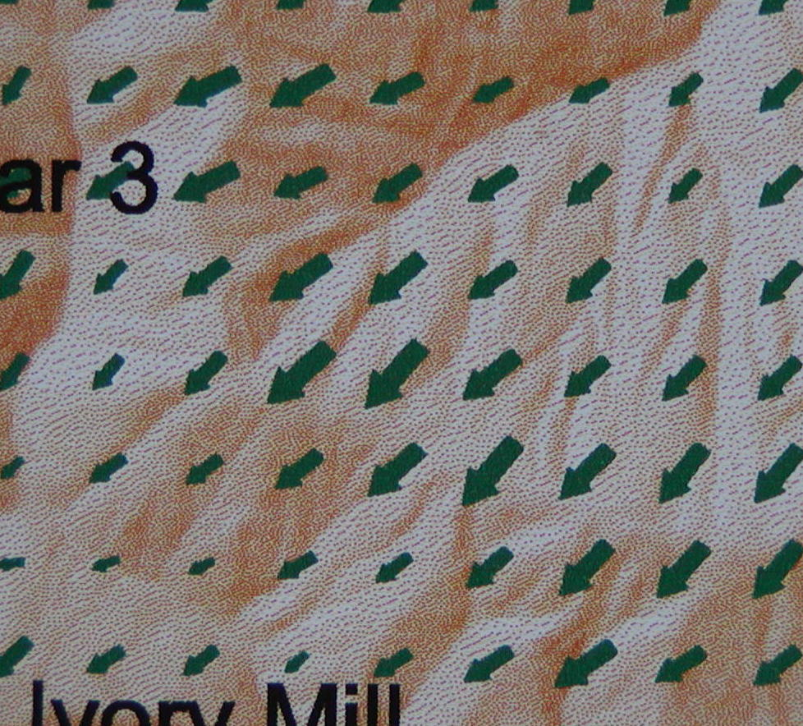
Pocket WindWizard & Real WindWizard Comparison

Slide 27
Wind on the Fire Depends on Flame Height and Sheltering Vegetation
The wind pushing the fire is the wind at about the midflame level (midflame wind speed, or MFWS).
Wind speeds are highest at levels above the surface and decrease downward.
A stand of trees or brush will reduce the wind speeds under the stand (more so the denser the stand)

Slide 28
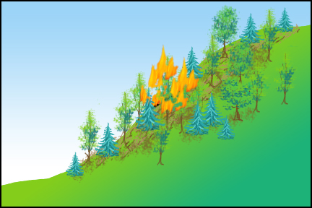
Once you have a wind speed that fits the location of the fire in the terrain, you must adjust it to fit the wind speed at flame level.
You’ve obtained the wind for the fire’s location on the slope
If you adjusted a 20-foot wind for the terrain, this is a 20-foot wind; if you adjusted eye-level wind this is eye-level
What is the wind speed at
flame level?
12-109-S290-EP

Slide 29
Midflame Wind that Best Fits the Fuel Type
Eye-level
¾ X
Crown or 20’
1X
Litter
¼ X
Grass (& low brush)
9 mph
at grass flame level
Crowns
12 mph
at crown flame level
Litter
3 mph
At litter flame level
For example, a 20-foot wind of 12 mph
12-110-S290-EP

Slide 30
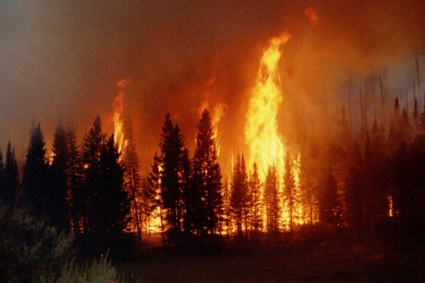
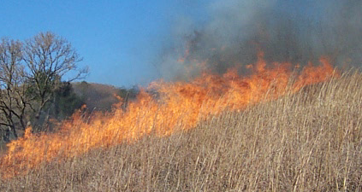
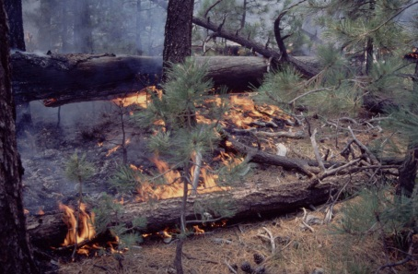
Flame-Level Wind Speed for Different Fuel Types
1 X
Crown Fire
(20-ft winds)
¾ X
Grass Fire
(eye-level)
¼ X
Litter Fire (under a stand)
12-111-S290-EP

Slide 31
Conversion Table Will Do the Adjustment
Wind speed to be adjusted
Adjustment | 2 | 4 | 6 | 8 | 10 | 12 | 16 | 20 | 24 | 28 | 32 | 36 | 40 | 50 | 60
1 → ½ or ½ → ¼ | 1 | 2 | 3 | 4 | 5 | 6 | 8 | 10 | 12 | 14 | 16 | 18 | 20 | 25 | 30
½ → 1 or ¼ → ½ | 4 | 8 | 12 | 8 | 20 | 24 | 32 | 40 | 48 | 56 | 64
1 → ¾ | 2 | 3 | 4 | 6 | 8 | 9 | 12 | 15 | 18 | 21 | 24 | 27 | 30 | 38 | 45
¾ → 1 | 3 | 5 | 8 | 11 | 13 | 16 | 21 | 27 | 32 | 37 | 43 | 48 | 53 | 67 | 80
¾ → ¼ | 1 | 2 | 2 | 3 | 3 | 4 | 5 | 7 | 8 | 9 | 11 | 12 | 13 | 17 | 20
¼ → ¾ | 6 | 12 | 18 | 24 | 30 | 36 | 48 | 60
1 → ¼ | <1 | 1 | 2 | 2 | 3 | 3 | 4 | 5 | 6 | 7 | 8 | 9 | 10 | 12 | 15
¼ → 1 | 8 | 16 | 24 | 32
½ → ¾ | 3 | 6 | 9 | 12 | 15 | 18 | 24 | 30
¾ → ½ | 2 | 3 | 4 | 6 | 7 | 8 | 12 | 14 | 16
or you can do the arithmetic
12-112-S290-EP

Slide 32
For a backing fire, EWS is always taken to be ½mph
Into the wind—flames lean back from vertical
Wind direction
Down a slope—flames lean back from
a perpendicular to the slope
Backing fire spread is largely by radiation/convection within the fuelbed and is relatively insensitive to wind or slope. Taking it to be ½ is a good approximation.
12-113-S290-EP

Slide 33
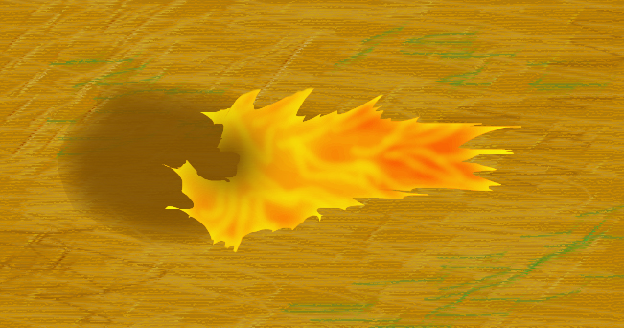
For a flanking fire, EWS is taken to be 1 mph
NO WIND-DRIVEN
SIDEWAYS SPREAD
WIND
Little net effect on the fire’s spread from wind and/or slope; flames do not lean outward either way.
12-114-S290-EP

Slide 34
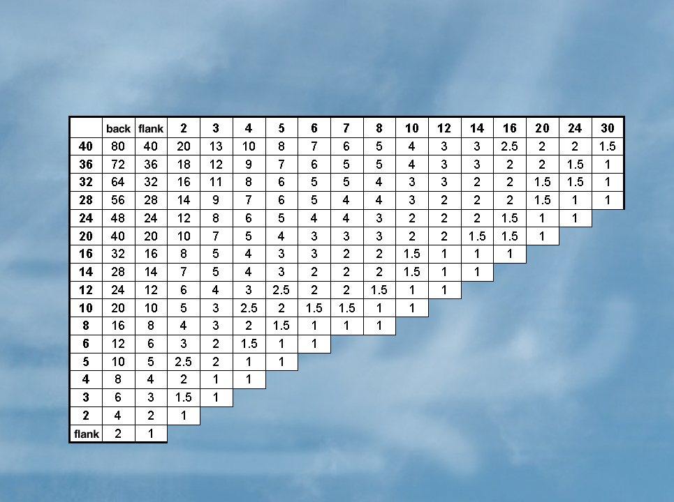
Calculating EWS-Ratio
Smaller EWS →
The column marked “back” is for backing fire
EWS = ½
The column marked “flank” is for flanking fire
EWS = 1
Larger EWS →
12-115-S290-EP

Slide 35
Illustration #2: Wind Change, Surfacing Mountain Wave
20
5
wind aloft surfaces on the fire
30
30
x
x
5
20
5
15
5
15
3X
Click image to play video clip
4X
x
Observed conditions:
Grass fire on flats below major mountain range; moving 1 utility pole-span every 8 minutes
Wind west 5; RH 30%
Building line 10 pole-spans east of the fire; escape time needed 5 min.
Weather forecast:
RH 30%;
west winds over major ridges 15-20 could surface any time after midmorning.
1 pole in
8 min
1 pole in 2 min
Note: These are “full force” surfacing ridgetop winds, not lee-side winds sheltered by a hill.
Before the wind increase, one pole-span provides enough
distance from the fire for escape, but after the increase it would take 3 pole-spans to provide 5-minute escape window. Best to plan for the larger escape window.
12-116-S290-EP
Notes:
Check illustration numbers

Slide 36
ROS-Ratio Table
EWS biggest in faster fuel type
EWS less in grass
Litter
to/from
Crown
Litter
to/from
Grass
Crown
to/from
Grass
Crown
to/from
Grass
Litter
to/from
Grass
EWS
Ratio
No fuel
change
Yellow highlights cases
In which ROS will be greater in the grass fuel.
1
1
4
14
4
3
10
2
2
10
30
8
1
5
3
4
15
60
13
1
3
4
5
20
80
20
1.5
3
5
7
30
100
27
2
2
Red highlights: ROS-ratio increases of 60x and greater have been associated with fatalities.
6
9
35
130
35
3
2
8
12
50
180
4
1
10
16
60
240
5
1
12
20
80
300
6
1.5
16
30
100
440
8
2
20
40
140
600
10
3
24
50
180
700
13
3
30
60
220
1000
17
4
40
80
300
1300
25
6
50
110
400
1800
30
8
60
140
500
2200
40
10
12-117-S290-EP

Slide 37
Exercise #2: Wind Change
3
15
crew
north
surfacing wind, dir. & speed chg
36%
36%
x
x
15
12
back
0
Click image to play video clip
12
24X
50X
x
Observed conditions:
9am July morning;
Upslope winds developing
Wind 3 mi/hr from NW
Temp 82; RH 36%
Smoke from fire on ridge
is capped by inversion and
shows a south wind above
Fire on north side is backing in
grass into the light NW surface
winds; Observed spread time is 1 chain in 30 min.
Weather Forecast:
General winds South at 10-15mph
Low-level inversion eroding by mid to late morning
1 chain
in 30 min
1 chain in 36 sec
Complete the
Exercise
12-118-S290-EP
Notes:
fix arrows

Slide 38
ROS-Ratio Table
EWS biggest in faster fuel type
EWS less in grass
Litter
to/from
Crown
Litter
to/from
Grass
Crown
to/from
Grass
Crown
to/from
Grass
Litter
to/from
Grass
EWS
Ratio
No fuel
change
Yellow highlights cases
In which ROS will be greater in the grass fuel.
1
1
4
14
4
3
10
2
2
10
30
8
1
5
3
4
15
60
13
1
3
4
5
20
80
20
1.5
3
5
7
30
100
27
2
2
Red highlights: ROS-ratio increases of 60x and greater have been associated with fatalities.
6
9
35
130
35
3
2
8
12
50
180
4
1
10
16
60
240
5
1
12
20
80
300
6
1.5
16
30
100
440
8
2
20
40
140
600
10
3
24
50
180
700
13
3
30
60
220
1000
17
4
40
80
300
1300
25
6
50
110
400
1800
30
8
60
140
500
2200
40
10
12-119-S290-EP

Slide 39
Slope contribution to effective wind speed is easily handled by adding a little to the upslope wind component
Over 80%,
add 5 mph
80%
5 mph
60% to 80%,
add 3 mph
Add the contribution for slope
to the upslope wind component
3 mph
60%
40% to 60%,
add 2 mph
2 mph
40%
20% to 40%,
add 1 mph
1 mph
20%
Less than 20%,
no adjustment
12-120-S290-EP

Slide 40
Illustration #3: Wind & Slope Change
8
4
50%
Next big change: fire moves upslope
& into more wind
15%
15%
x
x
4
8
4
8
0
+2
Click image to play video clip
4
10
2½ X
3X
x
Observed conditions:
Late morning; fire in small,
continuous brush; late morning
Wind on the fire 4 mph; RH 15%
Fire will reach the base of the slope in 1 hour
Wind speed on the slope reported at 8 mph eye-level (OK for small brush)
Weather Forecast: No significant changes through early afternoon
to slope in 1 hr
Up slope in 20m
12-121-S290-EP

Slide 41
ROS-Ratio Table
EWS biggest in faster fuel type
EWS less in grass
Litter
to/from
Crown
Litter
to/from
Grass
Crown
to/from
Grass
Crown
to/from
Grass
Litter
to/from
Grass
EWS
Ratio
No fuel
change
Yellow highlights cases
In which ROS will be greater in the grass fuel.
1
1
4
14
4
3
10
2
2
10
30
8
1
5
3
4
15
60
13
1
3
4
5
20
80
20
1.5
3
5
7
30
100
27
2
2
Red highlights: ROS-ratio increases of 60x and greater have been associated with fatalities.
6
9
35
130
35
3
2
8
12
50
180
4
1
10
16
60
240
5
1
12
20
80
300
6
1.5
16
30
100
440
8
2
20
40
140
600
10
3
24
50
180
700
13
3
30
60
220
1000
17
4
40
80
300
1300
25
6
50
110
400
1800
30
8
60
140
500
2200
40
10
12-122-S290-EP

Slide 42
Exercise #3: Wind & Slope Change
25
backing
4 hrs
litter
litter
40-50%
Next big change: slope reversal;
backing to upslope with the wind
40%
30%
x
x
25
12
3
back
+2
Click image to play video clip
5
10X
Observed conditions:
Early afternoon; fire backing down east-facing 50% slope in litter; RH 40
Expected to cover the lower half of the slope to the drainage in 4 hrs
Little wind on the east aspect; sheltered by terrain and vegetation
West-aspect slope is 40-50%
Early season live fuel moisture is high, and makes crown fire unlikely
Weather forecast:
Afternoon winds at ridgetop level west at 20-25 mph; min. RH 30%
16X
x
½ slope in 4 hrs
½ slope in ¼ hr
Complete the
Exercise
12-123-S290-EP

Slide 43
ROS-Ratio Table
EWS biggest in faster fuel type
EWS less in grass
Litter
to/from
Crown
Litter
to/from
Grass
Crown
to/from
Grass
Crown
to/from
Grass
Litter
to/from
Grass
EWS
Ratio
No fuel
change
Yellow highlights cases
In which ROS will be greater in the grass fuel.
1
1
4
14
4
3
10
2
2
10
30
8
1
5
3
4
15
60
13
1
3
4
5
20
80
20
1.5
3
5
7
30
100
27
2
2
Red highlights: ROS-ratio increases of 60x and greater have been associated with fatalities.
6
9
35
130
35
3
2
8
12
50
180
4
1
10
16
60
240
5
1
12
20
80
300
6
1.5
16
30
100
440
8
2
20
40
140
600
10
3
24
50
180
700
13
3
30
60
220
1000
17
4
40
80
300
1300
25
6
50
110
400
1800
30
8
60
140
500
2200
40
10
12-124-S290-EP

Slide 44
Your Basic FLAME Toolbox is Complete You now have the tools for handling changes in fuel, wind, and slope…with those, you can deal with very realistic problems.

Slide 45
We can apply FLAME to realistic situations by combining changes in Fuel-Type and Effective Wind Speed

Slide 46
Illustration#4: Wind & Fuel Change,
Slope Reversal
backing
15
6 hrs
50%
litter
crown
Next big change: slope rev; litr to crwn, & EWS incr
40%
20%
x
x
15
8
8
back
+2
10
Click image to play video clip
20X
140X
x
Observed conditions:
Early morning in September, fire is backing down a north slope in deep litter
Temp is 65ºF; RH is 40%
Fire’s progress will put it at the
bottom by about noon (6 hrs)
South slope is chaparral, crown fire occurred in brush yesterday
Weather Forecast:
Ridgetop wind S at 15 mph
Max temp. 85ºF; Min RH 20%
lower slope
in 6 hrs
lower slope in 3 min
In real life the change will take
place over time, but once a
crown run gets established it
can move that distance in a
few minutes.
12-127-S290-EP

Slide 47
ROS-Ratio Table
EWS biggest in faster fuel type
EWS less in grass
Litter
to/from
Crown
Litter
to/from
Grass
Crown
to/from
Grass
Crown
to/from
Grass
Litter
to/from
Grass
EWS
Ratio
No fuel
change
Yellow highlights cases
In which ROS will be greater in the grass fuel.
1
1
4
14
4
3
10
2
2
10
30
8
1
5
3
4
15
60
13
1
3
4
5
20
80
20
1.5
3
5
7
30
100
27
2
2
Red highlights: ROS-ratio increases of 60x and greater have been associated with fatalities.
6
9
35
130
35
3
2
8
12
50
180
4
1
10
16
60
240
5
1
12
20
80
300
6
1.5
16
30
100
440
8
2
20
40
140
600
10
3
24
50
180
700
13
3
30
60
220
1000
17
4
40
80
300
1300
25
6
50
110
400
1800
30
8
60
140
500
2200
40
10
12-128-S290-EP

Slide 48
Exercise #4: Wind & Fuel Change, Litter on Lower Slope to Crown Fire on Upper Slope
20
6
crown
65%
litter
Next big change: litter to crown,
and increase in wind
24%
15%
x
x
6
20
20
2
20
+3
+3
5
23
5X
30X
x
Click image to play video clip
lower slope
in 3 hr
Upper ½ slope in
6 min
Observed conditions:
Late morning in September; litter fire under pine overstory on a SW 65% slope; scattered torchouts occurring
RH 24%; Eye-lvl wind 6 mph
Fire’s progress will cover the lower half of the slope in 3 hrs
Weather Forecast:
Minimum RH 15-20%
Ridgetop winds SW at 15-20 mph (note: the winds are increasing slightly overall as well as being higher on the upper slopes)
Complete the
Exercise
12-129-S290-EP

Slide 49
ROS-Ratio Table
EWS biggest in faster fuel type
EWS less in grass
Litter
to/from
Crown
Litter
to/from
Grass
Crown
to/from
Grass
Crown
to/from
Grass
Litter
to/from
Grass
EWS
Ratio
No fuel
change
Yellow highlights cases
In which ROS will be greater in the grass fuel.
1
1
4
14
4
3
10
2
2
10
30
8
1
5
3
4
15
60
13
1
3
4
5
20
80
20
1.5
3
5
7
30
100
27
2
2
Red highlights: ROS-ratio increases of 60x and greater have been associated with fatalities.
6
9
35
130
35
3
2
8
12
50
180
4
1
10
16
60
240
5
1
12
20
80
300
6
1.5
16
30
100
440
8
2
20
40
140
600
10
3
24
50
180
700
13
3
30
60
220
1000
17
4
40
80
300
1300
25
6
50
110
400
1800
30
8
60
140
500
2200
40
10
12-130-S290-EP

Slide 50
Exercise #5: Flanking Litter Fire onto
Grass Slope with Wind
12
9
flanking
grass
Next big change as fire moves out of sheltered
litter and onto wind-exposed slope in grass
26%
26%
x
x
12
9
7
flank
+1
8
8X
Click image to play video clip
180X
x
Observed conditions:
Temp 83ºF; RH 26%
Time is early afternoon
Fire burning actively in litter
Slope nearly flat
Essentially calm in trees
Smoke drifts straight up in
trees, then drifts East
Spread 1/8 of slope in 2 hrs
Adjacent west slope is grass,
about 30% slope
Weather Forecast:
Ridgetop winds 8-12 from west
Afternoon temperature 85ºF
Minimum Rel. Hum. 26%
Slope in 16 hrs
Slope in 5 min
Complete the
Exercise
12-131-S290-EP

Slide 51
ROS-Ratio Table
EWS biggest in faster fuel type
EWS less in grass
Litter
to/from
Crown
Litter
to/from
Grass
Crown
to/from
Grass
Crown
to/from
Grass
Litter
to/from
Grass
EWS
Ratio
No fuel
change
Yellow highlights cases
In which ROS will be greater in the grass fuel.
1
1
4
14
4
3
10
2
2
10
30
8
1
5
3
4
15
60
13
1
3
4
5
20
80
20
1.5
3
5
7
30
100
27
2
2
Red highlights: ROS-ratio increases of 60x and greater have been associated with fatalities.
6
9
35
130
35
3
2
8
12
50
180
4
1
10
16
60
240
5
1
12
20
80
300
6
1.5
16
30
100
440
8
2
20
40
140
600
10
3
24
50
180
700
13
3
30
60
220
1000
17
4
40
80
300
1300
25
6
50
110
400
1800
30
8
60
140
500
2200
40
10
12-132-S290-EP

Slide 52
On the fireline, always continue to observe fire behavior and updating your assessment; continually improve the accuracy of your predictions. You can continue to extend your assessment of expected fire behavior into the future. When you see the “expected” fire behavior develop, ask what the next big change after that will be.

Slide 53
Rough Estimates of Actual ROS Can Suggest Realistic ROS Values
For litter:
ROS (ft/min) is roughly 2 x EWS (in mph). Example:for wind speed 4 mph, estimated litter ROS is about 2x4 = 8 ft/min
For crowns:
ROS (ft/min) is roughly 8 x EWS (in mph). Example: for wind speed 15 mph, estimated crown ROS is about 8x15 = 120 ft/min

Slide 54
Rough Estimates of Actual ROS Can Suggest Realistic ROS Values
For grass:
ROS (ft/min) is roughly 30 x EWS (in mph). Example: for wind speed 12 mph, estimated grass ROS is about 30x12 = 360 ft/min
Momentary ROS varies, and it is good to assume that ROS can range above and below the average ROS by a factor of 2x.

Slide 55
Real-World Application of FLAME to a Fatality-Case Situation
Using the description of the fire behavior setting and events—Not judging the decisions of the firefighters.
Considering how FLAME might have been applied in that situation, and the kind of fire behavior information that can be developed.

Slide 56
Photographs and maps are used to portray the setting and the situation involved in each case. The weather and fire behavior information is representative but not exact in every detail. But it allows us to exercise the FLAME process on a realistic situation.

Slide 57
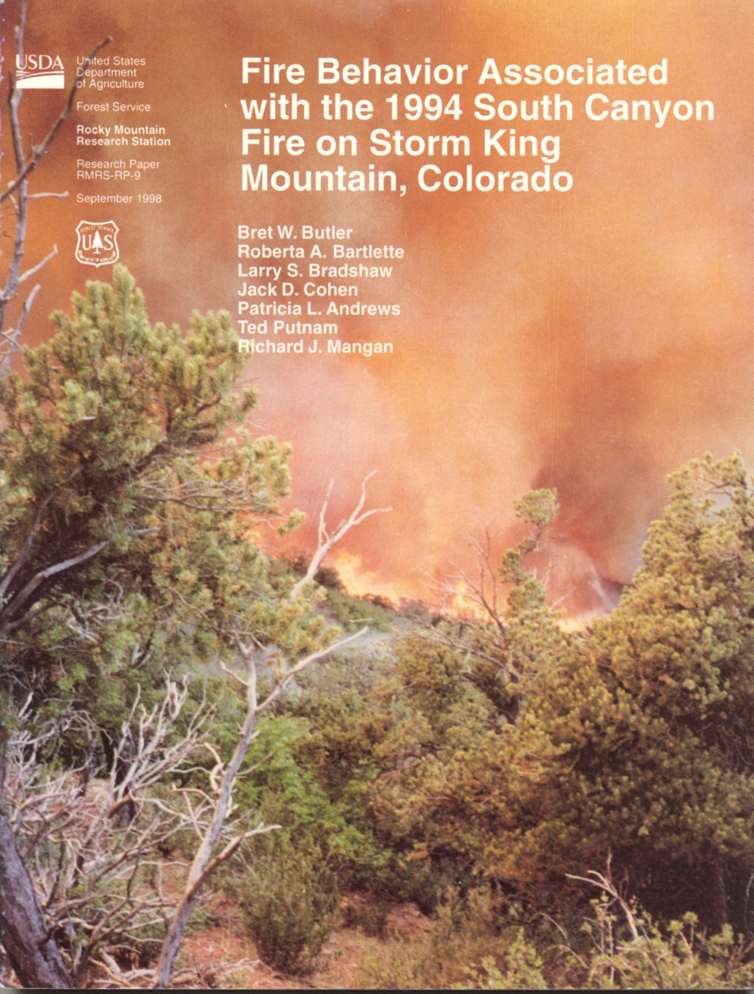
South Canyon Fire Case Study

Slide 58
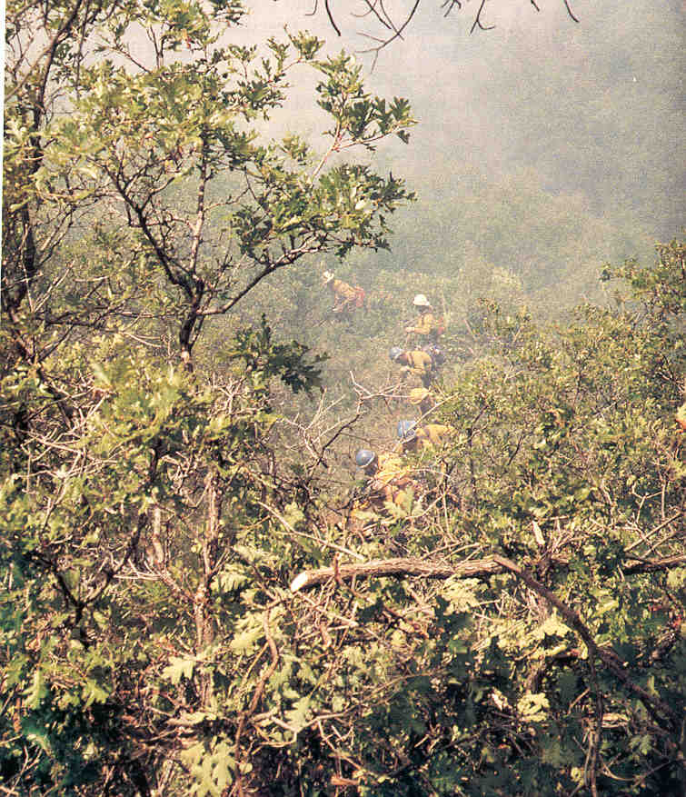
Gambel Oak Fuels, West Flank Fireline
Crews felt little wind, due to sheltering by topography and vegetation.

Slide 59
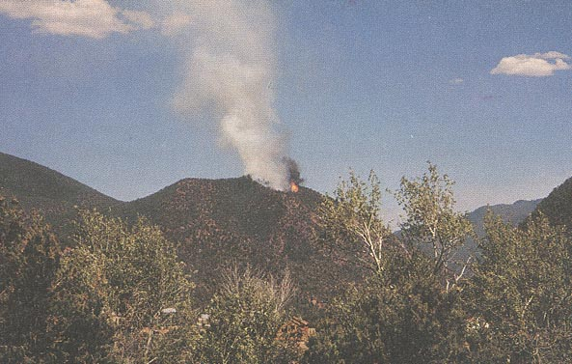
Observed Fire Behavior
32 ft/hr
60 hrs
South Canyon Fire, 1200 July 4

Slide 60
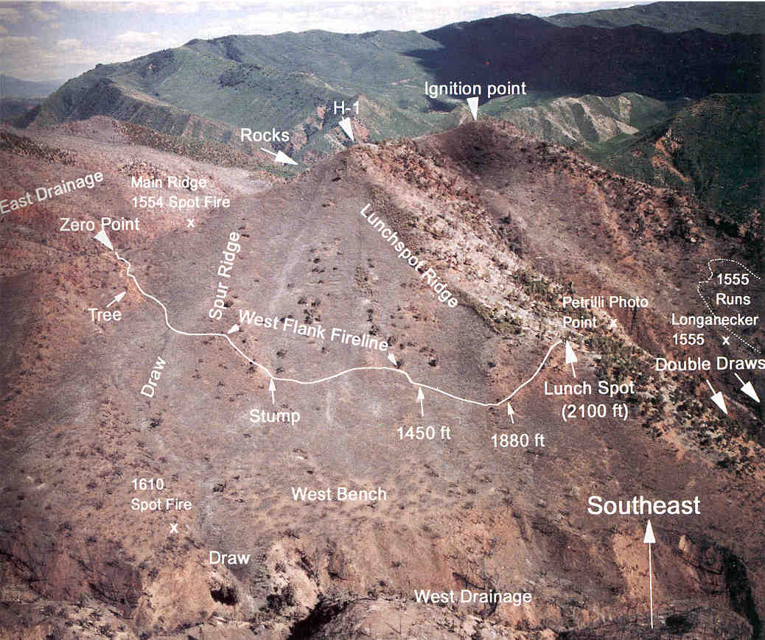
South Canyon Fire Site Overview

Slide 61
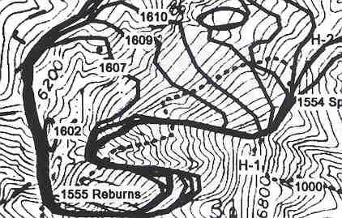
30
7+ min
backing litter fire
Crown fire
Actual: 9 min
60 hrs
Ridge
CFP; litter to crown; wind increase
20%
10%
x
x
Stream
60 hrs
30
?
Observed conditions:
July; drought; backing fire in litter
Light upslope wind; 20% RH
Fire may reach bottom this shift;
after 60 hour spread from top to
bottom
Weather Forecast:
Dry cold front predicted; WSW
winds to 30 mph; RH 10%
back
30
60X
500X
x
Slope in 60 hrs
Slope in 7+ min
What will happen if the fire moves up the drainage, pushed by prefrontal winds of 30 mph?
Crown fire indicators:
- Seasonal drought plus overall drought
- RH below 20%
- Backing fire causes torchouts
- Crown fire &/or torching on this or nearby fires

Slide 62
Calculating EWS-Ratio
Smaller EWS →
Larger EWS →
12-143-S290-EP

Slide 63
ROS-Ratio Table
EWS biggest in faster fuel type
EWS less in grass
Litter
to/from
Crown
Litter
to/from
Grass
Crown
to/from
Grass
Crown
to/from
Grass
Litter
to/from
Grass
EWS
Ratio
No fuel
change
Yellow highlights cases
In which ROS will be greater in the grass fuel.
1
1
4
14
4
3
10
2
2
10
30
8
1
5
3
4
15
60
13
1
3
4
5
20
80
20
1.5
3
5
7
30
100
27
2
2
Red highlights: ROS-ratio increases of 60x and greater have been associated with fatalities.
6
9
35
130
35
3
2
8
12
50
180
4
1
10
16
60
240
5
1
12
20
80
300
6
1.5
16
30
100
440
8
2
20
40
140
600
10
3
24
50
180
700
13
3
30
60
220
1000
17
4
40
80
300
1300
25
6
50
110
400
1800
30
8
60
140
500
2200
40
10
12-144-S290-EP

Slide 64
Implementing LCES
Lookouts (based on the major concerns)
To observe fire’s progress; signs of upslope spread, up-drainage movement
To observe the approach of the winds
Lookout positions? (Consider remote lookouts)
Communications
How frequent?
What key points to include
Escape Routes
Away from the crown-fire blast
Travel times much less than 7 minutes
Safe Zones
Big enough for expected flame-lengths
Big enough for all firefighters

Slide 65
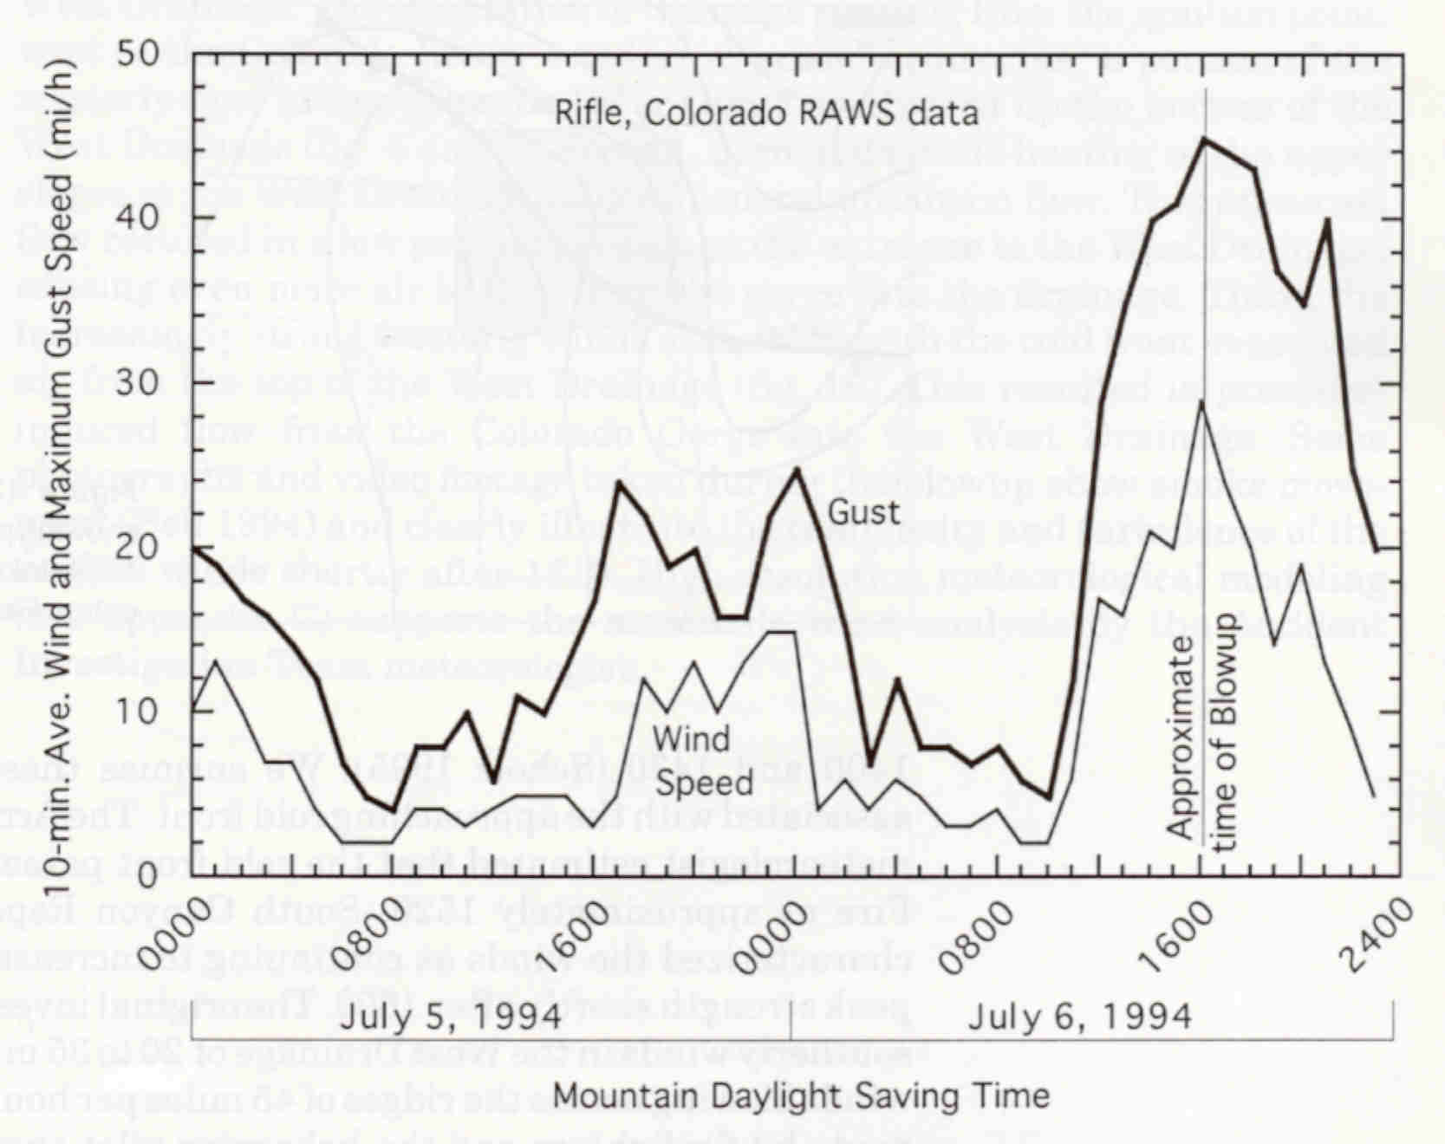
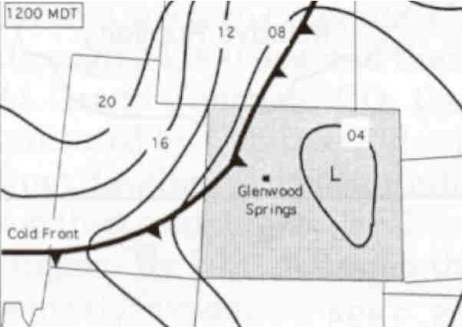
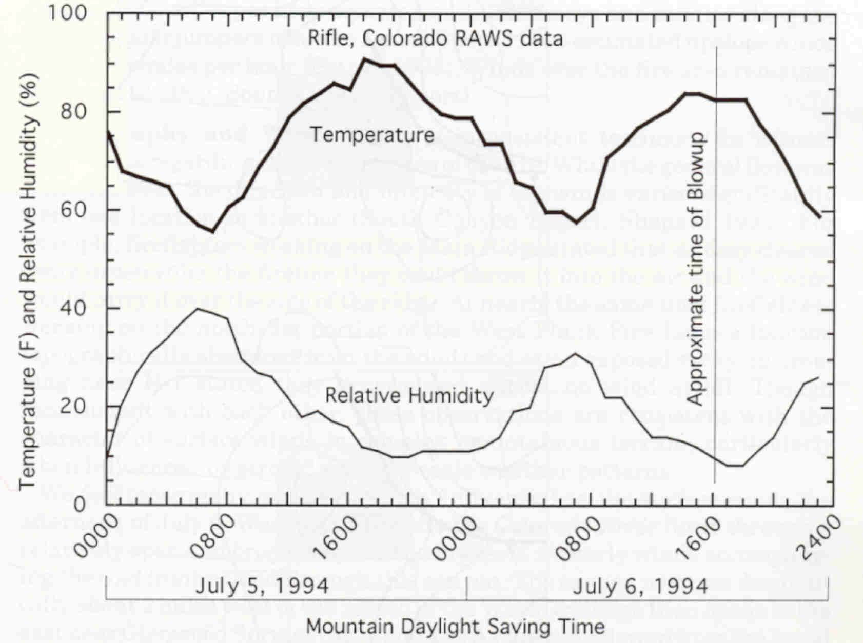
Cold Front
Wind at noon
blowup day
Wind at noon
previous day
South Canyon Fire location
12-146-S290-EP

Slide 66
Value of FLAME
Good match with actual ROS
Approx guidelines fit actual conditions
Errors tended to cancel out
Even a “ballpark” answer is OK
Suppose it was 4 min, or 15 min...
Reveals the potential danger
Shows fire will outflank control efforts
Could have drawn attention to:
Potential for transition to crown fire
Seeking information on increasing winds

Slide 67
How do you address the possibilities? Apply FLAME to all of them
Consider what is likely to happen, such as:
Inversion eroding and winds increasing
Cold front approaching
Up or down canyon winds developing
Plan for these in safety, LCES, tactics
Consider what might happen, such as
T-storm outflow winds
Surfacing of winds aloft (as in a mountain wave)
Winds gusting across a flank
Monitor if possible (for example T-storms), have a contingency plan if it should happen

Slide 68
When would you apply FLAME?
First arriving at a fire
Going on shift
A “next big change” occurs
FLAME should not be applied in place of ongoing situational awareness but used as a tool to enhance awareness.

Slide 69
FLAME Online
FLAME online is a self paced learning module which includes techniques for handling more complex situations and for improving your accuracy.
FLAME online also includes additional fatality-case studies and realistic exercise scenarios for practice.
Notes:
Add NWCG web site

Slide 70
Other Available Processors
A comparison of the features of more complex processors:
Nomograms
Appendix B Tables
BehavePlus

Slide 71
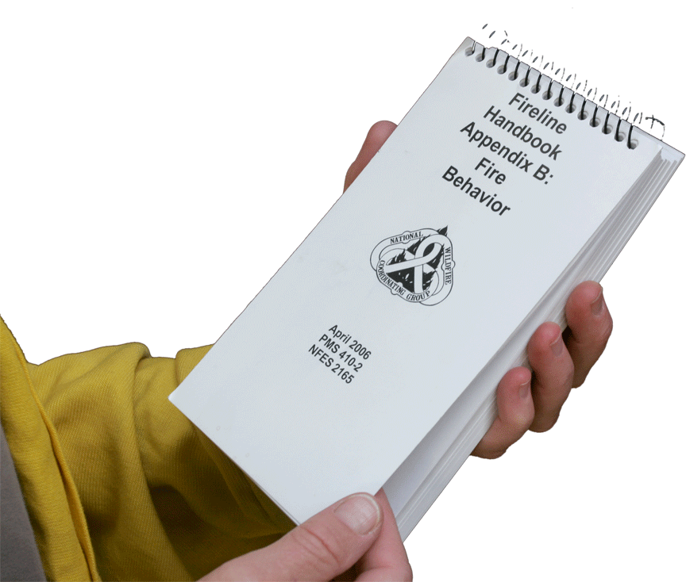
Appendix B of the Fireline Handbook Puts fire behavior information in the form of tables

Slide 72
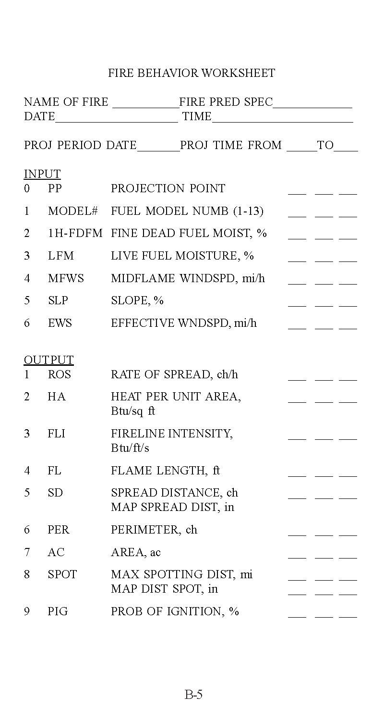
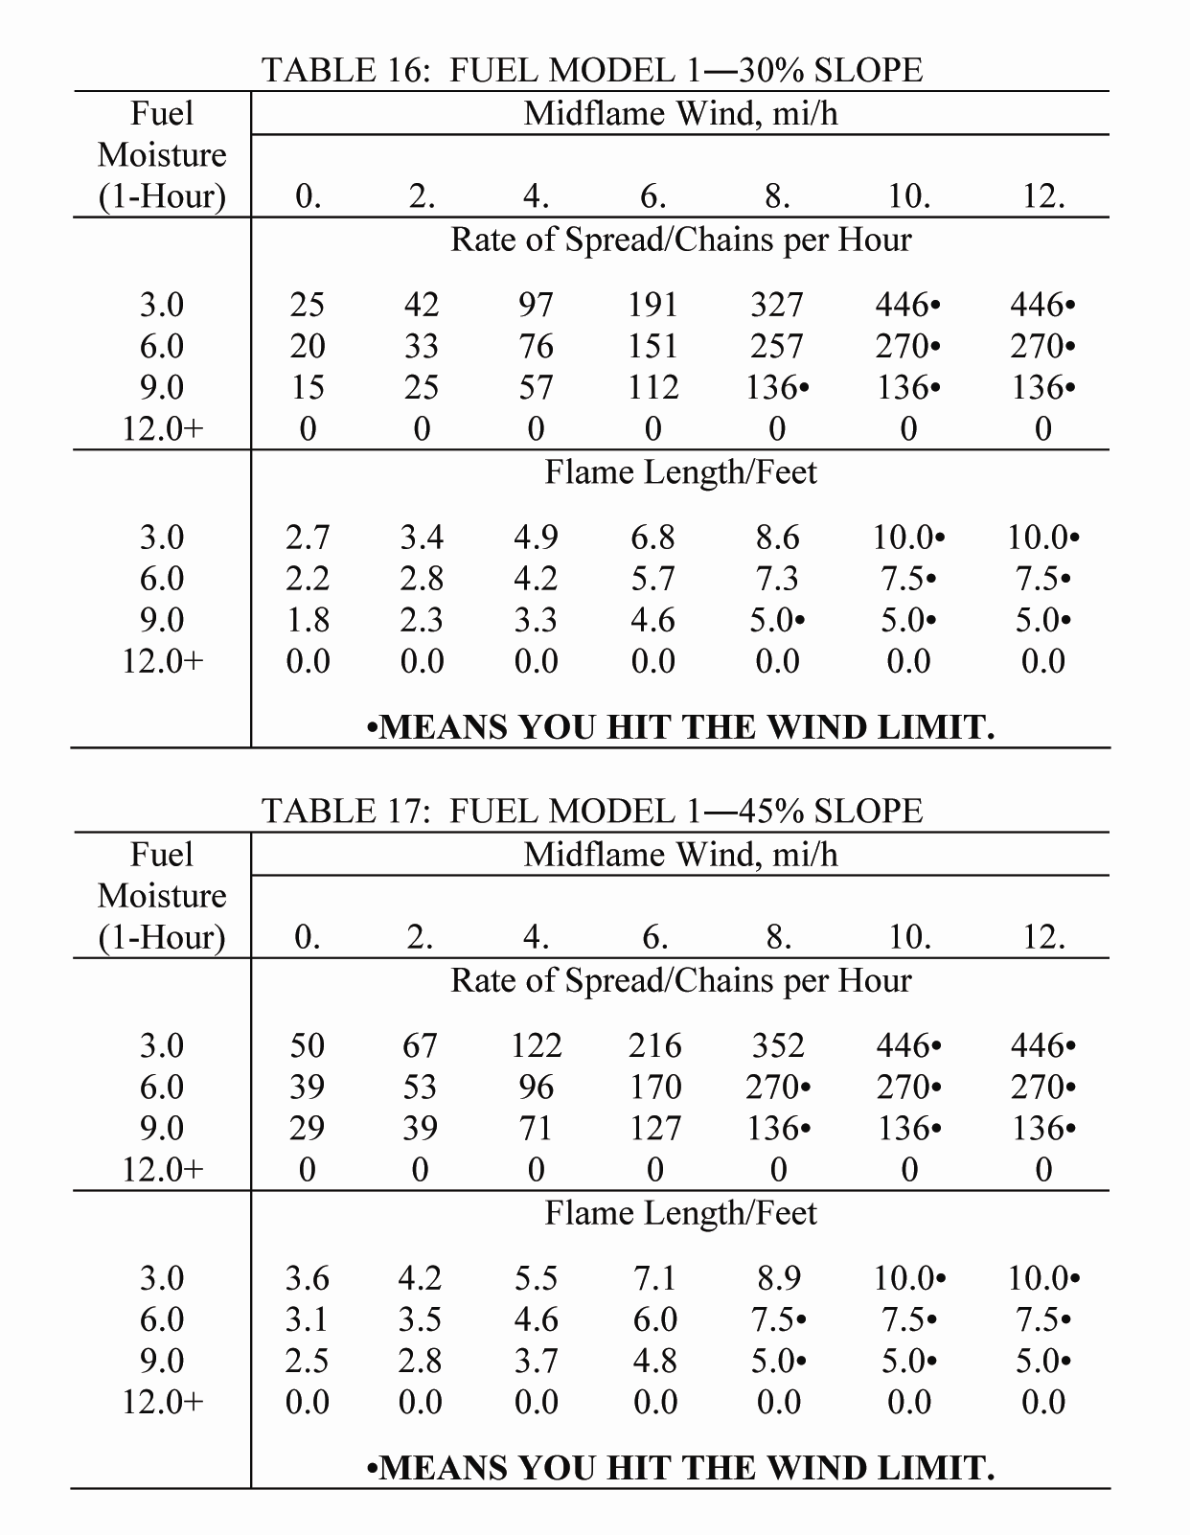
inputs required
After you utilize several tables to obtain the required inputs, you can look up the outputs in a table like this one.
possible outputs
Notes:
Replace with new appendix B tables

Slide 73
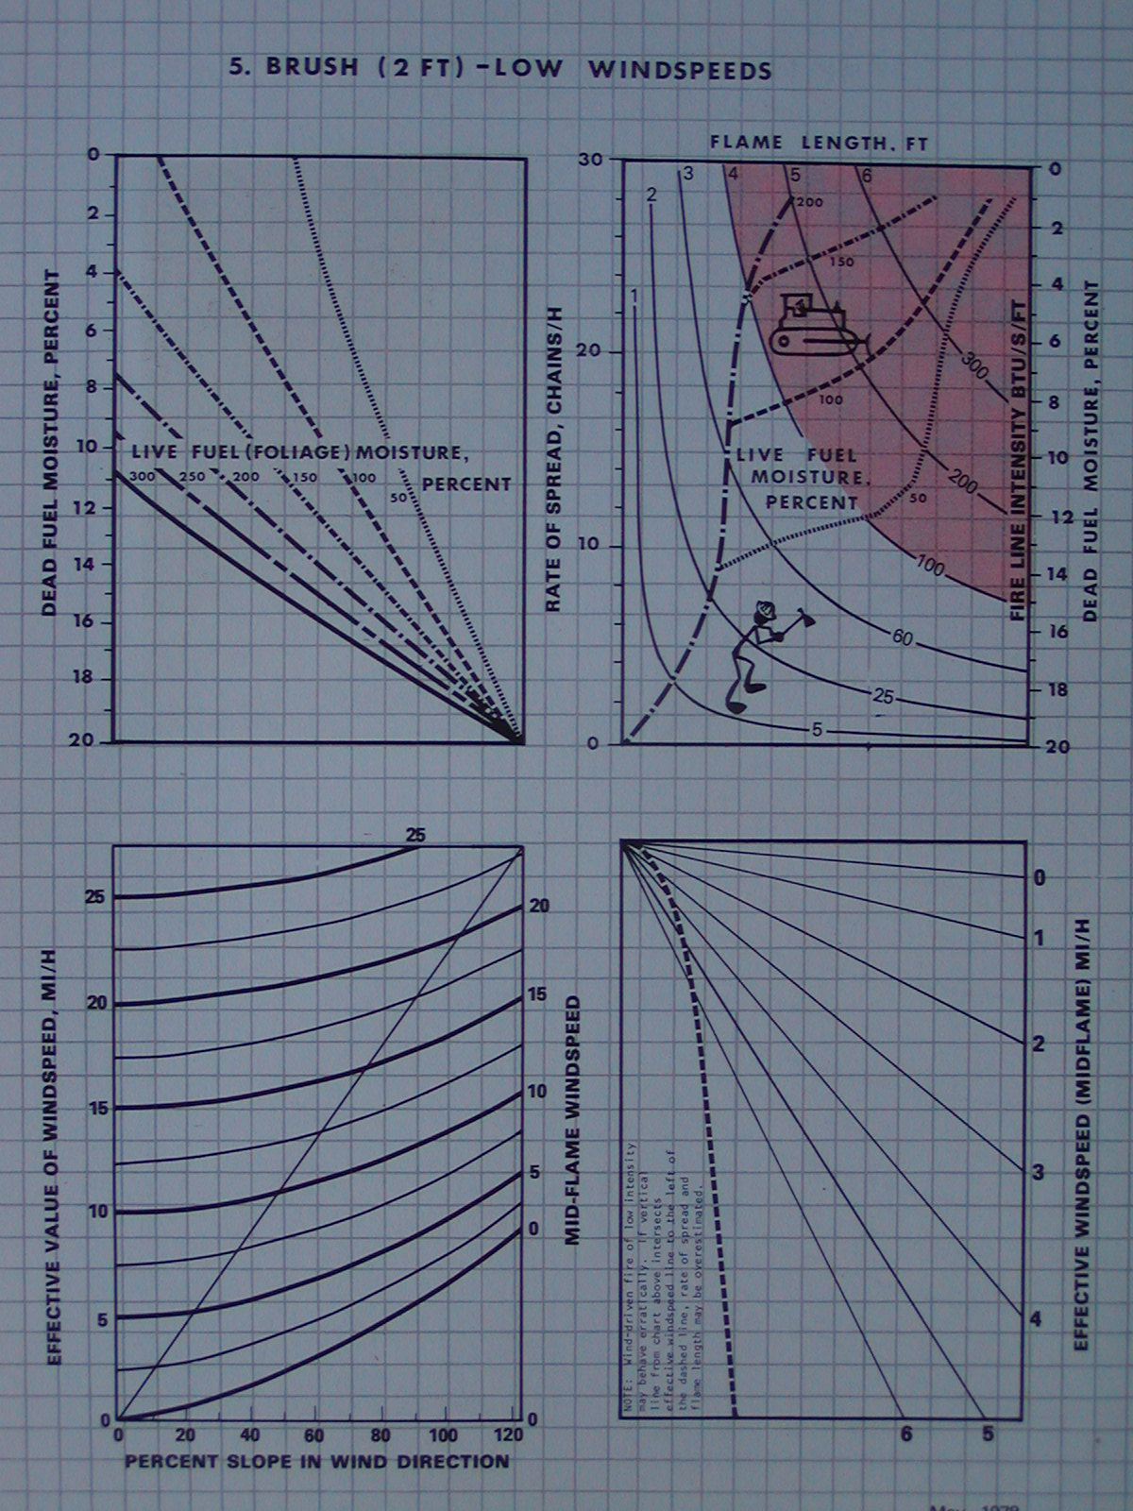
Nomograms Put fire behavior information in the form of graphs.
12-154-S290-EP
Notes:
Add graphic of nomogram

Slide 74
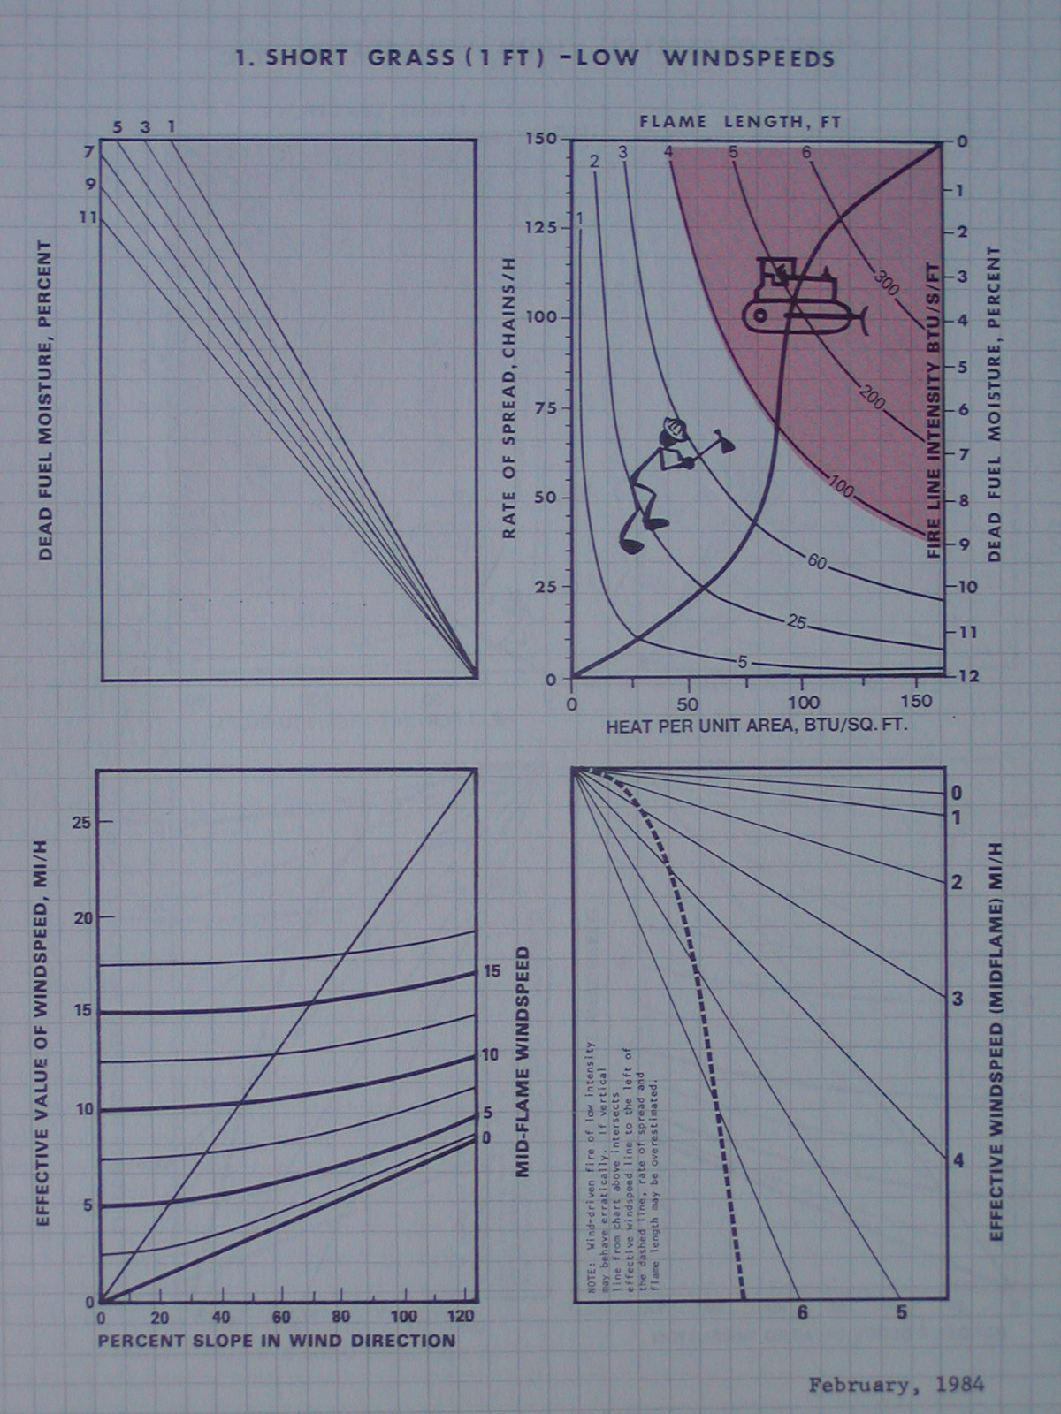
Required inputs:
- Fuel model
- Fine fuel moisture (maybe live FM)
- Midflame wind speed
- Slope
- Effective wind speed
After following the inputs you obtain the basic outputs of:
- Rate of Spread
- Flame Length
ROS in this case is about 90 ch/hr.
Notes:
Fix font, new graphic of nomogram

Slide 75
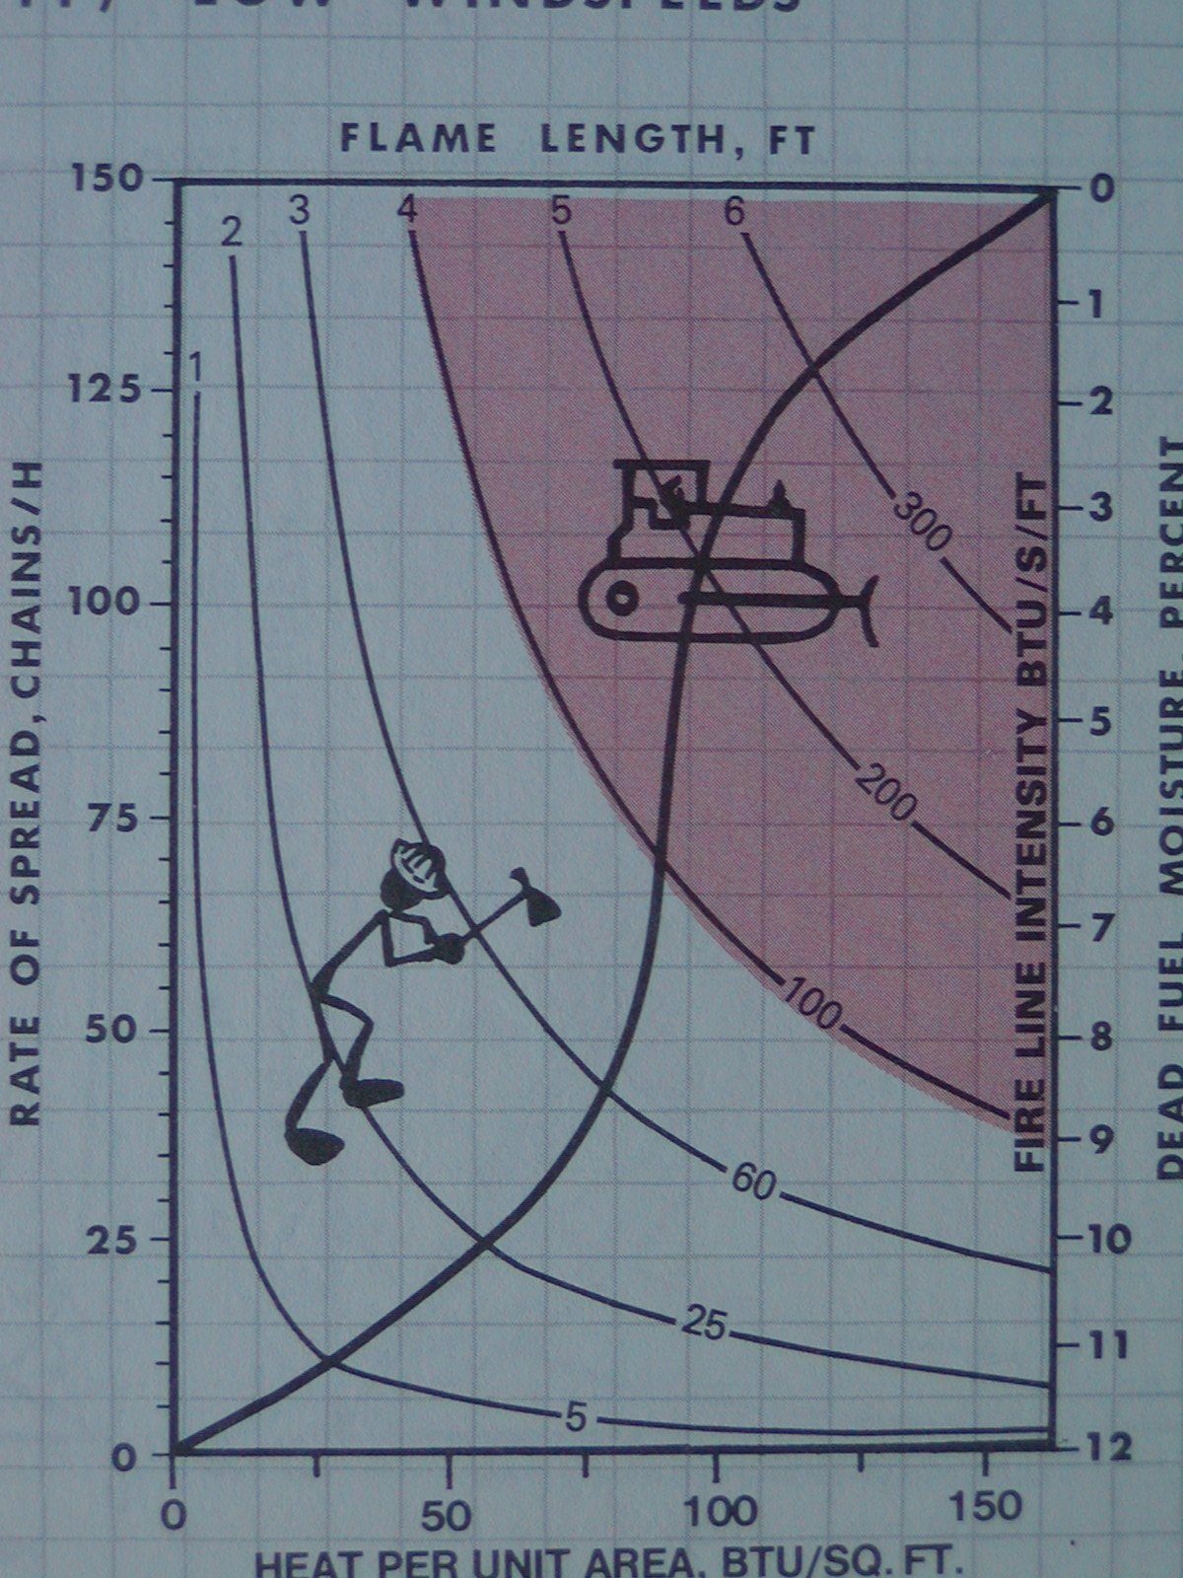
Using the values of Heat per Unit Area and Rate-of-Spread that came out of doing the nomogram place you on the Hauling Chart.
In this case the FL is predicted to be
about 4½ feet.
The Fireline Intensity is about 160 BTU per second per foot of fireline.
12-156-S290-EP
Notes:
Replace with new Nomogram

Slide 76
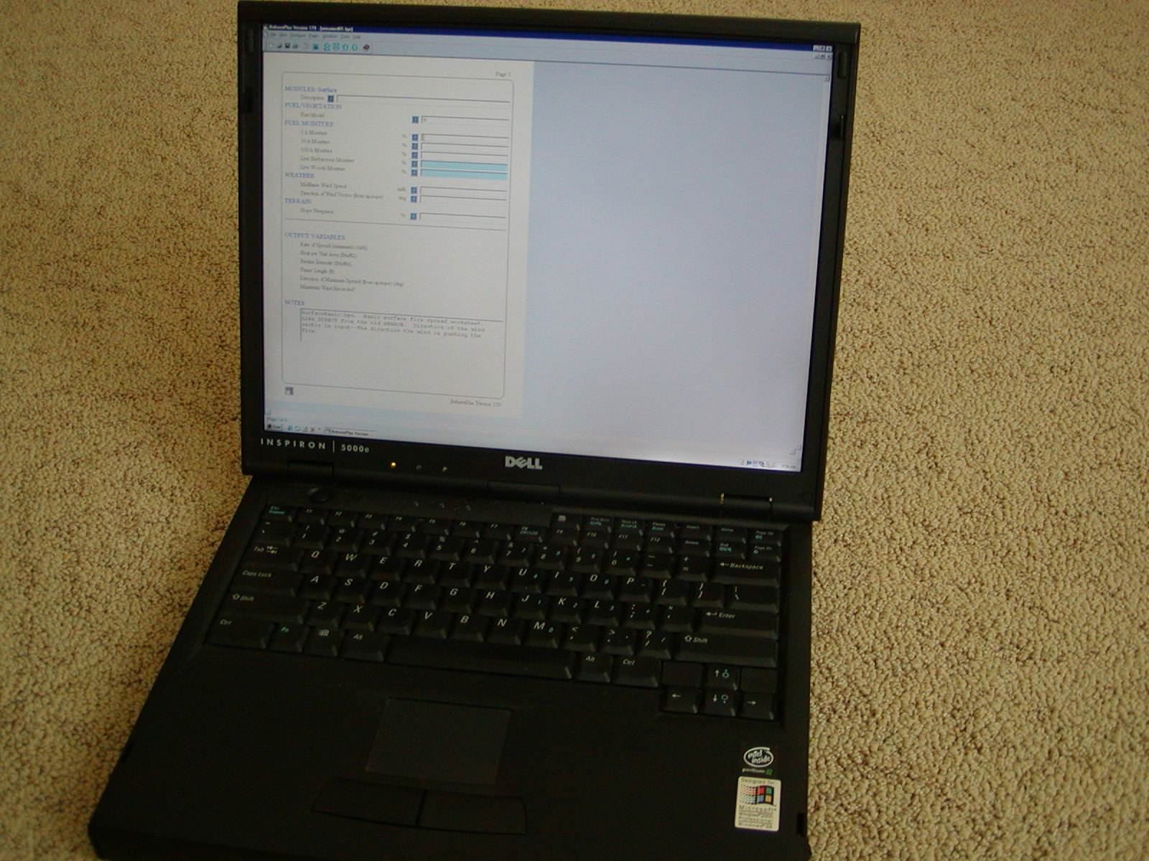
BehavePlus Computer Based Program
12-157-S290-EP
Notes:
Replace picture

Slide 77
The inputs are similar to those used with Appendix B and Nomograms The potential outputs are much the same However, there are now 40 fuel models available for BehavePlus

Slide 78
Another Widely Used Processor
Canadian Forest Fire Behavior Prediction System (CFFBPS)
Used mainly in: -Canada
-Alaska -The lake States (Michigan, Minnesota, etc.) -Areas of the Pacific Northwest

Slide 79
Comparison of Processors
FLAME
2 inputs (fuel-type & EWS) & observation of current fire spread
1 main table and 3 diagrams (for wind speed & slope)
Outputs the change in ROS and predicts fire spread time
Builds on the ongoing fire behavior
Appendix B
uses 6 inputs
114 pages of tables
up to 9 outputs, including ROS and FL
Nomograms
uses 6 inputs
26 nomograms (over 100 graphs) and several input tables
outputs ROS, H/A, and FL
BehavePlus
uses 6 inputs
Computer based
many outputs, including ROS and FL
Appendix B, Nomograms, and BehavePlus predictions do not account for current fire behavior, but use expected conditions only.

Slide 80
Review Unit 12 Objectives
Describe how to apply fire behavior information to safety and suppression decisions.
Demonstrate how to calculate the size of safety zones.
Identify the importance of changes in fire behavior to firefighter safety.
Notes:
161

Slide 81
Review Unit 12 Objectives
4. Discuss what drives large changes and identify the “next big change.”
5. Demonstrate a simple but systematic method for gauging change and estimating fire spread time.
6. Identify other fire behavior prediction tools.
Notes:
162

