Slide 1
Unit 2

Slide 2
Unit 2 Objectives
Identify standard features on a topographic map.
Describe how topography affects fuels and their availability for combustion.
Describe how topography can affect the direction and rate of spread of wildland fires.

Slide 3
Unit 2 Objectives
4. Describe how changes in fuel and topography can provide full and partial barriers to the spread of wildland fires.
5. Describe how slope percent can be determined or estimated in the field.

Slide 4
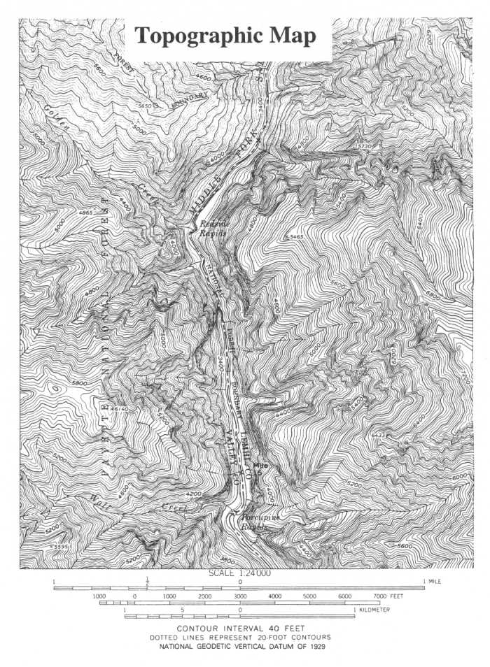
.F
.G
.J
I.
.A
H.
.E
B.
.D
C.
2-4-S290-EP

Slide 5
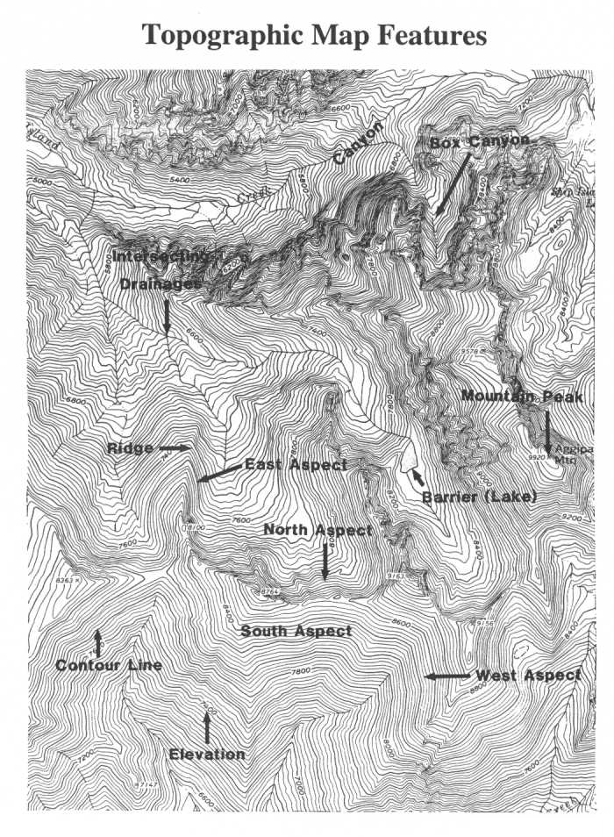
Topographic Map Features
Match these features to the boxes on map:
Contour Line
Elevation
East Aspect
North Aspect
South Aspect
West Aspect
Canyon
Barrier
Box Canyon
Mountain Peak
Intersecting Drainage
Ridge
2-5-S290-EP

Slide 6
Topographic Map Features
2-6-S290-EP

Slide 7
How Topography Affects Fuels and Their Availability for Combustion

Slide 8
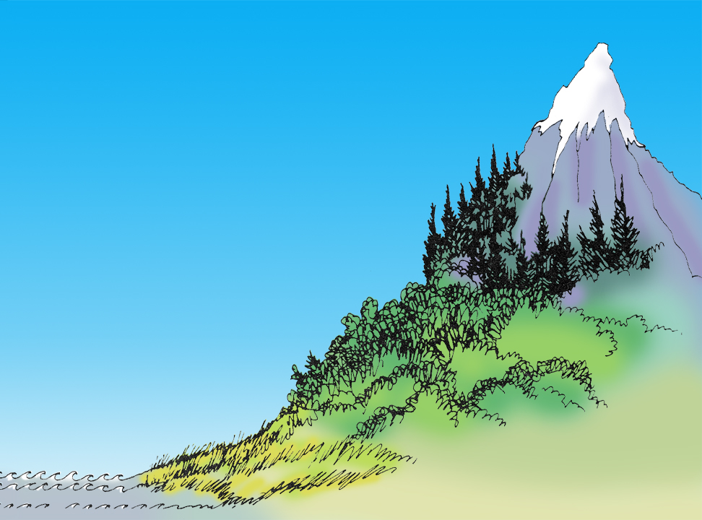
Elevation Above Sea Level
snow 10,000 ft.
tundra
timber
shrub
grass
sea level
2-8-S290-EP

Slide 9
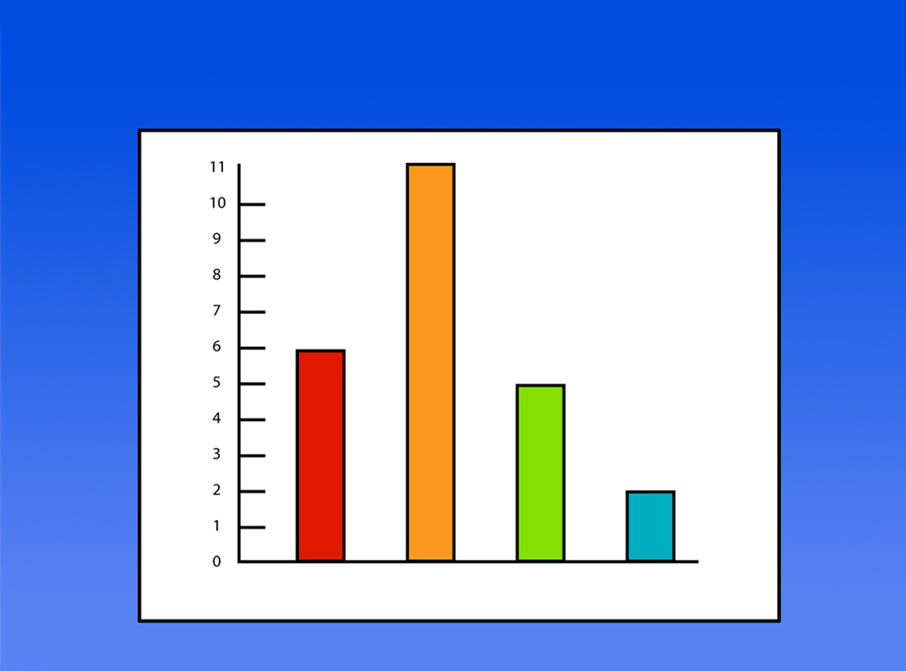
Fires on slope reaching 10 acres +
Percent of fires
Level
Base of
slope
Middle of slope
Top of
slope
2-9-S290-EP

Slide 10
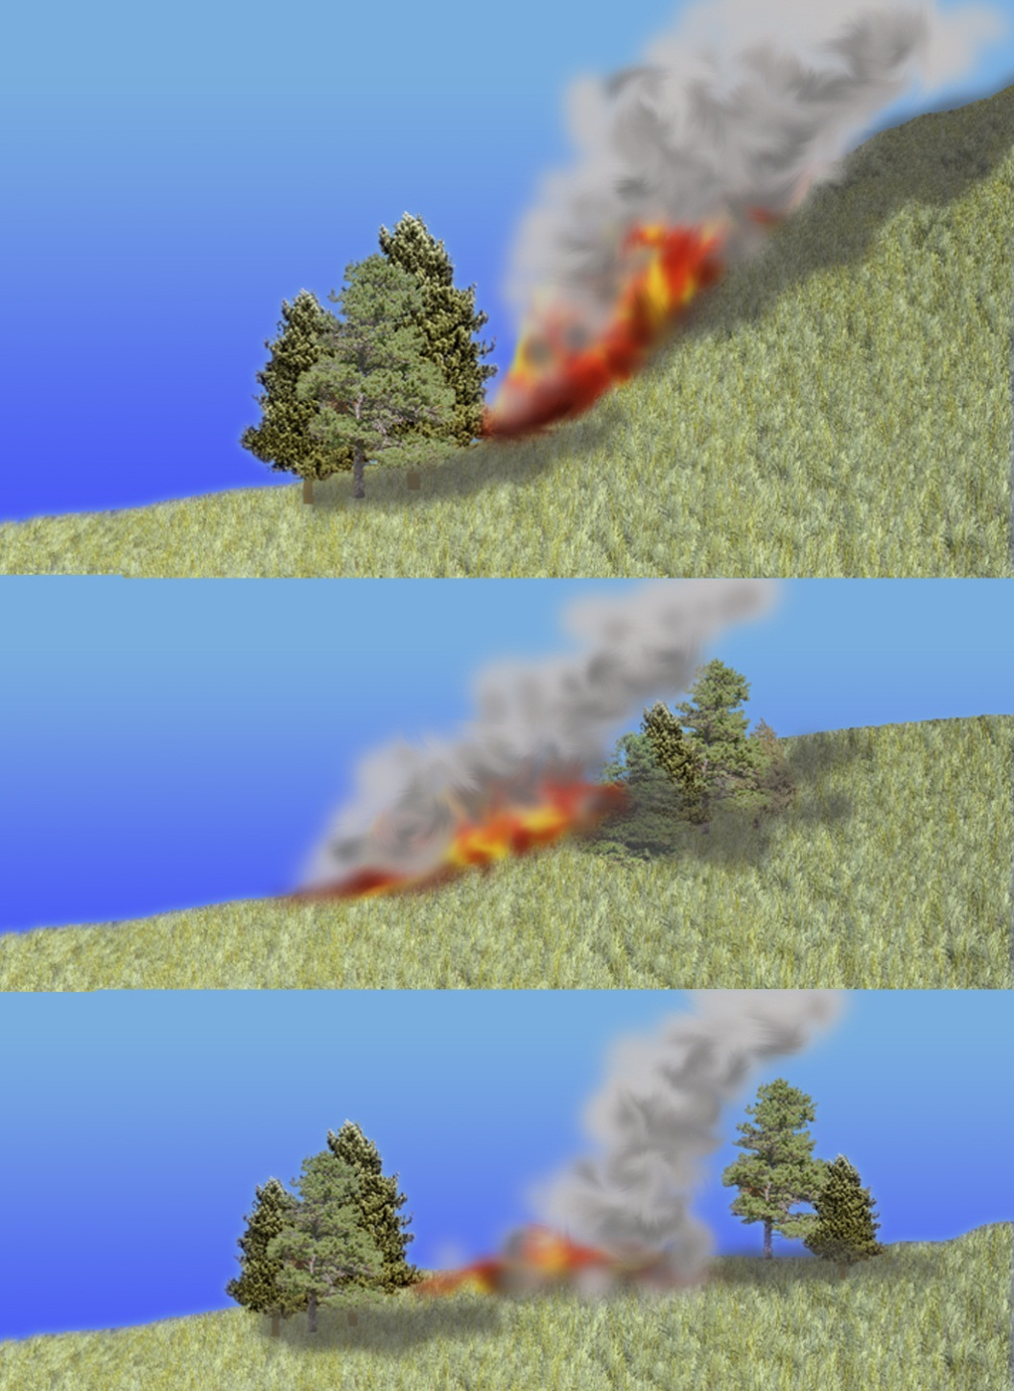
Fires starting at base of slope often become the largest fires.
55%
slope
30%
slope
0-5%
slope

Slide 11
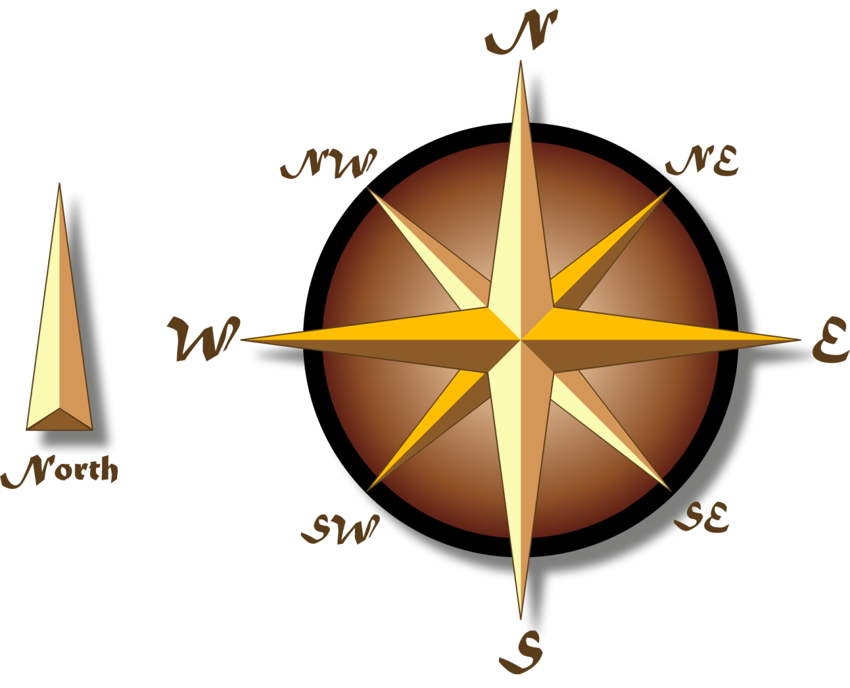
Cardinal Directions
North
South
East
West
Northeast
Northwest
Southeast
Southwest

Slide 12
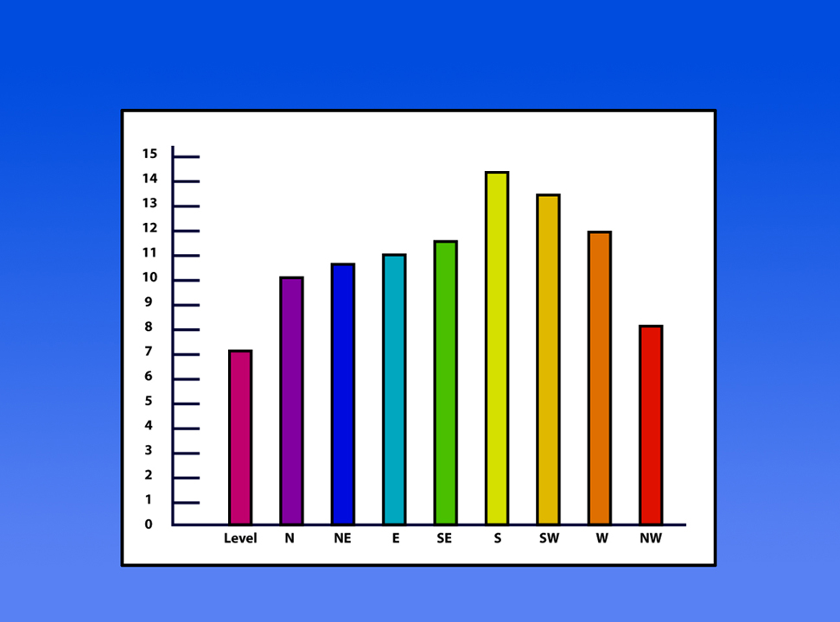
Fire Occurrence by Aspect
Percent of fires
Aspect
2-12-S290-EP

Slide 13
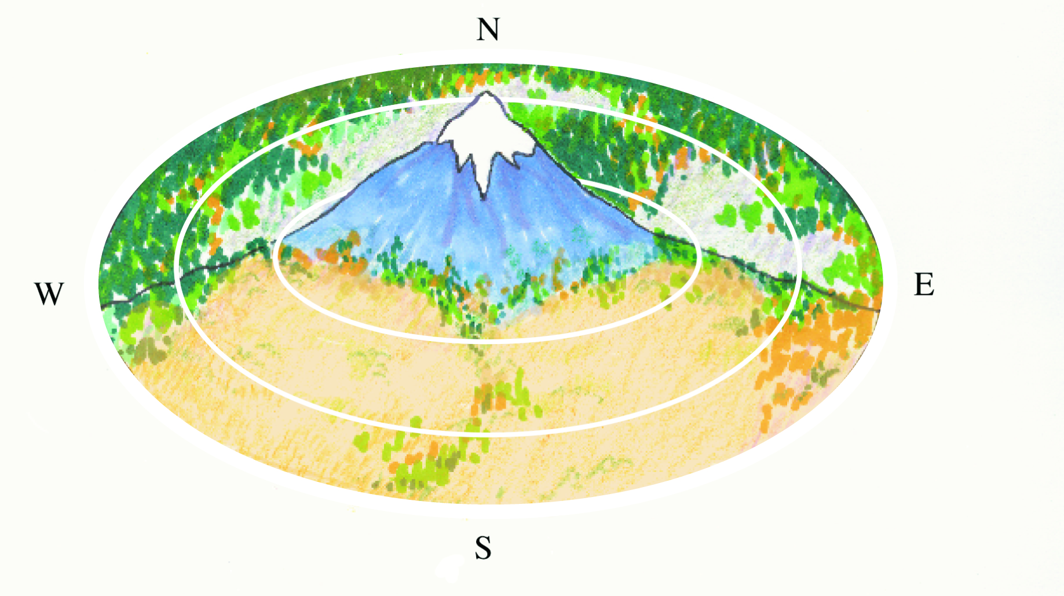
Effect of Aspect on Fuel Temperature and Moisture
Highest Fuel Moisture
Lowest Average Temperature
Lowest Rate of Spread
Later Curing of Fuels
Late Snow Melt
Later Heating
Later Cooling
Earlier Heating
Earlier Cooling
Lowest Fuel Moisture
Highest Average Temperature
Highest Rate of Spread
Earlier Curing of Fuels
Earlier Snow Melt

Slide 14
Aspect Affects Fuel Moisture

Slide 15
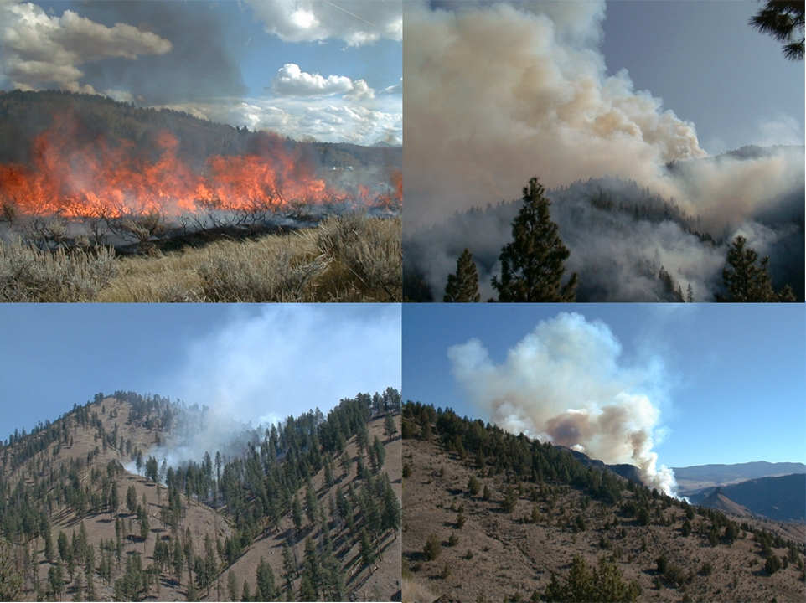
2-15-S290-EP

Slide 16
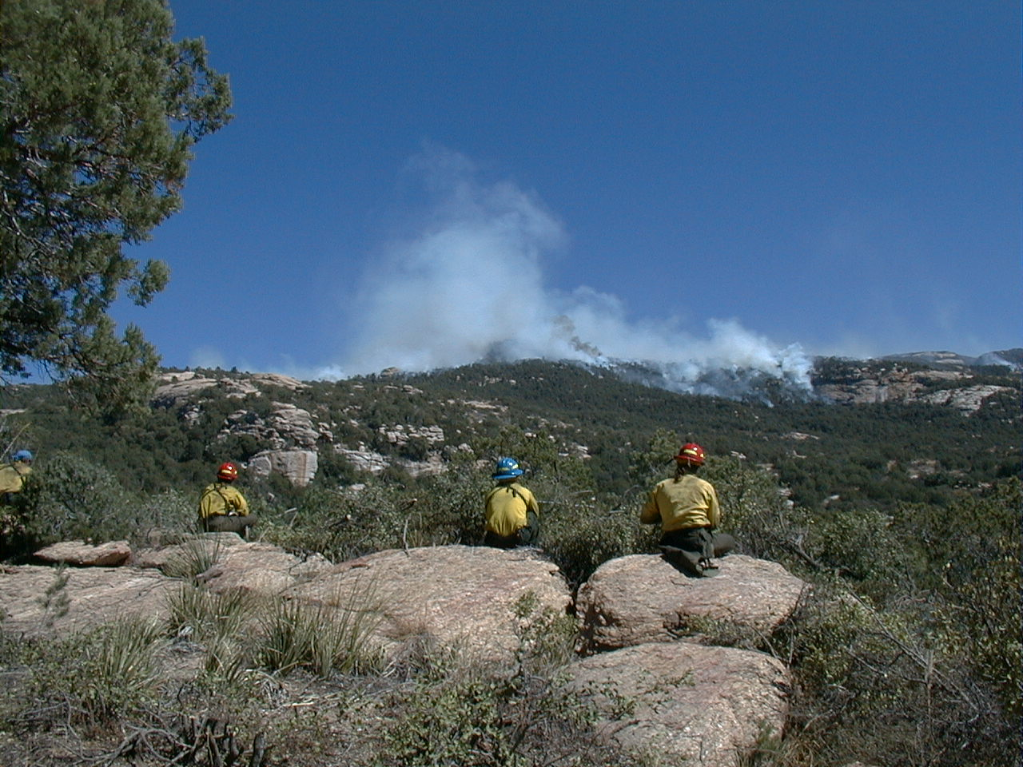
How Topography Can Affect the Direction and Rate of Spread of Wildland Fires
2-16-S290-EP

Slide 17
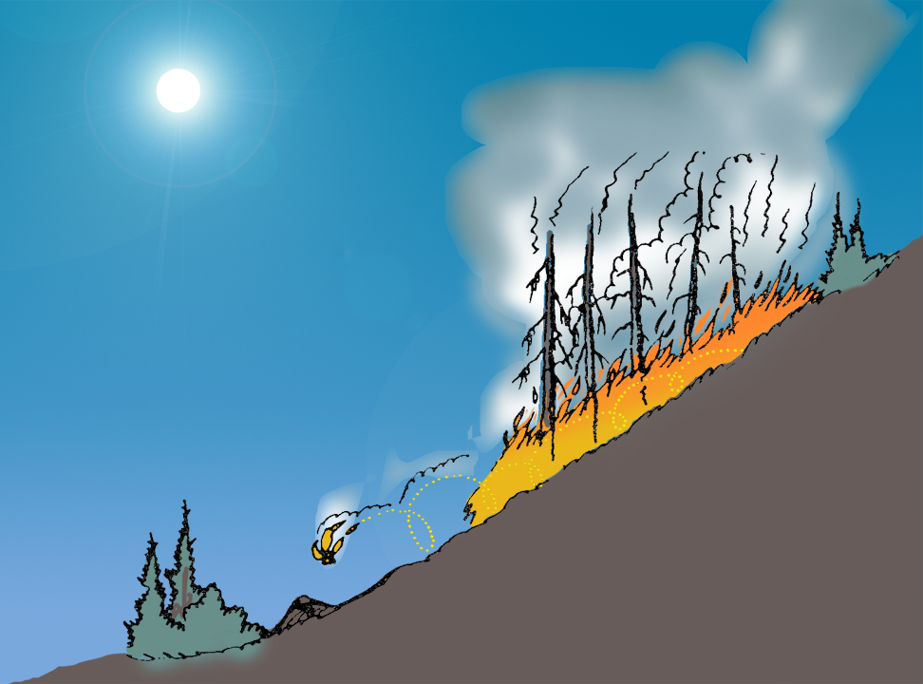
Slope affects fire behavior
Fresh air
Burning chunks
Rolling down slope
preheating
draft
Faster ignition and spread
2-17-S290-EP

Slide 18
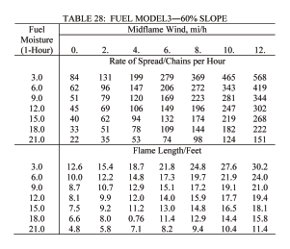
Slope Effects
Example:
Fuel Model=#3 (Tall Grasses)
Fine Fuel Moisture=3%
Mid-flame windspeed=0 mph
Rate of Spread/Flame Length
0% Slope = 6 cph /3.8’
30% Slope = 26 cph /7.3’
45% Slope = 50 cph /9.9’
60% Slope = 84 cph /12.6
90% Slope = 182 cph /17.9
Tables are located in the Fireline Handbook Appendix B
2-18-S290-EP

Slide 19
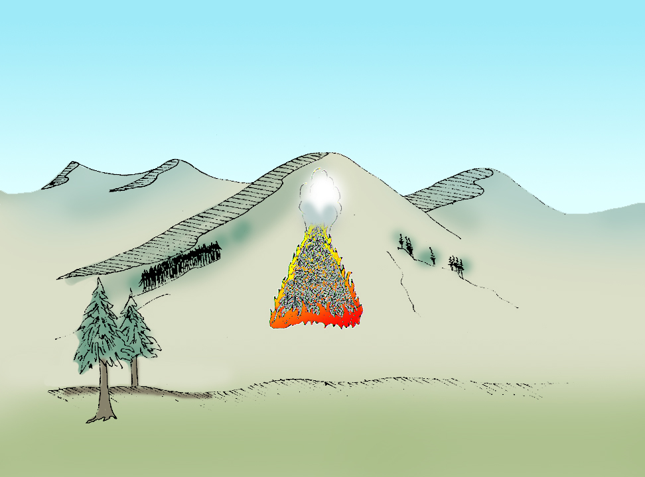
Wedge shape fire pattern
2-19-S290-EP

Slide 20
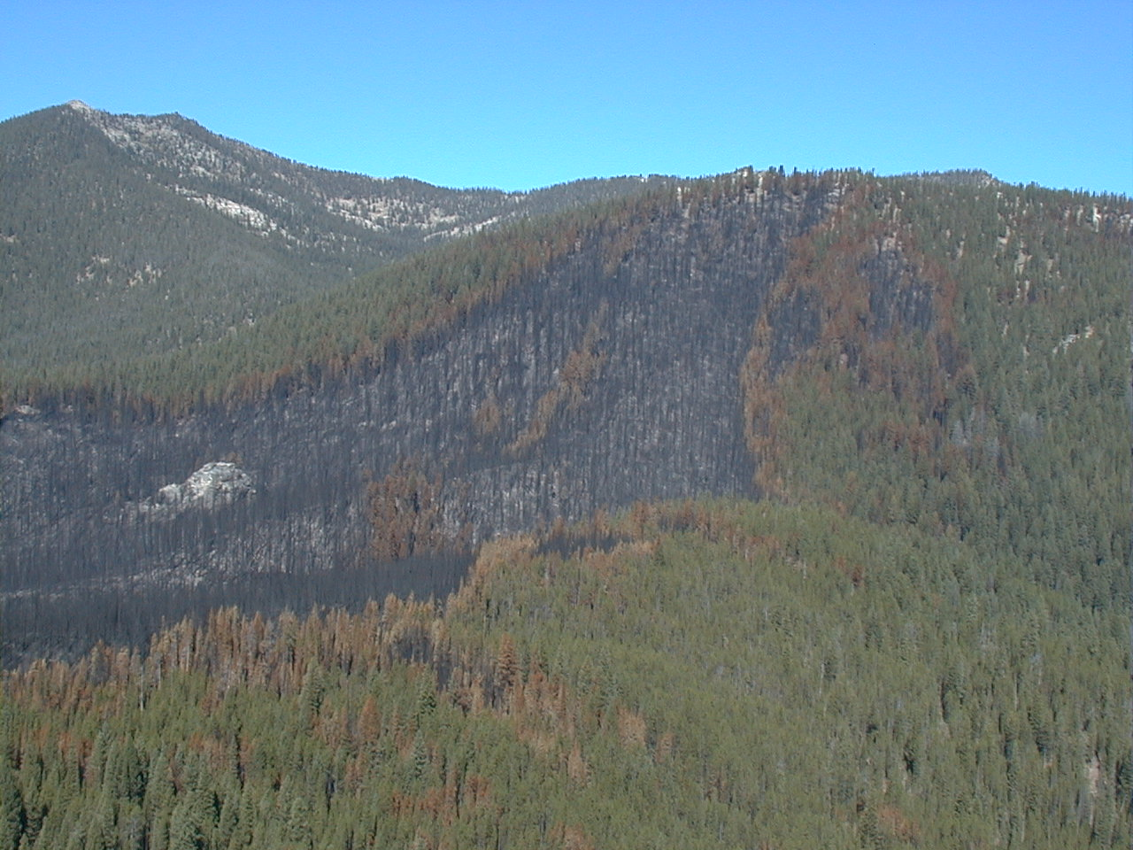
Wedge Shape
2-20-S290-EP

Slide 21
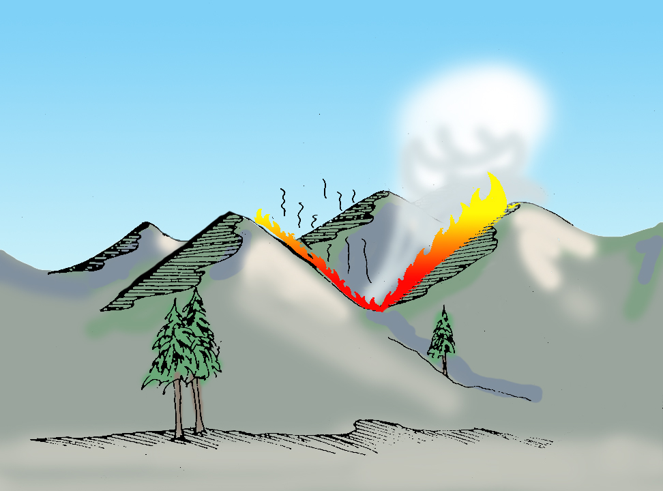
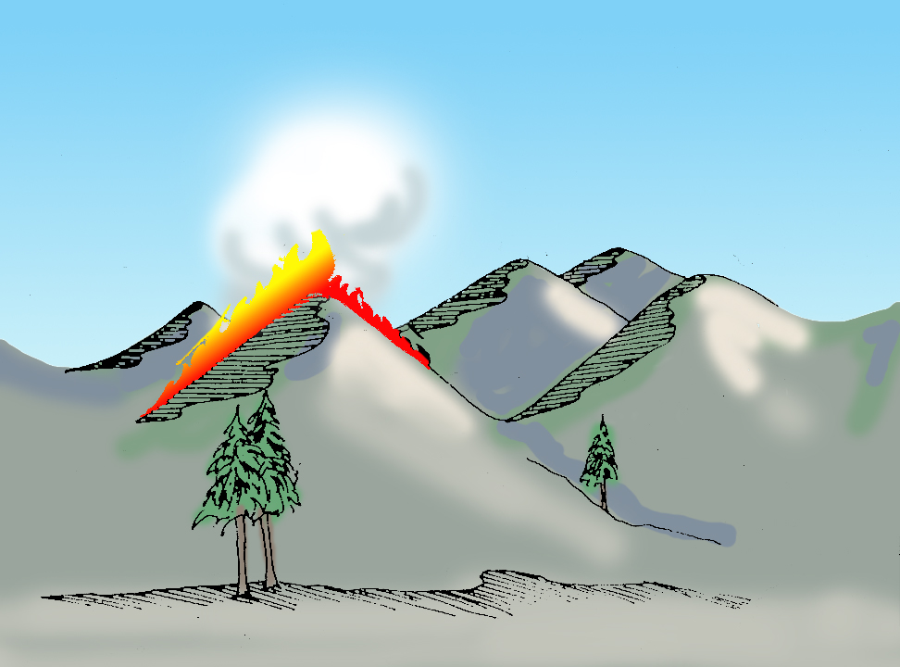
Slope Reversal

Slide 22
Slope Reversal
2-22-S290-EP

Slide 23
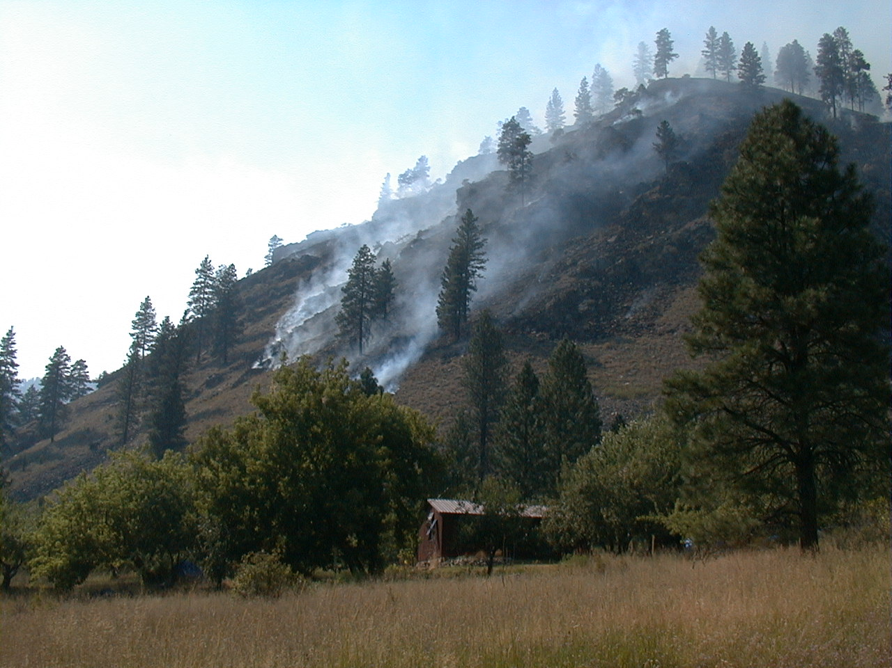
2-23-S290-EP

Slide 24
Slope Reversal
2-24-S290-EP

Slide 25
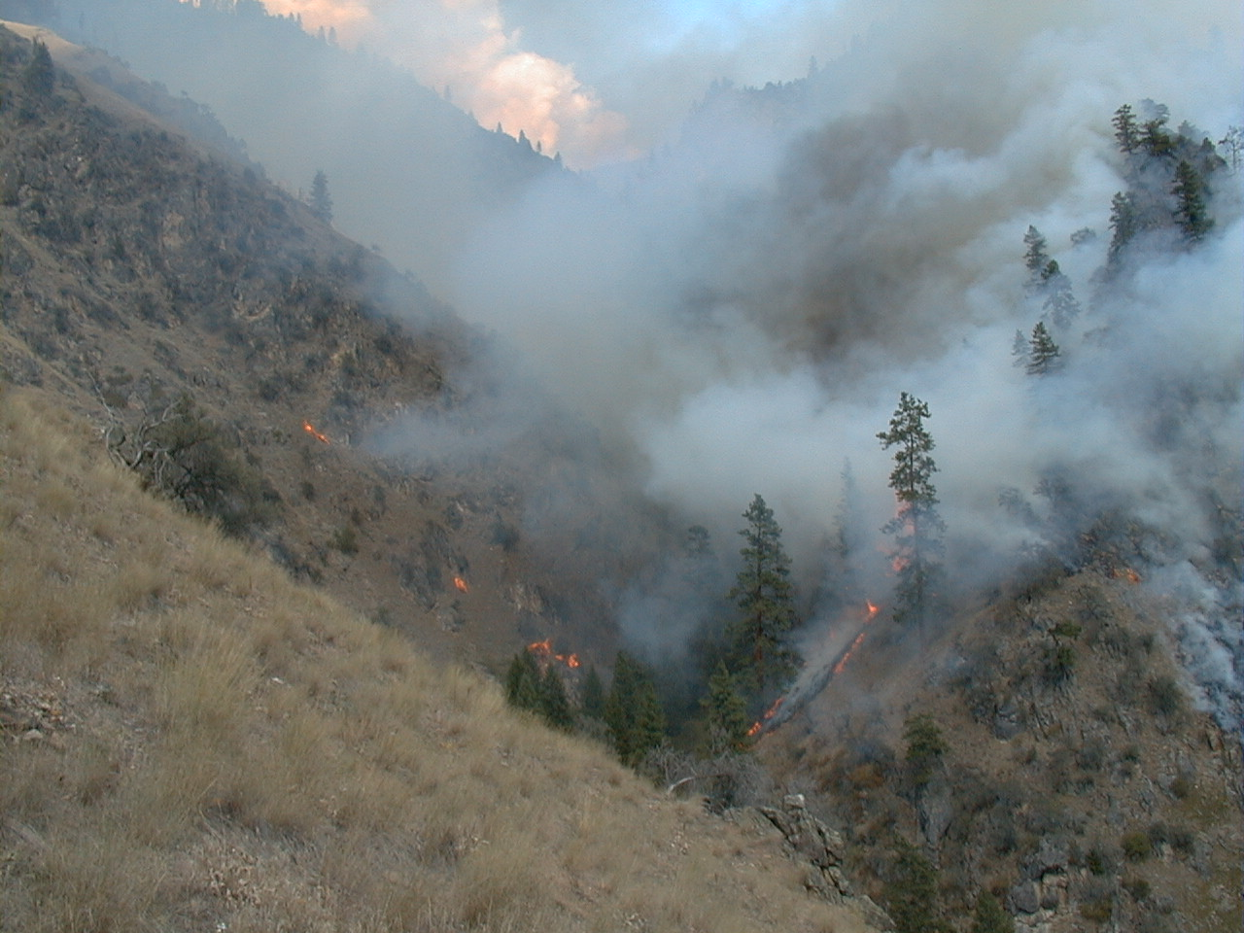
2-25-S290-EP

Slide 26
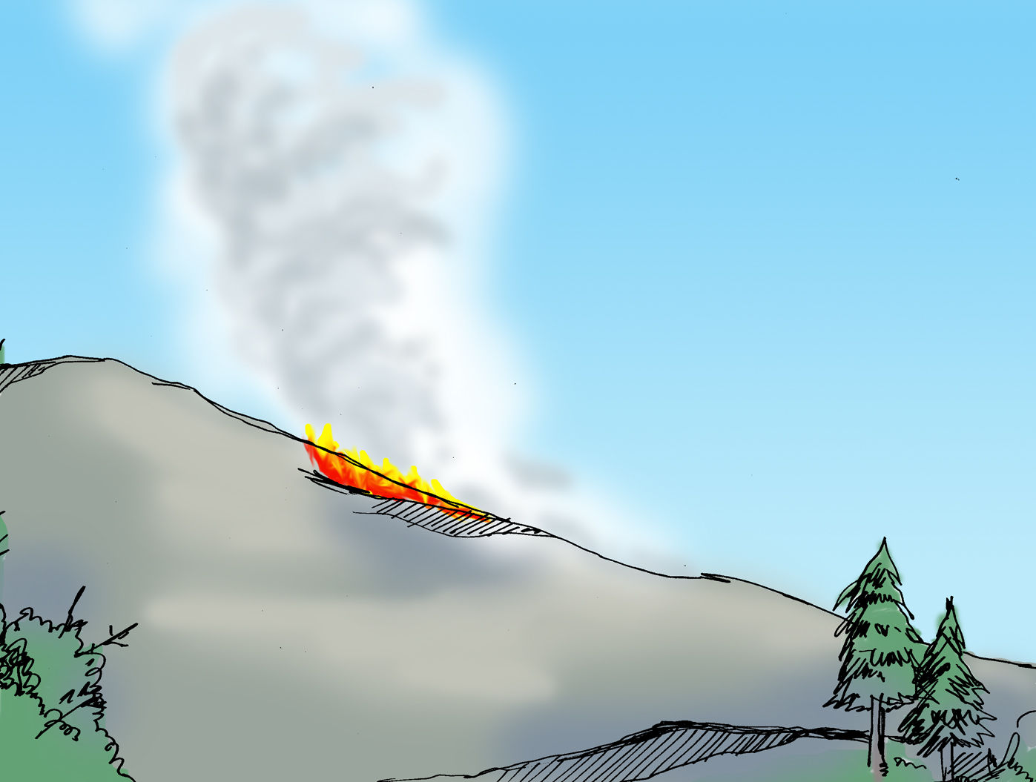
Ridges
2-26-S290-EP

Slide 27
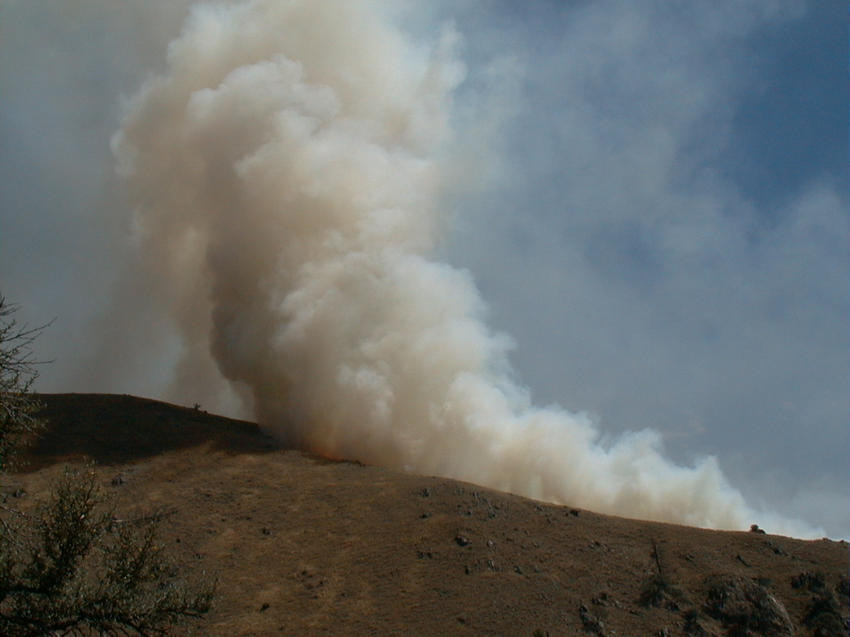
2-27-S290-EP

Slide 28
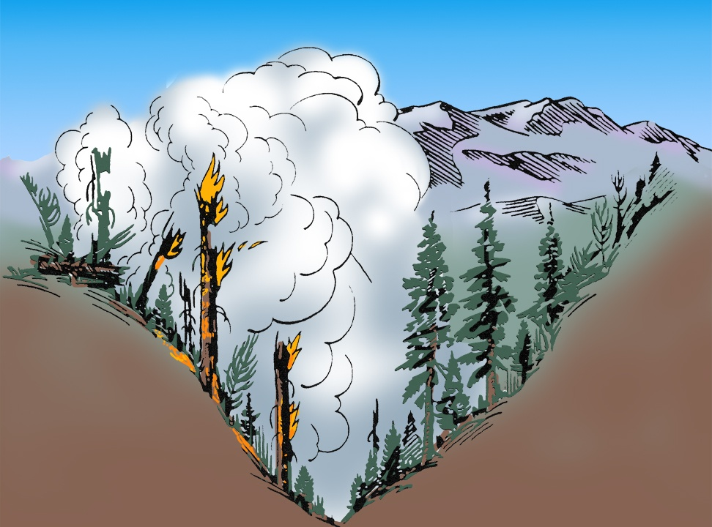
Fires in the bottom of narrow canyons
2-28-S290-EP

Slide 29
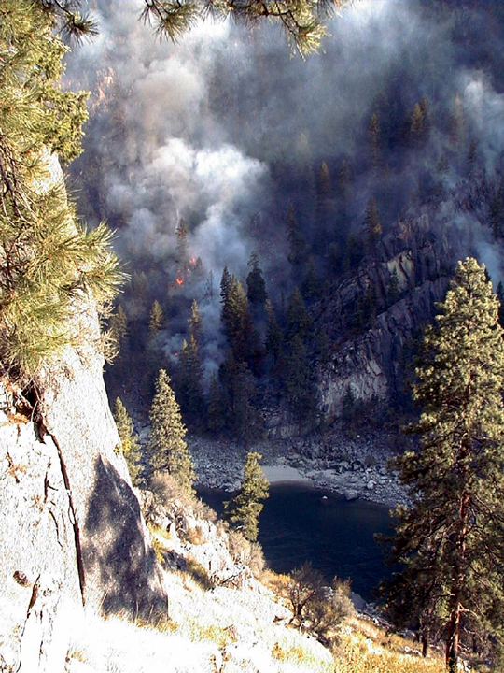
Bottom of a narrow canyon

Slide 30
Stable Air Conditions
Narrow canyons easily allow for stable air mass, such as an inversion to form.

Slide 31
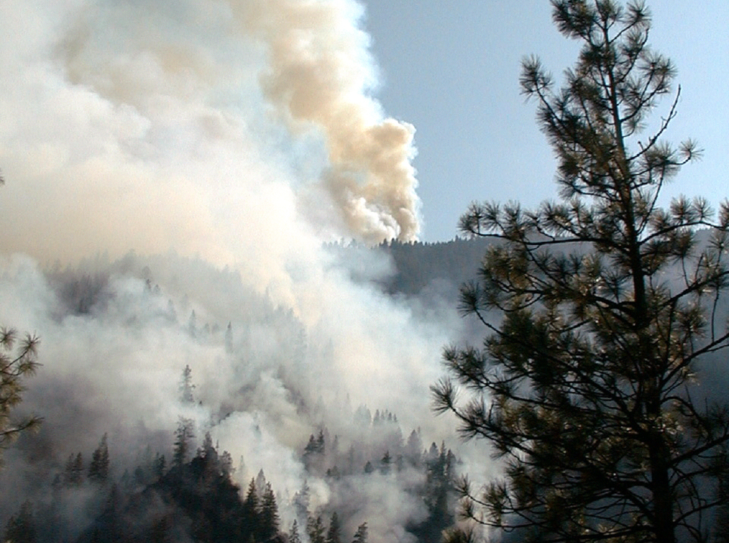
2-31-S290-EP

Slide 32
Air flow
Surface winds will usually be shaped by the canyon, following the canyon’s direction, forming eddies and strong upslope currents at its sharp bends.

Slide 33
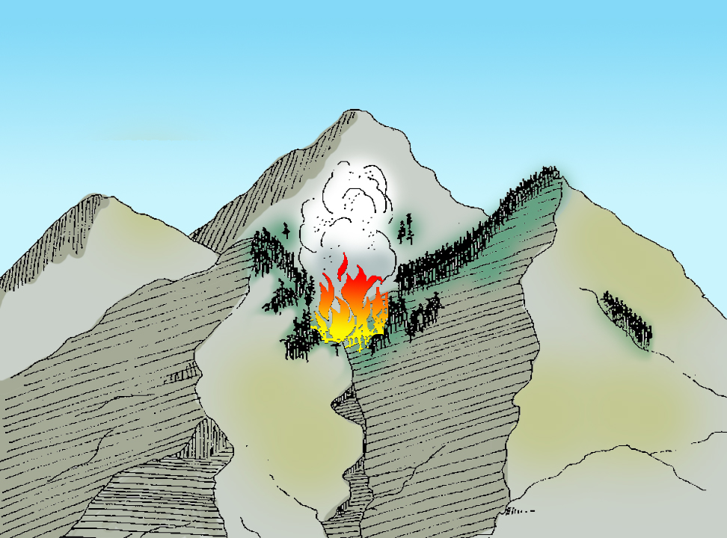
Intersecting Drainages
2-33-S290-EP

Slide 34
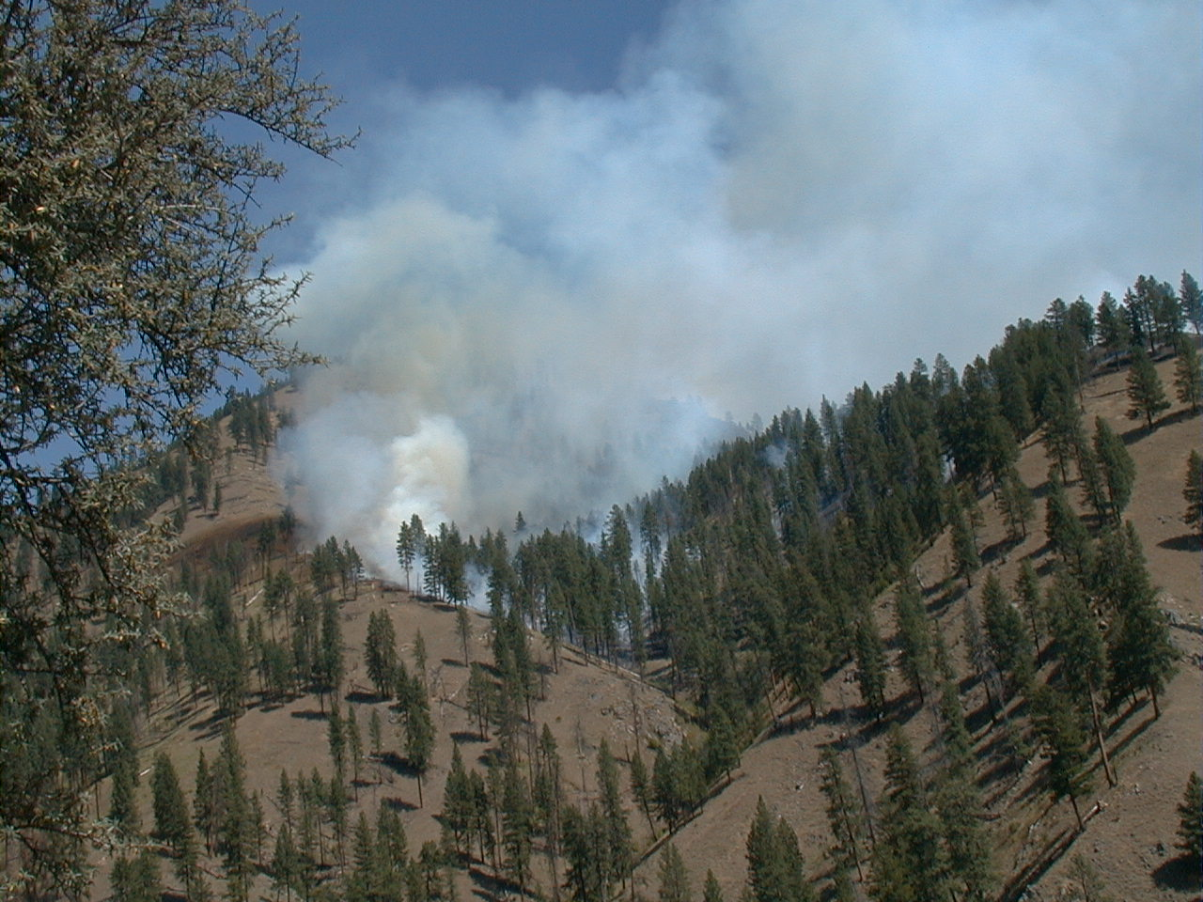
Intersecting Drainages
2-34-S290-EP

Slide 35
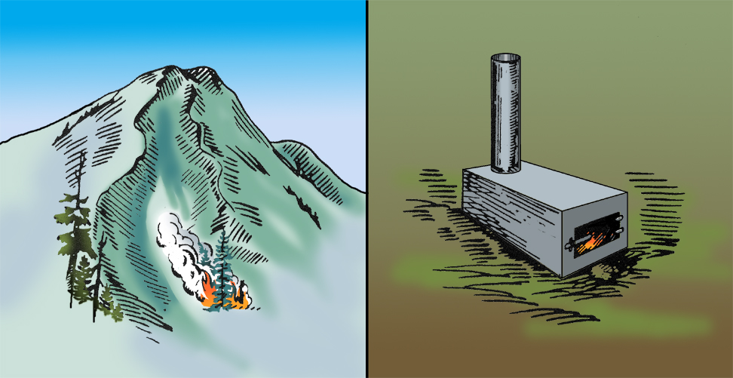
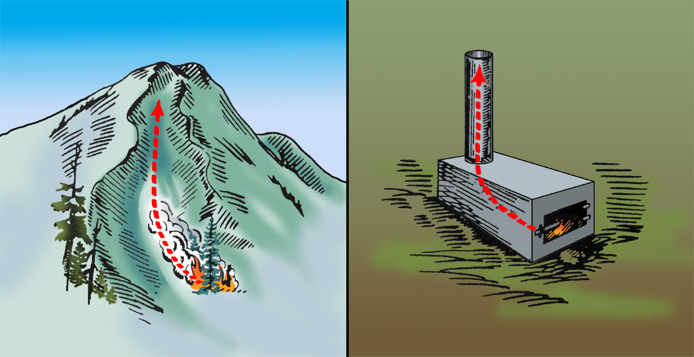
Chimney Effect

Slide 36
Chimney Effect Conditions
Unstable air conditions causing a convection current through the canyon.
Air drawn in at the base to support convection currents.
Available fuel to support rapid burnout.

Slide 37
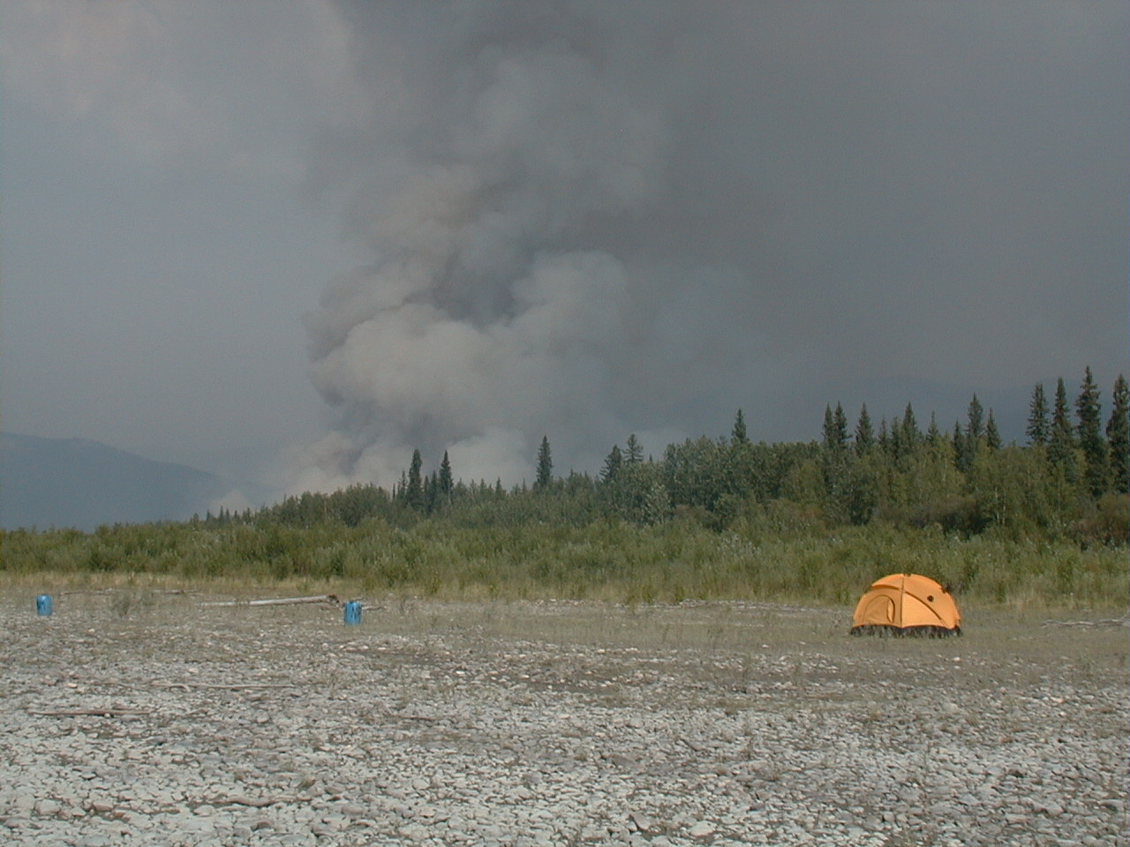
How Changes in Fuel and Topography Can Provide Full and Partial Barriers to the Spread of Wildland Fires
2-37-S290-EP

Slide 38
Barrier Definition
A barrier is any obstruction to the spread of fire. Typically an area or strip devoid of combustible fuel.
Barriers are natural or artificial.
Limit the direction of spread.
Can provide opportunities for control.
Barriers may not reduce spotting potential.

Slide 39
Barriers to Fire Spread

Slide 40
Partial Barriers
A change in fuel conditions may offer only a partial barrier by slowing the spread of fire.

Slide 41
Exercise #2

Slide 42
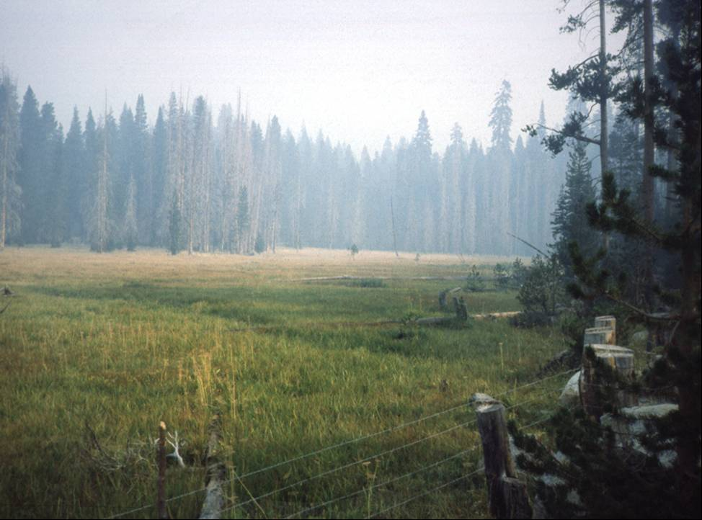
Is this a good barrier to fire spread?
2-42-S290-EP

Slide 43
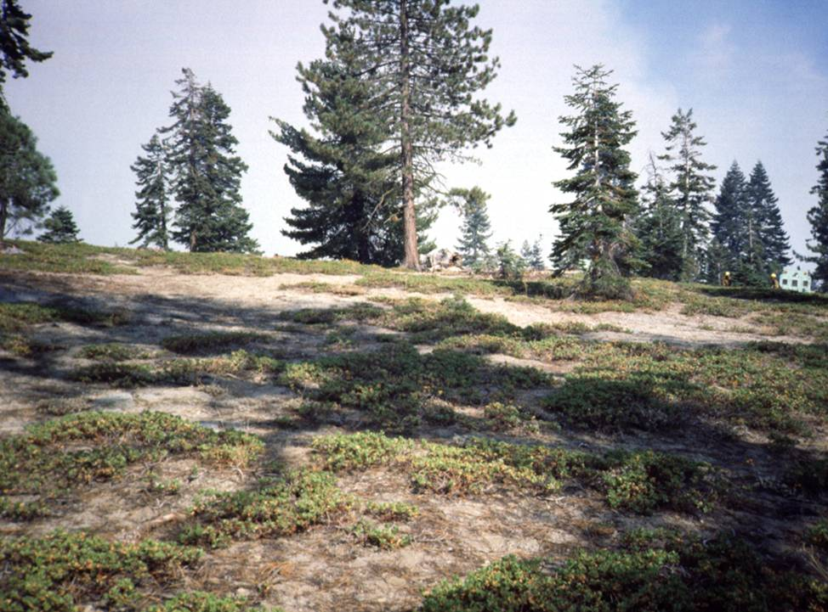
Is this a good barrier to fire spread?
2-43-S290-EP

Slide 44
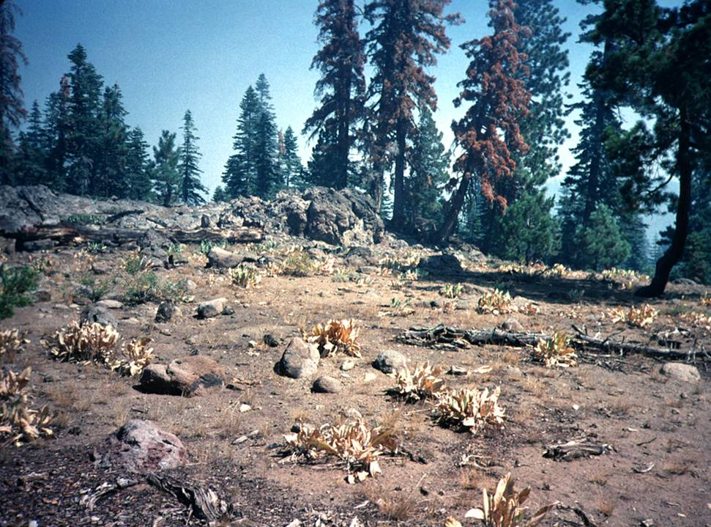
Is this a good barrier to fire spread?
2-44-S290-EP

Slide 45
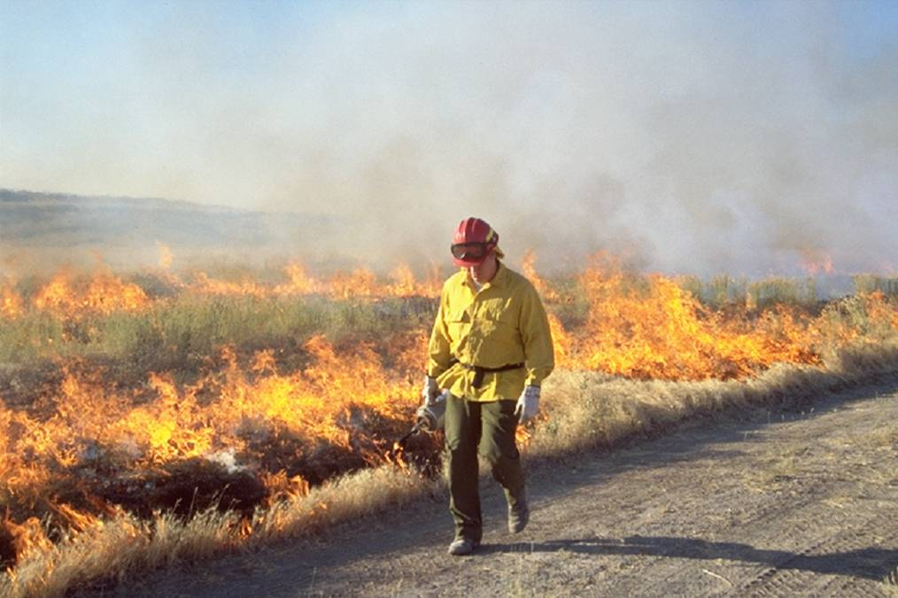
Is this a good barrier to fire spread?
2-45-S290-EP

Slide 46
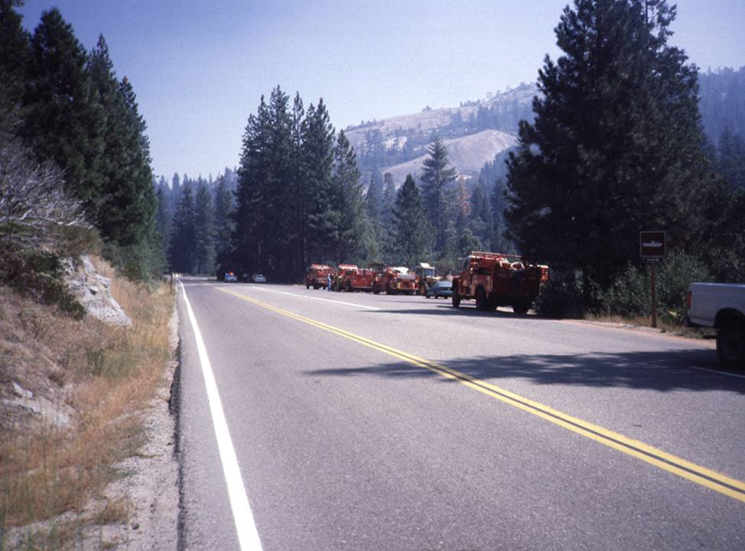
Is this a good barrier to fire spread?
2-46-S290-EP

Slide 47
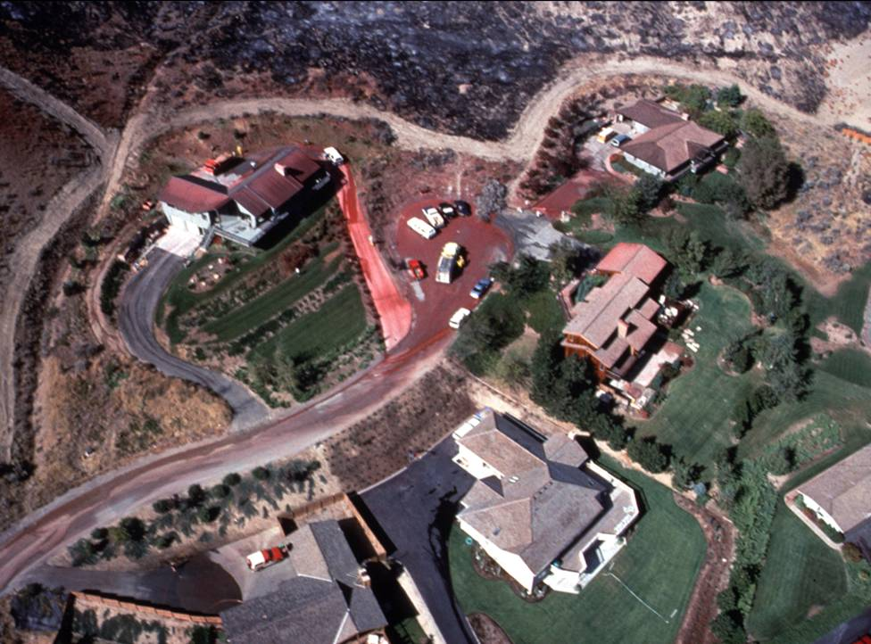
Is this a good barrier to fire spread?
2-47-S290-EP

Slide 48
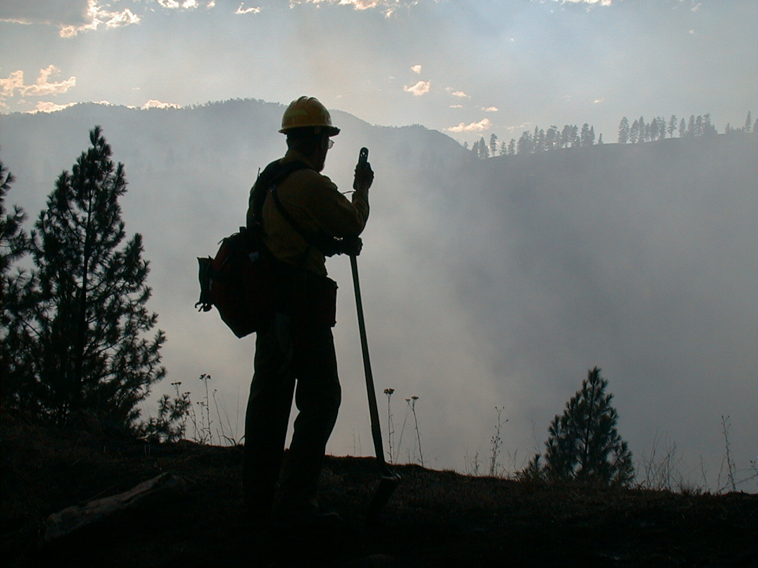
How Slope Percent Can Be Determined or Estimated in the Field
2-48-S290-EP

Slide 49
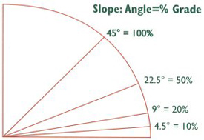
% Slope vs. Degrees
Rise
Run
Percent slope =
X 100
45º
100%
RISE
1 foot
1 foot
RUN

Slide 50
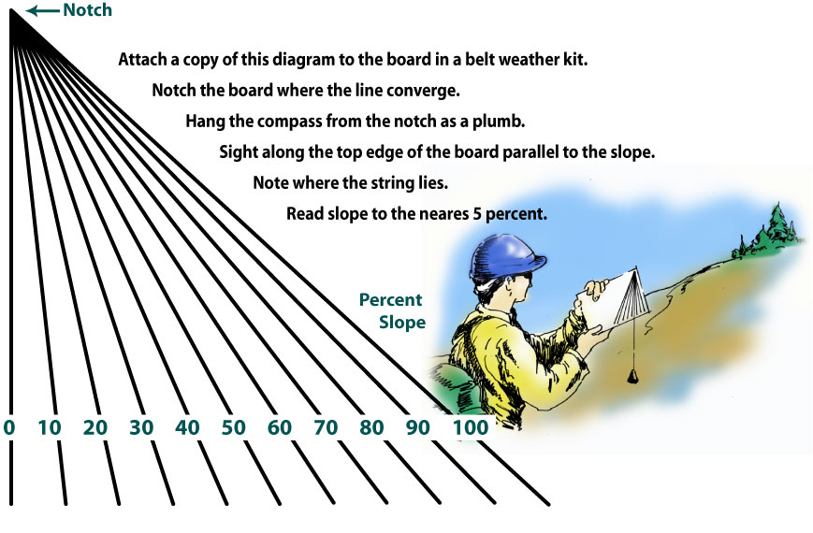
Slope Meter

Slide 51
Review Unit 2 Objectives
Identify standard features on a topographic map.
Describe how topography affects fuels and their availability for combustion.
Describe how topography can affect the direction and rate of spread of wildland fires.

Slide 52
Review Unit 2 Objectives
4. Describe how changes in fuel and topography can provide full and partial barriers to the spread of wildland fires.
5. Describe how slope percent can be determined or estimated in the field.

