Slide 1
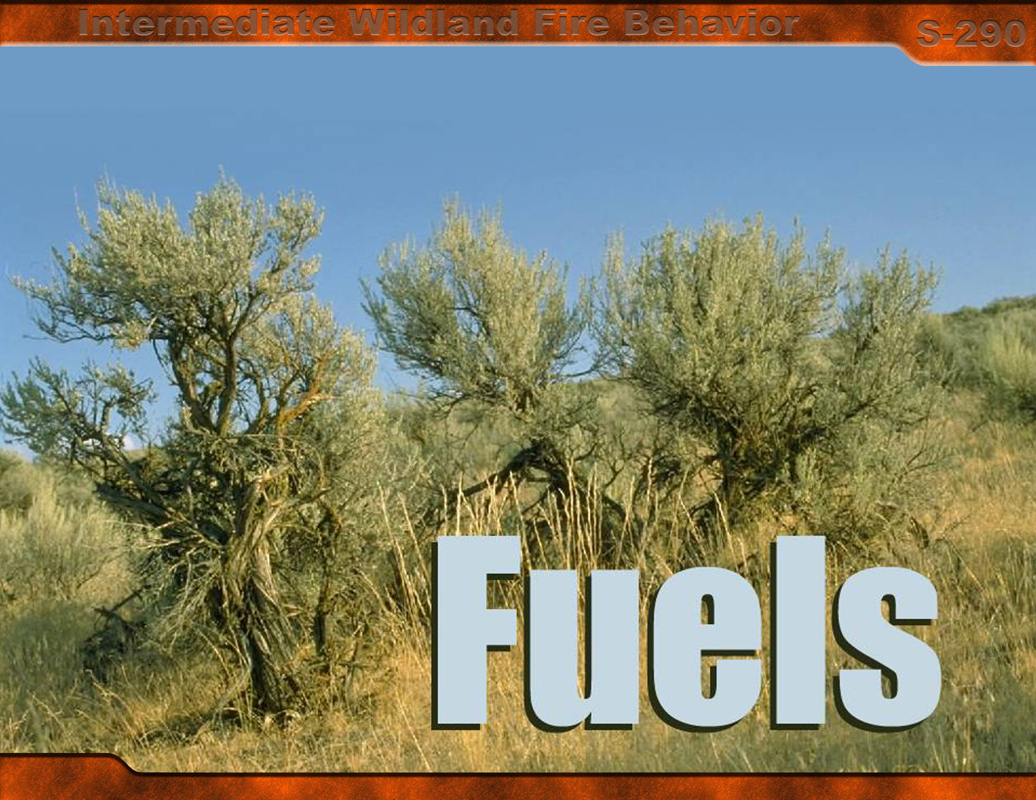
Unit 3

Slide 2
Unit 3 Objectives
Identify and describe basic wildland fuel characteristics.
Identify and describe seven characteristics of fuels that affect wildland fire behavior.
Identify and define by size class the four dead fuel timelag categories used to classify fuels.
Describe how fuel availability is essential to predicting wildland fire behavior.
Describe the fuel model concept and its utility for predicting wildland fire behavior.

Slide 3
Fuel Make-up
Fuel characteristics
Fuel moisture
Fuel temperature

Slide 4
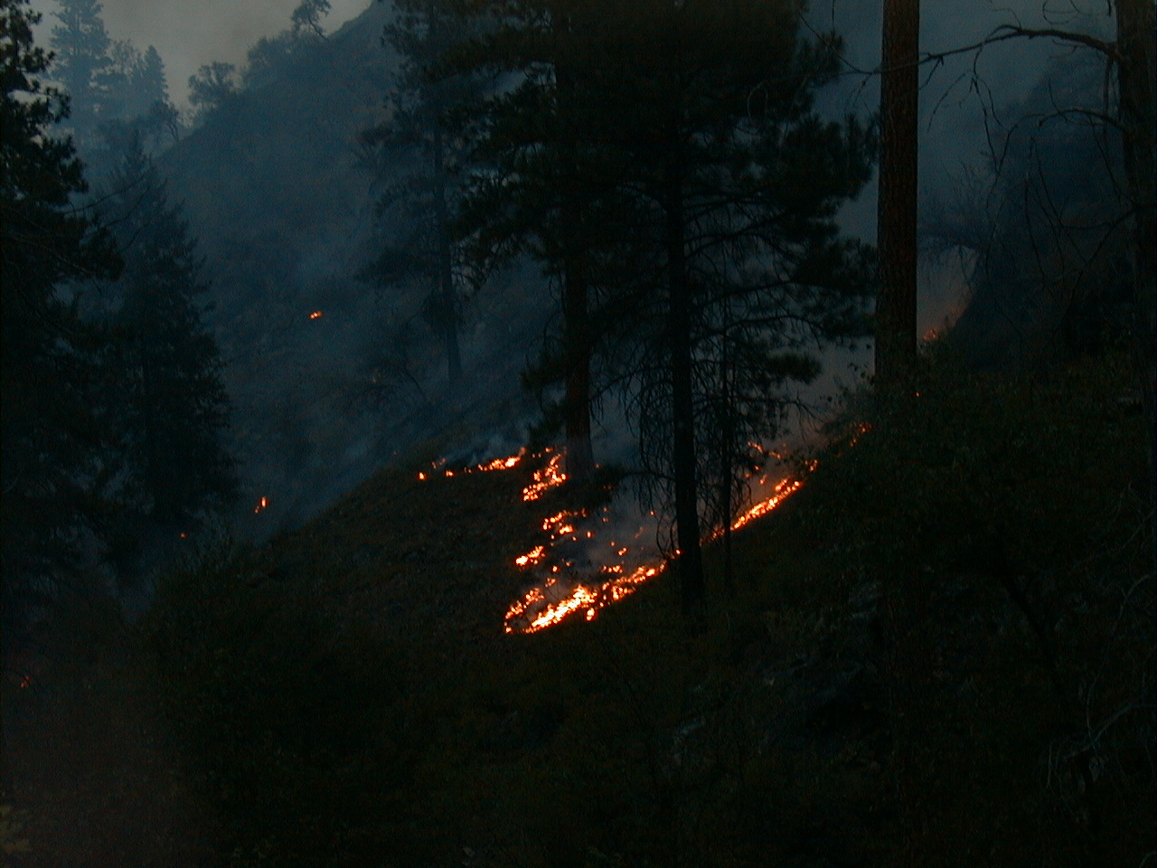
Fuels
Any combustible material that:
  Is living or dead
  Is in or on the ground
  Is in the air
  Can ignite and burn
3-4-S290-EP

Slide 5
Fuel Combinations
Kind
Amount
Size
Shape
Position
Arrangement

Slide 6
Fuel Levels and Components
Ground
Surface
Aerial fuels

Slide 7
Ground Fuels
All combustible materials lying beneath the surface:
    Deep duff
    Tree roots
    Rotten buried logs
    Other organic material

Slide 8
Ground Fuels
Important in terms of line construction and mop-up
Typical fire spread:
  smoldering
  creeping

Slide 9
Surface Fuels
All combustible materials lying on or immediately above the ground:
    Needles or leaves
    Duff
    Grass
    Small dead wood
    Downed logs
    Stumps
    Large limbs
    Shrubs to about six feet in height
    Litter

Slide 10
Surface Fuels
Less compact than ground fuels
Have other characteristics more favorable for faster rates of spread
Fires often have higher rates of spread
Most wildfires ignite in and are carried by the surface fuels

Slide 11
Surface Fuels
Important in terms of line construction and mop-up, most important regarding fire spread and fire behavior

Slide 12
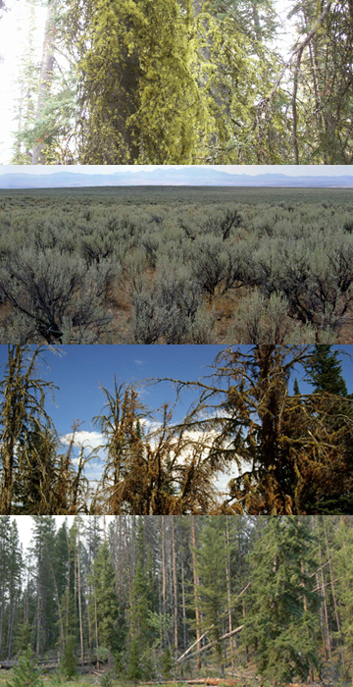
Aerial Fuels
All green and dead materials located in the upper canopy:
    Tree branches and crowns
    Snags
    Hanging moss
    Tall shrubs

Slide 13
Aerial Fuels
Open canopy:
Faster spreading surface fire than closed canopy stands.
  Torching of individual trees
  Crowning is unlikely

Slide 14
Aerial Fuels
Closed canopy:
Greater than 6 feet in height.
Best opportunity for a running crown fire.
Canopy closure is usually given in percent.
  25 percent of the ground is visible, there is 75 percent canopy closure.

Slide 15
Aerial Fuels
Important in terms of fire spread and fire behavior due to torching, crowning, and spotting.

Slide 16
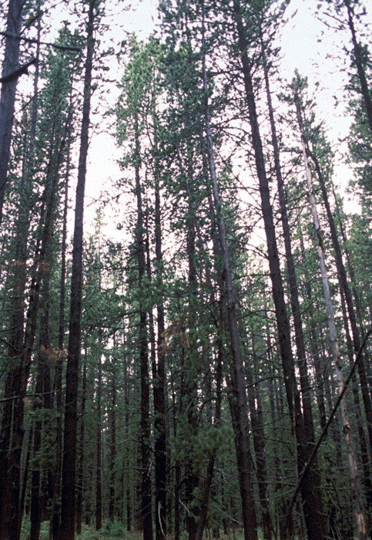
This slide demonstrates
the difference between
closed and open canopy
Closed Canopy
Open Canopy
Please allow animation time to complete.

Slide 17
Seven Characteristics of Fuels that Affect Wildland Fire Behavior
Seven principal characteristics:
    Fuel loading
    Size and shape
    Compactness
    Horizontal continuity
    Vertical arrangement
    Moisture content
    Chemical content
Two main categories:
    Physical and chemical characteristics
    Moisture content

Slide 18
Fuel Loading
The amount of fuel present expressed quantitatively in terms of weight of fuel per unit area.
Measured in:
tons/acre (tons/acre)
OR
pounds/acre (lbs/acre)

Slide 19
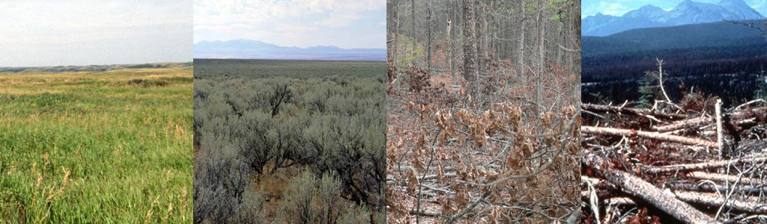
Loading Varies by Fuel Group
Grass
<1-5 Tons/Acre
Shrub
2-80 Tons/Acre
Timber Litter
4-12 Tons/Acre
Slash
10-200 Tons/Acre

Slide 20
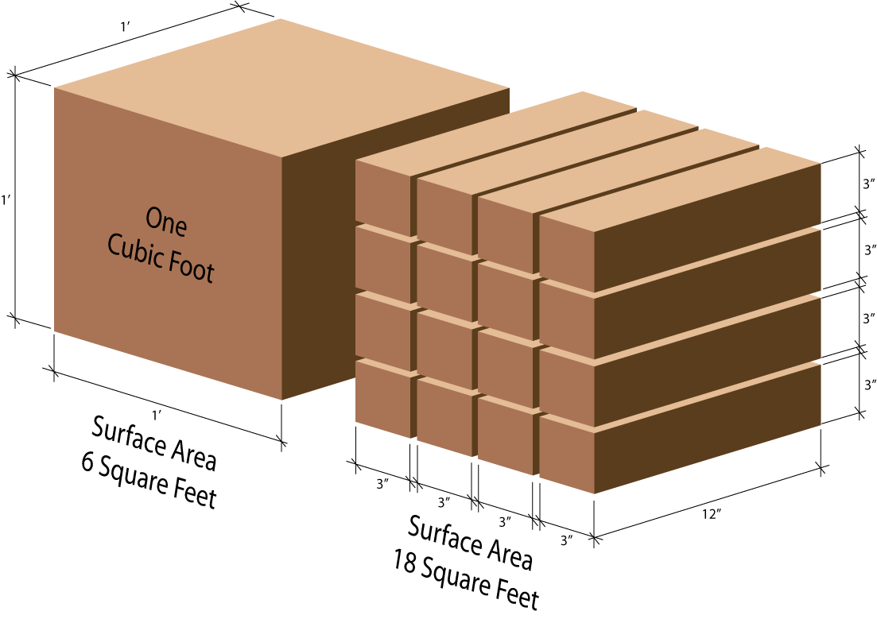
Size and Shape
Surface area to volume ratio

Slide 21
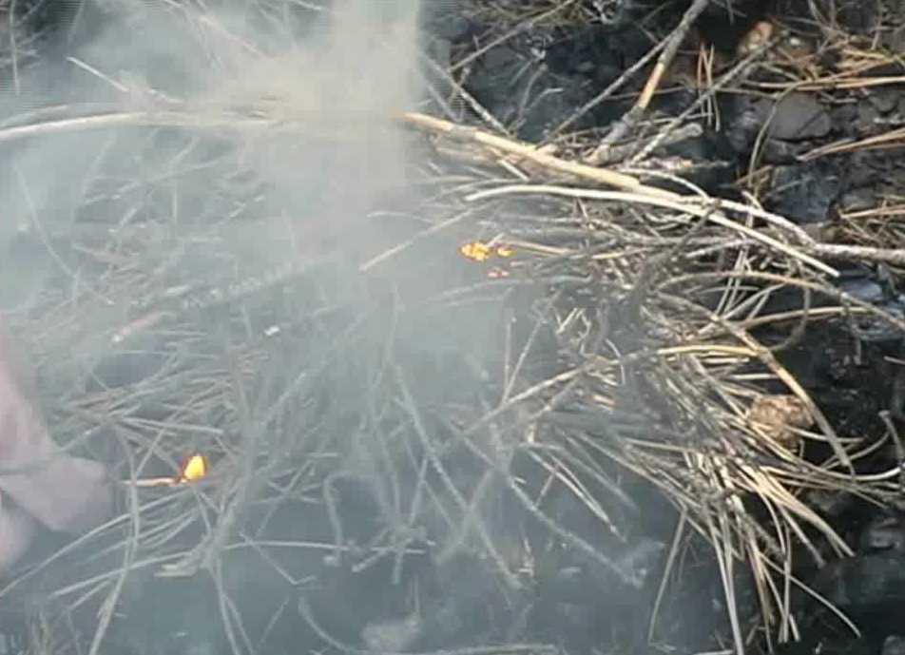
Size and Shape
Small fuels ignite and sustain combustion easier than large pieces of fuel.
Click image to play video clip

Slide 22
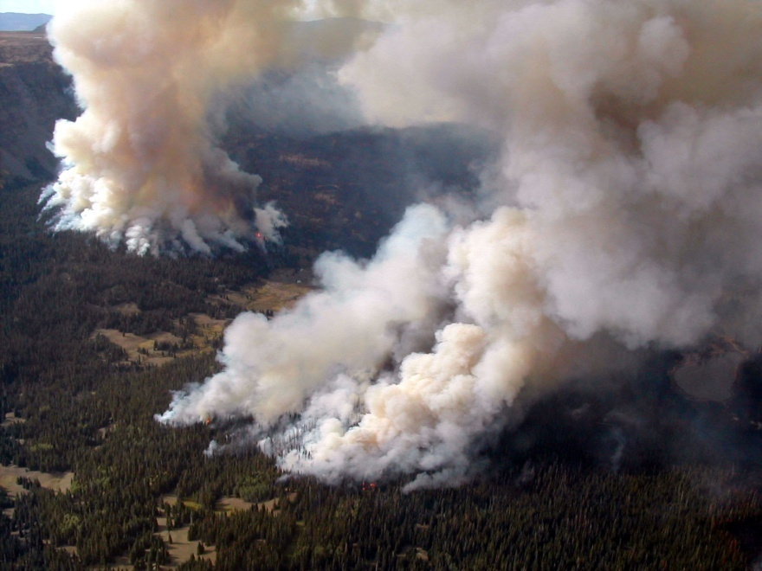
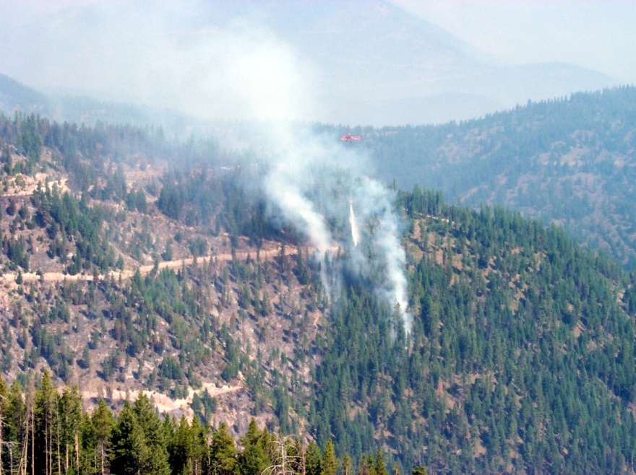
Size and Shape
Higher ratios burn more readily
Lower ratios do not burn as readily

Slide 23
Size and Shape
Firebrands
Small embers
  Ordinarily produce short-range spotting
  Cannot sustain combustion
Flatness and greater surface-area-to-volume ratios have increased the aerodynamic qualities
Examples:
  Cedar fronds
  Bark plates
  Pine needles

Slide 24
Size and Shape
Rolling firebrands
Important to spotting downslope
Examples:
  Pine cones
  Round logs
  Round yucca plants

Slide 25
Compactness
=
Spacing Between Fuel Particles
Closely compacted
  Less surface area exposed
  Restrict oxygen
  Inhibit convective and radiant heat transfer
  In most cases, slower rate of spread is expected
Loosely compacted
  Normally react faster to moisture changes
  Have more oxygen available for combustion
  Rate of spread is usually greater

Slide 26
Fuel Bed
Depth and Orientation
Fuel Bed
  The average height of surface fuel that is contained in the combustion zone of a spreading fire front.
Orientation
  The horizontal or vertical orientation of the fuel array that carries the fire.

Slide 27
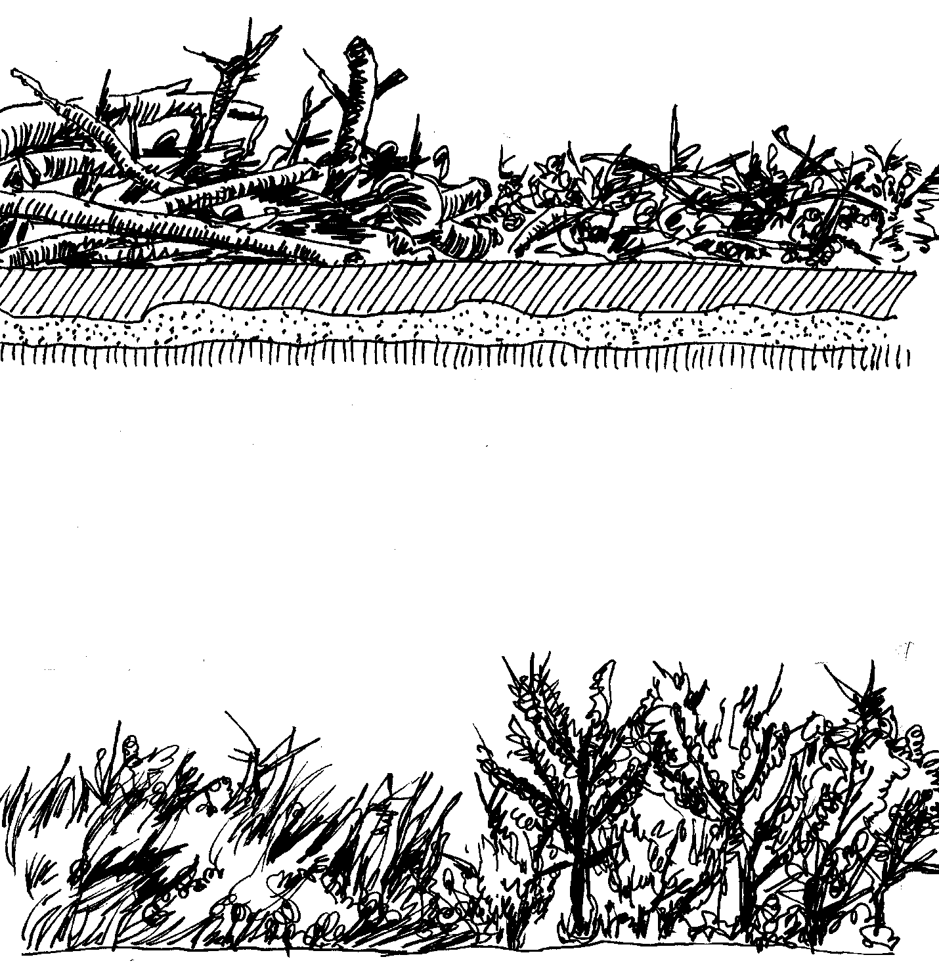
Vertically Oriented
Fuels
TONS/AC
Average depth of fuels
4
1.5
3
Fuel bed depth increases rapidly
2
1
Fuel load increase
1
.5
FEET
Grass group
Shrub group

Slide 28
Horizontally Oriented Fuels
TONS/AC
2
Average depth of fuels
Average depth of fuels
3
1.50
2
2
2
Fuel bed depth increases slowly
1.25
1
Fuel load increase
FEET
Slash
Litter
Timber litter group
Slash group

Slide 29
Horizontal Continuity
Horizontal distribution of fuels at various levels or planes.
Characteristics influence:
  Where a fire will spread
  How fast fire will spread
  Whether fire travels through
    Surface fuels
    Aerial fuels
    Both

Slide 30
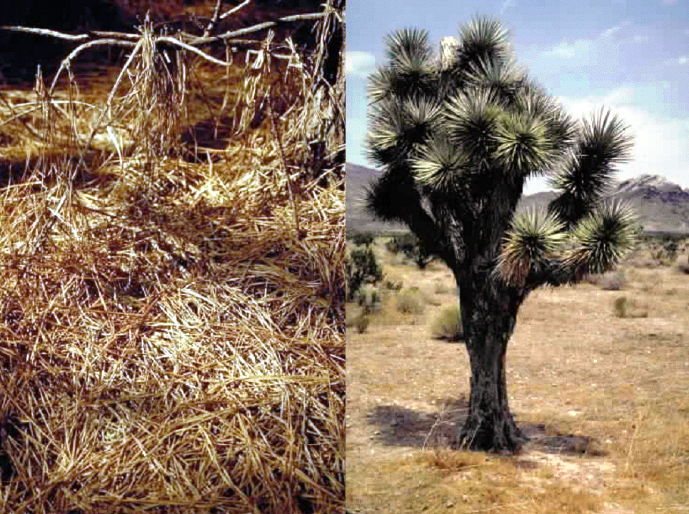
Continuous vs. Patchy Fuels
3-30-S290-EP

Slide 31
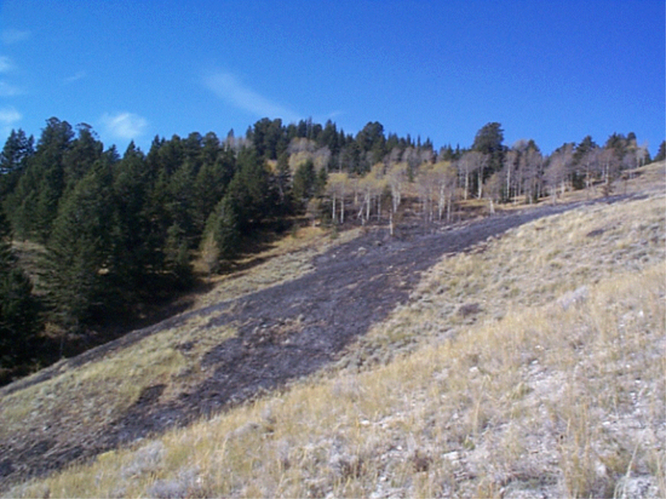
Aerial Fuels
20 mph
Closed Open
5 mph
2 mph
3-31-S290-EP

Slide 32
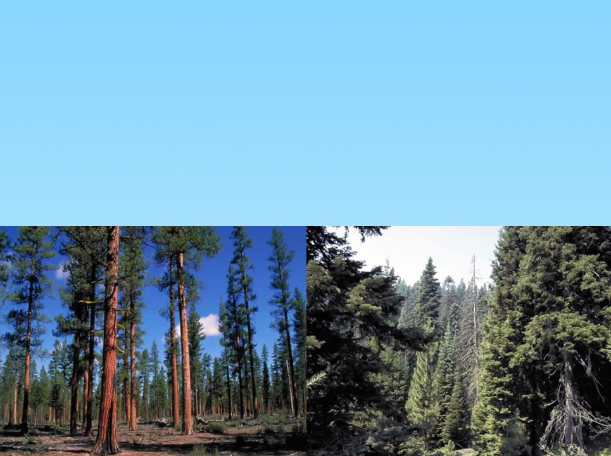
Vertical Arrangement
Fuels above ground and their vertical continuity, which influences fire reaching various levels or vegetation strata.
3-32-S290-EP

Slide 33
Ladder Fuels

Slide 34
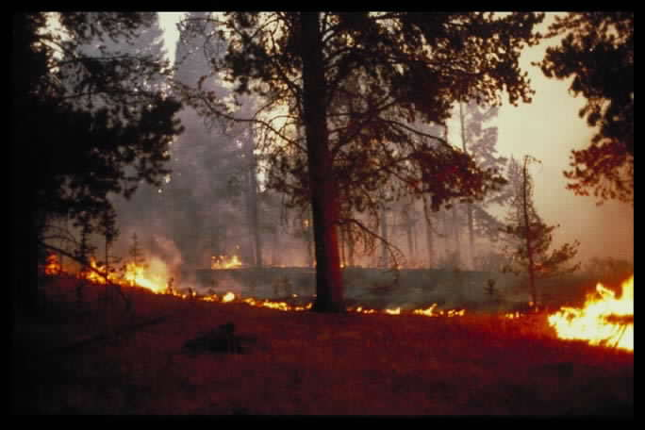
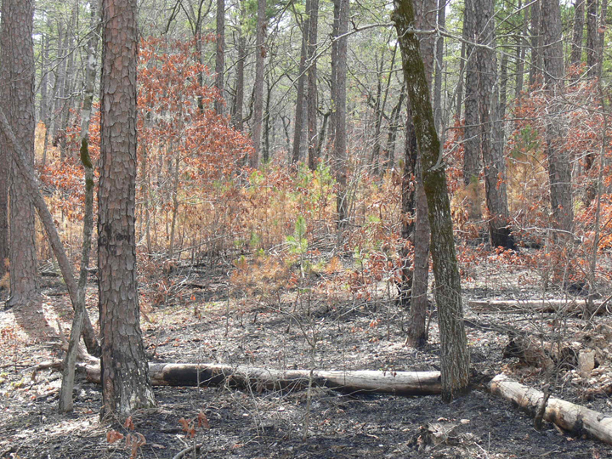
Reburn
3-34-S290-EP

Slide 35

Fuel Moisture Content
Humidity
Evaporation
Dew
Precipitation
Evaporation
Ground moisture
3-35-S290-EP

Slide 36
Live and Dead Fuel Moisture
Dead Fuel Moistures – rarely below
3-4%, fluctuate often due to environmental conditions.
Live Fuel Moistures – range much higher, with moisture contents of perhaps as high as 300% or more, fluctuate much more slowly, relate to growing season.

Slide 37
Fine Dead Fuels
Are considered the primary carrier of a surface fire.
Consist of needle/leaf litter, cured out grass.

Slide 38
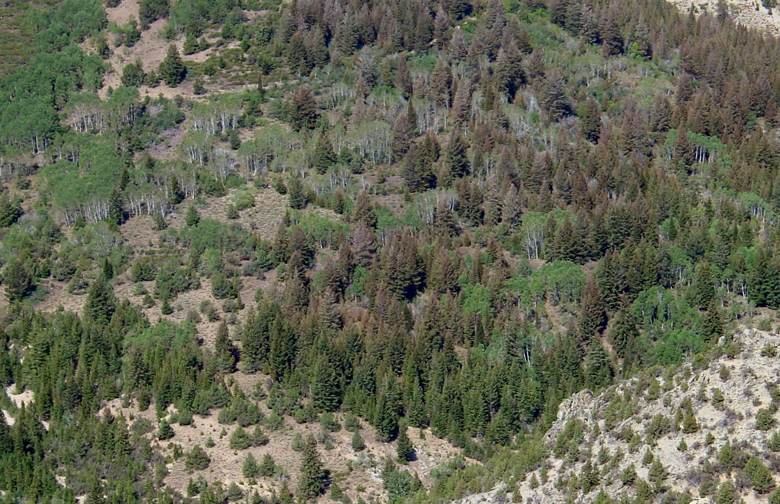
Live to Dead Ratio

Slide 39
Chemical Contents
All fuels, living or dead, contain fiber that is known as cellulose.
Include, but are not limited to certain volatile substances such as:
    oils
    resins
    wax
    pitch

Slide 40
Chemical Contents
Volatile fuels:
    Chaparral in the southwest
    Palmetto in the southeast
    Greasewood in the Pacific northwest
    Fountaingrass in Hawaii
    Pitchy stumps from some conifers
    Jack Pine in the Lake States
    Pitch Pine in the northeast

Slide 41
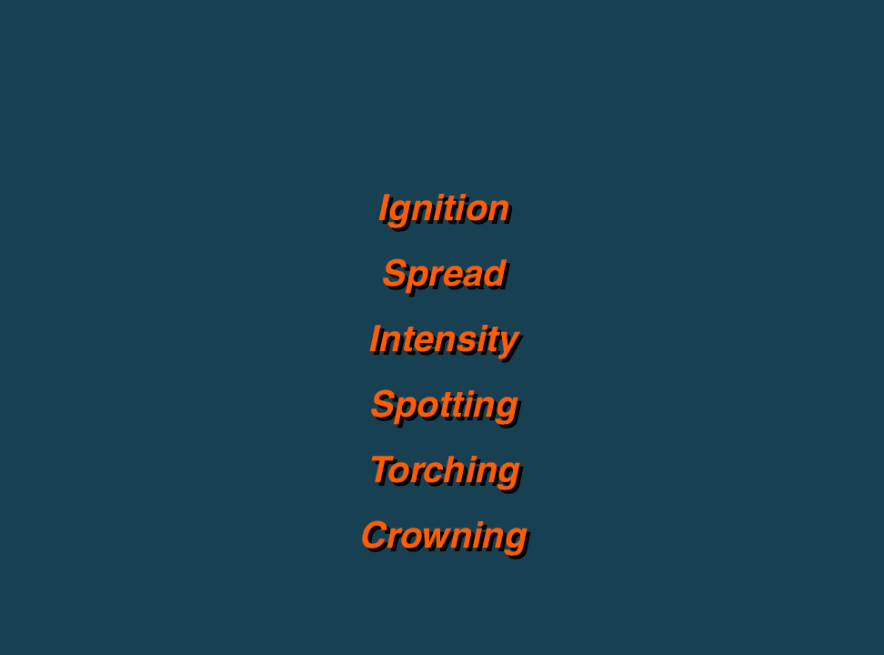
Fuel Characteristics/Fire Behavior
Compactness
Chemical
Content
Loading
Size and
Shape
Horizontal
Continuity
Vertical
Arrangement
Moisture
Content
3-41-S290-EP

Slide 42
Fuel Characteristics
Five fuel characteristics that most effect ignition:
    Compactness
    Loading
    Chemical content
    Size and shape
    Moisture content

Slide 43
Fuel Characteristics
Six primary fire behavior characteristics involved with the rate of spread:
Ignition
Spread
Intensity
Spotting
Torching
Crowning

Slide 44
Timelag
Time needed under specified conditions for a fuel particle to lose about 63 percent of the difference between its initial moisture content and its equilibrium moisture content.

Slide 45
Dead Fuel
Timelag Categories
1-hour
10-hour
100-hour
1000-hour
Which category gains/loses moisture the fastest?

Slide 46
Available Fuels
Fuels that will ignite and support combustion at the flaming front under specific conditions.
Grass
Up to 100%
Shrub
5-95%
Timber litter
5-25%
Slash
10-70%

Slide 47
Consumption of Various Fuels by Fires
The following play an important part in a fuel's availability to burn:
    Size
    Arrangement
    Moisture content
    Duration and intensity of the fire

Slide 48
Fuel Characteristics and the Fuel Model
Vertical
arrangement
Moisture
content
Size and
Shape
FUEL MODEL
Chemical
content
Loading
Horizontal
continuity
Compactness

Slide 49
Fuel Models
13 models:
Grass (3 fuel models)
Shrub (4 fuel models)
Timber Litter (3 fuel models)
Slash (3 fuel models)

Slide 50

Fuel Models
Anderson’s Aids to Determining Fuel Models for Estimating Fire Behavior

Slide 51
Major Fuel Groups
The four major fuel groups are:
    Grass
    Shrub
    Timber Litter
    Slash

Slide 52
Grass Group
Grass is primary carrier of fire
Fuel bed: 1’ to 2.5’ deep
Fuel Characteristics:
  300 lbs/acre to several tons/acre
  Usually < 0.25” in diameter
  Compactness
  Moisture content changes rapidly due to changes in RH
Fire Behavior: rapid burnout, low intensity,
wind strong influence,
ROS 35 to 100+ ch/hr,
FL 0 to 12 ft

Slide 53
Shrub Group
Shrub is primary carrier of fire
Fuel bed: 2’ to 6’ deep
Fuel Characteristics:
  1 to 80 tons/acre
  Usually < 1” in diameter, dead + live fuels
  Compactness: loosely layered to very deep
  Some volatiles may be present
Fire Behavior: very low to extreme intensities,
wind strong influence,
ROS 18 to 75 ch/hr,
FL 4 to 19 ft

Slide 54
Timber Litter Group
Surface litter is primary carrier of fire
Fuel bed: 0.2’ to 1’ deep
Fuel Characteristics:
  Size and shape mixed: litter, leaves, needles to large branchwood
  Compactness: loosely layered to compact
  Vertical arrangement < 1’, typically < 3”
  Moisture content retained when litter is compact
Fire Behavior: slow burning to running surface
fires, torching, crowing possible,
ROS 2 to 8 ch/hr, FL 1 to 5 ft.

Slide 55
Slash Group
Slash is primary carrier of fire
Fuel bed: 1’ to 3’ deep
Fuel Characteristics:
  Size and shape all sizes
  Fuel loading between 12 and 58 tons/acre
Fire Behavior: moderate to rapid spread rates, moderate to high intensities dependent on fuel arrangement, ROS 6 to 14 ch/hr, FL 4 to 11 ft, firebrands often produced and lifted into convection column, rolling materials may start spot fires

Slide 56
Group vs. Model
Grass Group:
Fuel Model 1 Short Grass (<1 foot high)
Fuel Model 2 Timber (grass and understory) Fuel Model 3 Tall Grass (2 feet high)
Shrub Group:
Fuel Model 4 Chaparral (6 feet)
Fuel Model 5 Short Brush (2 feet)
Fuel Model 6 Intermediate Brush
Fuel Model 7 Southern Rough

Slide 57
Group vs. Model
Timber Litter Group:
Fuel Model 8 Closed Timber Litter
Fuel Model 9 Hardwood Litter
Fuel Model 10 Timber (litter and understory)
Slash Group:
Fuel Model 11 Light slash
Fuel Model 12 Moderate slash
Fuel Model 13 Heavy slash

Slide 58
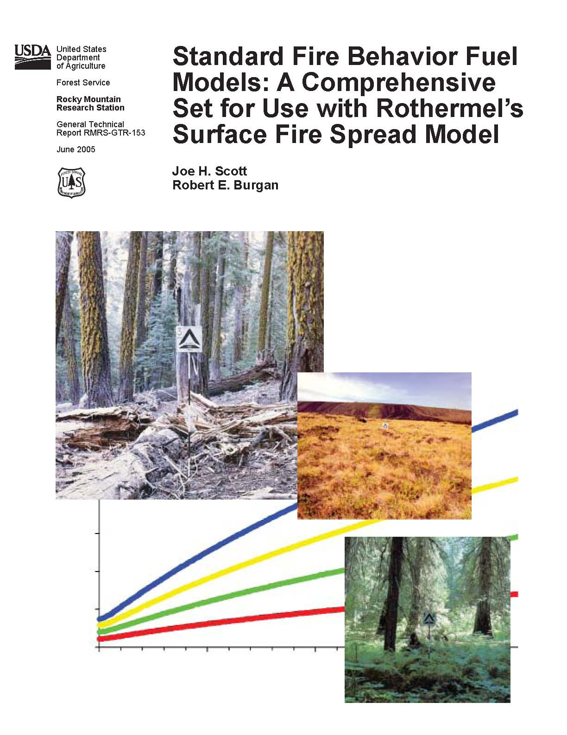
Introduction to the Standard Fire Behavior Fuel Models
The new Standard Fire Behavior Fuel Models, sometimes referred to as “the 40 fuel models.”

Slide 59
New Model Parameters
Load by class and component
Surface-area-to-volume (SAV) ratio by class and component
Fuel model type (static or dynamic)
Fuelbed depth
Extinction moisture content
Fuel particle heat content

Slide 60
Need for the New Models
Original 13:
For the severe period of the fire season.
Have worked well for predicting spread rate and intensity at peak of fire season.
Have limitations for other purposes:
  Prescribed fire
  Wildland fire use
  Simulating the effects of fuel treatments on potential fire behavior
  Simulating transition to crown fire using crown fire initiation

Slide 61
Need for the New Models
New Models:
Improve the accuracy of fire behavior predictions outside of the severe period of the fire season.
Increase the number of fuel models:
  Applicable in high-humidity areas.
  For forest litter
  For litter with grass
  For shrub understory
Increase the ability to simulate changes in fire behavior

Slide 62
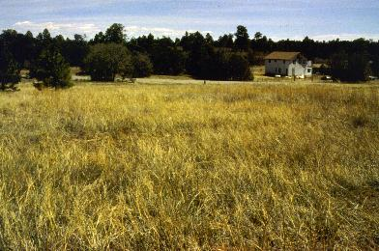
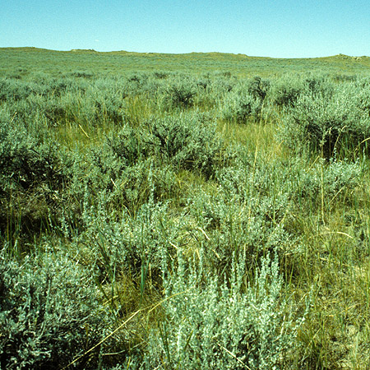
New Fuel Groups
Grass
Grass - Shrub

Slide 63
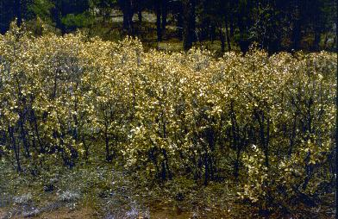
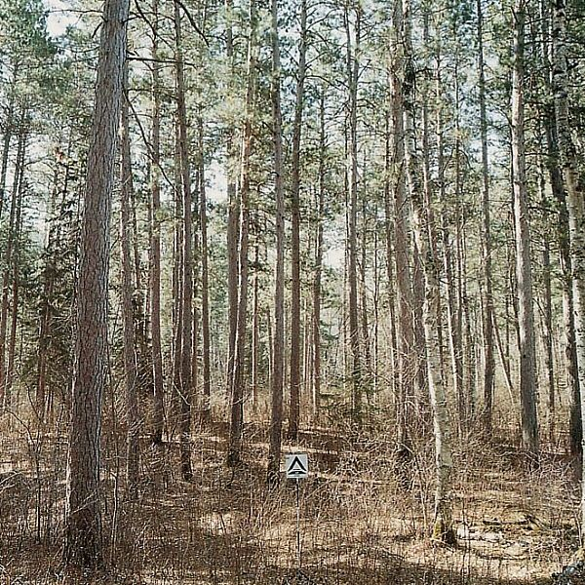
New Fuel Groups
Shrub
Timber - Understory

Slide 64
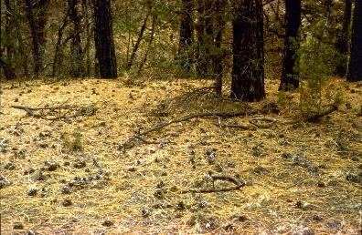
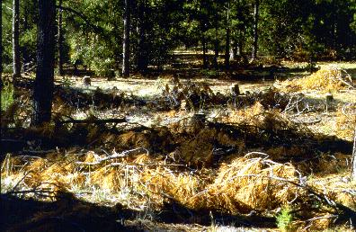
New Fuel Groups
Timber - Litter
Slash - Blowdown

Slide 65
Unit 3 Objectives
Identify and describe basic wildland fuel characteristics.
Identify and describe seven characteristics of fuels that affect wildland fire behavior.
Identify and define by size class the four dead fuel timelag categories used to classify fuels.
Describe how fuel availability is essential to predicting wildland fire behavior.
Describe the fuel model concept and its utility for predicting wildland fire behavior.

