Slide 1
Unit 5
Temperature
and
Humidity Relationships

Slide 2
Objectives
1. Describe the relationship between dry bulb temperature, wet bulb temperature, dew point temperature, and relative humidity.
2. Describe typical day and night (diurnal) variations in air temperature and relative humidity.

Slide 3
Objectives
3. Determine relative humidity, dew point and wet bulb temperatures using a psychrometric table.
4. Describe the effects of topography, vegetation, clouds, and wind on air temperature and relative humidity.
5. Describe the temperature and relative humidity characteristics of continental and maritime air masses.

Slide 4
Temperature
Definition:
RAWS
The degree of hotness or coldness of a substance.
In weather we refer to this as air temperature or dry-bulb temperature.

Slide 5
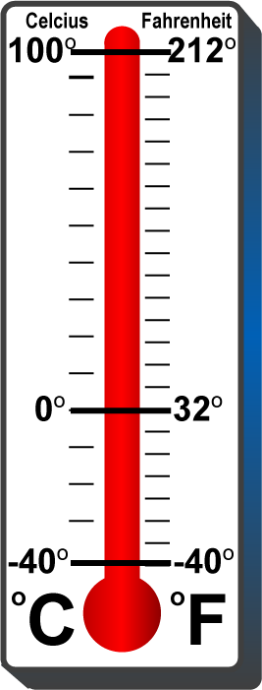
Temperature is measured with a thermometer
calibrated either to
the FAHRENHEIT scale
or the CELCIUS or centigrade scale.

Slide 6
Describing Water Vapor in the Atmosphere
Water Vapor Facts
Water vapor mixes with other gases, but maintains its identity
Water vapor stores an immense amount of energy through evaporation
Releases energy through condensation
Amounts of moisture in the atmosphere affect fuel moisture by wetting or drying
In this course we will study and apply:
Dewpoint Temperature
Wet-bulb Temperature
Relative Humidity
Click image to play video clip

Slide 7
Wet Bulb Temperature
Definition:
The lowest temperature to
which air can be cooled by evaporation.
Wet-
Bulb
Wet-bulb temperature is another good Indicator of
atmospheric moisture.
Cooling by
Evaporation

Slide 8
Wet Bulb Facts
Wet bulb temperature is another practical method for measuring atmospheric moisture.
When the wet bulb temperature is reached, the point of saturation for the air has been determined.
The wet bulb temperature is read from a wet bulb thermometer, mounted to a psychrometer.
Dew point and relative humidity can be determined using the difference in degrees between dry and wet bulb.
Do not confuse this term with dew point.

Slide 9
Dewpoint Temperature
Definition:
The temperature to which air must be cooled to reach saturation.

Slide 10
Dewpoint Facts
The saturation point is met when the air temperature becomes equal to the dewpoint temperature.
Once the dewpoint is met, the air temperature will no longer decrease unless the dewpoint temperature decreases.

Slide 11
Dewpoint Facts
The dew point is one of the most reliable measures of atmospheric moisture.
Absolute humidity is a more accurate method to represent atmospheric moisture, but is nearly impossible for the weather observer to measure. Thus, dewpoint is used instead.

Slide 12
Relative Humidity
Definition:
The ratio of the amount of moisture (water vapor) in the air to the amount the air could hold when saturated at the same air temperature.

Slide 13
Relative Humidity Facts
Is only a relative measure of atmospheric moisture as related to temperature.
Do not confuse it with dewpoint.
Is always expressed as a percentage.

Slide 14
Temperature and RH Relationships
3 grams
3 grams
3 grams
50ºF
70ºF
100%
(saturated)
90ºF
50%
(unsaturated)
25%
(unsaturated)

Slide 15
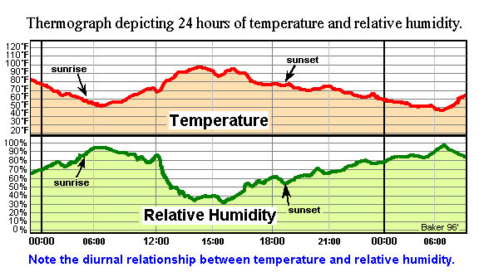
5-15-S290-EP

Slide 16
Temperature-Relative Humidity
Relationship
For each 20ºF increase in the dry-bulb temperature, relative humidity decreases by one-half; assuming atmospheric moisture (dewpoint) remains constant.
Dry-bulb Temp.
Dewpoint Temp.
Relative Humidity
50ºF
50ºF
100%
70ºF
50ºF
50%
90ºF
50ºF
25%
This represents an inverse relationship.

Slide 17
In Reality
Dewpoint Rarely Remains Constant
Dry-bulb Temp.
Dewpoint Temp.
Relative Humidity
50ºF
50ºF
100%
70ºF
45ºF
41%
90ºF
44ºF
20%
RH Values Based on Standard Atmospheric Pressure

Slide 18
Dewpoint temperature may decrease:
Following the dissipation of a surface based temperature inversion.
With the development of downslope winds.
With solar heating resulting in strong vertical mixing of the lower atmosphere.

Slide 19
Dewpoint temperature may increase:
With the passage of showers and thunderstorms.
With wind flow off a body of water, such as a lake or ocean.
With evaporation of surface water or the melting of snow and ice.

Slide 20
What Do They Tell Us?
When Dew Point
Rises
Moisture is
Increasing
When Dew Point
Falls
Moisture is
Decreasing
When
Relative Humidity
Rises
Temperature
is Decreasing
When
Relative Humidity
Falls
Temperature
is Increasing

Slide 21
Important Facts to Remember
The dry bulb temperature, wet bulb temperature and the dewpoint temperature will all be the same for saturated air. At that point relative humidity will be 100 percent.
If the air is not saturated the dry bulb will be higher than the wet bulb, and the wet bulb higher than the dewpoint. Always.

Slide 22
Exercise 1

Slide 23
Psychrometer
The wet bulb temperature is read from a wet bulb thermometer, mounted to a psychrometer.
Dew point and relative humidity are determined by using the difference in the dry-bulb and wet-bulb temperatures.

Slide 24
Psychrometric Table
23 Inches of Mercury (6,101-8,500 FT MSL)
Wet-Bulb Temperatures
RH 15% or Less
RH 16% to
30%
43 DP
19 RH
RH 31%
to
60%
RH 61%
to
100%
Dry Bulb Temperatures
Psychrometric tables are used to determine dew point and relative humidity.
5-24-S290-EP

Slide 25
Exercise 2

Slide 26
Psychrometric Table
23 Inches of Mercury (6,101-8,500 FT MSL)
Wet-Bulb Temperatures
RH 15% or Less
RH 16% to
30%
RH 31%
to
60%
RH 61%
to
100%
Dry Bulb Temperatures
Using the psychrometric table: Exercise 2 Answers
5-26-S290-EP

Slide 27
Variation in Relative Humidity with Aspect
Warmer, sun drenched south slopes have lower relative humidities than cooler, shaded north slopes. The cross slope difference in relative humidity is smaller near mountain tops because of stronger winds and
greater air turbulence.
5-27-S290-EP

Slide 28
Change in Relative Humidity with Elevation
5-28-S290-EP

Slide 29
Daytime Variation in Relative Humidity Around Trees
Warmest temperatures
And lowest relative humidity
Coolest temperatures and
Highest relative humidity
5-29-S290-EP

Slide 30
Nighttime Variation in Relative Humidity Around Trees
Coldest temperatures and highest relative humidity near tree top
Warmest temperatures and lowest relative humidity
5-30-S290-EP

Slide 31
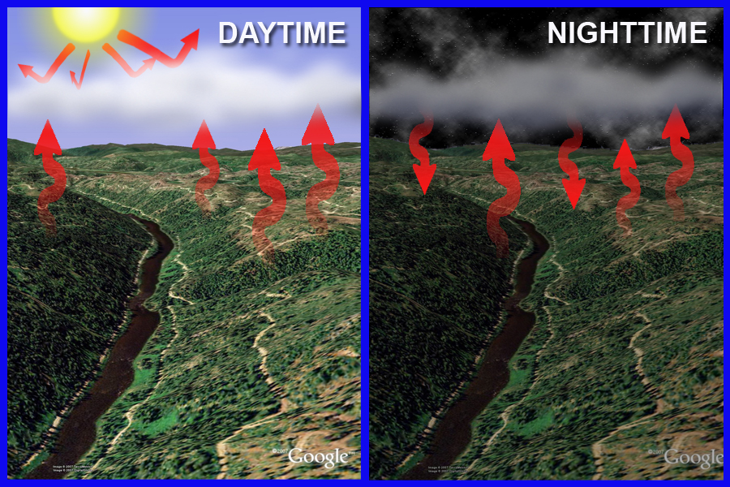
Diurnal Variation in Air Temperature and Relative Humidity
Due to Cloud Cover
Lower Temperatures
Higher Relative Humidities
Higher Temperatures
Lower Relative Humidities

Slide 32
5-32-S290-EP

Slide 33
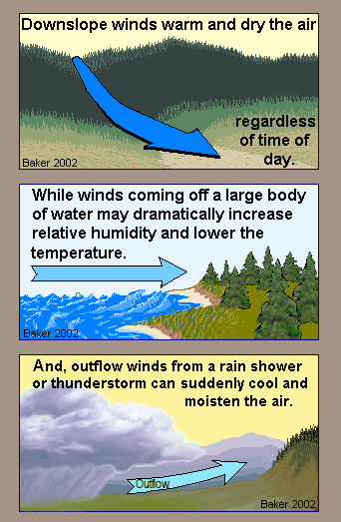
Other Affects
of Wind
on
Air Temperature
And
Relative
Humidity
5-33-S290-EP

Slide 34
Air Mass
Definition:
A large body of tropospheric air with “homogeneous” or similar temperature and moisture characteristics.

Slide 35
Air Mass Formation
Air mass Formation
Episodes of high pressure
Uniform surface characteristics
Water
Land
Ice
Result:
Air mass development with different temperature and moisture characteristics
Click image to play video clip

Slide 36
Air Mass Origins
Maritime
Originate over oceans
Continental
Originate over land
Polar
Originate over polar or sub-polar regions
Tropical
Originate over tropical or sub-tropical regions

Slide 37
Air Mass Types
Maritime Polar
Air originating from over cold oceanic region such as the North Pacific, the Gulf of Alaska and the North Atlantic
Maritime Tropical
Air originating from over warm oceanic regions such as the Central Pacific, the Gulf of California, the Gulf of Mexico, and the Central Atlantic

Slide 38
Air Mass Types
Continental Polar
Air originating from over large, often cold and dry continental land areas, such as northern portions of North America (e.g., Canada)
Continental Tropical
Air originating from over large, often warm and dry continental land areas, such as Central America (e.g., Mexico)

Slide 39
Exercise 3

Slide 40
Review Objectives
1. Describe the relationship between dry bulb temperature, wet bulb temperature, dew point temperature, and relative humidity.
2. Describe typical day and night (diurnal) variations in air temperature and relative humidity.

Slide 41
Review Objectives
3. Determine relative humidity, dew point and wet bulb temperatures using a psychrometric table.
4. Describe the effects of topography, vegetation, clouds and wind on air temperature and relative humidity.
5. Describe the temperature and relative humidity characteristics of continental and maritime air masses.

