Slide 1
Unit 6
Atmospheric Stability

Slide 2
Unit 6 Objectives
Describe the relationship among atmospheric
pressure, temperature, density and volume.
2. Describe temperature lapse rate and stability, and
the different temperature lapse rates used to
determine the stability of the atmosphere.
3. Describe the effects of atmospheric stability on
wildland fire behavior.
4. Name four types of temperature inversions and
describe their influence on wildland fire behavior,
including the thermal belt.

Slide 3
Unit 6 Objectives
5. Name and describe the four lifting processes that
can produce thunderstorms.
6. Describe the elements of a thunderstorm and its
three stages of development.
7. Use visual indicators to describe the stability
of the atmosphere.
8. Describe the four principle cloud groups, and identify the six clouds most often associated with critical wildland fire behavior.

Slide 4
Up to now, our attention has been on temperature and the factors that influence its change on and near the earth’s surface.
In this unit we will focus on air temperature in the third dimension, atmospheric stability, and how stability affects wildland fire behavior.
We will also discuss several visual indicators commonly used to identify critical changes in atmospheric stability.

Slide 5
Our atmosphere is composed of
numerous gases.
This gaseous mixture includes
permanent dry air gases
such as nitrogen, oxygen, argon,
helium, hydrogen, and xenon.
Nitrogen and oxygen account for 99%
of all permanent dry air gases
in the troposphere.

Slide 6
The remaining gases, called
variable gases;
include water vapor, carbon dioxide,
methane, nitrous oxide and ozone.
Of these gases,
water vapor is the most abundant,
varying from a trace to 4 percent by volume.

Slide 7
Behavior of Gases
Nearly all gases in the atmosphere
respond uniformly to changes in
temperature and pressure.
For that reason, we can use the
Ideal Gas Law (Equation of State)
which is based on a set of gas behavior laws,
to describe their behavior.

Slide 8
The relationship among pressure,
temperature and density (mass per volume)
can be expressed by the gas law equation
P = (ρ)RT or P = (m/V)RT
where: P is pressure, ρ is density, m is the
mass of the gas, V is volume, R is a gas
constant, and T is temperature.

Slide 9
R is the gas constant, and can be ignored.
P ~ (ρ)T or P ~ (m/V)T
Again: The term (m/V) represents the
density (ρ) of the gas.
~ is the symbol meaning “is proportional to.”

Slide 10
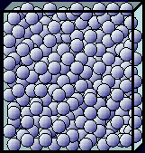
Often when referring to air in motion, we represent it in small units or volumes called
air parcels.

Slide 11
Air Parcel
An air parcel is a volume of air, large enough to contain a great number of molecules, but small enough so that its energy (heat) and mass (air molecules) are nearly uniform within is boundaries.

Slide 12
Air Parcel
Air parcels
expand and contract freely,
but neither heat nor outside air
is able to mix with air inside; making an air parcel
a sealed container.
Air parcels are commonly portrayed as 3-dimensional cubes or spheres.

Slide 13
Applying this Relationship
To a Rising Air Parcel
As atmospheric pressure decreases with increasing altitude:
Cooler &
Less dense
volume increases
density decreases
temperature decreases
Rising air parcels
always expand and cool
Rising
Air Parcel

Slide 14
Applying this Relationship
To a Sinking Air Parcel
Sinking
Air Parcel
As atmospheric pressure increases with decreasing altitude:
volume decreases
density increases
temperature increases
Sinking air parcels
always compress and warm
Warmer &
more dense

Slide 15
ADIABATIC PROCESS
When an air parcel
rises or sinks
without any loss of energy or mass
to the surrounding atmosphere

Slide 16
EXERCISE 1

Slide 17
Air in Motion
The rotation of the earth on its axis,
together with large and small scale variations
in pressure and temperature
are what produce the
horizontal and vertical
movement of air in the atmosphere.

Slide 18
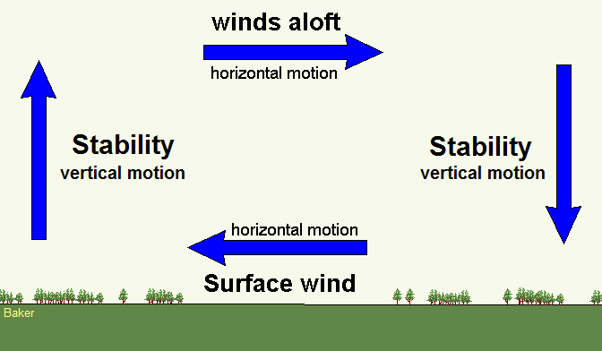
Wind and Stability
6-18-S290-EP

Slide 19
The magnitude or strength of wind is
far greater than the vertical movement of air
associated with atmospheric stability.
However, their influence on the behavior of
wildland fires is equally important.
In this unit, our attention will be on
vertically moving air associated with
atmospheric stability.

Slide 20
What is Stability?
It is the resistance of the atmosphere
to vertical motion.
More precisely, it is the degree to
which vertical motion in the atmosphere is enhanced or suppressed.
Depending on the vertical temperature profile
of the atmosphere, air will either rise,
sink or remain at rest.

Slide 21
Three Types of Stability
Unstable Atmosphere
Enhances or encourages vertical movement of air
Stable Atmosphere
Suppresses or resists vertical movement of air
Neutral Atmosphere
Neither suppresses nor enhances vertical movement of air. This condition seldom exists for long periods of time.

Slide 22
Unstable Atmosphere
Air parcels
will continue
to rise
Level of
Origin

Slide 23
Unstable Atmosphere
Promotes the formation and growth of
vertically developed clouds, thunderstorms and tall smoke columns
Rising
Air

Slide 24
Stable Atmosphere
Level of
Origin
Air parcels displaced upward (downward) will
eventually return to their level of origin.

Slide 25
Stable Atmosphere
Light winds and poor smoke dispersal from poor vertical mixing
trapped smoke
and haze

Slide 26
mountain wave
clouds
In mountainous terrain, however, stable conditions can produce gusty ridgetop winds, and warm, dry and gusty downslope winds called foehn winds.
leeward
slope
windward
slope
foehn
wind

Slide 27
Neutral Stability
Usually exists for only short periods of time during the transition between a stable and an unstable atmosphere.
Little vertical air motion occurs.
If this condition should exist through a deep layer of atmosphere, an air parcel’s vertical motion will cease.

Slide 28
An unstable atmosphere
is most often associated with critical or extreme wildland fire behavior.

Slide 29
A stable
atmosphere
will tend to
suppress or reduce
wildland fire
behavior.

Slide 30
Neutral atmospheric conditions
have little if any effect on
wildland fire behavior.

Slide 31
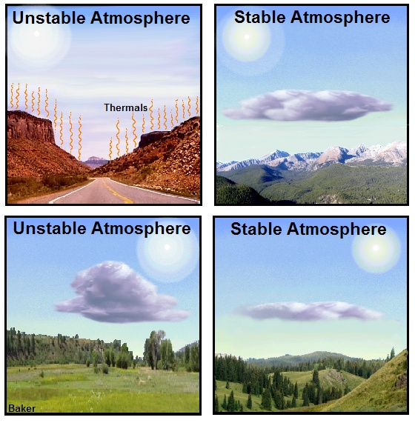
Heating from
below
Cooling from
below
Four Ways
To Change
Atmospheric
Stability
Cooling aloft
Warming aloft

Slide 32
Temperature Lapse Rate
The change in temperature with
a change in altitude.
Change in Temperature
Change in Altitude

Slide 33
Temperature Lapse Rates
differ throughout the troposphere,
particularly in the lowest 3000 feet
above the ground
where air temperature is
strongly influenced by:
daytime solar heating
nighttime radiational cooling

Slide 34
This lowest layer of the troposphere is called the
boundary layer.
Boundary
Layer
We will often refer to the boundary layer near the ground.

Slide 35
Lapse Rates within the
Boundary Layer
+15ºF per 1000 feet,
within a 24 hour period

Slide 36
Recall
from Unit 4
that temperature normally decreases
with increasing
altitude in the troposphere.
cooling

Slide 37
Air temperature can also increase
with increasing altitude in the troposphere.
This reversal in the normal trend in
temperature reduction with
altitude is what we refer to as an
inversion.
(More on inversions later)

Slide 38
Cooling with
Increasing
Altitude
Negative
Lapse Rate
Warming with
Increasing
Altitude
Positive
Lapse Rate

Slide 39
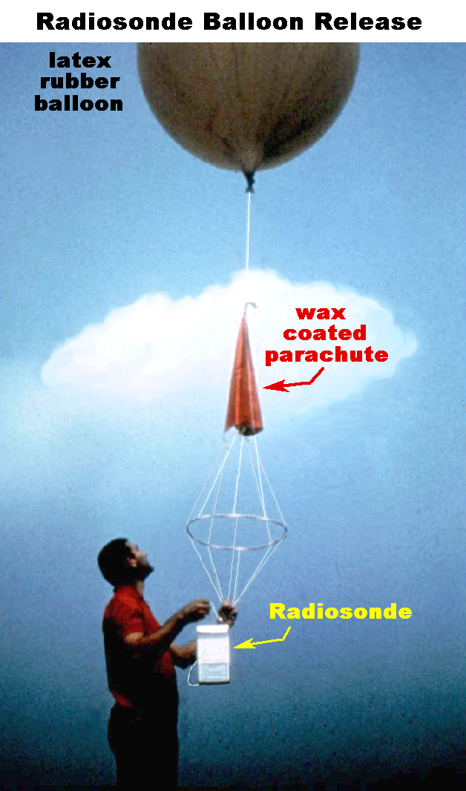
Determining the
Lapse Rate
Weather observing balloons called radiosondes, and
other observing systems, including weather satellites and aircraft, are routinely used to record changes in air temperature aloft.

Slide 40
Three Lapse Rates You Need to Know
Dry Adiabatic Lapse Rate
Moist Adiabatic Lapse Rate
Average Lapse Rate

Slide 41
Dry Adiabatic Lapse Rate
Represents the rate of
change in temperature of
rising and sinking
unsaturated air.
Rising “dry” air will
always cool at a rate of
-5.5º F per 1000 feet.
Sinking “dry” air will always warm at a rate of +5.5º F per 1000 feet.

Slide 42
Moist Adiabatic Lapse Rate
Represents the rate of
change in temperature of rising and sinking
saturated air.
Rising saturated air
cools at a rate of
approximately
-3.0ºF per 1000 feet.

Slide 43
During the
Moist Adiabatic Process
saturated
parcel
Heat released during condensation offsets the cooling that occurs due to expansion.
Rising saturated air parcels also lose mass, in the form of cloud droplets and precipitation.
Not a true adiabatic process
6-43-S290-EP

Slide 44
Sinking air parcels rarely warm at the moist lapse rate.
Once saturated air begins to sink, for example down the lee slope of a mountain range, compression causes it to warm.
Once this air becomes
unsaturated, or its relative
humidity lowers below 100
percent, this sinking air will
warm at the faster dry
adiabatic lapse rate of
+5.5ºF per 1000 feet.
6-44-S290-EP

Slide 45
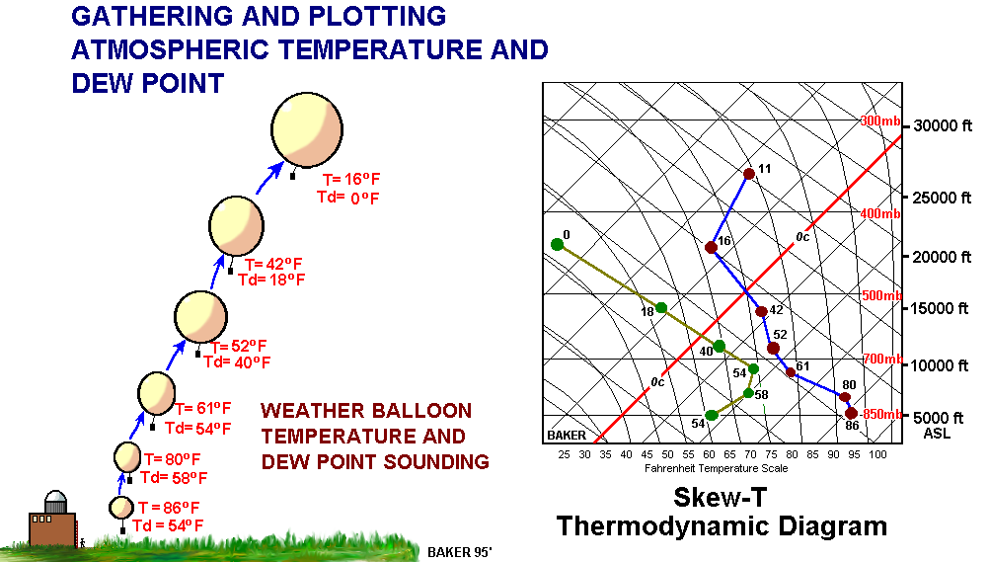
The skew-T diagram is used to represent the pressure, temperature, density, moisture, wind and atmospheric stability within a column of atmosphere above a point on the earth’s surface.
6-45-S290-EP

Slide 46
Average Lapse Rate: +/- 3.5ºF per 1000 feet
Represents
average vertical temperature change
for the entire
troposphere.
Can NOT be used
to determine the
stability of the
atmosphere.

Slide 47
Average lapse rate is useful
for estimating temperature and RH
for a shallow layer in the atmosphere
or for a point on a mountain side.
Because of variations in
topography, vegetation, wind, cloud cover, etc.
avoid using a lapse rate to
project temperatures more than 2000 feet above or below your location.

Slide 48
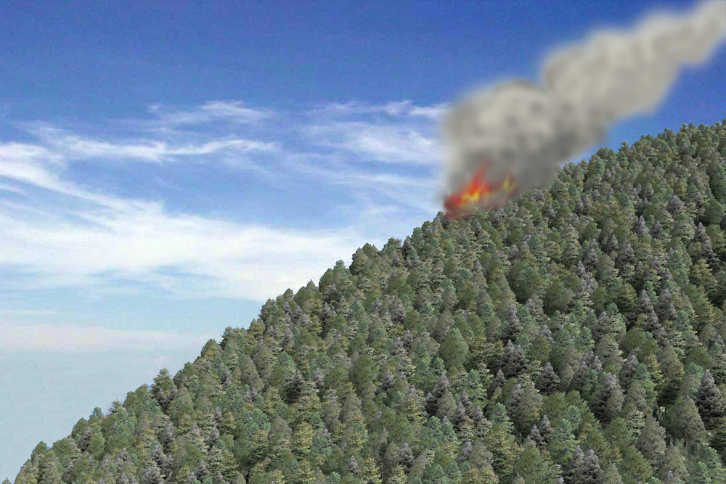
Example Using the Average Lapse Rate
Average Lapse Rate
Knowing your temperature at an elevation 4500 feet, project the temperature on a fireline at 6500 feet using the average lapse rate.
-3.5ºF/1000 ft
87ºF
6500 ft.
Elevation Change: 2000 feet
Lapse rate: -3.5ºF/1000 feet
94ºF
Temp. Change: (2 x -3.5ºF)
4500 ft.
Temp. at 6500 feet: 87ºF

Slide 49
A Day in the Life of a
Rising Air Parcel
8.0º F
8.5º F
13,000 ft AGL
49.0º F
52.5º F
5,000 ft AGL
If the parcel becomes saturated during its ascent, at 5,000 feet for instance, a cloud forms; assuming the parcel remains saturated as it continues to rise.
74.0º F
80.0º F
0 ft AGL
bare field
Fields covered with vegetation
6-49-S290-EP

Slide 50
How Fast Will Air Rise?
Fast
The greater the temperature difference between
an air parcel and the surrounding air, the faster the parcel will rise or sink. This difference in temperature is an indicator of how unstable or stable a layer of atmosphere is.
Slow
air temp.
90ºF
80ºF
82ºF
6-50-S290-EP

Slide 51
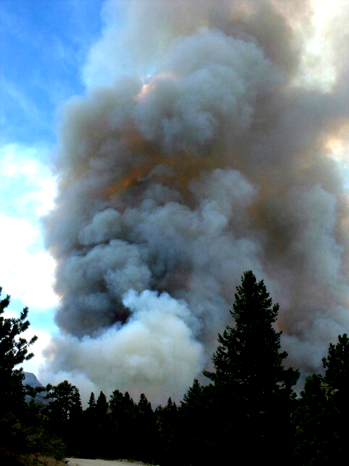
Large wildfires can produce strong convective updrafts capable
of lifting debris as large as small trees hundreds of feet into the air.
Strong
Updraft

Slide 52
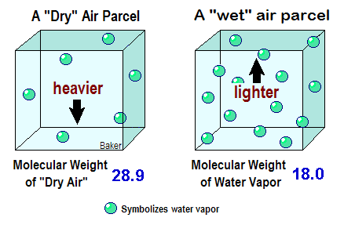
Influence of Moisture on Atmospheric Stability
Dry air is generally more STABLE than UNSTABLE
because it is “heavier.”

Slide 53
Use the appropriate lapse rates to calculate the temperature
of this moving air parcel at the designated altitudes.
Exercise 2
48.5F
?
UNSTABLE
STABLE
?
63.5F
76.0F
?
80F
92.5F
?
6-53-S290-EP

Slide 54
EXERCISE 3
Lapse Rates and
Atmospheric Stability

Slide 55
Over United States varies
from about
1/2 to 3 1/2 miles thick
The Mixing Layer
The lowest layer of the troposphere where surface heating mixes and vertically transports air molecules, water vapor and pollutants, such as smoke,
potentially to thousands
of feet above the ground.
Top of the Mixing Layer
Earth’s Surface
6-55-S290-EP

Slide 56
The Mixing Layer or Convective Mixing Layer
Generally deepest or highest over the interior regions of continents and tropical regions, and is shallowest or lowest over the oceans, coasts and polar regions
Deepest over
the Interior of
Continents
Shallowest over Oceans and
Coastal Regions
Shallowest over
Oceans and
Coastal Regions
6-56-S290-EP

Slide 57
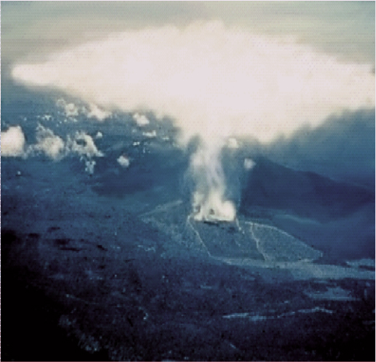
The convective mixing layer is normally “capped” by a layer of very stable air, which limits the rise of vertically developed clouds and smoke columns. The tops of tall smoke columns and cumulonimbus clouds are often seen spreading out at the top of the mixing layer.
Top of the Mixing Layer
Top of the Mixing Layer
6-57-S290-EP

Slide 58
Evolution of the
Daytime
Mixing Layer
12,000 Ft AGL
Maximum Mixing Height
2 PM
2 PM
7400 Ft AGL
Noon
Noon
2800 FT AGL
10 AM
10 AM
1500 Ft AGL
8 AM
8 AM
58F
G r o u n d
55ºF
63ºF
75ºF
80ºF
88ºF
6-58-S290-EP

Slide 59
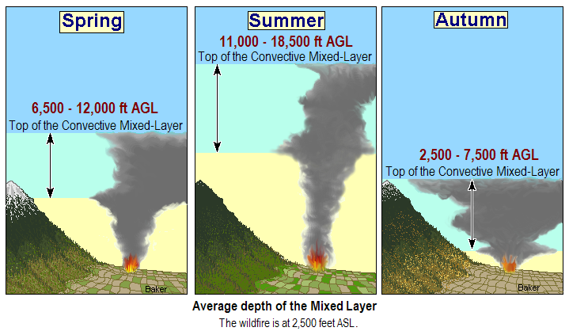
Seasonal Variation in the Height of the Mixing Layer
Average depth of the Mixing Layer
The wildfire is at 2,500 feet ASL.
The depth of the mixing layer varies considerably during the year.

Slide 60
Effects of Unstable Atmospheric Conditions
on Wildland Fire Behavior
Increased likelihood of fire whirls and dust devils
Increased likelihood for gusty and erratic surface winds
The height and strength of convection and smoke
columns often increase significantly
Increased likelihood of fire brands being lifted to great heights

Slide 61
Effects of Stable Atmospheric Conditions
on Wildland Fire Behavior
Limited rise of smoke columns, resulting in
poor smoke dispersion and visibility.
Reduced inflow of fresh air, thereby limiting
wildland fire growth and intensity.
Lowers surface wind speeds and fire spread
rates except in mountainous or hilly terrain.

Slide 62
Haines Index
A combination of:
stability and dryness
Indicates potential for large
plume-dominated fire growth.

Slide 63
Haines Index
Low: 2,000-5,000 ft
Mid: 5,000-10,000 ft
High: 10,000-18,000 ft
Due to large elevation differences, three atmospheric layers are used to determine the Haines Index.

Slide 64
Haines Index Numbers
The Potential for Large Plume
Dominated Fire Growth
2 or 3 … Very low potential
4 … Low potential
5 … Moderate potential
6 … High potential

Slide 65
Haines Index
Bottom Line…
The drier and more unstable the lower atmosphere, the HIGHER the Haines Index.
The more humid and stable the lower atmosphere, the LOWER the Haines Index.

Slide 67
What is a Temperatures Inversion?
An inversion is a layer of very stable air where temperature increases with an increase in altitude.
An inversion acts like a cap or lid to severely limit the upward movement of air.
Inversions often exist
at many levels of the troposphere.
Warmer
6-67-S290-EP

Slide 68
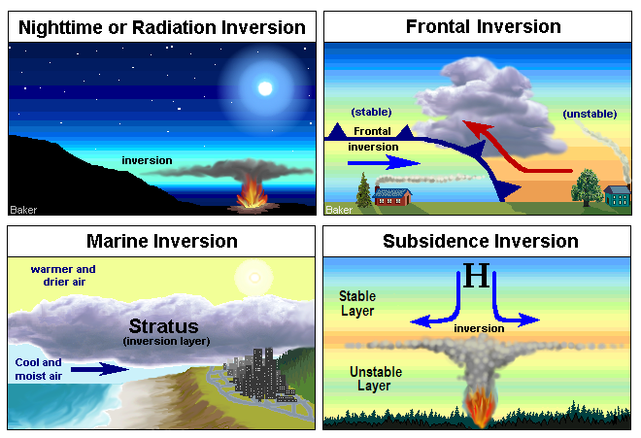
Four Types of Inversions
6-68-S290-EP

Slide 69
Nighttime or Radiation Inversion
Sunset
Midnight
Sunrise
Strong cold
air drainage
Weak cold
air drainage
Little or no
drainage flow
Weak
inversion
Strong
Inversion
Moderate
Inversion
During the evening hours, this surface based inversion is weak and shallow, usually no more than a few hundred feet deep. As cold air drainage and radiational cooling continues overnight, this inversion strengthens and eventually reaches its maximum depth around sunrise when surface temperatures are at their lowest.
6-69-S290-EP

Slide 70
The depth or strength of the nighttime or radiation inversion can range from several hundred feet to several thousand feet depending on:
cloud cover, wind, precipitation, snow cover, valley or canyon width and depth, and time of year

Slide 71
Effects of Cloud Cover and Wind
Top of the Inversion
Strong, Deep
Nighttime
Inversion
Top of the Inversion
Weak, Shallow
Nighttime Inversion
Surface-based nighttime or radiation inversions
are deepest or strongest on clear nights with
light or no winds; and shallowest or weakest on
cloudy, breezy.

Slide 72
Dissipation of the Nighttime Inversion
Late Morning
Mid-Morning
Early Morning
Transport Wind
Transport Wind
Transport Wind
Top of the Inversion Rises as it Weakens
Top of Surface Based Inversion
Surface Inversion
Has Dissipated
20-foot Wind
20-ft wind
20-ft wind
When the surface inversion breaks, fire intensity may suddenly increase with a rush of fresh oxygen.
6-72-S290-EP

Slide 73
What to Expect When
Nighttime Inversions Break
Winds often increase suddenly and
possibly become gusty and erratic
Air temperature increases suddenly
Relative humidity decreases
suddenly

Slide 74
There are several aspects of
stable air that should be understood
by the firefighter:
One is the relationship of the
nighttime or radiation inversion
to thermal belts.

Slide 75
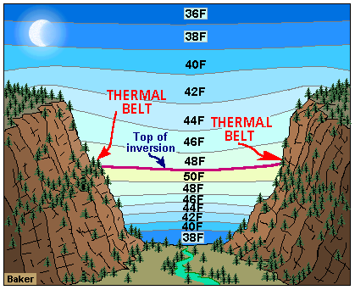
The Thermal Belt
Nighttime
Thermal belts form
where the top of the
nighttime inversion makes frequent contact with valley
wall or mountain slope.
Highest temperature and lowest average relative humidity
at night.
6-75-S290-EP

Slide 76
Hazards of the Thermal Belt
Nighttime
Dries out fuels and can create severe burning conditions.
Most importantly:
active burning at night, while areas above and below relatively quiet.
6-76-S290-EP

Slide 77
Elevation and location of the thermal belt varies by:
Locality
Time of year
Length of nighttime darkness
Size and steepness of the valley or canyon

Slide 78
Summer Nights
Lower on valley walls and mountain slopes during the summer with shorter nights and less radiational cooling and cold air drainage.
Shallow
Inversions
Winter Nights
Higher on winter nights with stronger radiational cooling and cold air drainage. May be thousands of feet above the valley floor.
Deep
Inversions
6-78-S290-EP

Slide 79
Thermal belts tend to form higher on the walls of broad valleys and
gently slopes canyons.
Broad Valleys
Lower on mountain slopes and steep canyons with strong drainage.
6-79-S290-EP

Slide 80
Clear Nights
Thermal
Belt
Thermal
Belt
Deep
Inversion
Nighttime cloud cover will limit the depth of the nighttime or radiation inversion.
Cloudy Nights
Thermal
Belt
Thermal
Belt
Shallow
Inversion
6-80-S290-EP

Slide 81
Frontal Inversion
warmer, lighter air
cooler, heavier air
The frontal inversion is strongest behind the advancing frontal boundary, as much as a hundred miles or more.
6-81-S290-EP

Slide 82
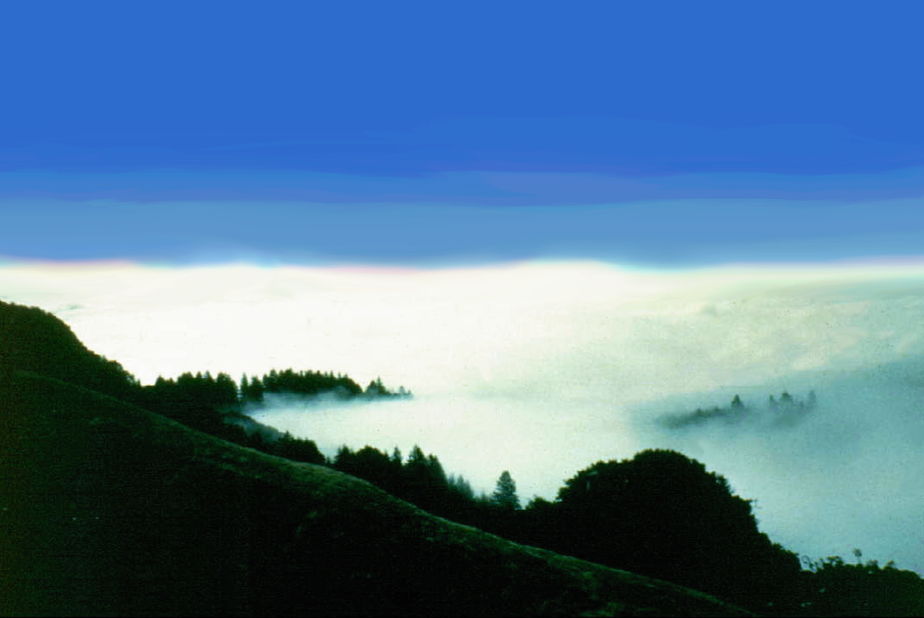
Marine Inversion
Commonly found along the shorelines of large lakes
and the West coast of the United States.
Varies in depth from a few hundred feet to several
thousand, and may extend hundreds of miles inland.
Ocean
Ocean
Stratus clouds
Similar to frontal inversions,
but often with more moisture
6-82-S290-EP

Slide 83
Inland Extent of Marine Inversions
Warm, drier air aloft
Cool, moist and stable marine air beneath a layer of warm, dry and unstable air will frequently move over the lowlands along the west coast with the diurnal cycle of winds and temperature.

Slide 84
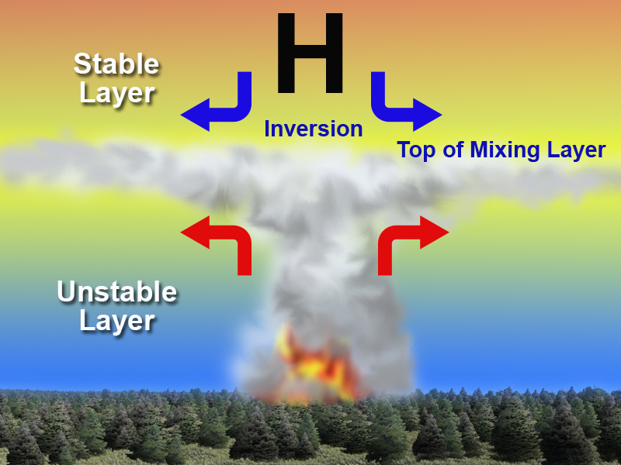
Subsidence Inversion
Form when an extensive layer of atmosphere slowly sinks beneath a large ridge of high pressure.

Slide 85
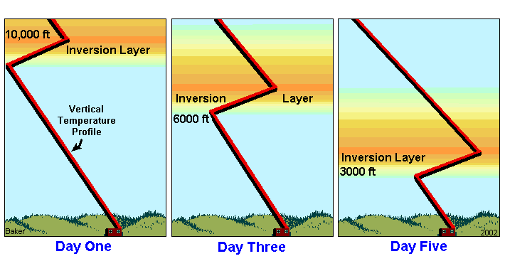
Lowering Subsidence Inversion
Subsidence is a slow process that can occur over several days.

Slide 86
The top of mountain
ranges will experience
the warm, very dry
conditions of the
subsidence inversion first.
Temperature
Sounding
Poor smoke dispersal
conditions may also
develop below a lowering subsidence inversion.

Slide 87
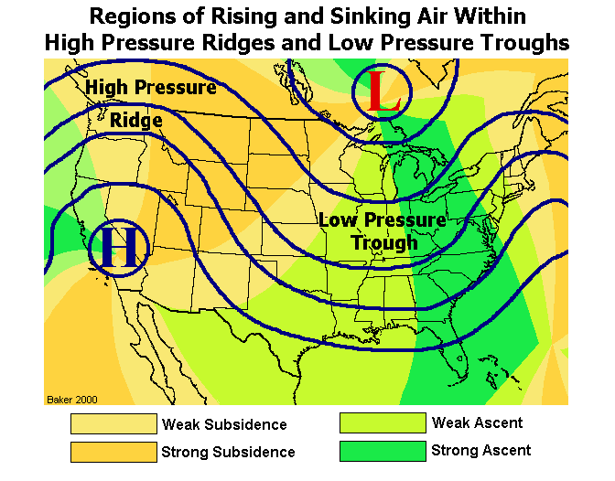
Subsidence
Inversions
Strongest in late summer and autumn, on the North and East sides of strong high pressure ridges.
Sometimes remains over a region for weeks at a time.
Aloft
Subsidence
Inversions
Aloft

Slide 88
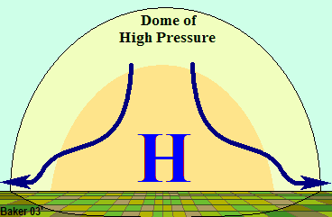
Subsidence and Foehn Winds
Winds on flat terrain are normally light in speed underneath large high pressure ridges and subsidence inversions.
In mountain regions, these same atmospheric conditions can produce warm and dry downslope winds called foehn winds.
H
gusty
winds
gusty
winds
Foehn Winds
light winds
light winds
Light winds
6-88-S290-EP

Slide 89
EXERCISE 4
Stability and Its Effects On
Wildland Fire Behavior

Slide 90
End of Part I

