Slide 1
Unit 9
Observing the Weather
Unit 9
Observing the Weather

Slide 2
Unit 9 Objectives
1. Describe when, how often, and where to take weather observations on wildland fires.
2. Describe the importance of having field observers or other fire personnel assigned as lookouts for potentially hazardous weather and wildland fire behavior conditions.
3. Demonstrate the correct use and maintenance of the belt weather kit in the field.

Slide 3
Weather Observations
In the Field

Slide 4
Wind Vane
Remote Automated Weather Stations
Anemometer
RAWS provide continuous and reliable weather observations, generally in remote area. Data from RAWS are available from the BLM website, as well as a number of other sites on the Internet. Data include air temperature, dewpoint, relative humidity, wind speed and direction, and wind gusts.
Temperature/
Relative Humidity
Sensors

Slide 5
Portable Weather Stations
These light weight, portable weather stations are normally assembled and monitored by NWS Incident Meteorologists (IMETs) dispatched to wildland fires.
Data collected from
these units are used to prepare fireweather forecasts, and to inform the FBAN and other fire personnel of changing local weather conditions.

Slide 6
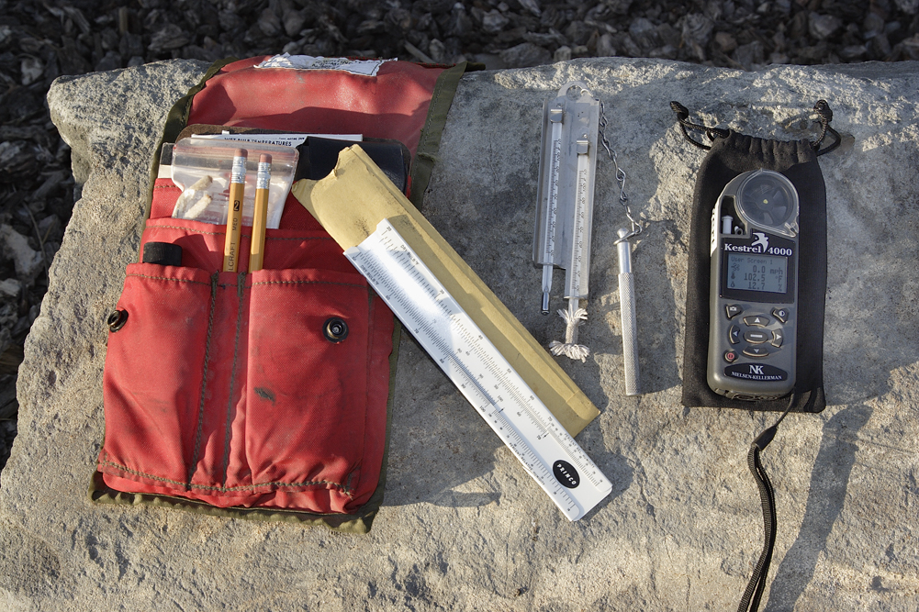
Belt Weather Kits
and Hand Held Observing Equipment
Small enough to be portable and used by observers in the field.
May measure temperature and wind speeds at eye level as well as calculate relative humidity.

Slide 7
Beaufort Wind Scale
If you have no access to an anemometer or hand-held wind meter, surface winds can be estimated by using the Beaufort Wind Scale.

Slide 8
Beaufort Wind Scale
Estimating 20-Foot Winds (mph)
Wind
Speed
Nomenclature
Very light – smoke rises nearly vertically. Leaves of quaking aspen in constant
motion; small branches of bushes sway; slender branches and twigs of trees move
gently; tall grasses and weeds sway and bend with wind; wind vane barely moves.
<3
4-7
Light – trees of pole size in the open sway gently; wind felt distinctly on face; loose
scraps of paper move; wind flutters small flag.
Gentle breeze – trees of pole size in the open sway very noticeably; large branches
of pole size trees in the open toss; tops of trees in dense stands sway; wind
extends small flag; a few crested waves form on lakes.
8-12
13-18
Moderate breeze – trees of pole size in the open sway violently; whole trees in
dense stands sway noticeably; dust is raised on the road.
19-24
Fresh – branchlets are broken from trees; inconvenience is felt in walking against
wind.
25-31
Strong – tree damage increases with occasional breaking of exposed tops and
branches; progress impeded when walking against wind; light structural damage.

Slide 9
Beaufort Wind Scale
Estimating 20-Foot Winds (mph)
Wind
Speed
Nomenclature
32-38
Moderate gale – severe damage to tree tops; very difficult to walk into wind;
significant structural damage occurs.
Fresh gale – surfaced strong Santa Ana; intense stress on all exposed objects;
vegetation, buildings; canopy offers virtually no protection; wind flow is systematic
in disturbing everything in its path.
>38

Slide 10
There is much you can do to monitor the weather using the tools in the belt weather kit, hand-held weather meters, and some basic observing skills.
It is also important to know when, how often and where to take observations, either visually or
with instruments.

Slide 11
When and How Often To Take
Observations
Whenever the weather is undergoing a
significant change.
At the coldest and warmest times of the day.
At the most humid and driest times of the day.
When the need demands that you document even subtle and short duration weather changes.

Slide 12
Observations should be taken
on wildland fires
when the following
critical weather conditions exist,
regardless of the time of
day or night.

Slide 13
Formation and dissipation of thunderstorms
Rapidly changing weather conditions
associated with an approaching cold front
Formation and dissipation of surface based
temperature inversions
Changes in atmospheric stability
Wind shifts

Slide 14
Sudden or large changes in relative humidity
and temperature
The formation of clouds significant to firefighters,
such as:
- cumulonimbus
- altocumulus standing lenticularus
- altocumulus castellanus
- altocumulus floccus
- cirrostratus
- jet stream cirrus

Slide 15
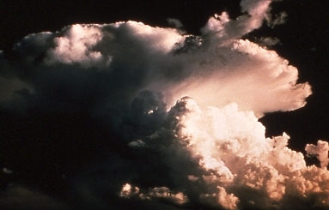
Cumulonimbus (Cb)
Cb

Slide 16
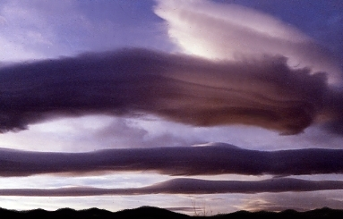
Altocumulus Standing
Lenticularus (Acsl)
Wave Cloud - Acsl
Wave Cloud - Acsl
Wave Cloud - Acsl

Slide 17
Altocumulus Castellanus (Accas)
Accas
Accas
Accas

Slide 18
Altocumulus Floccus (Ac)
Ac
Ac

Slide 19
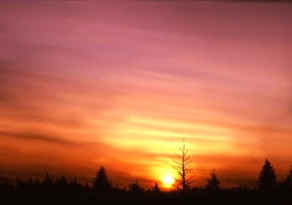
Cirrostratus (Cs)
Cs
Cs
Cs

Slide 20
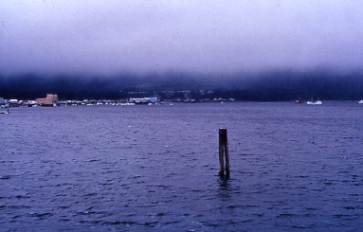
Stratus (St)
St
St
St
(Fog – Stratus in contact with the ground)

Slide 21
Ci
Jet Stream Winds
Ci
Ci
Jet Stream
Cirrus
(Ci)

Slide 22
Where to Take Observations
The preferred locations are in areas representative of
FIRE LINE conditions.
However, it can not be stressed more; you should never jeopardize your
SAFETY
for an observation.

Slide 23
In the Black
Avoid taking observations in “the black” because weather elements can be significantly modified, and therefore, unrepresentative of the conditions under which the fire will burn.

Slide 24
Avoid taking observations in areas sheltered from the fire, such as behind a cliff (A), or near a large body of water (B), or at a distance too far from the fire (C) to be representative.
A
B
C

Slide 25
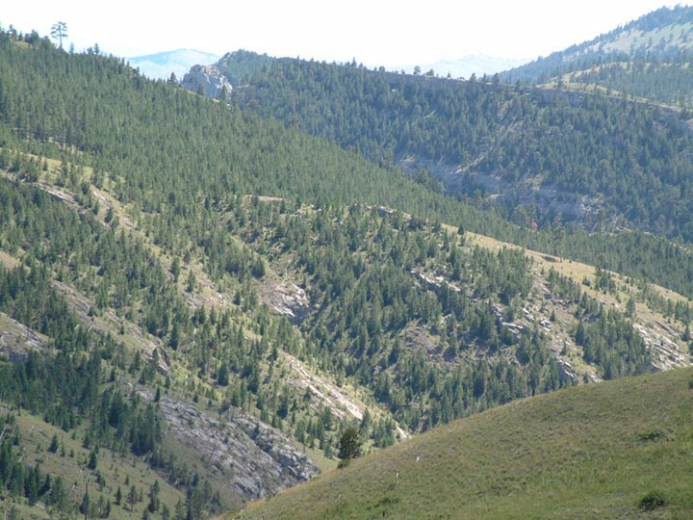
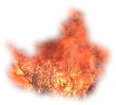
Where to Take Observations
Select a safe
location preferably at an elevation similar to the fireline, or in an area that is representative of the conditions that the fire will burn in.
Representative Observation Site

Slide 26
On Small Wildland Fires
A single observer may be all that is needed when the terrain is fairly uniform, and/or when the fuels are light or widely spaced.
Field
Observer

Slide 27
On Large Wildland Fires
Often in complex
or dangerous
terrain and/or fuels,
several observers
should be
positioned
in problem areas
around the fire.

Slide 28
When one or more of these critical weather
conditions are forecast
to develop or worsen,
potentially creating serious control and
safety problems…
…it would be prudent to establish a
Safety Weather Watch
on the fire.

Slide 29
The Safety Weather Watch
A Safety Weather Watch requires one or more observers to be posted at strategic locations around a fire to detect and warn of impending critical weather changes. These observers should have an unobstructed view of changing weather and fire behavior conditions, and be able to communicate rapidly with fire command and other field personnel.

Slide 30
While on a Wildland Fire or
a Prescribed Burn
Always anticipate a sudden change in the weather and fire behavior, and be prepared to respond quickly and wisely to these changes.
A sudden change in the weather can create dangerous if not deadly fire behavior, sometimes in just a matter of a few minutes!

Slide 31
Do not expect to have access to
the latest fireweather forecasts,
warnings or observations.
Therefore, it is up to
YOU
to maintain a basic weather watch
for your safety
and those around you.

Slide 32
Taking
Weather
Observations
in the Field

Slide 33
Hand-held observing meters provide users with an accurate alternative to measuring eye-level weather conditions in a timely matter.
These battery-powered,
digital display
devices vary widely
in price and
sophistication, and in
the number of weather
elements they record.

Slide 34
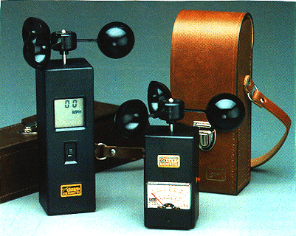
Hand Held Meters
of which there are many to choose from…
…are capable of taking measurements
of many if not all of the following weather elements:
windspeed, air temperature, relative
humidity, dewpoint and wet-bulb
temperatures, barometric pressure,
heat index and wind chill.

Slide 35
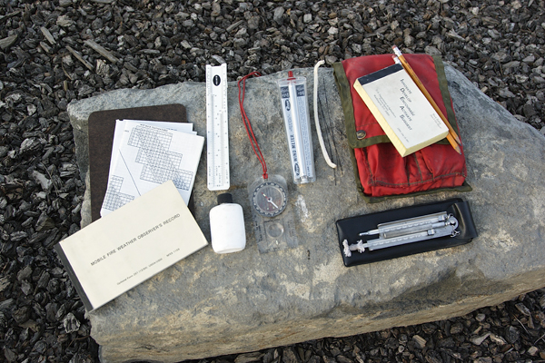
Belt
Weather
Kit
The Belt Weather
Kit
Remains as the standard set of basic weather observing tools used by fire personnel on
wildland fires
and
prescribe burns.

Slide 36
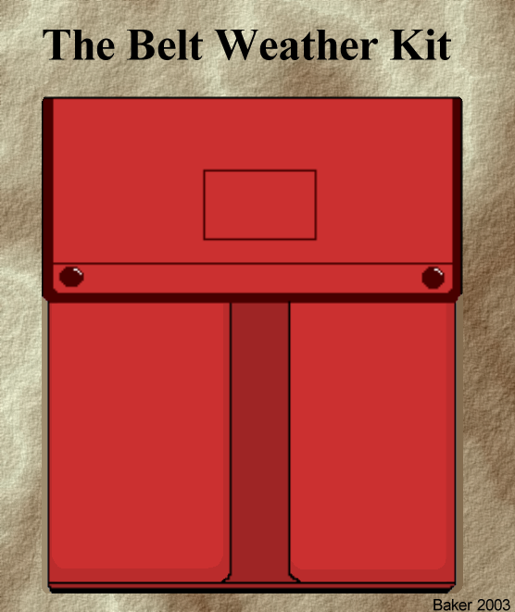
Besides being durable, reliable, and accurate,
instruments in the
belt weather kit requires
no batteries.
Unlike some hand-held
meters, the instruments
in the belt weather kit
have little problem
performing in extreme
weather conditions.

Slide 37
Components of the Belt Weather Kit

Slide 38
Taking Observations
With the
Belt Weather Kit

Slide 40
Measuring Dry Bulb and Wet-Bulb
Temperatures Using the Sling Psychrometer
Stand in an open area away from objects that might be struck during whirling.
Face the wind in a way that avoids exposing the
thermometers to your body heat and direct sunlight.
Saturate the wet-bulb wick with clean, distilled or
mineral-free water. Be sure to completely saturate it.
Holding your forearm parallel to the ground, ventilate
the sling psychrometer by whirling it at arm’s length from
your body at a constant speed. Spinning it too fast will
cause the wet-bulb wick to dry prematurely.

Slide 41
Whirl the psychrometer using a smooth wrist action for
one minute. Note the wet-bulb temperature.
Continue whirling for another 30 seconds, and then take a
second wet-bulb reading. If this temperature is lower than
the first reading, continue whirling and reading the wet-
bulb thermometer every five to ten seconds until it will go
no lower. Record this lowest wet-bulb temperature.
Now read and record the dry bulb temperature.
Finally, determine relative humidity and dewpoint using
the appropriate psychrometric table for your elevation.

Slide 42
Remember…
Not to completely saturate the
muslin wick would result in a
wet-bulb temperature
that is too high.

Slide 43
The sling psychrometer
also should be used
to check the accuracy of all hand-held observing meters;
particularly when they are used under extreme weather conditions
(for example, when it is very warm, very cold, very dry or very moist).

Slide 44
Determining Eye-Level
Windspeed
Using the
Windspeed Meter
In the Belt Weather Kit

Slide 45
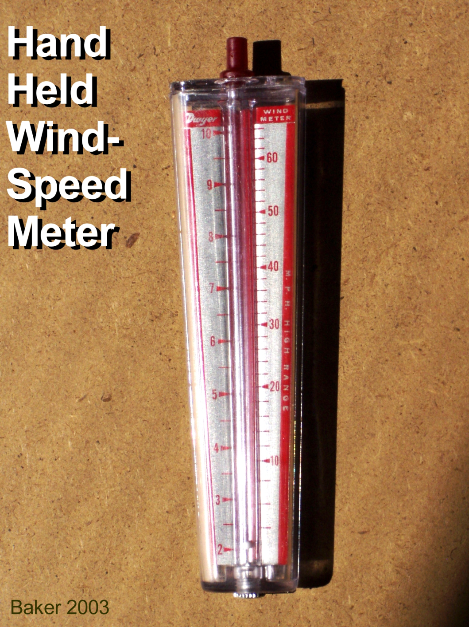
Face the wind and hold the meter at arm’s length near eye level.
Hold the meter about
midway from either
end, careful not to
block the two holes at
the bottom or the hole
at the top.
Check to see if the
small white ball in the
tube is moving freely.

Slide 46
If yes, now determine a
one-minute averaged
wind speed by
observing the ball
bouncing between 2 and
9 mph. Use the low
speed scale on the left.
If the ball rises up near
10 mph on the left
scale, cover the top red
stem with your finger
and read from the high
wind speed scale on the
right.

Slide 47
Using the Compass
Be sure to properly orient the compass to “true” north for your location.
Take a reading to the
nearest cardinal point
(N, NE, E, SE, S, SW,
W, NW).
Remember, the wind
direction is the direction the wind is from.

Slide 48
Recording Your Weather Observation

Slide 49
Filling Out the Observation Form
EXAMPLE
08-20-05
Sunny Ridge Fire
5300
W
mid-slope
PJ and Scrub Oak
1430
89
55
11%
8
SW
Gusts to 20 mph firewhirls
CBs and lightning NW

Slide 50
Maintenance
and
Use
of the Belt Weather Kit
Field
Exercise

Slide 51
Unit 9 Objectives
1. Describe when, how often, and where to take weather observations on wildland fires.
2. Describe the importance of having field observers or other fire personnel assigned as lookouts for potentially hazardous weather and wildland fire behavior conditions.
3. Demonstrate the correct use and maintenance of the belt weather kit in the field.

