Slide 1
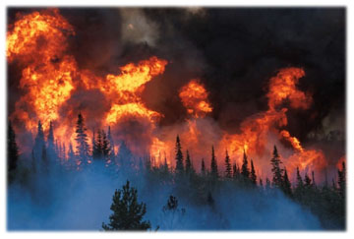
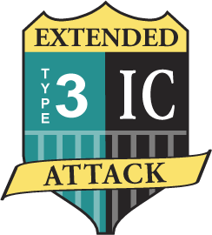
Extended Attack
Incident Commander, S-300
Final Simulation
The Zephyr Fire
Unit 7

Slide 2
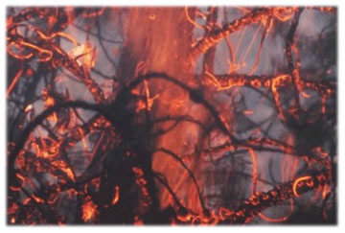
Unit 7 Intent
The intent of this simulation is to provide the maximum amount of learning through practice and coaching. This is where the majority of the tasks in the Simulation Task Book will be attained.
Unit 7

Slide 3
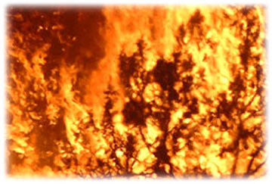
Unit 7 Objective
Given the criteria in the Simulation Task Book and an incident simulation, students will ensure the completion of eleven or more tasks.
Unit 7

Slide 4
Ground Rules Briefing
Two simulations may run simultaneously on two tables.
Each sand table will have a facilitator and an appropriate number of coaches.
Each simulation will have an ICP separate from the sand table.
Unit 7

Slide 5
Ground Rules Briefing
Each simulation will take between 1½ and 2 hours.
The facilitator will identify an IC based upon needs in STBs.
An instructor or coach will be in the Dispatch and FMO roles.
Students will be given a transition briefing from the ICT 4 before the simulation begins.
Unit 7

Slide 6
Ground Rules Briefing
When students are not face to face on the Zephyr Fire, communications will be over the radio.
Upon attainment of learning objectives in 1A, Assume Command, the facilitator will rotate students into new positions based upon needs in identified STB and transfer command.
Unit 7

Slide 7
Input cards
Facilitator will have two types
of input cards for each simulation:
  GREEN CARDS: These cards are given to each player at the beginning of the simulation.
  RED CARDS: Murphy’s Law, create dilemmas that bring students to a decision point.
Unit 7

Slide 8
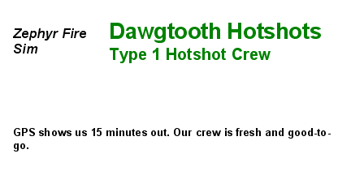
Front of Green Cards
  The front of the Green Card shows position and current status:
Unit 7

Slide 9
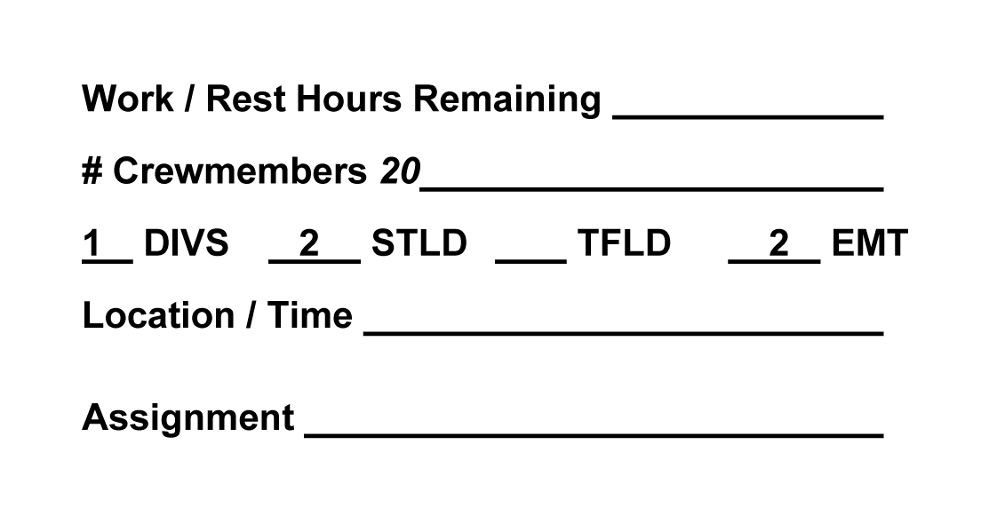
Back of Green Cards
The back of the Green Card has categories of information which can be developed during the simulation. This includes position qualifications from which the IC can build an organization.
Unit 7

Slide 10
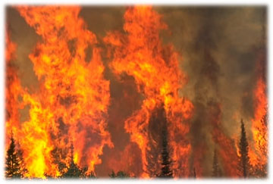
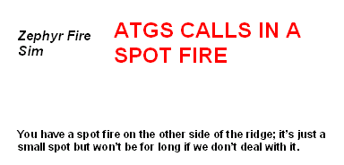
Red Cards
Red Cards (Murphy’s Law): These inputs are handed out at the discretion of the facilitator. Role players will be given these cards to communicate inputs to the team.
Unit 7

Slide 11
Ground Rules Briefing
Simulation Task Book elements can be signed off in all roles.
Conduct yourself as you would on an actual incident.
Unit 7

Slide 12
Ground Rules Briefing
You will be evaluated on your documentation; everyone will document as if they are the IC.
Use your Incident Commander’s Organizer!
Unit 7

Slide 13
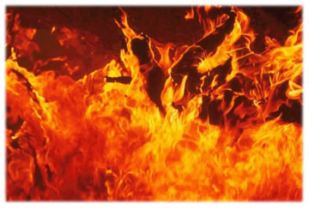
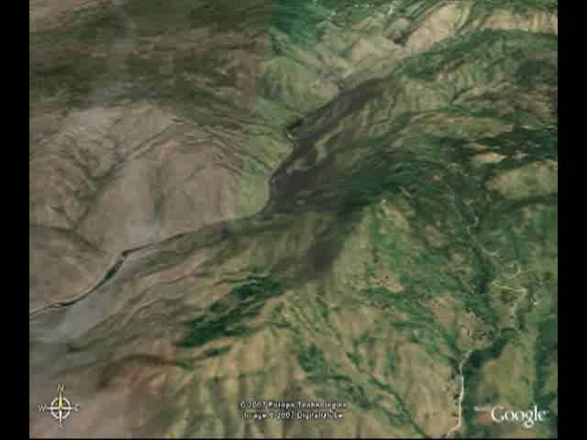
Zephyr Fire Briefing
It is 0800 on July 10. You are a Type 3 IC flying into a staging area by helicopter to relieve a Type 4 IC on the Zephyr Fire in Central Idaho…
Notes:
Play video.

Slide 14
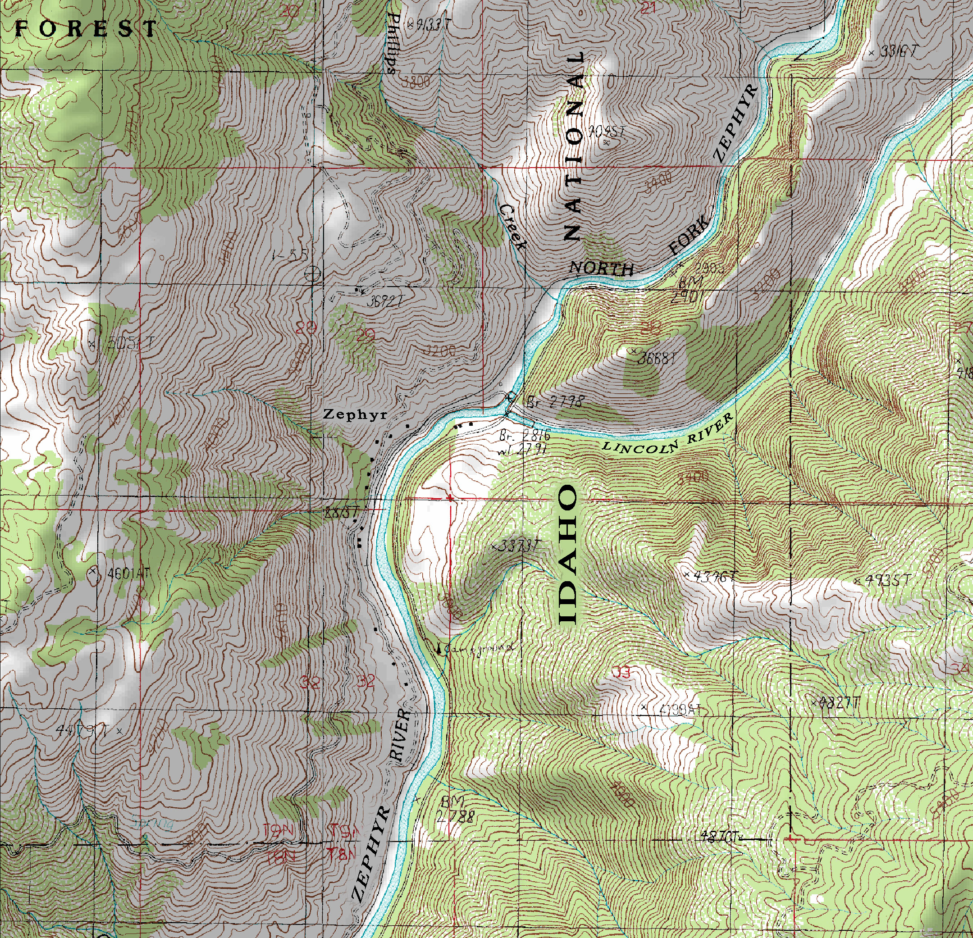
Zephyr Fire Briefing

Slide 15
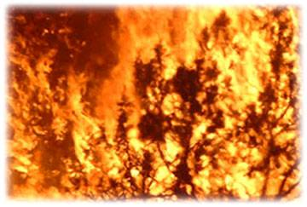
Unit 7 Objective
Given the criteria in the Simulation Task Book and an incident simulation, students will ensure the completion of eleven or more tasks.
Unit 7

