Slide 1
Unit 2

Slide 2
Unit 2 Objectives
Discuss sources of information to develop incident situation awareness.
Identify the actions necessary to ensure assigned resources are fully equipped and prepared for assignment.
Identify the elements of a pre-engagement briefing.

Slide 3
Information Gathering and Situation Awareness
Personal observations
Mobilization inspection
Single resource boss information
Briefings
Supervisory briefing
Operational period briefing
Incident Action Plans
Current and past
The resources being relieved

Slide 4
Ensuring Resources are Ready for Assignment
Actions to Ensure Line Readiness:
Plan ahead
Delegate to assigned supervisors
Assign specific responsibilities to ensure needs are promptly handled.
Follow up
Keep your supervisor informed

Slide 5
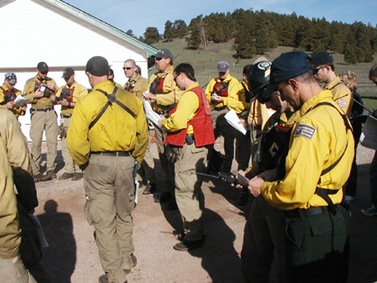
Ensuring Resources are Ready for Assignment
Brief all Personnel
Brief assigned personnel fully about the mission.
Determine status of assigned resources.
Inform resources of assigned radio frequency (ies).

Slide 6
Ensuring Resources are Ready for Assignment
Document
Ask questions and take written notes.
Maintain a current Activity Log.

Slide 7
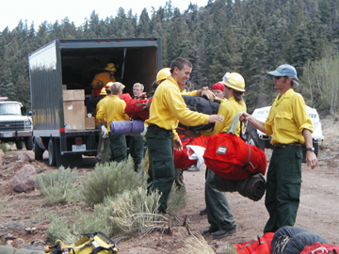
Ensuring Resources are Ready for Assignment
Ensure tools and equipment are appropriate for assignment
Daily readiness

Slide 8
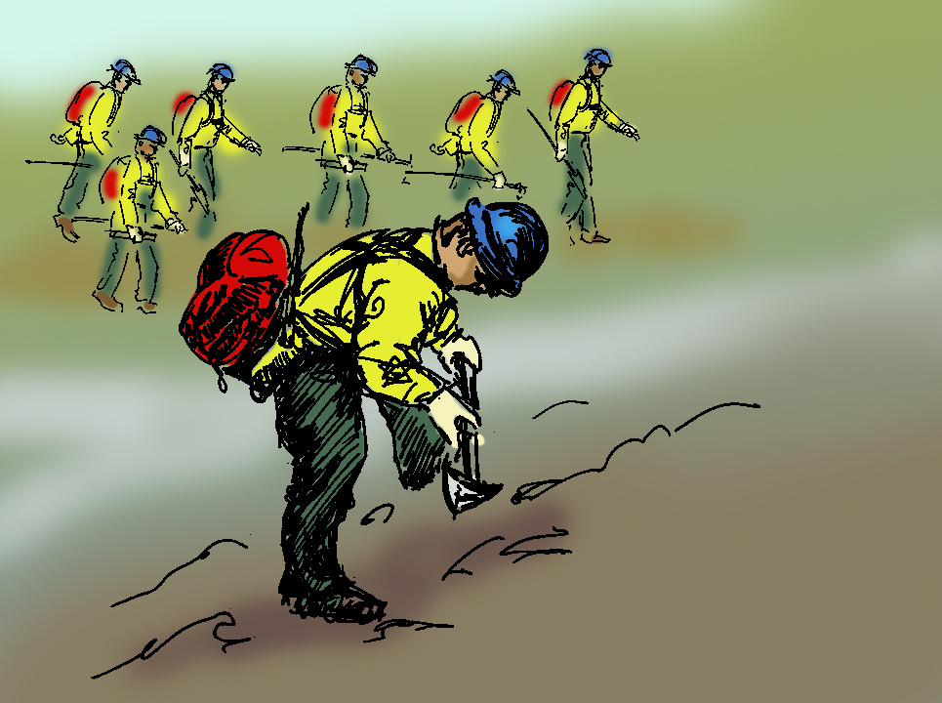
Marre Update- Pre-Engagement Briefing

Slide 9
Exercise - Pre-Engagement Briefing
Please click on video window to play.

Slide 10
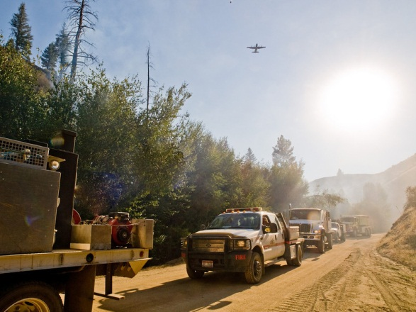
Transportation to and from Assigned Area
Meet time objectives.
Safe and adequate transportation for all assigned resources.
Adequate transportation for all equipment and supplies.

Slide 11
Transportation to and from Assigned Area
Resources are briefed on procedures for method of travel.
All assigned vehicles fully equipped and ready to go.
All equipment has been inspected and is under rental or cooperative agreement, if required.

Slide 12
Coordination
Coordination is extremely important and is required during all stages of the incident to meet safety, tactical, logistical, and administrative needs.
Cooperation is important as all functional groups work together to meet incident objectives.

Slide 13
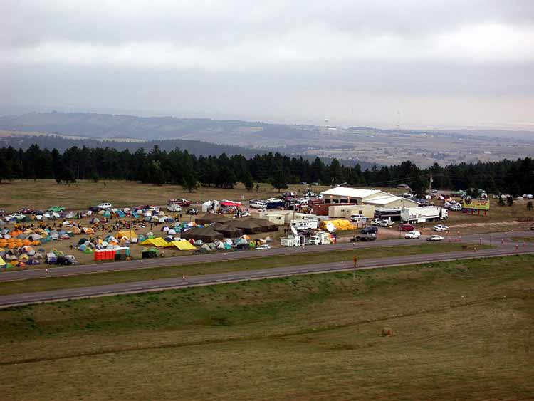
Marre ICS Coordination Exercise
Based on the events you have experienced up until now, what interactions will you have with the five ICS functional areas?

Slide 14
Review Unit 2 Objectives
Discuss sources of information to develop incident situation awareness.
Identify the actions necessary to ensure assigned resources are fully equipped and prepared for assignment.
Identify the elements of a pre-engagement briefing.

