Slide 1
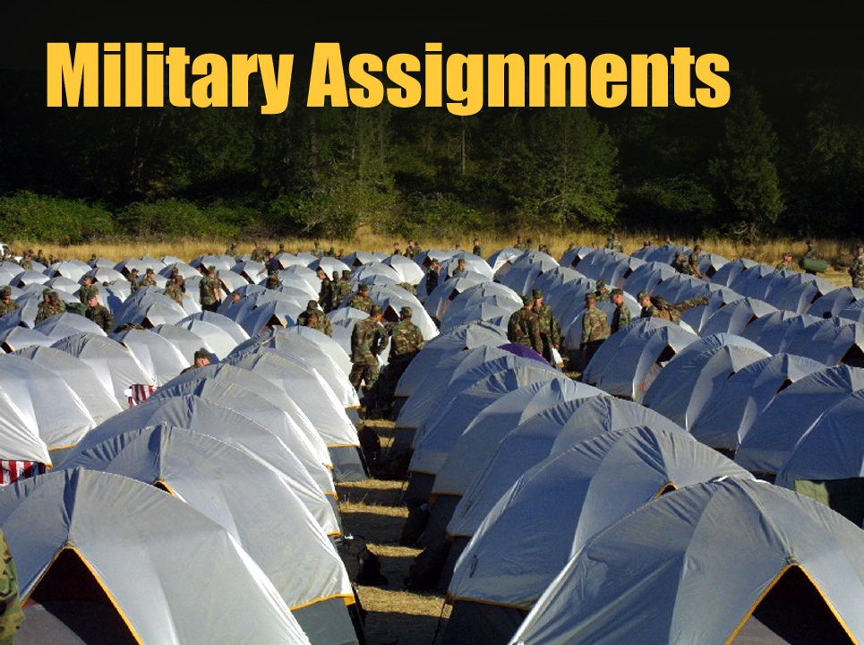
Unit 7

Slide 2
Unit 7 Objectives
Identify considerations when assigned as a Strike Team Leader/Military (STLM) or Military Crew Advisor (MCAD).
Define military organization and assigned military counterparts that a STL may interact with during a military assignment.

Slide 3
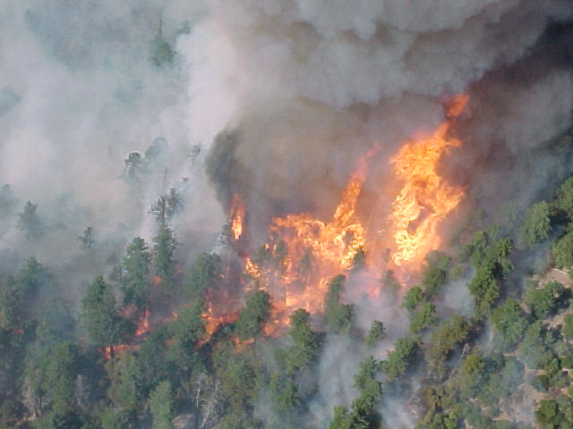
Introduction
Military Assistance at National Preparedness Level 5

Slide 4
Position Requirements
Strike Team Leader: Crew (STLC)
Military Crew Advisors (MCAD) function at a level similar to single resource boss crew, but due to the complexities of military coordination a higher level of training is required.
Prior military deployment experience or military background is useful, but not required.

Slide 5
Position Requirements
Strong leadership and communication skills, a good understanding of human factors and the ability to coordinate with a military command structure are essential.
Experience in delivering basic wildland fire training and mentoring fireline skills.

Slide 6
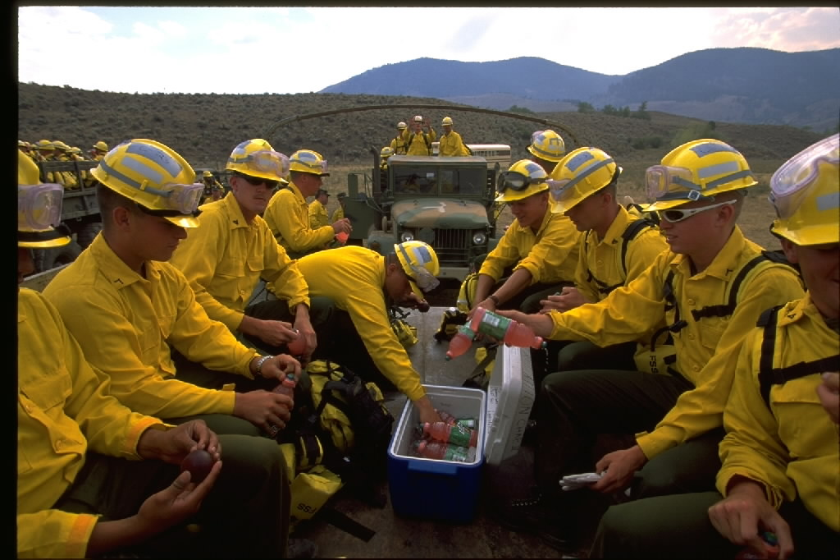
Position Requirements
Arduous Fitness Level
Individual and Agency must commit to minimum 30-day assignment.

Slide 7
Equipment Requirements
Line Gear and PPE
Tent, sleeping bag, red bag.
Programmable hand-held radio (if available).
Personal gear for extended assignment.

Slide 8
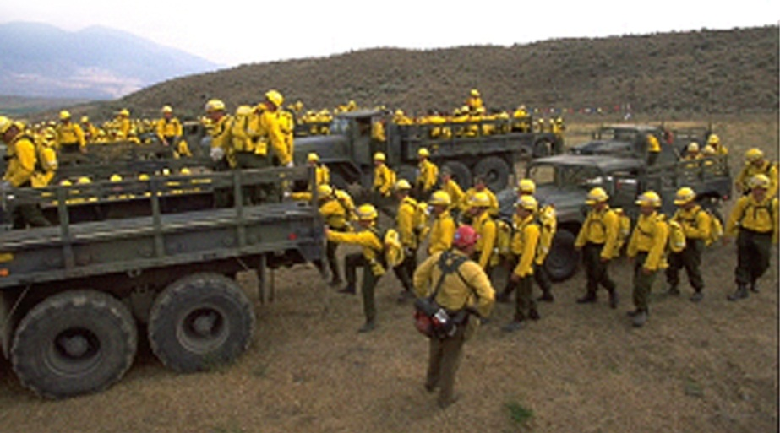
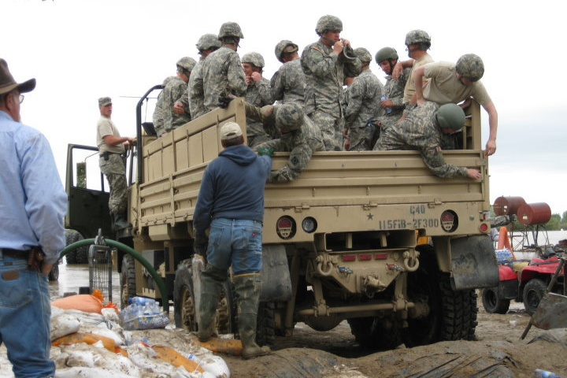
Military Structure for Mobilizations
Battalions: 500 plus people
Companies: 100 plus people (5 crews each)
Crews: 20 people (platoons are divided into crews)

Slide 9
Organization: Integrated into our Command Structure
S-1: Finance
S-2: Plans
S-3: Operations
S-4: Logistics

Slide 10
Military Chain of Command
Commissioned Officers:
Second Lieutenant, First Lieutenant, Captain, Major, Lt. Colonel, Colonel, and Generals.
Attended Officer Candidate School and College
They are saluted, called sir, and shown respect.
Personal interaction with enlisted ranks is limited.

Slide 11
Military Chain of Command
Non-Commissioned Officers (NCOs):
Corporals, Technical Specialists, Sergeants, and above.
Attended leadership training, and have experience.
Ensures actions are taken and accomplished.

Slide 12
Our Chain of Command BNML: Battalion Military Liaison:
Counterpart to Battalion Commanding Officer (CO): Lt. Colonel
Coordinates Operational and Support functions
Supervises STLMs
Liaison between the IMT and the Military Command Structure.
Some of these responsibilities may be delegated to a deputy.

Slide 13
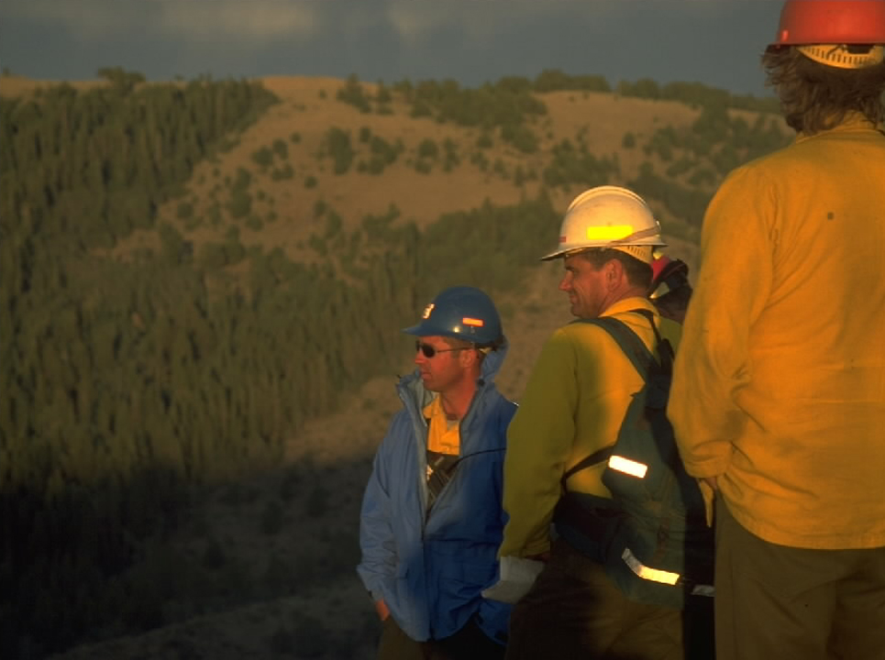
Our Chain of Command STLM: Strike Team Leader Military:
Counterpart to Company or Battery Commander: Captain
Supervises MCADs

Slide 14
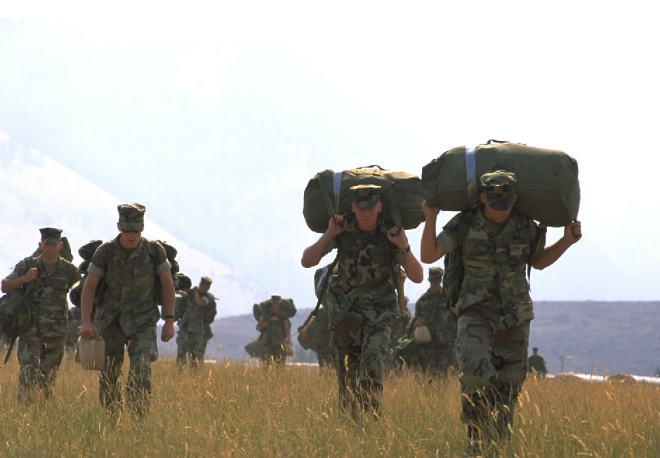
MCAD: Military Crew Advisor
Counterpart to Military Crew Leaders: Lieutenant
Coordinates crew needs

Slide 15
Our Role
Coordinate the Incident Command System with the military.
Use appropriate chain of command.
Train Military personnel to function in a wildland fire environment.
Provide for safety above all.

Slide 16
Our Role
Assume authority when critical safety issues arise.
Ensure quality briefings are provided.
Maintain close contact with our counterparts at all times. This is critical!

Slide 17
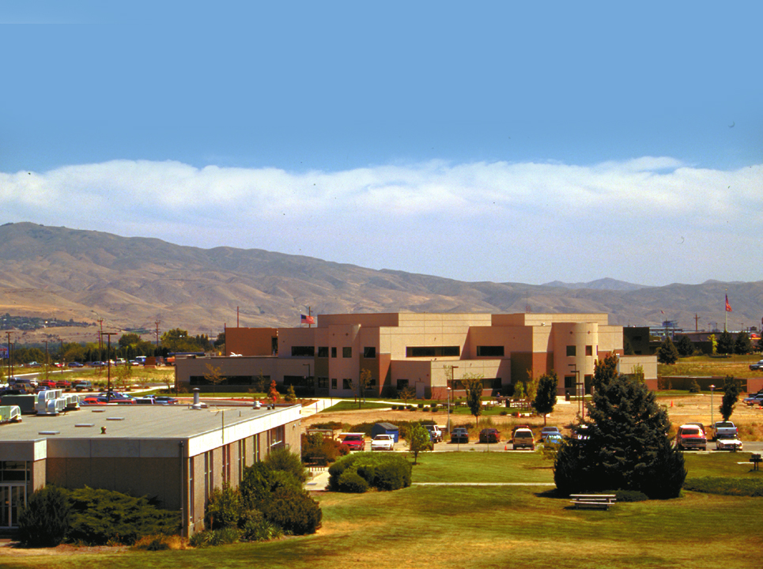
Travel to NIFC
Assemble the military support group:
BNML
Deputy BNML
5 STLMs
25 MCADs

Slide 18
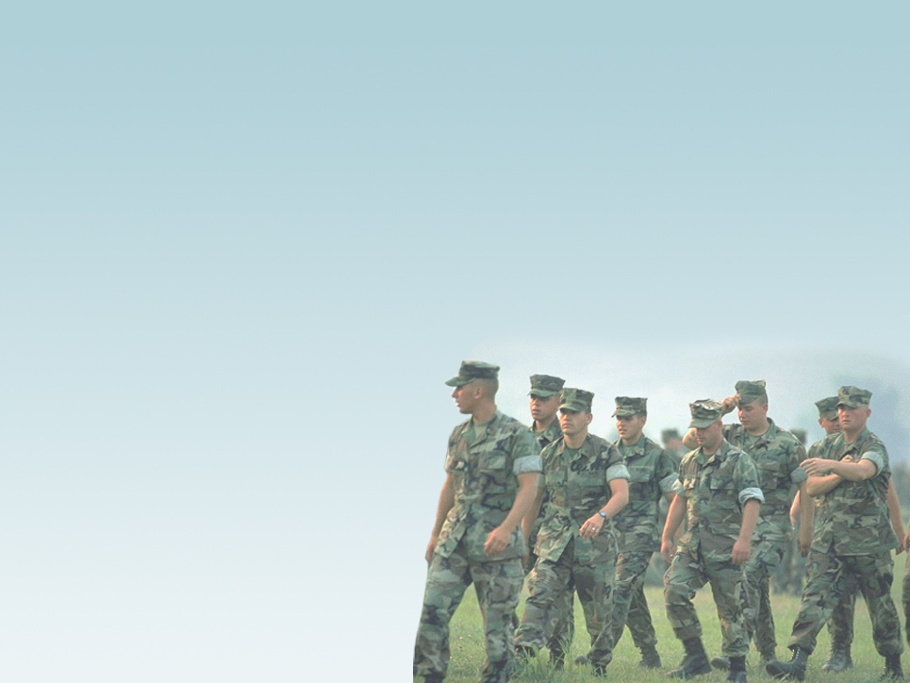
Travel to NIFC
BNML will brief the group to establish expectations, priorities, and protocols.
STLMs: usually people with prior military mobilizations or experience higher qualifications than the position requires.
MCADs: five work for each STLM.
Obtain needed supplies.

Slide 19
Travel to Military Installation
Advance party completes political and administrative requirements:
Logistics: Firefighting gear delivered to the battalion ready to be issued prior to training.
Training: Cadre prepared with training material.
Finance: Coordinate per prior agreements.

Slide 20
Travel to Military Installation
Travel via charter or civilian aircraft, housing off or on base.
Join up with counterparts: a formal process at formations.

Slide 21
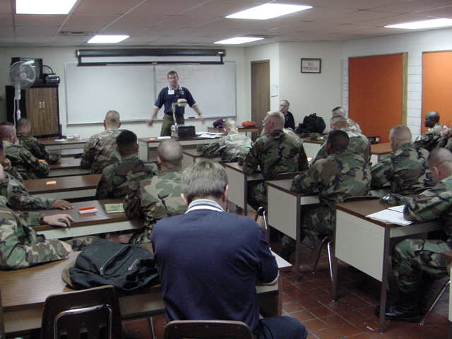
Classroom Training
One five-hour session, presented twice.
Condensed version of S-130, S-190, I-100, with emphasis on ICS, fire terminology, fire behavior, and safety.

Slide 22
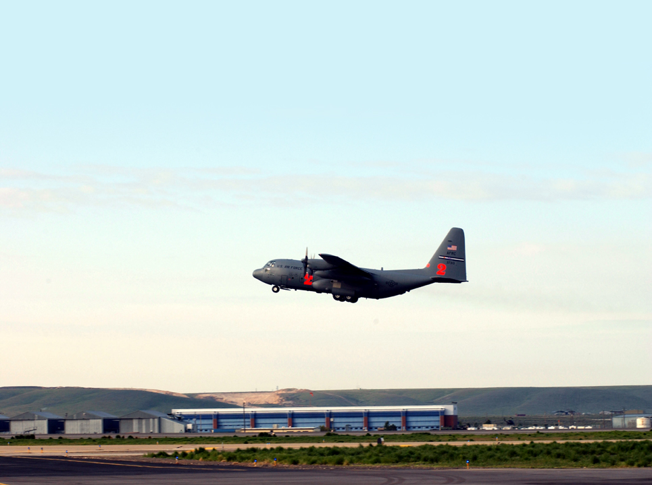
Travel to Incident
Military or charter flight with Battalion.
Organize camp.
Military in their own area.
STLMs and MCADs in close proximity.
Briefings, briefings, and more briefings.
Information exchange will be two way.

Slide 23
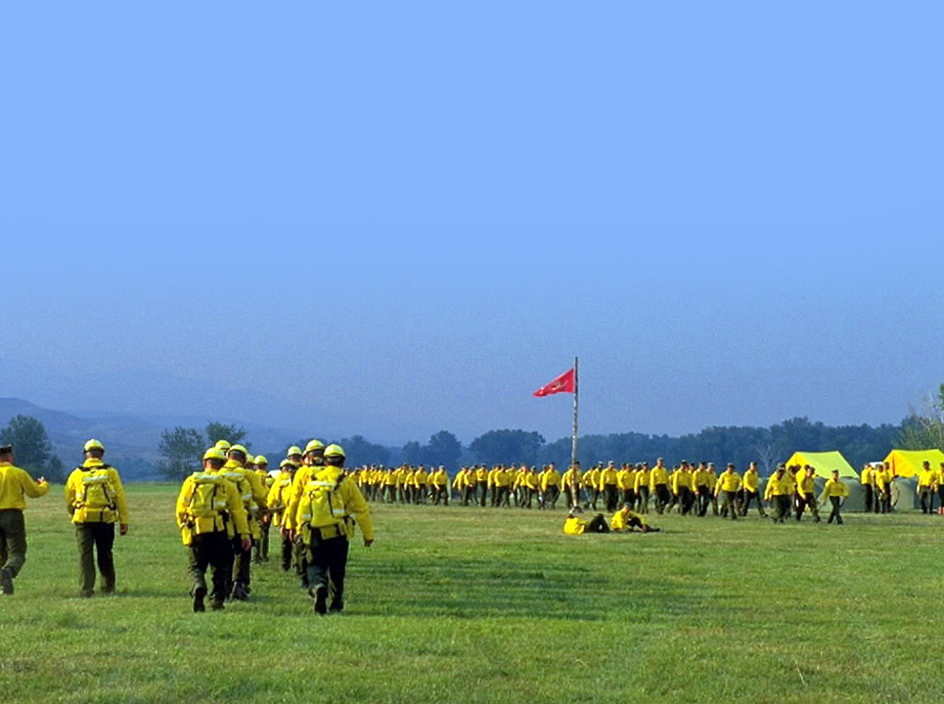
At the Incident
Field training is normally two days.
It is the responsibility of the MCAD, STLM, and BNML to certify and document that military crews are ready for assignment.

Slide 24
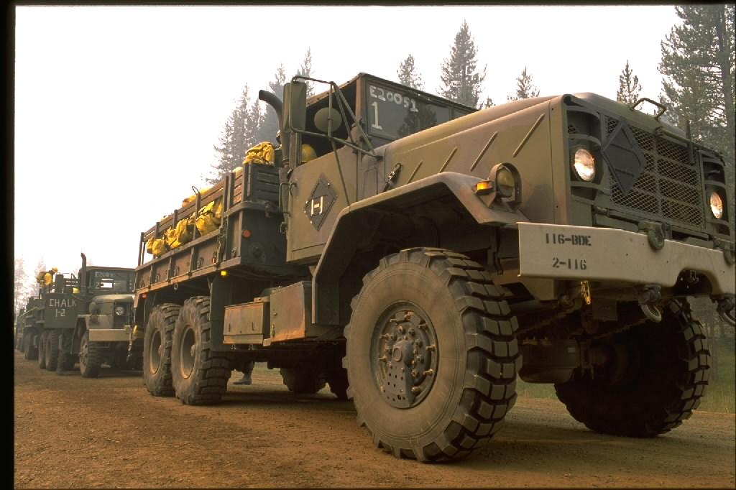
At the Incident
Chain saw training coordinated by BNML.
Type 1 Team assigned and the military will be integrated into the organization. The military will participate in strategy, planning meetings, etc.

Slide 25
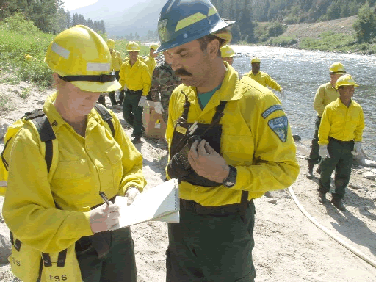
Military Crews are Considered Type 2
Provide meaningful assignments. Crews are normally capable of much more than mop-up after working together for a period of time.
Spiking out: some units are willing to participate.

Slide 26
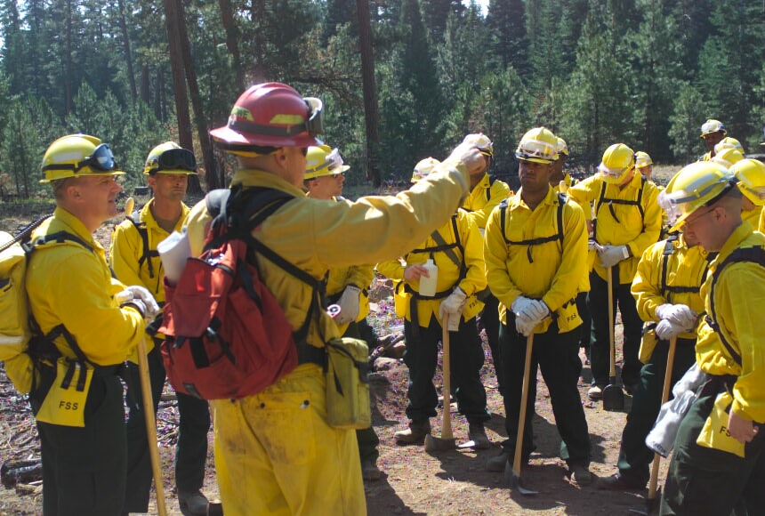
Military Crews are Considered Type 2
Coordinate with Division Supervisors. After troops have experience they will take a more direct role in their own supervision but you must maintain close contact.

Slide 27
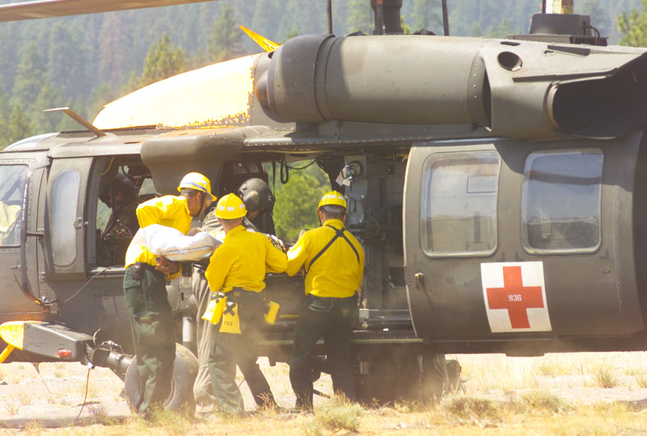
Military Crews are Considered Type 2
Military will normally have medics with the crews.
Military may provide support vehicles and aircraft when allowed by the incident.

Slide 28
Demobilization
Ceremonies will normally be held to thank the Military Advisors.
Military fire gear will be collected.
Advisors will demob through the normal process.
Evaluations will be completed by STLMs and BNMLs.

Slide 29
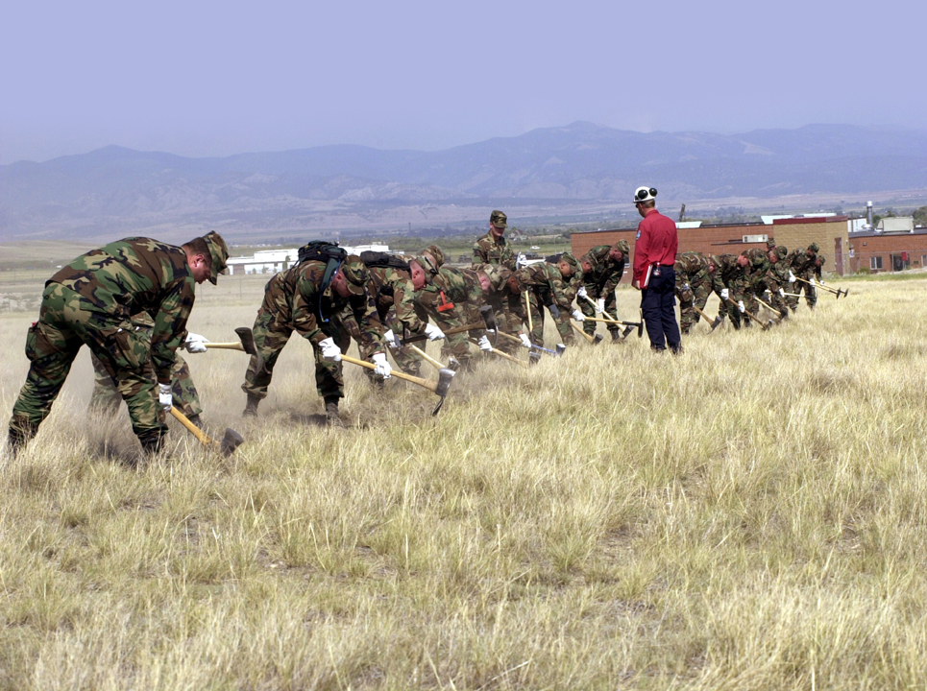
Military Operations Exercise

Slide 30
Review Unit 7 Objectives
Identify considerations when assigned as a Strike Team Leader/Military (STLM) or Military Crew Advisor (MCAD).
Define military organization and assigned military counterparts that a STL may interact with during a military assignment.

