Slide 1
Unit 5 Interaction
DIVISION/GROUP SUPERVISOR
Unit 2 – Interactions
Slide 5-1

Slide 2
Unit 5 Objective
Discuss the interactions with the command and general staff and other ICS functional areas that are required to perform the DIVS’s job.

Slide 3
An important task of the DIVS is interaction with:
Other positions within the operations section
Other sections in the incident organization
The command staff

Slide 4
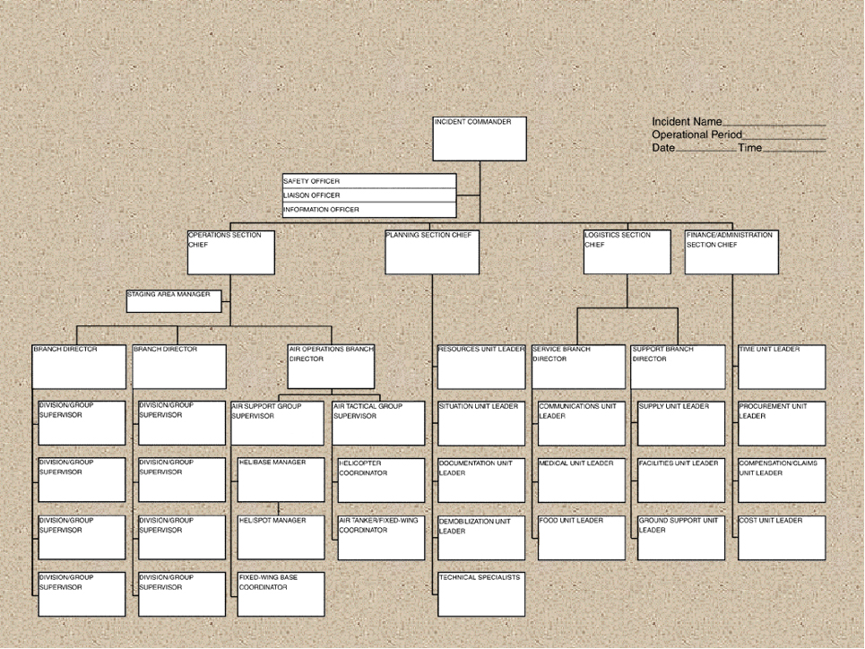
Panel Introductions
DIVISION/GROUP SUPERVISOR
Unit 2 – Interactions
Slide 5-4

Slide 5
Review Unit 5 Objective
Discuss the interactions with the command and general staff and other ICS functional areas that are required to perform the Division/Group Supervisor’s job.

