Slide 1
S-390
Unit 2 – Lesson A
Atmospheric Stability

Slide 2
Objectives
1. Define stable and unstable conditions using lapse rates.
2. Assess the effects of stability or instability on wildland fires.
3. Identify measures of stability and describe how they are computed.
4. Estimate atmospheric stability and probable fire behavior based upon identification of visual indicators.

Slide 3
Stability
The degree to which vertical motion in the atmosphere is enhanced or suppressed.
Wind
Stability

Slide 4
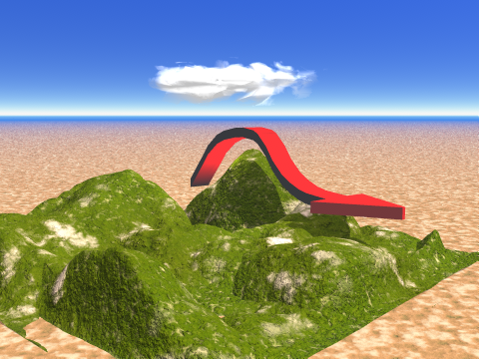
Stable Atmosphere
Vertical motion is suppressed
Air displaced up or down will tend to return to its original level

Slide 5
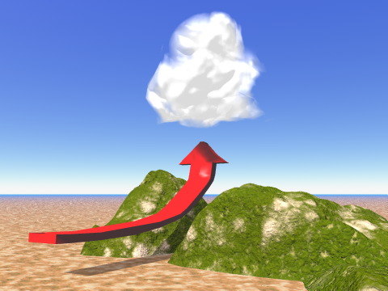
Unstable Atmosphere
Vertical motion is enhanced
Air displaced up or down will tend to continue moving in the direction of displacement

Slide 6
Stability
Related to buoyancy, or the tendency or capacity of air to rise.
Stability is relative – there are degrees of stability and instability.
The atmosphere is composed of layers of differing stability.
Can be defined by temperature lapse rate.

Slide 7
Lapse Rate:
The change in
temperature with altitude
Change in Temperature
Change in Altitude
Lapse rate is used to determine atmospheric stability.

Slide 8
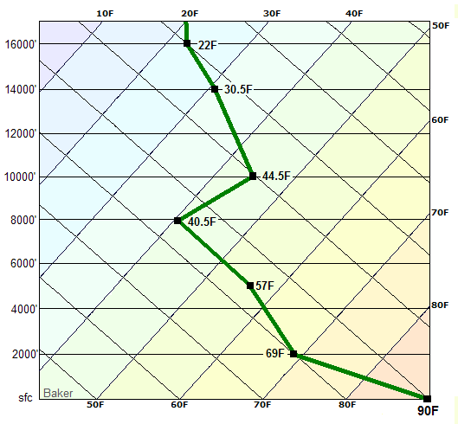
Environmental Lapse Rate
Actual or measured.
Ranges from +/- 15°F per 1000 ft.
Often multiple layers with different lapse rates.
Lapse rates change as layers move up (cool) and down (warm).
Global average is 3.5°F per 1000 ft.

Slide 9
Adiabatic Lapse Rate
Temperature change with altitude of rising or sinking air caused purely by expansion or compression due to changing pressure.
Dry (Adiabatic) Lapse Rate: 5.5° F per 1000 ft. Unsaturated air will cool at this rate as it rises. Rising air cannot cool more rapidly than this.
Moist (Adiabatic) Lapse Rate: 3° F per 1000 ft. Saturated air will cool more slowly at this rate as it rises. This is due to heat released from condensation.

Slide 10
Lapse Rate and Stability
Dry lapse rate is the benchmark for determining stability. Air rising from the lower atmosphere when wildland fire is a concern generally cools at this rate.
  - If the environmental lapse rate is > 5.5° F per 1000 ft, the atmosphere is unstable.
  - If the environmental lapse rate is < 5.5° F per 1000 ft, the atmosphere is stable.
  - If the environmental lapse rate is = 5.5° F per 1000 ft, the atmosphere is neutral.

Slide 11
Lapse Rate and Stability
3.5° F / 1000 ft. (Average)
5.5° F / 1000 ft. (Dry)
3.0° F / 1000 ft. (Moist)
Neutral
Height
<5.5° F / 1000 ft. (STABLE)
>5.5° F / 1000 ft. (UNSTABLE)
1,000 ft.
Temperature

Slide 12
Lapse Rate and Stability
5.5° F / 1000 ft. (Dry)
Lapse rate and stability are related to the slope and orientation of the environmental temperature line.
Superheated Ground
(Unstable)
<5.5° F / 1000 ft. (Stable)
Height
Inversion
(Very Stable)
>5.5° F / 1000 ft. (Unstable)
1,000 ft.
Temperature

Slide 13
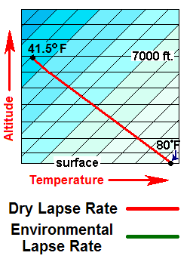
Lapse Rate and Stability
Dry Lapse Rate is the Stability Benchmark
Lapse rate > 5.5° F per 1000 feet
Lapse rate < 5.5° F per 1000 feet
Lapse rate = 5.5° F per 1000 feet
UNSTABLE
STABLE
NEUTRAL

Slide 14
Lapse Rate and Stability
-4.3º/1000 feet
6th Layer = Stable
-3.5º/1000 feet
5th Layer = Stable
+2.0º/1000 feet
4th Layer = Very Stable
-5.5º/1000 feet
3rd Layer = Neutral
-4.0º/1000 feet
2nd Layer = Stable
-10.5º/1000 feet
1st Layer = Unstable

Slide 15
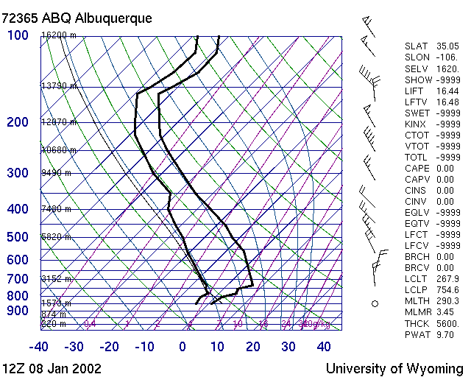
STABLE
UNSTABLE

Slide 16
Stability and the Wildland Fire Environment
Relationship to General Weather
Pressure
  - High Pressure ➔Stable
  - Low Pressure ➔Unstable
Vertical Motion
  - Sinking ➔Stable
  - Lifting ➔Unstable

Slide 17
Stability and the Wildland Fire Environment
Relationship to General Weather
Winds
  - Steady ➔Stable
  - Gusty, Erratic ➔Unstable
Temperature
  - Surface Cooling / Heating Aloft ➔Stable
  - Surface Heating / Cooling Aloft ➔Unstable

Slide 18
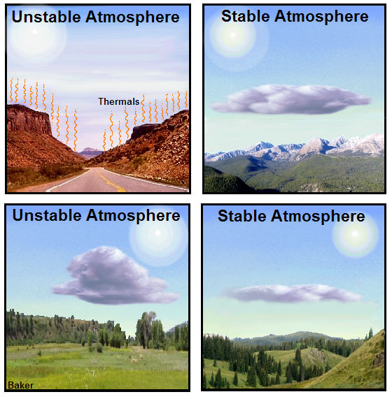
Four Ways
To Change
Atmospheric
Stability
Heating from
below
Cooling from
below
Heating from below and/or cooling aloft will produce an
unstable atmosphere.
Cooling aloft
Warming aloft
Cooling from below
and/or warming aloft will produce a
stable
atmosphere.

Slide 19
Effects of Surface Heating and Cooling on Lapse Rate and Stability
After Cooling the Ground
(Stable)
5.5° F / 1000 ft. (Dry)
After Heating the Ground
(Unstable)
<5.5° F / 1000 ft. (Stable)
Height
>5.5° F / 1000 ft. (Unstable)
1,000 ft.
Temperature

Slide 20
Most Effective Way to Destabilize
Change slope of temperature line to increase lapse rate.
5.5° F / 1000 ft. (Dry)
Cooling Aloft (Upper level “disturbance”)
Height
Resulting VERY UNSTABLE lapse rate
1,000 ft.
Surface Heating (Sunshine)
Temperature

Slide 21
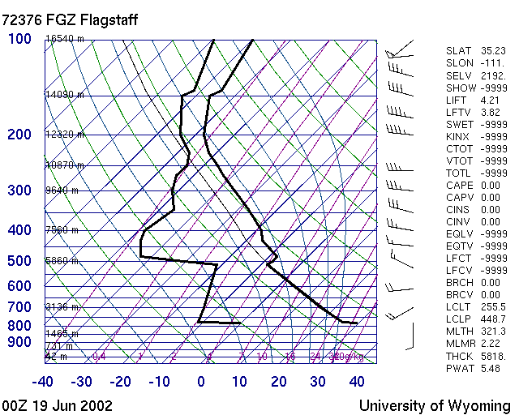
STABLE
UNSTABLE

Slide 22
Stability and the Wildland Fire Environment
Relationship to General Weather
  Topography
  - Affects stability by heating/cooling slopes.
  - Superheated, unstable air can be trapped in
  mountain valleys and release quickly.
  Relative Humidity
  - No direct relationship to stability.
  - May drop rapidly with breakup of morning
  inversion, especially in sheltered valley
  locations.

Slide 23
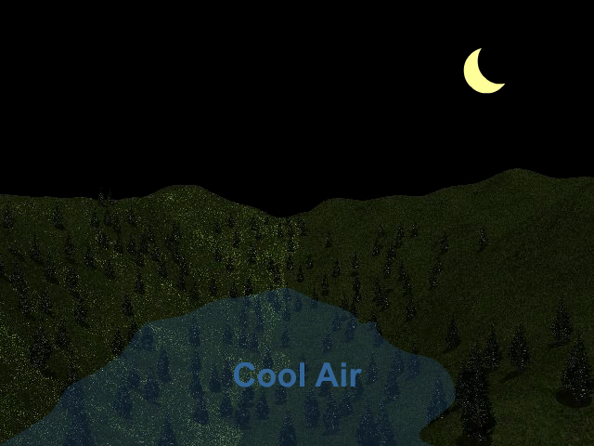
Rapid Inversion Breakup
Humidity can decrease and winds increase suddenly with release of superheated air beneath dissipating morning inversion.

Slide 24
Stability and the Wildland Fire Environment
Daily and Seasonal Changes
Stability in low levels of atmosphere directly related to surface temperature.
At night, stable conditions (surface inversion).
Daytime, most unstable during the hottest part of the day.
Abrupt transition from stable to unstable when inversion breaks.

Slide 25
Stability and the Wildland Fire Environment
Daily and Seasonal Changes
Seasonal changes in surface temperature, day length.
Winter generally more stable.
Summer more unstable.
Spring and Fall are more variable since they are transition periods.

Slide 26
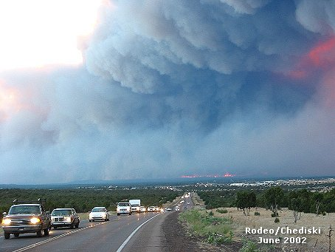
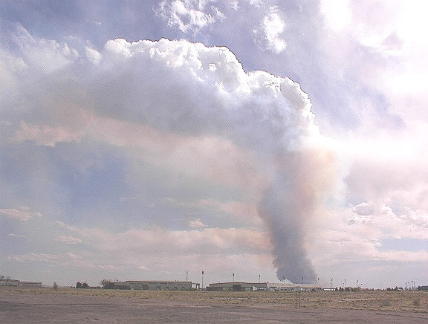
Stability and the Wildland Fire Environment
Effects on Fire Behavior
Unstable Atmosphere
  Strong potential for extreme fire behavior
  Good ventilation
  More complete fuel consumption

Slide 27
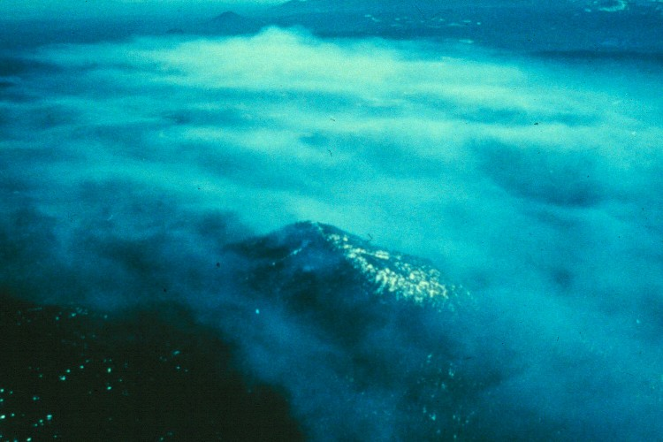
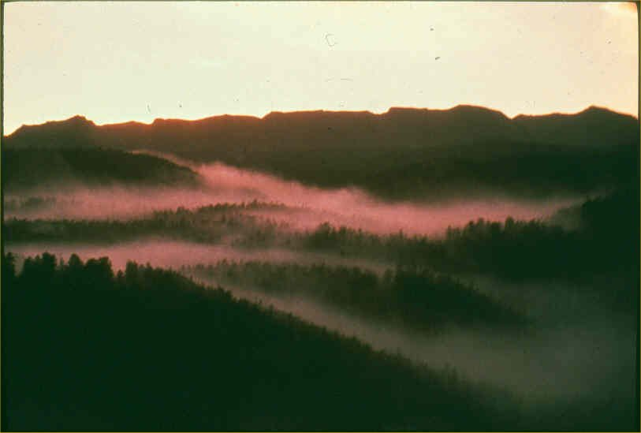
Stability and the Wildland Fire Environment
Effects on Fire Behavior
Stable Atmosphere
  Less potential for extreme fire behavior
  Poor ventilation
  Reduced ability to detect other fires

Slide 28
Measures of Stability
Indices used to assess fire behavior and/or smoke dispersion potential
  Davis Stability Index
  Haines Index
  Pasquill Stability Index
  Lavdas Dispersion Index
All attempt to quantify the impact of stability and other parameters.
All utilize lapse rate in one way or another.

Slide 29
Davis Stability Index
Looks at temperature lapse rate in the lowest 5000 ft. above ground level.
Correlates lapse rate to large (Class E or greater) fire occurrence looking at 70 fires in Alabama (most active fire behavior occurs when lapse rate > 5.5°F/1000 ft.).
Applicability limited because lapse rate > 5.5°F/1000 ft. occurs routinely below 5000 ft. AGL across most of the U.S. during the active fire season.
Used currently in portions of the southeast U.S.

Slide 30
Davis Stability Index
Davis Stability Index
Stability Class / Descriptor
Lapse Rate
% of Large Fires Occurring
1 – Stable
3.5°/1000 ft. or less
9 %
2 – Conditionally Unstable
3.5° - 5.4°/1000 ft.
21 %
3 – Unstable
5.5°/1000 ft.
21 %
4 – Absolutely Unstable
> 5.5°/1000 ft.
49 %

Slide 31
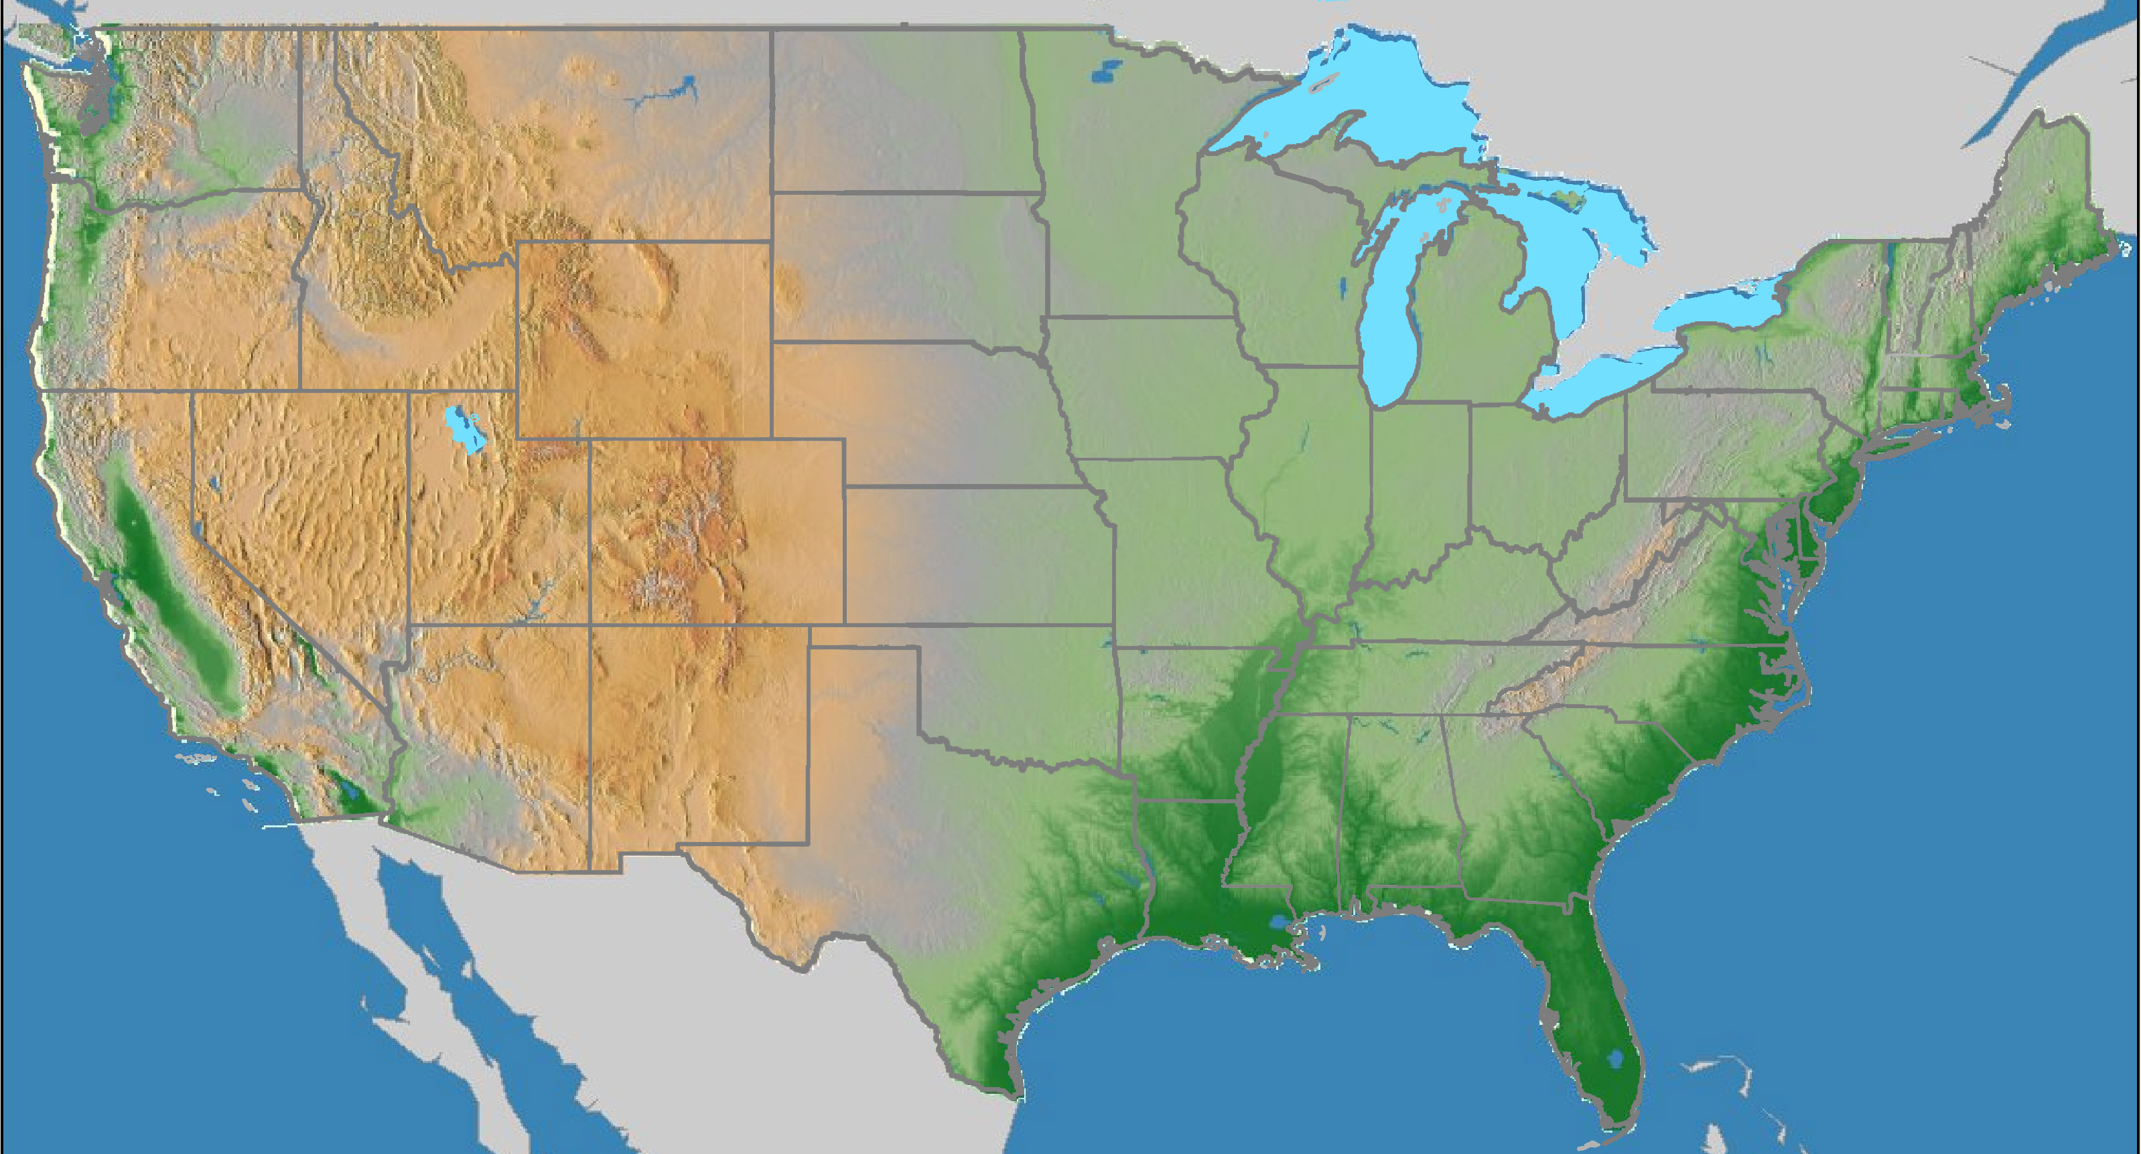
Haines Index
Looks at temperature difference and moisture in a layer of the atmosphere above the fire.
Three elevation layers
    Low
    Mid
    High
used to account for differing terrain across the country.

Slide 32
Haines Index
Correlates dryness and instability to “worse fire situations” on 74 fires across the country.
Has been shown to have application nationwide, though regional interpretation sometimes necessary.
Has been shown to relate to higher rates of spread, strong convection columns and extreme fire behavior on going fires.

Slide 33
Haines Index Calculation
Haines Index = Stability Term + Moisture Term
Stability Term
  Lapse rate of layer above fire
  Ranges from 1 to 3 (3 being most unstable)
Moisture Term
  Dew Point Depression Aloft
  Ranges from 1 to 3 (3 being driest)
Haines Index = 2 to 6
  Moist and stable = 2
  Dry and unstable = 6

Slide 34
Interpretation of Haines Index
(Stability + Moisture) | Potential for Large Fire Growth
2 or 3 | Very Low
4 | Low
5 | Moderate
6 | High

Slide 35
Pasquill Stability Index
Looks at combination of surface heating (solar radiation) and surface wind speed.
Surface heating based on solar radiation (latitude and time of year) and amount of cloud cover.
Used in smoke management (SASEM) as a quantifier of vertical dispersion potential.
Ranges from A (Very Unstable/Excellent Dispersion) to G (Moderately Stable/Poor Dispersion).
Dispersion and stability decrease as wind increases.
Lapse rate is inferred directly from the amount of incoming solar radiation.

Slide 36
Pasquill Stability Index
F G

Slide 37
Pasquill Stability Index

Slide 38
Lavdas Dispersion Index
More comprehensive index that involves stability, mixing height and transport winds.
Uses Pasquill Stability Index as an input, thus surface heating and surface wind speed are considered.
Quantifies combination of vertical and lateral dispersion, as opposed to just vertical with Pasquill.
Dispersion increases as transport wind increases.
Ranges from near zero to over 100.
Has been shown to have some correlation to large fire growth in Florida, especially with values over 80.
Lapse rate is included as part of the Pasquill Stability Index input.

Slide 39
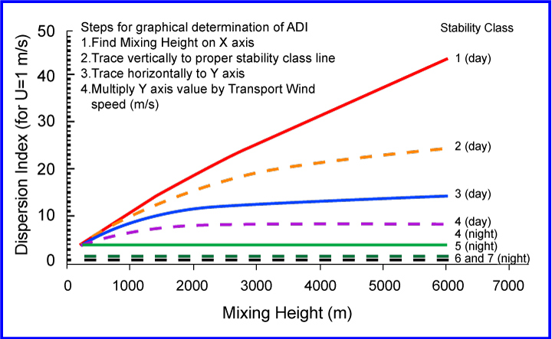
Lavdas Dispersion Index
Notes:
Build replacement graphic with same content

Slide 40
Lavdas Dispersion Index
Dispersion index | Interpretation
> 100 | Very good (but may indirectly indicate hazardous conditions; check fire weather)
61-100 | Good (typical-case burning weather values are in range)
41-60 | Generally good (Climatological afternoon values in most inland forested areas of the United states fall in this range
21-40 | Fair (Stagnation may be indicated if accompanied by persistent low wind speed)
13-20 | Generally poor; Stagnation if persistent (although better than average for a night value)
7-12 | Poor; stagnant at day (but near or above average at night)
1-6 | Very poor (very frequent at night; represents the majority of nights in many locations

Slide 41
Comparison of Indices
Index
Major Factors
Primary Utility
Davis
Lapse rate
Basic measure of stability
Haines
Lapse rate (layer temperature difference) and dryness
Large fire growth potential
Pasquill
Solar radiation, cloud cover and surface wind speed (surface based stability)
Smoke dispersion
Lavdas
Pasquill, mixing height, transport wind
Smoke dispersion (also shown to correlate to large fire growth in Florida)
Indices provide a way to quantify stability
No one index covers all the bases

Slide 42
Assessing Stability
Contact local fire weather forecaster
Visual indicators
Other sources
  Aircraft temperature profiles
  Lookouts, RAWS/NFDRS stations, fireline personnel
  Fireline Handbook, Appendix B
  Upper air soundings off Internet

Slide 43
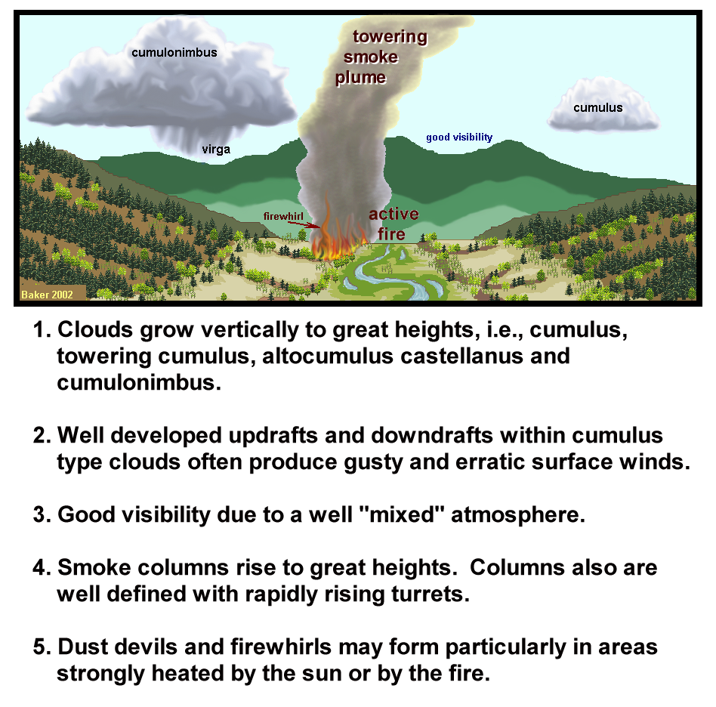
Visual
Indicators
of
Unstable Air

Slide 44
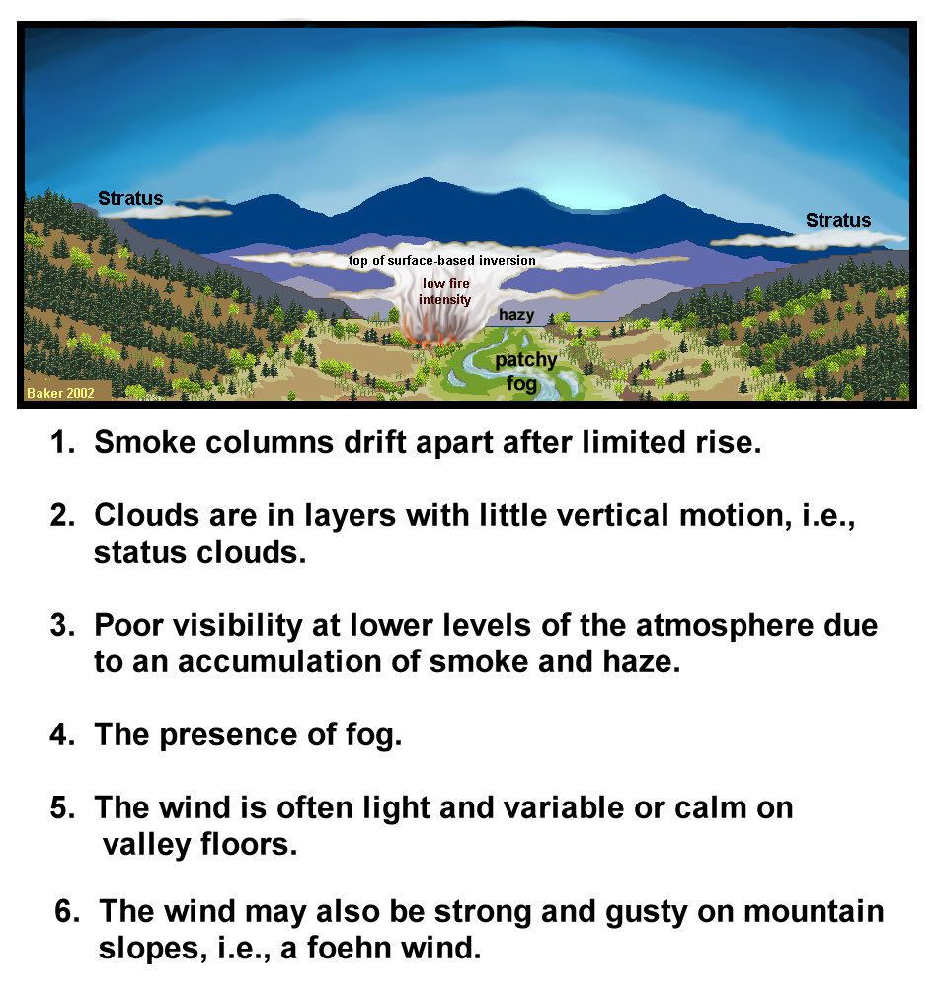
Visual
Indicators
of
Stable
Air

Slide 45
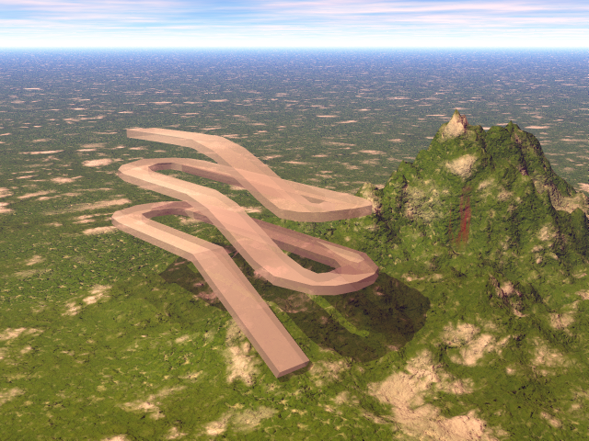
Assessing Stability
Other Sources – Aircraft
Temperature profiles can be obtained from aircraft and compared to the dry lapse rate.
70° F @ 7,500 ft. MSL
500 feet
73° F @ 7,000 ft. MSL

Slide 46
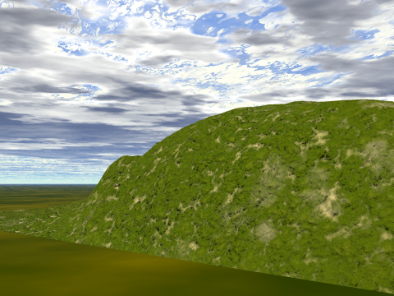
Assessing Stability
Other Sources – Fireline Observations
Compare the observed lapse rate to the dry lapse rate to estimate stability.
Observations must be taken on same aspect, at the same time and in similar fuels.
Best for assessing stability trends.
70° F @ 7,000 ft. MSL
80° F @ 5,000 ft. MSL

Slide 47
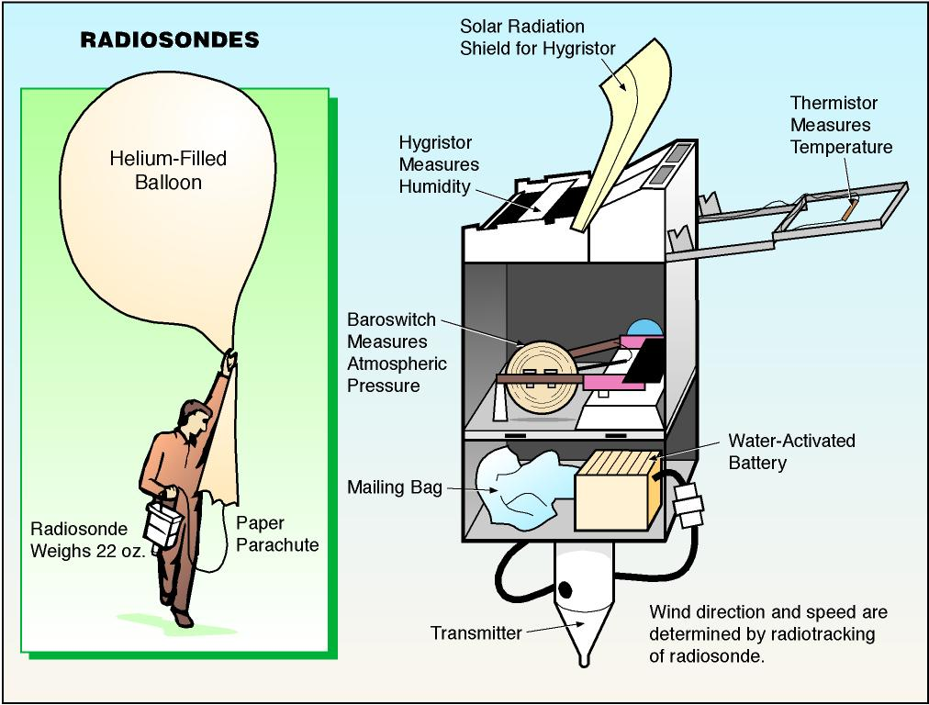
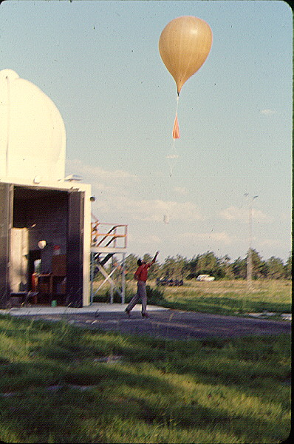
Assessing Stability
Other Sources – Radiosonde Network

Slide 48
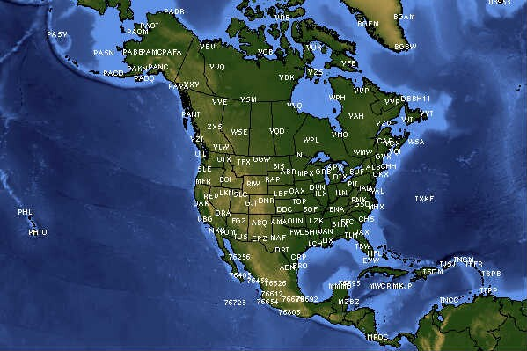
Assessing Stability
Other Sources – Radiosonde Network
http://weather.uwyo.edu/upperair/sounding.html

Slide 49
Review Exercise
Estimating Stability and Probable Fire Behavior Using Visual Indicators

Slide 50
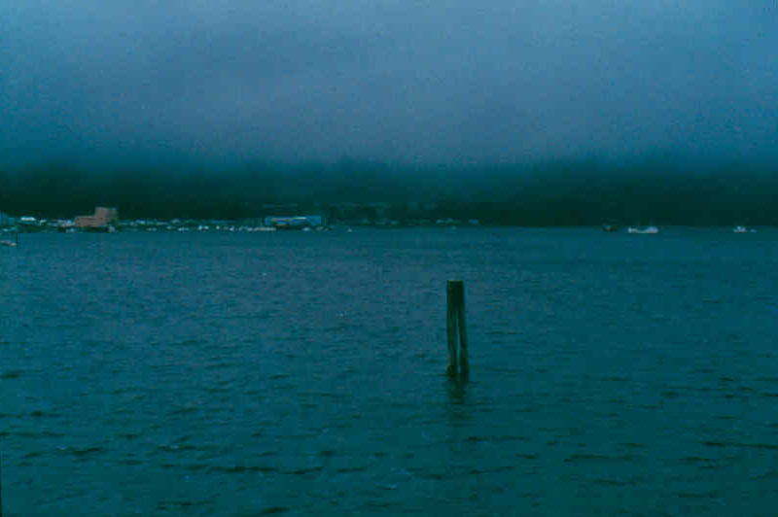
Stable or Unstable?

Slide 51
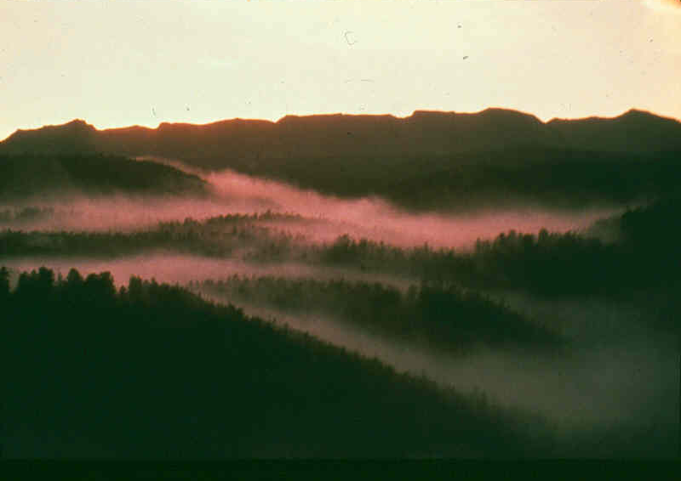
Stable or Unstable?

Slide 52
Stable or Unstable?

Slide 53
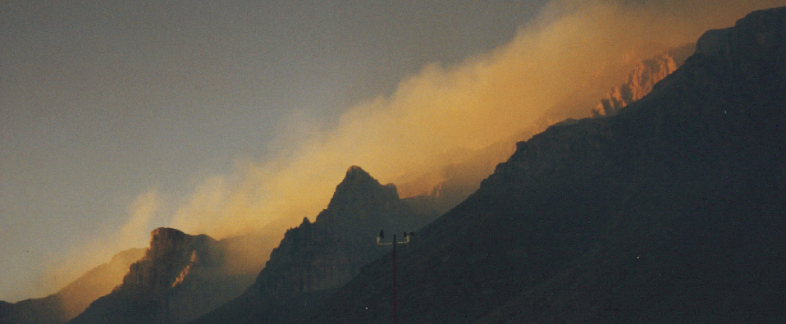
Stable or Unstable?

Slide 54
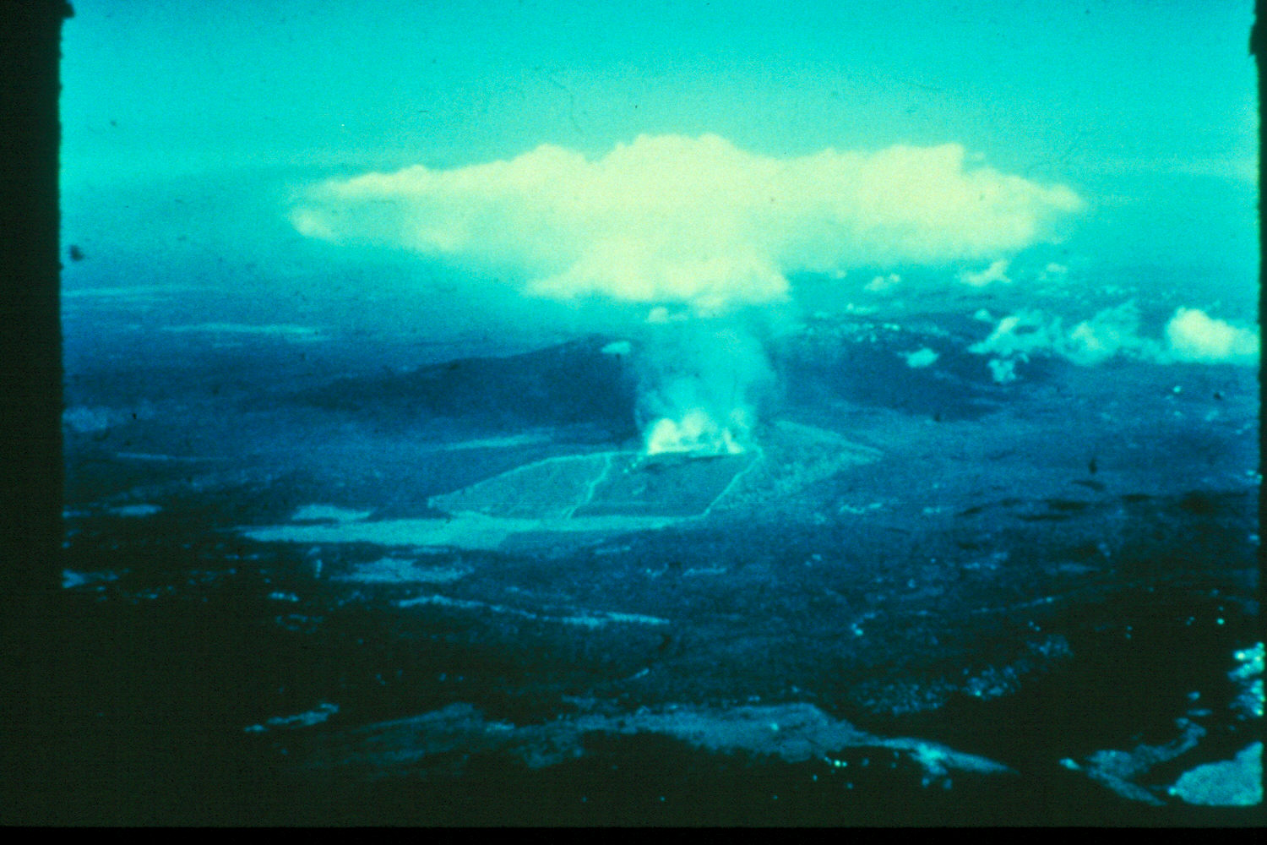
Stable or Unstable?

Slide 55
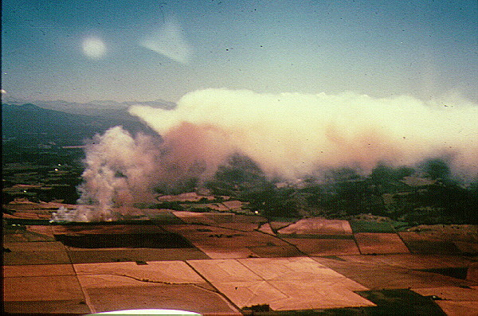
Stable or Unstable?

Slide 56
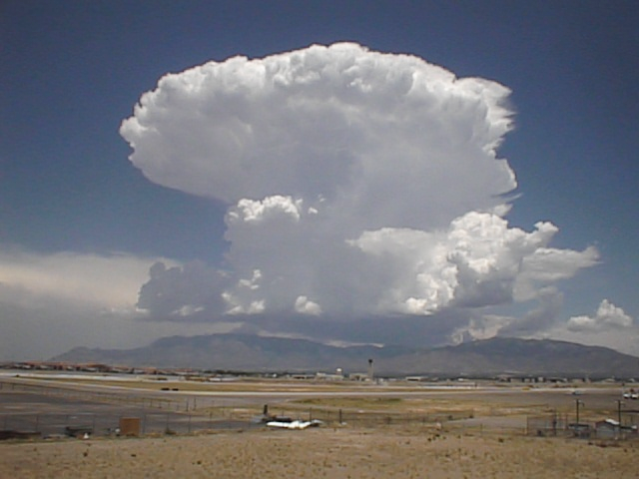
Stable or Unstable?

Slide 57
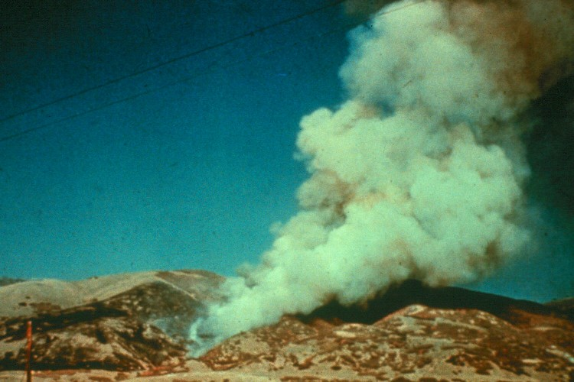
Stable or Unstable?

Slide 58
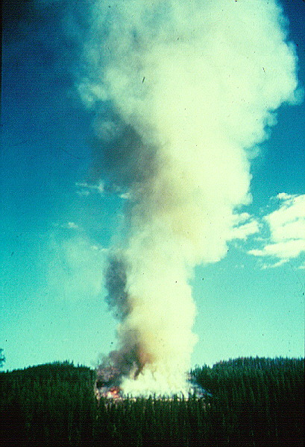
Stable or Unstable?

Slide 59
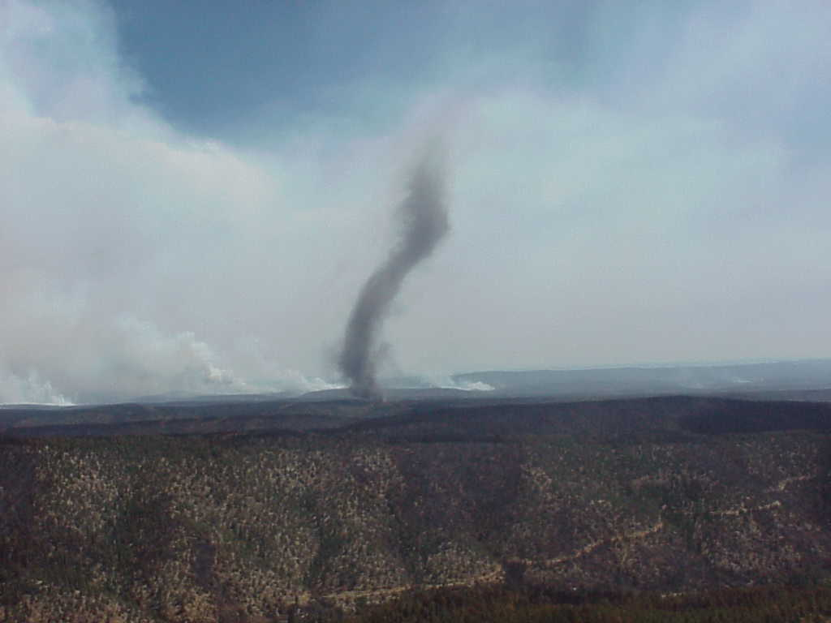
Stable or Unstable?

Slide 60
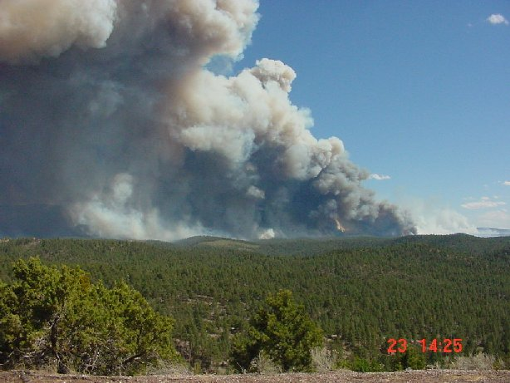
Stable or Unstable?

Slide 61
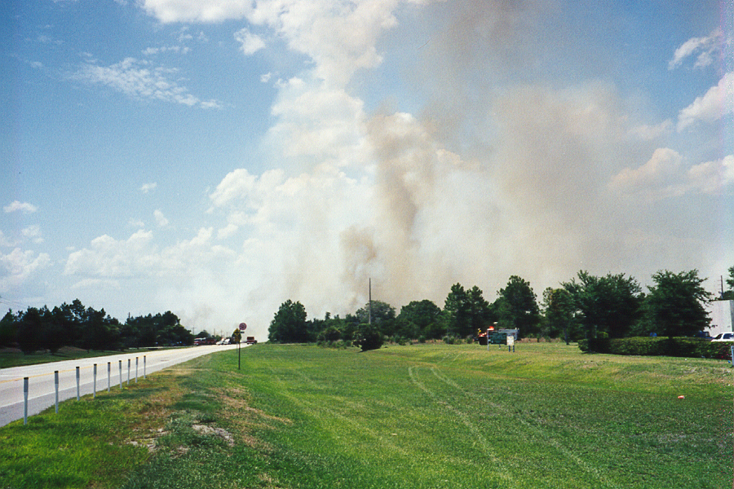
Stable or Unstable?

Slide 62
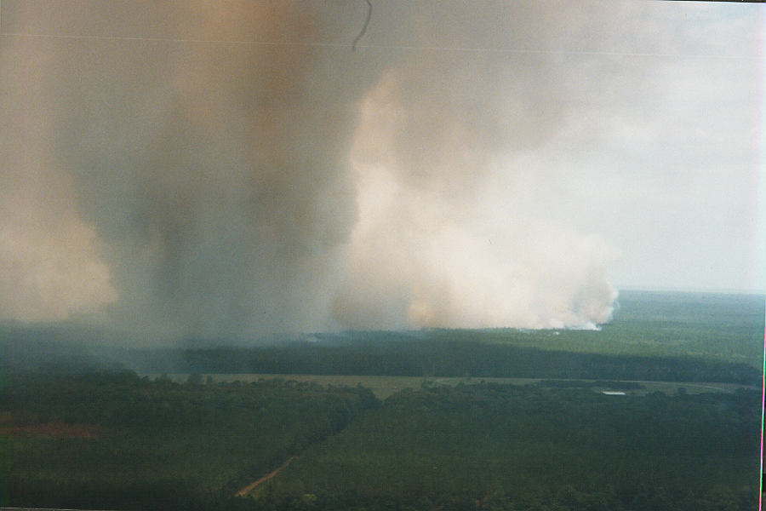
Stable or Unstable?

Slide 63
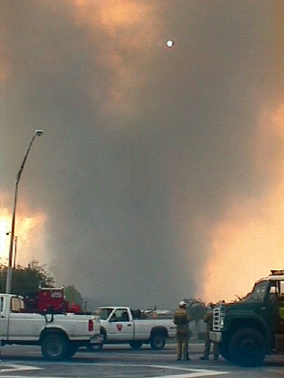
Stable or Unstable?

Slide 64
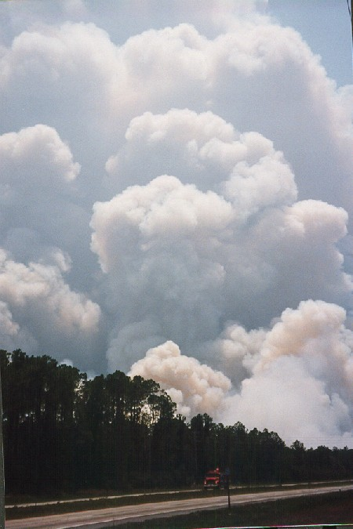
Stable or Unstable?

Slide 65
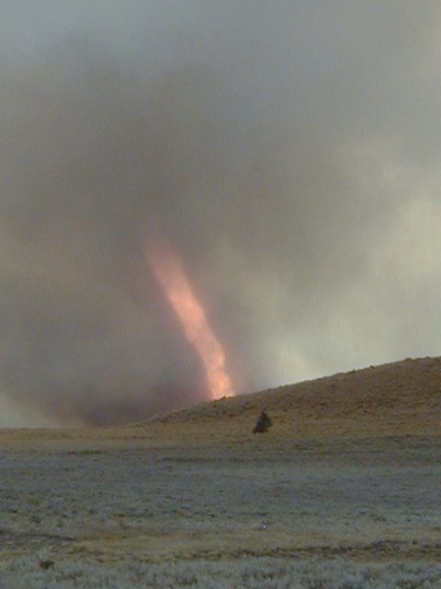
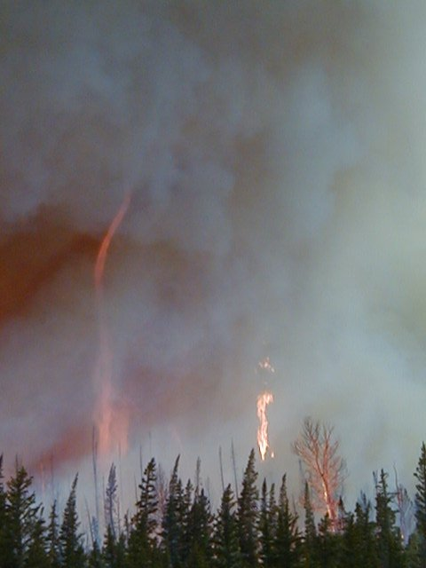
Stable or Unstable?

Slide 66
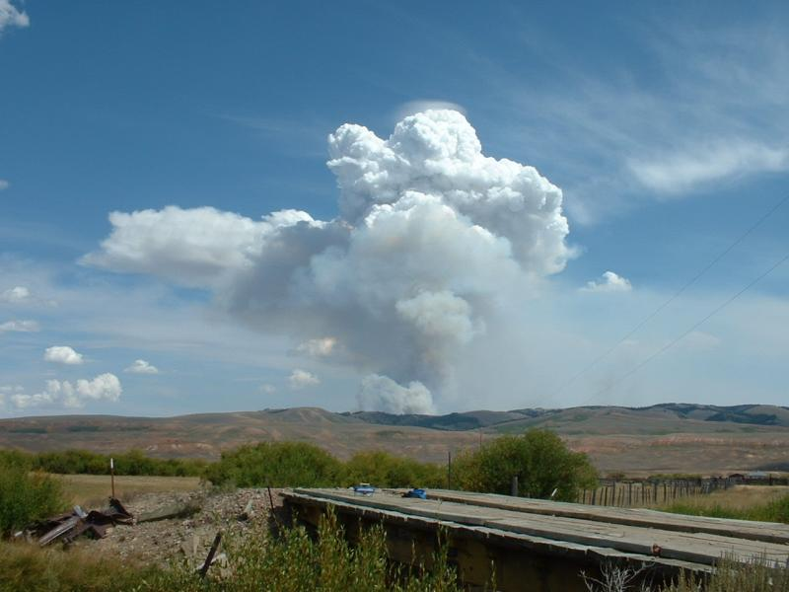
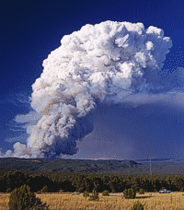
Stable or Unstable?

Slide 67
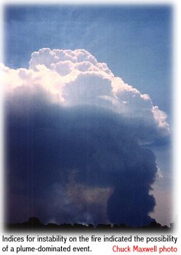
Stable or Unstable?

Slide 68
Stable or Unstable?

Slide 69
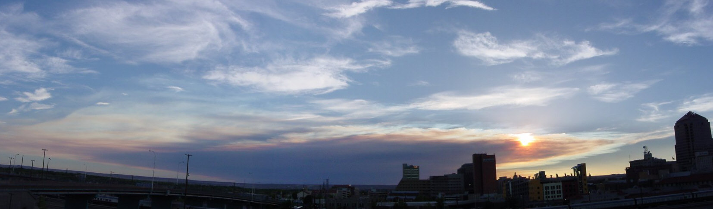
Stable or Unstable?

Slide 70
Wrap Up
Atmospheric stability can be defined using lapse rate (5.5°F/1000 ft. reference).
In the simplest sense, surface temperature determines lapse rate and the degree of instability.
Other factors besides surface temperature play a critical but less detectable role.
We use stability indices to attempt to quantify the complex factors of stability – all use lapse rate in one way or another.

Slide 71
Review Objectives
1. Define stable and unstable conditions using lapse rates.
2. Assess the effects of stability or instability on wildland fires.
3. Identify measures of stability and describe how they are computed.
4. Estimate atmospheric stability and probable fire behavior based upon identification of visual indicators.

