Slide 1
Medical Unit Considerations
Unit 5

Slide 2
Objectives
Identify roles and responsibilities
of the Medical Unit Leader (MEDL) and
Safety Officer.
Identify wildland fire medical resources.
Discuss common misconceptions about Emergency Medical Services (EMS) in wildland fire.
Discuss scope of practice and licensing.

Slide 3
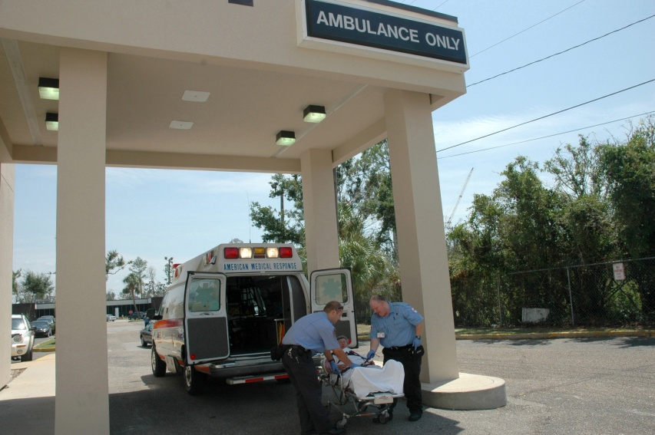
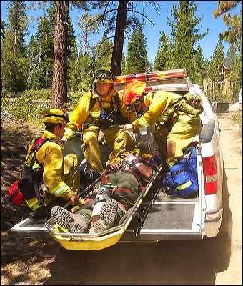
Introduction to
Medical Unit Considerations
There may be a different set of skills required for medical responders in an incident Medical Unit than for the typical 911 or other prehospital
short-term patient contact(s).

Slide 4
Introduction to Medical Unit Considerations
Two categories
  Medical Units
    Line-qualified EMTs
    Ambulance
    Medical facility
  Initial attack medical resources
    Type 3 Incident Management Organization

Slide 5
Introduction to Medical Unit Considerations
Key components of an effective Medical Unit include:
  Properly licensed personnel
  Sound protocols
  Establish communications
  Relationships with local medical resources

Slide 6
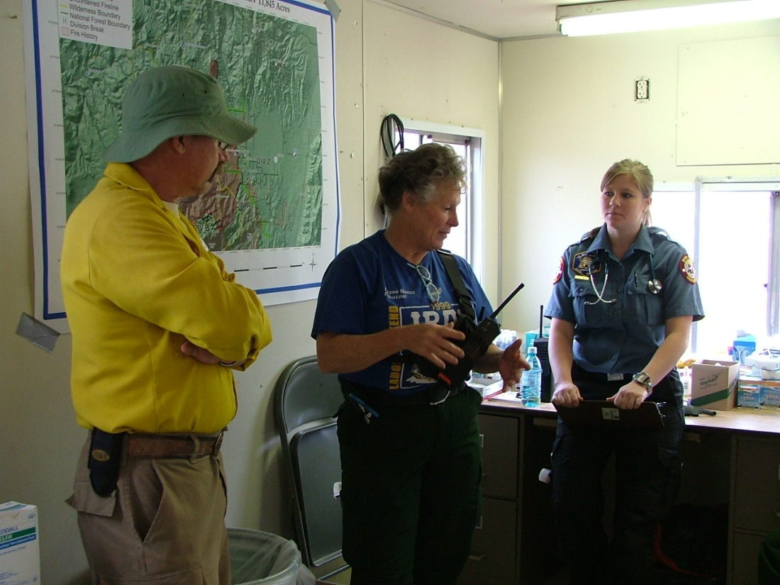

Interaction With the Medical Unit
Form a close working relationship with Medical Unit
personnel.
Click to hear MEDL procedures briefing.

Slide 7
Interaction With the Medical Unit
Medical Unit and Safety Officer interactions will include:
  Review and approve ICS 206 Medical Plan daily.
  Evaluate medical staffing.
  Review Medical Unit log.
  Review illness and injury documentation.
  Obtain daily briefings from MEDL.
Discussion Point

Slide 8
ICS 206 Medical Plan (top half)

Slide 9
ICS 206 Medical Plan
(bottom half)

Slide 10
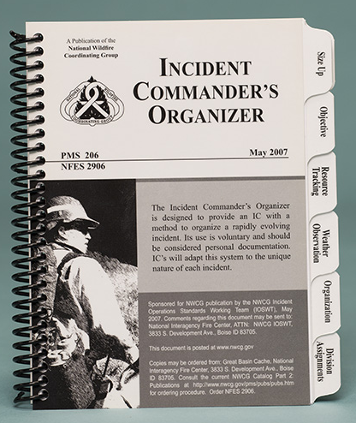
Incident Commander’s Organizer
Lower complexity
incident organizations
(Type 3) sometimes
use incident
organizers.

Slide 11
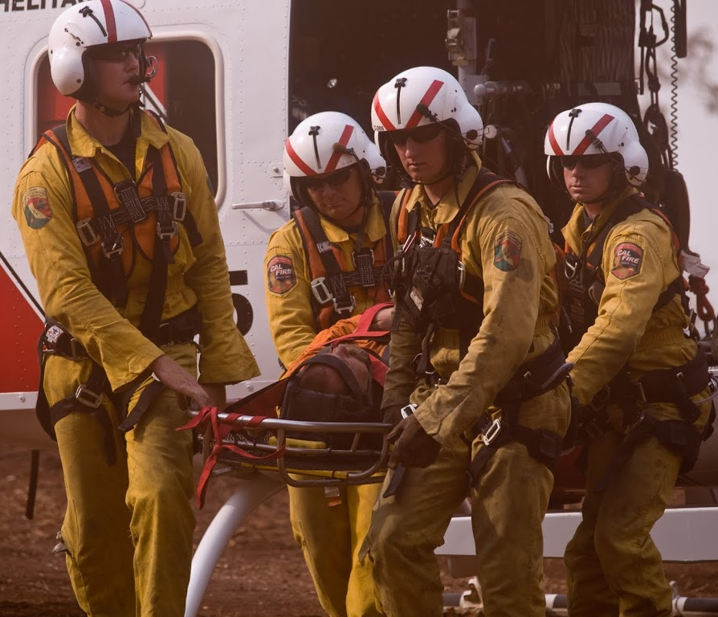
Air and Ground Medical Transport
Lengthy patient extraction time
Multiple patients
Terrain or road conditions
Distance or flight time
Discussion Point

Slide 12
Burn Injury Criteria
Know and understand the burn injury criteria
Outlined in Chapter 07 of the Interagency Standards for Fire and Fire Aviation Operations
NWCG memo, reference number NWCG#012-2008

Slide 13
Wildland Fire Medical Resources and Tools
  IEMS Web site
  NWCG Minimum Standards for Medical Units document
  Local dispatch Incident Emergency Plan
  I-Suite/E- Suite Injury/Illness Module
Discussion Point

Slide 14
Legal Issues

Slide 15
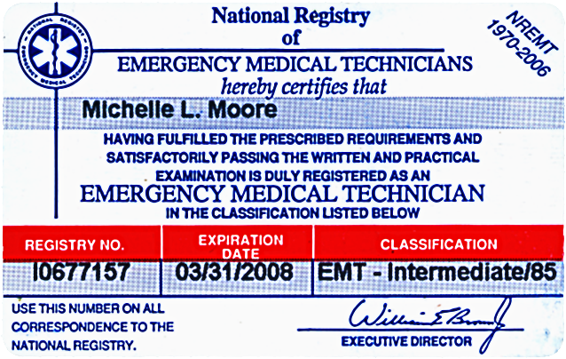
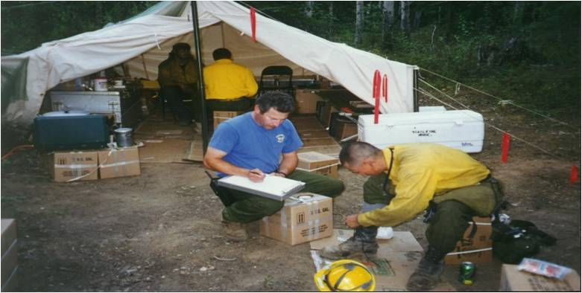
Legal Issues
Misconceptions

Slide 16
Liability
  Good Samaritan laws.
  EMS providers understand and operate within their scope of practice.

Slide 17
Scope of Practice
There are four required components that define the scope of practice for medical personnel.
Trained in the appropriate EMS level.
Must be certified as capable (tested based on criteria).
State licensed to practice.
Authorized by a medical director.

Slide 18
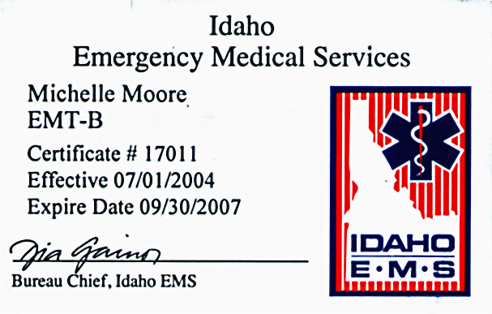
Scope of Practice Issues
national certification card
state licensed card
for an EMT-basic
red card with the qualification
of EMT-advanced

Slide 19
Limited Request for Recognition FORM
Purpose:
  To advise the state EMS office that a
  Medical Unit has been established
  within their jurisdiction.
  To identify out-of-jurisdiction EMS personnel.
  This form does not provide certification or licensure reciprocity.

Slide 20
Limited Request for Recognition Form
Process:
A new Limited Request for Recognition form must be completed and submitted within
24 hours after EMS operations have been established.

Slide 21
Limited Request for Recognition
Process:
It is the responsibility of the Medical Unit Leader to complete the Limited Request for Recognition form.
Discussion Point

Slide 22
Objectives
Identify roles and responsibilities
of the Medical Unit Leader (MEDL) and
Safety Officer.
Identify wildland fire medical resources.
Discuss common misconceptions about Emergency Medical Services (EMS) in wildland fire.
Discuss scope of practice and licensing.

