Slide 1
Reporting and Accident Investigation
Unit 8

Slide 2
Objectives
Identify the importance of reporting, and discuss the different types of reporting tools.
Discuss the Safety Officer’s role and responsibilities with regard to incident emergency procedures and accident investigations.

Slide 3
Objectives
Identify the basic steps for incident emergency procedures, accident investigation, and documentation.
Identify different types and levels of authority of accident investigations.
Discuss protocols when conducting accident investigations.

Slide 4
Introduction to Reporting and Accident Investigation
The ultimate goal of a safety program is to prevent accidents from occurring.
To achieve this goal, we need to recognize small indicators before they result in accidents.

Slide 5
Introduction to Reporting and Accident Investigation
Reporting and taking appropriate followup actions (e.g., including accident investigation) will improve safety and effectiveness for organizational operations.

Slide 6
Safety Triangle and Reporting

Slide 7
Safety Triangle and Reporting
Studies have found that, statistically, for every 600 near misses when appropriate mitigations are not put into place, a disabling injury or fatality is likely to occur.

Slide 8
Safety Triangle
Disabling Injury or Fatality
Significant Injury or Property Damage
Minor Injury or Property Damage
Near Miss
1
29
300
600

Slide 9
Safety Triangle and Reporting
Safety Triangle “A reporting culture is a safety culture.” (Weick and Sutcliff)

Slide 10
Safety Triangle and Reporting
Reporting As illustrated in the safety triangle, most events occur with small indicators; these indicators are often called near-miss events.

Slide 11
Safety Triangle and Reporting
Reporting Respective agencies have agency-specific reporting requirements and systems that should be followed.

Slide 12
Safety Triangle and Reporting
Reporting – Tools available to the wildland fire community:
SAFENET
SAFECOM

Slide 13
Safety Triangle and Reporting
Reporting

Slide 14
Emergency Planning

Slide 15
Emergency Planning
Assist with establishing Incident Management Team (IMT) Standard Operating Procedures (SOPs) for emergency responses.

Slide 16
Emergency Planning
Ensure medical emergency actions are implemented according to the standard Medical Emergency Procedures found in the Incident Emergency Plan (IEP).
Ensure accident scene is secured.
Determine type of accident.
Start the preliminary investigation.

Slide 17
Emergency Planning
Initiating Emergency Response Protocols
The Dutch Creek Fatality – 2008
Memo can be found at:
http://www.nwcg.gov/general/memos/nwcg-025-2010.html

Slide 18
Emergency Planning
Emergency Reporting
Any incident personnel can initiate emergency medical actions according to the procedures outlined in the Incident Medical Plan (ICS 206).

Slide 19
Emergency Planning
Emergency Reporting – Seven Basic Steps
Step 1: First priority is to ensure onsite medical care is given for the injured.

Slide 20
Emergency Planning
Emergency Reporting – Seven Basic Steps
Step 2: Make notifications as outlined in the Incident Emergency Plan.

Slide 21
Emergency Planning
Emergency Reporting – Seven Basic Steps
Step 3: Assign personnel to secure the scene from further injuries or disturbance.

Slide 22
Emergency Planning
Emergency Reporting – Seven Basic Steps
Step 4: Start preliminary investigation:
Document site.
Gather names and contact numbers.
Begin completing:
Motor Vehicle Accident Report
Statement of Witness
Document all medical treatment.

Slide 23
Emergency Planning
Emergency Reporting – Seven Basic Steps
Step 5: Determine level of accident investigation.

Slide 24
Emergency Planning
Emergency Reporting – Seven Basic Steps
Step 6: Notify and coordinate with the local authorities that have jurisdiction.

Slide 25
Emergency Planning
Emergency Reporting – Seven Basic Steps
Step 7: Ensure that initial accident documentation is complete.

Slide 26
Accident Investigation

Slide 27
Accident Investigation
Do not lose continuity of operations; remember why you are there, to manage the incident.

Slide 28
Accident Investigation Types and Levels of Investigation
Investigation Types and Requirements
Wildland Fire Event | Investigation Type | Notification Requirement | Management level that determines review type and authorizes review*
Serious Wildland Fire Accident | Serious Accident Investigation (SAI) | National | National
Wildland Fire Accident | Accident Investigation (AI) FS only- FLA may be used | BLM/NPS-National FS/FWS- Management Discretion | Region/State/Local
Entrapment | SAI, AI, LLR, depending on severity | National | National
Fire Shelter Deployment | SAI, AI, LLR, depending on severity | National | National
Near-miss | LLR, AAR | Management Discretion | Region/State/Local
Fire Trespass | Fire Cause Determination & Trespass Investigation | Local | Local

Slide 29
Accident Investigation
Types and Levels of Investigation
Serious Wildland Fire Accident (National Authority)
Investigation Types and Requirements
Wildland Fire Event | Investigation Type | Notification Requirement | Management level that determines review type and authorizes review*
Serious Wildland Fire Accident | Serious Accident Investigation (SAI) | National | National
Wildland Fire Accident | Accident Investigation (AI) FS only- FLA may be used | BLM/NPS-National FS/FWS- Management Discretion | Region/State/Local
Entrapment | SAI, AI, LLR, depending on severity | National | National
Fire Shelter Deployment | SAI, AI, LLR, depending on severity | National | National
Near-miss | LLR, AAR | Management Discretion | Region/State/Local
Fire Trespass | Fire Cause Determination & Trespass Investigation | Local | Local

Slide 30
Accident Investigation
Types and Levels of Investigation
Wildland Fire Accident
Investigation Types and Requirements
Wildland Fire Event | Investigation Type | Notification Requirement | Management level that determines review type and authorizes review*
Serious Wildland Fire Accident | Serious Accident Investigation (SAI) | National | National
Wildland Fire Accident | Accident Investigation (AI) FS only- FLA may be used | BLM/NPS-National FS/FWS- Management Discretion | Region/State/Local
Entrapment | SAI, AI, LLR, depending on severity | National | National
Fire Shelter Deployment | SAI, AI, LLR, depending on severity | National | National
Near-miss | LLR, AAR | Management Discretion | Region/State/Local
Fire Trespass | Fire Cause Determination & Trespass Investigation | Local | Local

Slide 31
Accident Investigation
Types and Levels of Investigation
Near-miss
Investigation Types and Requirements
Wildland Fire Event | Investigation Type | Notification Requirement | Management level that determines review type and authorizes review*
Serious Wildland Fire Accident | Serious Accident Investigation (SAI) | National | National
Wildland Fire Accident | Accident Investigation (AI) FS only- FLA may be used | BLM/NPS-National FS/FWS- Management Discretion | Region/State/Local
Entrapment | SAI, AI, LLR, depending on severity | National | National
Fire Shelter Deployment | SAI, AI, LLR, depending on severity | National | National
Near-miss | LLR, AAR | Management Discretion | Region/State/Local
Fire Trespass | Fire Cause Determination & Trespass Investigation | Local | Local

Slide 32
Accident Investigation
Types and Levels of Investigation
Entrapment
Investigation Types and Requirements
Wildland Fire Event | Investigation Type | Notification Requirement | Management level that determines review type and authorizes review*
Serious Wildland Fire Accident | Serious Accident Investigation (SAI) | National | National
Wildland Fire Accident | Accident Investigation (AI) FS only- FLA may be used | BLM/NPS-National FS/FWS- Management Discretion | Region/State/Local
Entrapment | SAI, AI, LLR, depending on severity | National | National
Fire Shelter Deployment | SAI, AI, LLR, depending on severity | National | National
Near-miss | LLR, AAR | Management Discretion | Region/State/Local
Fire Trespass | Fire Cause Determination & Trespass Investigation | Local | Local

Slide 33
Accident Investigation
Types and Levels of Investigation
Fire Shelter Deployment
Investigation Types and Requirements
Wildland Fire Event | Investigation Type | Notification Requirement | Management level that determines review type and authorizes review*
Serious Wildland Fire Accident | Serious Accident Investigation (SAI) | National | National
Wildland Fire Accident | Accident Investigation (AI) FS only- FLA may be used | BLM/NPS-National FS/FWS- Management Discretion | Region/State/Local
Entrapment | SAI, AI, LLR, depending on severity | National | National
Fire Shelter Deployment | SAI, AI, LLR, depending on severity | National | National
Near-miss | LLR, AAR | Management Discretion | Region/State/Local
Fire Trespass | Fire Cause Determination & Trespass Investigation | Local | Local

Slide 34
Accident Investigation
Types and Levels of Investigation
Resources and Information
www.nifc.gov/safety/safety_reprtsInvest.html
www.nwcg.gov/pms/pubs/large.html#iibmh

Slide 35
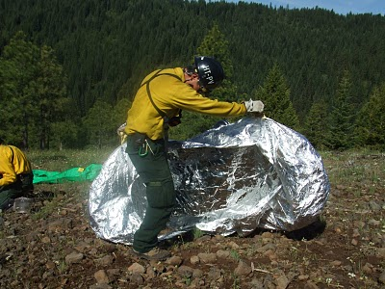
Exercise
Burnover and Shelter Deployment Scenario

Slide 36
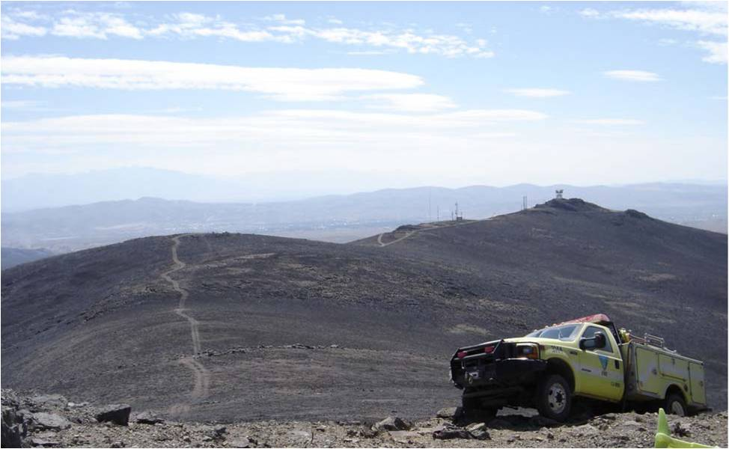
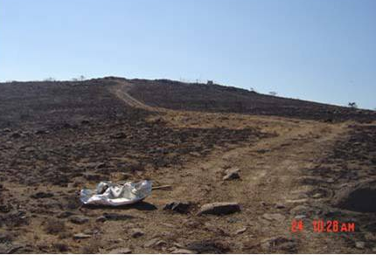
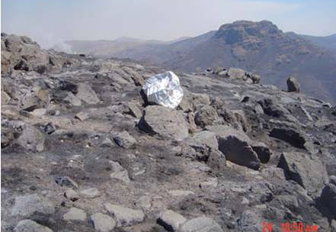

Slide 37
Summary

Slide 38
Objectives
Identify the importance of reporting, and discuss the different types of reporting tools.
Discuss the Safety Officer’s role and responsibilities with regard to incident emergency procedures and accident investigations.

Slide 39
Objectives
Identify the basic steps for incident emergency procedures, accident investigation, and documentation.
Identify different types and levels of authority of accident investigations.
Discuss protocols when conducting accident investigations.

