Slide 1
All Hazard Assignments
Unit 9

Slide 2
Objectives
Identify and modify required products for the specific task or mission of an all hazard assignment.
Discuss the impact of assignment diversion on the mission.
Discuss roles and responsibilities involving working with all hazard teams.
Identify indicators of behavioral changes related to critical stress on all hazard assignments.

Slide 3
Objectives
Discuss the Stafford Act of 1988 and the National Response Framework.
Discuss preparations timeframes related to all hazard assignments.
Identify eight categories of hazards relating to situational awareness for all hazard assignments.
Discuss resources for technical experts for all hazard assignments.

Slide 4

Introduction to All Hazard Assignments
Your role as Team Safety Officer on an all hazard assignment is to provide for the health and welfare of resources assigned to the incident.

Slide 5
Introduction to All Hazard Assignments
Required Products
Risk Management Analysis
NWCG 215A and Risk Assessment Code Matrix
Briefings
Safety message
Safety action plan

Slide 6




Introduction to All Hazard Assignments
Risk management assessment approach

Slide 7
Introduction to All Hazard Assignments
Length of Assignments
May last up to 30 days.
Fatigue and stress may be outside the normal experiences.

Slide 8
Introduction to All Hazard Assignments
Assignment Diversion (Mission Creep)
Is common in all hazard assignments
And can have unforeseen effects

Slide 9
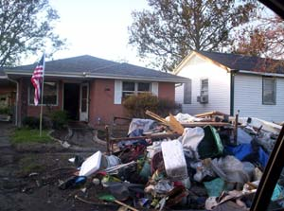
Introduction to All Hazard Assignments
Assignment Diversion (Mission Creep)
Example of mission creep

Slide 10
Working With All Hazard Teams (FEMA, Area Command, Etc.)

Slide 11
Working With All Hazard Teams
All hazard teams may have specialized search and rescue or hazmat cleanup units that use equipment and terminology with which you may not be familiar.

Slide 12

Working with All Hazard Teams
Communication - Radio Use

Slide 13
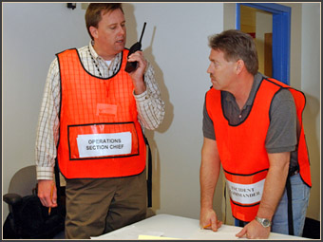
Working With All Hazard Teams
Communication – Roles and Responsibilities
Responding agencies may have different roles, responsibilities, policies, and procedures.

Slide 14
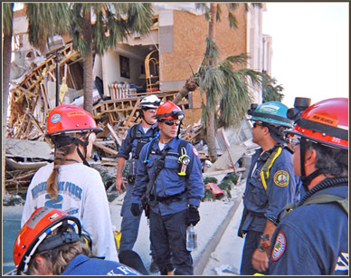
Working With All Hazard Teams
Stress
Stress levels may be very high with local agencies that have been affected by the disaster.

Slide 15
Working With All Hazard Teams
Information Requests
Be sure to have a clear understanding of the type of information being requested.

Slide 16



Slide 17
All Hazard – Critical Incident Stress Management

Slide 18
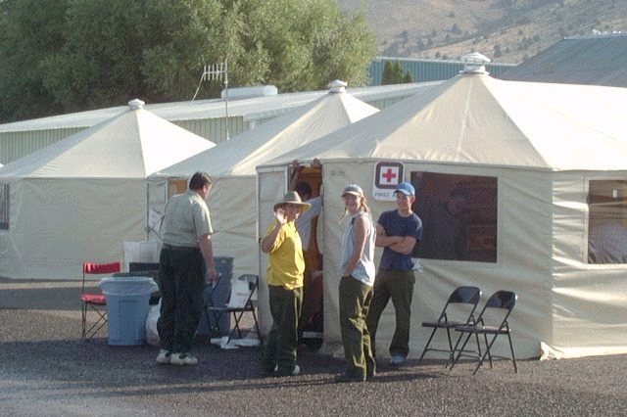
All Hazard – Critical Incident Stress Management
Taking Care of Yourself

Slide 19

All Hazard – Critical Incident Stress Management
Taking Care of the Team

Slide 20
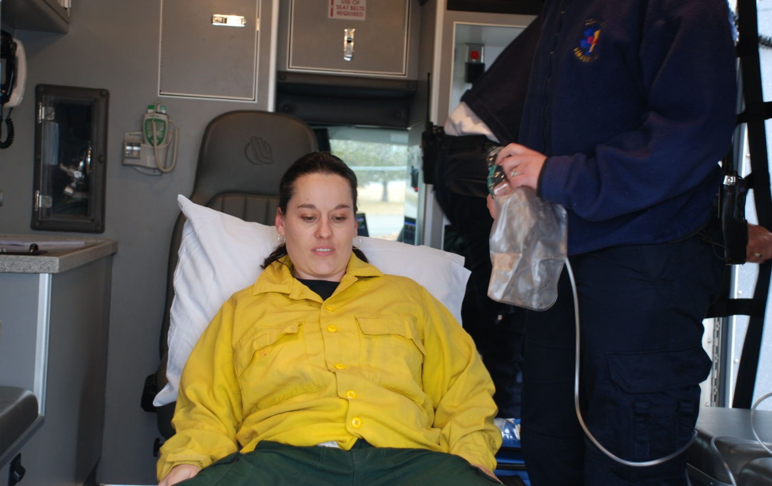
All Hazard – Critical Incident Stress Management
Medical

Slide 21
Stafford Act of 1988

Slide 22

Stafford Act of 1988
The Stafford Act authorizes the President of the United States to provide financial
and other
assistance.

Slide 23
National Response Framework

Slide 24
National Response Framework
NRF presents the guiding principles that enable all response partners to prepare for and provide a unified national response—from the smallest incident to the largest catastrophe.

Slide 25

National Response Framework
Mission Assignment
DHS and FEMA may issue mission assignments to other Federal agencies.

Slide 26
National Response Framework
Mission Assignment
FEMA Form 90-129

Slide 27
Assignment Preparation

Slide 28
Assignment Preparation
Preplanning
All hazard response presents some of the most difficult and complex management challenges that our agencies face.

Slide 29
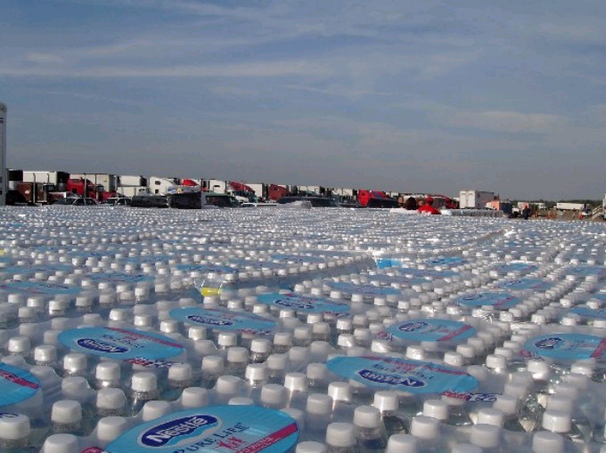
Assignment Preparation
Preplanning – Examples of assigned tasks:
  Logistical distribution centers

Slide 30
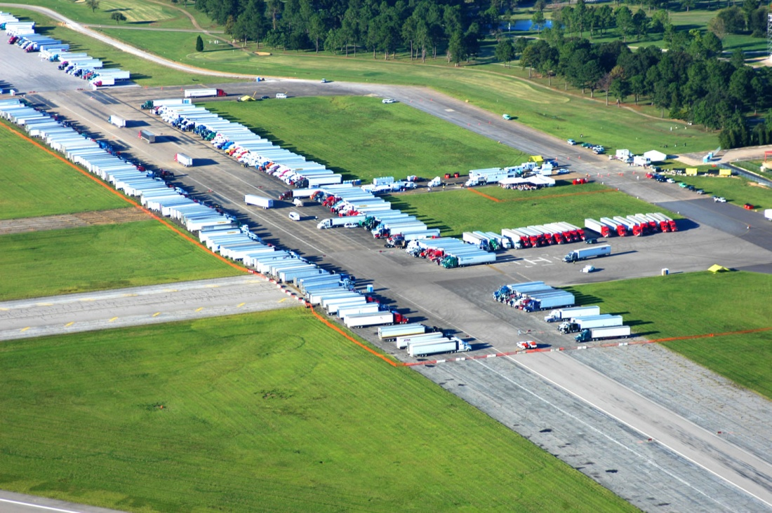
Assignment Preparation
Preplanning – Examples of assigned tasks:
  Staging areas

Slide 31
Assignment Preparation
Preplanning – Examples of assigned tasks:
  Base camps for emergency responders

Slide 32
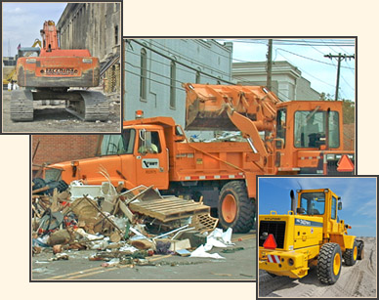
Assignment Preparation
Preplanning – Examples of assigned tasks:
  Clearing roadways and debris

Slide 33


Assignment Preparation
Preplanning – Examples of assigned tasks:
  Law enforcement and security duties

Slide 34
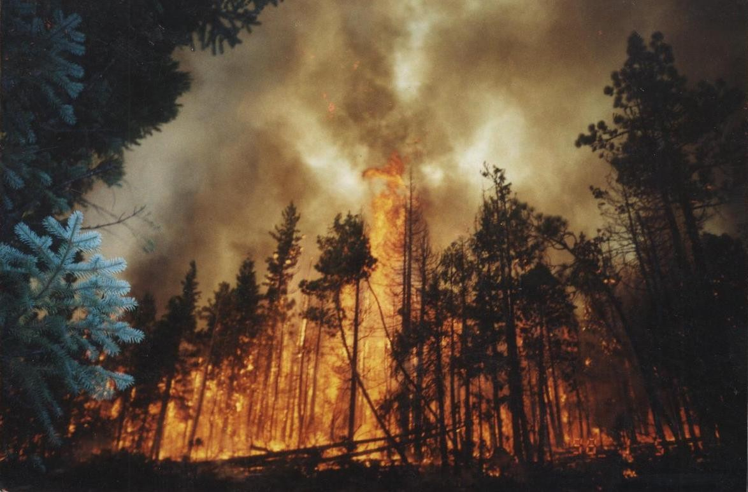
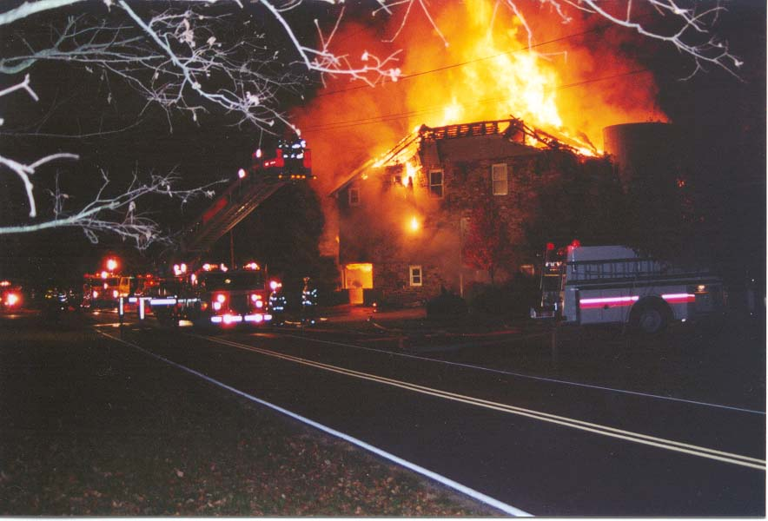
Assignment Preparation
Preplanning – Examples of assigned tasks:
  Support for wildfire or structural fire suppression

Slide 35

Assignment Preparation
Preplanning for an all hazard assignment is essential.

Slide 36
Assignment Preparation
Understanding the Geographic Area and Mission Assignment
Where am I going? What am I going to? How am I going to operate in that environment?

Slide 37
Situational Awareness for All Hazard Assignments

Slide 38

Situational Awareness for All Hazard Assignments
Culture

Slide 39
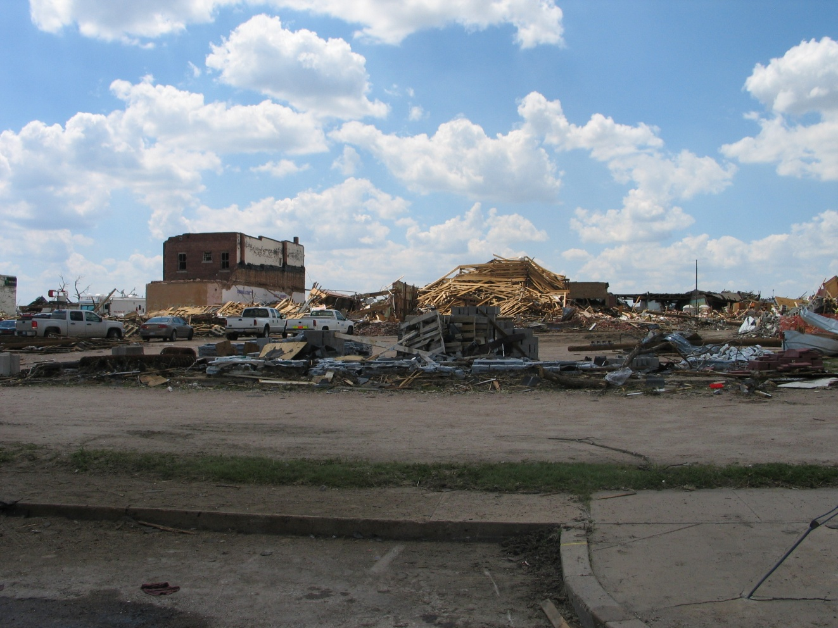
Situational Awareness for All Hazard Assignments
Hazards

Slide 40
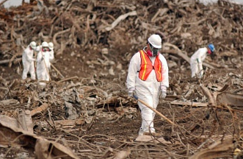
Situational Awareness for All Hazard Assignments
Hazards – Environmental
  Disaster aftermath

Slide 41
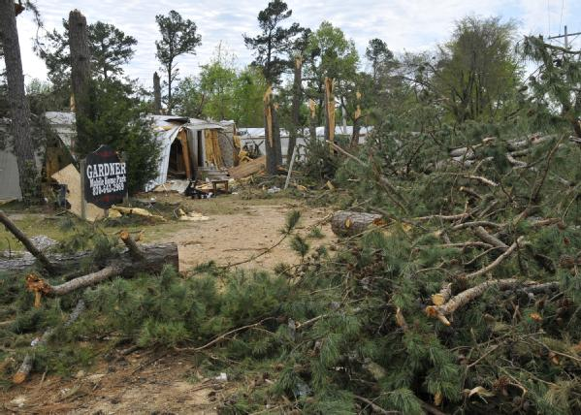
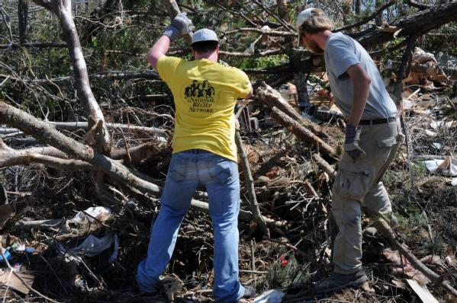
Situational Awareness for All Hazard Assignments
Hazards – Environmental
  Downed vegetation

Slide 42
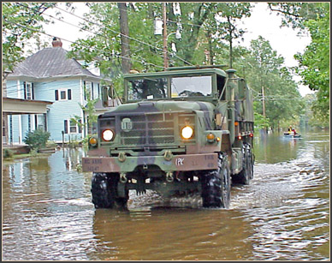
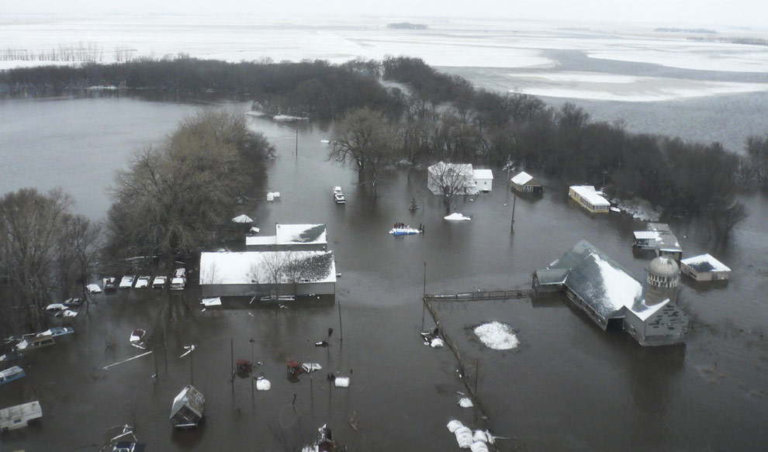
Situational Awareness for All Hazard Assignments
Hazards – Environmental
  Water

Slide 43

Situational Awareness for All Hazard Assignments
Hazards – Environmental
  Topography

Slide 44
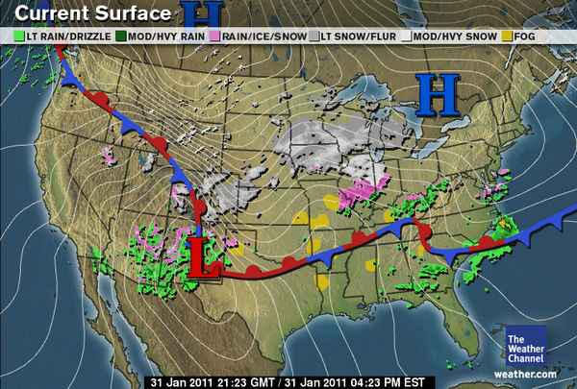
Situational Awareness for All Hazard Assignments
Hazards – Environmental
  Weather

Slide 45
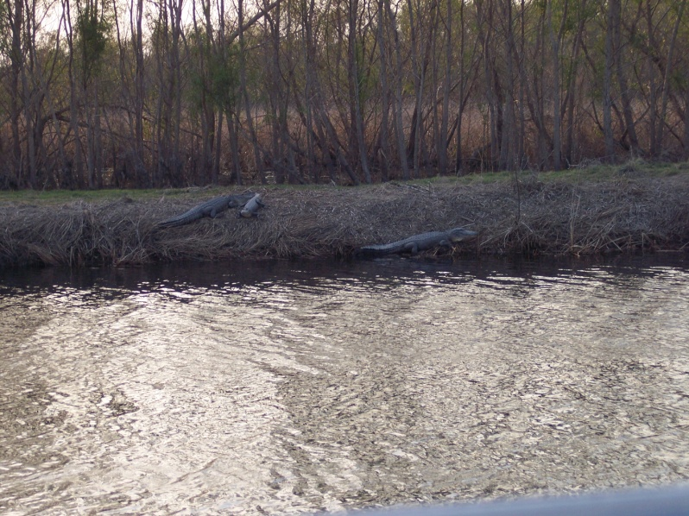

Situational Awareness for All Hazard Assignments
Hazards – Environmental
  Animals and reptiles

Slide 46

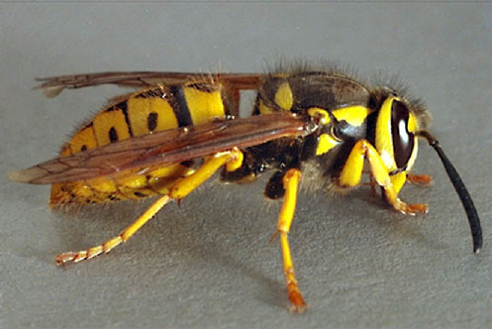
Situational Awareness for All Hazard Assignments
Hazards – Environmental
  Insects

Slide 47
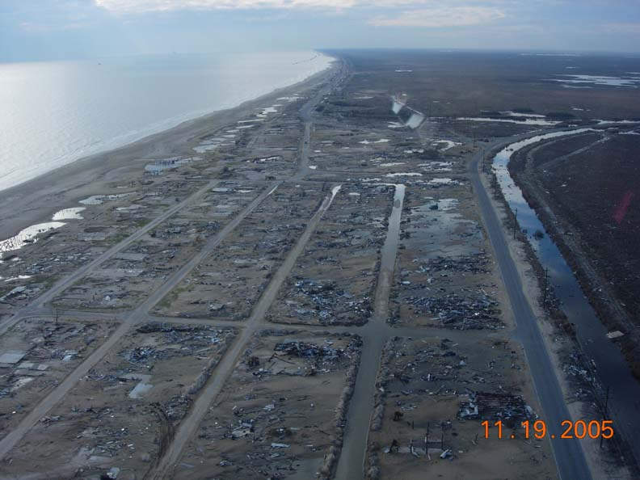
Situational Awareness for All Hazard Assignments
Hazards – Infrastructure

Slide 48

Situational Awareness for All Hazard Assignments
Hazards – Infrastructure
  Gas leaks

Slide 49
Situational Awareness for All Hazard Assignments
Hazards – Infrastructure
  Lack of sanitation
  Raw sewage
  Water system (lack of or contamination)

Slide 50
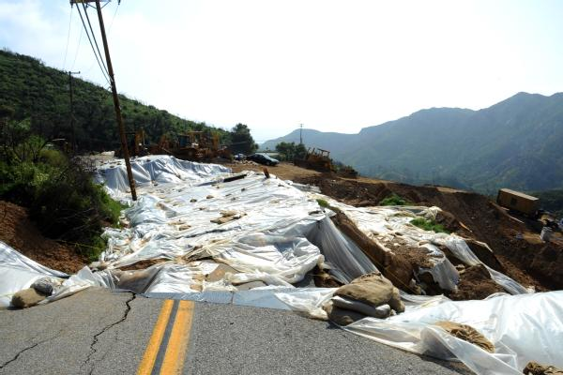
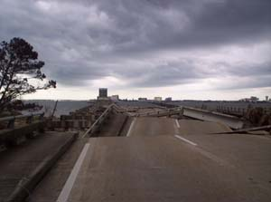
Situational Awareness for All Hazard Assignments
Hazards – Infrastructure
  Road and bridge systems

Slide 51
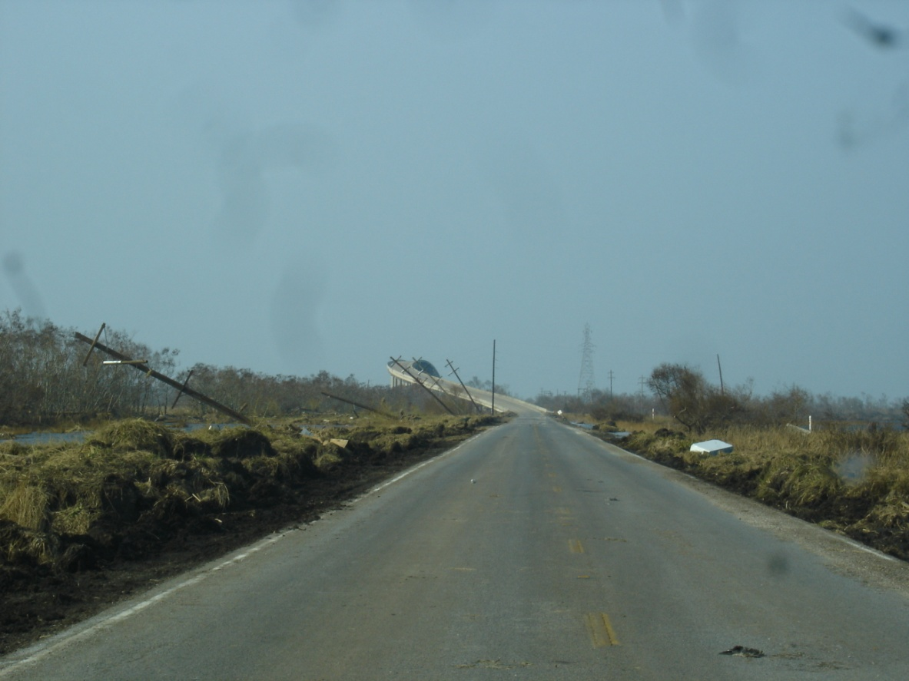
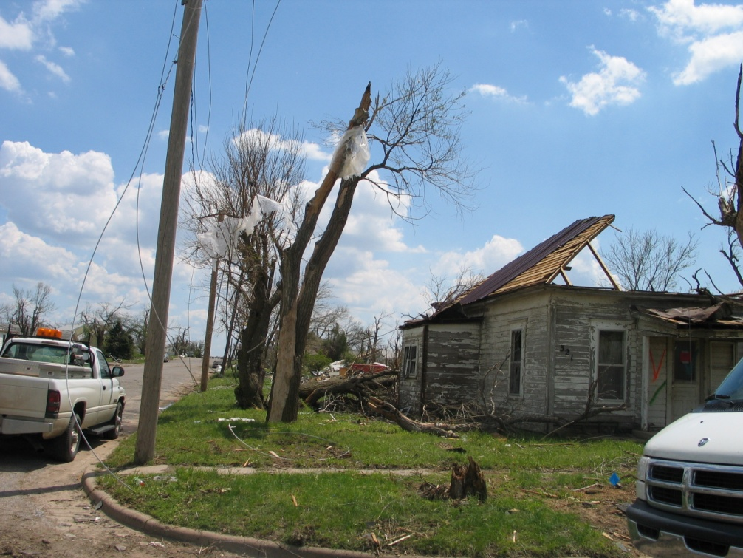
Situational Awareness for All Hazard Assignments
Hazards – Infrastructure
  Power lines
  Lack of telephone or data lines

Slide 52
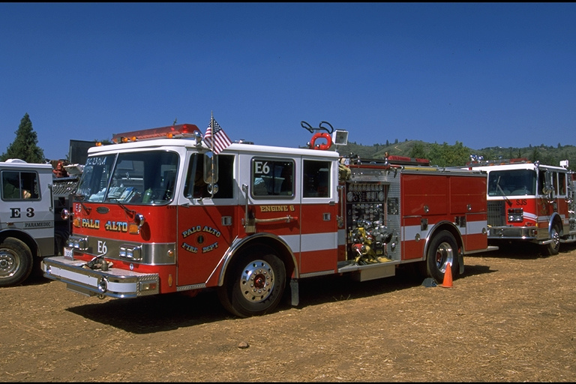
Situational Awareness for All Hazard Assignments
Hazards – Infrastructure
  Structural fire protection

Slide 53
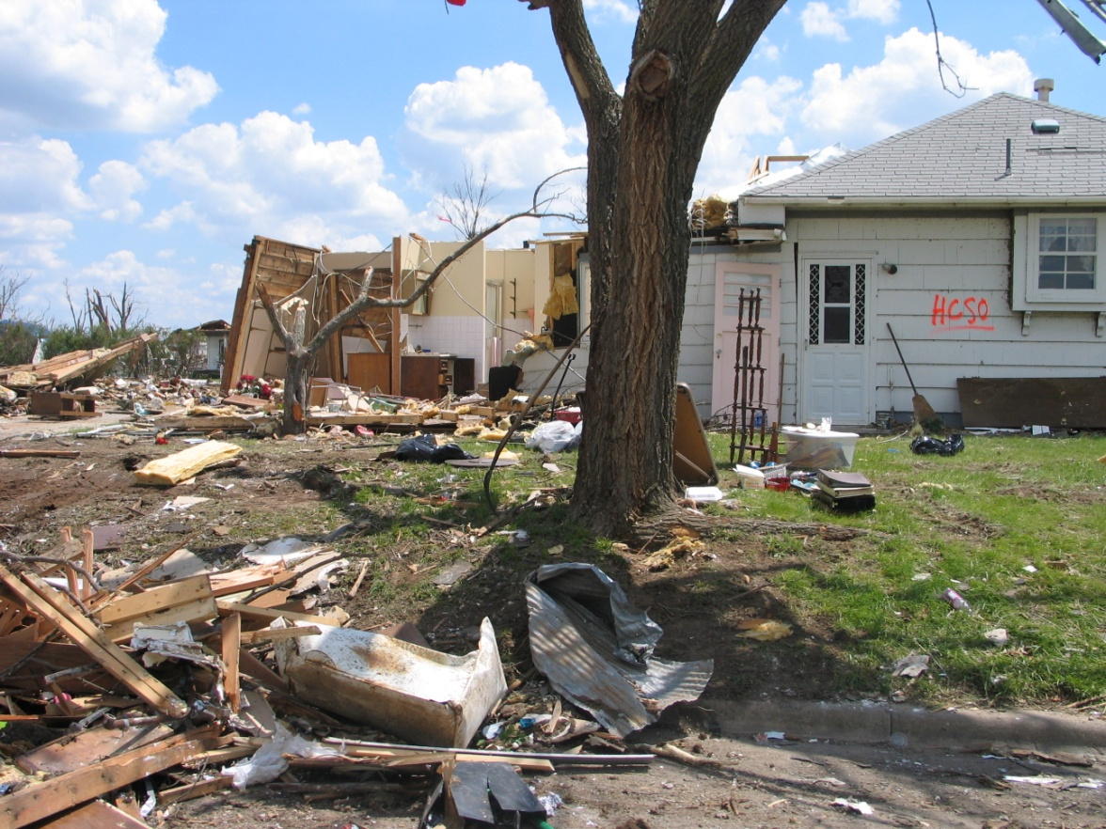
Situational Awareness for All Hazard Assignments
Hazards – Infrastructure
  Structural damage

Slide 54
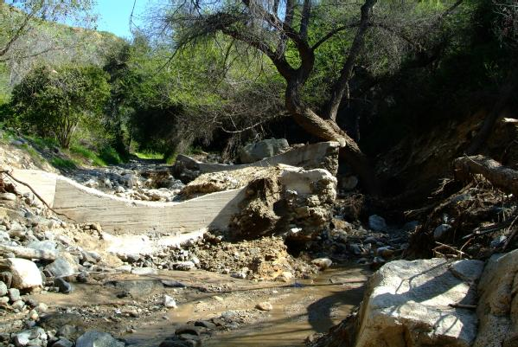
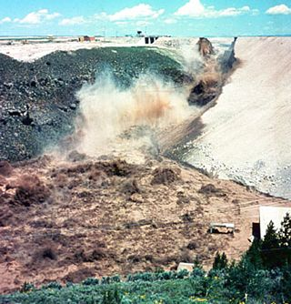
Situational Awareness for All Hazard Assignments
Hazards – Infrastructure
  Dam integrity

Slide 55

Situational Awareness for All Hazard Assignments
Hazards – Infrastructure
  Medical facilities

Slide 56
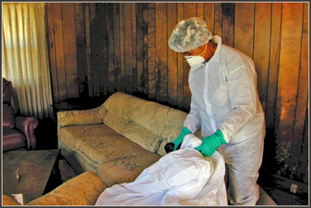
Situational Awareness for All Hazard Assignments
Hazards – Biological

Slide 57
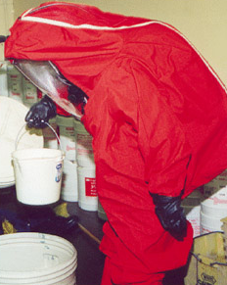
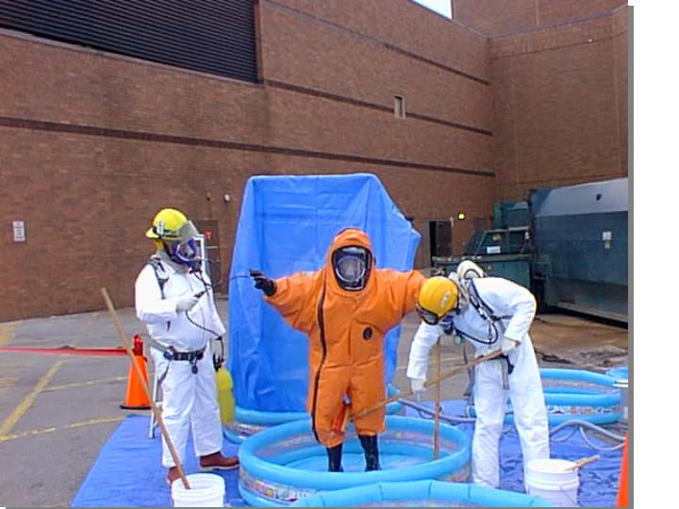
Situational Awareness for All Hazard Assignments
Hazards – Chemical

Slide 58
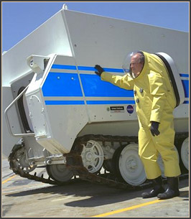
Situational Awareness for All Hazard Assignments
Hazards – Radiological

Slide 59
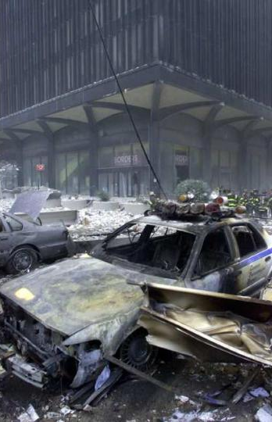
Situational Awareness for All Hazard Assignments
Hazards – Explosive

Slide 60
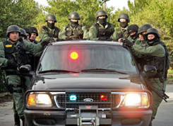
Situational Awareness for All Hazard Assignments
Hazards – Human

Slide 61
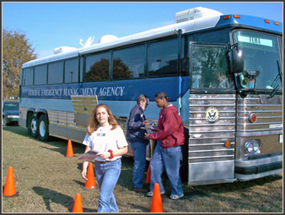
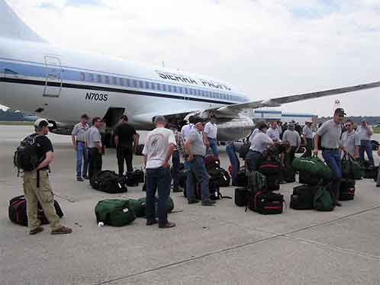
Situational Awareness for All Hazard Assignments
Transportation

Slide 62
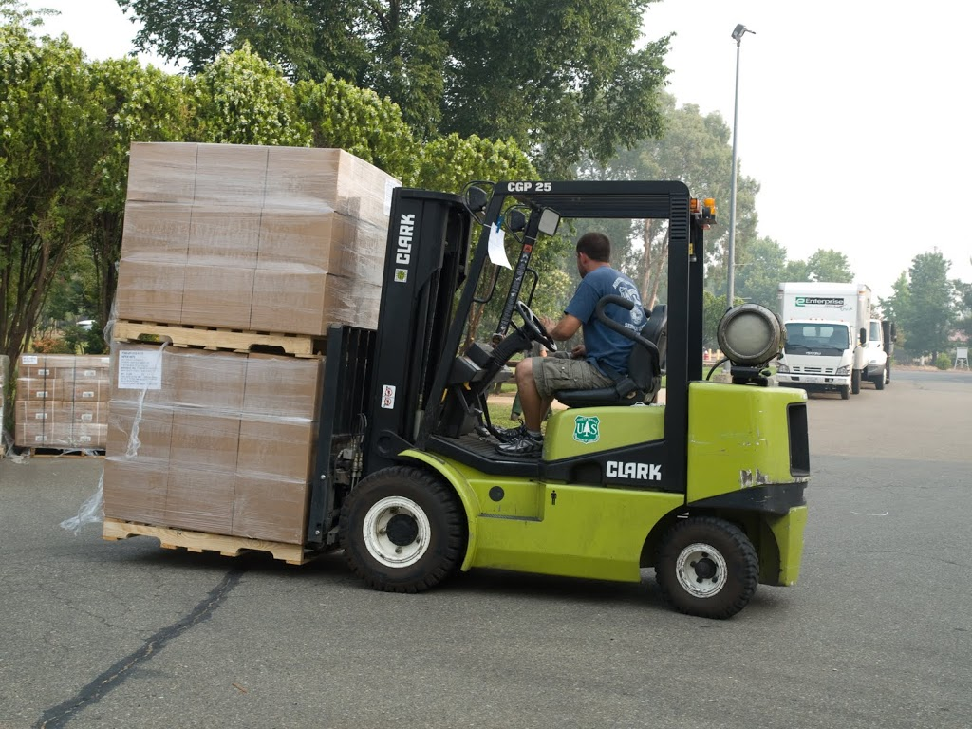
Situational Awareness for All Hazard Assignments
Supply Chain

Slide 63
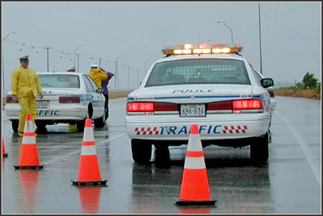
Situational Awareness for All Hazard Assignments
Personal Safety and Security

Slide 64
Technical Experts

Slide 65
Technical Experts
You will need to work with various resources to find the technical experts you will need.

Slide 66
Technical Experts
Contacts

Slide 67
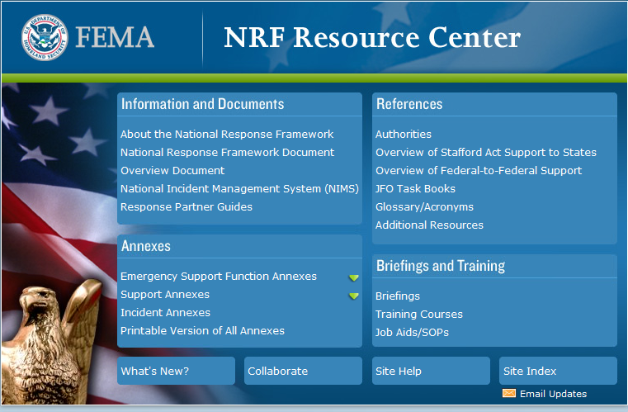
Technical Experts
Resources – Web sites

Slide 68
Objectives
Identify and modify required products for the specific task or mission of an all hazard assignment.
Discuss the impact of assignment diversion on the mission.
Discuss roles and responsibilities involving working with all hazard teams.
Identify indicators of behavioral changes related to critical stress on all hazard assignments.

Slide 69
Objectives
Discuss the Stafford Act of 1988 and the National Response Framework.
Discuss preparations timeframes related to all hazard assignments.
Identify eight categories of hazards relating to situational awareness for all hazard assignments.
Discuss resources for technical experts for all hazard assignments.

