Slide 1
National Wildfire Coordinating Group
Mission Statement
The purpose of NWCG is to coordinate programs of the participating wildfire management agencies to avoid wasteful duplication and to provide a means of constructively working together. The goal is to provide more effective execution of each agency’s fire management program. The group provides a formalized system to agree upon standards of training, equipment, qualifications, and other operational functions.
E-mail comments or suggestions pertaining to this or any NWCG course to: nwcg_evaluation@nifc.blm.gov
NWCG Website: http://www.nwcg.gov/
Slide 0-1

Slide 2
Safety Officer, S-404
Unit 0 Introduction

Slide 3
Objectives
1. Introduce the course coordinator, instructors, and students.
2. Discuss course logistics.
3. Present course overview.
4. Discuss instructor and student expectations.
5. Identify course reference materials.
6. Discuss position responsibilities.
7. Review pre-course work.

Slide 4
Introductions
Name and job title
Agency and home unit
ICS qualifications
Experience

Slide 5
Course Logistics
Course agenda
Sign-in sheet
Housekeeping

Slide 6
Course Overview
Safety Officer Type 1 (SOF1)
Safety Officer Type 2 (SOF2)
Line Safety Officer (SOFR)
Course Objectives
Instructional Methods

Slide 7
Assessment/Evaluation
Participate
Achieve an accumulated total score of 70% or higher
Course and Unit Evaluation Forms

Slide 8
Course Reference Materials
Incident Response Pocket Guide (PMS 461)
Interagency Helicopter Operations Guide (NFES 1885)
Interagency Standards for Fire and Fire Aviation Operations (Red Book) (NFES 2724)
Wildland Fire and Aviation Program Management Operations Guide (Bureau of Indian Affairs [BIA]) (Blue Book)

Slide 9
expectations
Student Expectations
Instructor Expectations

Slide 10
Position Responsibilities
The Safety Officer is typically designated as a primary member of the command staff of an Incident Management Team (IMT).

Slide 11
Roles and Responsibilities
The Safety Officer’s function is to develop and recommend measures for assuring personnel safety and to assess and/or anticipate hazardous and unsafe situations.
It should be the role of the Safety Officer to instill in all incident personnel the value of applying the risk management principles and “thinking safety” while performing all assigned duties.

Slide 12
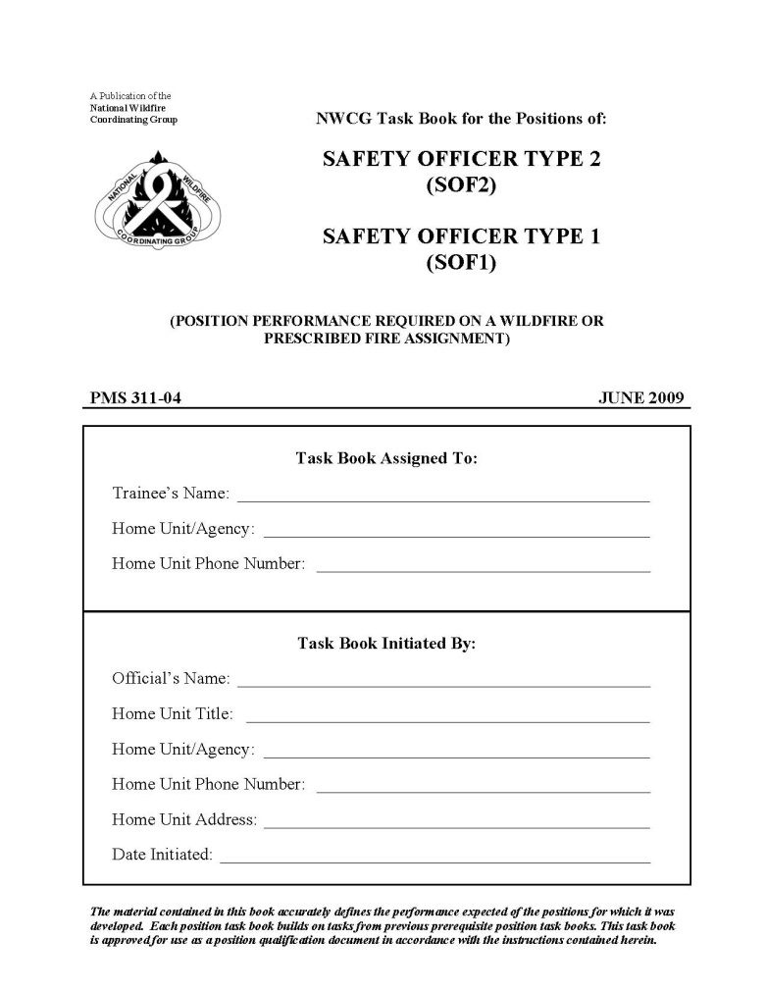
Position Task Book
Trainees must complete the tasking in the PTB to become qualified as a Safety Officer (SOF1, SOF2, SOFR).
PTB can only be initiated by the home unit.

Slide 13
Pre-Course Work Review
Components of the pre-course work will be used and expanded on throughout the course.

Slide 14
EXERCISE: S-404 Safety Officer Kit
Purpose: Ensure students have identified the required items and assembled their kit as listed in the online module.
Time: 15–20 minutes
Format: Students work in assigned small groups.
Materials Needed: Safety Officer kits

Slide 15
Kit Contents
Required Items:
Camera
Special flagging
Tape measure
Red Book
IRPG
Pencil, paper, and steno pad
Required Forms:
ICS 206
ICS 214

Slide 16
Objectives
1. Introduce the course coordinator, instructors, and students.
2. Discuss course logistics.
3. Present course overview.
4. Discuss instructor and student expectations.
5. Identify course reference materials.
6. Discuss position responsibilities.
7. Review pre-course work.

