Slide 1
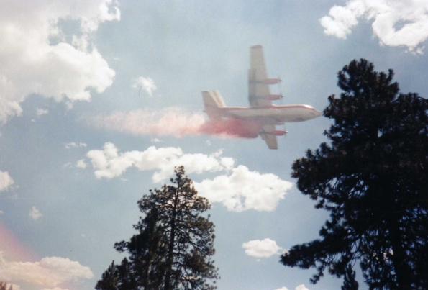
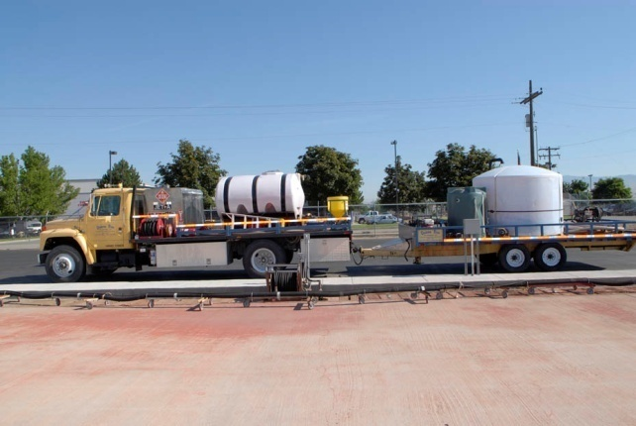
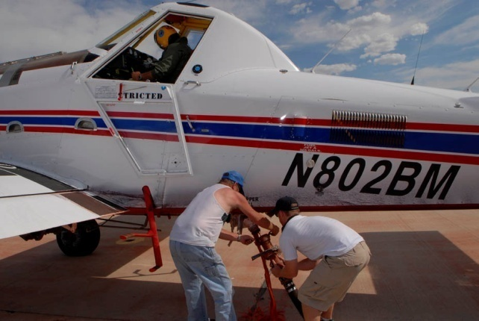
Coordination and Leading
Assigned Personnel

Slide 2
Unit 4 - Objectives
Identify sources both internal and external to the incident that the AOBD must coordinate with.
Identify interdependent activities that must be coordinated.
Establish work assignments and performance expectations for assigned personnel.
Describe how to monitor assigned personnel performance and provide feedback.

Slide 3
Coordination with Local Dispatch
Airspace Coordination
Resources
Communications
Ordering
Hazard maps
Flight following
Emergency response
Aviation facilities
Initial attack

Slide 4
Coordination with Local Dispatch
Airspace Coordination
Is there a coordinator assigned / available / needed?
Resources
Review what is currently assigned, ordered, or on a UTF list.

Slide 5
Coordination with Local Dispatch
Communications
Verify assigned frequencies and phone list numbers.
Ordering
Confirm ordering protocols.

Slide 6
Coordination with Local Dispatch
Hazard map
Obtain copies and ensure they are up-to-date.
Flight following procedures
Who is responsible (helibase/dispatch)?

Slide 7
Coordination with Local Dispatch
Emergency response / medevac procedures
Is information complete and up-to-date?
Aviation facilities
Aviation sites in proximity to the incident
(airport, heliports, etc.).

Slide 8
Coordination with Local Dispatch
Initial Attack
What is the area?
Communication procedures established?
Are resources available to share?

Slide 9
EXERCISE
Meeting with Dispatch
Purpose:
Be able to demonstrate the information that must be coordinated with host agency dispatch.
Scenario:
Prepare a prioritized list of information and documents you would like to receive from the local dispatch office.

Slide 10
Coordination with Vendors and Contractors
As an AOBD, you are indirectly responsible for ensuring contracts are administered properly.
Examples of contract equipment / personnel:
Helibase trailers
Water tenders
Portable retardant
Aircraft support personnel

Slide 11
Coordination: Other Incidents and Groups
Depending on incident complexity, you may be working with (or affected by) other incidents or additional coordinating groups and incident management teams such as: GMAC, NMAC, Area Command, NIMO, etc.

Slide 12
Coordination: External Resources
May include the following:
Local airport authority
Media
Land owner
Adjacent incident personnel
Aviation support groups
Other fixed-wing bases

Slide 13
EXERCISE
Coordination with External Resources
After being assigned your topic(s), answer the following questions:
Why might this interaction need to occur?
What is the nature of the relationship?
  What does the resource need from the AOBD?
  What does the AOBD need form the resource?
What type of information needs to be coordinated?

Slide 14
Military Resources
Refer to the most recent version of the Military Use Handbook.
Ensure that appropriate measures are being taken while working with the National Guard and active military.

Slide 15
Leading Assigned Personnel
Establish work assignments (schedule)
Performance expectations
Monitor assigned personnel
Feedback (two-way communication)
Personnel issues

Slide 16
EXERCISE
Interaction Scenarios / Panel Discussion
An important part of the AOBD position is interacting with other personnel within the incident. The ability to interact effectively will determine your success in this position.
This exercise and panel discussion will help emphasize the importance of successful incident interactions.

Slide 17
Interaction Scenarios / Panel Discussion
Panel members:
Incident Commander
Safety Officer
Logistics Section Chief
Finance Section Chief
Plans Section Chief
Operations Section Chief
Aircraft/IA Dispatcher
Other (regional specific position, etc.)

Slide 18
Interaction Scenarios / Panel Discussion
The panel will:
Discuss intersectional relationships.
Identify topics and coordination needed by the AOBD to accomplish the job.
Serve as expert advisors to the scenarios created during the exercise.

Slide 19
Unit 4 - Objectives
Identify sources both internal and external to the incident that the AOBD must coordinate with.
Identify interdependent activities that must be coordinated.
Establish work assignments and performance expectations for assigned personnel.
Describe how to monitor assigned personnel performance and provide feedback.

