Slide 1
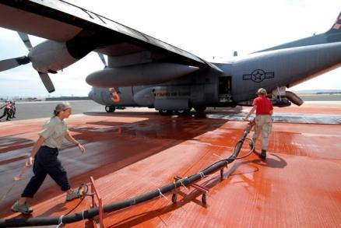
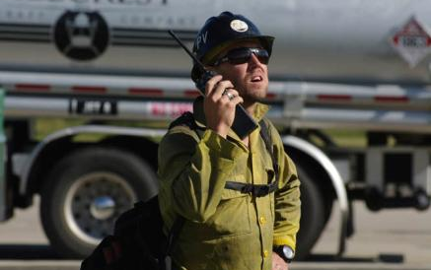
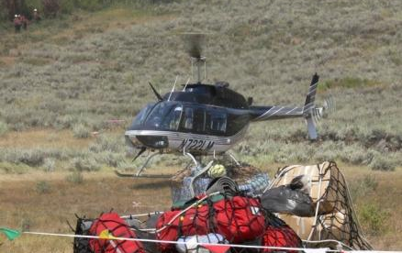
Unit 5
Daily Operations and Legal Requirements

Slide 2
Unit 5 - Objectives
Analyze current situation to prepare for the next operational period.
Identify and discuss safety and legal requirements.

Slide 3
Monitoring and Evaluating Daily Aviation Operations
Collect and process information as required by the incident
  Flight hours
  Cost summaries
  Water, foam, retardant gallons
  Number of personnel transported

Slide 4
Safety and Legal Requirements
Which agency has authority?
Consult the appropriate aviation policy.
Consider agency or geographical differences
  Load calculations
  PPE
  Duty day limitations
  Interagency guides

Slide 5
Exercise: NTSB Aviation
Accident Review

Slide 6
Public and Civil Resources
(Pressler Bill)
Review the Pressler Bill Briefing Paper (Public Law 106-181)
How would this impact you as an AOBD?

Slide 7
Contracts
Bound by the federal acquisition regulation.
No contractual authority (cannot modify; no ratification).

Slide 8
Unit 5 - Objectives
Analyze current situation to prepare for the next operational period.
Identify and discuss safety and legal requirements.

