Slide 1
National Wildfire Coordinating Group
NWCG TRAINING BRANCH
Mission:
To develop relevant National Wildfire Coordinating Group training in a cost-effective manner to meet the needs of the wildland fire community.
Vision:
To develop professional training packages which provide a solid training foundation and enhanced training experience to the wildland fire community.
E-mail comments or suggestions pertaining to this or any NWCG course to: BLM_FA_nwcg_Training@blm.gov Online: training.nwcg.gov

Slide 2
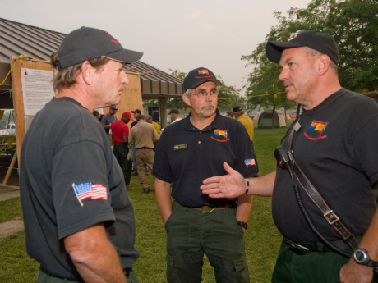
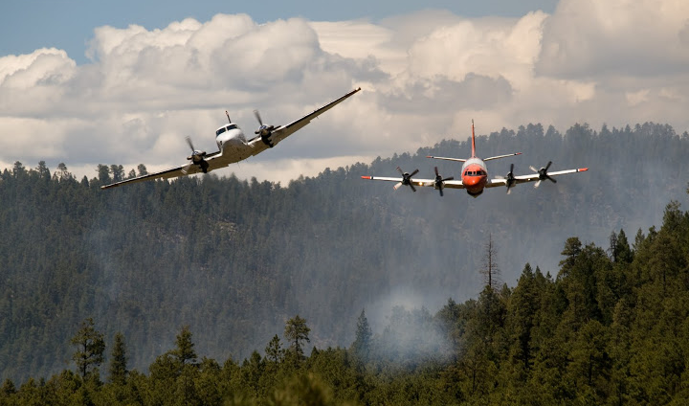
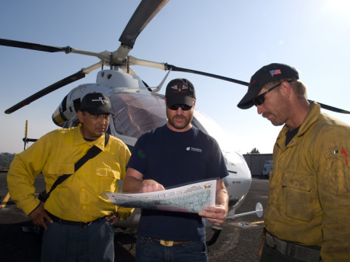
S-470
Air Operations Branch Director

Slide 3
Unit Objectives
1. Introduce the course coordinator, instructors, and students.
2. Discuss course logistics.
3. Present course overview.
4. Discuss course expectations.
5. Identify course reference materials.
6. Discuss position responsibilities.
7. Review pre-course work.

Slide 4
Unit 0
Introduction

Slide 5
Course Logistics
Course Agenda
Sign-in sheet
Housekeeping
Other

Slide 6
Course Objectives
At the successful completion of this course, students will be able to:
Perform the tasks required of an Air Operations Branch Director to mobilize and transition into an incident aviation environment, and be able to prepare for, manage, and oversee an aviation operation.

Slide 7
Course Expectations Exercise

Slide 8
Course Reference Materials
Incident Response Pocket Guide, PMS 461
Wildland Fire Qualification System Guide, PMS 310-1
Interagency Standards for Fire and Fire Aviation Operations (Red Book)
Aviation Risk Management Workbook
Interagency Helicopter Operations Guide (IHOG)

Slide 9
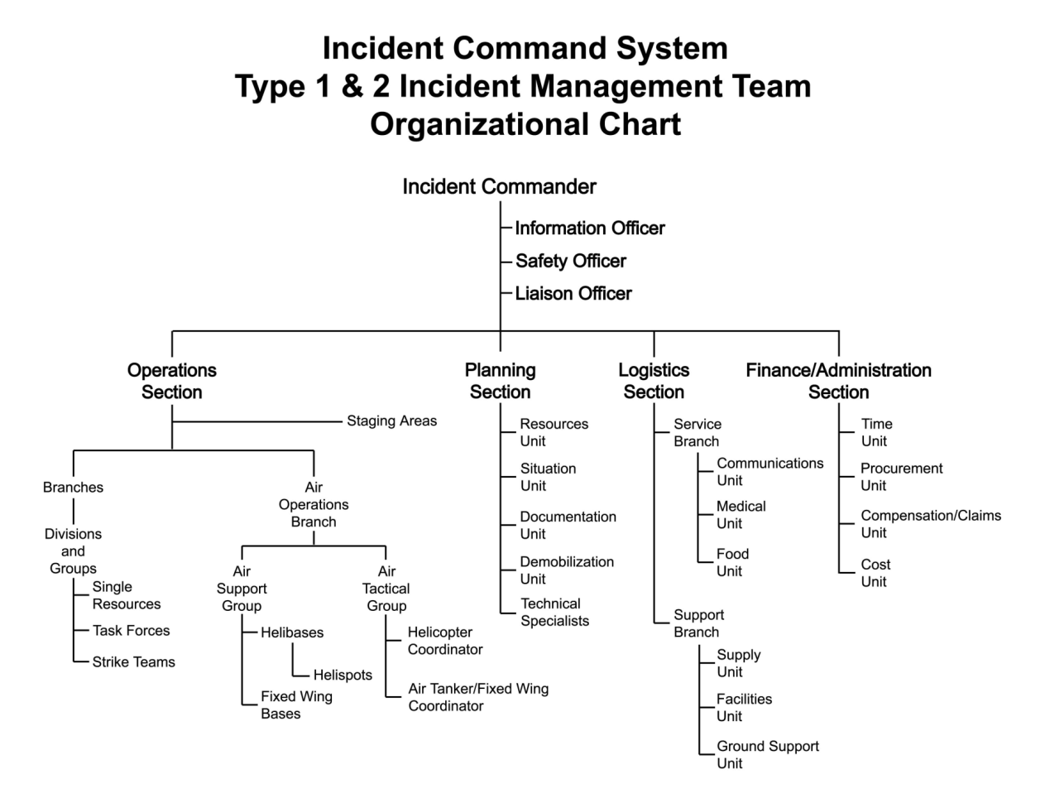

Slide 10
Pre-Course Work Review
Information Sharing
Example forms and other reference material will be available throughout course (instructors and students should share thumb drives)
Document Review
AOBD Position Task Book
Introduction to Aviation Risk Management
Aviation Risk Management Workbook
Daily Operational Risk Assessment Tool (DORA)
Interagency Airspace Coordination Guide
Military Use Handbook
Red Book
ICS 220
ICS 213 – Unit Log
IHOG
Emergency Helicopter Extraction Source List
Technical Assistance Directory
Wesley WFDSS Decision

Slide 11
Pre-Course Work Review, cont.
Website Review
NTSB: aviation incidents
Wildland Fire Chemicals
Questions?

Slide 12
Unit Objectives
1. Introduce the course coordinator, instructors, and students.
2. Discuss course logistics.
3. Present course overview.
4. Discuss course expectations.
5. Identify course reference materials.
6. Discuss position responsibilities.
7. Review pre-course work.

