Slide 1
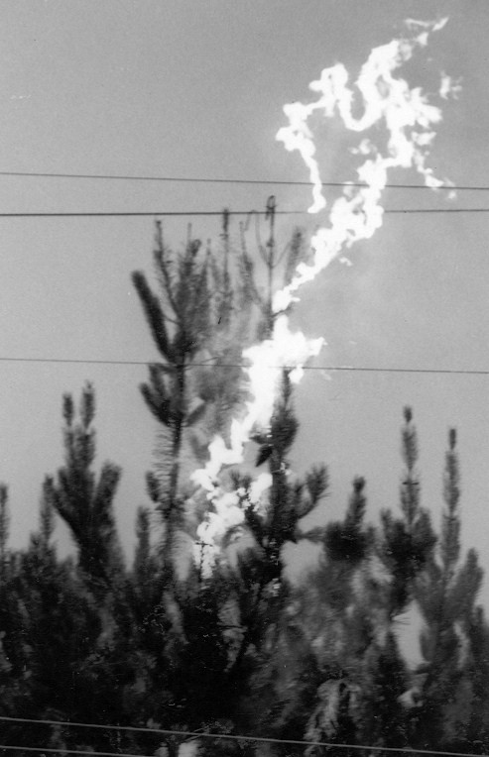
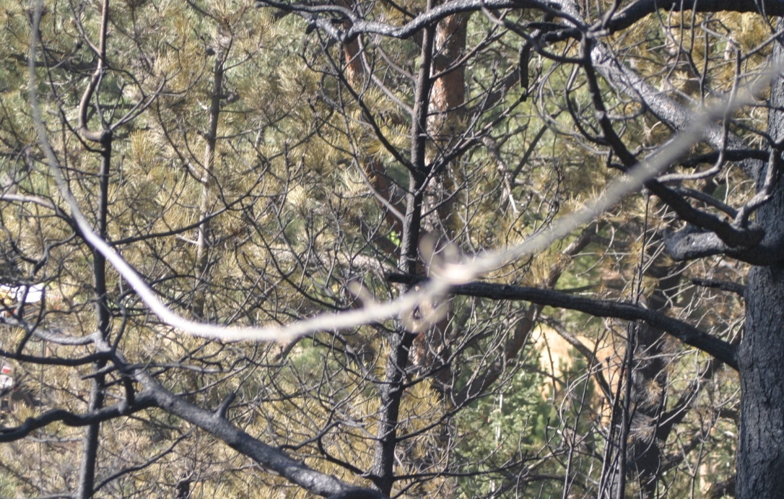
Safety
Notes:
REMEMBER, electrical lines and equipment is very unforgiving. That innocent looking line or hanging cable, tie wire, or guy wire may look de-energized, but “Are You Sure?”. Don’t bet your life on it! Before we cover anything further in this course we want you to know how to work safely in, on or around any electrical lines or electrical equipment.

Slide 2
Objective
Describe the hazards of working around electrical Power Lines and their related equipment.
Notes:
The hazards include the electrical energy, handling heavy materiel and items, working high above the ground, using specialized equipment, handling equipment that might contain hazardous materials.

Slide 3
Objective
Describe the methods and terminology regarding Safety Practices when investigating power line related wildfires.
Notes:
Each Electric Power Company may have different terms for these types of operations. You must know and understand their safety terminology and required safety practices.

Slide 4
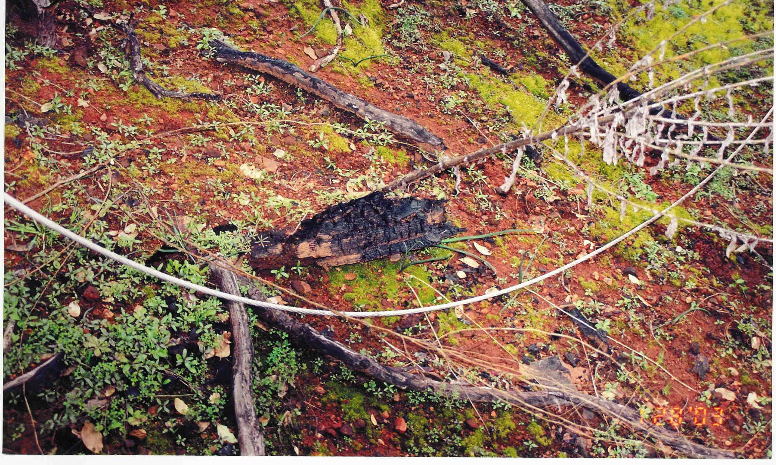
Is This Line Safe?
Notes:
How can you know?
Don’t guess? The only way to know is to have the respective electric utility company line staff render the line “Dead and Grounded” and having the circuit “Locked Out”. That includes having them certify to you that they have completed these tasks. You might even have THEM disconnect the lines or the equipment, under your direction and supervision.
Don’t take chances.

Slide 5
How about this one?
Notes:
It looks like it’s completely down, including the insulator.

Slide 6
Video Review
Please review the following videos:
(Note: Both videos can be found in the Appendices Section – Electrical Video file on the training disk)
Overland - Boom Cable contacting Power Lines
Transformer Failure – Shorting out of transformer

Slide 7
This Could Happen To You!
Downed Power Line Claims the Life of One Fire Fighter and Critically Injures Two Fellow Fire Fighters
A fire fighter was electrocuted and two other fire fighters were injured when they contacted an electric fence while fighting a grass fire. A fire was started when a downed power line ignited the surrounding grass. The Chief was the first to arrive on scene, and he confirmed that a power line was down. He also indicated to the responding fire fighters that the electric fence bordering the area was energized by the downed power line. Two fire fighters arrived and crawled underneath the bottom wire of the electric fence. After approximately 15 minutes on the fire ground, the three fire fighters were found lying in the area of a secondary fire.
Notes:
How could this have been prevented?

Slide 8
Another Example
Fire Fighter Dies After Coming into
Contact With a Downed Power Line
A fire fighter was electrocuted after responding to a call involving a brush fire located in a utility easement. The victim, the Chief, the Captain, the Lieutenant, and a fire fighter proceeded to the utility easement. They noted a tree had fallen and was leaning against the overhead power lines but did not see any downed lines. They found a small patch of smoldering debris between the base of an oak tree and woody brush. The victim, standing approximately 2 feet from the oak tree, was directed by the Chief to stomp out the embers in the smoldering brush. The victim contacted a downed, single-phase, 7.2 KV power line when he stepped on the smoldering pile.
Notes:
Even with your standard fire service and investigation Personal Protective Equipment (PPE), the potential for injury and death when dealing with electrical power lines and equipment is monumental.
Where can you get the right PPE for dealing with these dangers?

Slide 9
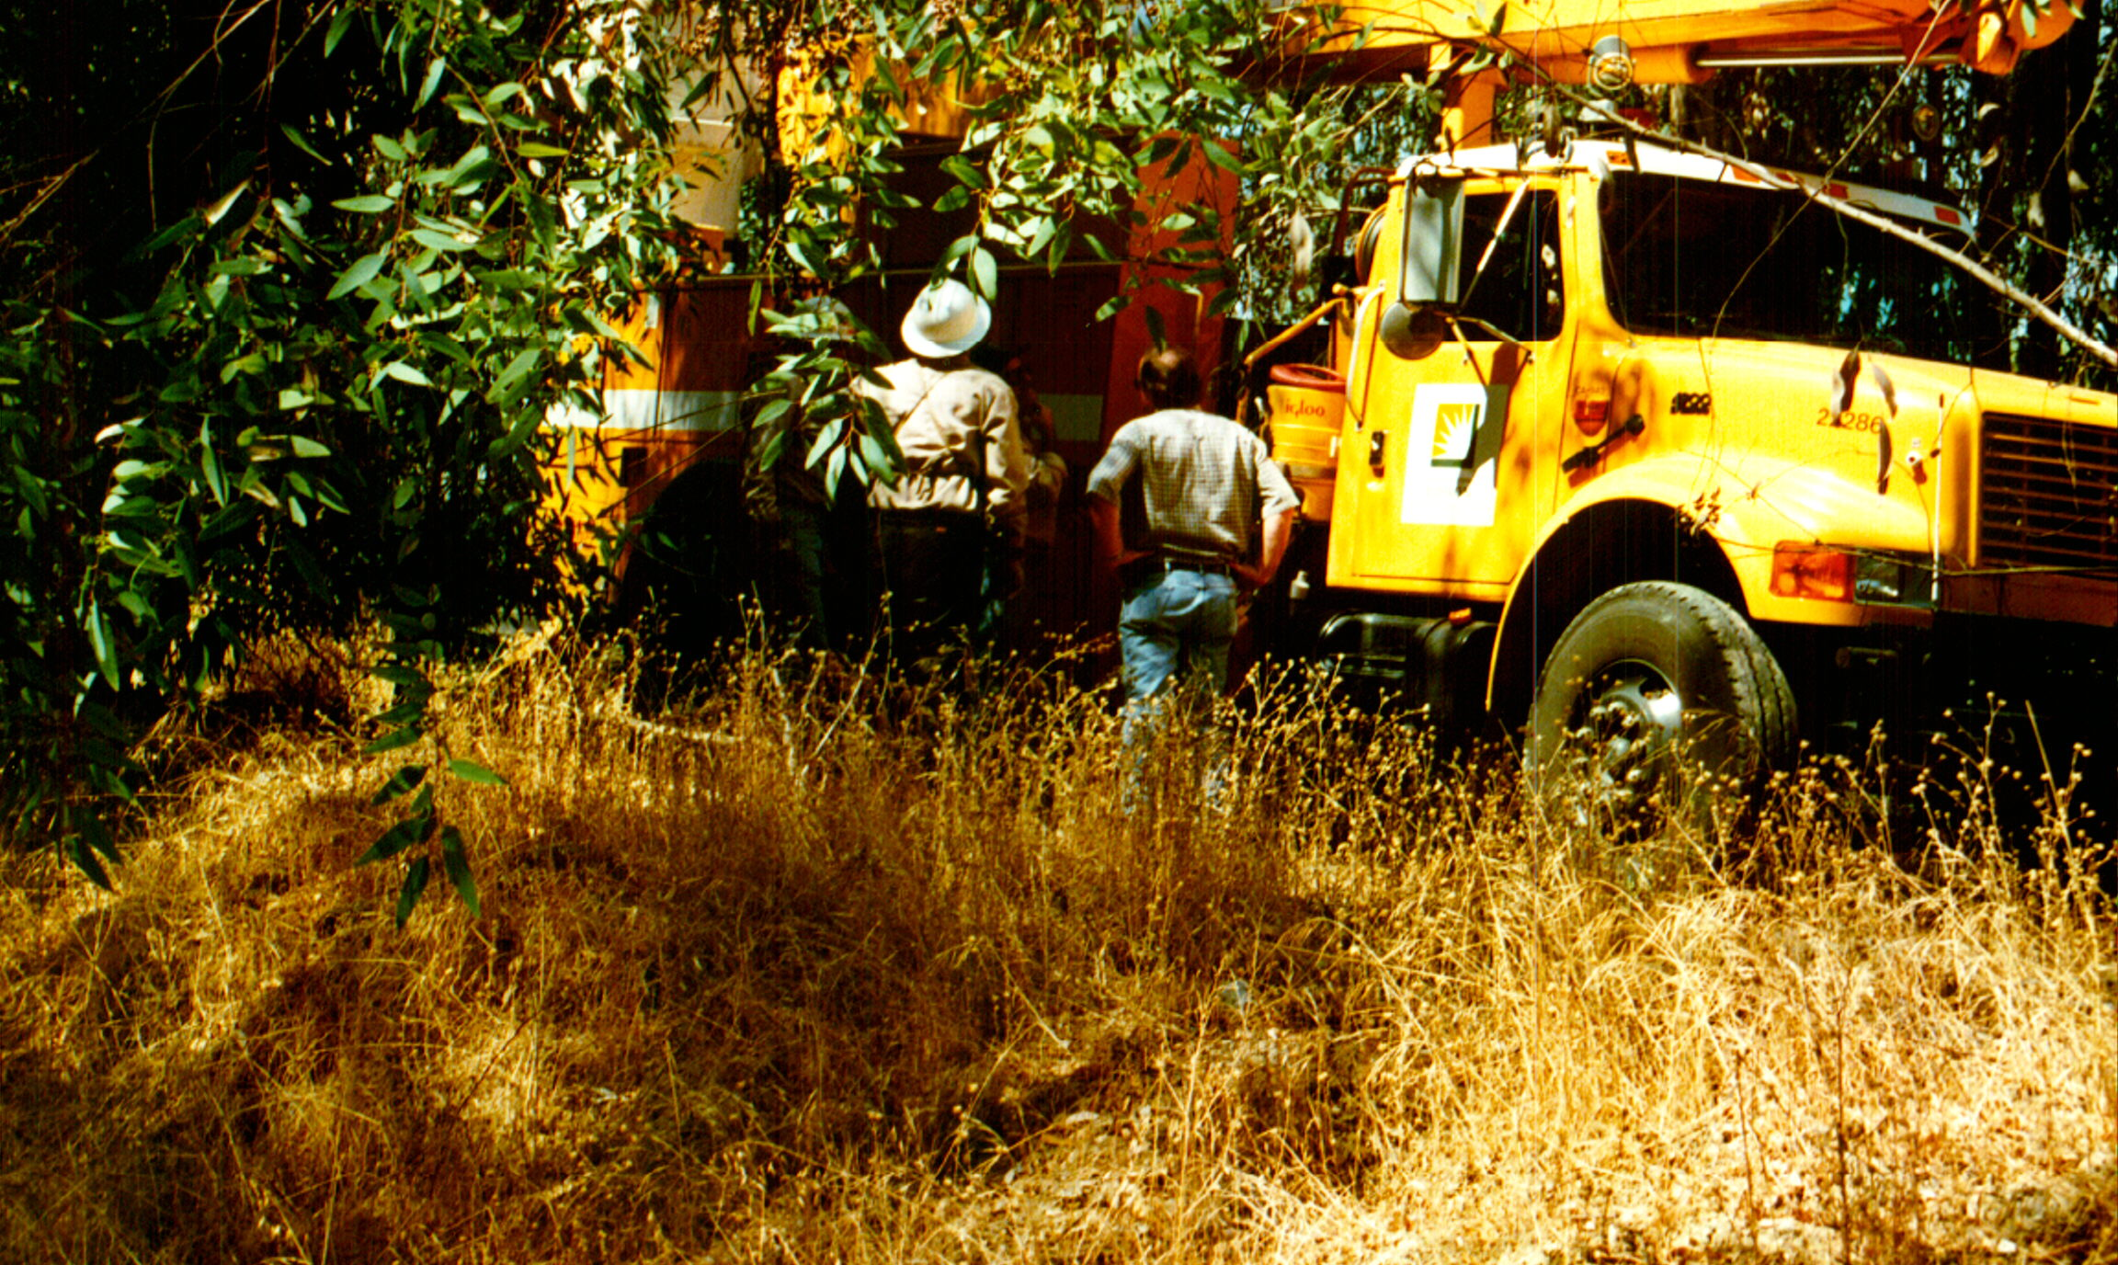
Call In the Experts -
They have the proper PPE.
Notes:
You will not have all of the necessary equipment or proper PPE for addressing the numerous safety requirements for working in, on or around electrical facilities, lines, or equipment. DO NOT be afraid to call in the necessary experts to assist you with your initial investigation.

Slide 10
Terminology
Each Electric Power Company may have different terms for these types of operations. Find out the terms used by the companies in your area and make sure that you are operating in an area that has been rendered safe.

Slide 11
Important Safety Terms
Dead: De-Energized (temporarily or permanently) disconnected from electrical energy or source of electrical energy.
Grounded: To connect a line or a piece of equipment to the earth.
Notes:
Although a line may be classified as “Dead”, it does not mean that it will stay that way. An Automatic Recloser may have recognized a fault and opened, rendering the line “Dead” for short period of time. If you walk on or pick-up the line or touch the equipment while the Recloser is open – nothing will happen; but, if the Recloser cycles to “On” to test the system, that 720 volts or however many KV’s are going to go right through YOU.
Although the line or equipment may be grounded, that does not mean that it is safe to handle the line or equipment as it may still be energized. Electricity will always take the path to least resistance; and, that path may be directly through YOU.

Slide 12
Important Safety Terms (cont’d)
Dead and Grounded: Disconnected from a source of electric energy and connected by a secondary or safety line to earth so that any electrical energy that passes through the line or equipment will shunt to ground.
Locked Out: The electric line or equipment has been physically removed from the system and cannot be energized until the circuit has been physically reconnected to the system.
Notes:
Once the electric utility staff can certify to you that these two conditions have been met, then you can confidently work around the electric lines and equipment.

Slide 13
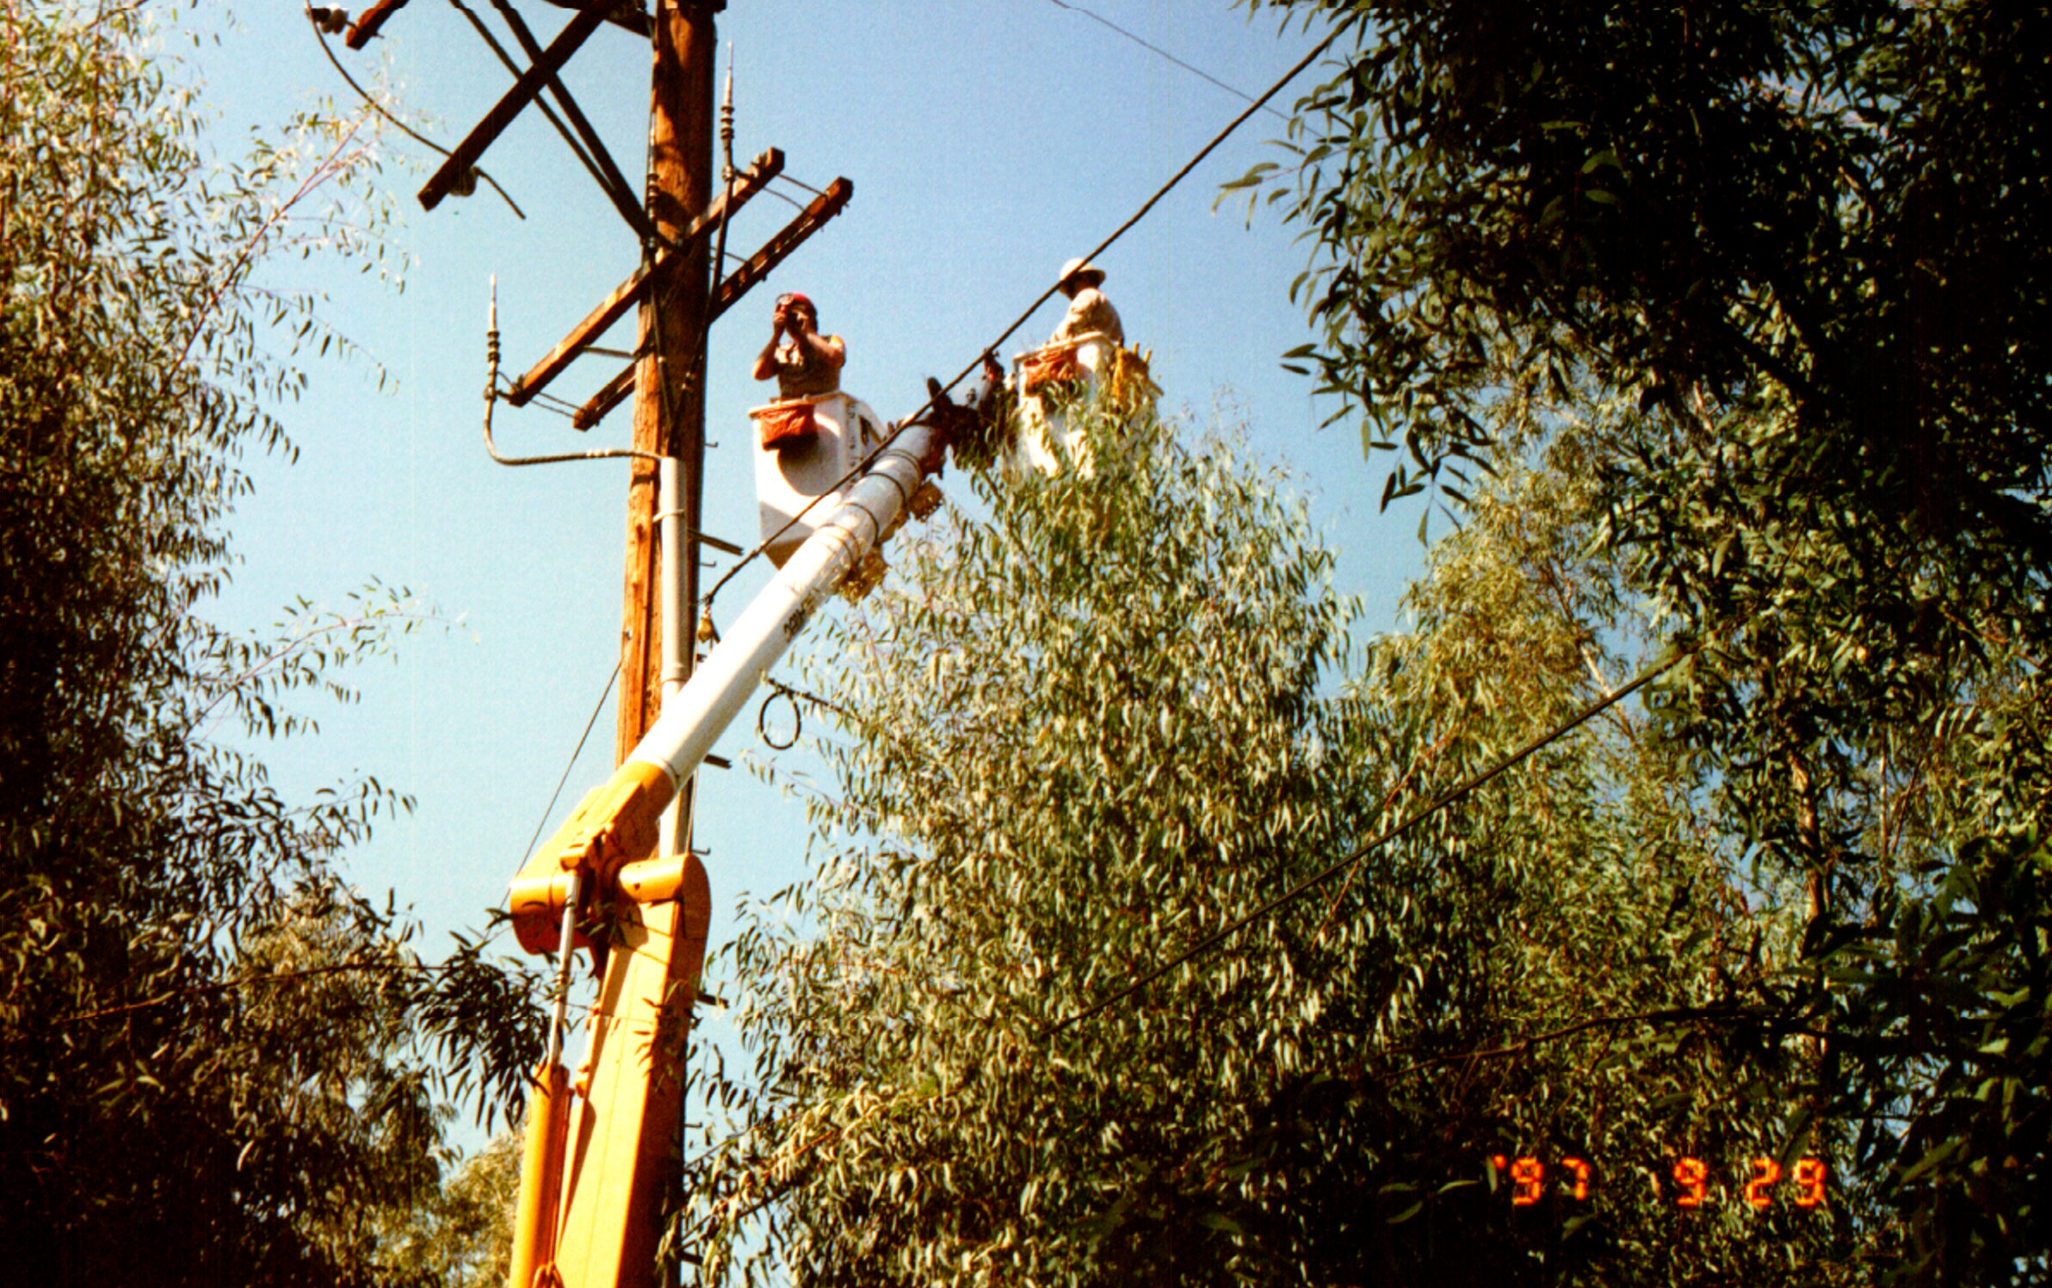
On with Your Investigation and Collection of Evidence
Notes:
By working with the electric utility provider, you will be able to conduct your investigation safety and may even be able to their equipment to help in the collection of the evidence that you require.

Slide 14
Additional Safety Tips
Check Industry Standard, Occupational Health and Safety, and Environmental Protection Agency Regulations in your area:
Some provisions prohibit non-certified individuals from operating or having lift equipment within 10 feet of energized conductors
Some provisions prohibit non-certified individuals from being in possession of or storing hazardous materials that can be found in electrical equipment
Notes:
Make sure you know the standards and requirements for your area. Don’t get caught and have an OSHA Citation issued for your Fire Investigation activities.

Slide 15
Knowledge Check
When initiating your fire investigation of a wildfire potentially caused by electric power lines or equipment, the necessary PPE includes:
Your standard wild land fire service PPE
Specialty items from the electrical utility provider
Your standard investigative safety equipment
Specialty items from your agency’s supply unit.
Notes:
The correct answer is B. The electric utility’s construction and line personnel have the necessary PPE and equipment to render the circuit. Line, and equipment safe and have the correct tools to remove the lines and equipment for investigative purposes.

Slide 16
Knowledge Check
You can conduct fire investigations around electric facilities and equipment when they are found to be:
Show no signs of arching and are safe to the touch
Are touching the ground
Show no signs of arching, are safe to the touch, and are touching the ground
Certified “Dead and Grounded” or “Locked Out” by the electric utility provider
Notes:
The correct answer is D. In any other situation, the line or equipment can become energized at any time and cause injury and/or death.

