Slide 1
Equipment Description
Notes:
The Electric Utility System is much more than just Generation facilities, Towers, Poles, Lines, and Substations. At each of these locations there must be ancillary equipment that helps attach the lines to the towers, poles, and substations; equipment to protect the systems from shorting, overloading, and adjusting the levels of electric current throughout the system.

Slide 2
Objective
Describe the Typical Electric Utility Ancillary Equipment, their Primary Function, and their Potential Faulting and Failures.
Notes:
This section will provide you with the basic understanding of the types of equipment used throughout the system and how the function. In addition, the standard operation of many of these devises may generate potential ignition sources and should not be considered as a “failure” on the equipment’s function. However, electrical equipment can “fail” to function properly when if it is installed improperly, is not properly maintained or it is subjected to conditions outside the normal range of operations.

Slide 3
Ancillary Equipment
Fuses
Cutouts
Disconnects
Lightning Arresters
Hot Tap Clamps
Split Bolt Connectors
Miscellaneous Connectors
Air Switches
Reclosers
Sectionalizers
Voltage Regulators
Capacitor Banks
Transformers
Parallel Grove Connectors
Piercing Tap Clamps Wedge Connectors
Compression Connectors
Flat Plate Connectors
Automatic Deadends
Splices
Insulators
Notes:
Most equipment can be categorized into these general areas. Depending on the style, type, and components when operating properly the item may generate moderate to large quantities of ignition source materiel or may not generate any. Those that are known to generate ignition source materiel are classified as “Non-Exempt” in many areas and will require the application special clearance and maintenance requirements. Those that do not normally generate sources of ignition when operating properly are classified as “Exempt” and are not normally subject to the same requirements as “Non-Exempt”. However, the Fire Investigator must be aware that even though the types of equipment in the Area of Origin are classified an “Exempt”, they may have generated the source of ignition and their classification should not be mistaken as excluding them from consideration.

Slide 4
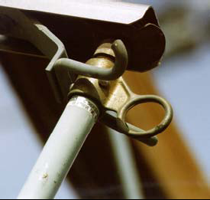
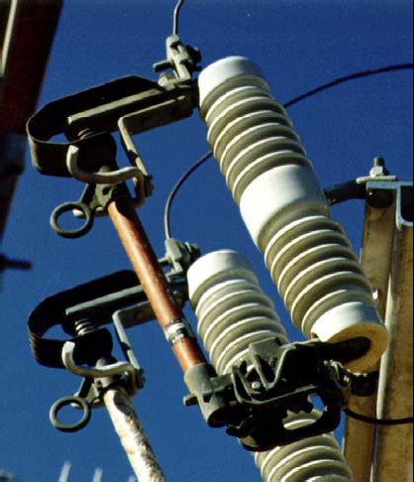
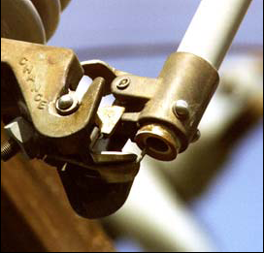
Universal Fuse
Non-Exempt
Pull Ring
Expulsion end of fuse
Notes:
When functioning properly, the heating and breaking of the fuse will drop out hot molten materiel that would be expelled from the bottom of the fuse and may be an ignition source. The Fire Investigator may find melted pieces of the fuse or parts of the expelled materiel. If contact is made by a foreign object between the upper and lower portions of the fuse or fuse holder a failure can occur.

Slide 5
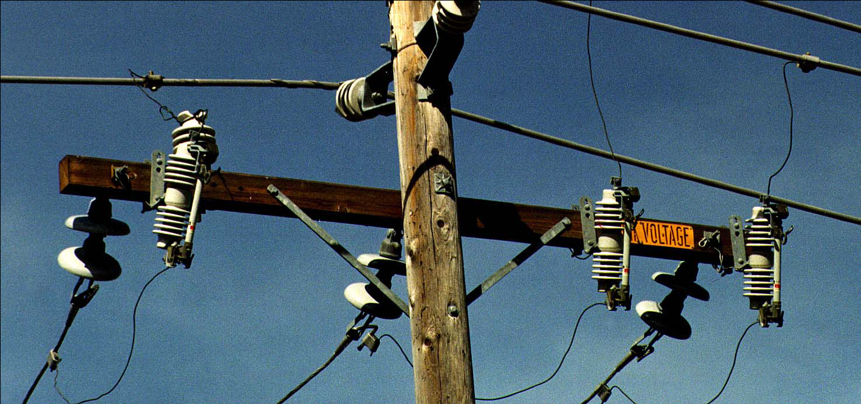
Universal Fuse
Non-Exempt
Arm Mounted Cutout with Universal Fuse

Slide 6
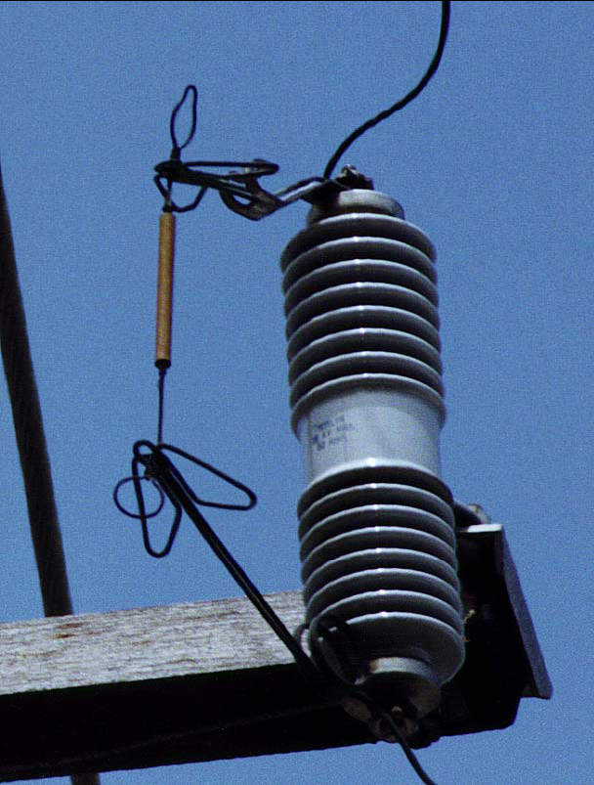
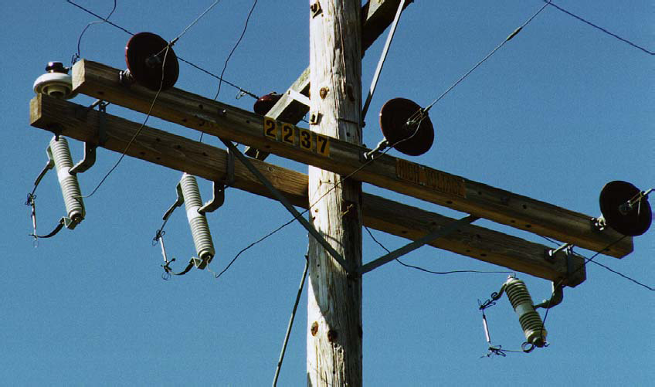
Open Link Fuse
Non-Exempt
Arm Mounted Cutout with Open Link Fuse
Notes:
When functioning properly, the heating and breaking of the fuse will drop out hot molten materiel that would be thrown from the fuse and may be an ignition source. The Fire Investigator may find melted pieces of the fuse or parts of the expelled materiel.

Slide 7
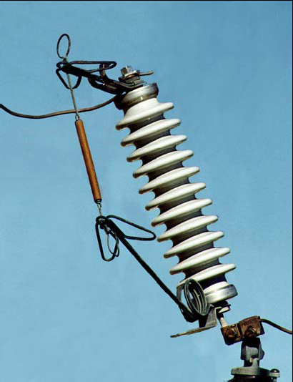
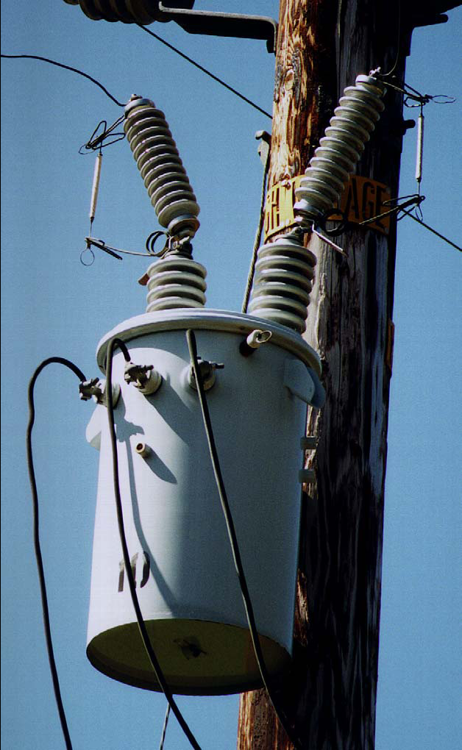
Open Link Fuse
Non-Exempt
Bushing Mounted Cutout with Open Link Fuses

Slide 8
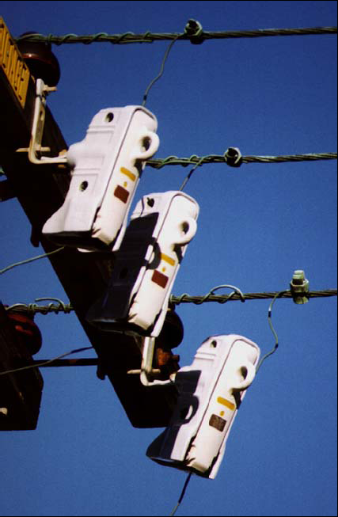
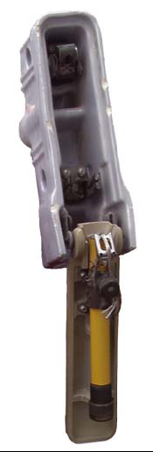
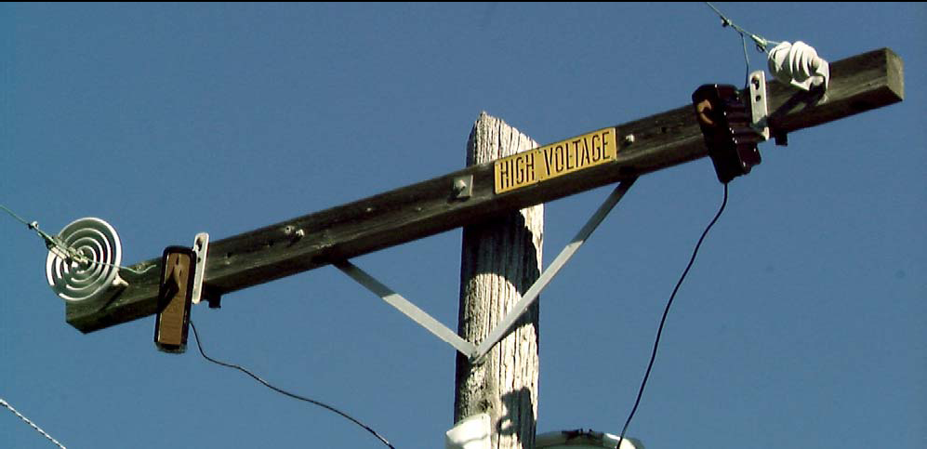
Enclosed Cutouts with Universal Fuse
Non-Exempt

Slide 9
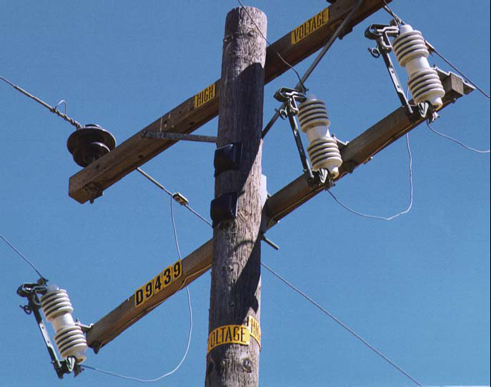
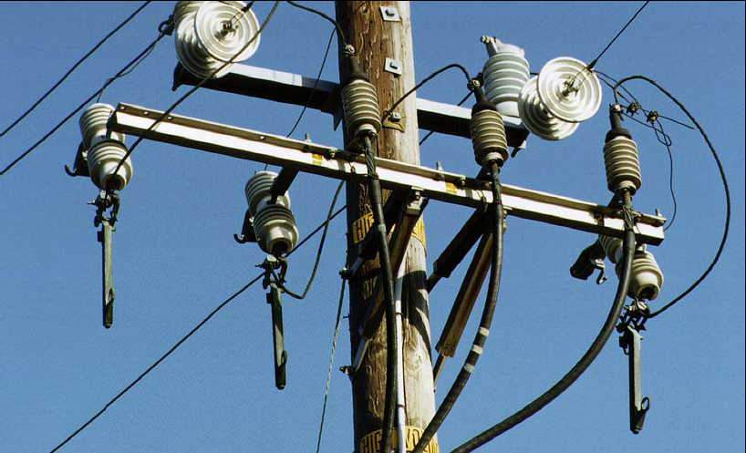
Solid Blade Disconnect
Non-Exempt
Solid Blade Disconnect - Closed
Solid Blade Disconnect - Open
Notes:
When moving from the closed to open position there is the potential for an electrical arch that may produce hot molten materiel that may be an ignition source. The Fire Investigator may find molten pieces of metal and would need to exam the blades to determine if they had been damaged and were a sources of the materiel.

Slide 10
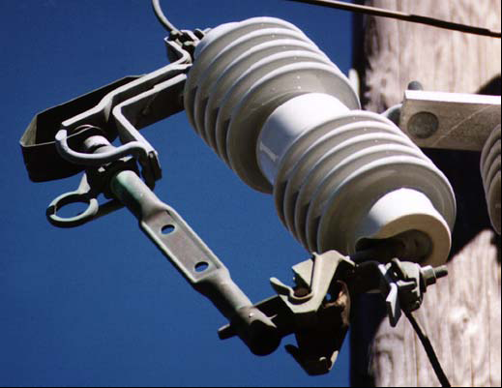
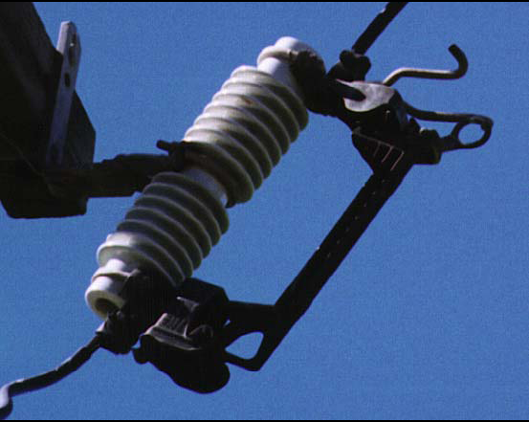
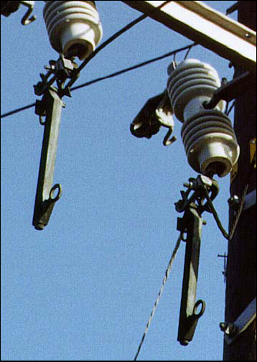
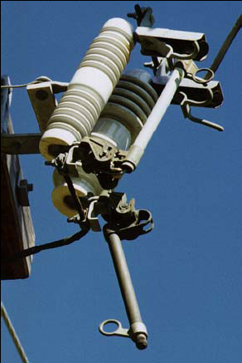
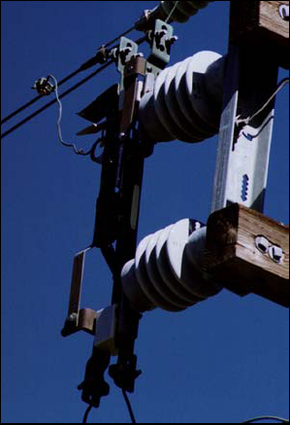
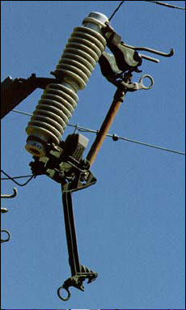
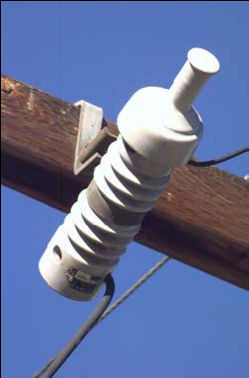
Solid Blade Disconnect
Non-Exempt
4 kV Bayonet
600 amp disconnect
Notes:
Note: Solid Blade Disconnects are considered “Exempt” when used in conjunction with Reclosers, Sectionalizers, and Voltage Regulators. However, they may still expel materiel.

Slide 11
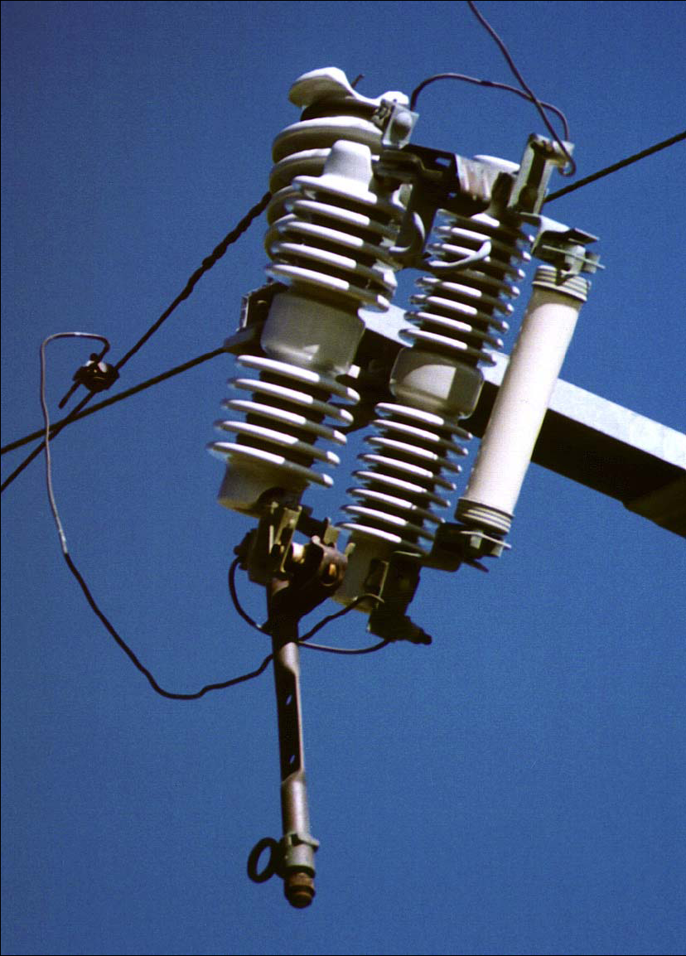
Combination
Non-Exempt and Exempt Hardware
Arm Mounted Cutout with Non-Expulsion Fuse - Exempt
Solid Blade Disconnect in
Open Position – Non-Exempt

Slide 12
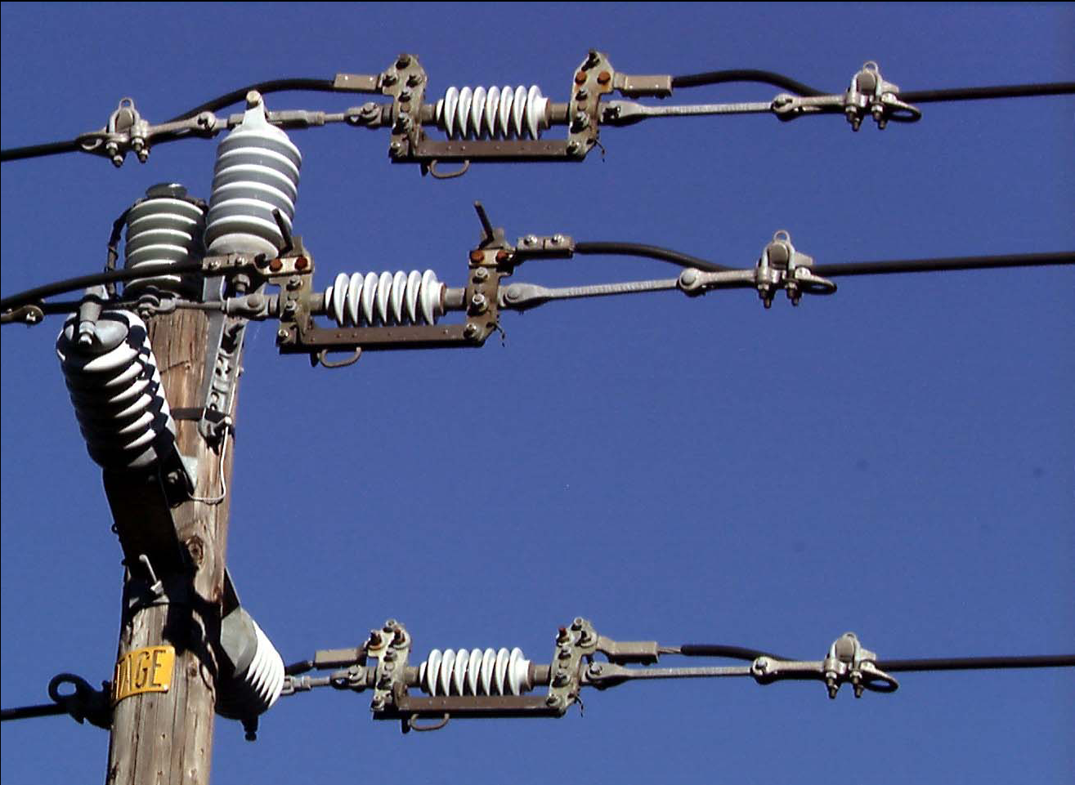
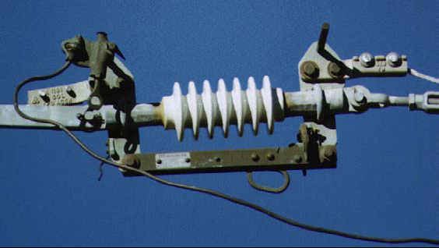
In-Line Disconnect
Non-Exempt
Notes:
When moving from the closed to open position there is the potential for an electrical arch that may produce hot molten materiel that may be an ignition source. The Fire Investigator may find molten pieces of metal and would need to exam the blades to determine if they had been damaged and were a sources of the materiel.

Slide 13
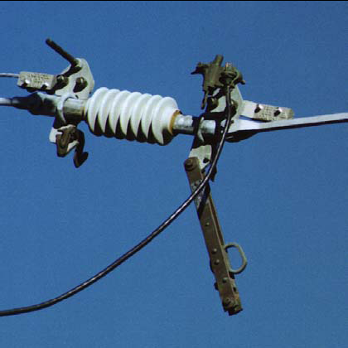
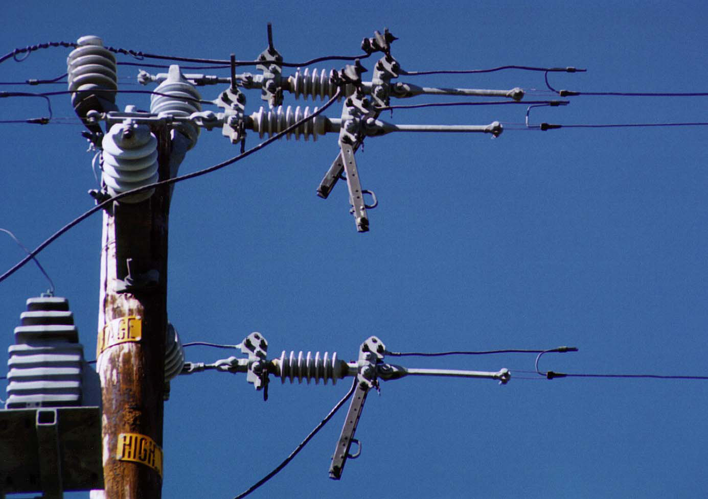
In-Line Disconnect
Non-Exempt

Slide 14
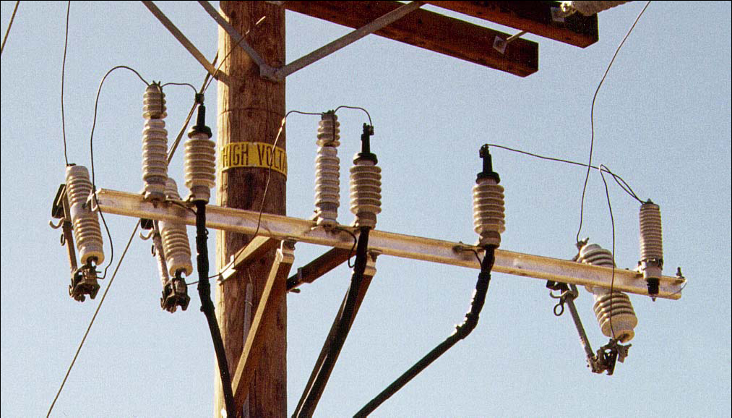
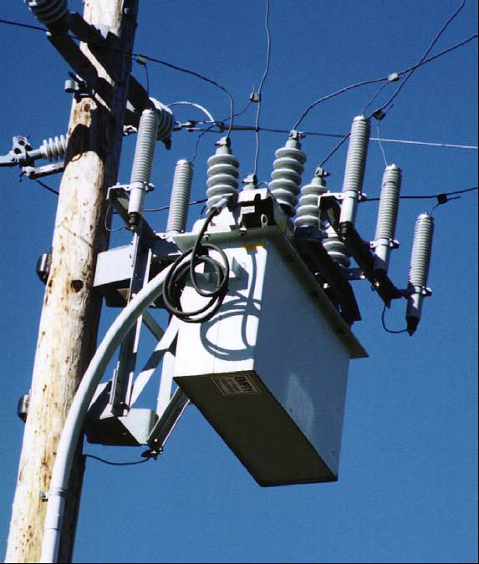
Lightning Arrestors
Non-Exempt
Lightning Arrestors
with Recloser
Arm Mounted Lightning Arrestors with Cable Riser and Universal Fuses
Notes:
When functioning properly, the lightning arrestor may drop out hot molten materiel springs or parts from the bottom of the arrestor and may be an ignition source. The Fire Investigator may find melted pieces of the arrestor or parts of the expelled materiel. If contact is made by a foreign object between the upper and lower portions of the arrestor a failure can occur.

Slide 15
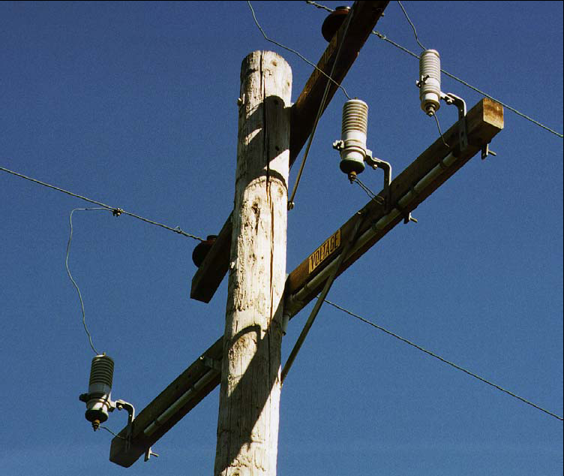
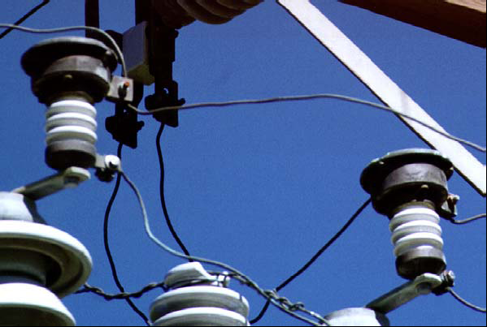
Lightning Arrestors
Non-Exempt

Slide 16
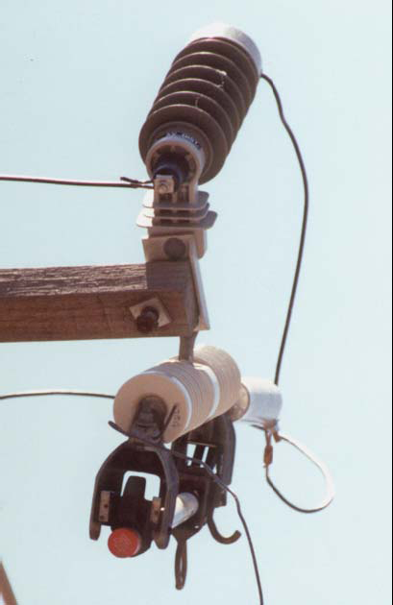
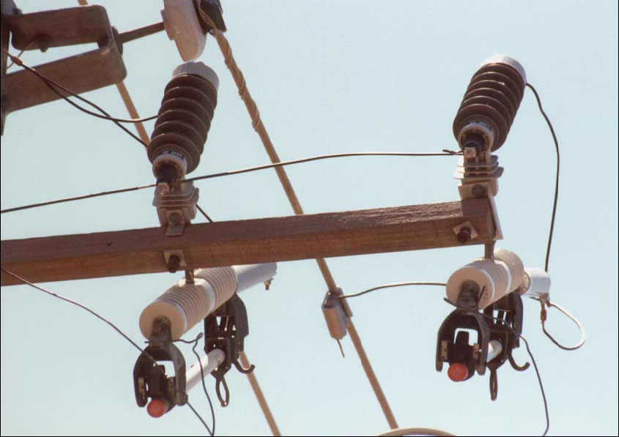
Non-Porcelain Lightning Arrestors
Non-Exempt

Slide 17
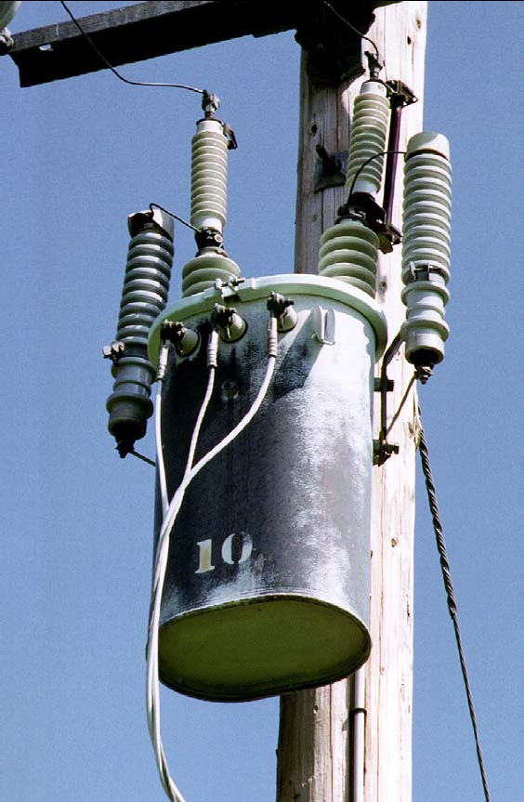
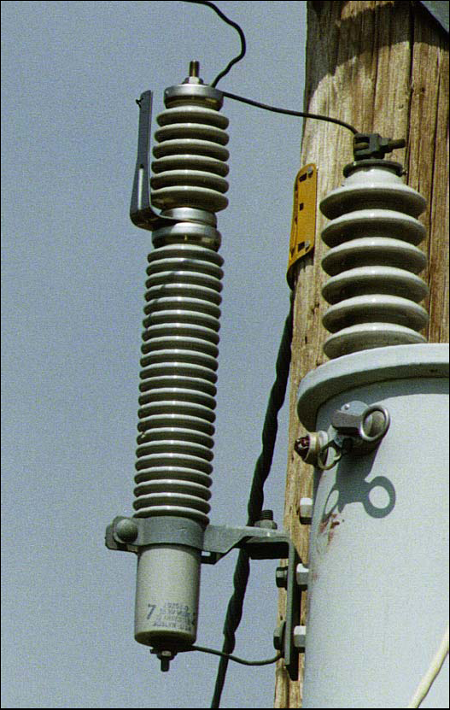
Lightning Arrestors
Non-Exempt
Gapped Lightning Arrestor
Lightning Arrestors
with Transformer

Slide 18
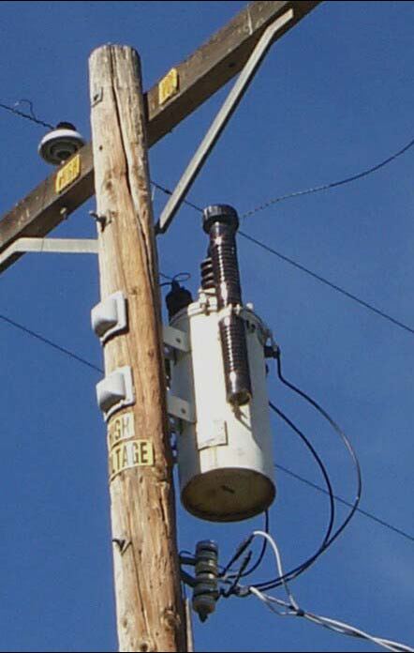
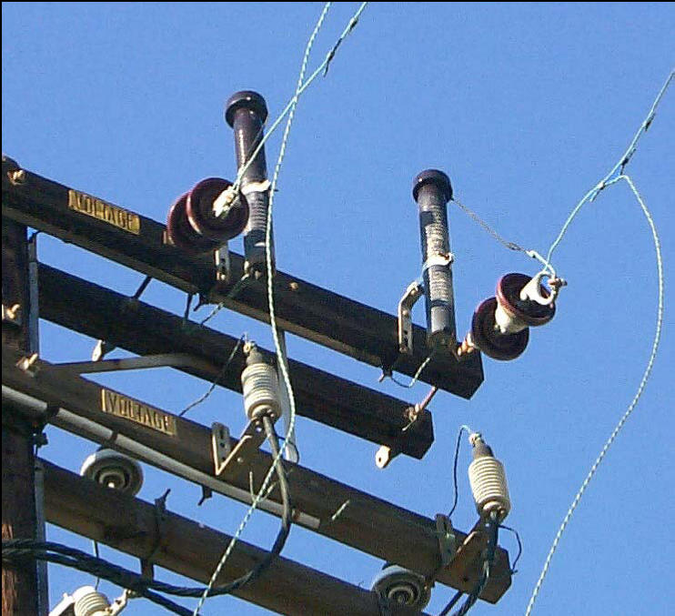
Lightning Arrestors
Non-Exempt

Slide 19
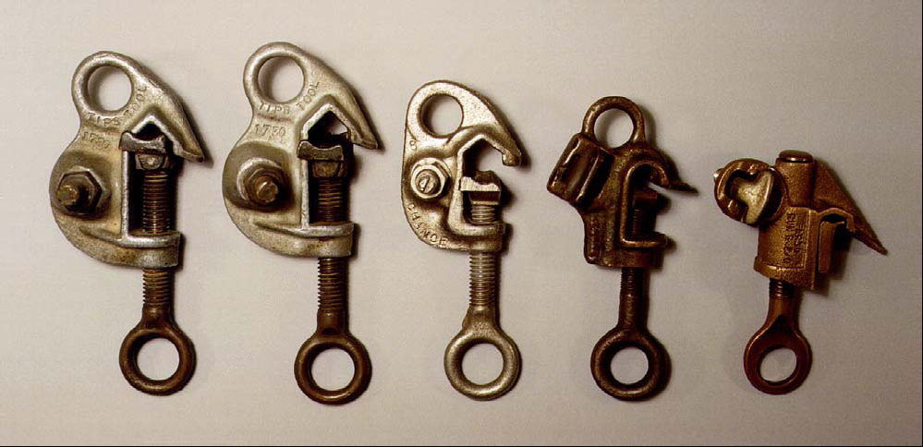
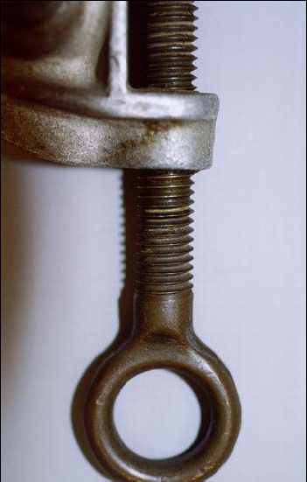
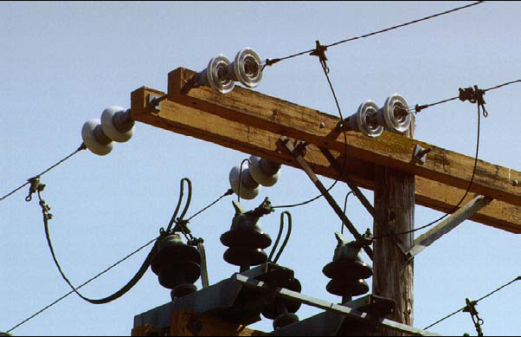
Hot Tap Clamps
Non-Exempt
Notes:
Note: These types of Hot Tap Clamps are “Non-Exempt”. Other types of Hot Tap Clamps shown later are “Exempt”. Those have mechanisms that maintain pressure on the clamping device to avoid slippage and arching. The Fire Investigator may find molten pieces of metal and would need to exam the clamps and the line to determine if they had been damaged and were a sources of the molten materiel.

Slide 20
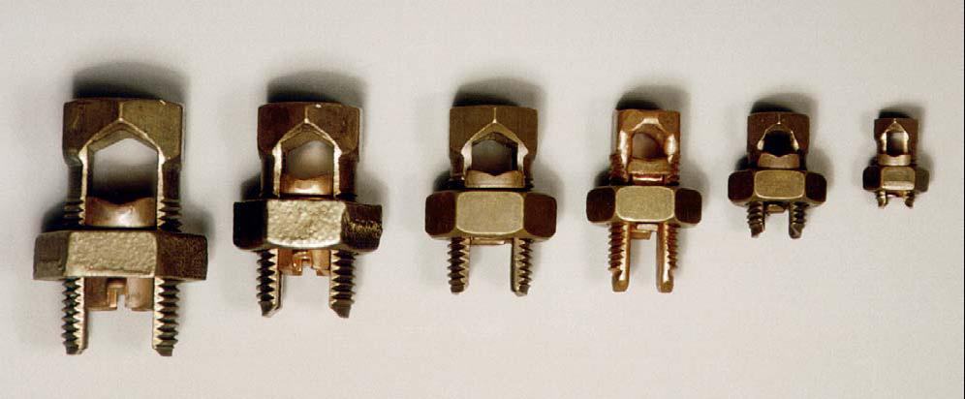
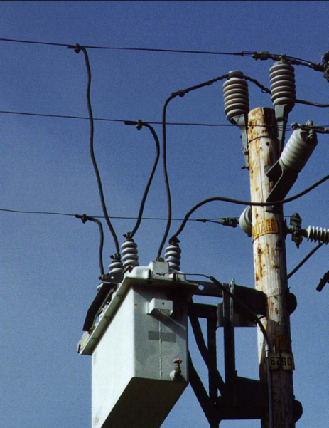
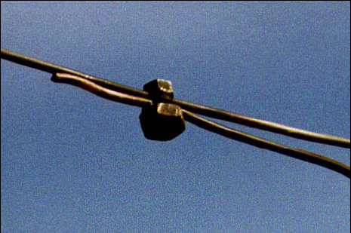
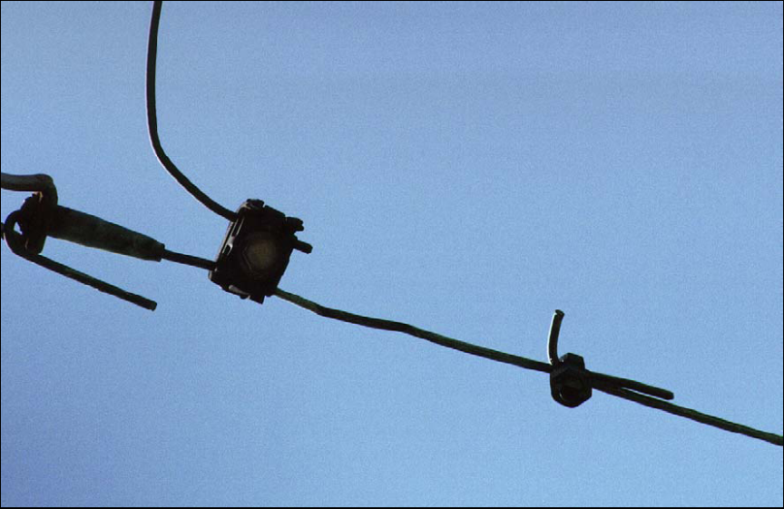
Split Bolt Connectors
Non-Exempt
Idle Split Bolt
Notes:
Note: Split Bolt Connectors used in this configuration are “Non-Exempt”. If shown in an “Idle Position” , that is the Split Bolt is connected to one line but the other line is not connected to any line. Equipment or other hardware it is “Exempt”. The Fire Investigator may find molten pieces of metal and would need to exam the connectors and the line to determine if they had been damaged and were a sources of the molten materiel.

Slide 21
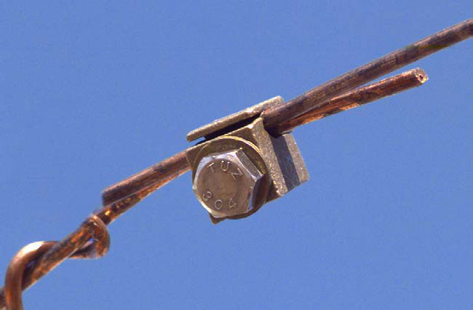
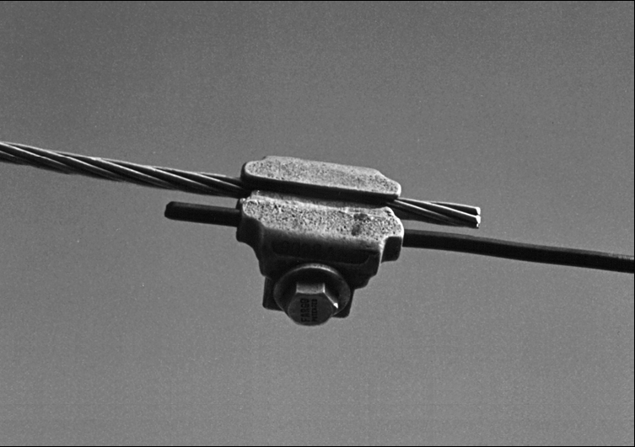
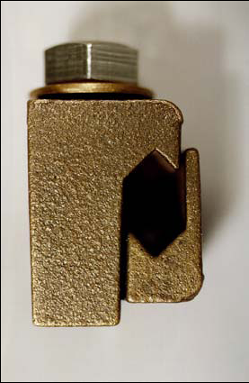
Miscellaneous Connectors
Non-Exempt
Fargo Connectors
LM Connector

Slide 22
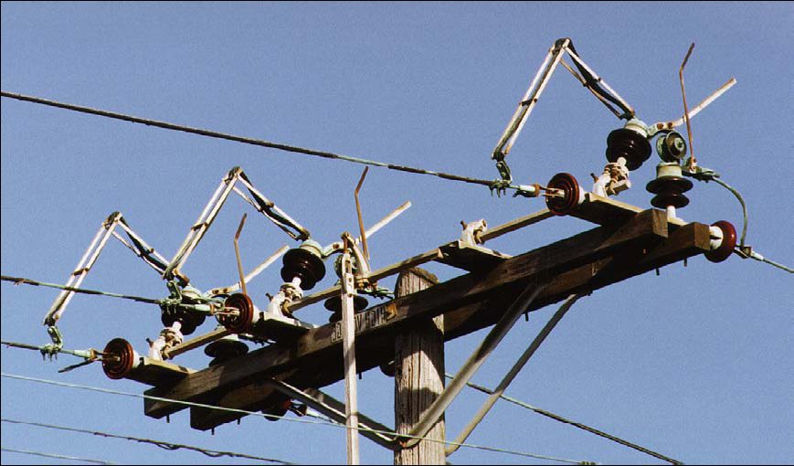
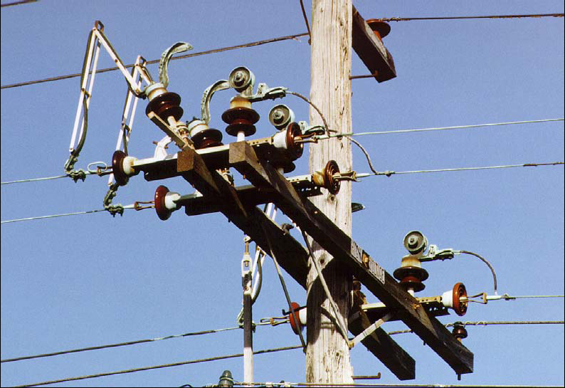
Grasshopper Air Switch
Non-Exempt
Closed
Open
Notes:
When operating normally, the action of moving from the closed to open position may establish an arch between the blades that may expel molten materiel that may be an ignition source. The Fire Investigator may find molten pieces of metal and would need to exam the blades and the connecting points to determine if it had been damaged and was a source of the molten materiel.

Slide 23
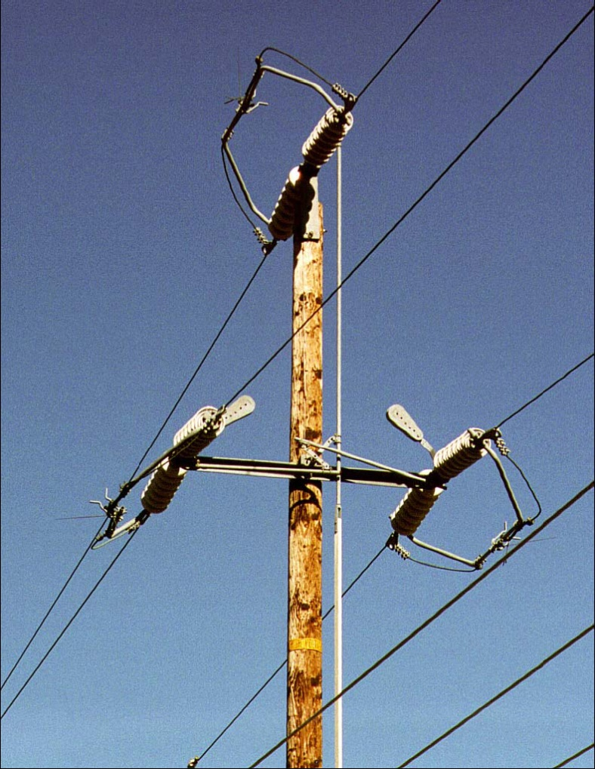
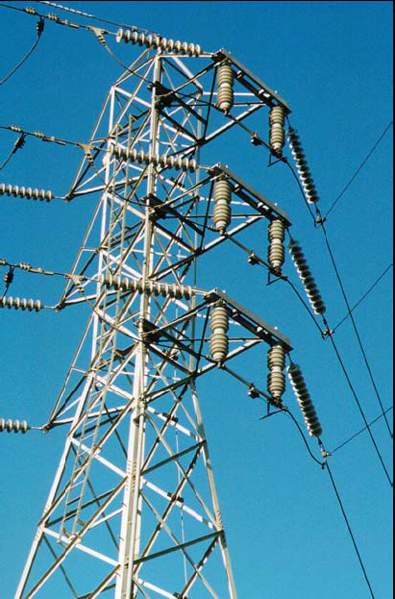
Transmission Air Switch
Non-Exempt
Notes:
When operating normally, the action of moving from the closed to open position may establish an arch between the blades that may expel molten materiel that may be an ignition source. The Fire Investigator may find molten pieces of metal and would need to exam the blades and connecting points to determine if it had been damaged and was a source of the molten materiel.

Slide 24
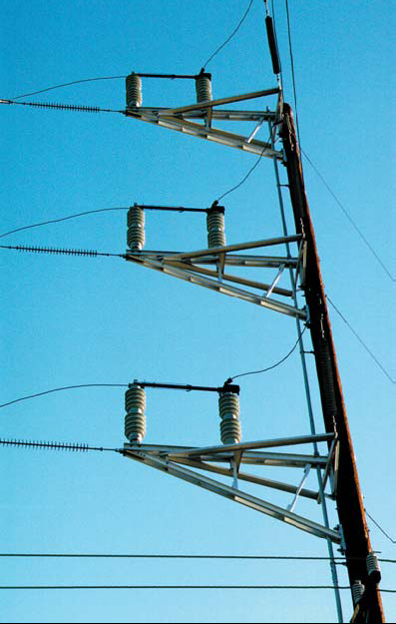

Transmission Air Switch
Non-Exempt

Slide 25



Non-Expulsion Fuses
Exempt

Slide 26


Non-Expulsion Fuses
Exempt

Slide 27


Liquid Filled Fuses
Exempt

Slide 28


Liquid Filled Fuses
Exempt

Slide 29



SMU-20 Fuses
Exempt

Slide 30

SMU-20 Fuses
Exempt
Lightning Arrestors
Non-Exempt

Slide 31


S&C Fault Tamer Fuses
Exempt

Slide 32




600 Amp KPF Air Switch
Exempt
Triangular Construction – Open and Closed Positions
Notes:
Although these Air Switches operate similar to those that are “Non-Exempt” the metal “whip-like tail” that can be seen in the open position minimizes the arching potential and molten metal development.

Slide 33


600 Amp KPF Air Switch
Exempt
Crossarm Construction – Closed Position

Slide 34


Underarm Sidebreak Switch
Exempt
Open Position

Slide 35


Underarm Sidebreak Switch
Exempt
Closed Position

Slide 36


S&C Underarm Side-break Switch
Exempt
Closed Position

Slide 37



S&C Omni-Ruptor Switch
Exempt
Open Position
Closed Position

Slide 38



S&C Scada-Mate Switch
Exempt
Closed Position - Red
Open Position - Green

Slide 39


Recloser
Exempt
Solid Blade Disconnects
In-Line Disconnects
Notes:
Solid Blade and In-Line Disconnects are considered “Exempt” when used in conjunction with Reclosers, Sectionalizers, and Voltage Regulators. However, they may still expel materiel.

Slide 40


Sectionalizer
Exempt

Slide 41


Voltage Regulators
Exempt

Slide 42


Capacitor Bank
Exempt

Slide 43


Transformers
Exempt

Slide 44



Parallel Groove Connectors
Exempt

Slide 45



Hot Tap Clamps
Exempt
Notes:
Note the “Ears” on the bottom of the Exempt Hot Tap Clamp. The “Non-Exempt” Hot Tap Clamps do NOT have the “Ears”.

Slide 46


Piercing Hot Tap Clamp
Exempt
Piercing Clamp on Tree Wire

Slide 47



Wedge Connectors
Exempt

Slide 48



Compression & Bolted Flat Plate Connectors
Exempt

Slide 49



Splices
Exempt
Notes:
Note: Splices may be installed on lines that have been weakened by line to line or contact that caused arching and dropped molten metal as an ignition source or tree to line contact that was an ignition source for a wildfire. The splices will cover the pit marks and make the identification of the evidence difficult. Once in place the splices are difficult to remove. For the Fire Investigator, the discovery of freshly installed splices within the area of origin, may require additional evidence gathering that may include obtaining the section of the line in question.

Slide 50


Animal Protection Devices
Insulated Conductor Covering
Birds – Squirrels - Cats
Raptor Perch - Birds

Slide 51



Animal Protection Devices
Anti-Perch Guard
Anti-Perch Owl

Slide 52


Animal Protection Devices
Squirrels Guards

Slide 53




Circuit Protection Devices
Vibration Dampers
Vibration Dampers
Line Opener
Long Span Conductor Spreader

Slide 54




Insulators
Notes:
Insulator failures are common when they are not maintained. Age may warp the holes hold the insulator seating pin and cause arching. Dirt, moisture, bird drops may negate the insulating properties and cause a short, arching, and insulator failure.

Slide 55
Knowledge Check
Which of the following pieces of electrical ancillary equipment is classified as “Non-Exempt”:
  Piercing Hot Tap Clamp
  Universal Fuse
  SMU-20 Fuse
  Transformer
Notes:
The correct answer is B. A Universal Fuse will expel hot molten materiel from the expulsion port of the fuse.

Slide 56
Knowledge Check
Which item of electrical ancillary equipment is always classified as “Non-Exempt :
  Hot Tap Clamps
  Split Bolt Connectors
  Solid Blade Disconnects
  Grasshopper Air Switches
Notes:
The correct answer is D. The Grasshopper Air Switch. The others may be classified as “Exempt”: Hot Tap Clamps are Exempt if fitted with a spring type locking mechanism (Clamp will have “ears” on the end of the fitting); Split Bolt Connectors are Exempt if they are in an idle position; and Solid Blade Disconnect are Exempt if they are used in conjunction with a Recloser, Voltage Regulator, or Sectionalizers.

Slide 57
Knowledge Check
“Exempt” hardware can be an ignition source for Wildfires:
True
False
Notes:
The correct answer is True. The Fire Investigator should not discount those ancillary electric equipment because they are classified as “Exempt”.

