Slide 1
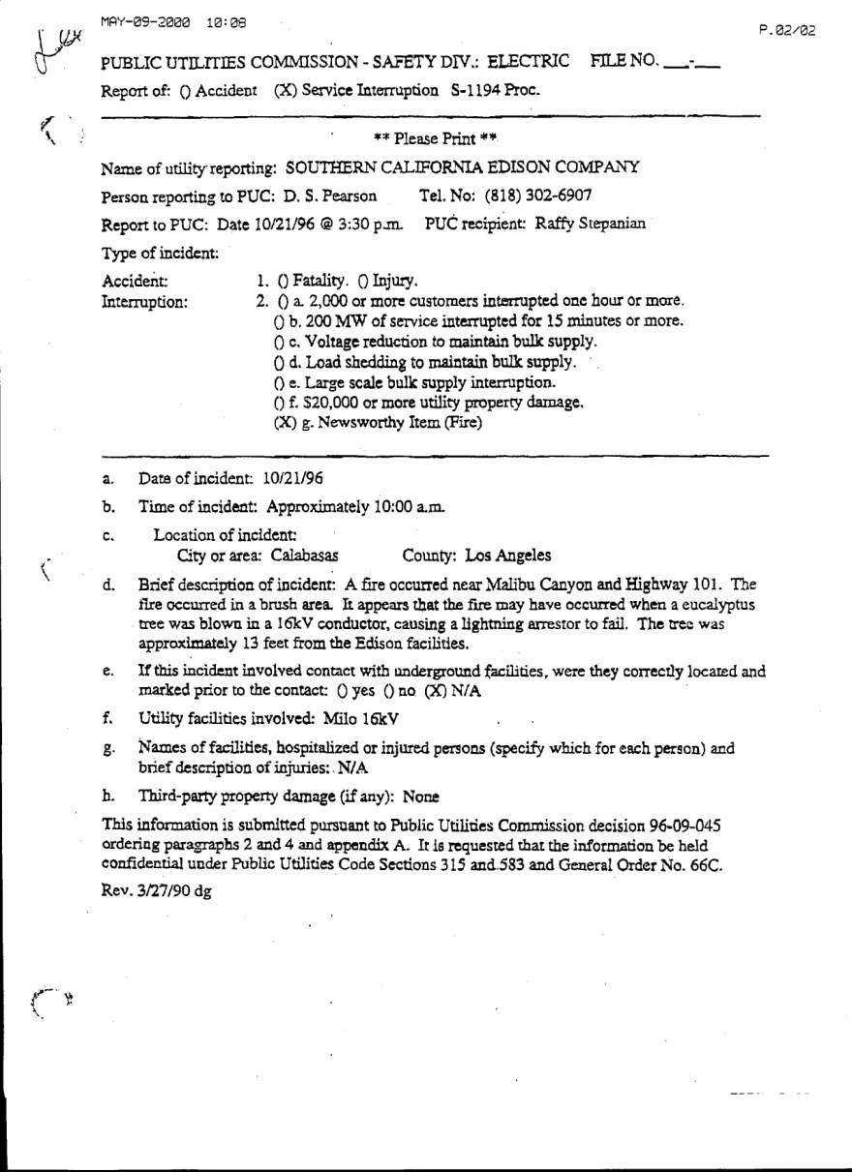
Records and Information
Notes:
Each electric utility company is required to maintain numerous records and reports as part of their normal business practices. Many, if not all of these manuals, records, reports, and logs will be available either through general written requests for your investigation, and if necessary, through administrative subpoenas, warrants, or through discovery requests during litigation.

Slide 2
Objective
Describe the types of records that can be requested and obtained from the electric utility and regulators.
Notes:
There’s a lot of them that will be available and any one of them may help you show that the company can be held liable for the damages and suppression costs.

Slide 3
Information
General Information:
Circuit Maps
High Wind Area Maps and Construction Standards
Circuit Construction Records
Operations and Maintenance Manuals
Patrol Manuals
Operation & Maintenance Policy and Procedures
Use Permits
Easements
Notes:
Each utility may use different terminology for all of these types of items, but they will have something similar. Do not hesitate to find out what each of the electric utilities within your jurisdiction uses and if you can obtain copies prior to an incident – do so. You may have access to these items through the areas Public Utility Commission or Authority.

Slide 4
Information
General Information (con’t):
Line and Pole Clearance Operations Manuals
Line Clearance Supervisor’s Manual
Accident Prevention Manual
Hazard Reduction Guides
Fire Reporting & Response Manual
Training Programs and Records
Annual Reports
Annual Budget and Expenditure by Program
Reports to Stockholders
Reports ro Public Utility Commission or Authority
Notes:
A lot of these items are available and may help with the initial investigation.

Slide 5
Records
Line Crews:
Grid and Circuit Records
Outage Reports
Automatic Recloser Reports
Daily Crew Logs
Patrol Records and Reports
Individual Line or Patrol Member Daily Activity Reports
Notes:
Line crews are an important source of general and specific information. They may have direct knowledge of the circuit that was involved in the incident and may provide insight as to specific issues regarding the incident.

Slide 6
Records
Maintenance Crews:
Maintenance Records
Maintenance Schedules
Trouble Notification Records and Reports
Daily Crew Logs
Individual Crew Member Daily Activity Reports
Maintenance Budgets and Expenditures
Notes:
Very similar to all agencies, maintenance and replacement cycles may have been “extended” due to budget shortfalls or even budget shifts, in some cases to allow for payment of “incentive bonuses” for management and executive staff. In a previous California case, it was shown that several million dollars was shifted from the Vegetation Management Program. The jury found the utility guilty of over 700 misdemeanor violations of clearance statutes.

Slide 7
Records
Inspection and Clearance Crews:
Weed Abatement Manuals
Planned Tree Trimming and Clearance Cycles
Inspection Records, Reports, and Referrals
Individual Tree Identification Records – Daily Tree Logs
Patrol Records and Reports
Specific Tree Trimming Records
Specific Clearance Records
Clearance Budget and Expenditures
Notes:
A lot of these records can assist you in setting up a “Time Line” leading up to the incident that shows a history of problems that were not addressed. See the “Time Line” in the Appendices File, Example Folder.

Slide 8
Records
Tree Trimming Contractors:
Vegetation Clearance Contracts
Inspection Reports
Clearing Inspector Referrals
Clearance Work Orders
Specific Tree Trimming Records
Specific Clearance Records
Notes:
In some cases, the tree trimming contractors may be on the hook for the incident and may have information regarding the utility directing them NOT to trim on the established cycle or in the area where the incident occurred. They may be willing to shift the issue of non-compliance back to the utility.

Slide 9
Knowledge Check
Prior to having fire incidents regarding the electric utility in your area you should:
Establish Fire Agency/Electric Utility protocols for response and investigations
Obtain available Electric Utility Operation and Maintenance Manuals
Obtain the names and contact information for those utility employees that you will be working with during a response
Schedule and participate in annual or bi-annual meetings with all of the electric utility companies in your area, especially prior to fire seasons
Notes:
This was another one of those Thought Questions. All of the answers are equally correct and important for you activities.

Slide 10
Knowledge Check
The first step in obtaining any needed documents or records regarding a specific incident should be:
Provide a written request
Go to the corporate headquarters and ask the clerk
Issue an Administrative Subpoena for Records and Things
Complete an Affidavit and submit to the court for a warrant
Notes:
The correct answer is: A. Try the simple method first and if that doesn’t work within a 30 day period, go on to the next step – Ask the clerk!!! No that’s not right. Move on to the “Official Processes”.

